Slide 1
Tumor Board Conference April 25th 2016 Baylor McKinney Hospital
Jonathan Bard, MD, Board certified by the ABR
Medical Director, Envision Imaging McKinney
Jbardmri.com, jbardmri@yahoo.com

Slide 2
History
42 year old female with complaints of epigastric pain, two occurrences in past four months
Gastric Sleeve surgery 6/2014
Diabetes Type 2 – not taking Metformin
GFR 107 Creatinine 0.7 Liver function tests not known initially, later reported as normal or mild elevation
Medication – Singulair, Wellbutrin, no oral contraceptives

Slide 3
Additional History
No history of patient taking Oral contraceptives. Four separate information sheets were filled out for the four studies, no mention of oral contraceptives.
Conversation with the consulting GI the day of biopsy revealed the patient had been taking Oral contraceptives for twenty years, but stopped a few months prior to these studies
AFP and other tests for HCC were reportedly Negative

Slide 4
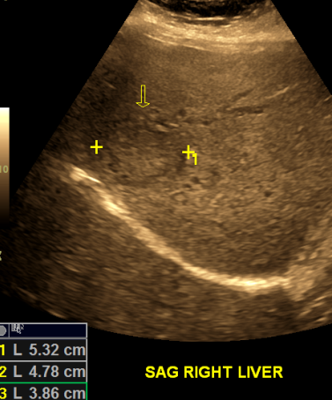
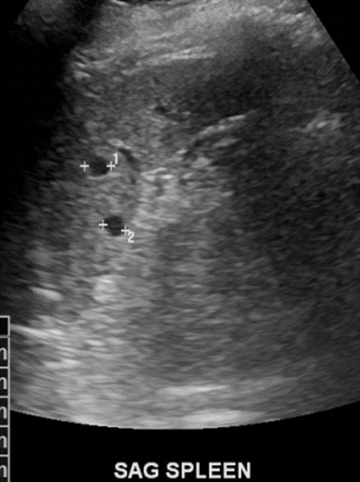
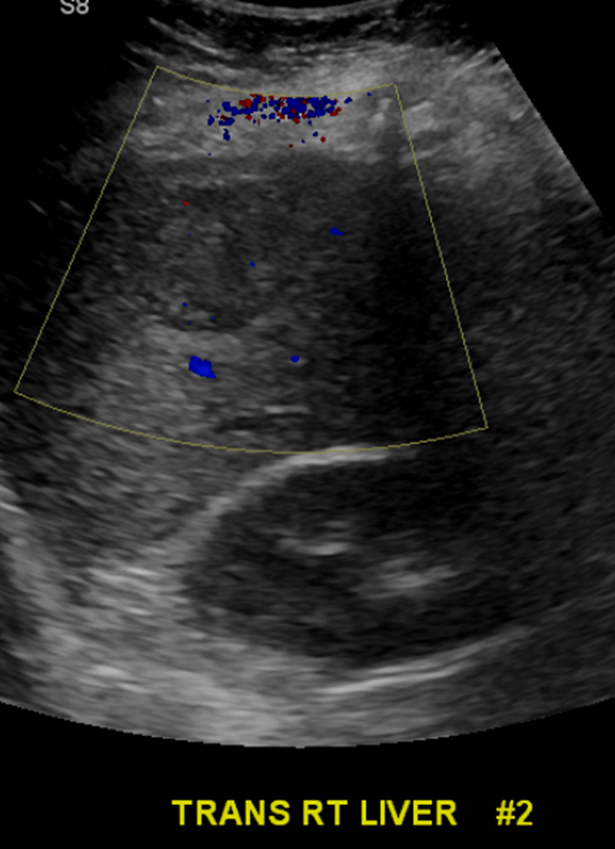
Ultrasound 3/17/16
Impression:
Two RIGHT hepatic lobe masses measuring up to 5.3 and 4.0 cm each. Differential considerations include, but are not limited to, FNH, adenoma, and more aggressive neoplasms.
Gallstones
Splenic cysts

Slide 5
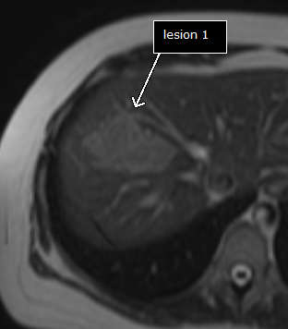
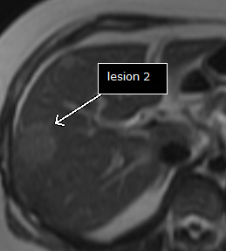
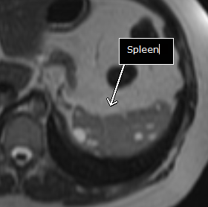
MRI Abdomen wo/w contrast 3/22/16
Magnevist contrast (gadopentetate dimeglumine)
Adenomas, FNH, Tumors, Hemangiomas all enhance with Magnevist
Multiple enhancing liver lesions
Mildly hypo intense on T2 weighted scans (this page)
2 largest lesions are compared

Slide 6
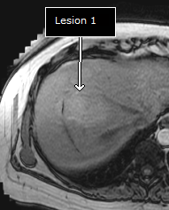
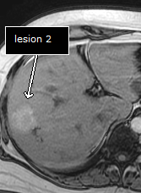
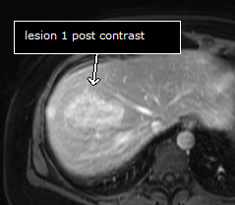
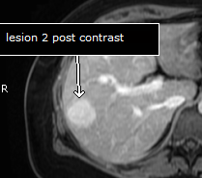
MRI abdomen 3/22/16
Mildly hyperintense lesions on non contrast T1 weighted scans (top row this page)
Multiple enhancing liver lesions (bottom row this page)
Early and delayed enhancement
No central scar
No peripheral enhancement pattern

Slide 7
MRI report 3/22/16
Impression: “Multiple, at least six enhancing liver lesions with irregular, lobular margins and no central scar. These are mildly hyperintense on T1 and mildly hypointense on T2-weighted scans, however. The ultrasound showed echogenic areas centrally with a peripheral hypoechoic rim.”
“Differential for these lesions includes multiple areas of focal nodular hyperplasia, metastatic disease, multiple somewhat atypical adenomas.”
Cystic Splenic lesions. Peliosis? Evaluate immune status
Gallstones

Slide 8
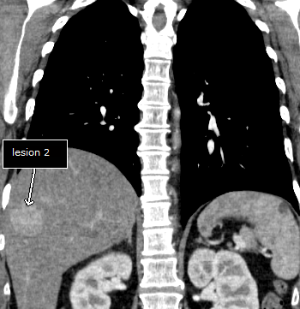
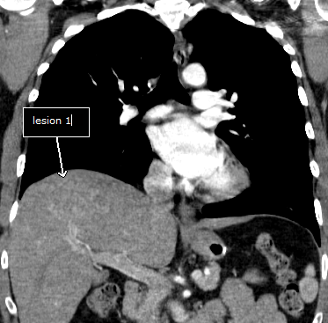
CT Chest 3/28/16
Thickening of the distal esophagus. Prior gastric surgery likely gastric sleeve.
Enhancing liver lesions. Multiple splenic cystic lesions.
No evidence of any spiculated mass, consolidation or effusion. No lymphadenopathy.

Slide 9
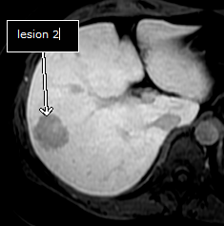
MRI Liver with Eovist contrast 3/28/16
Eovist® (gadoxetic acid disodium)
Specifically taken up by hepatocytes, excreted by bile ducts
Improved contrast between lesions and liver
On Arterial and portal venous phase, acts like Magnevist
On delayed images, lesions that have hepatocytes will enhance. Normal liver, HCC, and FNH will enhance.
Other lesions, such as Hemangiomas, Adenomas, Metastases, will not enhance, and be dark on delayed Eovist MRI.
Can also be used for a contrast MRCP for Bile duct enhancement

Slide 10
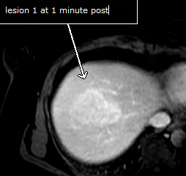
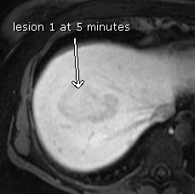
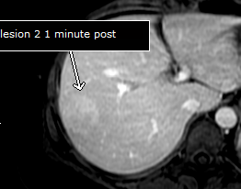
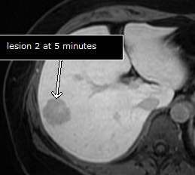
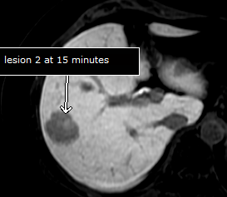
MRI with Eovist 3/28/16

Slide 11
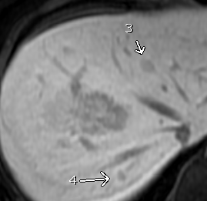
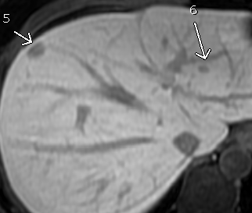
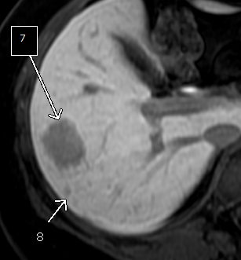
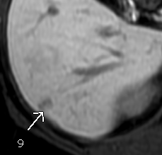
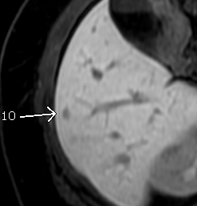
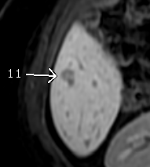
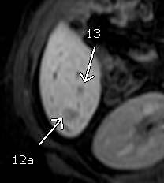
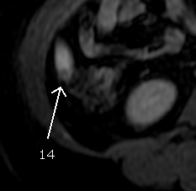
14 liver lesions on Eovist

Slide 12
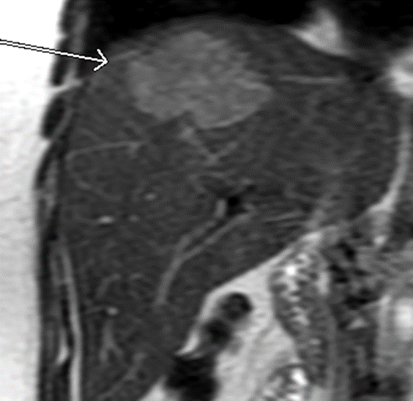
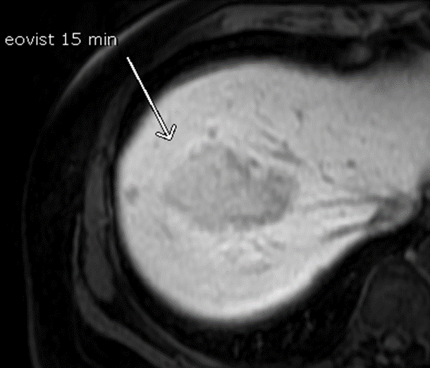
MRI Report 3/28/16 from Impression
“1. Multiple hypervascular early enhancing liver lesions which do not show any activity or enhancement on delayed images with Eovist. Metastatic disease is considered less likely possibility.” (this is a typo).
“The largest mass in the hepatic dome does have some hepatocellular uptake. It does not have a characteristic appearance for focal nodular hyperplasia however”… “The etiology of this lesion is not certain. It is not a classic FNH. It is more likely primary hepatocellular carcinoma with mixed characteristics and hepatocellular uptake, or metastatic disease rather than FNH given the overall pattern.”
Gallstones, Peliosis of the Spleen?
History of chronic Oral contraceptives would have influenced reports

Slide 13
Pathology –Hepatic Adenomatosis
14 lesions suggest Hepatic Adenomatosis.
This corresponds to all the lesions on Eovist MRI
Peliosis form of Hepatic Adenomatosis, With Splenic Peliosis?
EXCEPTION IS THE LARGEST LESION IN THE HEPATIC DOME.
Malignant degeneration in the largest lesion is possible. AFP is often negative in these tumors
Liver cell adenoma and liver cell Adenomatosis
Ludger Barthelmes and Iain S. Tait HPB (Oxford). 2005; 7(3): 186–196.
http://www.ncbi.nlm.nih.gov/pmc/articles/PMC2023950/

Slide 14
Malignant Transformation of Adenomas
Adenomas with malignant degeneration in general do not have markers for AFP, beta-catenin, and p53 immunostains and no beta-catenin mutations
This patient tested negative for AFP and other markers
Malignant transformation of hepatic adenomas
Mod Pathol. 2008 Apr;21(4):491-7. doi: 10.1038/modpathol.2008.8. Epub 2008 Feb 1.
.Micchelli ST¹, Vivekanandan P, Boitnott JK, Pawlik TM, Choti MA, Torbenson M.
Molecular pathogenesis of hepatic adenomas and its implications for surgical management
J Gastrointest Surg. 2013 Oct;17(10):1869-82. doi: 10.1007/s11605-013-2274-6. Epub 2013 Jul 9.

Slide 15
Thank you
Images and reports available from Envision Imaging McKinney
469-420-9077 phone, 469-420-9098 fax
PowerPoint presentation and PDF of slides available online at:

