Slide 1
Steps for Avoiding Scams
Presented by
Cindy B. Stevens, BS, CDMM®, CSA®
of Personal Financial Solutions
a Daily Money Management Company

Slide 2
Cindy B Stevens BS, CDMM®, CSA®
BS = Bachelor of Science
So what do all those letters mean?
Notes:
In health sciences

Slide 3
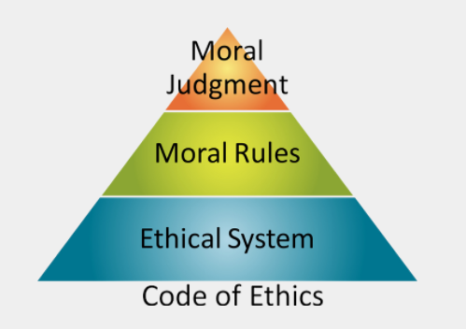
Cindy B Stevens BS, CDMM®, CSA®
CDMM - Certified Daily Money Manager
Integrity
Confidentiality
Standards of Practice
Competence
Professionalism
Notes:
Adhere to a code of ethics
Background check
Minimum 1500 hours paid DMM work experience in last 3 years not within a corporation or a combo of work and 250 hours of pro bono work
Examination – 100 question

Slide 4
Cindy B Stevens BS, CDMM®, CSA®
Certified Senior Advisors (CSAs) are professionals, who in the course of their practice, apply multidisciplinary knowledge of the aging process and aging issues to identify the most appropriate options and solutions for seniors’ individual needs and best interests to improve their lives.
Notes:
Pass CSA certification exam
Pass the Roles , Rules & Responsibilities Ethics Exam
Criminal Background check
Continuing ed

Slide 5
Cindy B Stevens BS, CDMM®, CSA®
Personal Assistance tailored to individual needs, helping to prevent Scams and Swindles by navigating personal, financial and insurance matters to create ease of living and peace of mind.
Notes:
Now that you know who I am and about my alphabet soup. You may be asking ” What exactly do you do as a PDMM? How is that relevant to today’s topic about avoiding scams and swindles? And most importantly, what are you trying to sell us?”
I create a dome of protection through assistance and organization. But let’s start with the easy stuff, what DON”T I do.

Slide 6
Nope,
NOT
any of these.
Notes:
I don’t put my name on your accounts
I don’t sell insurance or any products like annuities
financial – wealth management control of your portfolio
I’m not your lawyer, I’m not your CPA, in short, I’m not your Mother. So what do I do?

Slide 7
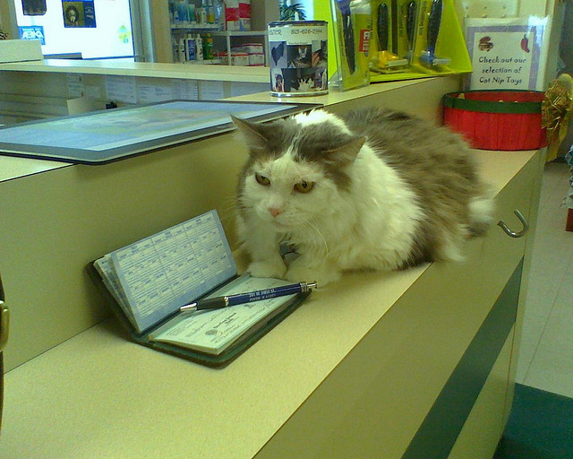
Assisting those with
Physical Barriers
Arthritis
Failing Eye Sight
Memory Issues
Assistance
with
writing checks

Slide 8
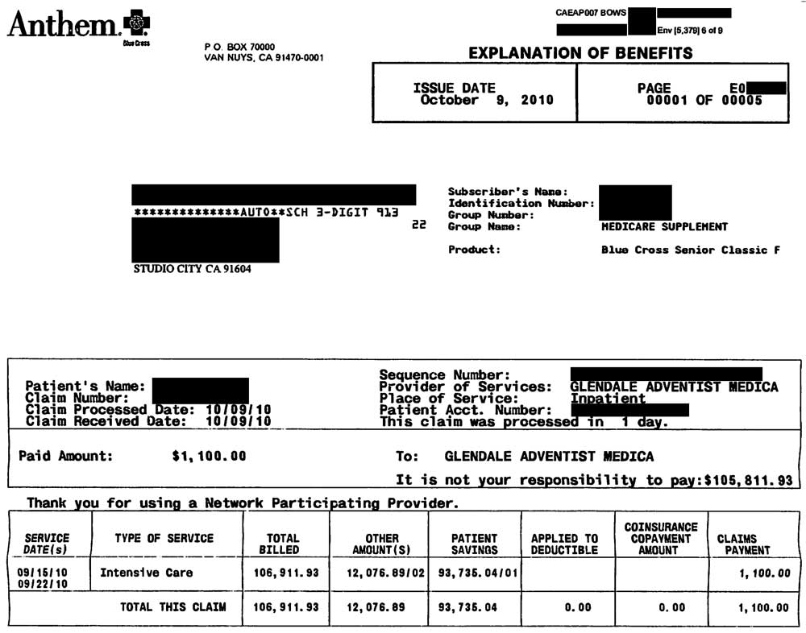
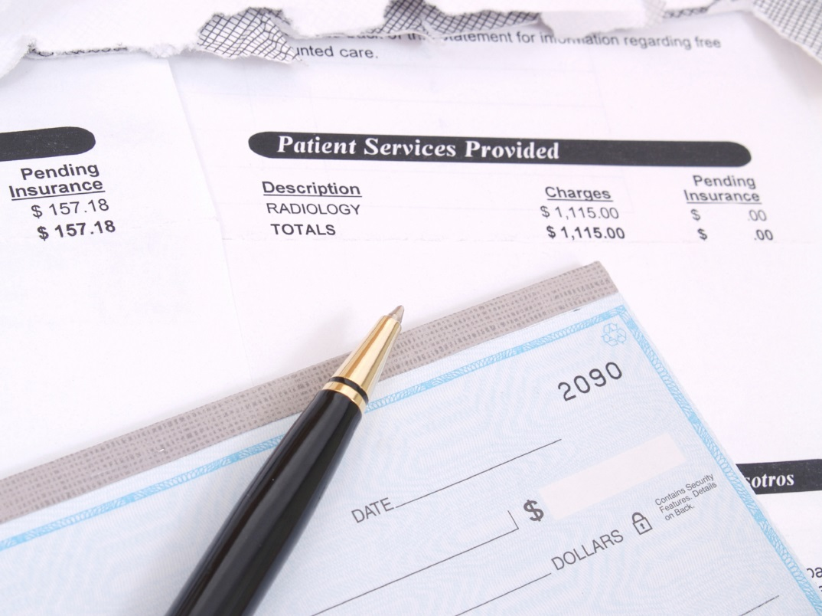
Insurance Explanation of Benefits statements matched to health provider bills for accurate bill payment.

Slide 9
Assistance with
Time Constraints
Traveling
Medical Appointments
Family
Active Lifestyle
Balancing
bank and credit card accounts
Assistance with
creating & maintaining
a budget
Compiling tax documents for maximum filing deductions
Document organization
Notes:
Its hard to keep up with it all

Slide 10
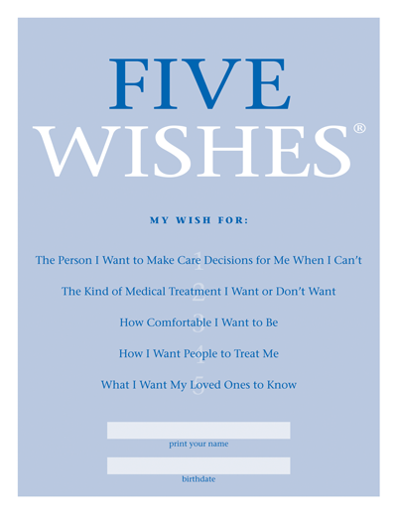
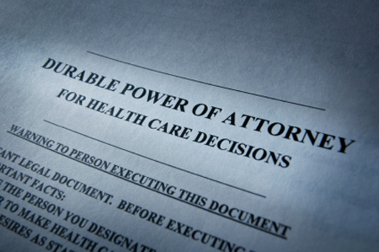
Guidance for obtaining new,
or review of existing,
end of life documents
for accuracy of:
Current wishes for both
health directive and asset
distributions
Final resting place instructions
Beneficiary designations
on all possible items to
avoid probate
Inclusion of all current
assets

Slide 11
Personal Financial Solutions, an advocate for you.
Negotiating with creditors
Assisting with phone calls
Interpreting legal and medical documents
Offering guidance
Providing referrals to other professionals
Layer of protection against scams
Drafting of correspondence
Communications with distant family
Notes:
So now that you know a bit about what I do, you can see I have experience in thwarting scammers and protecting seniors. I would like to pass on to you information gleaned from my certification associations, the national council on aging and my years of experience.

Slide 12
Notes:
Today we will talk about
How much do you know about scams
Why you’re at risk for financial scams
The usual suspects & types of scams
Protecting yourself & loved ones form scams
Resources to report scams & financial abuse

Slide 13
1 in 5 individuals in the U.S. is aged 60+
1 in 20 older persons indicate recent financial mistreatment
Only 1 in 44 elder financial abuse cases is ever reported to law enforcement
Family members perpetrate 73% of all reported Elder Abuse Crimes
9% of financial abuse victims must turn to Medicaid after their own funds are stolen
Notes:
Statistics are from the National Council of Aging
Why they target seniors : fears, frailties of aging, dependence on others, isolation
Only 1 in 44 cases of elder financial abuse get reported

Slide 14
Strangers preying on older people who may be isolated, lonely, confused or desperate for attention.
Family members to whom the person wants to stay connected.
Caregivers (family and other) who use fear or guilt to take advantage of a senior.
Notes:
Feb, 2018 AARP article Fraud in the Family by Gary Weiss. Roughly 6 out of 10 cases of elder financial abuse are committed by relatives, according to a large-scale 2014 study. And about 3 out of 10 instances can be traced to friends, neighbors or home care aides. In other words, 90 percent of perpetrators of fraud are known to their victims.
The closer the tie between perpetrator and victim, the greater the damage

Slide 15
Tips for Avoiding Scams & Swindles
Notes:
Lets take a look at the types of scams. New scams are created every day. The best way to defend yourself is to be aware of the tactics that scammers use.

Slide 16
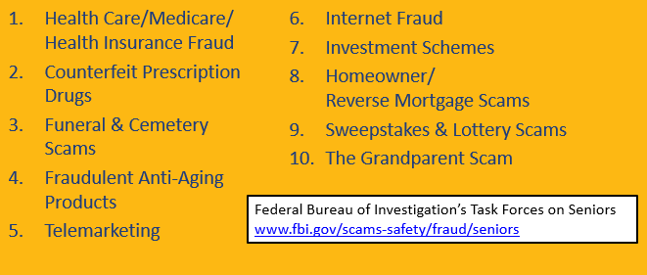
Notes:
APS eldercare.gov
Mail opt out DMAchoice.org – opt out of email, mail, credit offers, catalogs, magazine offers, donation requests
Sonotcall.gov register phone or report unwanted calls this never expires….scam fake emails saying it is expiring…
Annualcreditreport.com transunion Equifax experian

Slide 17
Notes:
National council on aging economiccheckup.org

Slide 18
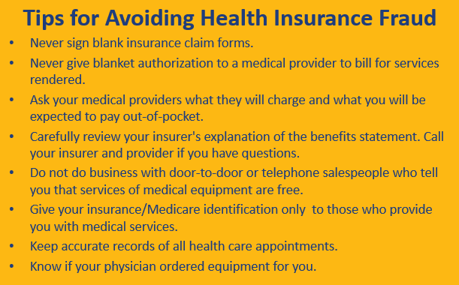

Slide 19
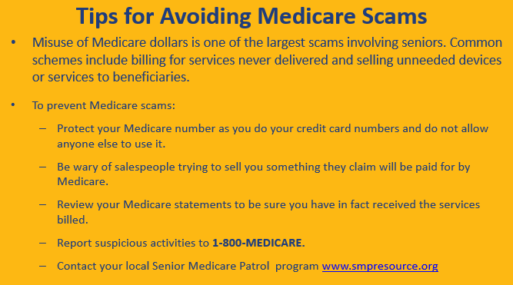
Notes:
Jamie Robinson, SMP Coordinator, MD Dept of Aging Jamie.robinson@Maryland.gov
410-767-2077
Please, actually look at those thick envelopes from Medicare and EOBs from your insurance. Match them up to bills. If you don’t have the time, patience or where with all to do it…hire a DMM!

Slide 20
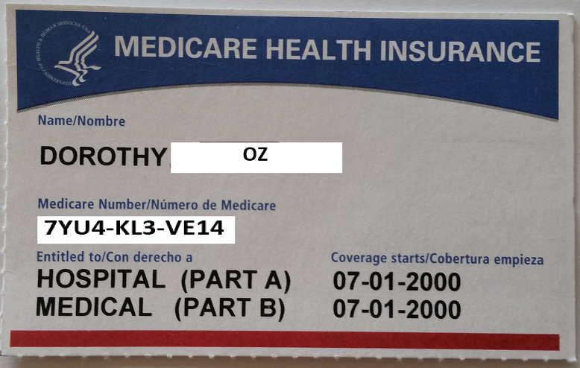

Slide 21
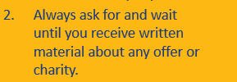
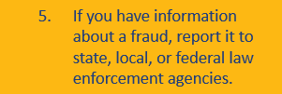
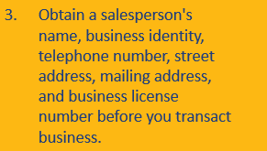
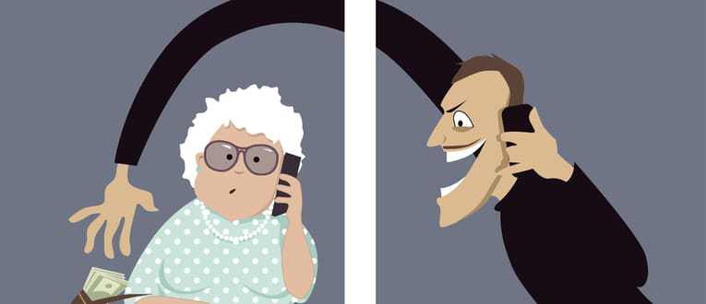

Slide 22
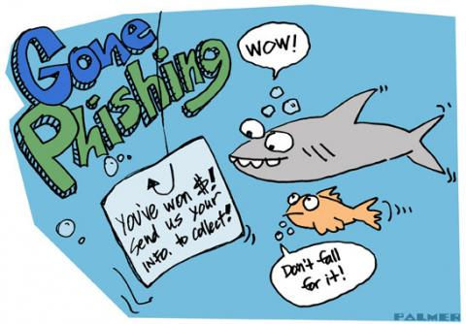
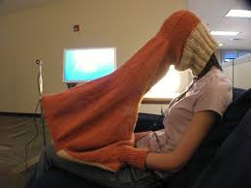
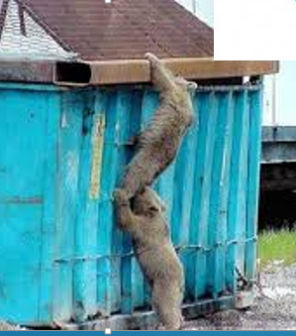
Never give personal information over the phone to someone WHO CALLS YOU.
Never click on links within an email. Always go to the site.
Be careful where you use your portable electronic devices
If you can’t keep up with your paperwork, hire a professional who can.
Invest in and use a paper shredder or ID Guard Stamp
Monitor and reconcile your financial statements monthly
Notes:
Shoulder surfing – someone looking over your shoulder as you fill out forms, use credit card, ATM
Dumpster Diving – someone going through garbage for copies of checks, credit card, bank statements or personal info
Phish – emails that appear to be from a legitimate company asking you to update or verify personal info. Never click or call those numbers. GO to your records and contact from those trusted contacts.

Slide 23
Notes:
OK, destress time. Go to your happy place. Now how to protect yourself

Slide 25
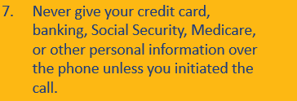
Notes:
If you suspect you are a victim of identity theft, contact your bank and credit card companies immediately.
File a report with the police. They might be able to do much but you may need a police report in order to clear up the problem.
File complaint with the Federal Trade Commision online www.ftc.gov or call 1-877-ID-THEFT

Slide 26
Notes:
Mention requesting a credit report www.annualcreditreport.com – stagger the three free reports throughout the year – every 4 months.

Slide 27
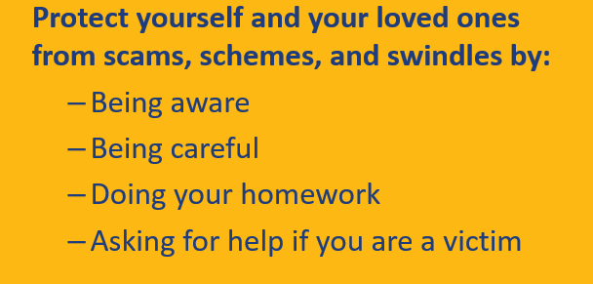
Presented by
Cindy B. Stevens, BS, CDMM®, CSA®
of Personal Financial Solutions
a Daily Money Management Company

