Slide 1
Color Perception Task
You are going to be asked to identify which shade of blue is the lightest from a set
I’ll ask our participants to share their answers out loud
Notes:
Select however many students you want as “participants” in this study. You’ll pass out a slip of paper (see the Word doc) to each “participant” – serving the role of the confederates in this study – and select one person to serve as the naïve actual participant in the study. Make sure to call on the naïve participant last or near the end (after several confederates have responded)

Slide 2
Example Trial
A
B
C
Notes:
Here’s an example so the students know what they are getting in to. Get students to respond out loud to this one – “Of course, the answer is C"

Slide 3
Color Perception Task
I’ve assigned some of you to complete different preparation tasks before we start the Color Perception Task
Read the instructions on your sheet to learn what your task is
Notes:
Now, have students read their instructions silently. Tell them that everyone will be randomly assigned to slightly different tasks so they should not compare notes.

Slide 4
Trial 1
A
B
C
Notes:
Note: These colors are closer than the later trials, so you can use this to discuss how conformity is more likely under conditions of ambiguity, etc.
You can use as many trials as you want, here are 6 sample trials

Slide 5
Trial 2
A
B
C

Slide 6
Trial 3
A
B
C

Slide 7
Trial 4
A
B
C

Slide 8
Trial 5
A
B
C

Slide 9
Trial 6
A
B
C

Slide 10
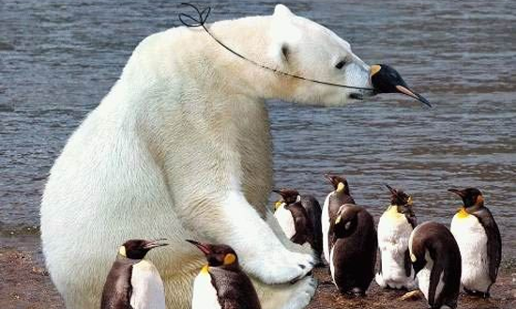
Normative Social Influence
The influence of other people that leads us to conform in order to be liked and accepted by them
Conformity is produced because a person fears the negative social consequences of appearing deviant
“I want to fit in”
Notes:
Note: Here are some extra slides to discuss the topic of conformity with students and bridge to the Asch line study

Slide 11
Informational Social Influence
When people assume the actions of others reflect correct behavior for a given situation
Conformity is produced because a person believes that others are correct in their judgments
“The group must
know better”

Slide 12
Types of Conformity
Private Conformity (from informational social influence):
Changes in both overt behavior and personal beliefs to match others.
Public Conformity (from normative social influence):
Superficial change in overt behavior to match others.

Slide 13
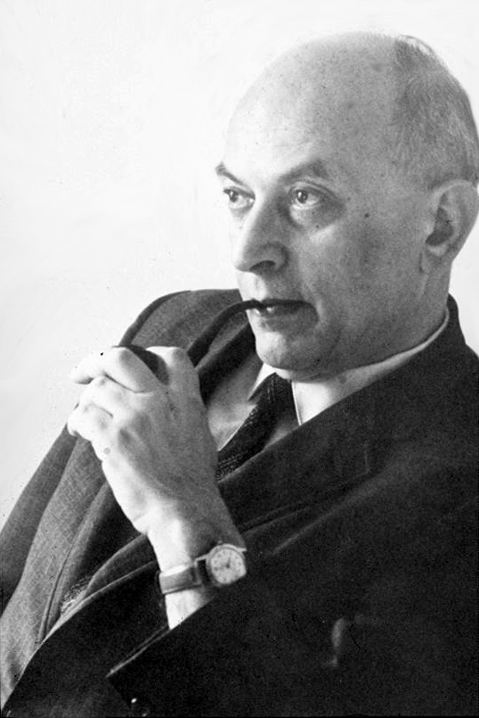
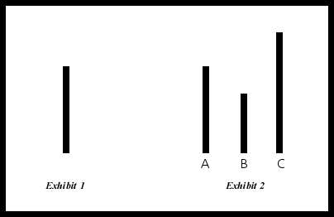
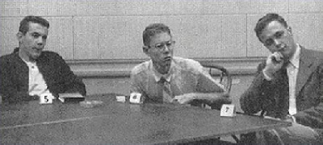
Solomon Asch

Slide 14
Asch’s Famous Line Study
When participants completed the task alone (the control condition), less than 1% of the participants gave a wrong answer
One real participant came into a room with seven confederates (people hired by the experimenters to play fake participants)
Asked to complete this line task for 18 different rounds (trials)
On 12 of the 18 trials, all seven confederates gave deliberately wrong answers
Asch, 1951

Slide 15
Results of the Study
On average, participants went along with incorrect majority 37% of the time
The amount of “going along with the majority” depended on the particular person
50% went along with the majority for more than half of the time
However, 25% of the participants NEVER went along with the majority

Slide 16
Asch’s Famous Line Study
Notes:
Note: This video is a re-creation from the 1970s

Slide 17
Why did people conform?
Normative social influence
Don’t want to be ridiculed or thought of as strange!
Public conformity: they changed only their spoken judgments/behavior (but not their perceptions – very few people actually believed the group’s wrong answers!)
Notes:
Note: Have students guess before revealing these answers

Slide 18
What affects conformity?
Group size
The larger the group, the more conformity – but larger than 4-5 people had no increasing effect
Similarity of line length
The more ambiguous the task, the more conformity
Other deviants
Just another partner in crime reduced conformity dramatically – by 80%!
Giving private answers

Slide 19
Sherif’s study on the autokinetic effect
Autokinetic effect: in darkness, points of light that are not moving appear to move
Participants looked at points of light in the dark and judged how far they jumped
On their own, most participants said the dot jumped between 1 and 10 inches
But when other people in the group were asked to give estimates out loud at the same time, participants conformed to these estimates
Participants gave the same answers later when they were alone in a room
Sherif, 1936

Slide 20
Sherif’s study on the autokinetic effect
Informational social influence
Private conformity: they changed their perceptions (“that’s what I really saw”), and not just judgments/behavior
Sherif’s task was ambiguous – hard to know the right answer! So maybe it makes sense to conform in such situations
That’s why Asch designed his simple line task… but he got surprising results!

