Slide 1
Expand your MIND Fuel your BODY Feed your SOUL

Slide 3
When we solve problems for others we disempower them.
We don’t allow them to build resilience because they haven’t had the opportunity to develop the confidence in themselves to problem solve.

Slide 4
How do you help empower them?
If you’re not solving problems for them
how can you help them?

Slide 5
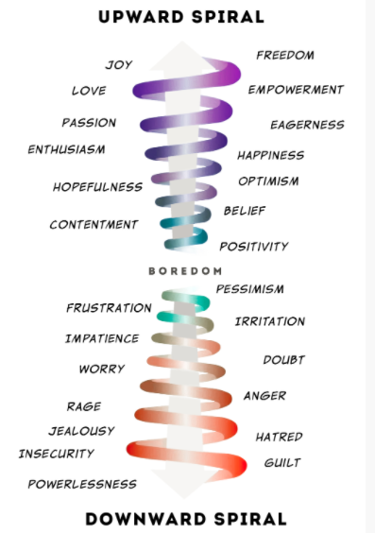

Slide 6
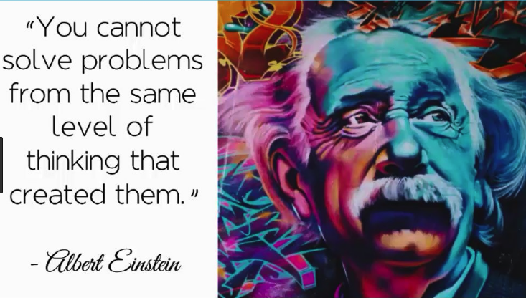

Slide 7
TIP 1: PRIORITISE YOUR OWN WELLBEING

Slide 8
TIP 2: FOCUS ON WHAT YOU WANT

Slide 9
Neuroscientists tell us we must activate our RAS ! Our Reticular Activation System

Slide 10
Your reticular formation picks up all the sensory input from your environment and, if it’s related to what you’re focussing on, it sends a signal to your conscious brain to alert it that something of interest to you is going on.
It does this at a speed 800 times faster than your conscious brain cells operate.

Slide 12
Are you too busy complaining about what you don’t want or are you focussed on what you do want?
That which you put your attention on
expands!

Slide 13
TIP 3: RE-SET THE MOMENTUM

Slide 14
Your thought processes work on momentum too.
This is why sometimes it feels like you can control your thoughts and other times it feels like your thoughts control you.

Slide 16
Momentum eases when you
SLEEP
MEDITATE
EXERCISE

Slide 17
Teenagers, these days, rarely give their brains any time to re-set momentum.
Conflicting momentum makes them feel so much more
anxious & vulnerable.

Slide 18
TIP 4: FIND THE BALANCE BETWEEN MANAGER & CONSULTANT

Slide 19
Lean on the side of MANAGER
NUTRITION
SLEEP
WHO THEY HANG AROUND WITH
THEIR ONLINE ACTIVITY
THEIR DOWN TIME

Slide 20
Lean on the side of CONSULTANT
THEIR PROBLEMS
THEIR GOALS
THEIR LIFE PATH

Slide 21
As a CONSULTANT HOLD THE VISION OF THEIR SUCCESS

Slide 22
As you try to strike the right balance between manager & consultant you’ve got to be TALKING TO THEM- CONNECT
Be involved but not too involved

Slide 24
To understand someone really means…
LISTEN WITHOUT JUDGEMENT

