Slide 1
The South Texas Association of School Maintenance Officials By Climatec
Providing safe, comfortable and energy efficient buildings for over 40 years

Slide 2
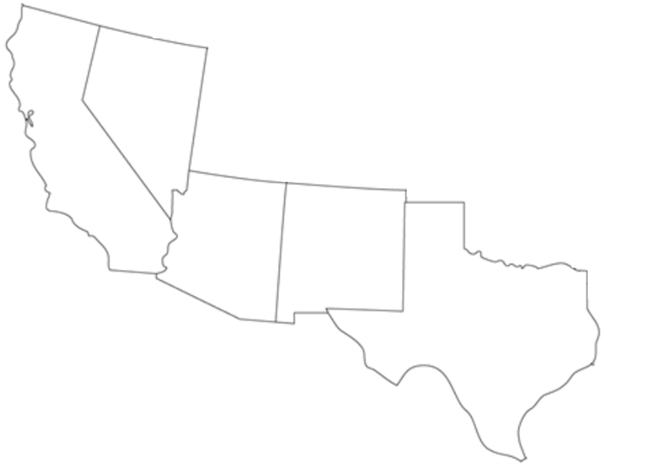
QUICK STATS
CLIMATEC BY THE NUMBERS
40 YEARS IN BUSINESS
11 BRANCH OFFICES
10,000+ CUSTOMERS
700+ EMPLOYEES
45 LOCAL TEAM SIZE AUSTIN OFFICE
SAN ANTONIO OFFICE
McALLEN OFFICE
10 NET ZERO BUILDS
15 STADIUMS
30 DATA CENTERS
50 HOSPITALS
500 OFFICE BUILDINGS
3000 SCHOOLS
#1 INDEPENDENT
#1 ALERTON
#1 ARIZONA
#1 SO CAL
#1 TEXAS by 2020
A leading provider of advanced building technologies
Devoted to customer satisfaction
We provide safer, more comfortable and more efficient building environments

Slide 3
Networked Thermostats
Save you money by saving you time and energy

Slide 4
Seven Day Programmable Thermostat
 | Seven Day Programmable Thermostat | NETWORKED
Cost | $100 to $200 | $315
Install Cost | As Thermostat | Same add Communication
Real Time Clock | Battery Back | Synchronized
Programming | Schedule | Complete
Scheduling | Individually | All at once or Individually
Remote Operation | None | Via Internet Explorer
Space Relative Humidity | Extra | Included
Supply Air Temperature | No | Included
Occupied Economy Setpoints | No | Add Motion Detector
Training | Read the Manual | Included
Demand Ventilation | Provided with AHU | Add CO2 sensor and Actuator
Aux. Lighting Contactor | No | Output Available
Aux. Exhaust Fan | No | Output Available
BACnet Interface (Lighting, OAU, Energy Metering, …) | No | Included

Slide 5
Best Practices

Slide 6
Best Practices
Provide bidders with
Detailed scope
Develop scope with bidders
Proposal
Clearly defined scope
Sample graphics
Three references
Contractor qualifications defined by contractor

Slide 7
Best Practices
Scope Review!!!!!!

Slide 8
Best Practices
Submittal
Drawing Package
Wiring Details
Bill of Materials
Product Data Sheets
Sequence of operation
Subcontractor List

Slide 9
Best Practices
Navigation
Navigation Tree
User Name and Passwords for every user
Easy access to schedules trends alarms
Return to Home on every Page

Slide 10
Best Practices
Graphics
HTML5 – Access from any web browser and from any platform without the need for plug-ins or apps (Java, Adobe Flash,…)
Capable of re-sizing to fit Window
Graphics
Site Plan
Floor Plan Graphics
Outside Air Temperature and Relative Humidity
Thermal gradient indicating temperature deviation from setpoint
Links to Home Page

Slide 11
Best Practices
BACnet
Require PIC Statements
Require BACnet BTL Certification or proof that products are in submission phase
Provide BACnet over IP at global controller and/or field controller
Provide BACnet MS/TP at field controller

Slide 12
Best Practices
Programming
Provide all programming tools
Provide documented sequence of operation for every device
Define operation during occupied and unoccupied times
Define startup and shutdown
Define scheduling and setpoints
Define operation on the failure of a device or controller
Define alarms and their annunciation requirements
Define trending requirements

Slide 13
Best Practices
Record Documents
Updated Submittal
Provide table of device addressing
Provide floor plans
Include Controller and device locations
Include network routing
Provide clearly defined warranty letter with agreed upon start and end dates

Slide 14
Best Practices
Training
Provide Site Specific Training
Review Record documents
Inspect accessible field controllers. Understand wiring and configurations
Inspect field devices
Review LAN routing
Provide Software Training
User definitions
Navigation
Alarms, escalation, annunciations, messaging…
Trends, sinlge, multi-point, archiving…
Schedules, standard, holiday, events,…

Slide 15
Best Practices
After Completion
Warranty Phase
Quarterly inspections
Seasonal Sequence checks
Review Operators Log
Yearly Maintenance Agreement
Physically inspection of all devices and their operation
System Review
Sensor verification
Sequence Checks
Software backups
Discounted Service and Material Rates

Slide 16
Final Comments and Questions

