Slide 1
Taking MAGIC forward …
14:30-15:00 Taking MAGIC forward – the funding space for air pollution research + Discussion about research interests in the room
Alan Robins, University of Surrey
    A discussion of some activities and options deriving from research calls and research networks (UK only).
    An open debate about research interests.
    Hopefully, leading to some orderly conclusions

Slide 2
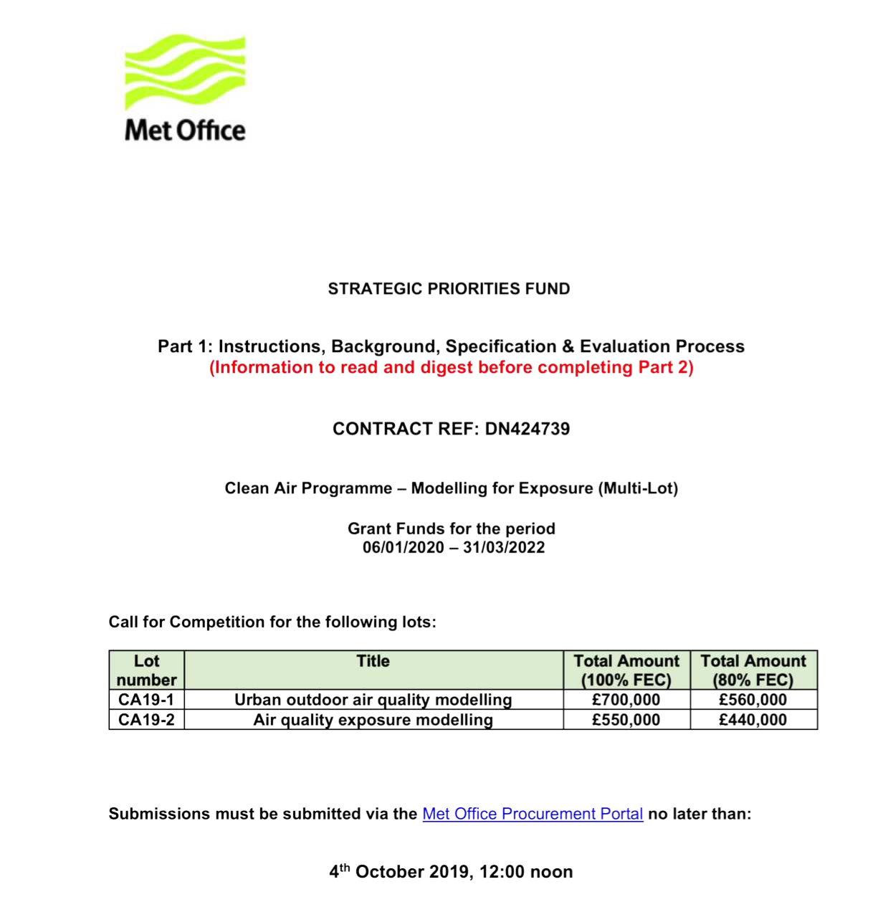
NERC Calls
CA19-1
The aim of this activity is to develop modelling system(s) that can be used by members of the air quality community to simulate outdoor air quality in the UK spanning national to urban street scales.
CA19-2
The aim of this activity is to develop a modelling system(s) to evaluate exposure and health impacts from air quality at national and individual scales that can be used and further developed by the UK air quality community.

Slide 3
Urban outdoor air quality modelling
Dispersion in Urban Streets, DUST: Fine scale urban dispersion
Imperial College, University of Surrey, etc.
However … there was a full NCAS modellers proposal … we didn’t proceed.

Slide 4

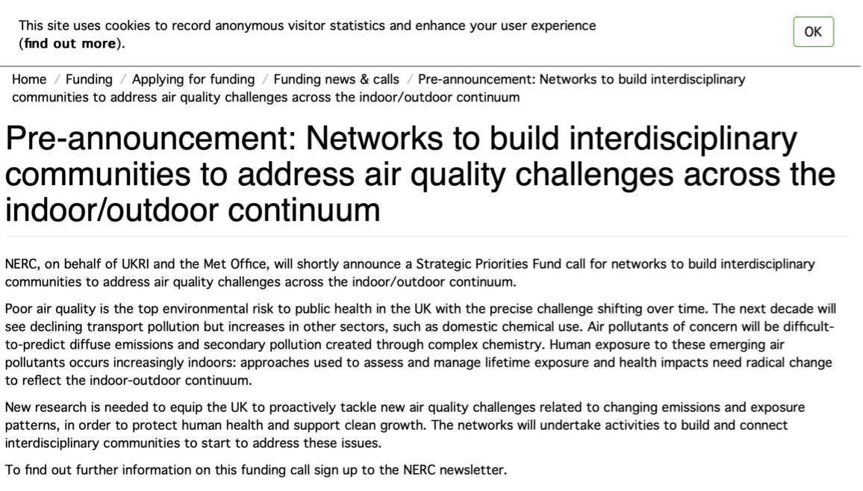
NERC Calls
Dated 10th September

Slide 5
The Smart Cube
NERC Capital Call Jul 2019: Smart Cube, £140,000; PI David Birch, Surrey.
… to produce a highly instrumented generic building model, for use as
a portable wind-tunnel calibration standard, and
a measurement instrument for experimental use.

Slide 6
The Smart Cube – draft specification
~150 mm cube with modular faces (to allow some freedom to add windows, etc.)
(b) 512 channels of surface pressure, +/- 160 Pa FS
(c) 20 channels of surface microphones (60 kHz, analogue- or best offer)
(d) 128 channels of surface temperature (tentative)
(e) Active control surface film heaters
(f) Detailed calibration data - sensors against PIV & LDV in some 'canonical' flow
Detail design work is just starting.

Slide 7
Exploitation of the Smart Cube
NERC proposal for utilising the smart cube
Provisional title: "Thermal fluxes in the urban canyon: effects on air quality and natural ventilation" (or something like that).
Expression of interest stage.

Slide 8


EPSRC
Special interest groups, SIGs:
LEVN Low energy ventilation network
UFM Urban fluid mechanics
UKFN grant coming to an end in 2020, so groups looking at means of continuing after that.

Slide 9

LEVN
The SIG will bridge the knowledge-gap between optimal strategies for building ventilation and current industry practice.
It will apply fundamental fluids mechanics and lead research to simultaneously address energy consumption and occupancy experience (thermal comfort, indoor air-quality), unifying two distinct research themes in building physics.

Slide 10
LEVN
Cath Noakes: “I’m aware that there are a handful of proposals that mentioned LEVN in pathways to impact, but we don’t have a proper list from within the network”.
State of the Art Ventilation Solutions
Low Energy Ventilation Network Meeting 9-10th Jan
Rooms 4.06-4.07, School of Chemical and Process Engineering, University of Leeds
… two-day symposium … explores the state of the art in low energy ventilation solutions for buildings.
… focuses on the practical challenges in delivering good ventilation through exploring solutions applied in practice and the underpinning research to both develop and evaluate ventilation effectiveness.

Slide 11


UFM
… SIG focuses on atmospheric flows over rough surfaces, urban flows, dispersion of gas and PMs in neutral and non-neutral stratifications, air quality and wind engineering problems.
The scope ranges from fundamental to applied research, with an emphasis on experimental, numerical and theoretical approaches.
Reviewed and identified four ‘challenges’ – EPSRC proposals being worked-up.
Also building a data-base Data Portal, providing information and links for the latest available datasets of urban fluid mechanics. The Data Portal contains information from field experiments, laboratory, physical modelling and CFD studies.

Slide 12
UFM Challenges
C1: Very rough BLs. Flow predictions in neutral boundary layers with very large obstacles.
C2: Stratification/buoyancy effects. The effect of non-neutral environments on air flow, air quality and comfort.
C3: Dispersion in urban BLs. Passive and active [e.g. heavy gases] scalar dispersion in urban environments.
C4: Building-scale fluid dynamics. Flows around buildings, surface pressure on buildings, effects on pedestrians/vehicles/indoor-outdoor exchange.
… but proposal don’t really map directly onto these descriptions.

Slide 13
Global and Local effect Of tall buildings on the Built Environment (GLOBE)
Surrey (PI Robins), Southampton (Xie), Reading (Barlow, Coceal)
EPSRC, 3 years, 3PDRAs, submission end 2019.

Slide 14
LSBU proposal
Proposal from Elsa Aristodemou, LSBU
A MAGIC follow-on:
“… an EPSRC proposal with Chris Pain and Prashnat Kumar from Surrey
… developing an impacts tool to enable assessment of different mitigation strategies for air quality and thermal cooling (through green roofs and green walls) in urban setting with tall buildings.
… emphasis on tall, "Green", buildings and their local effect on air quality (particulate matter in particular) and thermal comfort through cooling (green walls and green roofs in particular).
… incorporate non-linear geo-spatial models to assess the 3D impact of different mitigation strategies”

Slide 15
National Wind Tunnel Facility

Slide 16
NWFT Workshops, December/January
Open a dialogue to articulate the industry needs / gaps
Help UK industry enable opportunities that are available
Reinforce the UK Aero industry case for the value (and opportunities) of NWTF
Seize the skills generation and learn from the lessons in setting-up a common UK community activity
Explore the opportunities for similar developments within a group of industry wind tunnels taken to be of strategic importance
Exploit simulation / experiment complementarity - databases
To provide shaping of any future proposal NWTF+
Provide direction for a new PM to further develop industry links
Incorporation of other sectors – environment, automotive

Slide 17
… to summarise …
Proposals mainly address the outdoor environment
Few treat outdoor-indoor exchanges
There could be relevant proposals from the LEVN – I don’t know
Options for the MAGIC team:
    The NERC Network call
    Standard /large grant applications – but they must be distinct

