Slide 1
Pender County Foster Care Program
Pender County Department of Social Services
Annie Murphy , Foster Care Placement Social Worker

Slide 2

WHAT IS FOSTER CARE ?

Slide 3

The Goal of Foster Care

Slide 4

TYPES OF FAMILIES
FOSTER ONLY
FOSTER TO ADOPT
ADOPT ONLY
KINSHIP

Slide 5
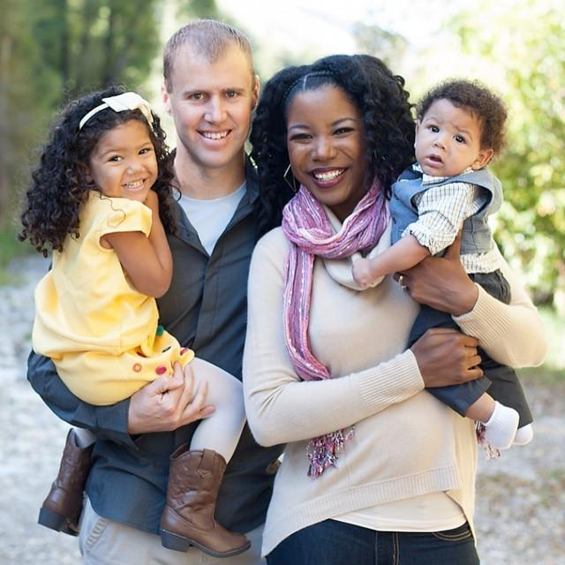
WHO IS A FOSTER PARENT ?

Slide 6

WHAT IS REQUIRED TO BE A FOSTER PARENT ?
30 HOUR FOSTER PARENT TRAINING
HOME MUST PASS FIRE & SAFETY INSPECTION
21 YEARS OLD OR OLDER
HIGH SCHOOL DIPLOMA / GED
ADEQUATE FINANCIAL INCOME
TRANSPORTATION
PERSONAL BEDROOM SPACE
HOUSEHOLD MEMBERS 18 YEAR OLD AND OLDER MUST BE FINGER PRINTED FOR CRIMINAL RECORD CHECKS LOCALLY, THROUGH THE SBI, AND TRHOUGH FBI

Slide 7

WHAT ARE THE RESPONSIBILITIES OF FOSTER PARENTS
Supervision at all times
Promote Well-being
Advocate for child
Encourage Spiritual & Social Development
Meet Medical Needs
Meet Educational Needs
Help child maintain birth family connection

Slide 8

Foster Care Statistics
Pender County DSS has 40 Foster Children
North Carolina had 11,223 Foster Children in 2019
United States had an estimate of 407,000 Foster Children in 2021

Slide 9

AGES OF CHILDREN IN FOSTER CARE
The ages of children in foster care range from 0-18.
18 -21 Voluntary Placement Program

Slide 10


FOSTER CARE LINKS PROGRAM

Slide 11

FOSTER CARE STIPEND
0-5 $ 514.00
6-12 $ 654.00
13-18 $698.00

Slide 12
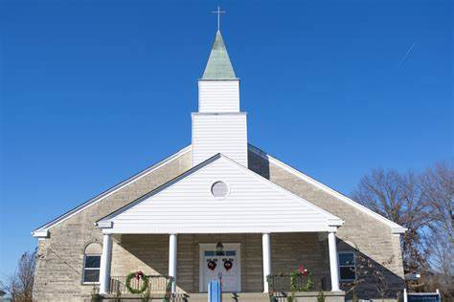
HOW YOUR CHURCH CAN SUPPORT CHILDREN IN FOSTER CARE
IDENTIFY PROSPECTIVE FOSTER FAMILIES
IDENTIFY SUPPORTS FOR FOSTER FAMILIES
SUPPORT FOSTER FAMILIES ALREADY IN YOUR CHURCH
DONATE TO FOSTER CARE PROGRAM

Slide 13

Children Ages 0-4
Diapers
Formula
Clothes
Pack & Play
Car Seats

Slide 14

Children Ages 5-12
Clothes
School Supplies
Athletic Gear
Comforter Sets
Shoes/Sneakers
Suit case/ Duffle Bags

Slide 15

Youth Ages 13-17
Clothes
School Supplies
Shoes/Sneakers
Athletic Gear
Personal Hygiene Items
Hair Products
Comforter Sets
Suitcase/ Duffle Bags

Slide 16

Young Adults Ages 18-21
Gift Cards to Foodlion
Gift Cards to Walmart
Laundry Detergent
Household Items
Comforter Sets
School Supplies
Personal Hygiene Items
Care Packages

Slide 17

James 1:27
Matthew 25:40-45

Slide 18

Building Resilient Families

Slide 19

Pender County Resiliency Task Force
Vision
Mission
Faith Based Partners
Pender County Community Health Assessment

Slide 20

Adverse Childhood Experiences
What are ACEs?
Some Impact of ACEs
ACEs Treatable & Preventable?
What the Pender County Resiliency Task Force is Doing

Slide 21

What you can do about ACEs in your Church and Community
Join PCRTF
Virtual Meeting 4th Tuesdays
Host a Screening of the film “ Resilience the Science of Hope” at your Church

Slide 22
Resource:
Connected Congregations/Connected Communities
APRIL IS NATIONAL CHILD ABUSE PREVENTION MONTH
MAY IS NATIONAL FOSTER CARE MONTH
NOVEMBER IS NATIONAL ADOPTION MONTH

Slide 23
Annie Murphy, Foster Care Licensing & Placement Social Worker
(910) 259-1331 amurphy@pendercountync.gov
Thank you !!!!
Pender County Department of Social Services
810 S. Walker Street
Burgaw, North Carolina
(910) 259-1240
(910) 259-1531 (Fax)

