Slide 1
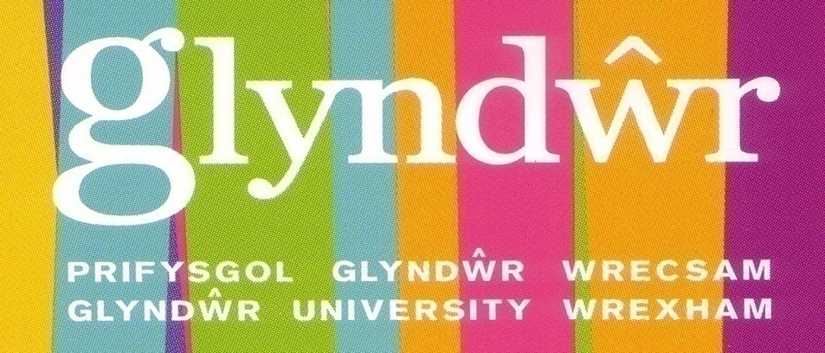
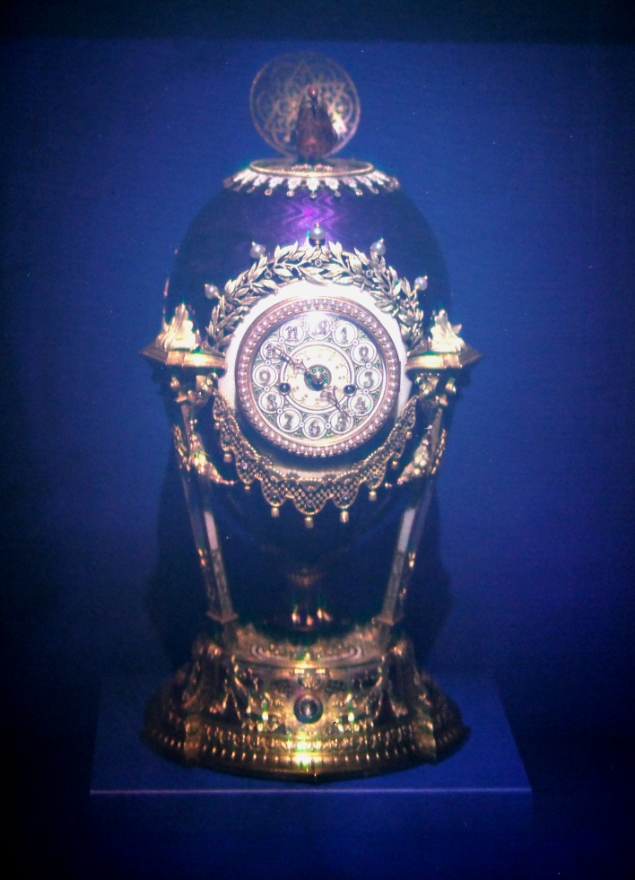
ULTRA-REALISTIC IMAGING AND OptoClonesTM Hans I. Bjelkhagen Professor at the Centre for Ultra-Realistic Imaging
www.hansholo.com

Slide 2
Holograms of Artifacts in Museums
In the early days of holography, display holograms were introduced to museums as a new display technique for showing rare and expensive artifacts . These early monochrome holograms looked very realistic, but not being able to reproduce the artifact’s color was unacceptable for most museum applications. In addition, museums hesitated because of the expense and the need for special recording laboratories.

Slide 3
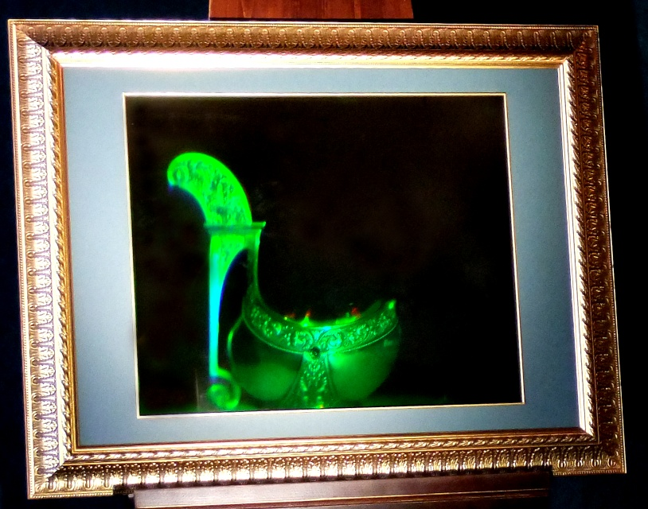
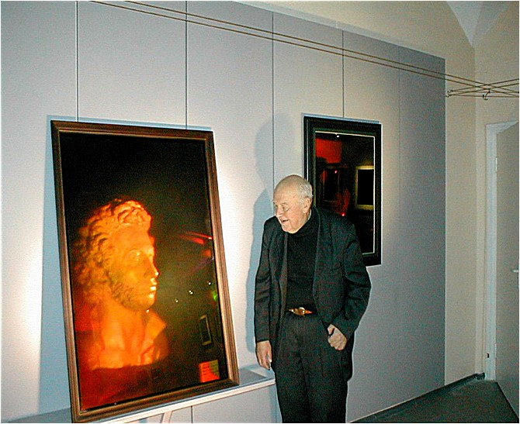
Denisyuk Monochrome Holograms
BRATINA (1976) Silver bucket by Fabergé shop (end of XIX c.)
The first large format , size 80×60 cm hologram,
by Holography lab of S. I. Vavilov SOI.
Denisyuk next to PUSHKIN (1987)
Bust of Russian poet Pushkin. One of the largest Denisyuk holograms, size 80x120 cm , by Holography lab of S. I. Vavilov SOI.
The early monochrome large-format Denisyuk holograms recorded in the former USSR were very impressive. The bright, high-contrast, holograms were recorded using red-wavelength lasers on ultra-fine-grain, silver-halide emulsions. Such holographic materials were not produced by Agfa, Ilford or Kodak, which made it difficult to record such holograms in other parts of the world.

Slide 4
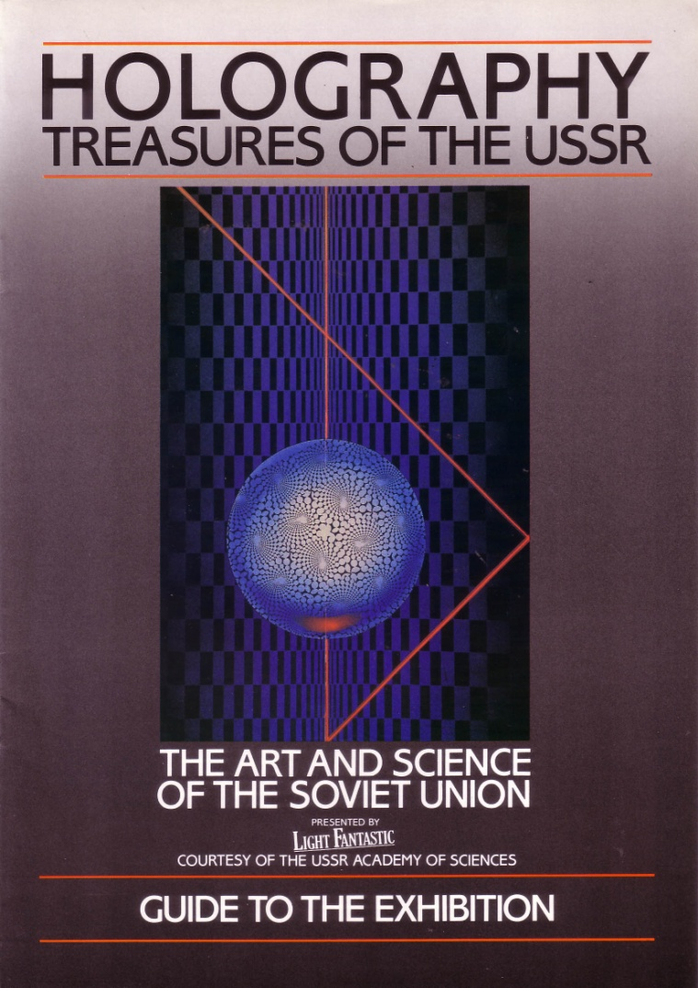
Denisyuk Monochrome Holograms
Because of the high-quality of the Denisyuk reflection holograms in the former USSR; museums in these countries were keener than western museums to study and test holography. A selection of these holograms was brought to the West at the 1985 exhibition:
‘Holography – Treasures of the USSR’
at the Trocadero Centre in London

Slide 5
Ultra-Realistic Imaging
Monochrome and Color Denisyuk Holograms

Slide 6
What is an Ultra–Realistic Image?
It looks “identical” to the real object observed by eye,
Very accurate color rendition,
Same scale – no magnification,
Resolution corresponds to the eye resolution,
No detectable image blur (spatial or chromatic),
No field-of-view limitations,
Image light reflections move like they do on the object,
In principle – recording light waves reflected off an object, store and recreate them later,
ONLY COLOR DENISYUK HOLOGRAPHY can accomplish this.

Slide 7
What is an OptoCloneTM?
It is a Denisyuk hologram recorded with a minimum of three RGB lasers and displayed using RGB-LED lights in a special display case.
Since “hologram” and “holography” are used for non-holographic applications today (“2D Pepper’s Ghost” - projection techniques) it is important to introduce new terms which describe real holograms and ultra-realistic imaging. OptoCloneTM has been world-wide trade-marked.

Slide 8
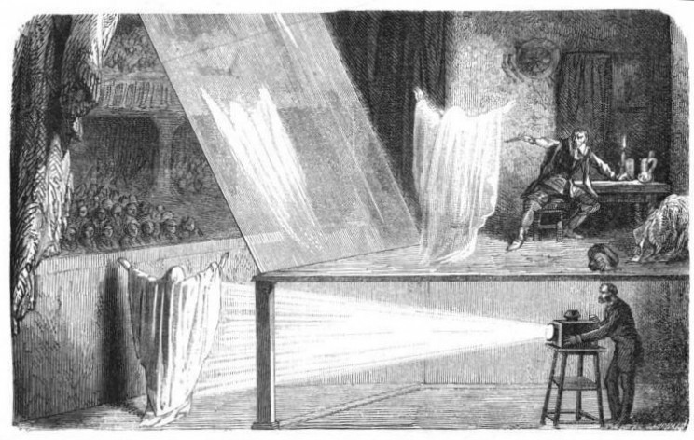
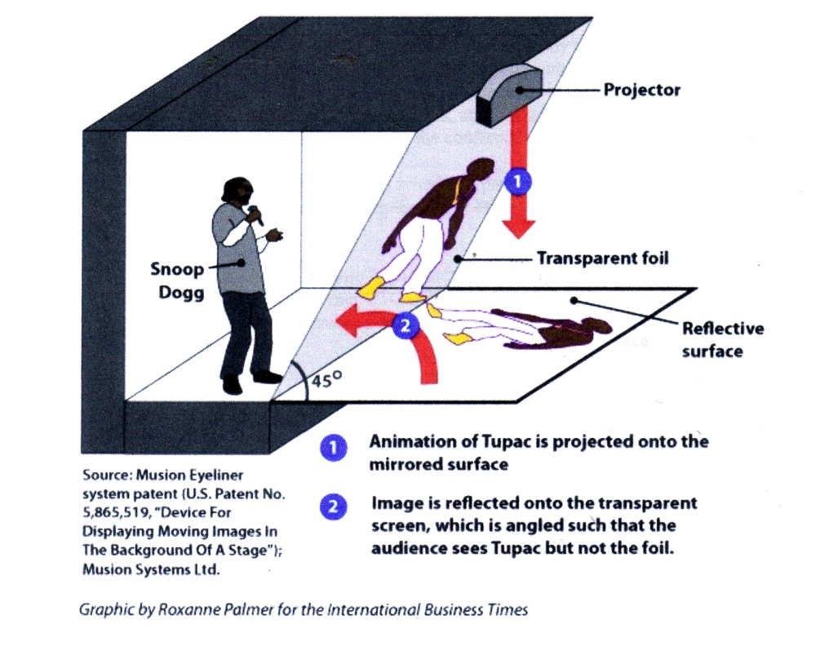
Old and Modern Pepper’s Ghost
F. Marion, L’Optique (1869) 3-D display
But not “holography” or “holograms”
Hologram USA has exclusive rights to exploit patented technologies used to create life-size, hologram-like images across all platforms
2-D display

Slide 9
Analogue Color Hologram Recording

Slide 10
Recording Materials
Panchromatic materials needed:
Ultrafine-grain silver-halide (SH) materials
Slavich (improved versions by the end of 2013)
Sphera-S (only custom orders)
Ultimate (new 4-nm emulsion introduced – limited production)
Colour Holographic (recent improved materials)
SilverCross (limited manual production)

Slide 11
OptoCloneTM of Watches

Slide 12
Museum Artifacts Recorded in a Laboratory
Bringing the Artifacts Back to the People was a UK project to record color holograms instead of the real artifacts for a touring exhibition. One of the first artifacts to benefit under this project was the 14,000-year-old Decorated Horse Jaw Bone from the ice age. The bone was discovered in Kendrick's Cave in Llandudno and is the only piece of artwork dated to the end of the last Ice Age or Late Glacial period in Britain. It was dug up by Thomas Kendrick in 1880. Acquired by the British Museum in 1959. The OptoCloneTM of the jaw bone was recorded at CMO on 21 April 2009.

Slide 13
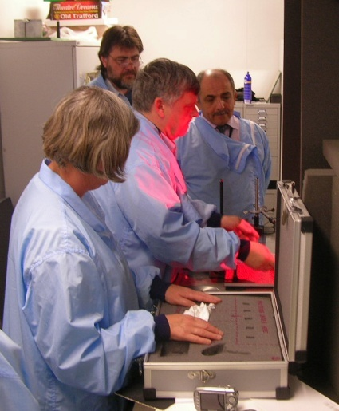
Decorated Horse Jaw Bone Recording
Jill Cook, British Museum Horse Jaw under the recording plate
Peter Crosby, Hans Bjelkhagen,
Ardie Osanlou, CMO
Recording of the Horse Jaw OptoClone TM at CMO

Slide 14
Decorated Horse Jaw Bone Hologram
Photo of the OptoClone TM

Slide 15
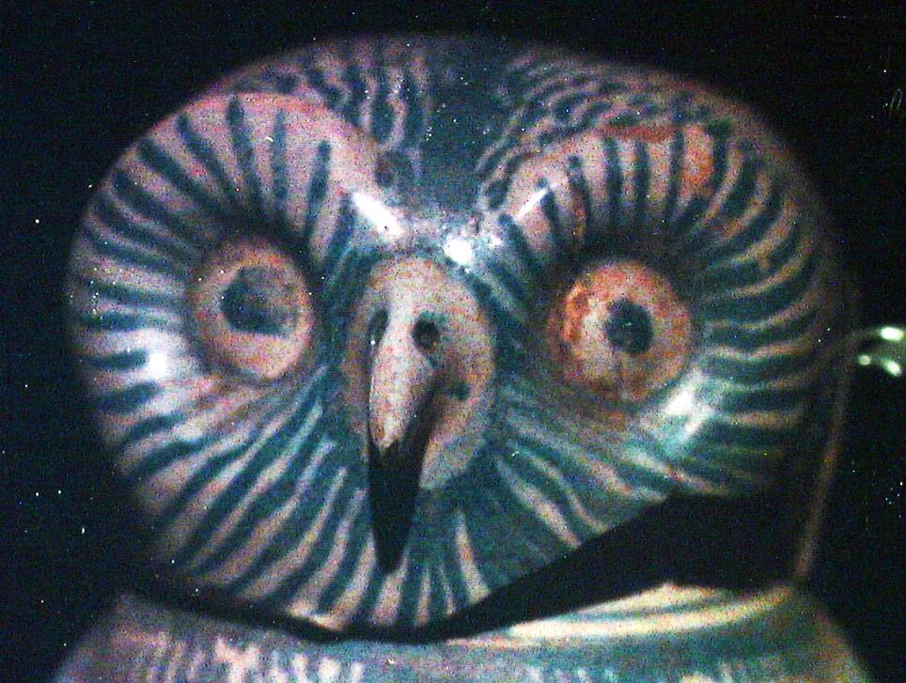
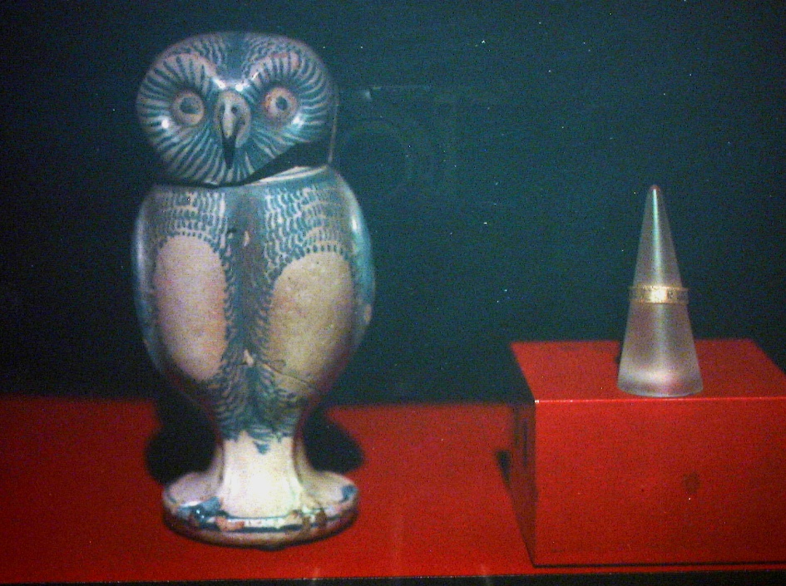
Tudor Owl Jug and Sergeant at Arms Ring
Recording of the hologram at CMO
Photo of the recorded OptoClone TM plate, size 30 cm by 40 cm

Slide 16
Llangollen Museum Hologram Exhibition
Bronze Age Axe Head
Bronze Age Axe Head OptoCloneTM

Slide 17
HiH Mobile Recording Equipment
Mobile recording equipment essential for applications, such as, e.g. museum artifact recording. Thanks to the new solid-state lasers, it is now possible to build the necessary recording equipment.
The Hellenic Institute of Holography (HiH) in Greece has a portable three-color analogue holographic recording system, the ZZZyclopsTM with the following lasers:
Red laser: 638 nm at output power 90 mW (HiH-R100 DL laser)
Green laser: 532 nm at output power 100 mW (Cobolt Samba laser)
Blue laser: 457 nm at output power 50 mW (Colbolt Twist laser)

Slide 18
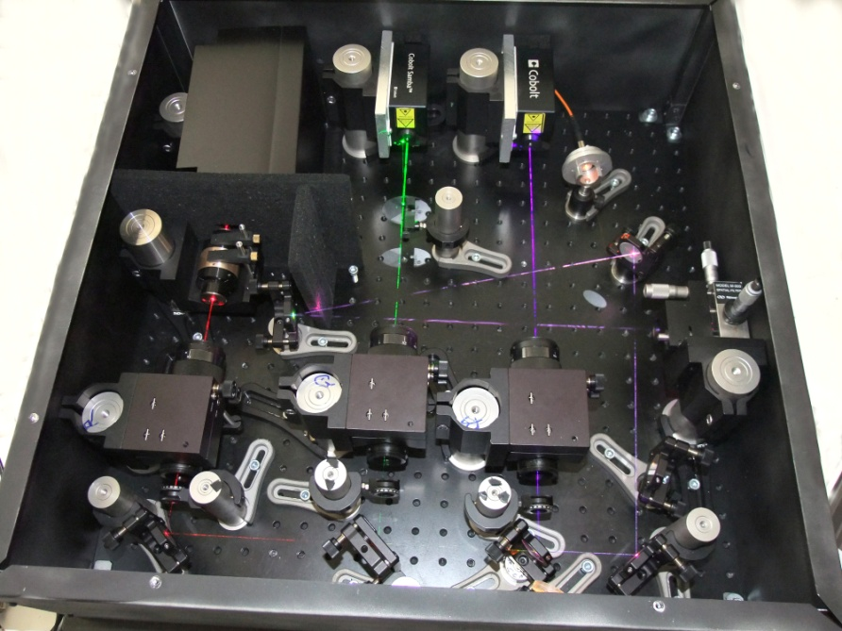
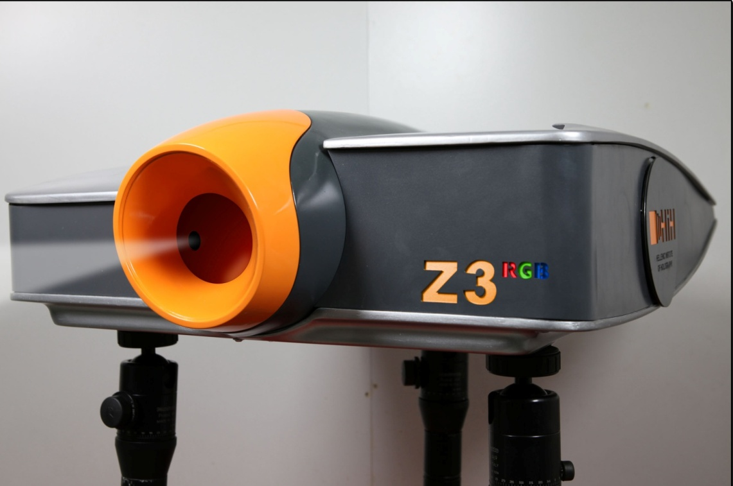
HiH Mobile Recording Equipment
Recording equipment

Slide 19
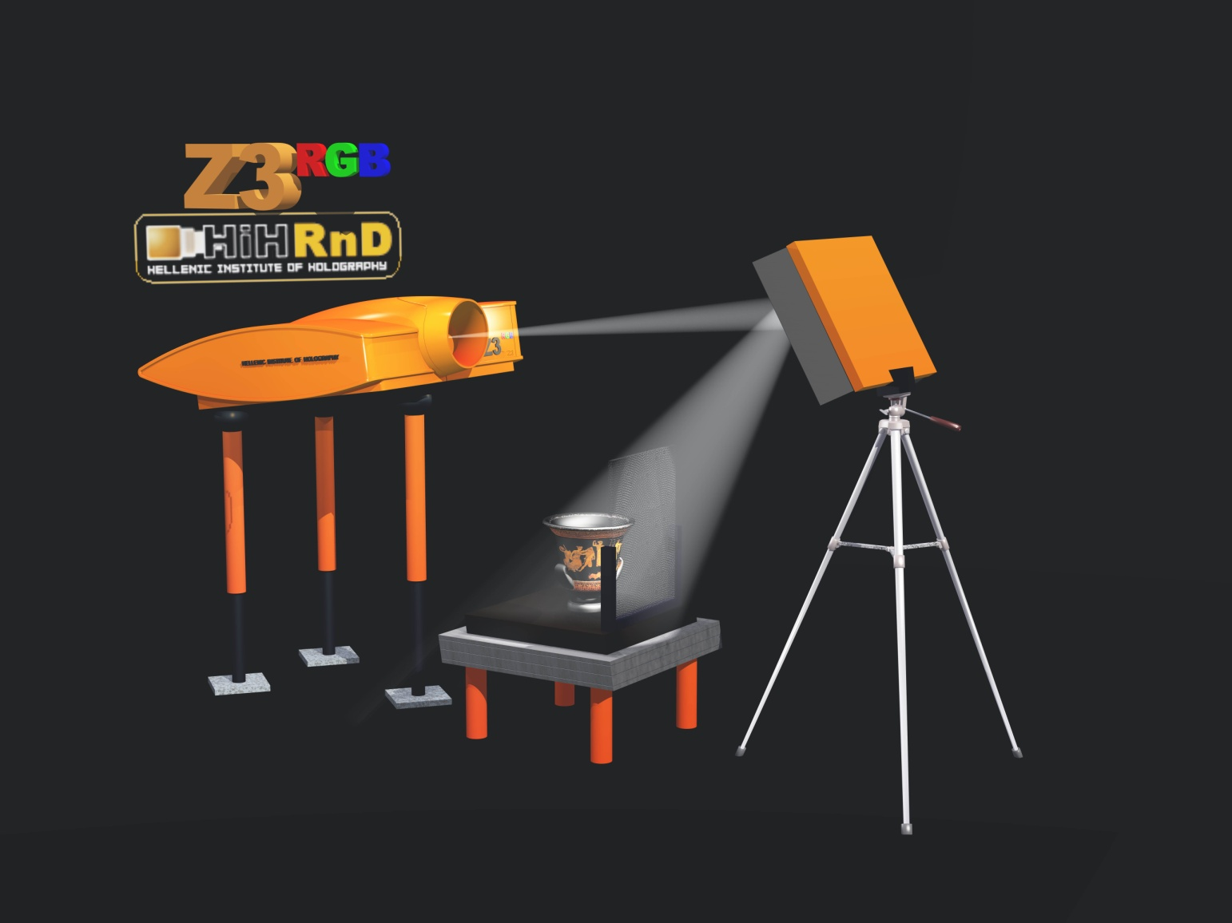
HiH Mobile Recording Equipment

Slide 20
New LED Lights for OptoClonesTM
The progress in Light-Emitting Diodes (LEDs) has opened new possibilities for the display of color holograms. The ideal situation would be if the wavelengths of the LED light source could match the recording laser wavelengths used. This would guarantee that only the light from the source (mixture of the wavelengths) to illuminate the hologram is the same as the one used to create the holographic image. Using a halogen spotlight, which is the common practice today, a large part of the light spectrum emitted is illuminating the surface of the plate without having any impact on the intensity of the image. Instead it creates light scattering, lowering the image contrast.

Slide 21
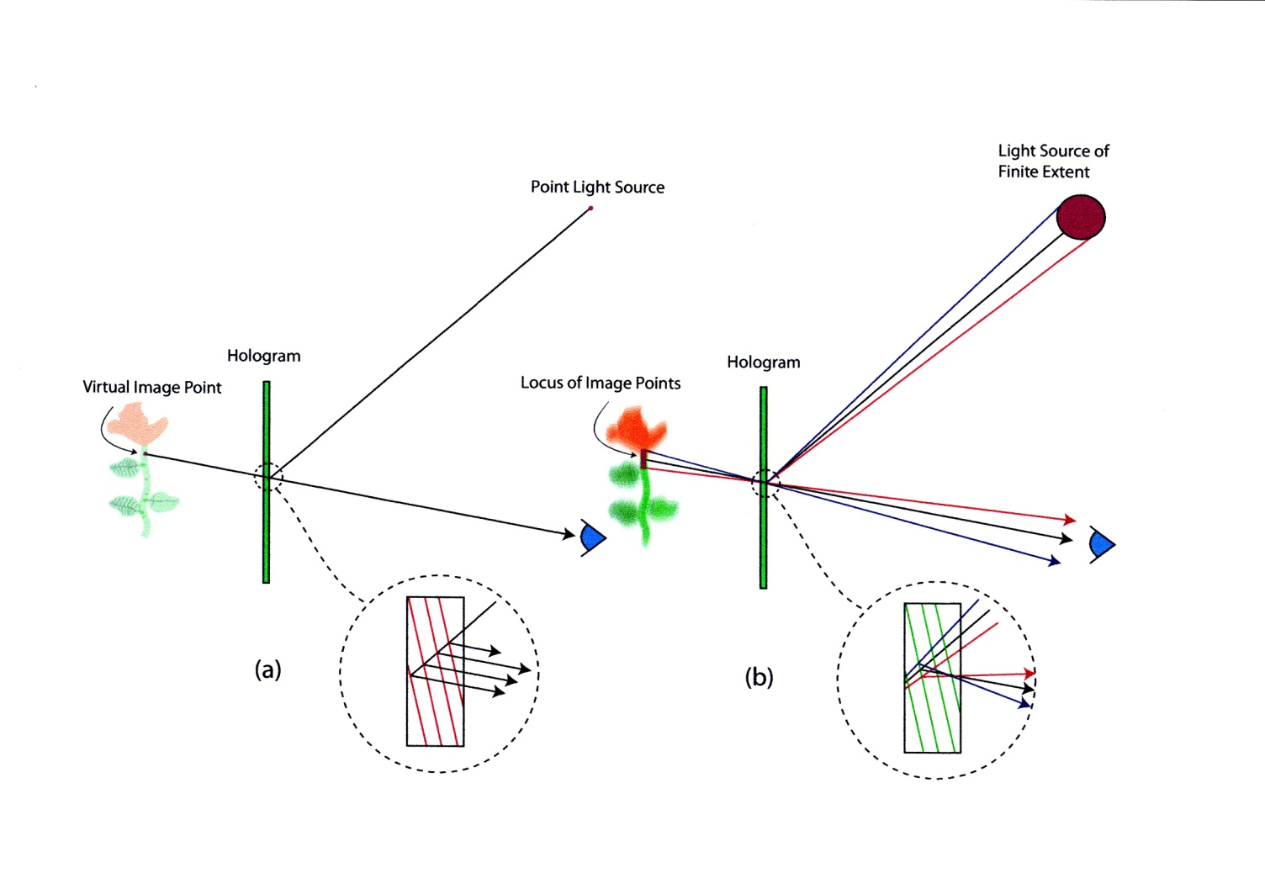
Image Blur in Display Holograms
Image blur needs to be less than the resolution of the eye at the hologram viewing distance

Slide 22
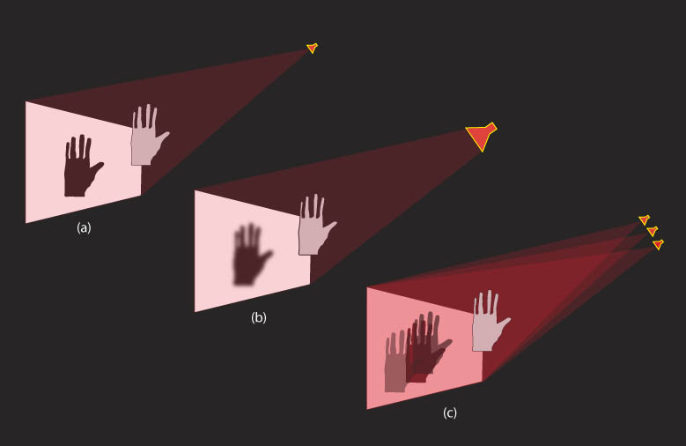
Display of Reflection Holograms
Layman's diagram showing the importance of using a point source light to illuminate a hologram. Here we make an analogy to the shadow cast by a spotlight on a screen. In (a) the spotlight emits light from a small point, resulting in a sharp image. In (b) a large-area diffuse spotlight results in a diffuse image. In (c) many spotlights illuminate the hologram, resulting in multiple images.

Slide 23
Light for Illuminating Color Holograms
The selection of a suitable lamp for the reconstruction (illuminating) of color holograms is much more important than the selection of lamps for monochrome hologram display. The color balance for the recording of a color hologram must be adjusted with the type of light that is going to be used for the display of the finished hologram in mind. Color reproduction in a reflection hologram is only correct when the light is illuminating the hologram or film at a specific angle.

Slide 24
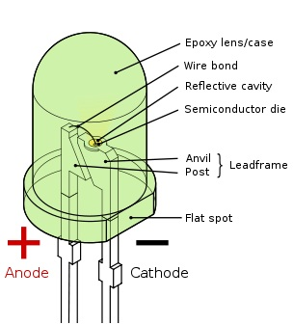
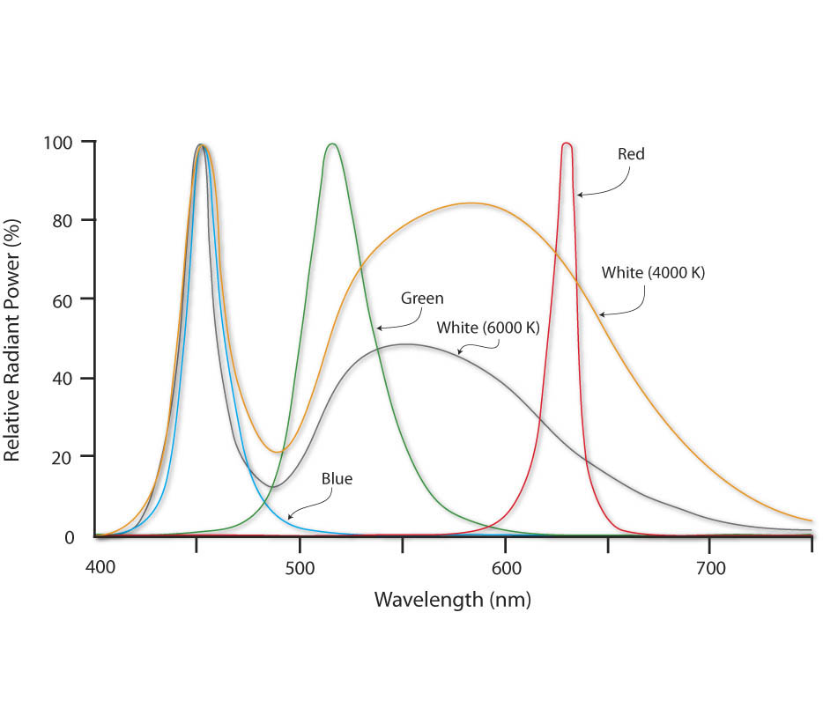
Light-Emitting Diodes (LEDs)
Long life (20,000 to 100,000+ hours),
Small size for improved design and sharper holographic images,
High durability and robustness to thermal and vibration shocks,
Low energy usage / high energy efficiency,
No IR or UV in the beam output,
Directional light output for increased system efficiency,
Digital dynamic colour control – white point tuneable.

Slide 25
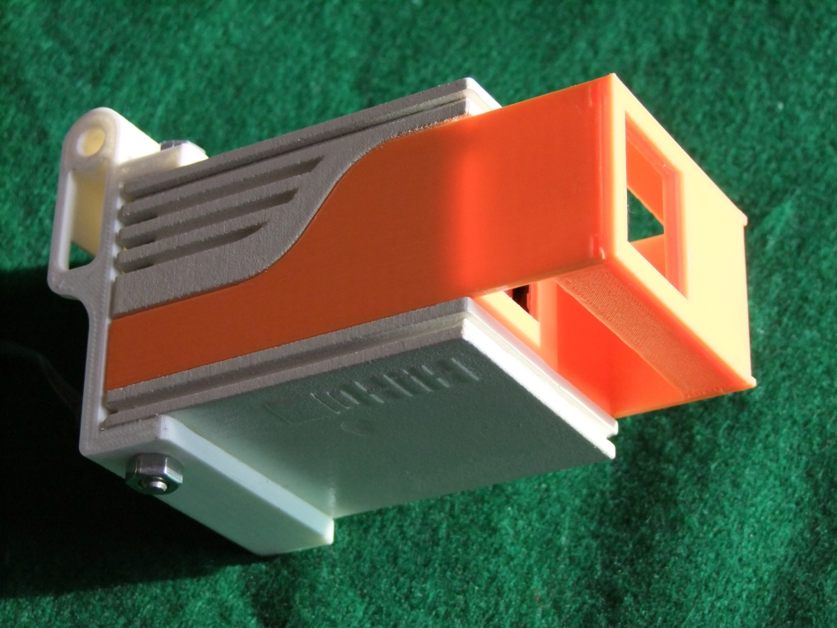
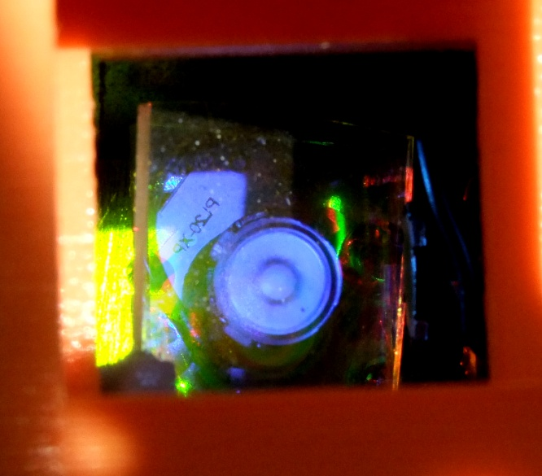
AutoTech RGB LED Light
The Hellenic Institute of Holography in Greece has developed a special LED spotlight, the
for the OptoCloneTM display
The HoLoFoSTM model (λ) LED with a source size about Ø2 mm

Slide 26
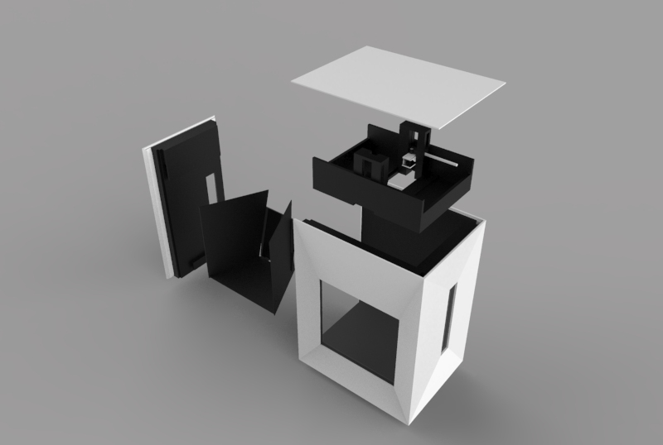
Display Case with Integrated LED Light
The HiH display box with integrated LED light for the correct display of OptoClonesTM

Slide 27
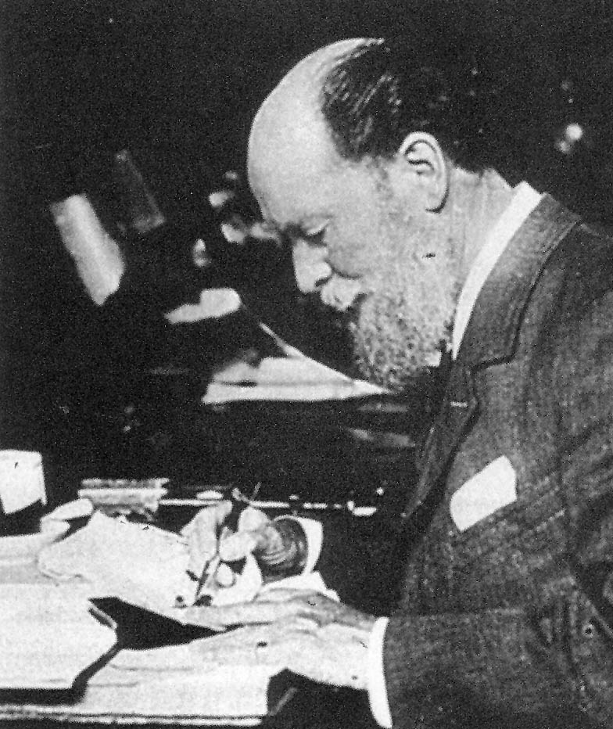
The Fabergé EGG OptoCloneTM Project
Carl Fabergé (1846 -1920)
Photo by H. Aubert, about 1900

Slide 28
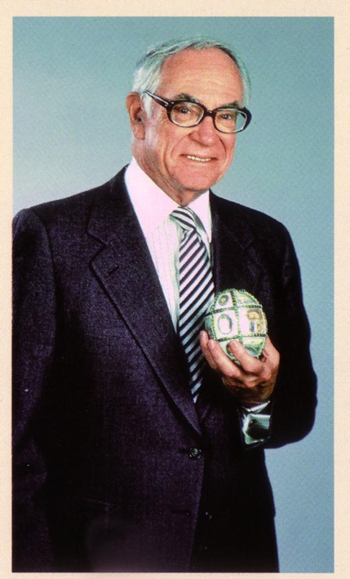
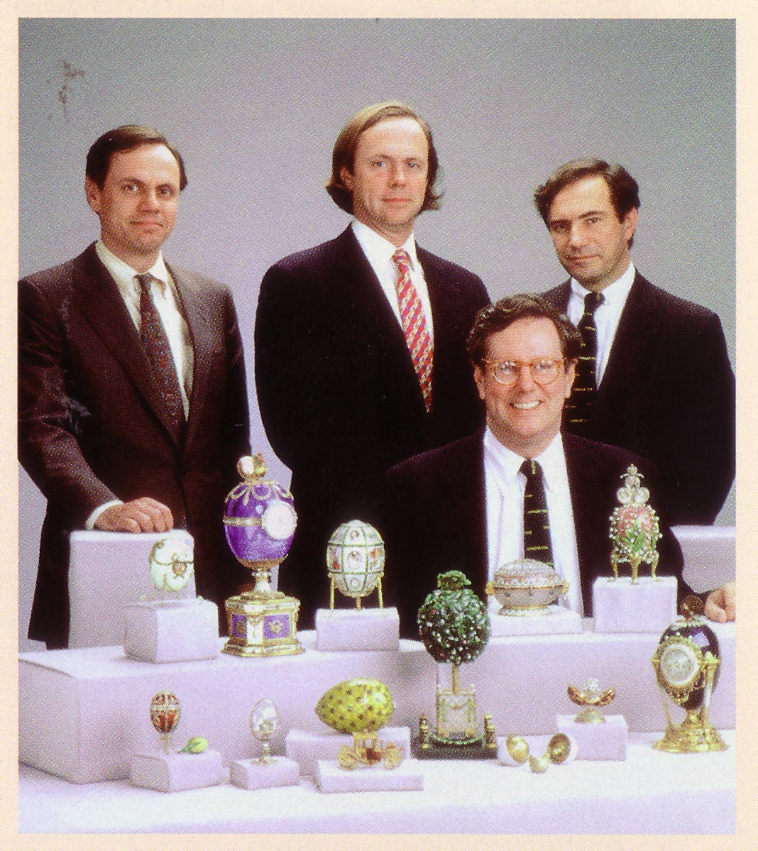
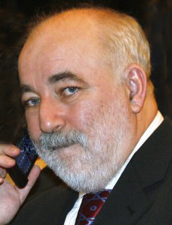
The Fabergé EGG OptoCloneTM Project
Malcolm Forbes (1919 –1990) His sons with the Fabergé Eggs Viktor Vekselberg who bought the collection for $120M

Slide 29
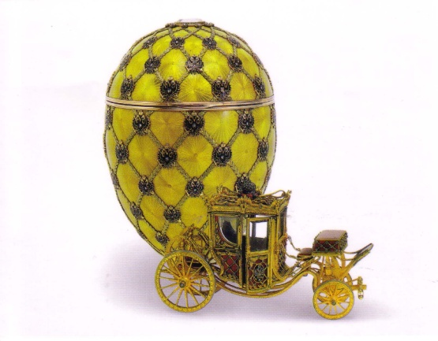
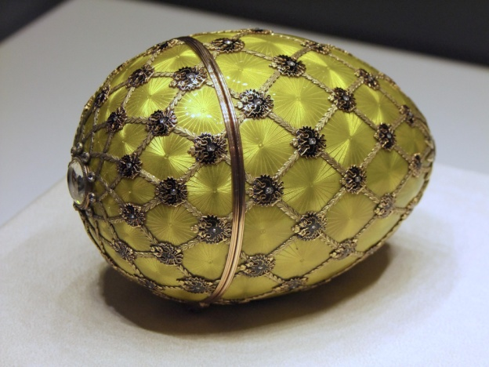
The Fabergé EGG OptoCloneTM Project
To introduce this imaging technique to the world, we selected to record the most beautiful artifacts we could think of, namely the Imperial Fabergé Easter Eggs. The jewelled eggs with enamel and painted details were made by Carl Fabergé (1846 – 1920) in his workshop in St. Petersburg. Each egg often took a whole year to complete. One of the most famous eggs is the Coronation Easter Egg which was given to Empress Alexandra in 1897 by the Emperor Nicholas II as a memory of the coronation in 1896. This egg has a surprise inside: a model of a tiny gold carriage.

Slide 30
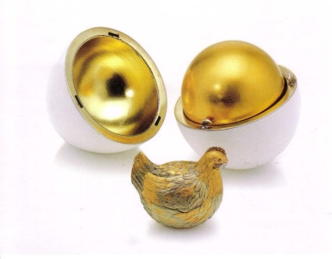
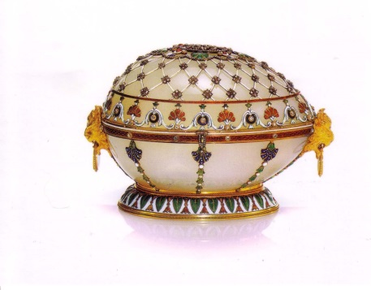
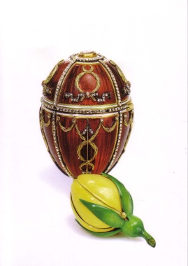
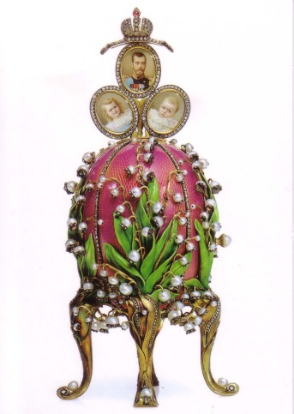
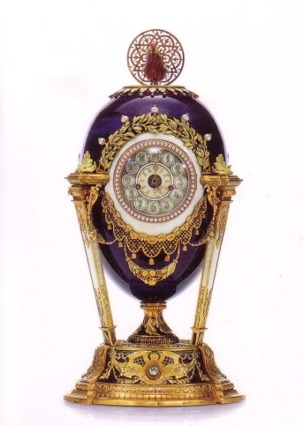
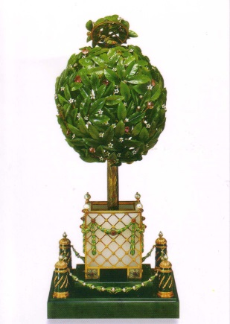
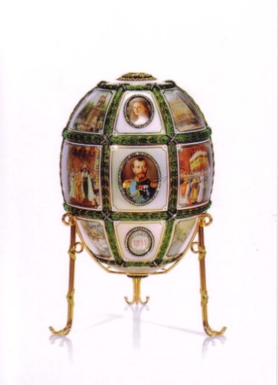
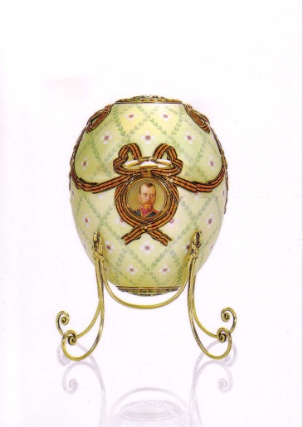
The Fabergé EGG OptoCloneTM Project
The nine Imperial Fabergé Easter Eggs from the Forbes’ Collection

Slide 31
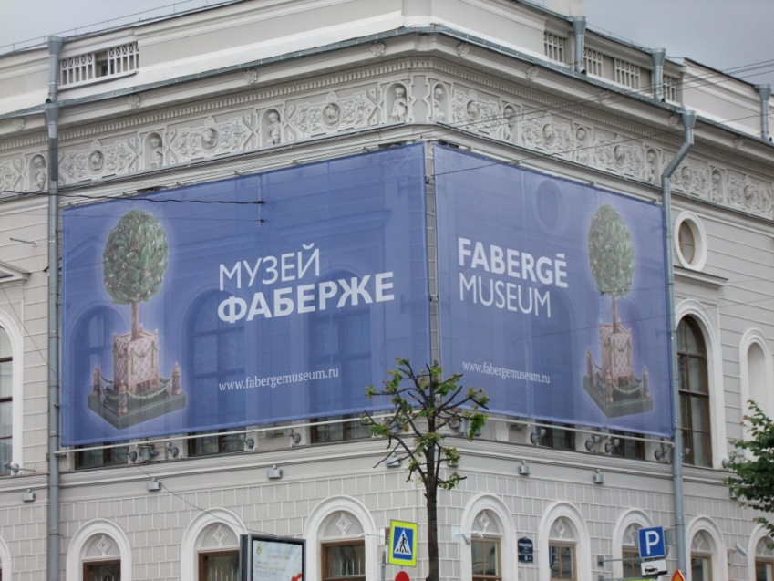
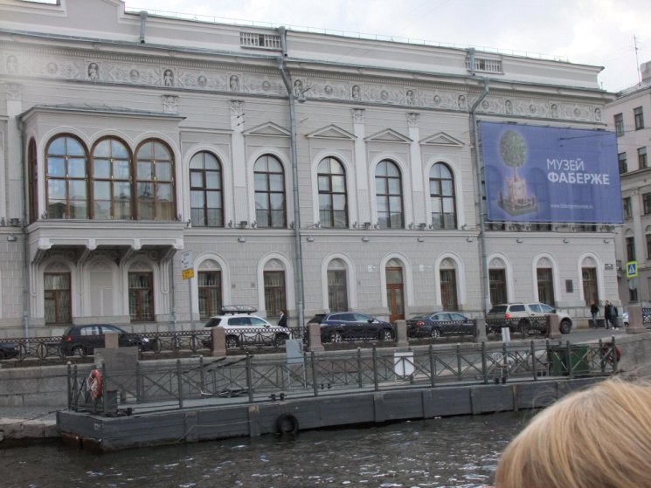
The Fabergé EGG OptoCloneTM Project
The Forbes Fabergé collection in the USA contained nine of the Imperial Easter Eggs. In 2004 these eggs were acquired by Viktor Vekselberg for about $120 million. He brought them to Russia to be displayed to the general public in St. Petersburg. In November 2013 the Eggs were finally put on display in St. Petersburg at the new Fabergé Museum located in the Shuvalov Palace in the centre of St. Petersburg. The museum contains a total of approximately 4000 works of fine art and decorative applied art, including gold and silver items, paintings, porcelain, and bronze.

Slide 32
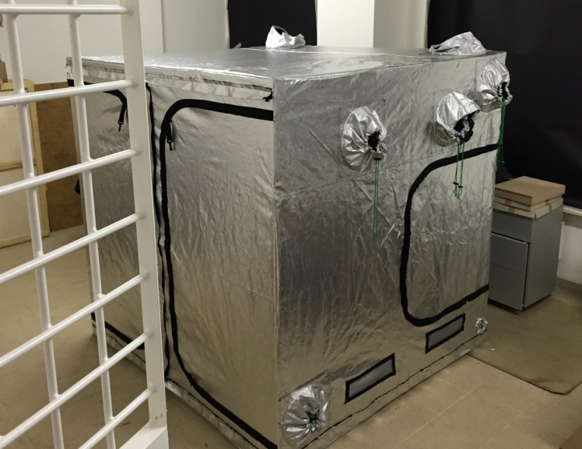
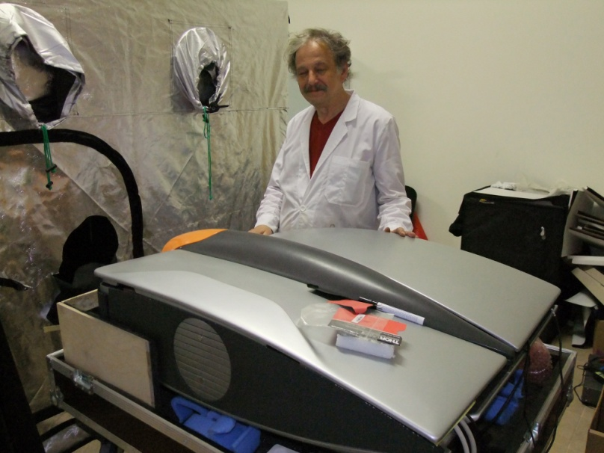
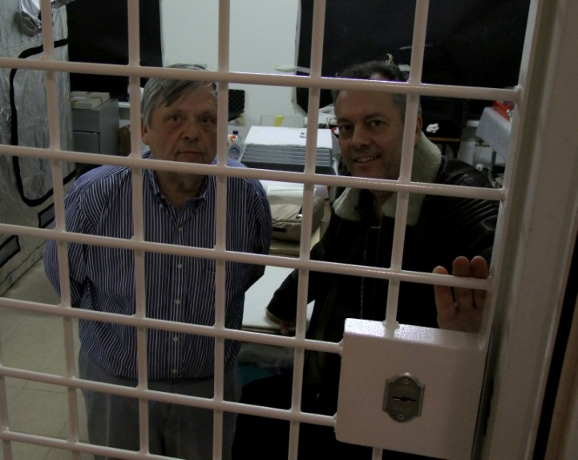
The Fabergé EGG OptoCloneTM Project
The mobile equipment from HiH in Greece was sent to the museum in St. Petersburg. During a few weeks in the spring of 2015 the recording took place in the basement laboratory of the museum. A recording tent was installed there and outside the tent the ZZZyclopsTM equipment was positioned, sending “white” laser light into the tent.
The recording tent
Andreas Sarakinos next to the equipment
Hans & Alkis “behind bars”

Slide 33
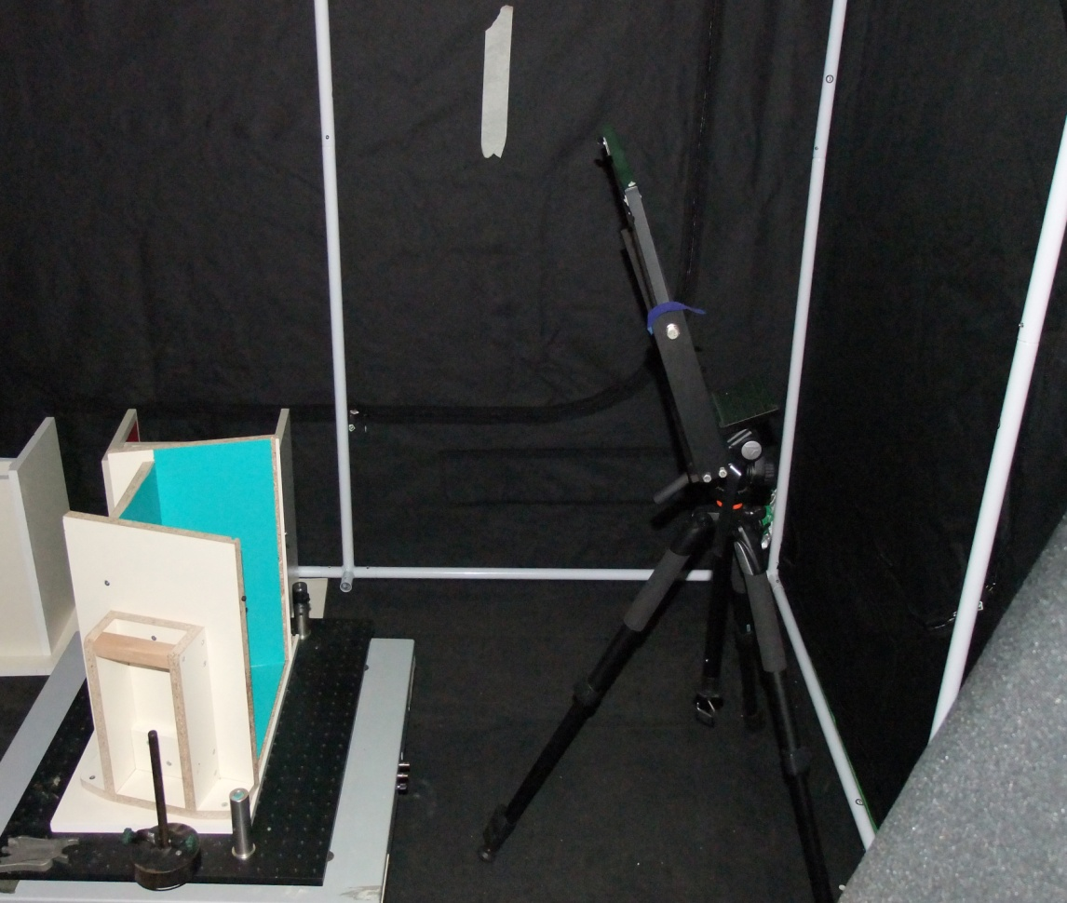
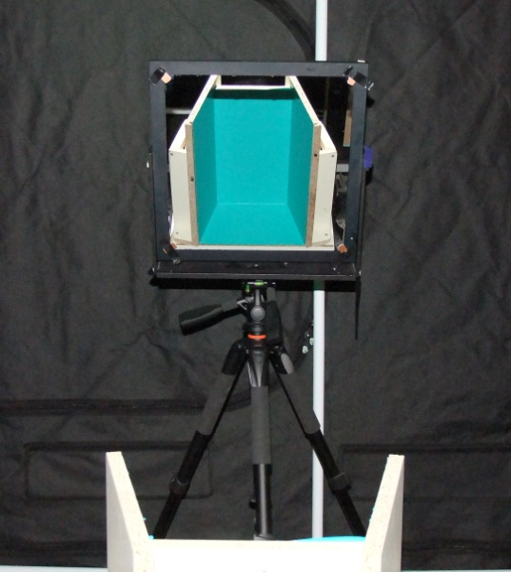
The Fabergé EGG OptoCloneTM Project
Inside the tent there is a tripod with a front-silvered mirror to send the laser light down at a platform with a box in which the Eggs are placed for the recording

Slide 34
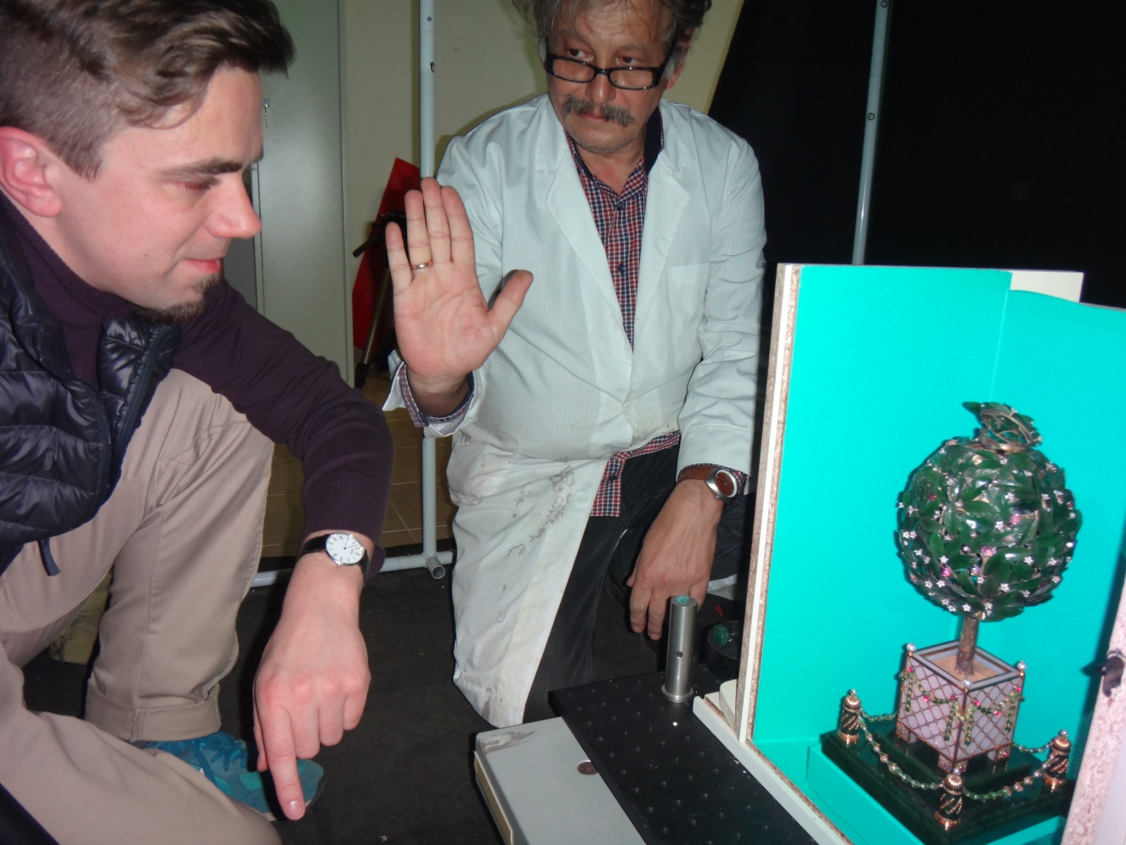
The Fabergé EGG OptoCloneTM Project
One example of how the recording was performed.
The 1911 Bay Tree Easter Egg is shown positioned in the recording box.

Slide 35
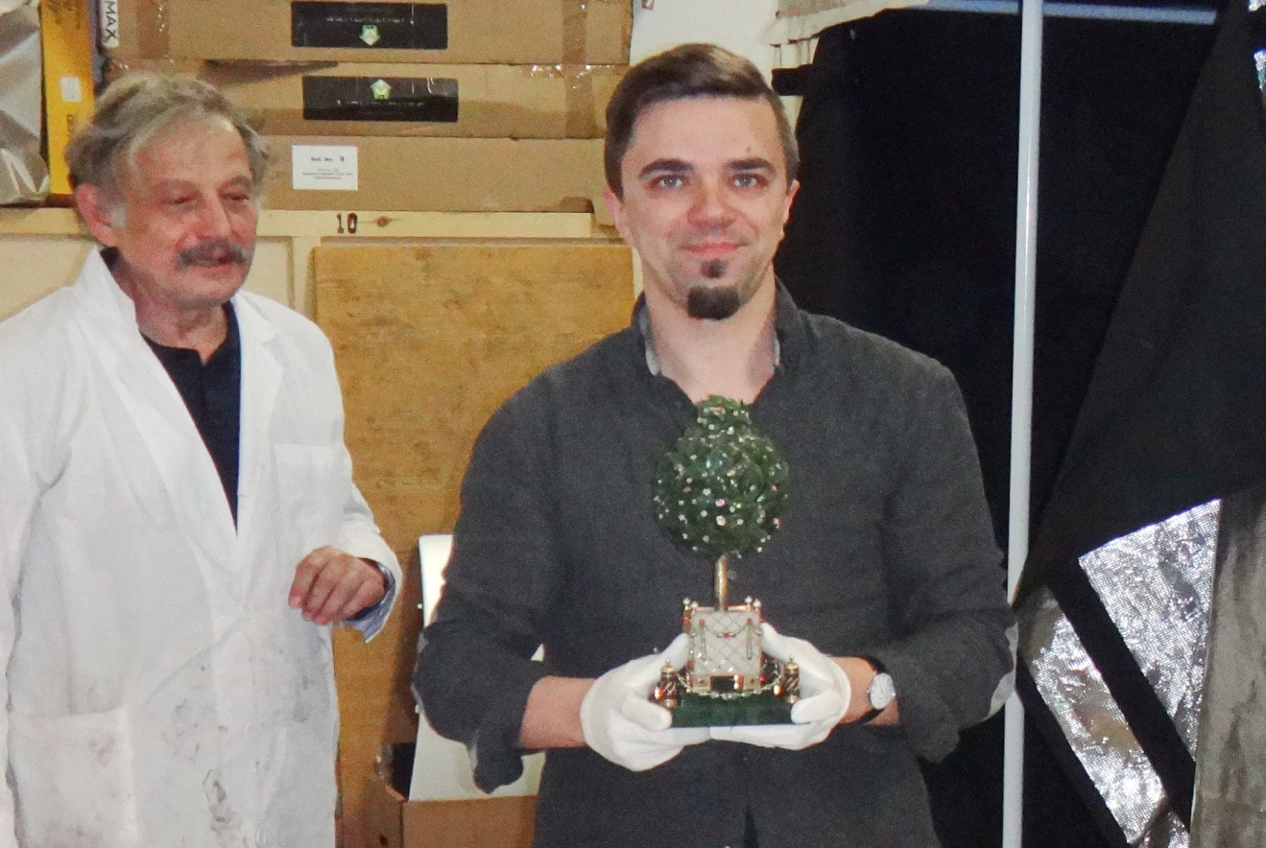
The Fabergé EGG OptoCloneTM Project
The recorded Egg being carried out of the tent by Museum Curator Alexey Pomigalov

Slide 36
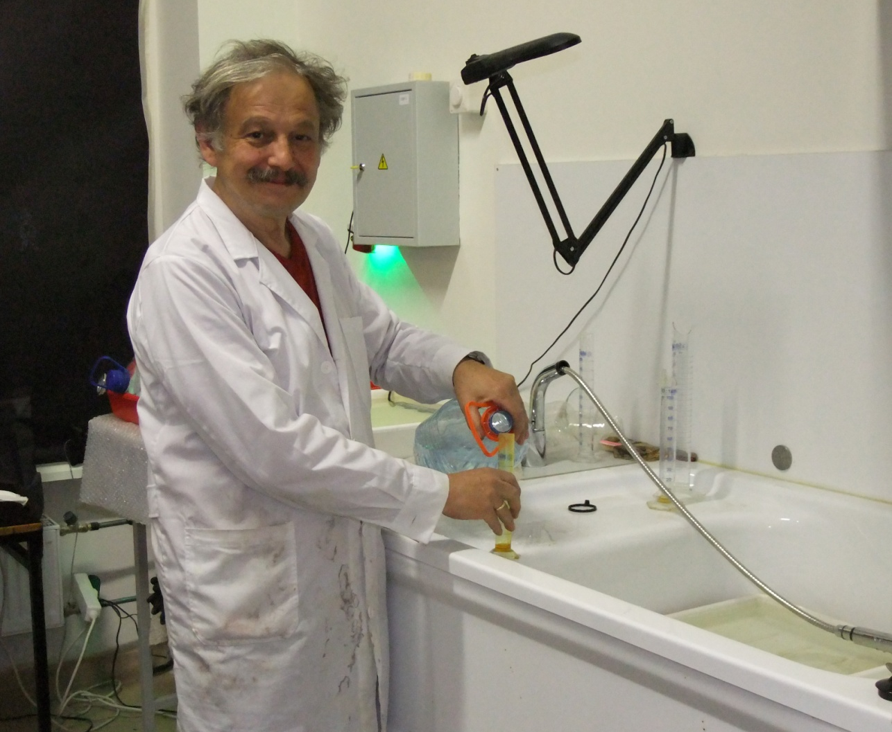
The Fabergé EGG OptoCloneTM Project
The excellent quality of the recordings was achieved thanks to Andreas Sarakinos.
He spent long hours every day during several weeks, recording a total of about fifty OptoClonesTM
In the Fabergé Museum Lab there was a sink with water, which was convenient for the processing

Slide 37
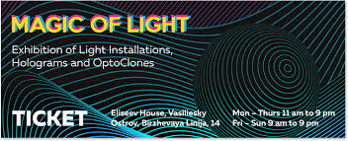
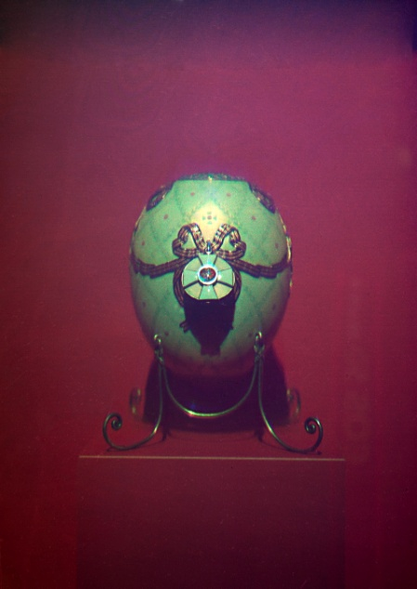
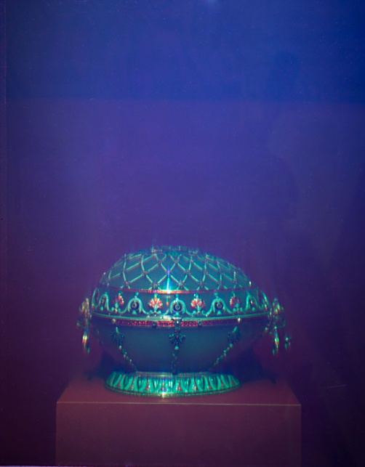
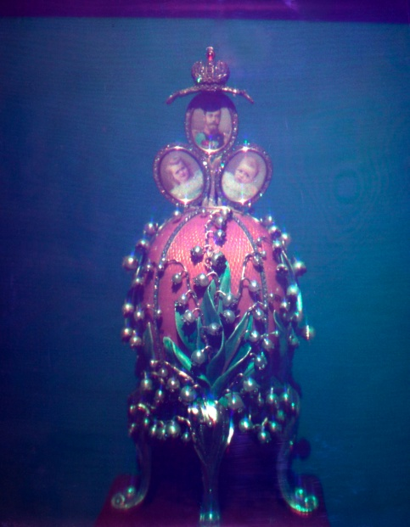
The Fabergé EGG OptoCloneTM Project
Fabergé Egg OptoClonesTM at the Eliseev House, ITMO University

Slide 38
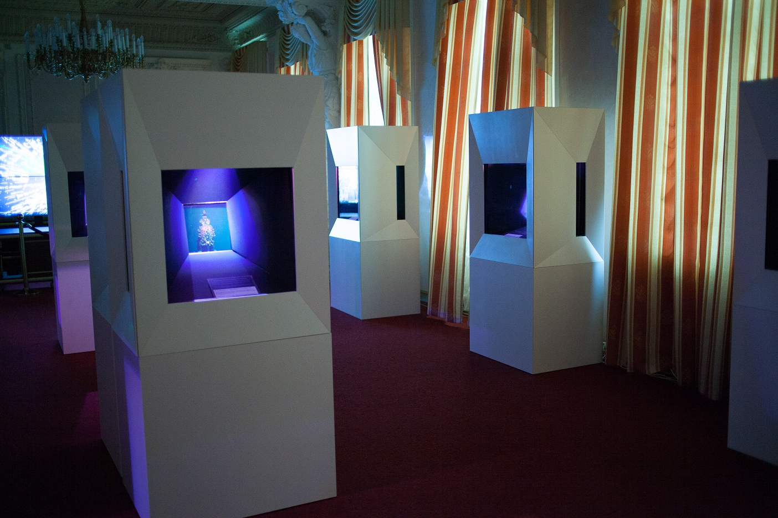
The Fabergé EGG OptoCloneTM Project
The Fabergé Egg OptoCloneTM exhibition at the Eliseev House, ITMO University

Slide 39
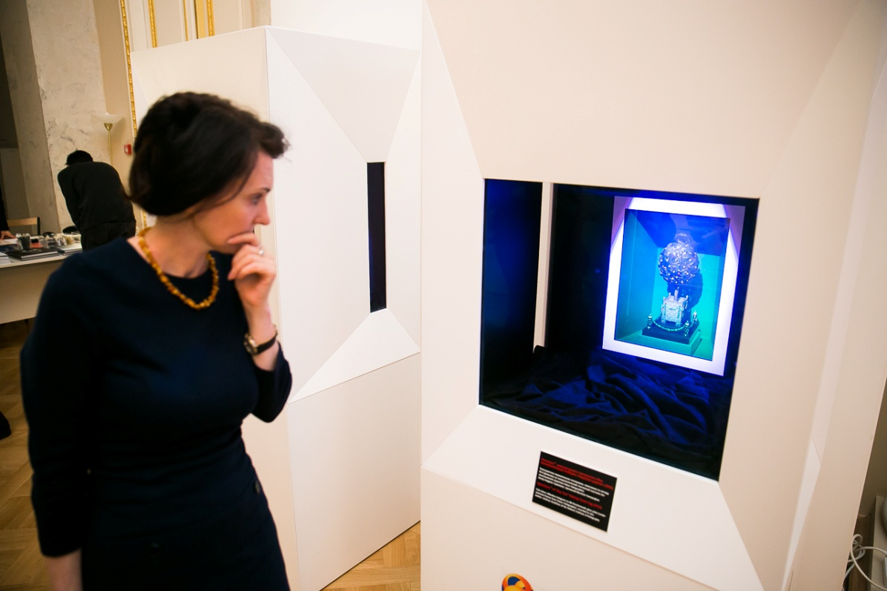
The Fabergé EGG OptoCloneTM Project
A photo of the display case with the recorded Bay Tree OptoCloneTM

Slide 40
The Fabergé EGG OptoCloneTM Project
Coronation Egg and Rosebud Egg OptoClonesTM

Slide 41
The Fabergé EGG OptoCloneTM Project
A photo of the
1900 Cockerel
Easter Egg-Clock
OptoCloneTM

Slide 42
Book Published in 2013
It covers interferential imaging techniques, Lippmann photography, analogue and digital color holography, including in-depth details about panchromatic recording materials and recording equipment, including RGB lasers and digital printers as well as applications of colour holograms

Slide 43
Contact Details
Professor Hans I. Bjelkhagen
Hansholo Consulting Ltd
13 Rhodfa Gofer
Dyserth LL18 6LP
North Wales, UK
Email: hansholo@aol.com
Telephone: +44 (0)1745 571780
www.hansholo.com

