Slide 1


Rectifier Troubleshooting
NACE San Antonio
February 3rd, 2017

Slide 2
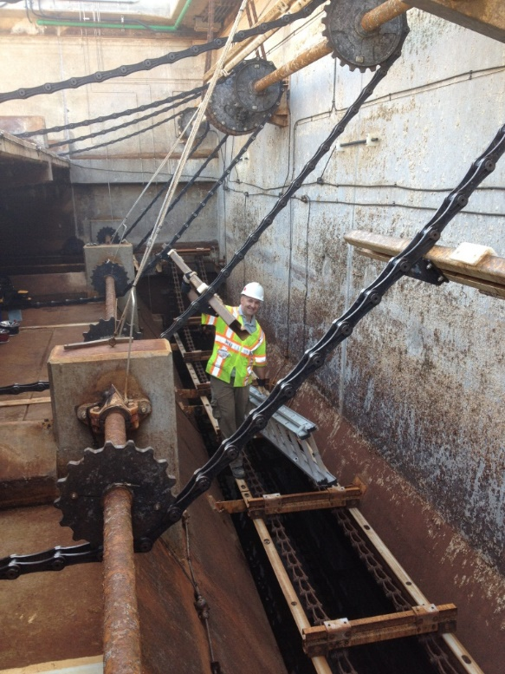
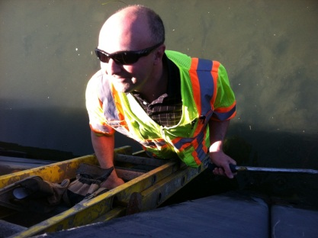

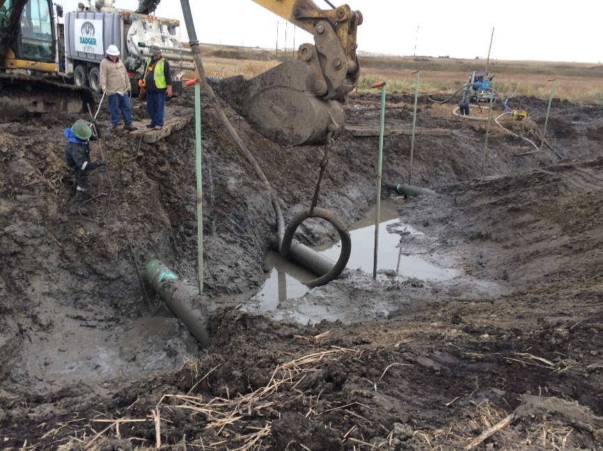
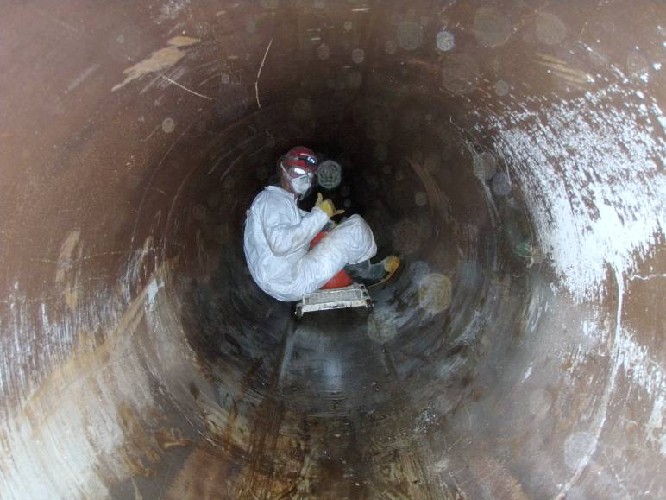
Corrosion Career
How do you get into this thing of ours?
Notes:
Acknowledgments to NACE

Slide 3
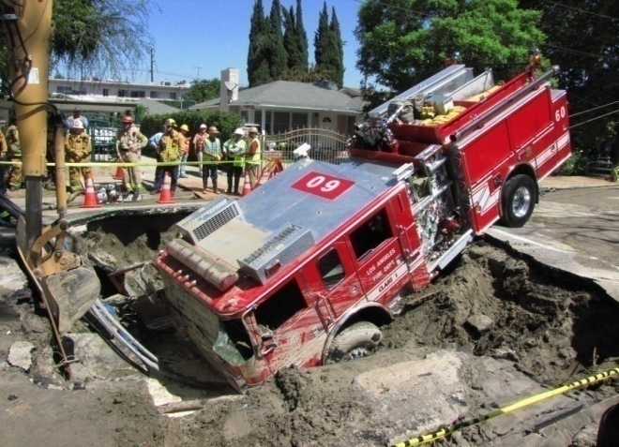
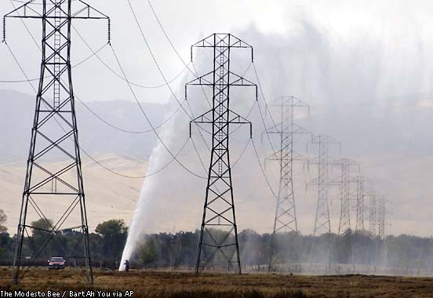

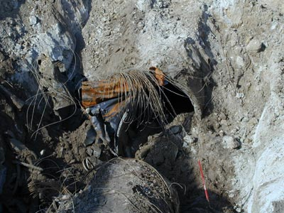
Results of Corrosion (marketing)

Slide 4
Corrosion Control
Four Basic Methods of Corrosion Control
  Material Selection/Design Detail
  Corrosion Inhibitors
  Coatings
  Cathodic Protection

Slide 5
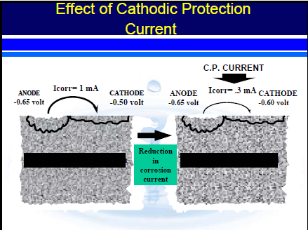
Cathodic Protection
Electrochemically alter the surface condition of the metal to move the anodic reactions elsewhere
NACE SP0572: A technique to reduce the corrosion of a metal surface by making that surface the cathode of an electrochemical cell

Slide 6
Types of Cathodic Protection Systems
Galvanic Systems
  Aluminum, Zinc, Magnesium anodes
Impressed Current Systems
  More noble anode materials (Cast Iron, Carbon, Conductive Polymer, Titanium)
  External Power Source

Slide 7
Impressed Current
Systems
AC Power Source
Rectifier
- +
DC out
Protected
Pipe
Anode Bed

Slide 8
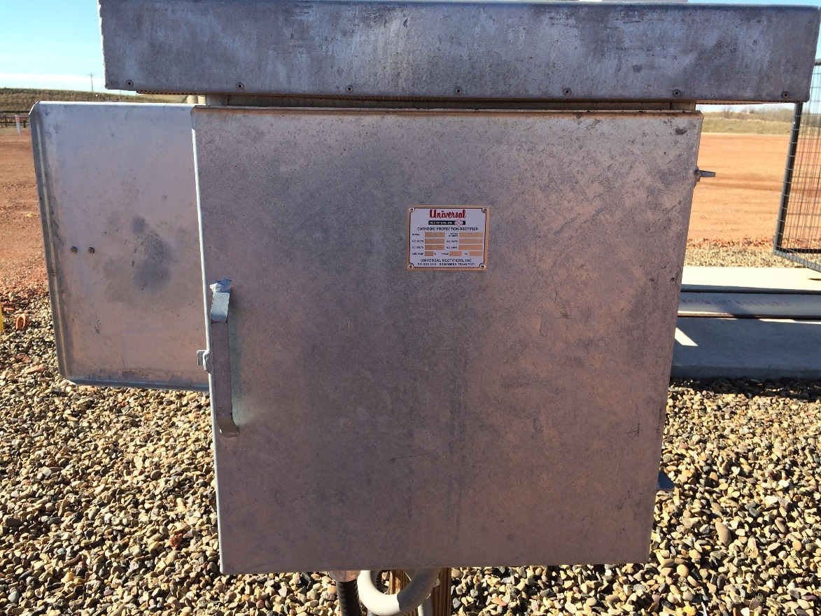
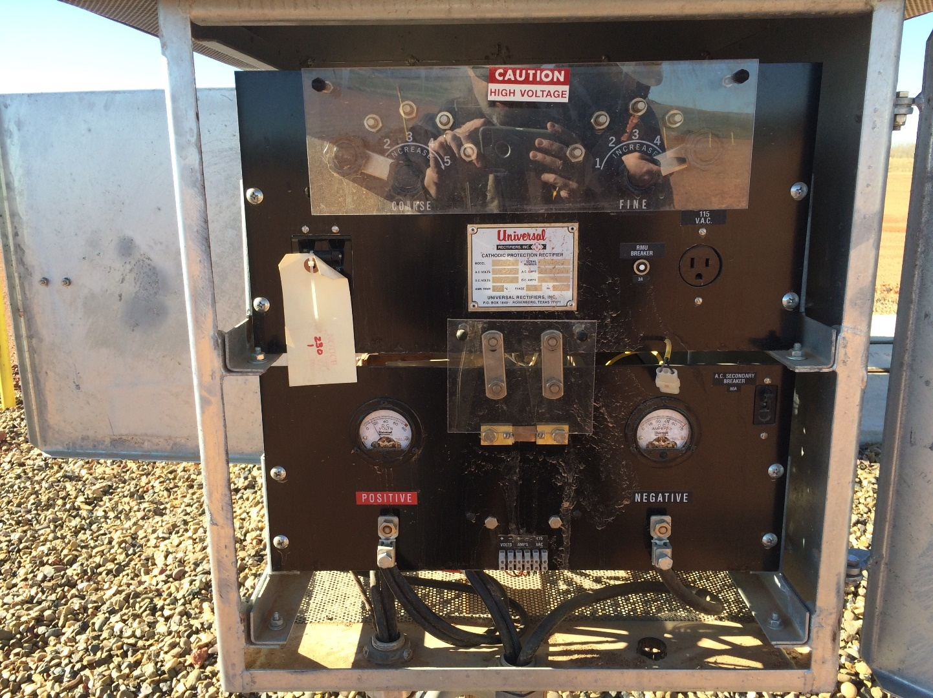
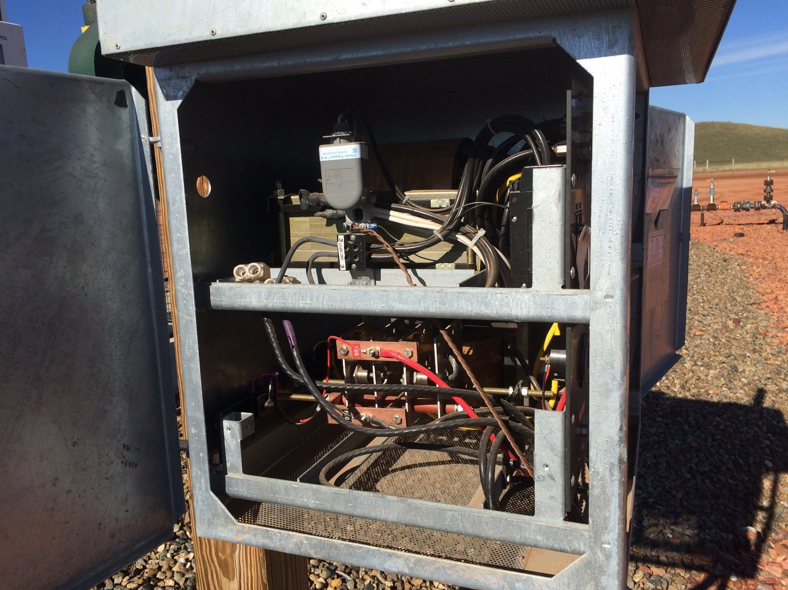
Transformer-Rectifier

Slide 9
Rectifier Components
AC Supply
Circuit breaker
Transformer
Rectifying elements
Meters
DC Output Terminals
Fuses*
Surge protection*
* depending on unit

Slide 10
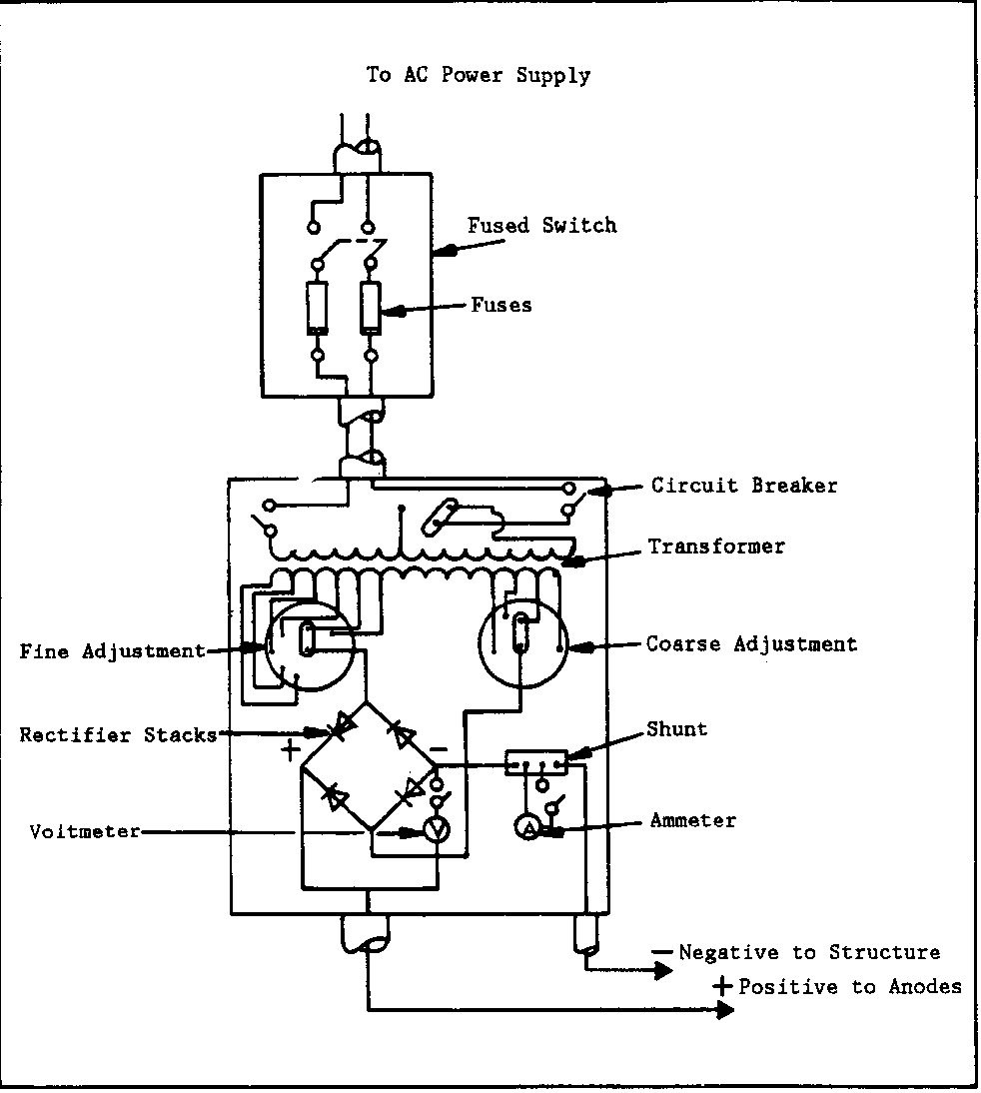
Common Rectifier

Slide 11
Rectifier Testing
Safety Caution:
Safety is of the utmost importance when working on an electrical device.
Only qualified personnel should test
Electrically hazardous area: Do not open any explosion proof junction boxes unless otherwise qualified and then only if the circuits are turned off and locked out/tagged out.

Slide 12
Rectifier Testing (cont)
Safety Caution:
Do not work on or remove any rectifier component without first turning the upstream power off and locking/tagging out.
Confirm that the case is not electrically “hot” either by taking an AC voltage to ground or with a voltage alert device.
On first opening the rectifier identify any exposed terminals that will have a voltage and take measures to protect yourself from them.

Slide 13
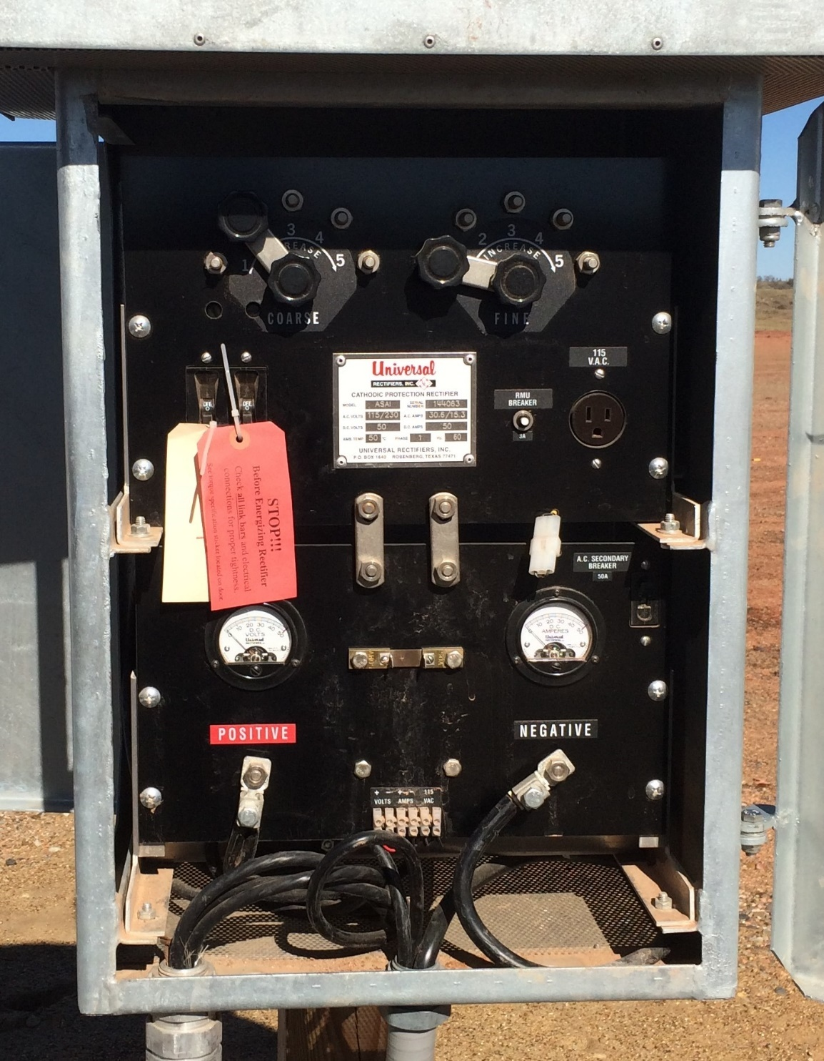
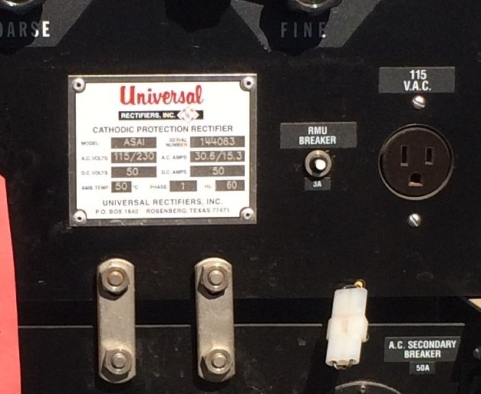
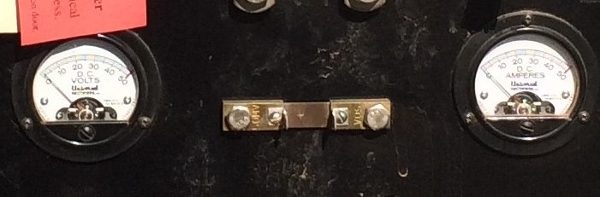
Basic Tests
Name Plate
O&M Manual
DC Volts
DC Amperes
Tap Setting (Potential set point)
Tap AC Voltage
AC supply Voltage (if qualified)

Slide 14
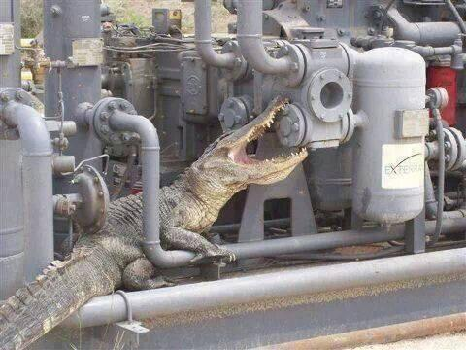
Now to the Real Experts
On Troubleshooting

Slide 15
Diode Testing from Panel
Test diodes from panel after removing taps and DC cables

Slide 16
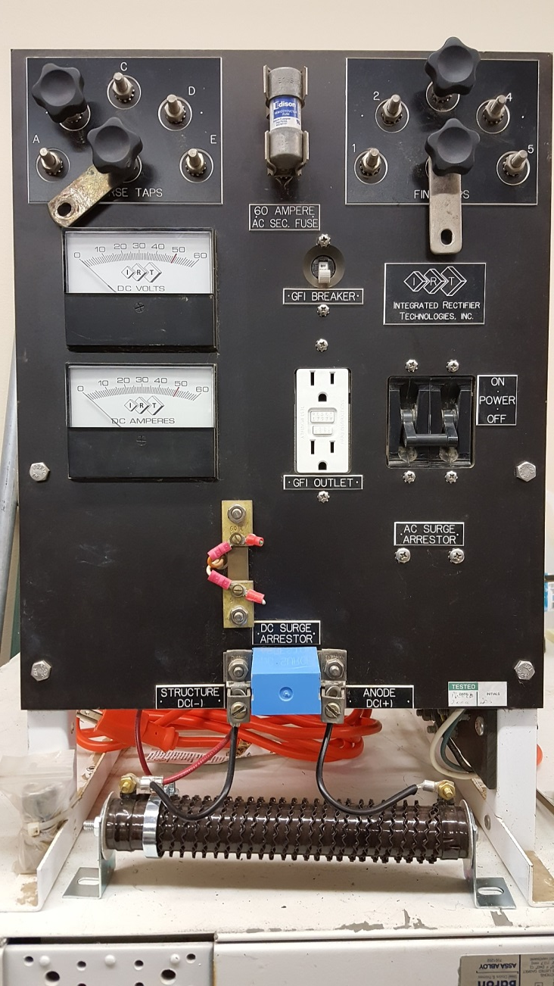
Rectifier Safety
Rectifiers vary in AC voltage feed from 120 to 480 VAC.
Any voltage over 15 that passes through a person (touch potential) is an extreme safety hazard.
Before opening a rectifier cabinet, check the case for AC voltage

Slide 17

Shock Hazards Inside
This rectifier is an example of poor safety design.
How many points of contact inside this unit can you spot?
There are over 15.
The worst points share a voltage of 79.5 VAC!

Slide 18

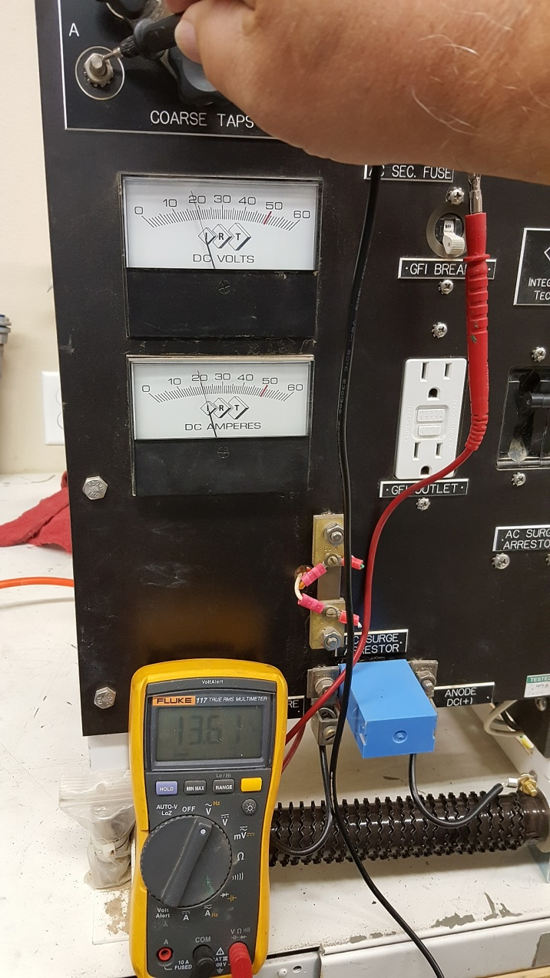
Safety Danger Spots Ex#1 13.6VAC

Slide 19

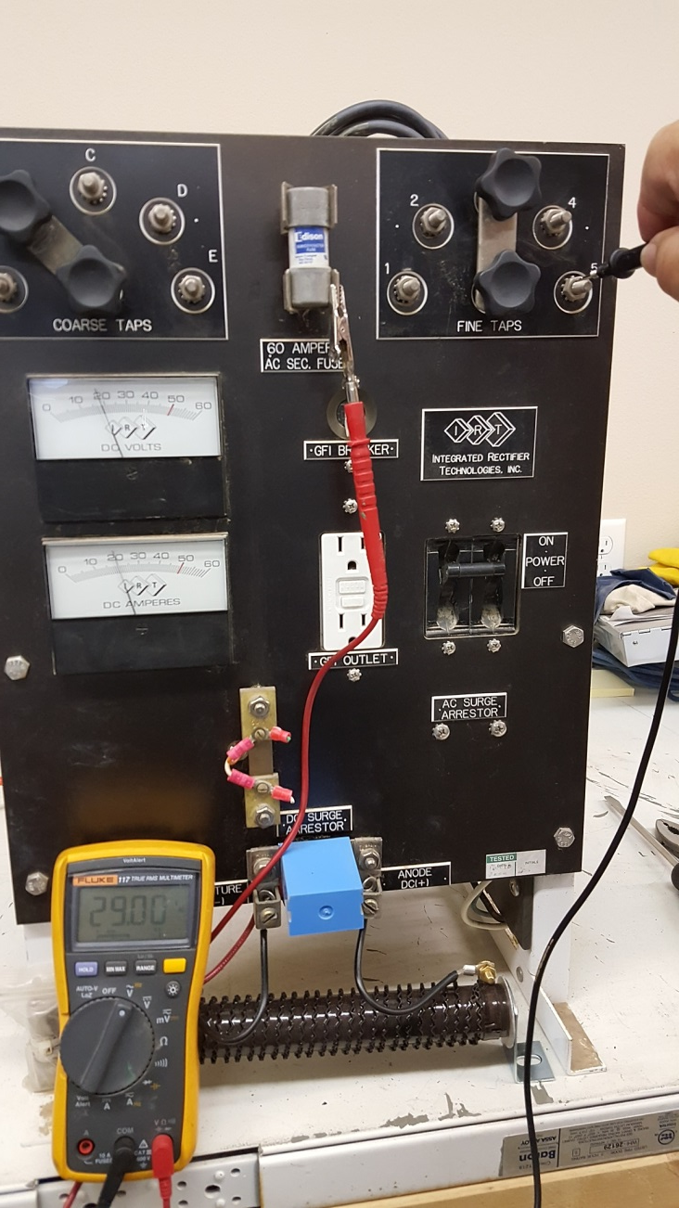
Safety Danger Spots Ex#2 29VAC

Slide 20
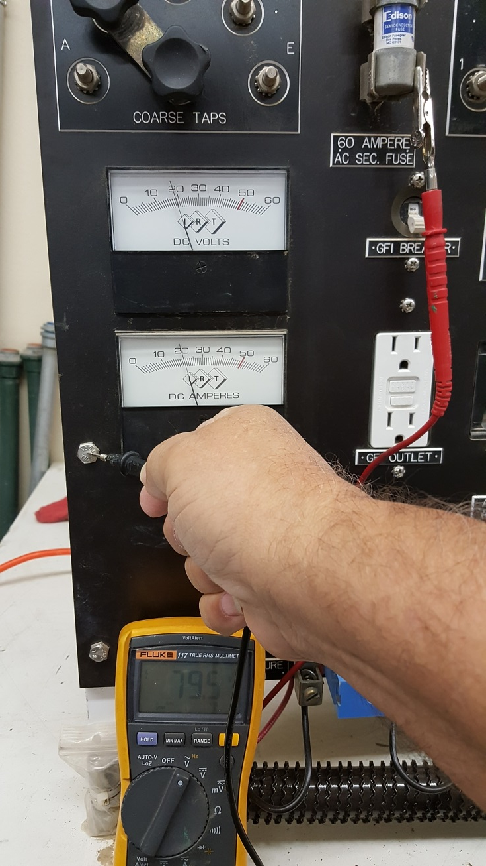
Safety Danger Spots #3 79.5VAC

Slide 21
Safety Considerations

Slide 22
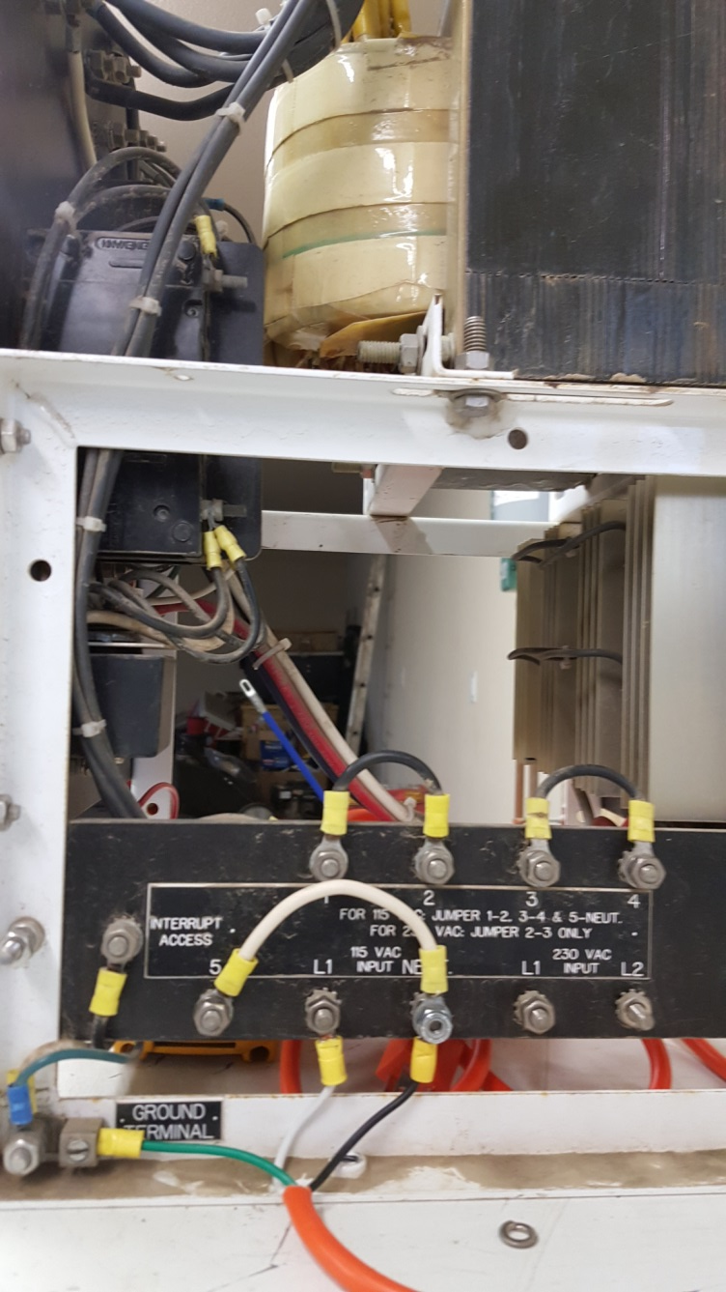
The AC Feed
This rectifier can run on 120 to 240 VAC.
Note the jumpers in place to run on 120 VAC
Also the neutral jumper
Another example of poor design layout is the location of the AC lightning arrestor.

Slide 23
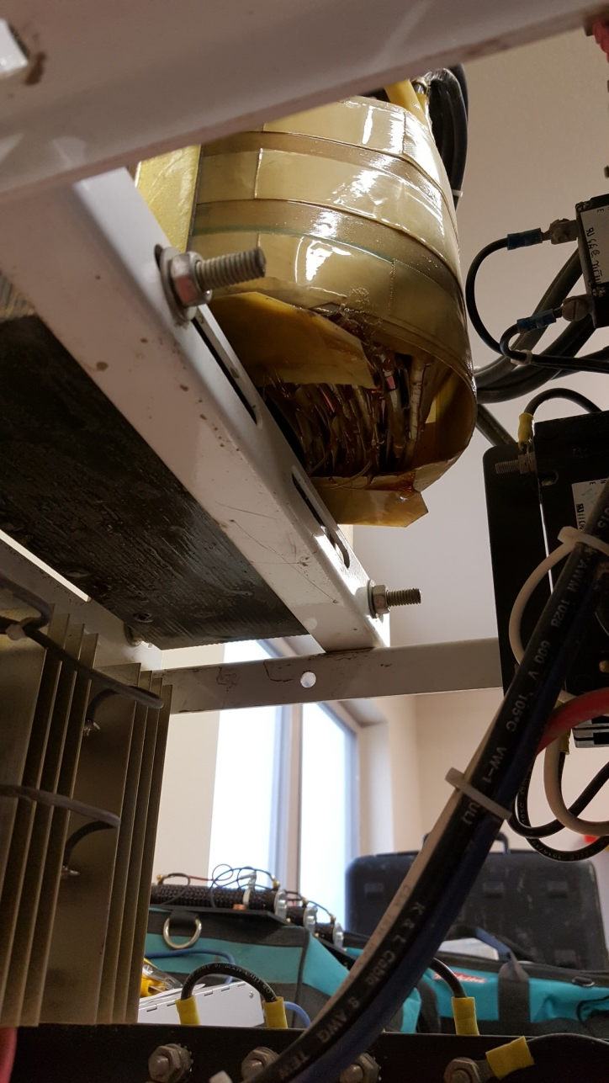
Visual Inspection
When checking a rectifier out that has tripped a breaker or blown a fuse, the initial step is a visual inspection.
Note any burned spots in the cabinet, faceplate, wires, transformer, diodes, lightning arrestors, etc.

Slide 24
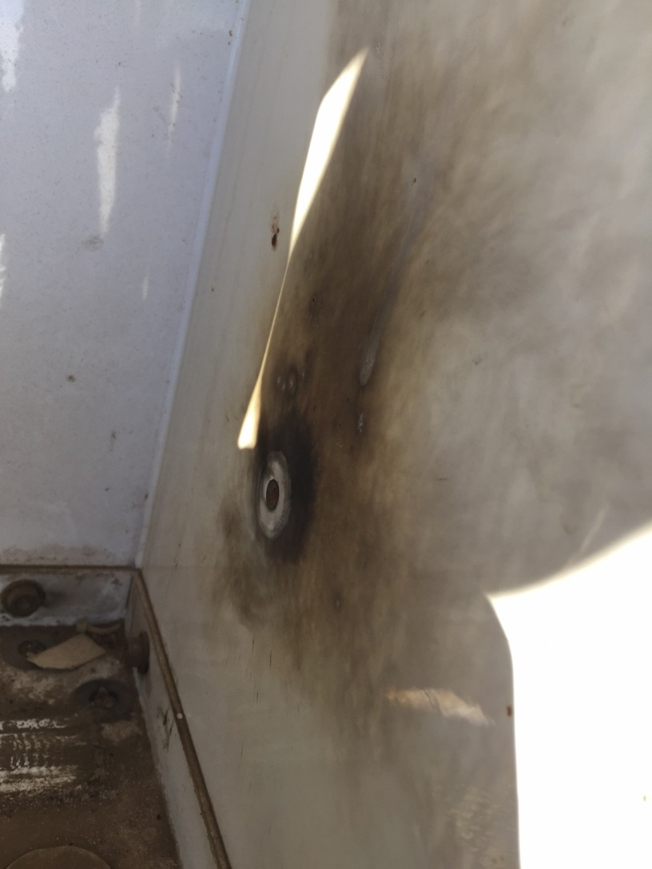
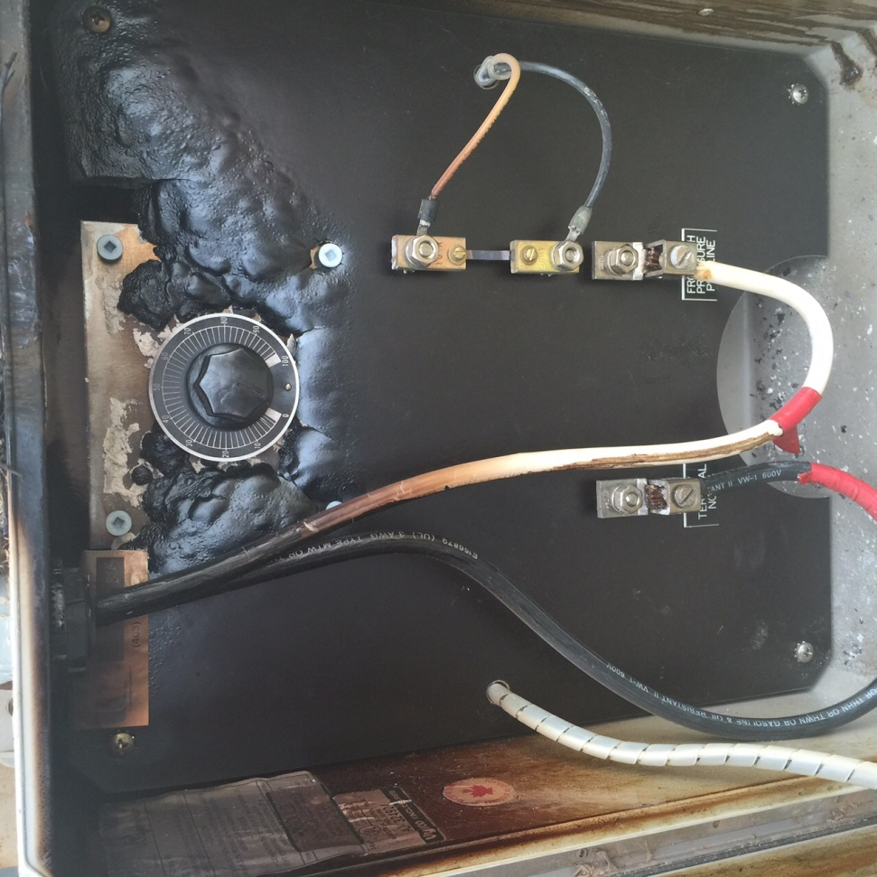
Things to Visually Spot

Slide 25
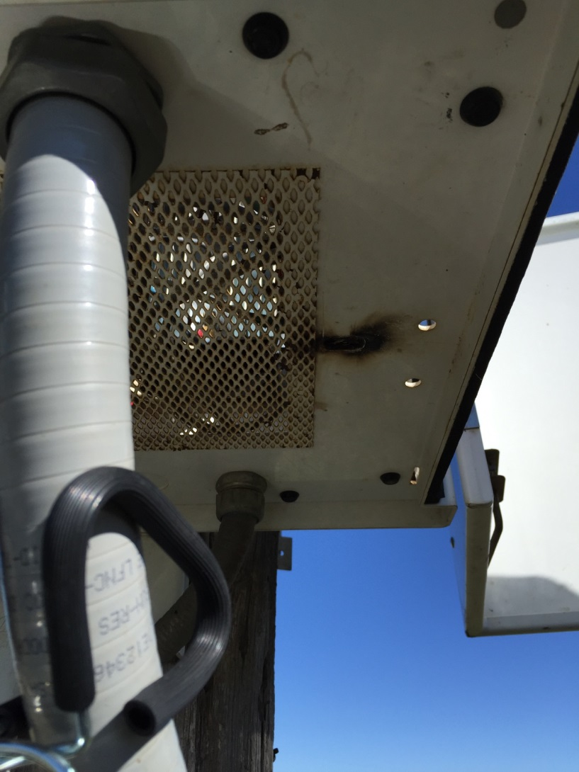
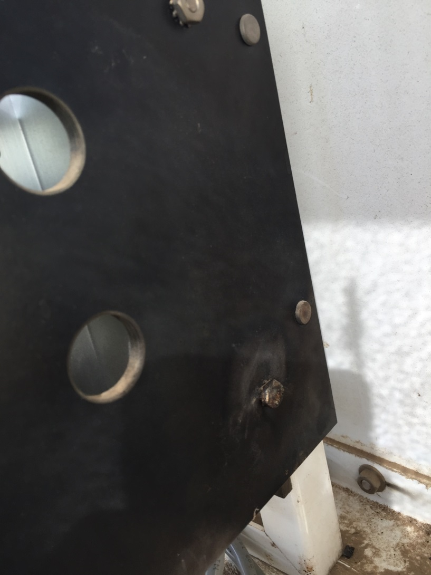
Visual Inspections

Slide 26

Note Rectifier Redline
Normally the redline numbers are on the manufacturer tags.
Also they are actually represented by red lines on the rectifier gages.
In this case 50V and 50 A DC.
Note the GFI socket and trip – many companies have outlawed these.

Slide 27

Test Setup and Controls
This test setup has a 1 ohm, 300 watt rated resistor as a “dummy load” connected between the + and – DC lugs.
This resistor simulates the circuit between the negative lead to a pipeline, and the positive lead to the ground bed.
This circuit then represents a ground bed resistance value of 1 ohm.
What would be the current in this resistor if the voltage applied was 10 volts DC?
Would that be too high for the resistor to withstand?

Slide 28
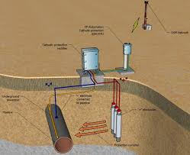
Cathodic Protection Circuit
As mentioned, the resistor takes the place of the groundbed, soil, pipeline, and all inline wires at the rectifier.
So a good test of a rectifier can be done with a resistor.
If the suspicion is that there is a short between the ground bed and pipeline wires, or between them and the conduit, you can take the wires loose and check the rectifier with a resistor.

Slide 29

Resistor Tests
Resistors are rated at a wattage level (V * A = Watts) that is stated on their side with a variance of =/- 10%.
This resistor is 300 watt rated. So at the maximum the resistor can handle 330 watts for extended times. Beyond that, they react the same as a slow blow fuse and will burn out!
What is the maximum VDC we can put on this resistor?
330W/17.3A = 19.08 VDC Max
Over that, heat light and discontent!
Note especially – HEAT!

Slide 30
Rectifier Controls
Note the AC Breaker
At the top Left the Course Taps
At the top right the Fine Taps
Note the very dangerous AC secondary fuse
Where is the current shunt?
Where do you measure DC Volts?
Can you use the Gages?
Where is the DC Lightning Arrestor?
Where is the AC Lightning Arrestor?
What polarity goes to the pipeline?
Would it matter if it were reversed?

Slide 31
Resistor Test Results

Slide 32
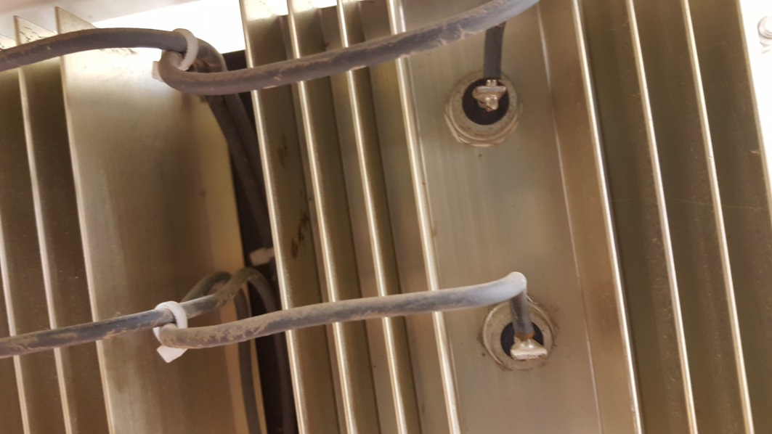
What’s Inside?
There are two primary types of rectifiers
  Full Wave Bridge
  Half Wave
95% of the rectifiers in the field are Full Wave Bridge Design
Of these two types the internal device that changes AC to DC is a diode or a selenium “stack” element.
Shown here are 2 of the 4 diodes needed for a “bridge” design Full Wave rectifier.

Slide 33
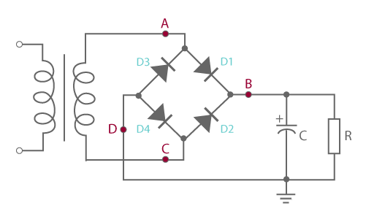
What’s Inside?
A “rectifier” is basically the same as a battery charger – similar to that used on car batteries.
The elements are:
  Transformer
  Full Wave Diode Bridge
  Possible smoothing agents such as a choke or capacitor or both.
  Tap Settings, Breakers, Lightning arrestors.

Slide 34
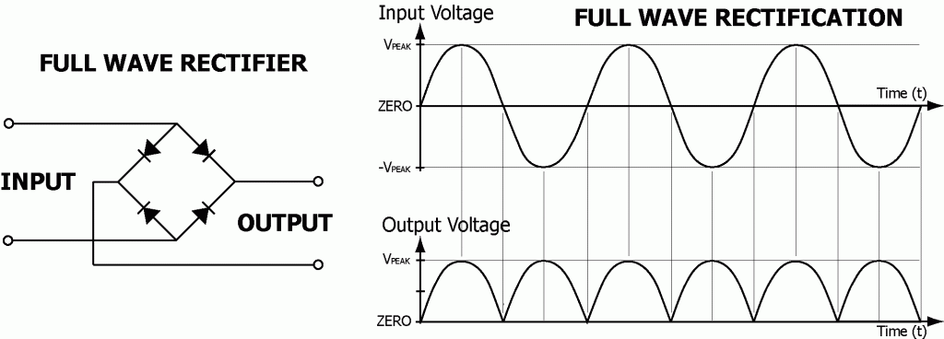
Full Wave Diode Bridge
This arrangement of diodes changes the full AC “sine wave” into a rippling DC output.
Using a frequency meter on this, it should show 120 hertz.
If the meter shows 60 hertz, the unit is half waving and has a burned out diode.

Slide 35
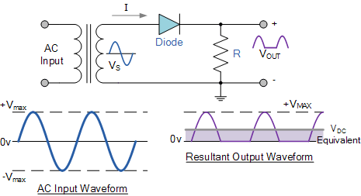
Half Wave or Malfunction?
A single diode rectifier is a half wave design.
Note the ripple pattern shown for this.
If a full wave bridge rectifier has a burned out diode, this may be the result or even zero output DC.
Frequency for this would be 60 hertz on your meter.

Slide 36
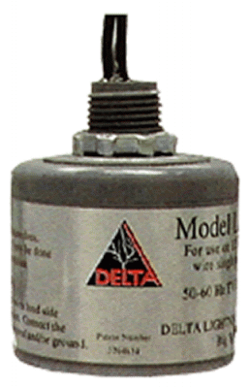

Lightning Arrestors
Lightning arrestors are to short between the leads they are connected to in event of a high voltage surge.
On the AC side this shuttles the current to the rectifier ground.
On the DC side it shuttles the current to the ground bed.

Slide 37

Lightning Arrestors Can Short Out
Nothing can withstand a direct large lightning bolt! It travels miles through air, will a small arrestor survive? Nope
Lightning arrestors can short out and trip the breaker when turned on.
Take them out of service and check for low resistance. Replacements are available.

Slide 38
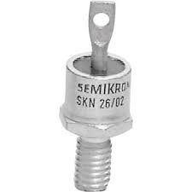
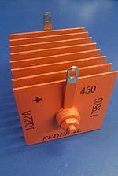
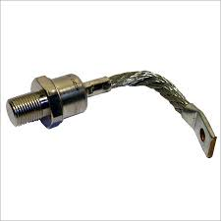
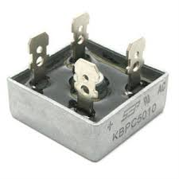
Diodes and Selenium Stacks

Slide 39
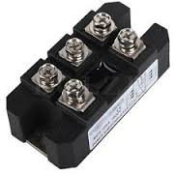
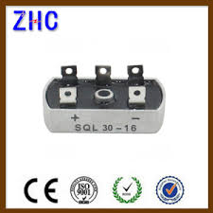
Three Phase Rectifier Bridges
Three phase rectifiers have three AC connections and the usual +/- DC outputs.
They are mounted on very large heat sinks to carry high currents.
All modularized diode bridges are somewhat easy to replace and have in stock.

Slide 40
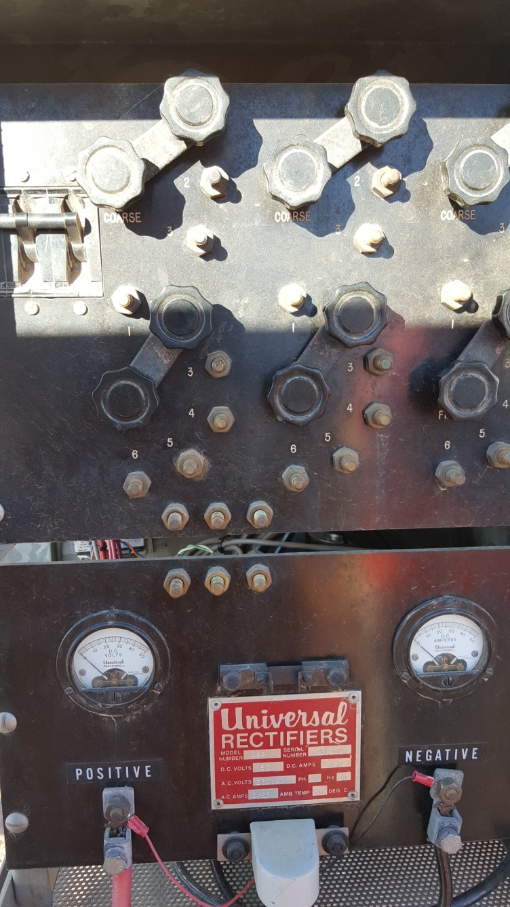
Three Phase – Cherry Creek
Three phase rectifiers have 3 course and 3 fine tap settings.
Note the junction straps between the AC section and the dc section – Nice!
Each section in this design slides out for ease of testing and repairs.

Slide 41
Summation of Safety Rules
If you are not trained, do not work on them.
If you have never seen the one in front of you before, do not work on them.
Readings and measurements can be taken on all rectifiers by qualified CP1 and higher techs.
First check for AC on the case – ALWAYS!
Check with back of the hand a safety check also.
Any work done to a rectifier is to be done with AC power OFF and confirmed NO AC Present!
Always fill out the form in the rectifier pocket on all measurements taken, date, and sign as well as record them and report them.
Be SAFE!

Slide 42
One Last Word
Generally an experienced tech would be the only doing any repairs to a rectifier.
Normally CE would only be involved with rectifier replacements when not working.
Qualified Techs of CP1 or higher are to take measurements, and operate changes and interrupters to the rectifiers.
Construction crews can of course mount rectifiers and connect DC cables.

Slide 43
Questions/Comments
Visit www.chapman.engineering for more!
Eric Frechette, PE, NACE CP-4
Chapman Engineering
Boerne, TX
Office: (830) 816-3311 office
Email: efrechette@chapman.engineering

