Slide 1
Iceboat Right of Way Rules
LRIBYC

Slide 2
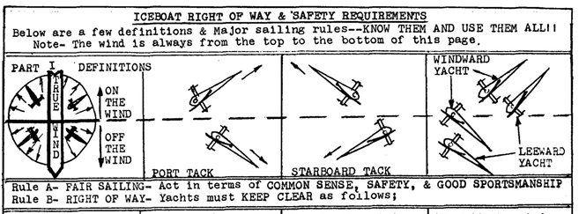

Slide 4
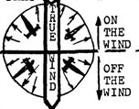
Off Wind keep clear on both
PORT and STARTBOARD
Tacts (DIFFERENT THAN
WET SAILING)

Slide 5
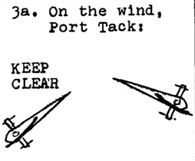

Slide 8
(DIFFERENT THAN
WET SAILING)

Slide 13
8
All iceboats shall be entitled to cross
Finish line
NEW 3rd Lap ROUND UP

Slide 14
Darling Mark
Darling Mark is a mark of the course to prevent starboard tack from forcing inside OVERLAP at the Leward Mark. (cannot go between Darling and Leward mark)
GREEN Flag Located 100 yds to windward from Leward Mark.
Now there may be Darling Mark at the windward Mark (DN Nationals)

Slide 15
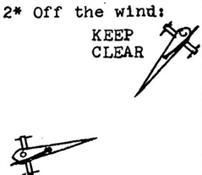
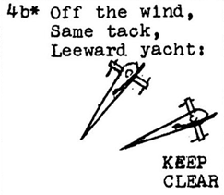
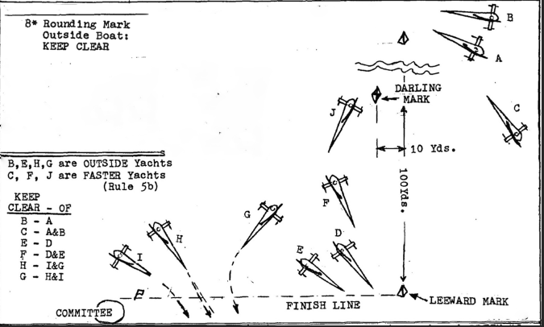
Different from Wet Water Sailing
Rules 2, 4b, and 8 differ from Wet sailing
8

Slide 16
DN North America Standard Course

Slide 17
DN North America Darling Course

Slide 18
DN North America In-Line Course

