Slide 1
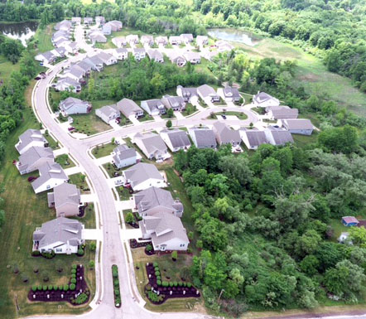
Woodland Pointe HOA
General Meeting
October 24, 2019

Slide 2
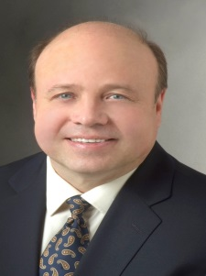
Introductions Board of Directors
Marty Kuboff
President
Kitty Flauto
Vice-President
Edward McTernan
Treasurer
Michael Flora
Secretary
Amy Ginsberg
Officer at Large
The above Directors are all volunteers without any form of compensation…..
Do you ever wonder what they do?????

Slide 3
Woodland Pointe HOA Board of Directors Guiding Principals
Fulfill obligations in carrying out declarations
Address Development Needs Today & Future
Insure the Development Remains attractive, Safe and Desirable
If all of the above is performed, will facilitate property appreciation

Slide 4
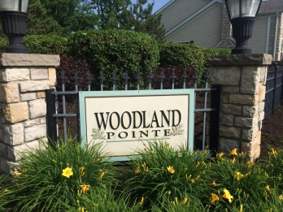
Woodland Pointe HOA Agenda
Introductions
2018-2019 Review
Financial Report
Housekeeping
2020 Budget
Election of Trustees
Q & A

Slide 5
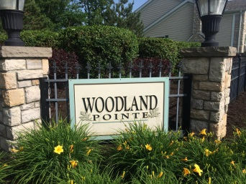
Introductions
New Neighbors
Jordan Pouncey
Jill Giesey
Tony & Kyra Gray
Jeane Holley
Animesh & Harshita Jain
Mark & Leslie Ann Magda
Kevin & Liz Poest

Slide 6
Woodland Pointe HOA Accomplishments 2018-2019
Administrative
Architectural
Maintenance
Social
Legal
Financial

Slide 7
Administrative Accomplishments
Negotiated Landscape Contract
Street Lamps Repaired
Numerous Meetings-City of Macedonia
Created New Snow Removal Specification
24/7 Service w/ Iris Management Group
Trail Improvements
Playground Improvements
New Front Entrance Lighting

Slide 8
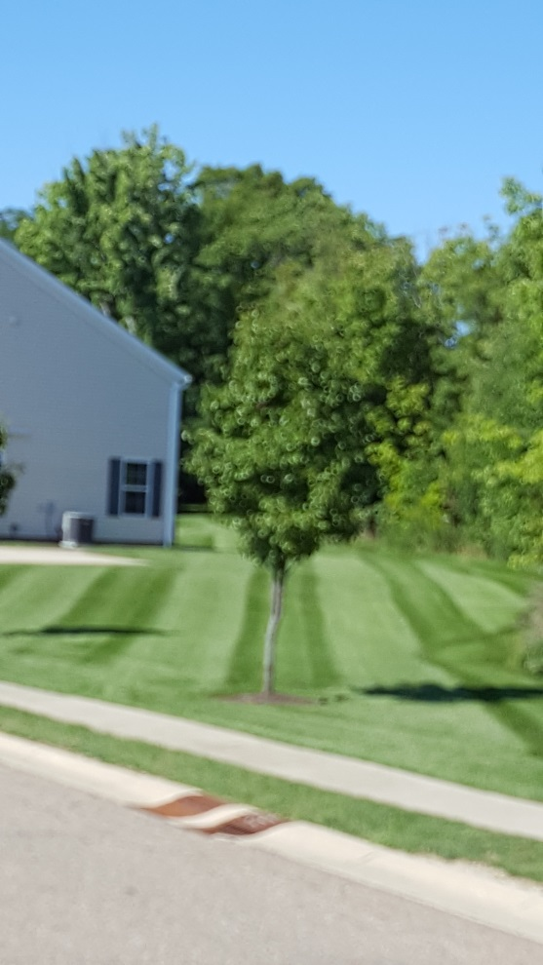
Architectural Activities
Removed 9 Dead Trees
9 Landscape Approvals
2 Awning Approvals
17 New Bushes Planted
4 New Trees Planted

Slide 9
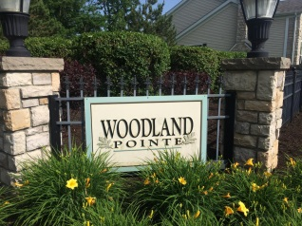
Maintenance Activities
Trail Improvement
Bridge Repaired
Bridges Stained
Repaired Pond Fountain

Slide 10
Financial Approved 2020 Budget
Line Item |  |  |  |  |  | 2020 Budget
Bank Service Charge |  |  |  |  |  | $2,900.00
General Insurance |  |  |  |  |  | $1,300.00
Landscaping |  |  |  |  |  | $35,000.00
Maint & Repair |  |  |  |  |  | $3.750.00
Management Fee |  |  |  |  |  | $8,532.00
Legal Fees |  |  |  |  |  | $2,000.00
Accounting Services |  |  |  |  |  | $600.00
Utilities, Water and Sewer |  |  |  |  |  | $1,300.00
Utilities Electric |  |  |  |  |  | $2,500.00
Maintenance Pond & Trail |  |  |  |  |  | $8,500.00
Real Estate Tax |  |  |  |  |  | $300.00
Snow Removal |  |  |  |  |  | $8,450.00
Tree & Bushes Maintenance |  |  |  |  |  | $1,500.00
Miscellaneous |  |  |  |  |  | 1,000.00
Reserve Account |  |  |  |  |  | $12,900.00
Totals |  |  |  |  |  | $90,532.00
Monthly Association Dues per Owner: |  |  |  |  |  | $120.00

Slide 11
$$$$ LOWERED MONTHLY FEES $$$$

Slide 12
Woodland Pointe HOA Housekeeping
Dog Clean Up
Garbage Cans
Parking
Speed Limit
Concerns/Compliments

Slide 13
Woodland Pointe HOA 2020 Vision
Continued Trail Improvement
New Trees & Bushes
LED Lighting
Lower Monthly Fees

Slide 14
Woodland Pointe HOA
Election of Trustees
2 Trustees Terms expire EOY ‘19
Those Trustees up for reelection are
Mike Flora-
Ed McTernan
Floor Nominations Welcomed

Slide 15
Question & Answer

