Slide 1
Taking care of your teeth and mouth
Dr. Smith

Slide 2
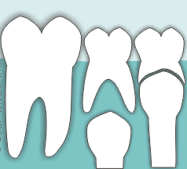
By age 6, you might start to lose some of your baby teeth and have a few gaps
So you have to take care of all your teeth now, otherwise if you lose your adult teeth- THEY WONT GROW BACK!!
...but soon enough you will have adult teeth that will replace your baby teeth and stay with you forever!
https://www.animated-teeth.com/baby-teeth/a-deciduous-baby-teeth.htm

Slide 3

How can you take care of all your teeth?
Brush your teeth
Floss (no, not the floss dance, actually floss between your teeth)
Eating nutritious foods
Regular dental visits
https://dribbble.com/shots/4881132-Giraffe-Floss-Dance?utm_source=Pinterest_Shot&utm_campaign=jormation&utm_content=Giraffe%20Floss%20Dance&utm_medium=Social_Share

Slide 4
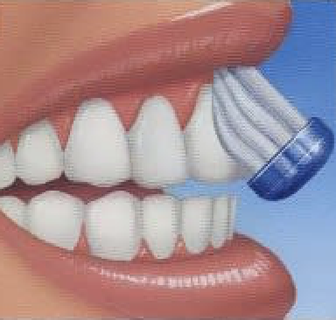
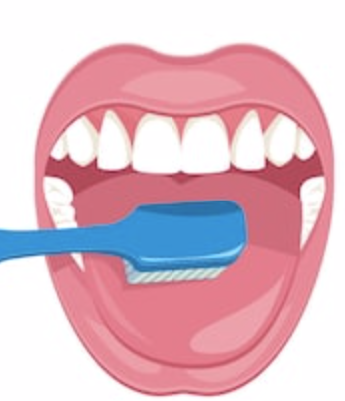
What is the best way to brush your teeth?
Brush 2 times/day, once in the morning and once at night!
Brush for 2 minutes each time!
Use a soft bristle toothbrush
Use FLUORIDE toothpaste
If you need help, ask your parents to help you!
DON’T FORGET TO BRUSH YOUR GUMS
AND TONGUE!
https://www.clipart.email/clipart/brush-your-tongue-clipart-306751.html

Slide 5
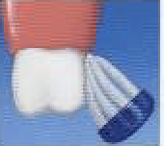
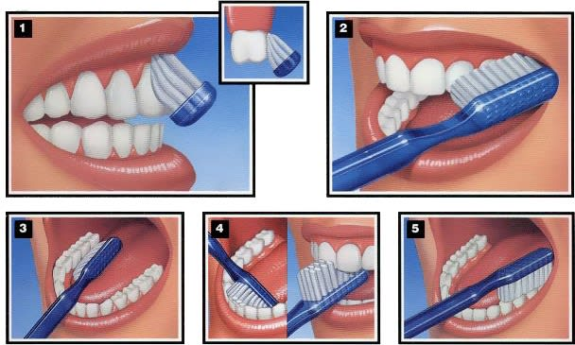
Brush every tooth starting from the back to the front, don’t forget to brush both the top and the bottom.
Don’t brush too hard
Hold brush at a 45-degree angle against your gums
If you need help, ask your parents to help you!
Use a CIRCLE motion while brushing back and forth
There are 3 SIDES TO EACH TOOTH to brush.
OUTSIDE
INSIDE
CHEWING SURFACES
https://www.dentalcare.com/en-us/patient-education/patient-materials/manual-brushing-and-flossing

Slide 6
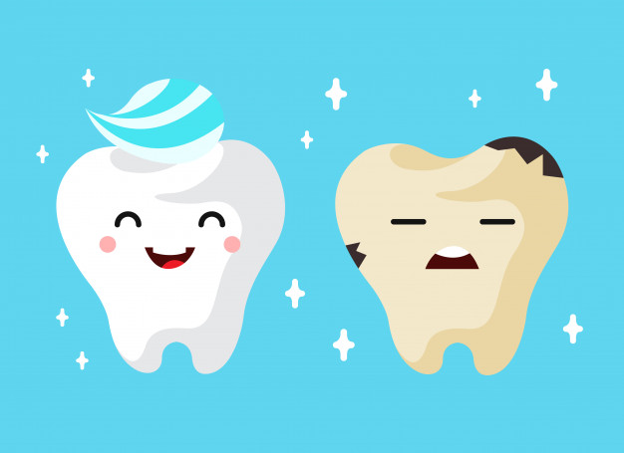
Why do we have to brush our teeth?
To remove the sticky PLAQUE, to stay CLEAN, and to prevent CAVITIES.
PLAQUE is a sticky build up from germs, bacteria, and sugar bugs that feed off the sugar on your teeth.
If too much plaque builds up and you don’t brush it off or don’t go see a dentist, it could cause CAVITIES, which are holes in your teeth!
A DENTIST would fix your cavity.
https://www.vecteezy.com/free-vector/tooth-decay

Slide 7
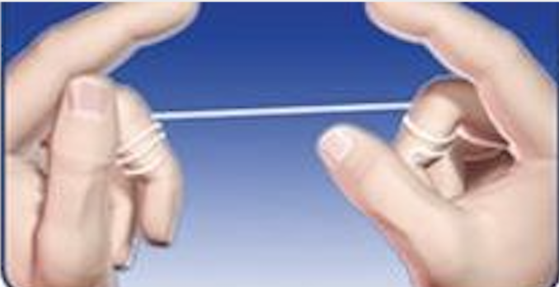
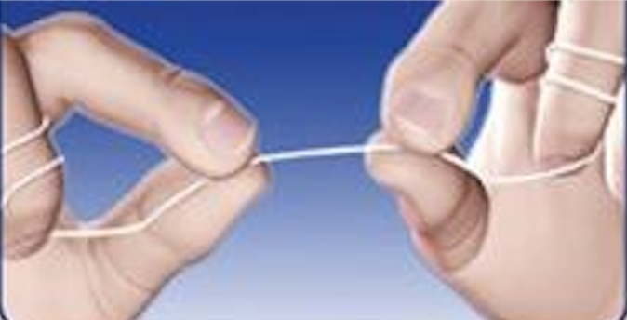
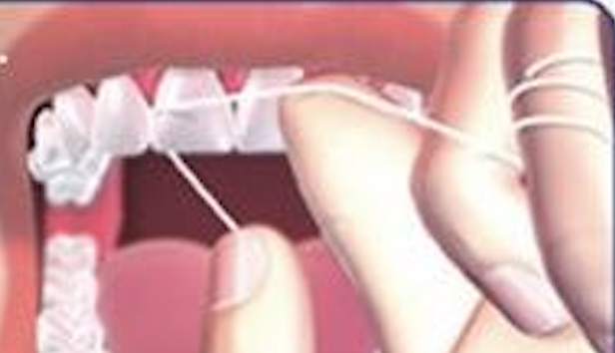
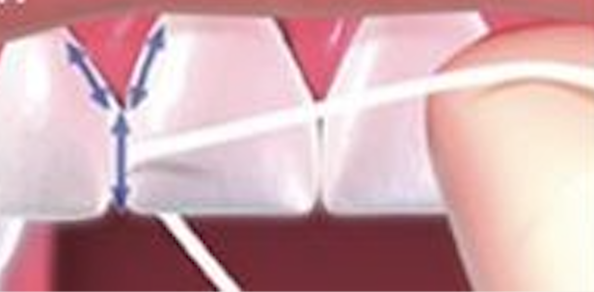
What is the best way to floss your teeth?
Have about an arms length of floss ready to use
Wrap the floss around your fingers
Floss each tooth gently down to your gum area
If you need help, ask your parents to help you!
Hug and form a “C-shape” with the floss around each tooth while you go up and down
Usually by age 10, you should be able to floss on your own.
https://www.drbrianvalle.com/how-to-floss-your-teeth/

Slide 8
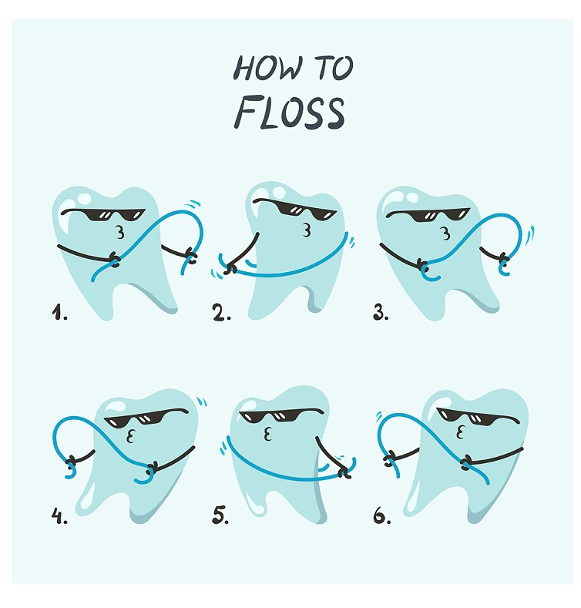
Why do we have to floss our teeth?
To remove the sticky PLAQUE in between your teeth!
To help reach the areas that your tooth brush misses.
To help keep your gums healthy!
Don’t forget to floss behind your last back tooth!
https://creativemarket.com/drakonova/3403040-How-to-floss-cartoon-infographic

Slide 9
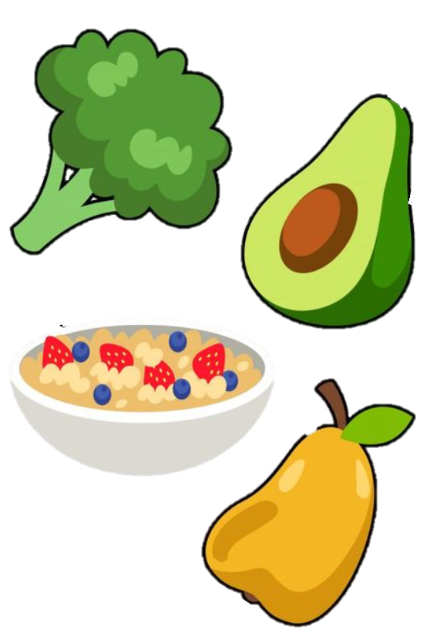


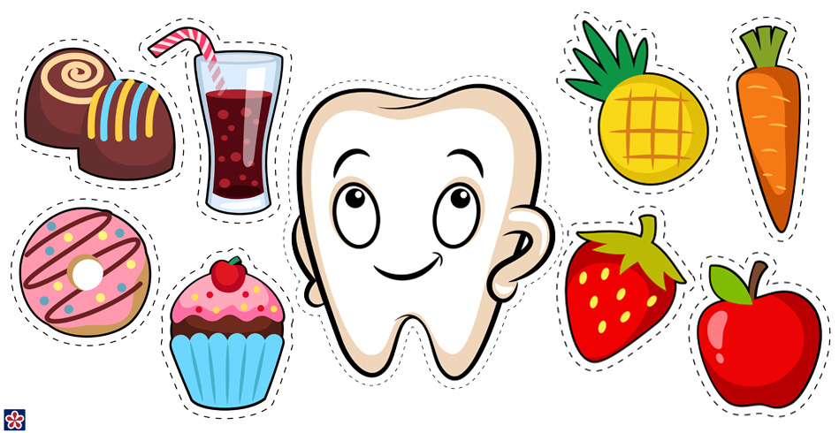

Do you know which foods are good and bad for your teeth?
Try to eat healthy foods that don’t have a lot of sugar; those foods are the best for your teeth
http://teachersmag.com/posts/happy-and-sad-tooth-preschool-dental-health-free-printables/

Slide 10
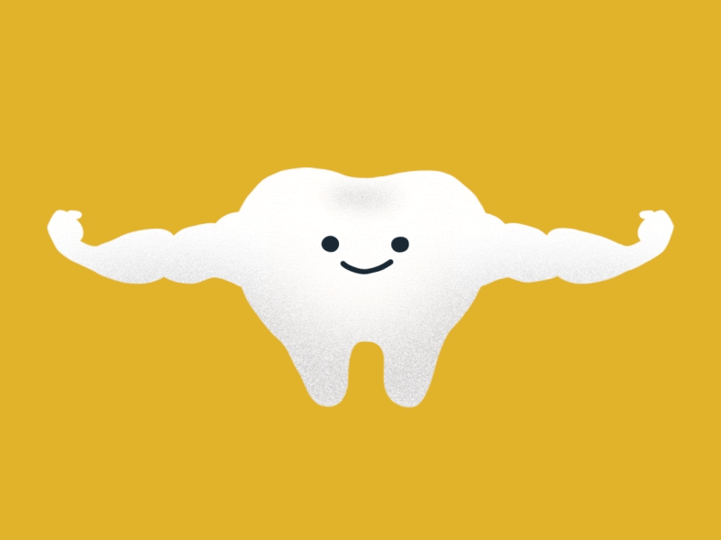
Other diet tips for strong teeth...
Sugary drinks, like Mountain Dew or even juices, should be limited.
Drink water or low fat milk at meal times
Stay away from chewy candy, especially if you have braces.
Reduce the amounts of snacks you have (like potato chips and cupcakes) and eat your breakfast, lunch, and dinner.
Add more fruits and veggies.
https://dribbble.com/shots/4203162-Tooth-Strong

Slide 11
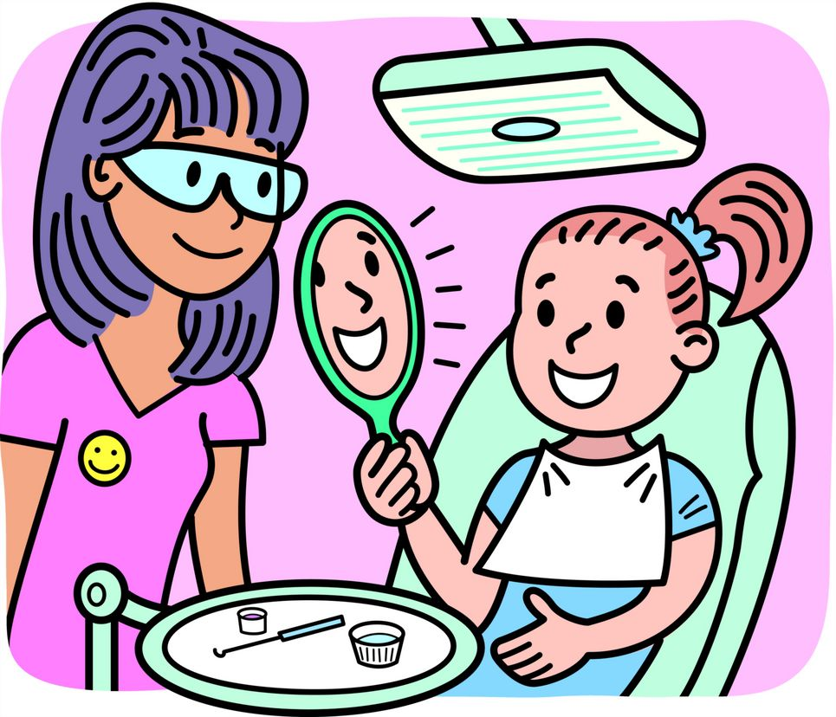
Visit your dentist regularly
You should visit a dentist at least 2x a year!
Dentists catch any problems and fix your cavities before they get worse!
Dentists can take pictures to watch the growth of your adult teeth
Dentists clean off the plaque, sugar bugs, germs, and bacteria that you couldn’t scrub off with your toothbrush.
Dentists help you have a healthy and happy smile!
http://clipart-library.com/dentist-pictures-for-kids.html

Slide 12
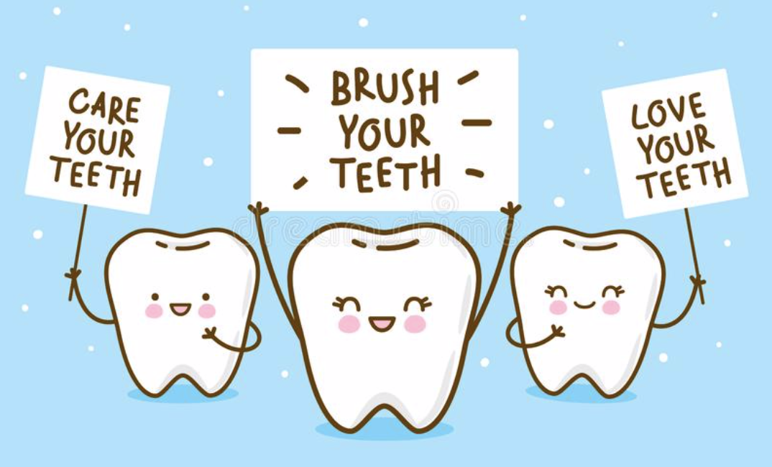
What’s your favorite thing about visiting a dentist office?
Wearing cool glasses?
Getting to pick out stickers after the appointment?
Getting FLUORIDE vitamins put on your teeth?
Getting rid of the sugar bugs?
https://www.shutterstock.com/image-vector/cute-cartoon-tooth-mouthwash-on-blue-688363708

Slide 13
Make sure to always take care of your teeth!

Slide 14
References of photos
Video of tooth eruption (slide 2): https://www.animated-teeth.com/baby-teeth/a-deciduous-baby-teeth.htm
Photo of flossing tooth (slide 3): https://creativemarket.com/drakonova/3403040-How-to-floss-cartoon-infographic
Photo of tongue brushing (slide 4): https://www.clipart.email/clipart/brush-your-tongue-clipart-306751.html
Photo of brushing teeth positions and also the flossing technique picture (slide 4 & 5): https://www.dentalcare.com/en-us/patient-education/patient-materials/manual-brushing-and-flossing
Photo of two teeth (slide 6): https://www.vecteezy.com/free-vector/tooth-decay
Photo of how to floss (slide 7): https://www.drbrianvalle.com/how-to-floss-your-teeth/
Photo of giraffe flossing (slide 8): https://dribbble.com/shots/4881132-Giraffe-Floss-Dance?utm_source=Pinterest_Shot&utm_campaign=jormation&utm_content=Giraffe%20Floss%20Dance&utm_medium=Social_Share
Photo of food (slide 9): http://teachersmag.com/posts/happy-and-sad-tooth-preschool-dental-health-free-printables/
Photo of strong tooth (slide 10): https://dribbble.com/shots/4203162-Tooth-Strong
Photo of dentist and child (slide 11): http://clipart-library.com/dentist-pictures-for-kids.html
Photo of teeth (slide 12): https://www.shutterstock.com/image-vector/cute-cartoon-tooth-mouthwash-on-blue-688363708

