Slide 1
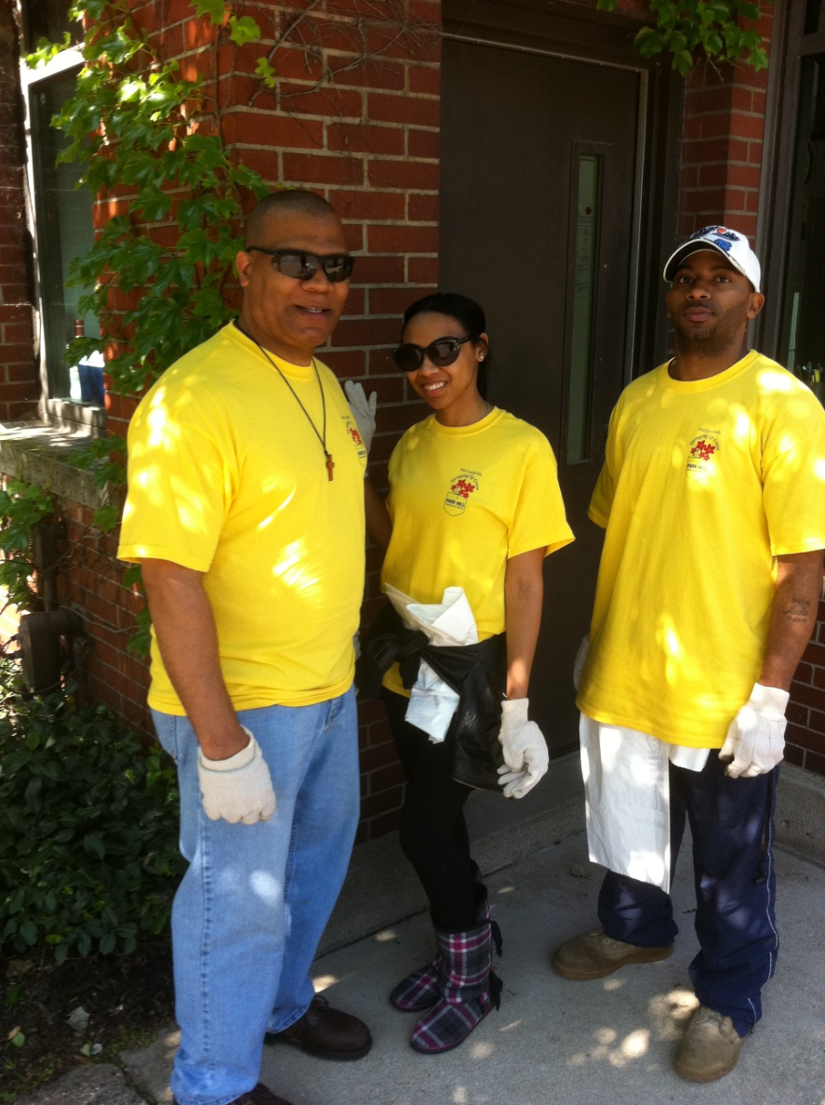
West Louisville Springing Up Green
Darryl
Brittany
Thomas
Park Hill Coming Into Bloom
April 30, 2011

Slide 2
I thought we were going shopping…
Brittany

Slide 3
Did someone say…lunch?
Thomas

Slide 4
Do these shoes go with my outfit?
Brittany

Slide 5
Thought I saw something…B-F campus is already spotless!
Darryl

Slide 6
Look! Is that a penny in the street?
Thomas

Slide 7
Dad! I actually found something on B-F campus!
Brittany

Slide 8
Going green can be fun…
Darryl
Thomas

Slide 9
Please stop playing in the street!!!
Darryl
Thomas

Slide 10
See, if you had stayed out of the street you would have collected as much as me!
Thomas
Darryl

Slide 11
Volunteers munch on KFC…..

Slide 12
1.6 miles and 5 garbage bags full

