Slide 1
Envision Process Handler Setup
IIPS 2009 Spring Mini-Conference
Phone # 919-233-5885
Presented by Dawn Rountree, College of The Albemarle
Disclaimer – Everything I know about EPH,
I learned from Joel Brubaker, from Cape Fear.
He gets credit for all the information. Any errors are all mine.

Slide 2
What is EPH?
It’s like a crontab inside of Datatel.
You can use it to schedule jobs to run even when you are not there.
Why EPH?
Saves time
Automates Processes
Non-mission critical tasks can been completed while you sleep.

Slide 3
What processes can be automated?
EDQM – shutdown and startup
WAGC – shutdown and startup
BGVU – to verify Ws throughout the semester
WebAdvisor /Campus Cruiser login creation

Slide 4
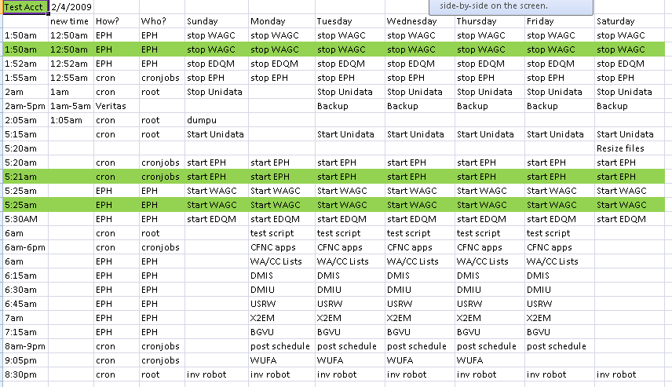
Sample Cron Schedule

Slide 5
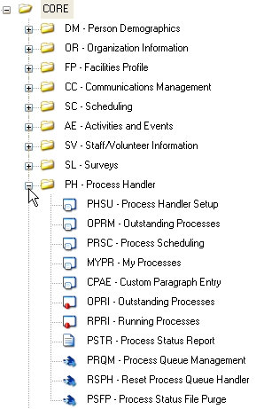
EPH Menu in Core

Slide 6
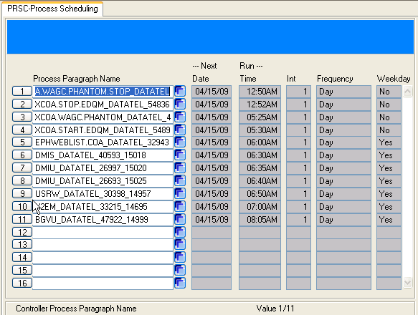
PRSC

Slide 7
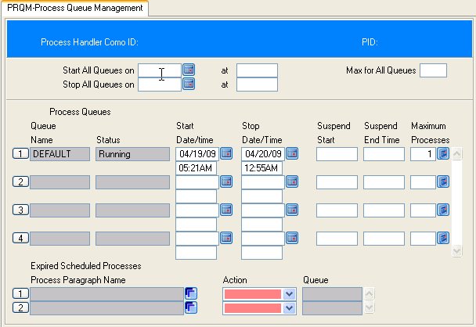
PRQM
To stop manually, input a time that is a few minutes different from the current time.
Notes:
Starting and stopping manually – gets old – setup automation
Could have multiple queues. We have one, running one job at a time. No other users are scheduling anything in EPH.

Slide 8
Steps to start EPH automatically
To start EPH automatically, you’ll need to create
A subroutine with the start/end times/dates
A paragraph to use the subroutine and start the EPH
A unix script to run the paragraph
A crontab entry to run the unix script
A unix and datatel user to start the process from the unix prompt and thru the unix cron

Slide 9
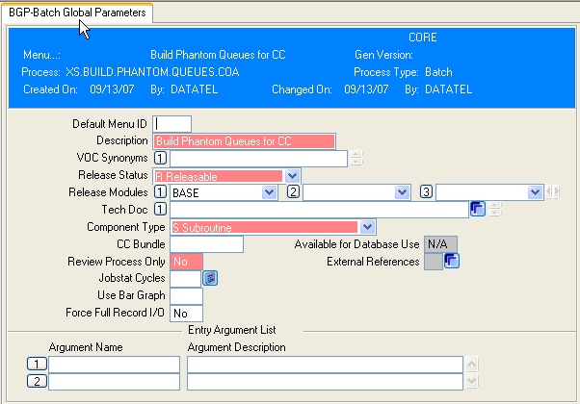
UniData Subroutine
Unidata
Subroutine
Create in the
Core Toolkit

Slide 10
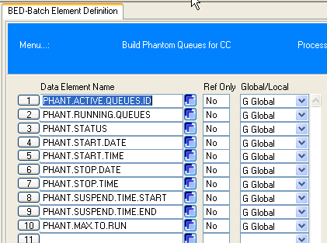

Slide 11
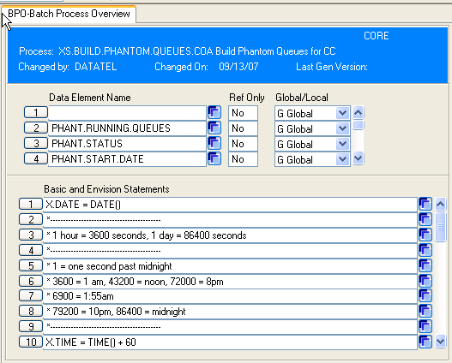

Slide 12
X.DATE = DATE()
*-------------------------------------------
* 1 hour = 3600 seconds, 1 day = 86400 seconds
*-------------------------------------------
* 1 = one second past midnight
* 3600 = 1 am, 43200 = noon, 72000 = 8pm
* 6900 = 1:55am
* 79200 = 10pm, 86400 = midnight
*-------------------------------------------
X.TIME = TIME() + 60
* Set stop time to 12:55am:
X.STOP.TIME = 3300
V.PHANT.ACTIVE.QUEUES.ID = 'PHANT.ACTIVE.QUEUES'
FOR_THE PHANT.ACTIVE.QUEUES.ID
VL.PHANT.RUNNING.QUEUES = 'DEFAULT'
VL.PHANT.STATUS = 'START'

Slide 13
* START DATE THIS CRON IS RUN
VL.PHANT.START.DATE = X.DATE
*START TIME IS ONE MIN FROM NOW
VL.PHANT.START.TIME = X.TIME
*STOP DATE IS TOMORROW
X.DATE = DATE() + 1
VL.PHANT.STOP.DATE = X.DATE
*STOP TIME IS 12:55AM
VL.PHANT.STOP.TIME = X.STOP.TIME
VL.PHANT.SUSPEND.TIME.START = ''
VL.PHANT.SUSPEND.TIME.END = ''
*RUN ONLY ONE JOB AT A TIME
VL.PHANT.MAX.TO.RUN = '1'
END_THE PHANT.ACTIVE.QUEUES.ID
RETURN

Slide 14
GEN the subroutine

Slide 15
Create the paragraph
:AE VOC XCOA.START.PROCESS.HANDLER
Top of "XCOA.START.PROCESS.HANDLER" in "VOC", 7 lines, 136 characters.
*--: P
001: PA
002: *STARTS E.P.H.RUN AS CRONJOBS FROM CRON
003: *
004: XS.BUILD.PHANTOM.QUEUES.COA
005: UDT.OPTIONS 8 OFF
006: PHANTOM PROCESS.PHANTOM.QUEUES
007: PROC.BROWSE '‘
Bottom.
*--:

Slide 16
Test the paragraph
Run the paragraph
Check PRQM
You should see the start/end dates/times from your subroutine.
It may show ‘start pending’
Cancel out of PRQM and try again
It takes a few minutes to actually start
Once it starts, you can change the end time to 5 minutes ago and save out of PRQM. This will set the process handler shut down process.
Check PRQM, once it is stopped you can move to the next step.

Slide 17
Unix Script
root@grace # pg envision.process.handler.sh
#!/bin/sh
# This script starts the Envision Process Handler.
# The E.P.H. allows for jobs to be scheduled and run from
# within Envision. Items like RPWP (Reset
# Web Advisor Password) must be run from within Envision.
#
# A Hardcoded shutdown time of 12:55am is in the
# START.PROCESS.HANDLER SUBR
# XS.BUILD.PHANTOM.QUEUES.COA
#
PRODUCTION=/datatel/coll18/production/apphome
PATH=".:/usr/bin:/usr/local/bin"; export PATH
UDTBIN=/usr/ud71/bin; export UDTBIN
UDTHOME=/usr/ud71; export UDTHOME
VFIELDSIZE=6000; export VFIELDSIZE
LC_ALL=en_US; export LC_ALL
LANG=C; export LANG
#
cd /datatel/coll18/production/apphome
$UDTBIN/udt XCOA.START.PROCESS.HANDLER
(EOF)

Slide 18
To run the script, you have to have a user that can log into Datatel
If you use the ‘datatel’ user, you will have to be able to pass the password. See answernet 4901. You can also see http://www.nccommunitycolleges.edu/CIS_Docs/docs/THIRD-PARTY/cfnc-mentor/CIS_ST_UG_CFNC.pdf for setup of this user.
I use the ‘cronjobs’ user. I already had it setup to run WUFA, so I used it.
I have my LOGIN paragraph set up so I don’t have to pass in the password.
The user also has to have an SOD and SVM and PERSON record.

Slide 19
LOGIN paragraph
:AE VOC LOGIN
Top of "LOGIN" in "VOC", 11 lines, 351 characters.
*--: P
001: PA UT Rel 4.7.1.8 06/11/07 by DATATEL
002: *IF @LOGNAME # 'datatel' THEN QUIT
003: IF @LOGNAME = 'datatel' THEN TERM 132
004: IF @LOGNAME = 'datatel' THEN GO SKIPTIME
005: TIMEOUT 3600
006: SKIPTIME:
007: SETUSERNAME
008: IF @USER.RETURN.CODE = "cronjobs" THEN ENVINIT
009: IF @USER.RETURN.CODE NE "cronjobs" THEN SQLENVINIT DMI:grace.albemarle.edu:5550,production
010: RESET.TERM
011: CORE.JUMPSTART
Bottom.
*--:

Slide 20
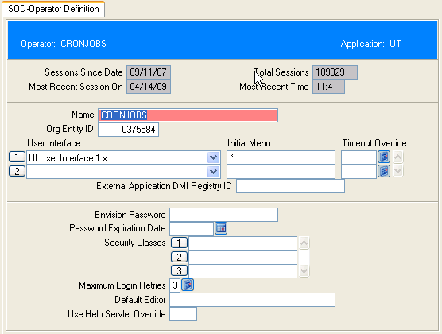

Slide 21
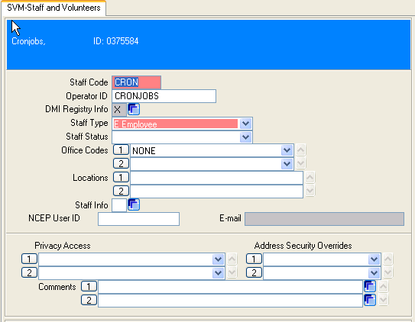

Slide 22
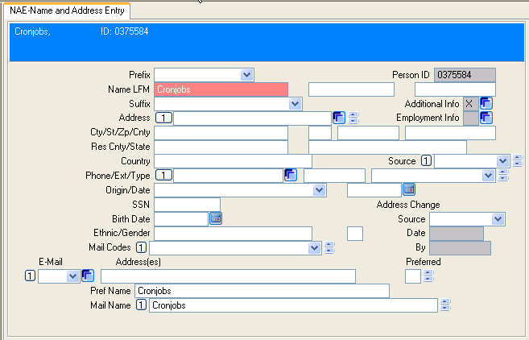

Slide 23
Test the Unix Script
Test running the script as user.
Once it’s working, shut it down again and create the crontab entry to run the unix script.
20 5 * * * /export/home/cronjobs/envision.process.handler.sh

Slide 24
OK, so now you’ve got it running, how to you get jobs in PRSC?
Most Datatel screens have the ‘Run in background mode’ screen.

Slide 25
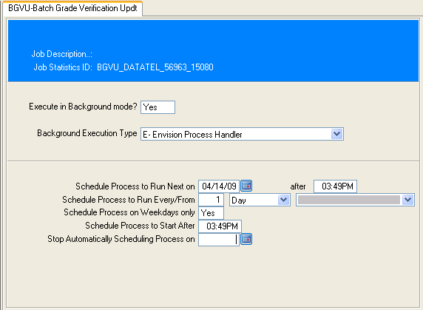

Slide 26
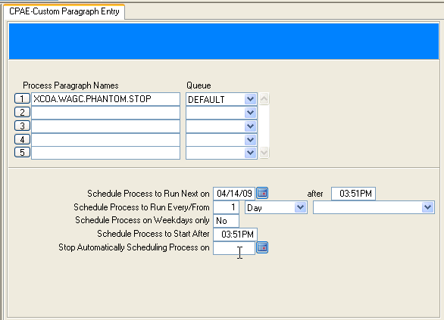
Paragraphs you have created can be scheduled using CPAE

Slide 27
AE VOC XCOA.START.EDQM
PA
XMANAGE.EDX.PHANTOM START
AE VOC XCOA.STOP.EDQM
PA
XMANAGE.EDX.PHANTOM STOP

Slide 28
AE VOC XCOA.WAGC.PHANTOM
PA PARAGRAPH TO START GARBAGE COLLECTOR - TO BE RUN FROM EPH
PHANTOM S_DMI_GC_DRIVER 0~300~0~ADMIN
AE VOC XCOA.WAGC.PHANTOM.STOP
PA PARAGRAPH TO STOP GARBAGE COLLECTOR AND CLEAN UP _PH_ - TO BE RUN FROM EPH
* Got info from Datatel Answernet 5401
MODIFY GC.STATUS GCSTAT.HALT.REQUEST = 'H' WITH @ID EQ 'GC.STATUS'
*
SELECT _PH_ WITH @ID LIKE '...cronjobs...'
IF @SYSTEM.RETURN.CODE LE 0 THEN GO FINISHED
DELETE _PH_
DATA Y
FINISHED:
DISPLAY PH Directory Clean-Up Complete.

Slide 29
Paragraphs are stored in PHANT.ACTIVE.QUEUES
SORT PHANT.ACTIVE.QUEUES ID.SUP @ID FMT '45L' 13:55:33 Apr 19 2009 1
PHANT.ACTIVE.QUEUES..........................
BGVU_DATATEL_47922_14999
DMIS_DATATEL_40593_15018
DMIU_DATATEL_26693_15025
DMIU_DATATEL_26997_15020
EPHWEBLIST.COA_DATATEL_32943_14695
OUTSTANDING.PHANTOMS
PHANT.ACTIVE.QUEUES
RUNNING.PHANTOMS
SCHEDULED.PHANTOMS
USRW_DATATEL_30398_14957
X2EM_DATATEL_33215_14695
XCOA.START.EDQM_DATATEL_54892_14859
XCOA.STOP.EDQM_DATATEL_54836_14859
XCOA.WAGC.PHANTOM.STOP_DATATEL_45219_14873
XCOA.WAGC.PHANTOM_DATATEL_44767_14751
15 records listed

Slide 30
AE VOC EPHWEBLIST.COA
PA
COMO ON EPHWEBLIST
XCOA.WEB.CC.LISTS
COMO OFF
!mail -t drountree@albemarle.edu < _PH_/O_EPHWEBLIST
Note: To get a subject on the email use this command instead…
!mailx -s "Webadvisor Savedlists" drountree@albemarle.edu < _PH_/O_EPHWEBLIST
Thanks to Shawn Rudd (Halifax CC) for this bit of info.
Another option if you don’t want to use the bang (!) and get a subject also.
UTSEND _PH_ O_EPHWEBLIST drountree@albemarle.edu “WebAdvisor Savedlists”
See Answernet 3904 for details. Thanks to Buddy Ellis (Southwestern CC) for this info.
AE VOC XCOA.WEB.CC.LISTS
R
XCOA.VOCLIB
XCOA.WEB.CC.LISTS

Slide 31
AE XCOA.VOCLIB XCOA.WEB.CC.LISTS
PA Saved on 09:49:50 Mar 02 2007 by DATATEL
* CREATE THE SAVEDLISTS NEEDED TO POPULATE AND REMOVE PERSONS FROM THE WEBADVISOR REGISTRY
*
CS
DATE
DISPLAY THIS PROCESS CREATES SAVEDLISTS FOR WEBADVISOR AND CAMPUS CRUISER
DISPLAY
DISPLAY WebAdvisor lists include those to create STUDENT, FAC/STAFF users
DISPLAY
DISPLAY
DISPLAY
SELECT ORG.ENTITY.ENV WITH OEE.RESOURCE SAVING OEE.RESOURCE
SSELECT PERSON
SAVE.LIST CURR.REGISTRY
DISPLAY COUNT ABOVE IS THE CURR.REGISTRY COUNT
DISPLAY
DISPLAY ***************************************
DISPLAY ST>DMIS BUILD DMI REGISTRY FOR STUDENTS
DATE
DELETE.LIST WEB.DMIS.STUDENT
DELETE.LIST WEB.DMIS.STUDENT.ADD
and so on…

Slide 32
XCOA.WEB.CC.LISTS
Creates save lists
WEB.DMIS.STUDENT and WEB.DMIS.STUDENT.ADD
WEB.DMIU.FACSTAFF and WEB.DMIU.FACSTAFF.ADD
WEB.DMIU.APPL and WEB.DMIU.APPL.ADD
WEB.DDRU.FACSTAFF (I run DDRU manually)
WEB.DMRS.STUDENT (I run DMRS manually)
CC.STUDENT and CC.STUDENT.ADD (for USRW)
CC.FACULTY and CC.FACULTY.ADD (for USRW)
CC.EMPLOYEE and CC.EMPLOYEE.ADD (for USRW)
Processes through deleted webaccounts to expire CC accounts
Re-activates expired CC accounts as needed
You can also set expired accounts to delete after a certain amount of time.

Slide 33
Set up DMIS, DMIU, and USRW in EPH using the savelists from the paragraph through the normal Envision screens ‘run in background mode’ screen.
There won’t always be something in every ‘ADD’ savelist. To get it to work, there must be something in the savelist.
CCFT cannot be setup to run through EPH because of the way it saves the file name to be ftp’d to CC.
We edited our CCFT to also ftp the file to Active Directory for LDAP.

Slide 34
Warning!!
When using the Envision Process Handler to run jobs that have SAVEDLISTS as input, it is advised to examine the generated PA.
Some processes have incorrect logic when dealing with null savedlists.
Examine the records created in the PHANT.ACTIVE.QUEUES file (record names are listed on PRSC) for logic issues with savedlists.
Examine the logic, adding as needed
IF @SYSTEM.RETURN.CODE <= 0 THEN GO xxxxx

Slide 35
AE PHANT.ACTIVE.QUEUES DMIU_DATATEL_26997_15020
001: PA DMIU_DATATEL_26997_15020 Phantom Process
002: UDT.OPTIONS 8 OFF
003: ST.INIT
004: DISPLAY Phantom process DMIU_DATATEL_26997_15020 started.
005: TIME
006: TAG.PHANTOM DMIU_DATATEL_26997_15020
007: JSBU03 DMIU_DATATEL_26997_15020
008: UT.GET.LIST WEB.DMIU.FACSTAFF.ADD
009: UDT.OPTIONS 8 OFF
010: IF @SYSTEM.RETURN.CODE LE 0 THEN GO NO.LIST (should be DELIST if no savelist)
011: NO.LIST:
012: MIOSELS PERSON WITH PERSON.CORP.INDICATOR NE "Y" AND WITH\
013: DECEASED.DATE EQ "" BY SORT.NAME
014: UDT.OPTIONS 8 OFF
015: UT.SAVE.LIST DMIU_DATATEL_26997_15020
016: UDT.OPTIONS 8 OFF
017: MIOSETPTR 0,132,65,0,0,3,NFMT,NOEJECT,BANNER\
018: DMIU_DATATEL_9673,NHEAD,BRIEF,NOMESSAGE
019: UDT.OPTIONS 8 OFF
020: UT.GET.LIST DMIU_DATATEL_26997_15020
021: UDT.OPTIONS 8 OFF
022: IF @SYSTEM.RETURN.CODE LE 0 THEN GO DELIST
023: DMB016 "WEBFAC" "" "Y" "0" ""
024: PROC.BROWSE ""
025: DELIST:
026: PROC.CLEANUP DMIU_DATATEL_26997_15020
027: CLEANUP.PHANTOM DMIU_DATATEL_26997_15020
028: DISPLAY Phantom process DMIU_DATATEL_26997_15020 completed.
029: TIME

Slide 36
Don’t forget about it!
It will work for you, but don’t forget about it!
Check the queue, reports, email – if you set up reports to go through email.
Shut it down for resizing or other maintenance.

Slide 37
Answernet Docs
3480 – Overview to the Phantom Process Handler
4558 – Information About the Envision Process Handler
3835 – Envision Phantom Process Handler – Troubleshooting Guide
3443 – Phantom Processor and UniData – Starting/Suspending/Stopping
3060 – Automating the Phantom Process Handler
If you receive an error of "A Phantom submit subroutine hasn't yet been defined“ – See 6394 - FRXE: Creating Paragraphs for Use with the ProcessHandler

Slide 38
Side note…
There's another quite useful utility for general reporting -- Cedarville 'DOWNLOAD' which has all sorts of nifty query tools (querying across different files without creating virtual fields, output to formats like csv, fixed width formats, html tables, xml, etc.)
http://www.cedarville.edu/departments/compserv/ftp.htm
Thanks to Buddy Ellis (Southwestern CC) for this info.

Slide 39
Questions?

