Slide 1
Neighbourhood Plan Open Meeting
7.00 p.m. 26th March 2018
Belbroughton Recreation Centre
Notes:
What is it all about
Where has it come from
what are the other terms associated with the idea.

Slide 2
Agenda
Notes of our previous meeting
Hearn Report presentation
“Facing up to Reality or Fiction”
Next steps
Call for expertise and general assistance
Preparing for a response to the District Council’s Green Belt review
Discussion on the pursuit funding from Localities Commission
Liaison with Parish Council
Communication methodology
Open discussion forum
Future meetings and discussion topics

Slide 3
Facing up to Reality or Fiction
The Hearn Report
Councillor Bob Morgan
Belbroughton and Fairfield Parish Council NHP lead

Slide 4
Birmingham Housing Market Area
Strategic Growth Study

Slide 5
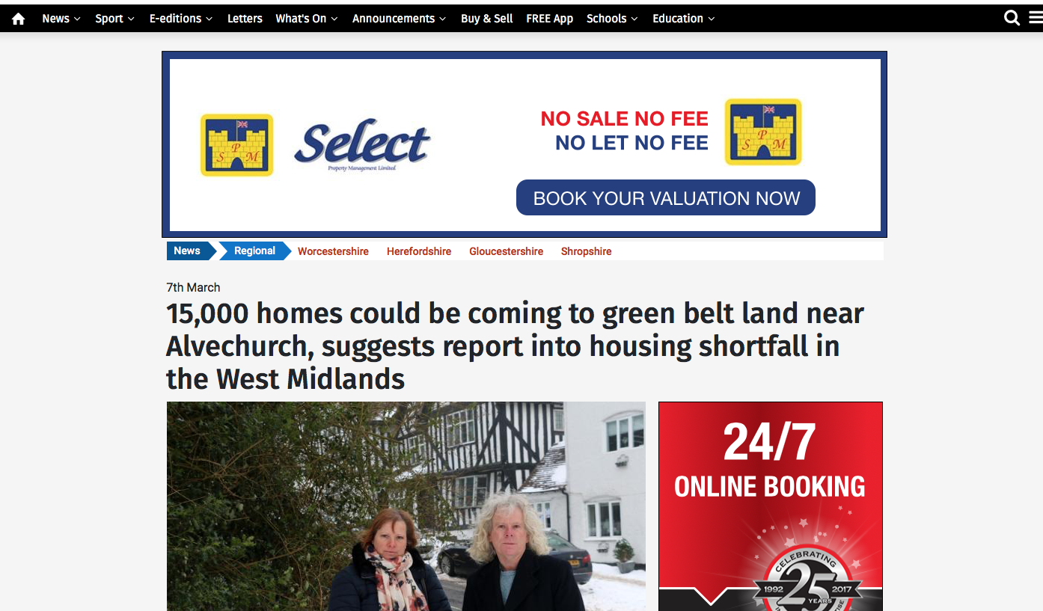

Slide 6
Birmingham Housing Market Area
Strategic Growth Study
The National Planning Policy Framework and the Localism Act 2011 requires local authorities to work together though the “Duty to co-operate” across the relevant Housing Market Area
( HMA) to identify and then meet housing need where it is sustainable to do so

Slide 7
A Strategic Growth Study into the Greater Birmingham and Black Country Housing Market Area
G L Hearn and Wood PLC
February 2018

Slide 8
“It cannot be stressed strongly enough that the council has not accepted the findings of the study but is looking to the residents and other interested parties of Bromsgrove to help inform its view on the study through a full consultation on the issues and options…….
The district plan review will include looking at the whole green belt and assessing future development needs for the district
Geoff Denaro Leader of Bromsgrove District Council

Slide 9
Study Brief
It has been established that there is a shortfall in planned provision to meet the housing requirements in the Greater Birmingham and Black Country Market Area
Source Birmingham Development Plan (BDP) 2017
The Birmingham Development Plan (BDA) contains a clause requiring adjacent local Authorities to work together to address the shortfall
Source Black Country Core Strategy Review
A series of studies indicates a major shortfall
Source G L Hearn

Slide 10
Study Brief
Review of existing identified supply to consider whether, by positively applying policies that are consistent for each type of site across the HMA, more dwellings could be provided through increased densities.
Should a shortfall remain following consideration of option (1), consider the potential additional supply on other land outside of the Green Belt that has not been previously considered for housing development, by applying a consistent approach across the HMA. This should take into account the sustainability of the locations for accommodating housing growth, including the need to provide other land uses.

Slide 11
Study Brief
Should a shortfall remain after undertaking tasks (1) and (2) consider the development potential and suitability of any large previously developed sites within the Green Belt that may lie in sustainable locations.
Should a shortfall remain after undertaking tasks (1) to (3), undertake a full strategic review of the Green Belt within the HMA utilising a consistent Green Belt Review methodology, which assesses Green Belt against its five purposes, followed by consideration of distribution and broad locations, taking into account market capacity to deliver.

Slide 12
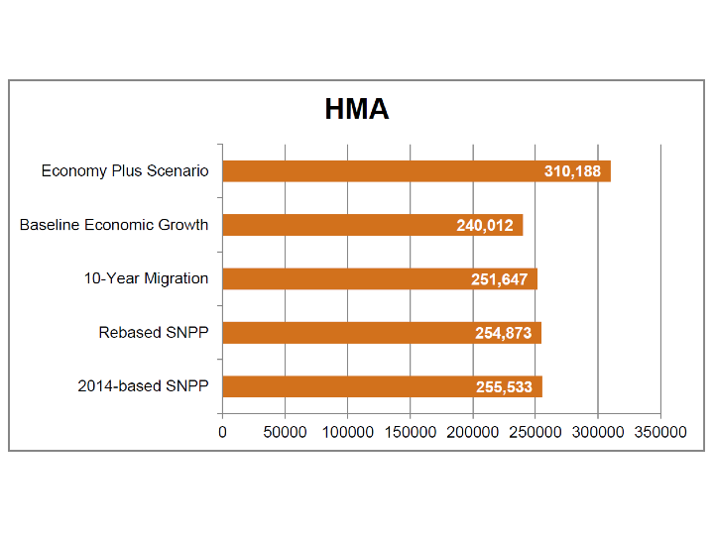
Dwellings needed by 2032
Greater Birmingham and Black Country Market Area

Slide 13
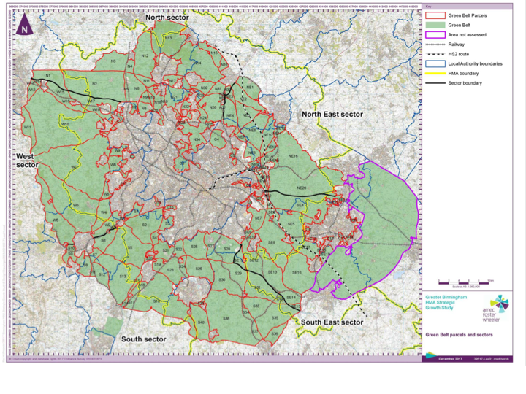

Slide 14
Purposes of the Green Belt
To check the unrestricted sprawl of large built-up areas
To prevent neighbouring towns merging into one
another
To assist in safeguarding the countryside from
encroachment
To preserve the setting and special character of historic
towns
To assist in urban regeneration, by encouraging the recycling of derelict and other urban land.

Slide 15
Development Types
A range of sites of different sizes can contribute A range of small and medium sized sites – particularly in short/medium-term
Proportionate Dispersal (500 -2,500 dwellings) Need to identify strategic development options
Study moves on to investigate potential strategic development options:
Urban Extensions (1,500 – 7,500 dwellings)
Employment-Led Strategic Development (1,500 – 7,500 dwellings)
New Settlements (10,000+ dwellings)

Slide 17
Recommendations
Implications for Bromsgrove is the report is suggesting further testing of the below scenarios
Proportionate dispersal of a range smaller of sites of 500 to up a combine total of 2,500 houses in total
South of Bromsgrove by the train station, South of Birmingham in and around the Wythall area.
Urban extension circa 1,500 - 7,500 houses on the South of Dudley in close proximity to Hagley
New Settlement circa 10,000+ houses in the Barnt Green / Alvechurch area

Slide 18
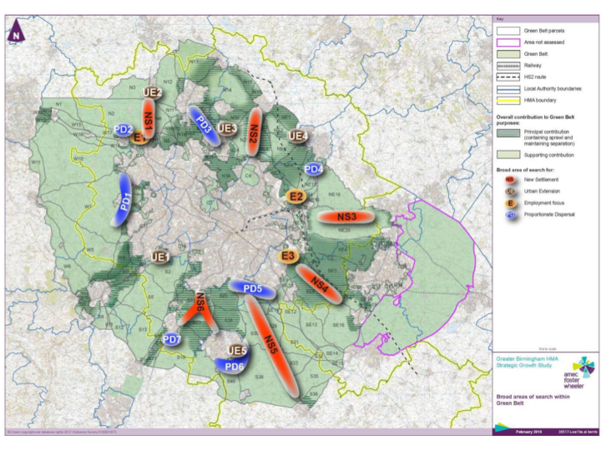

Slide 19
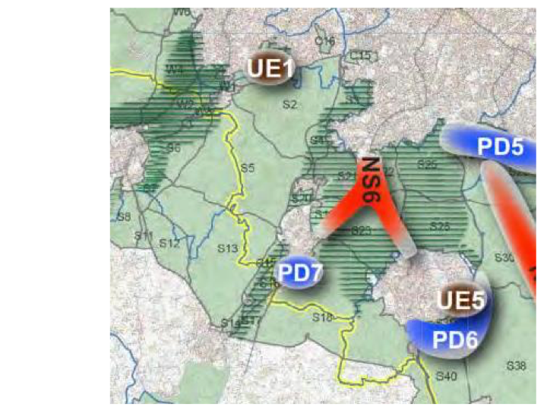

Slide 20
Next Steps for BDC
Testing the strategic Review
Bromsgrove local Plan review
Issues and options consultation
Green Belt review methodology
Site selection methodology

Slide 21
Agenda
Notes of our previous meeting
Hearn Report presentation
“Facing up to Reality or Fiction”
Next steps
Call for expertise and general assistance
Preparing for a response to the District Council’s Green Belt review
Discussion on the pursuit funding from Localities Commission
Liaison with Parish Council
Communication methodology
Open discussion forum
Future meetings and discussion topics

Slide 22
Putting Communities in charge of Planning

Slide 23
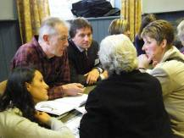
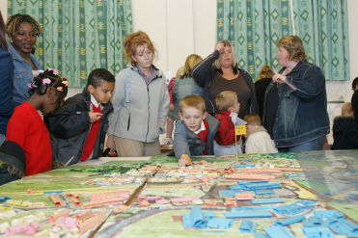
Basic Principles:
Planning at neighbourhood level
Empowers Communities to take control
Is Community NOT Parish Council led
Can Inspire improving innovation and creativity
Explore ways of enabling community development and maturity
Notes:
While the exact details of the Government’s neighbourhood planning policy are still in development we certainly have a strong feel for the direction of travel and we have clauses for the Localism Bill that support that Direction of Travel. So what are the key principles – at their heart is genuine and active community engagement and empowerment and planning’s role as an enabler of change. There are some basic principles which have stayed consistent:
reducing local authority decision-making on development and planning in neighbourhoods
the ability for neighbourhoods to be self-defined (but within constraints)
a neighbourhood-owned and community-initiated process – not an LPA led process (they are far more in a supportive role)
creating a light-touch testing process, ensuring that examinations with public hearings will be the exception rather than the rule
using the planning process and decentralisation to maximise creativity and innovation at a local level
through the granting of pp it reduces the amount of small scale development in the planning system
it is an entirely permissive regime – there is no requirement to have a neighbourhood plan– you can still apply for planning permission through the normal LPA application route

Slide 24
Structure of Planning System
National Planning
Policies
Right to build
Bromsgrove
Local Plan
Right to buy
Right to challenge
Neighbourhood Plan
Notes:
I will now try to run through the key highlights of the new neighbourhood planning system. This will be quite a high-level discussion, but I am happy to discuss the details with anyone after this event and over the next few weeks.
Crucially, there neighbourhood plans can only be brought forward by 2 applicants – a neighbourhood forum or a parish council. A neighbourhood development order can be bought forward by 3 applicants – a neighbourhood forum, a parish council or a CrTB organisation. If a developer wants to bring forward a neighbourhood plan it will need to be sponsored, supported and formally submitted by one of these organisation.
A neighbourhood forum will be a community group – they will be designated “the neighbourhood forum” :
- at least 3 members of the neighbourhood to which the neighbourhood plan or order relates
- written constitution, - bank account
- establish to further social, economic or environmental interests of the residents
A CrTB organisation has similar definition plus it has specific requirements around the distribution of any profits made from the development granted by the CrTB order, the membership, and how its assets are distributed.
A parish council can make an application in relation to any area that consists of or includes the whole or any part of the council’s area.
There are 3 tools:
A Neighbourhood Development Order which can grant outline or full permission for certain categories or types of development
A Neighbourhood Development plan which sets out policies for the development and use of land in the neighbourhood
A CrTB Order which can grant outline or full permission but only where the order is brought forward by a CrTB organisation and that the benefits of the development are explicitly retained within the community

Slide 25
Neighbourhood planning cannot
Switch off....Town & Country Planning regulations
Override….Strategic plans or national policy
Go beyond.... Local authority policies on development
Promote....less.. but can promote…. more suitable development
Notes:
Neighbourhood plans will not replace Local Plans – they are in addition to comprehensive coverage of local authority plans
Once adopted neighbourhood plans become part of statutory development plan
Despite rumours to the contrary, we will still be encouraging LPAs to produce Local Plans that set out their policies for the development and use of land across the LPA area
Neighbourhood plans will need to sit “within” the framework of Local Plans and national policy but they can promote more development than in the strategic plan and include more detailed policies (e.g. on design, car parking, landscaping)
One of the key issues for neighbourhood planning is funding the process, and thus another key principle is that development which gains permission through the NDO route, and is thus not subject to a planning application fee, will pay a charge to the LPA at the commencement of development

Slide 26
A Neighbourhood Plan
Notes:
Building on the previous slide – neighbourhood plans have to work within limits – they cannot permit development in the middle of a proposed strategic road link or houses on a site for a major employment facility
These limits include – have regard to national policy and guidance, to other DPDs and perhaps most critically being in general conformity with strategic policies in the development plan. We will define in the NPPF what we mean by strategic policies rather than in legislation – but we anticipate them to include the broad distribution and overall need for housing delivery across a LPA area, the broad distribution and overall need for employment premises across an LPA, policies on energy infrastructure and transport infrastructure. Finally, one of the key constraints on developing the neighbourhood planning proposals has been ensuring they are compatible with ECHR legislation and obligations of various EU Directives. These will be the tests that must be met before a neighbourhood plan/order can be adopted.

Slide 27
WHAT CAN A NEIGHBOURHOOD PLAN DO ?
Be expensive
Divert precious resources
Absorb energy of a community
Divide a community
Be ineffective if legally challenged
Fail to engage with the community wishes
Ineffectually absorb the time and enthusiasm of volunteers
An initiative that fails because of change of national government policy.

Slide 28
An Ambition Restore the idea that development can be a force for good, rather than something to be resisted at all costs
Capturing Benefits and Incentives
Notes:
Finally, and apologies for the very quick trawl, but to conclude we must go back to the beginning.
Neighbourhood planning is a key part of the must wider agenda of turning the tables on the development discussion. From communities resisting development because they only see the costs to communities welcoming development because they have had a role in controlling its form and nature, they feel ownership towards it and they feel collective responsibility for the future of their communities. They also have the incentives to see the tangible difference development has on their own lives and to gain real pride in their surroundings which they have helped to change.

Slide 29
Parish Council has approved some funding
Considering if Localities Commission to be approached for further funds
Steering group formed and active with two open meetings held
Executive group identified but needs to be developed
BDC have approved the application to ‘designate’ the Parish area
Notes:
What is it all about
Where has it come from
what are the other terms associated with the idea.

Slide 30
We need to :-
Develop volunteers into an effective team
Identify areas where no experienced volunteers exist
Project planning
Expert advice on the correct approach to plan development
Cost the above……Catshill will be spending Circa £15,000 possibly
Engage with the community at every stage
Engage with BDC and other active groups
Educate our community on the issues enabling informed judgements
Focus on how engagement and consultation can effect improvements in our community
Notes:
What is it all about
Where has it come from
what are the other terms associated with the idea.

Slide 31
Thanks you for attending this evening
Notes:
What is it all about
Where has it come from
what are the other terms associated with the idea.

