Slide 1
Changing the mindset
Presented by:
Dave Hurt (Dist. 5790)
www.davidwhurt@sbcglobal.net

Slide 2
Why is Membership Growth So Difficult?
What Internal Mindsets Need Adjustment?
What External Variables Must Be Addressed?
How Do We Change?

Slide 3
“People are much more likely to act their way into a new way of thinking than to think their way into a new way of acting.”
*HBR OnPoint Pascale & Sternin

Slide 4
Leading change
What Works and What Doesn’t
Winter 2014 OnPoint Harvard Business Review Articles

Slide 5
What’s to be changed?
What’s to be left alone?
Touch this and you will surely die!
*HBR OnPoint Peabody & Stybel
Notes:
16. Resource Materials: * Club Leadership Plan (EN-245) – publication that explains how to implement the plan
* Frequently Asked Questions – Answers to commonly asked questions about the Club Leadership Plan
* Recommended Rotary Club Bylaws – Operating procedures for Rotary clubs can be amended to reflect a club’s practices and procedures
* Planning Guide for Effective Rotary Clubs – goal setting tool based on the interactive club concept
District Membership Chair – acts a consultant as clubs go through implementation steps
Assistant Governor – acts a consultant as clubs go through implementation steps
District committees – supports work of club committees; coordinates district wide efforts
* Available on www.rotary.org.

Slide 6
Mindset: The Key To Change

Slide 7
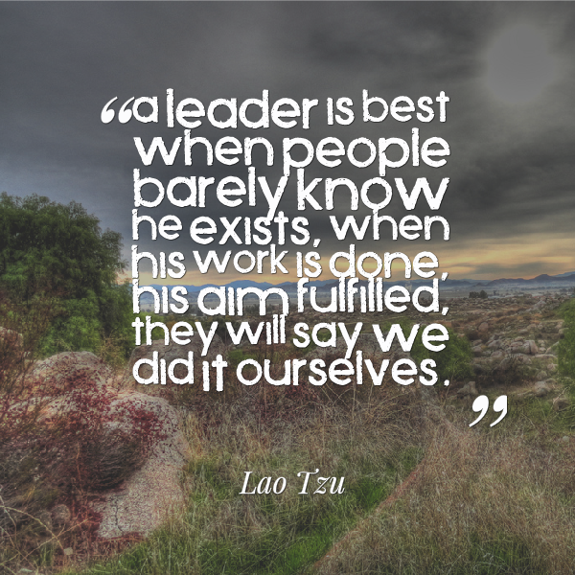
Learn From the People
Plan With the People
Begin With What They Have
Build On What They Know

Slide 8
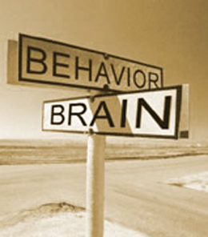
To change behavior, it is important to know:
Reasons People Resist Change
Strategies for Change
Getting People to Change
Dealing with Resistance
Your Role as Club President
Why Change Does Not Occur

Slide 9
A desire not to lose something of value.
A misunderstanding of the change.
Believing the change will not produce the desired result.
A low tolerance for change.
Why They Resist
*HBR OnPoint J. Kotter & L. Schiesinger

Slide 10
Buy-in can be a simple
matter of being heard.
HBR OnPoint Jeffrey Ford & Laurie Ford

Slide 11
Analyze situational factors.
Determine the optimal speed of change.
Consider methods to counter resistance.
*HBR OnPoint Kotter & Schiesinger
Notes:
16. Resource Materials: * Club Leadership Plan (EN-245) – publication that explains how to implement the plan
* Frequently Asked Questions – Answers to commonly asked questions about the Club Leadership Plan
* Recommended Rotary Club Bylaws – Operating procedures for Rotary clubs can be amended to reflect a club’s practices and procedures
* Planning Guide for Effective Rotary Clubs – goal setting tool based on the interactive club concept
District Membership Chair – acts a consultant as clubs go through implementation steps
Assistant Governor – acts a consultant as clubs go through implementation steps
District committees – supports work of club committees; coordinates district wide efforts
* Available on www.rotary.org.

Slide 12
Focus on 1 behavior at a time.
Have concrete and measurable goals.
Activate peer pressure.
Remove barriers to change.
Teach and coach well.
Inspire Change
*HBR OnPoint Morten Hansen

Slide 13
Education and Communication
Participation and Involvement
Facilitation and Support
Negotiation and Agreement
Manipulation
Coercion
Make the Group the Guru
Dealing with Resistance
*HBR OnPoint John Koester

Slide 14
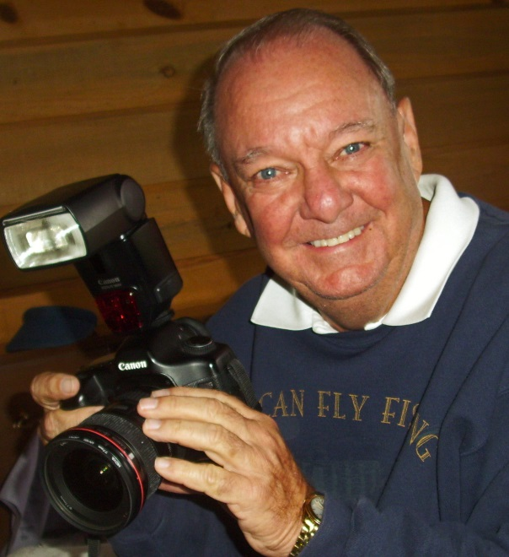
I might suggest you take club pictures during your term and replay them with the year end changing of the guard.
Very best wishes as you grow your club!
www.DavidWHurt
@sbcglobal.net

