Slide 1
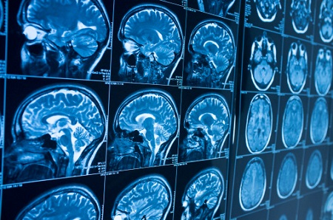
RADIOGRAPHIC FINDINGS OF EMPTY SELLA AND FACIAL NERVE ENHANCEMENT IN SARS-COV-2 PATIENTS
Clinical
Notes:
Slide 1

Slide 2
RADIOGRAPHIC FINDINGS OF EMPTY SELLA AND FACIAL NERVE ENHANCEMENT IN SAA-COV-2 PATIENTS
Erum Siddiqui
Dr. Harpal Mangat
Sagar Matharu
Aamna Siddiqui
Apanjit Sahi

Slide 3
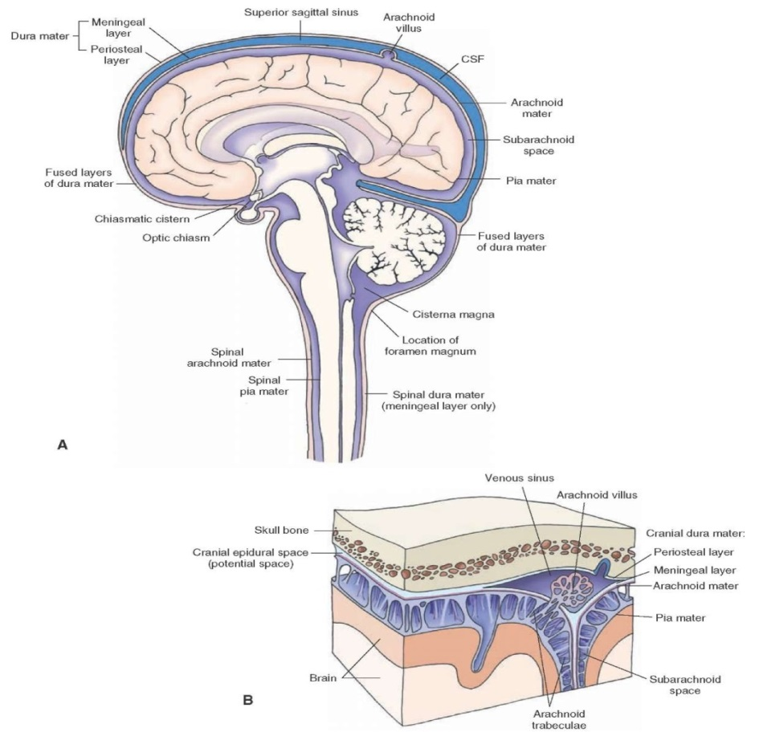
INTRODUCTION
SUBARCHANOID CISTERNS
The subarachnoid cisterns are compartments within the subarachnoid space where the pia mater and arachnoid membrane are not in close approximation
This results in cerebrospinal fluid pools.
Figure A. Gross anatomy of cisterns

Slide 4
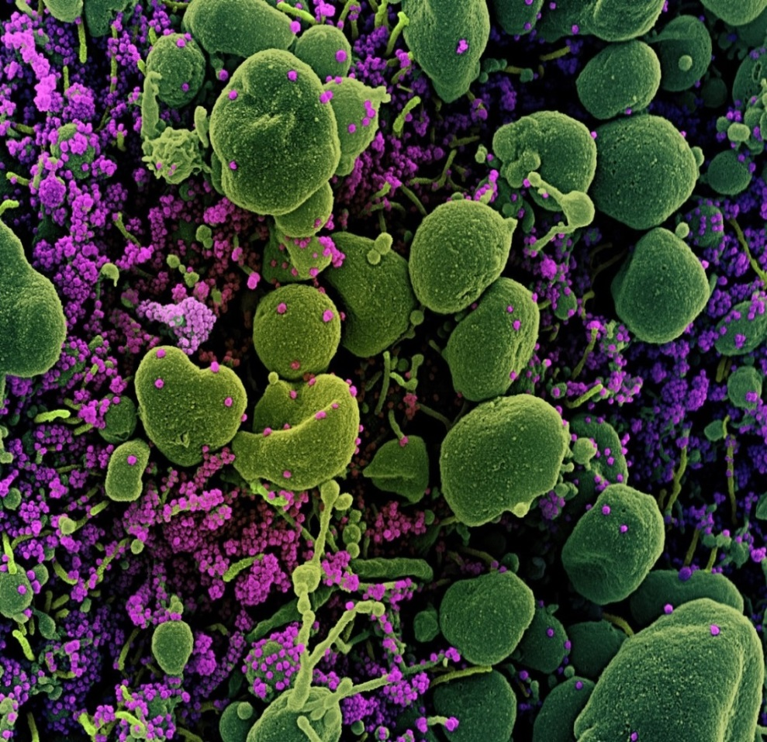
INTRODUCTION
PATHOLOGICAL CAUSES OF EXCESS CSF
AND RAISED INTRACRANIAL PRESSURE
-Brain trauma
-Infections-Bacterial or Viral
-The virus causes a bradykinin and a cytokine storm.
-The net result is a rise in ICP due to lymphatic fluid aggregation
-The ICP is released by natural pathways
-One of them causes CSF to flood and accumulate into the subarachnoid cisterns
Figure B. Infected cells with Sara-Cov-2

Slide 5
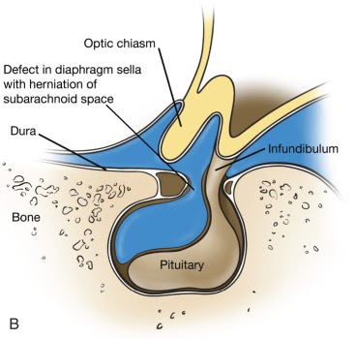
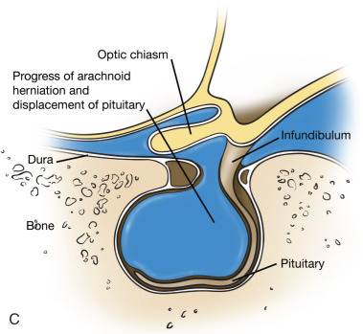
INTRODUCTION
EMPTY SELLA
Increased ICP causes CSF to flood and accumulate into the subarachnoid cistern overhead the sella turcica, causing the sella turcica to appear empty on a MRI scan
Figure C :Early stage of ES
Figure D : Advanced stage of ES

Slide 6
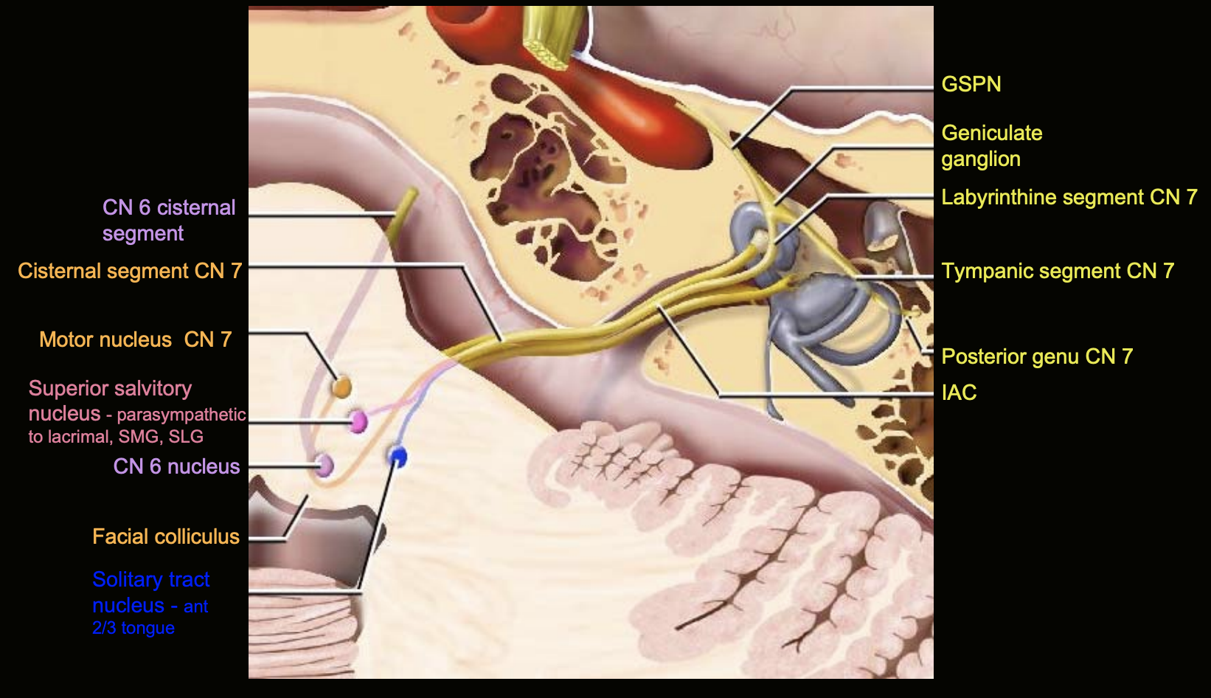
INTRODUCTION
INVOLVEMENT OF FACIAL AND VESTIBULOCCHLEAR NERVE
The subarachnoid space envelopes around the mastoid branch of the facial nerve, nerve to the stapedius and vestibulocochlear which are located in IAC
Figure E : Cranial nerve 7th and 8th in IAC

Slide 7
CASE PRESENTATION
A retrospective review was conducted selecting cases presenting with neurological symptoms and a positive NAA test of SARS-CoV-2. Subjects were separated on the basis of absence or presence of any abnormal neuro radiological manifestations .

Slide 8
CASE PRESENTATION
CLINICAL DATA CHART
Pt. | Headache, Dizziness, Loss of Taste and Smell | COVID Test | Hyperacusis | Empty Sella | Mastoid Effusion | Facial Nerve Enhancement | Vestibulocochlear Enhancement
1 | Yes | Pos | No | Pos | Pos | Pos | Neg
2 | Yes | Pos | Yes | Pos | Pos | Pos | Neg
3 | Yes | Pos | No | Pos | Pos | Pos | Neg
4 | Yes | Pos | No | Pos | Neg | Pos | Neg
5 | Yes | Pos | Yes | Pos | Neg | Pos | Neg
News Flash!!!- Sars-Cov-2 isolated from the Middle Ear and Mastoid.
Research article published by John Hopkins Dept. of Otolaryngology-Head and Neck Surgery discusses about finding Mastoid effusions in 2 out of 3 Postmortem dissections

Slide 9
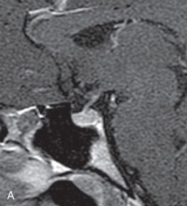
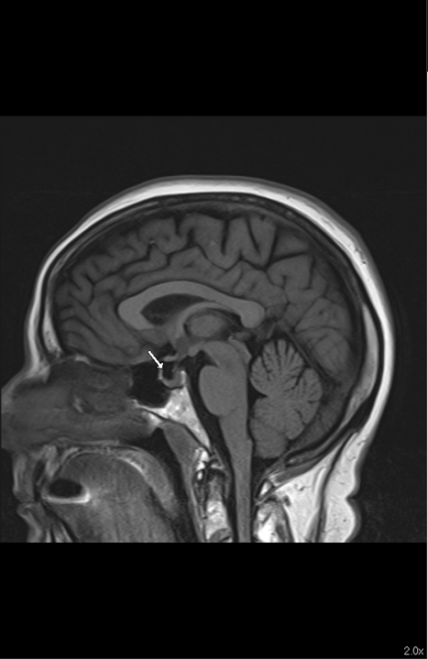
CASE PRESENTATION
EVIDENCE OF EMPTY SELLA SIGN ON MRI RADIOGRAPHS
Figure F. Radiograph of Early Stages of Empty Sella
Figure G. Radiograph of Advanced Empty Sella from Pt.1

Slide 10
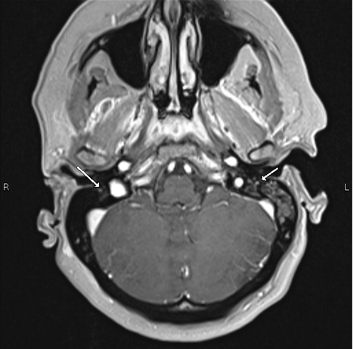
CASE PRESENTATION
FACIAL NERVE ENHANCEMENT
Figure H :
Enhancement of Mastoid branch of facial nerve on a MRI brain and IAC in Covid 19 patient .
Pt.2

Slide 11
DISCUSSION
Viral infections like SARS-CoV-2 could lead to lymphatic fluid aggregation in the subarachnoid space leading to Empty sella or Partially empty sella sign on a MRI radiograph.

Slide 12
DISCUSSION
-Sars-Cov-2 infection hence could affect the IAC segment of the vestibulocochlear nerve causing dizziness
-Sars-Cov-2 infection could also effect mastoid branch of Facial nerve and nerve to stapedius causing sensitivity to high pitched sounds

Slide 13
DISCUSSION
RESULT
The study links SARS-CoV-2 and the abnormal neuro radiological manifestations of empty sella and enhancement of the mastoid segment of the facial nerve.

Slide 14
REFERENCES
https://thejns.org/focus/view/journals/neurosurg-focus/43/5/article-pE7.xml
https://radiopaedia.org/articles/subarachnoid-cisterns?lang=us
https://www.thelancet.com/journals/laneur/article/PIIS1474-4422(20)30221-0/fulltext
https://www.ncbi.nlm.nih.gov/pmc/articles/PMC7609129/
https://www.news-medical.net/news/20200521/COVID-19-may-damage-the-central-nervous-system.aspx
https://jamanetwork.com/journals/jamaotolaryngology/fullarticle/2768620?resultClick=1

Slide 15
THANK YOU
Have a blessed day!

