Slide 1
Empowering Districts through Technology
Investments and Directions
Cliff Lloyd | CIO | September 2016, Murfreesboro, TN

Slide 2
TNReady Online Assessment Update

Slide 3
Rigorous Vendor Selection & Due Diligence
Specific, detailed and contractually enforced technical requirements:
Device compatibility
Infrastructure alignment
Server capacity
Process and procedures
Emphasis on vendor readiness over district readiness
Online phase-in with multiple, incremental proof points
On site verification of vendor platform
“Tennessee imposed the most rigorous technical requirements of any state we’ve worked with.”
- QAI

Slide 4
The Phased Uplift Approach
17/18+
Scaled Operationalization
Scaled Performance
Spring Testing
Scoring
Customer Service
Fall Practice
User Experiences
Training & Operationalization
Pilot
Device Compatibility
Infrastructure & Capacity

Slide 5
Participation Opportunities in 16/17
Sep
Oct
Nov
Dec
Jan
Feb
Mar
Apr
May
Jun
Pilot
Training
Practice
Testing
9/27
High Schools
(By Invitation)
9/99 – 9/00
High Schools
(Open to All)
9/99 – 9/00
High Schools
(Open to All)
9/99 – 9/00
High Schools
(Open to Trained Staff)
9/99 – 9/00
High Schools
(Open to Trained Staff)
9/99 – 9/00
High Schools
(Open to Practice Participants)

Slide 6
Data and Systems

Slide 7
Single Sign On Authentication
One user name, one password, all state systems
Single portal design
Highly robust and secure
September 2016 Update:
Kicking off account verification next week to ensure permissions are correct
Operationalized by November 30 2016

Slide 8
Dashboards and State Reporting
Integration of districts via Ed-Fi remains a priority but progress has slowed
All additional Ed-Fi interchanges needed to support automated state reporting are complete
Error management system to support automated state reporting is temporarily on hold with resource constraints
C.O.R.E. continues to make good progress training districts on the use of dashboards
Assessment data conflicts have been resolved and now match report card data
Data quality and completeness continues to be a challenge in the operationalization of dashboards

Slide 9
Personalized Learning

Slide 10
Digital Content
#GoOpen
Amazon Inspire Partership
Canvas LMS Partnership
Schoology LMS Partnership

Slide 11
Predictive Analytics
Identifying indicators of possible failure while there is still time to correct.
Recognizing evidence of ability so that we can build on the potential early.
Personalizing curriculum to meet the individual outcome goals of every student.
Adapting learning content to meet the specific learning style of every student.
Matching students with optimal career and college opportunities.

Slide 12
Affordable Laptop Program – Goals
Every student in the state has a permanently assigned personal computing device.
Students have access to the latest technology with no device more than three years old.
Acquisition of the technology is affordable and sustainable for school districts.
School districts have the support they need to meet the increased infrastructure demands of 1:1 devices.

Slide 13
Successes:
Strong vendor buy-in
Expected cost savings realized
District CFO support
Challenges:
Multi-year commitment audit concerns
Difficult procurement
Program uncertainty
Solutions:
Comptroller support
New state procurement vehicle
Road shows to county commissions and schools boards explaining program

Slide 14
Imagine Academy
Ensuring every high school student has the opportunity to gain the essential computer skills needed to be successful in post secondary studies.
Imagine Academy is a Microsoft program that delivers extensive, modular training on the use of computers, operating systems, productivity software and communications software to students.

Slide 15
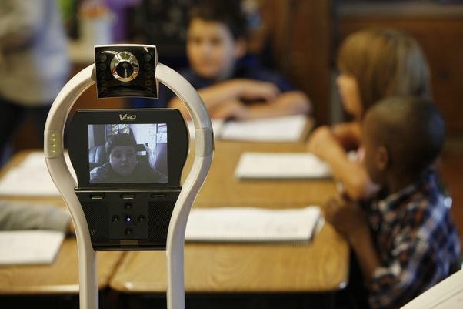
Classroom Avatar
Active participation solutions for students with long term class absences.
The Classroom Avatar is a robot that “sits in” for a student when he or she is absent from class.
The Avatar includes real time voice and video feeds and is controlled directly by the remote student.
Imagine a student in a hospital bed with a long term illness who can still participate actively in class?

Slide 16
Questions?
2016 Attendance Conference
April, Murfreesboro, TN

