Slide 1
Intensive Intervention in Mathematics: Hands-on Tools for Rational Numbers and Algebra Building Fluency

Slide 2
srpowell@austin.utexas.edu
@sarahpowellphd
119

Slide 3
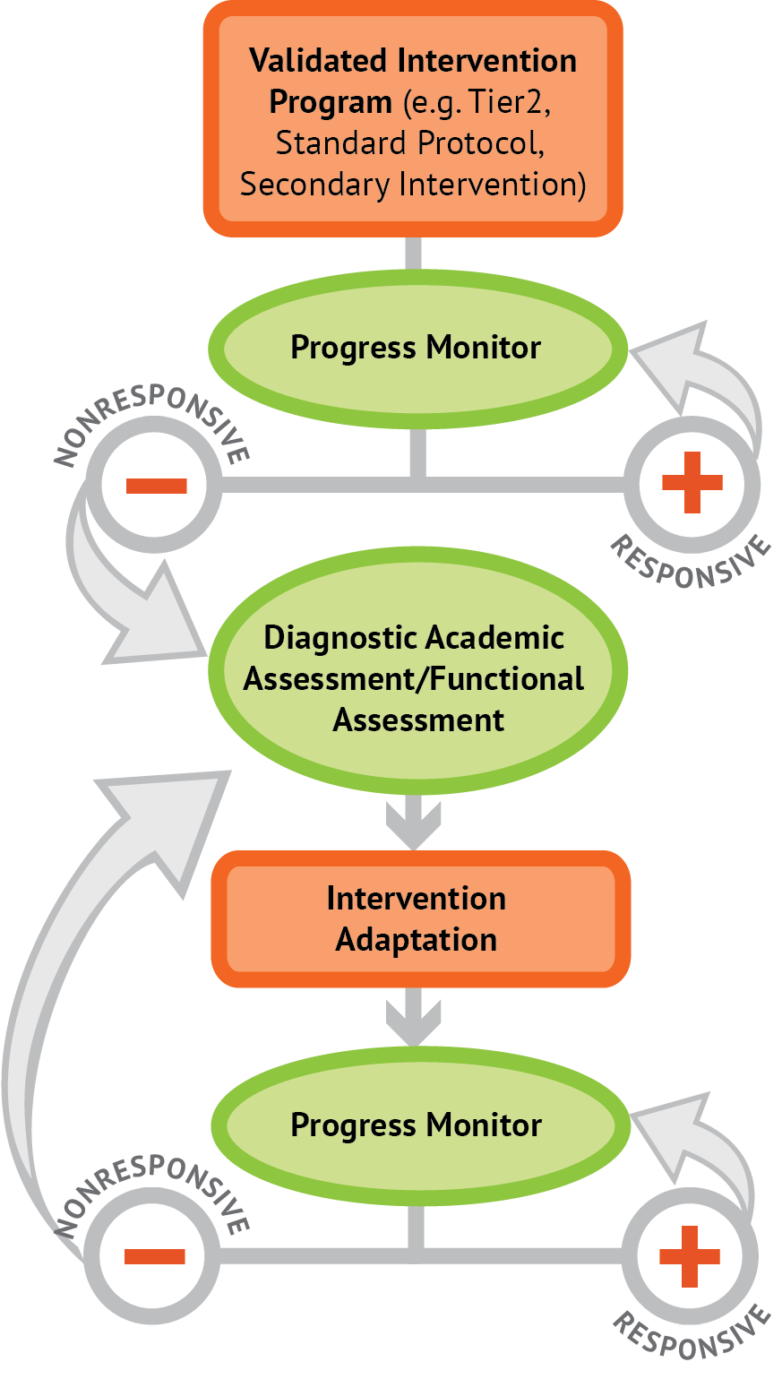
Instructional Platform
INSTRUCTIONAL DELIVERY
Explicit instruction
Precise language
Multiple representations
INSTRUCTIONAL STRATEGIES
Fluency building
Problem solving instruction
Motivation component

Slide 4
Explicit Instruction
Modeling
Practice
Clear Explanation
Guided
Practice
Planned
Examples
Independent Practice
Supporting Practices
Asking the right questions
Eliciting frequent responses
Providing immediate specific feedback
Maintaining a brisk pace

Slide 5
Precise Language
Use formal math language
concise
Use terms precisely

Slide 6
Multiple Representations
Abstract
Pictorial
Concrete

Slide 7
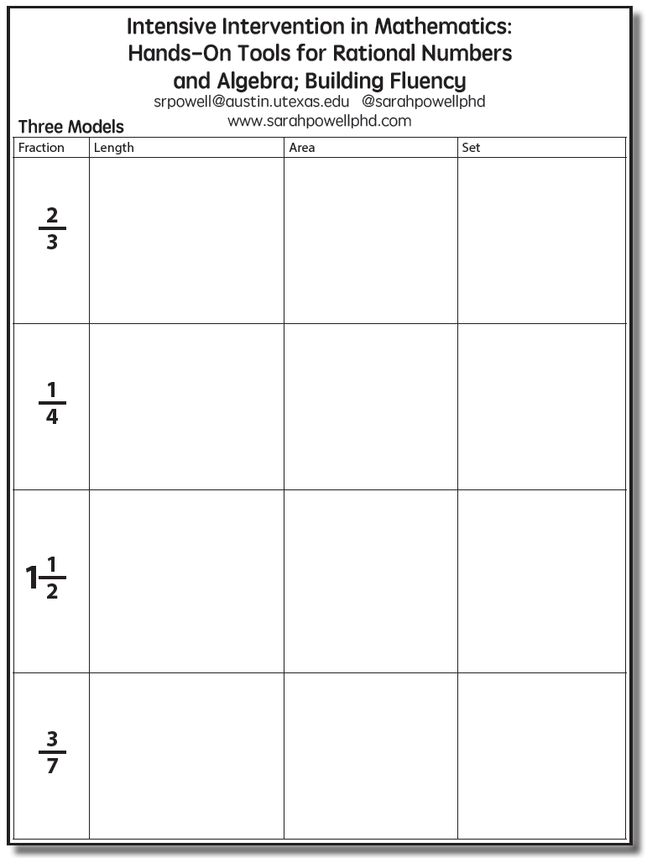

Slide 8
Length/Measurement
Fractions are appropriated by length
Fraction tiles/bars

Slide 9
Length/Measurement
Fractions are appropriated by length
Cuisenaire rods

Slide 10
Length/Measurement
Fractions are appropriated by length
Number line

Slide 11
Select a fraction and teach using the length model.
Explicit instruction
Precise language
Multiple representations

Slide 12
Area/Region
Shapes divided into equal sections
Fraction circles

Slide 13
Area/Region
Shapes divided into equal sections
Geoboards

Slide 14
Area/Region
Shapes divided into equal sections
Pattern blocks

Slide 15
Area/Region
Shapes divided into equal sections
Legos

Slide 16
Area/Region
Shapes divided into equal sections
Anglegs

Slide 17
Select a fraction and teach using the area model.
Explicit instruction
Precise language
Multiple representations

Slide 18
Set/Discrete
Individual shapes match the fraction
Two-color counters

Slide 19
Set/Discrete
Individual shapes match the fraction

Slide 20
Select a fraction and teach using the set model.
Explicit instruction
Precise language
Multiple representations

Slide 21
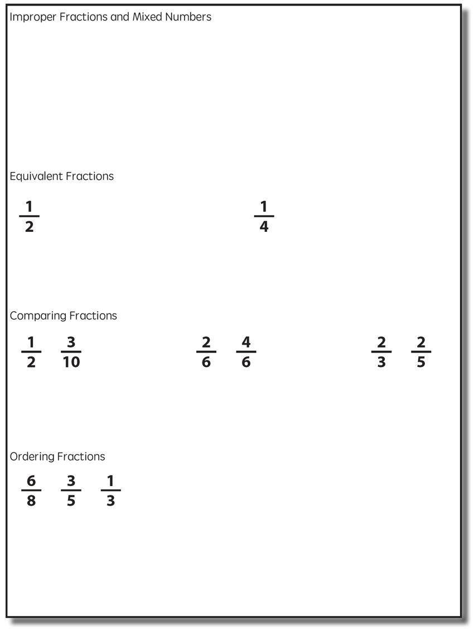

Slide 22
Improper Fractions
Fractions equal to or greater than 1
Numerator is equal to or greater than denominator
Select a fraction and teach using two models of fractions.
Explicit instruction
Mixed Numbers
Precise language
A mix of a whole number and a fraction
Multiple representations

Slide 23
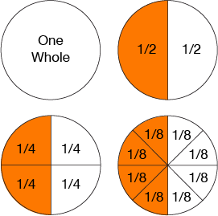
Equivalent Fractions
Determine equivalent fractions.
Explicit instruction
Precise language
Multiple representations

Slide 24
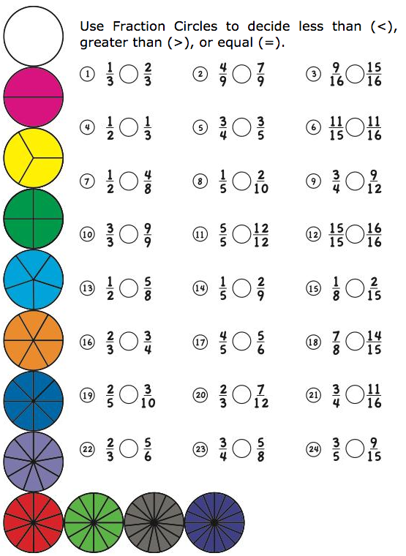
Comparing Fractions
Compare two fractions.
Explicit instruction
Precise language
Multiple representations

Slide 25
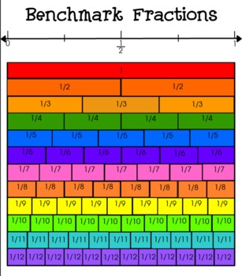
Ordering Fractions
Compare to benchmark fractions
Order three fractions.
Explicit instruction
Precise language
Multiple representations

Slide 26
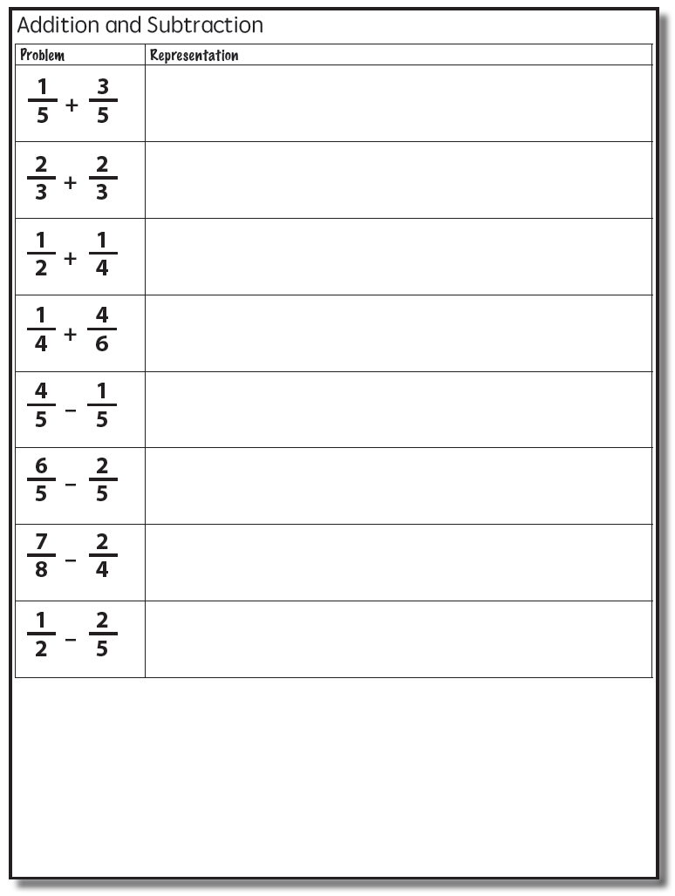

Slide 27
Addition

Slide 28
Addition

Slide 29
Explicit instruction
Precise language
Multiple representations

Slide 30
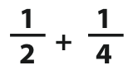
Addition

Slide 31
Addition
2: 2, 4, 6, 8, 10
4: 4, 8, 12, 16, 20

Slide 32
Addition

Slide 33
Explicit instruction
Precise language
Multiple representations

Slide 34
Subtraction

Slide 35
Explicit instruction
Precise language
Multiple representations

Slide 36
Subtraction
Take away from this set
This is for reference

Slide 37
Explicit instruction
Precise language
Multiple representations

Slide 38
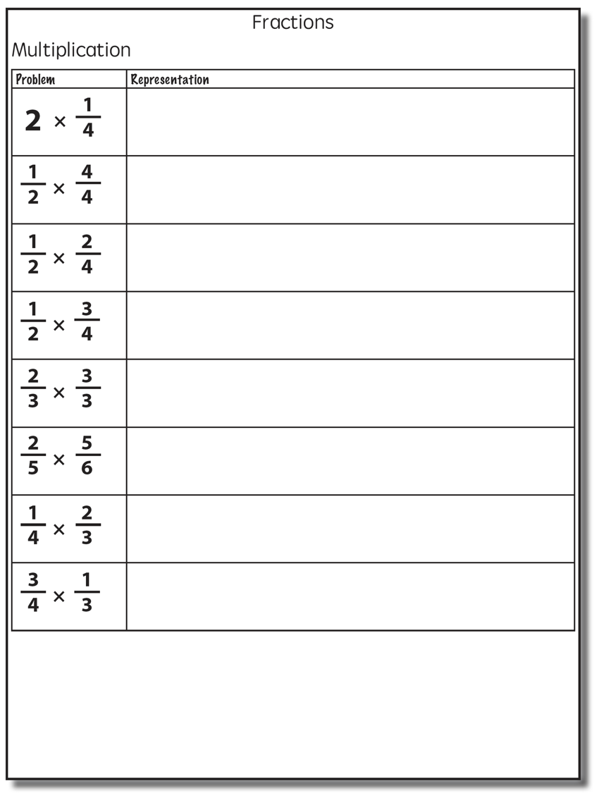

Slide 39
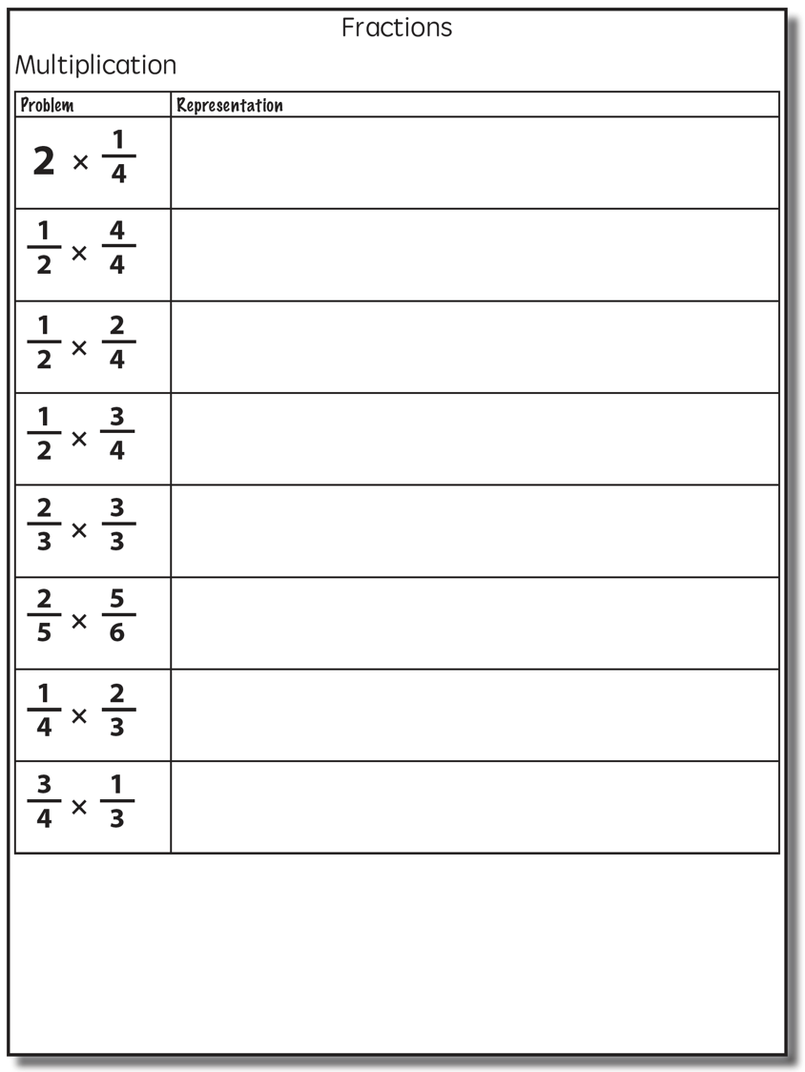
Multiplication
Multiplication
Interpret multiplication sign as “of”
2/3 of 3/4

Slide 40
Multiplication
Show
One-half of four-fourths

Slide 41
Multiplication
Show
One-half of two-fourths

Slide 42
Multiplication
Show
One-half of one-fourth
One-half of one-fourth

Slide 43
Multiplication
Show
One-half of three-fourths

Slide 44
Multiplication
Show
One-half of one-fourth
One-half of one-fourth
One-half of one-fourth

Slide 45
Multiplication
Show

Slide 46
Multiplication

Slide 47
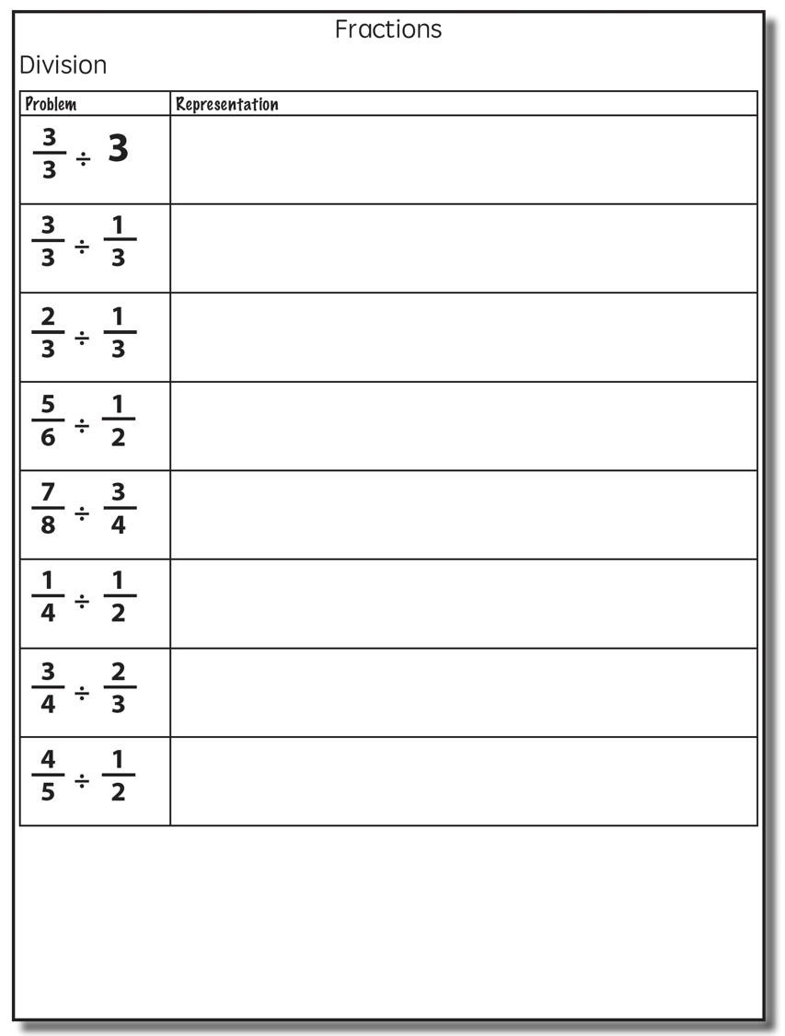
Division
Division
“How many sets of the second fraction fit into the first fraction?”

Slide 48
Division
Show
1 set of one-third
2 sets of one-third
3 sets of one-third

Slide 49
Division
Show
1 set of one-third
2 sets of one-third

Slide 50
Division
Show
1 set of one-half
Two-thirds set of one-half

Slide 51
Division
Show

Slide 52
Division

Slide 53
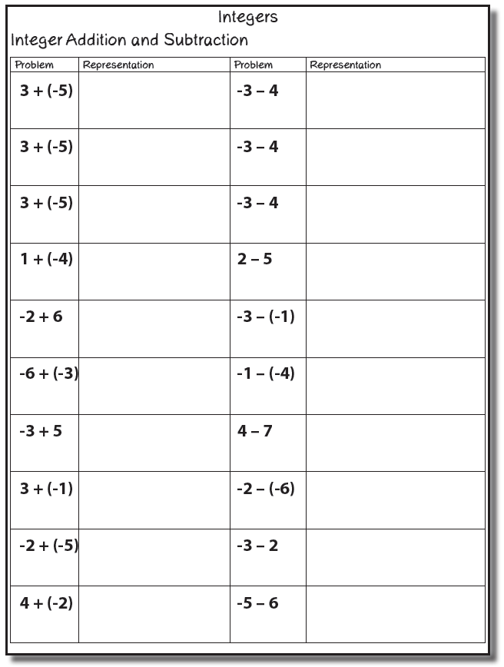
Integers

Slide 54
Integer Concepts
Zero pairs
A positive and a negative cancel one another
If you add a positive, you must add a negative
A number is assumed positive if a negative sign (-) doesn’t proceed it
Be sure to use the negative sign (-) not the minus sign (–)

Slide 55
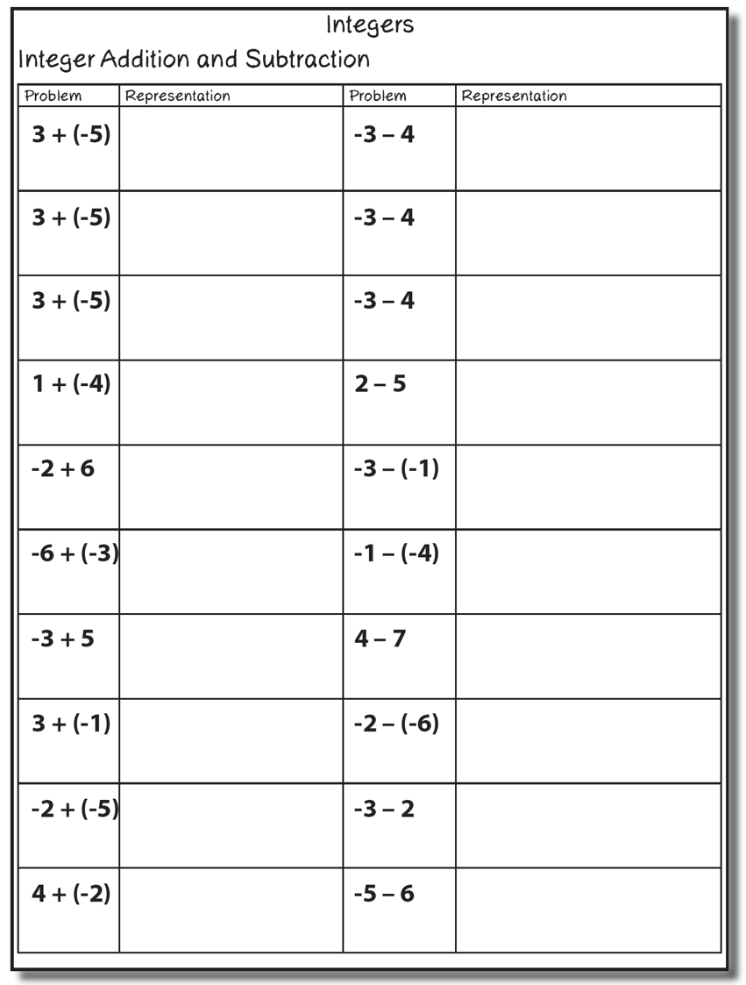
Integer Addition and Subtraction

Slide 56
Operations with Integers
Positive/negative mats
Two-color counters
Number line

Slide 57
Mats
A “+” and “-” mat can be used (T-chart)
Zero pairs cancel
-
+

Slide 58
Mats
A “+” and “-” mat can be used (T-chart)
Zero pairs
-
+
-
-
+
+
-
-
+
-

Slide 59
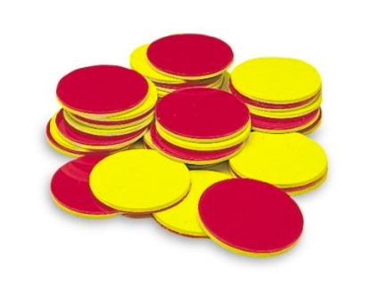
Two Color Counters
Red side used for negative numbers and yellow for positive numbers
Zero pairs cancel

Slide 60
Number Lines
The sign signals whether to change direction (and not which direction to go)

Slide 61
Number Lines
Start on 3 facing positive direction
Minus sign tells you to change direction
Walk backwards (-) 5

Slide 62
Mat
Two-Color Counters
Number Lines

Slide 63
Mats
A “+” and “-” mat can be used (T-chart)
Zero pairs cancel
-
+

Slide 64
Mats
A “+” and “-” mat can be used (T-chart)
Zero pairs
-
+
-
-
-
+
-
+
-
-
+
-
+

Slide 65
Two Color Counters
Red side used for negative numbers and yellow for positive numbers
Zero pairs cancel

Slide 66
Number Lines
The sign signals whether to change direction (and not which direction to go)

Slide 67
Number Lines
Start on (-3) facing positive direction
Minus sign tells you to change direction
Walk forwards 4

Slide 68
Number Lines
Start on (-3) facing positive direction
Minus sign tells you to change direction
Walk forwards 4

Slide 69
Number Lines
Start on (-3) facing positive direction
Minus sign tells you to change direction
Walk forwards 4

Slide 70
Mat
Two-Color Counters
Number Lines

Slide 71
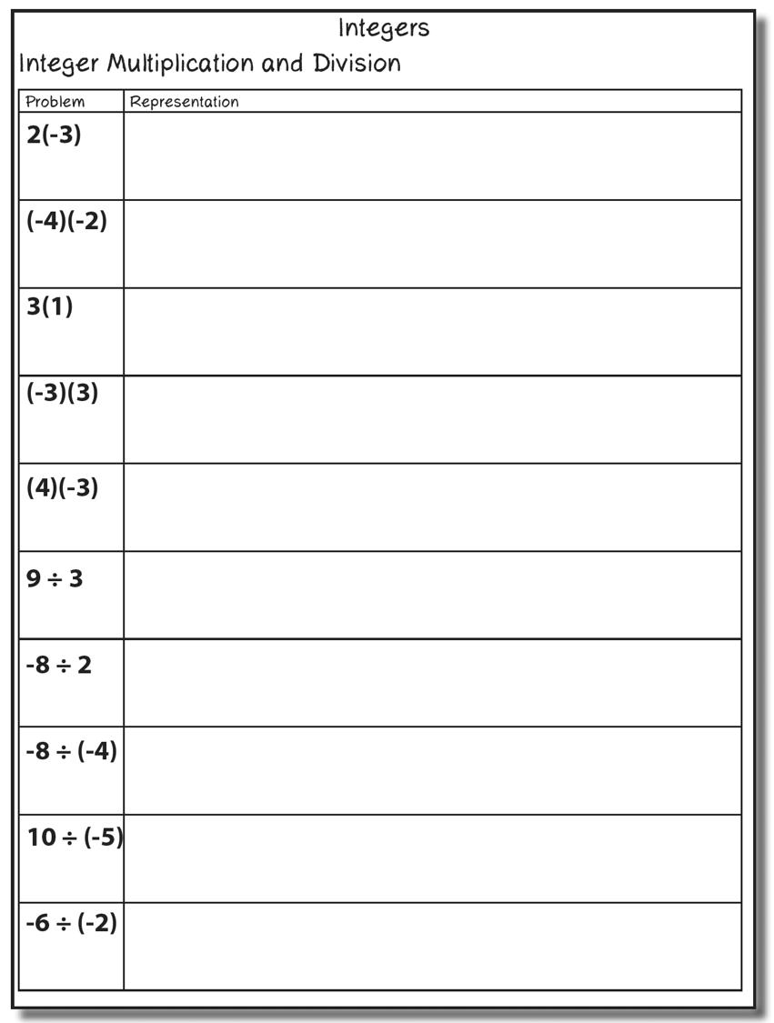
Integer Multiplication and Division

Slide 72
Mats
A “+” and “-” mat can be used (T-chart)
Zero pairs cancel
-
+

Slide 73
Two Color Counters
Red side used for negative numbers and yellow for positive numbers
Zero pairs cancel

Slide 74
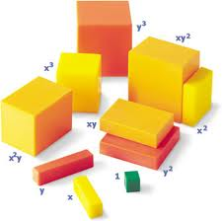
Algeblocks
Green cubes = 1
Yellow rectangles = x
Yellow square = x²
Orange rectangle = y
Orange square = y²
Light orange rectangle = xy
Basic Mat: addition and subtraction
Quadrant Mat: multiplication and division
Sentences Mat: anything with equal sign

Slide 75
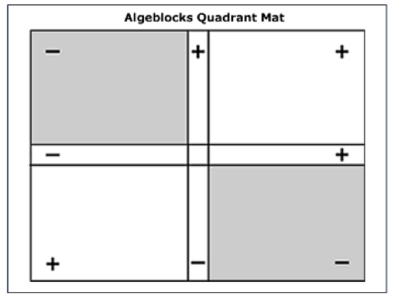
Algeblocks

Slide 76
Multiplication

Slide 77
Algeblocks

Slide 78
Algeblocks

Slide 79
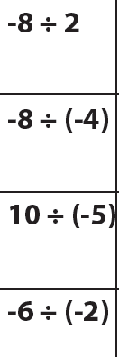
Multiplication

Slide 80
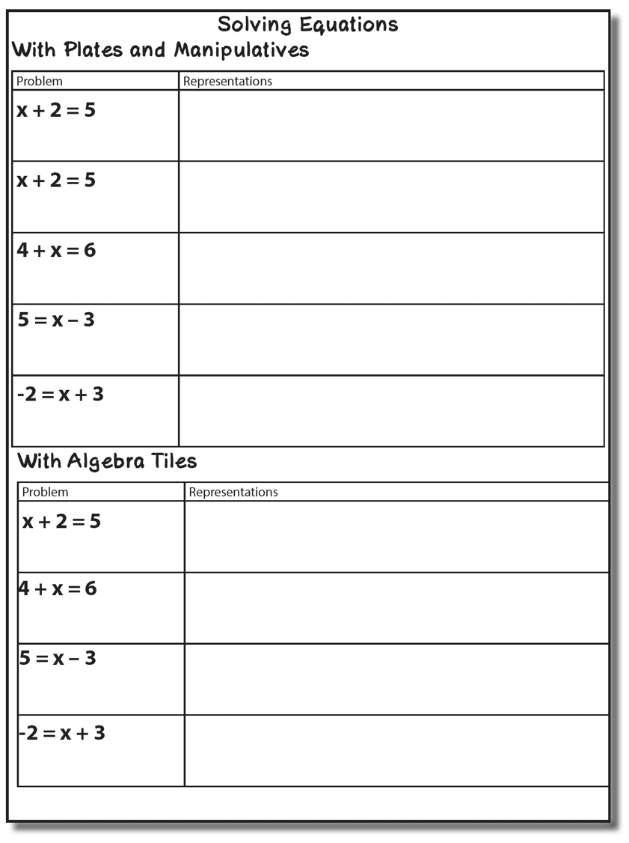
Solving Equations

Slide 81
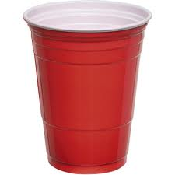
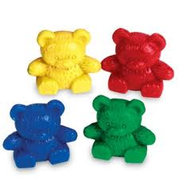
Plates and Manipulatives
Use a cup(s) for students to develop concept of variable/unknown
variable
constant
=

Slide 82
Plates and Manipulatives
=

Slide 83
Cup Model
=

Slide 84
Cup Model
=

Slide 85
Algebra Tiles
Use a mat and tiles to solve for unknown
=

Slide 86
Algebra Tiles
=

Slide 87
Algebra Tiles
=

Slide 88
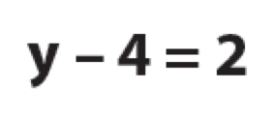
Algebra Tiles
=

Slide 89
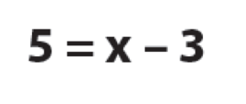
Algebra Tiles
=

Slide 90
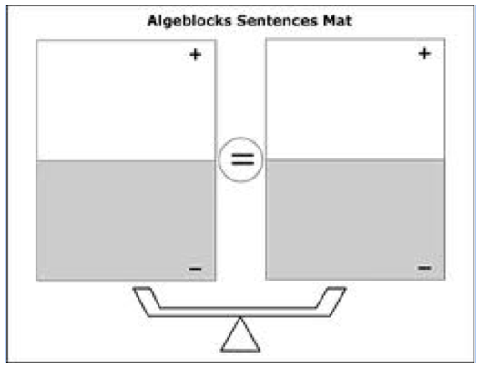
Solving for an Unknown

Slide 91
Solving for an Unknown

Slide 92
Solving for an Unknown

Slide 93
Solving for an Unknown

Slide 94
Coefficients

Slide 95
Coefficients

Slide 96
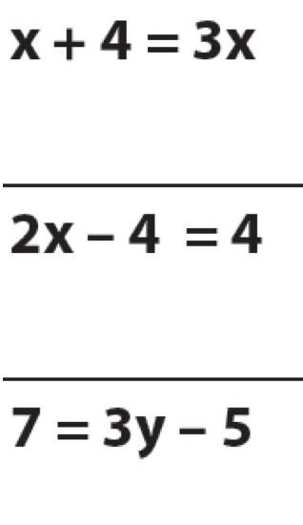
Coefficients

Slide 97
Distributive Property

Slide 98
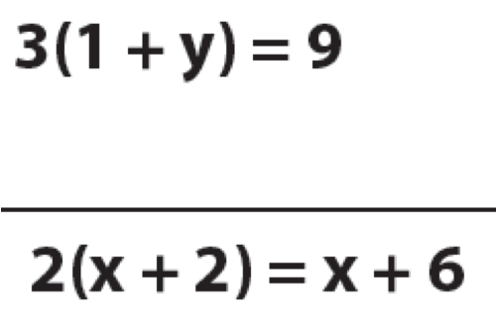
Distributive Property

Slide 99
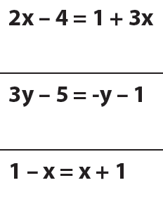
More…

Slide 100
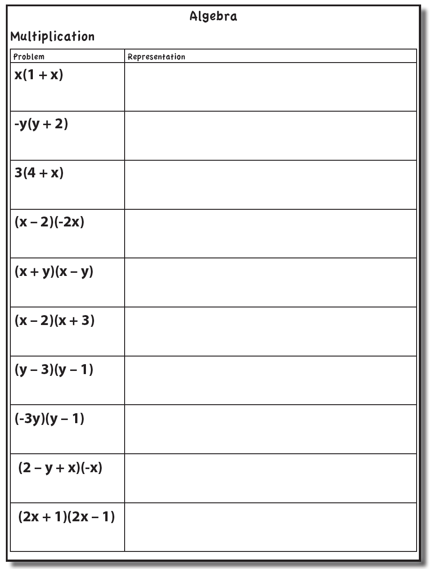
Multiplication

Slide 101
Algeblocks

Slide 102
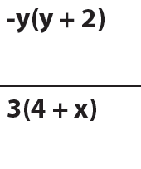
Algeblocks

Slide 103
Algeblocks

Slide 104
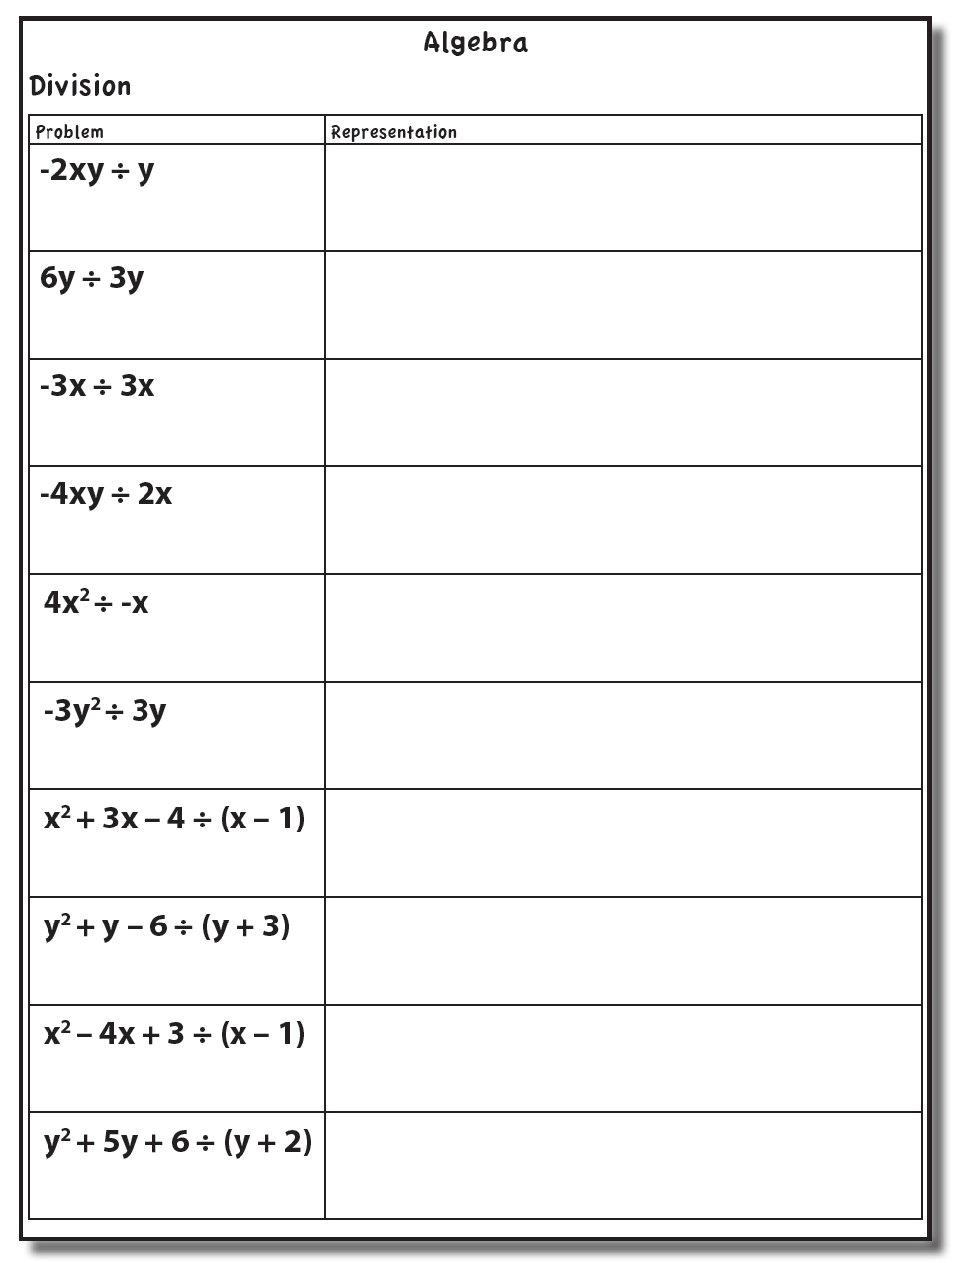
Division

Slide 105
Algeblocks

Slide 106
Algeblocks

Slide 107
Algeblocks

Slide 108
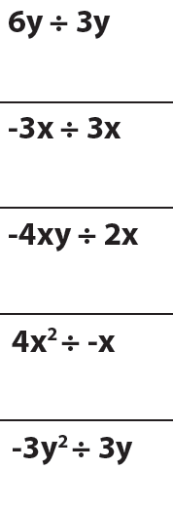
Algeblocks

Slide 109
Algeblocks

Slide 110
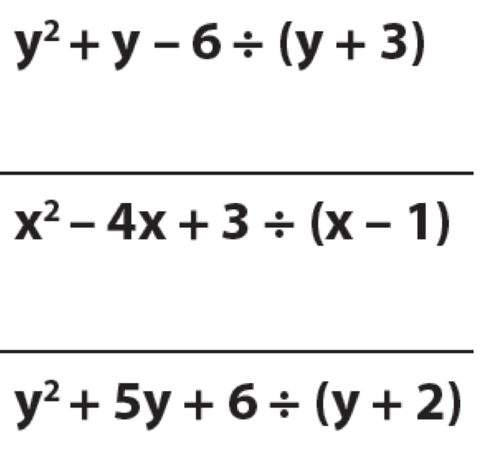
Algeblocks

Slide 112
Fluency Focus
There are 390 facts.
Addition
Subtraction
Multiplication
Division

Slide 113
Fact Practice
Students should practice small sets of facts
These small sets should include known and unknown facts
BRIEF
(1-2 min)
DAILY
(everyday)

Slide 114
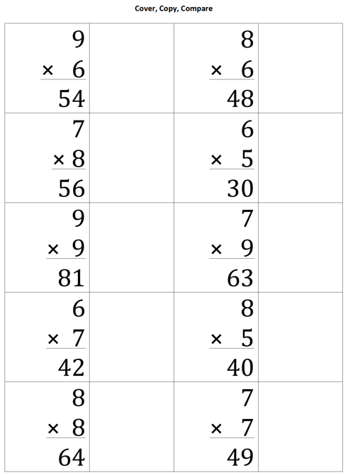
Cover, Copy, Compare
BEFORE
Create sheet with 10-12 answered problems and room to copy facts
DURING
Student reads entire fact
Student covers fact
Student rewrites entire fact
Student compares

Slide 115
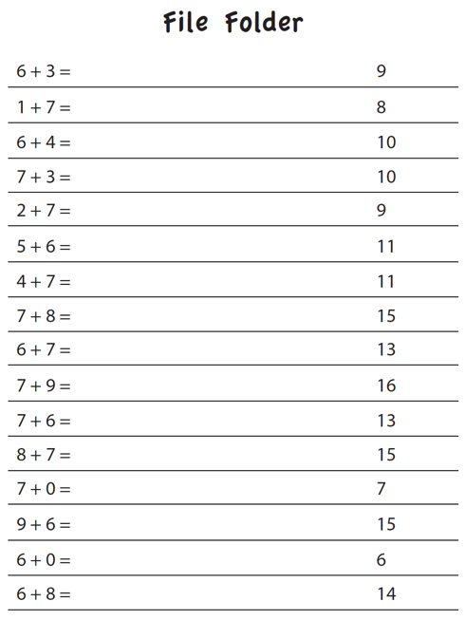
File Folder
BEFORE
Create sheet with 15-25 answered facts
DURING
Student folds answers over
Student writes answers to all facts
Student unfolds answers and compare

Slide 116
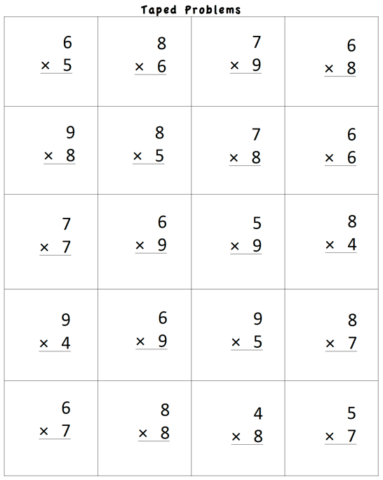
Taped Problems
BEFORE
Create worksheet with 15-25 facts
Make a recording:
Say fact (e.g., “6 times 5 equals…”)
Pause for 1-5 seconds
Say fact answer (e.g., “30”)
Continue with all facts on page
DURING
Student listens to recording
Student writes fact answer before the answer is stated on the recording

Slide 117
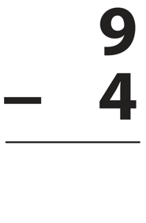
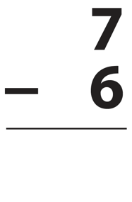
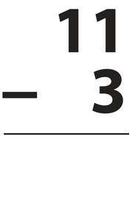
Flash Cards with Constant Time Delay
BEFORE
Collect small set of flash cards
DURING
Show student flash card for 3 seconds
Student answers
If correct, state correct answer and place back in pile
If incorrect, state correct answer and have student repeat it; place back in pile
Work through pile of cards for 1-2 minutes

Slide 118
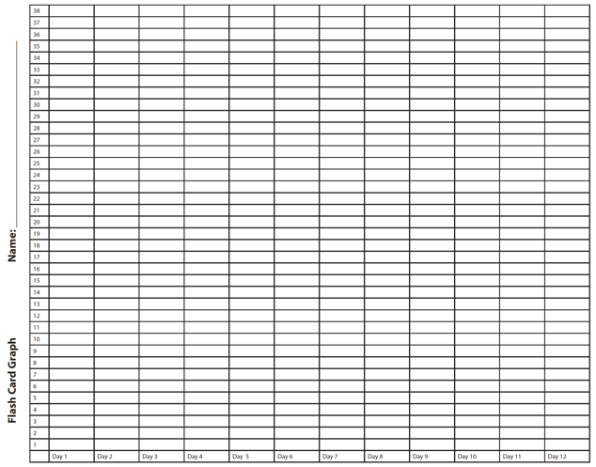
Flash Cards with Graphing
BEFORE
Collect small set of flash cards
DURING
Show student flash card
Student answers flash card
If correct, place in correct pile
If incorrect, review fact
Time for 1-2 minutes
Count total score
Graph total score
Could opt to try to beat score for another 1-2 minutes
Graph highest score

Slide 119
Flash Cards with Incremental Rehearsal
BEFORE
Select 1 unknown fact from a set of flash cards
Select 9 known facts from a set of flash cards
DURING
Read unknown fact aloud, provide answer, and ask student to read problem with you
Keep unknown fact flash card and combine with 1 known fact flash card
Show 2 flash cards to student
If student answer correctly, go to next flash card
If student answers incorrectly, read fact with answer and ask student to read with you
Work on cards until student answers correctly within 2 seconds
Add in 1 known fact flash card; continue with 3 cards
Keep adding in known fact flash cards until student achieves fluency with unknown card
Select new unknown fact and repeat process

Slide 120
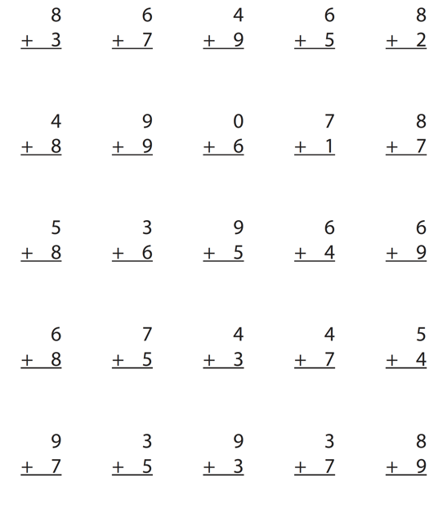
Worksheets
DURING
Students answer facts for 1-2 minutes
Students graph highest score of day or week

Slide 121
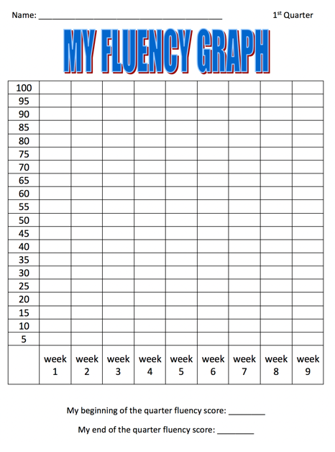
Worksheets with Graphing
DURING
Students answer facts for 1-2 minutes
Students graph highest score of day or week

Slide 122
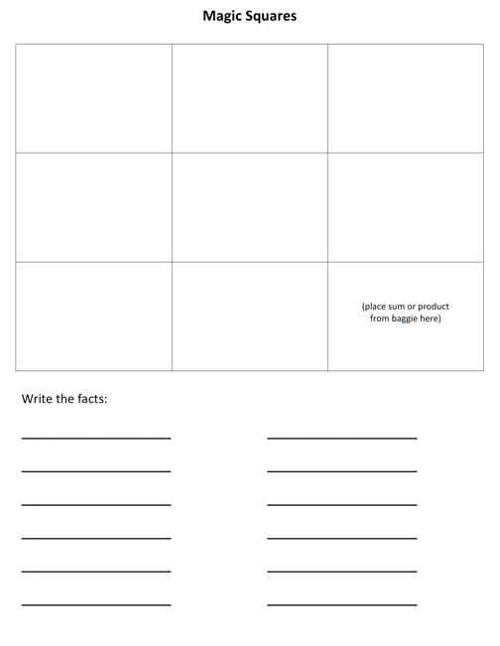
Magic Squares
BEFORE
Create sets of magic squares
See templates http://www.sarahpowellphd.com/presentations.html
DURING
Place sum or product in bottom right corner
In bottom row, create a fact with a sum or product of bottom right corner
In right column, create a fact with a sum or product of bottom right corner
Create two columns with a sum or product of bottom number
Create two rows with a sum or product of right column number
Write created facts
See demonstration on next slide.

Slide 123
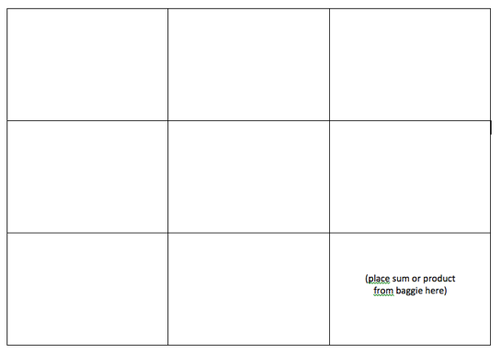
Magic Squares
5
4
12
8
6
1
3
3
6

Slide 124
Playing Cards
BEFORE
Select numbered playing cards from a deck of cards
DURING
Divide deck in half
Students place set of cards face down
Each student flips over top card
First student to add, subtract, or multiply the cards gets to keep both cards; cards go back in student’s set
Students continue until one student has all the cards
This game is similar to War.

Slide 125
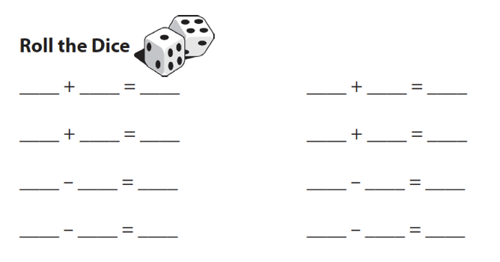
Dice Roll
DURING
Student rolls two die
Student adds, subtracts, or multiplies
Student writes facts

Slide 126
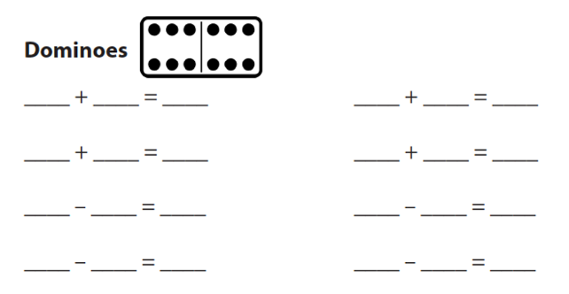
Dominoes
DURING
Student select domino
Student adds, subtracts, or multiplies
Student writes fact

Slide 127
Wrap-Ups
DURING
Student wraps string behind key and places around top left notch
Student answers fact by wrapping string in front of key and around to answer notch
Student brings string around the back to next left notch
Student continues
At end, student checks facts by comparing string to raised pattern on back of key

Slide 128
Mobi
DURING
Students begin with a specific number of blue tiles; the white tiles can be used at anytime
Students create a set of equations that build off of one another (each student makes their own set of equations)
Students draw more blue tiles after blue tiles are used; students rearrange and add to equation set
This game is similar to Bananagrams.

Slide 129
SMATH
DURING
Students use tiles to create equations on a game board
Students take turns and build off of one another’s tiles
This game is similar to Scrabble.

Slide 130
Technology
Individual activity
BEFORE
Select game that will practice small sets of facts
Select game that will track and monitor student progress
Select game that will provide feedback to student (especially when student makes mistake)

Slide 131
Other Ideas
Tic-Tac-Toe (with facts)
Connect Four (with numbers)
Chutes and Ladders (with numbers)
Add to this list!

Slide 132
srpowell@austin.utexas.edu
@sarahpowellphd
119

