Slide 1
Care Givers of Arizona
Company Orientation

Slide 2
Mission Statement
To respectfully & compassionately meet the needs of our clients & their families, by listening, planning, educating, & delivering the highest quality of individualized home healthcare.

Slide 3
Welcome!
Care Givers of Arizona is an at-will employer and employees should understand that employment is not offered, contracted, or promised for any specific length of time. Employees have the right to terminate employment at any time, but are responsible for giving a two week notice in writing. Care Givers of Arizona has the right to terminate employment without notice if needed.

Slide 4
Just to start..
Please be very honest about availability and transportation. If you feel a client we have is too far please do not take it. These clients want caregivers who are going to stay long term.
Being reliable is huge, our clients depend on you being there for them.
Communication to office needs to be priority if you are late, not going to work, or any issues.

Slide 5
Diagnosis we may work with:
Autism: A mental condition, present from early childhood, characterized by difficulty in communicating and forming relationships with other people and in using language and abstract concepts.
Down Syndrome: A congenital disorder arising from a chromosome defect, causing intellectual impairment and physical abnormalities including short stature and a broad facial profile.
Cerebral Palsy: A condition marked by impaired muscle coordination (spastic paralysis) and/or other disabilities, typically caused by damage to the brain before or at birth.
Cognitive Impairment: Is when a person has trouble remembering, learning new things, concentrating, or making decisions that affect their everyday life.

Slide 6
Services We Offer
Respite- RSP- Watching consumer in home or community.
Habilitation- HAH – Doing a set of goals to improve daily living skills.
Attendant Care- ATC – Daily living such as bathing, feeding, changing, cleaning, etc.
Housekeeping- HSK – Cleaning
Private Duty- These services vary from companion ship- skilled nursing.

Slide 7
Interview Etiquette
Dress professional (No torn or low cut clothes, appropriate undergarments )
Remove piercings and cover tattoos
No heavy makeup or perfume
Do not speak about your private life
Let the consumer know your experience or care for the industry
ASK QUESTIONS (What they are expecting, challenges they have, issues they had with previous providers, etc.)

Slide 8
After the interview
Please call the office let us know how it was.
Be honest if you are comfortable with the particular case
Communicate any questions you may have
We will follow up with the consumer as well to see how they felt about the interview

Slide 9
Employment Trial Period
Employment may be considered to be on a trial basis for the first three months of employment for purposes of establishing eligibility for employment benefits.
After the trial period of satisfactory performance you will normally achieve regular full-time or part-time employment & may be eligible for employee benefits. (Dental, Health Care, etc.)

Slide 10
Licensing & Certifications
Employees are required to maintain current licensing & certification requirements as a condition of employment. If you fail to maintain your certifications there may be sufficient cause for discharge due to state regulations.
These include Article 9, CPR, First Aid, TB, CRSD, Finger print clearance card, etc.

Slide 11
Conflict of Interest
You must inform your supervisor or Care Givers of Arizona of any other job appointments that might interfere with your duties or assignments with the company.
PLEASE remember if you need coverage on your case to call the office with at least 24 hours notice.
Please remember it is against policy to date any consumer of Care Givers of Arizona.

Slide 12
Accident/Incident Reporting
An accident or incident must be reported to your supervisor immediately. The employee must fill out & sign the Employee Accident/Incident Report immediately following the occurrence of the accident/incident. You can obtain this report from our website.

Slide 13
Time Cards!
The 1st-15th will be on one time card that can be faxed or emailed once signed by responsible party.
The 16th-31st will be included with the WHOLE month timecard (Wet Ink) you will need to hand in or bring to our office.
We get paid semi monthly on the 7th and 22nd of each month unless it lands on a weekend! Please make sure to get the payroll calendar to make sure everything is in by payroll.

Slide 14
Absenteeism/Tardiness/Time off
Must report to office before you need off or are going to be late.
If you fail to report to work for three consecutive working days without proper notification it is considered “abandoning” your job and is subject to termination.
Abandonment is recognized as voluntarily quitting.
In order to use paid sick time, you must notify the office 1 week prior when it is foreseeable or the soonest you are able to call the office. You must fill out a request off form prior to your shift and submit it to caregiverskatey@gmail.com.
Time off request forms must be filled out for all requested time off at least 2 weeks in advance for the requested time off. Administration will make every effort to grant your time off, however in some instances where coverage cannot be found, we may not grant your request. Time off request forms need to be submitted to caregiverskatey@gmail.com

Slide 15
Confidentiality
If there are issues with the office direct them to the office not your client.
Discussing clients personal information to anyone outside of the “team” is against HIPPA.

Slide 16
General Policies
Appearance is important as you want to look professional.
An employee who exhibits inappropriate behavior, which is suggested of being under the influence may be required to have a drug test or alcohol test done that same day.
You are not to borrow money or property to or from your clients.

Slide 17
Phone & Visitor Policy
While on the clock you are not to have visitors at work.
This includes bringing children to your clients house. THIS IS NEVER ALLOWED.
Using your cell phone should be to a minimum if at all unless there is an emergency and your client allows it. This includes texting.

Slide 18
Policies
Thefts or dishonesty are a serious offense and will not be tolerated. If it is not yours do not take it.
Smoking at work is prohibited. If you do it you should before your shift. It is not professional to take multiple smoke breaks.
Personal errands while on the clock is part of the dishonesty and will not be tolerated.

Slide 19
Social Networking
You are not to have clients, other employees on any social networking sites.
Putting any information about work on these sites it’s a HIPPA violation
We do look at most social networking sites so do not put anything on them that you do not want your supervisor seeing.

Slide 20
Driving Policy
If you are driving the client you need to have the proper insurance and up to date registration.
Client should be in rear passenger seat so you can keep an eye on them. Not in the front!
We need car information on file if you are transporting as well as MVD record and quarterly inspections.

Slide 21
Write up policy!
We have the right to write up an employee if we feel the employee broke any rules, commitments, and responsibilities with their client or Care Givers of Arizona.
An employee can have three write ups. After the third, termination will happen and will result in you voluntarily quitting.

Slide 22
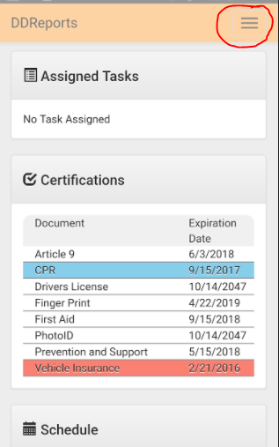
DDREPORTS AND DDTRACKING
When you first log into ddreports, you will be brought to your dashboard. Here you will see assigned tasks from the office staff,(as you can see there are not any on the dashboard) The list of certifications and their expiration dates, and the schedule section(We currently do not use the schedule function)
On the upper right hand corner(circled in red here) You will see an icon with 3 horizontal lines. Clicking this icon will give you a drop down menu. The next slide will show the menu.

Slide 23
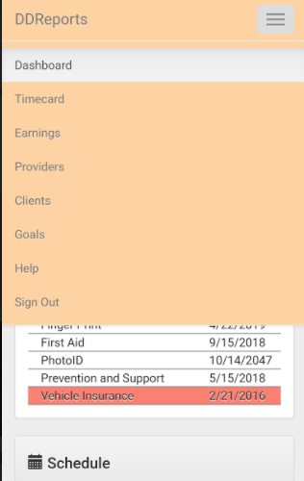
In the drop down menu, you have several categories. The Timecard area, is where we will be most of the time. This is where we are going to put our time, etrial data, and monthly summary reports.
The Earnings tab is where you will see your salary information.
You shouldn’t see a Providers tab, It is on this example because I am an admin.
The clients section will bring up information in regards to your client’s hours available and the dates that the authorization ends. This tab is helpful if you are trying to track how many respite hours your have left or should be working in a week until the end of the auth.
The Goals section will bring up the goals for a specific client should you wish to review them again.
The help tab will lead you to the help section
The Sign out button will log you out of ddreports.

Slide 24
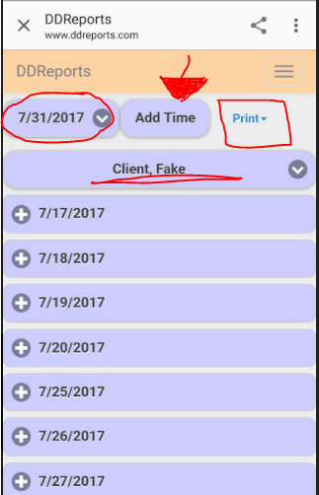
When you click on time card, It will bring you to a page where you can insert your time. A couple of things to keep in mind when you are on this page:
Where you see the red circle to the left, This is the button which indicates what billing period you are currently in. Each month is broken up into the 1st-the 15th of the month, and the 16th to the 31st. The date listed in the bubble here, will be the LAST day of the billing period. So as you see here it says 7/31/17, That means all of the time that I worked between the 16th and the 31st will go in this period. In order to change the period, just tap on this bubble and it will open up other available time periods.
Where you see the red square, this is the print button. You need to print off a time card at the end of every billing period. When you are printing for the end of the month, you will need to click on the button and click on ALL(Entire month) This will print out a time card from the 1st to the 31st. This time card needs to be signed by guardian and either mailed or dropped off to the office by the designated date in the payroll calendar. The time card that is due for the 1st to the 15th needs to be printed, signed by guardian and either faxed in or emailed into the office.
Where you see the underlined “Fake Client” This is where your client’s name will be. If you have more than one client, make sure your put your time in under the correct client.
Where you see the red arrow, is where you will input your time worked

Slide 25
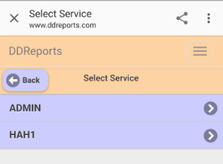
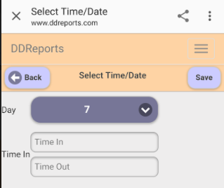
On the picture on the upper left, you will see the next window when you are inputting time worked with a client. It will ask you to select which service you are doing. Because I am admin, it shows my options as admin or HAH. I selected Hah.
On the bottom left picture, you will see the next window which prompts you to select a date, a start time and an end time. The date bubble when tapped will allow you to select another date. The time input areas will bring up scroll times. BE CAREFUL TO CHECK AM AND PM and that you are putting your time in accurately. Then, click the save button on the upper right

Slide 26
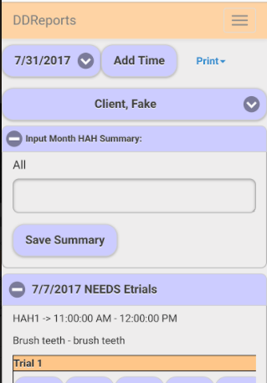
When you have put in a service that requires etrials, It will show you “NEEDS Etrials” next to the date that you inputted, as well as a tab to input monthly HAH or ATC Summary. The monthly HAH or ATC summary only needs to be filled out once per month. This will give the team an overall idea on how the client has been doing with habilitation over the coarse of the month. The Etrial data needs to be filled out EVERY time that you input time for HAH or ATC. The next slide will show how to complete the etrials.

Slide 27
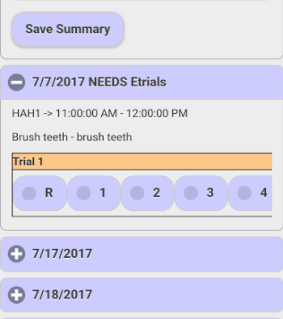
Here you will see that my client has a hah goal of brushing his teeth. I need to mark what his progress was on brushing his teeth today. Because I had to help him put the toothpaste on his toothbrush, I would tap the bubble marked 2.
The following is a Key of how to properly score a hah goal
R= Refusal, the client refused to work on this goal at all. Didn’t even want to watch provider complete the goal correctly
1= Full assist, The provider did a vast majority of the steps in completing the goal
2= Partial assist, The provider did some of the steps, the client did some of the steps
3= Promps/Cues The client was able to complete the task but needed prompts or reminders throughout to get the task completed
4= Independence= Aside from prompting to work on the goal, the client is able to complete all of the goal without further input from provider
B= Barrier, there is a reason why the goal could not be worked on.

Slide 28

For ATC, you are only given 3 bubble options. Below is the key for scoring ATC data
B= Barrier(same as above)
1= Completed the task
R= Refusal (the client refused)
That is pretty much everything you need to know in regards to ddreports. If you ever have an issue or a problem, Do not hesitate to give us a call or shoot us an email. Most of the time, technical issues can be resolved with a simple phone call, but sometimes, we actually need to see what the problem is. In those cases, we will schedule a time for you to bring your device into the office and get the help you need.

Slide 29
Our information
Our website: caregiversofarizona.com
Our main email: caregiversofaz@gmail.com
Staffing Coordinators: Alejandra Garcia & Danielle Rangel
Director of Member Services: Heather Smith
Director of Operations: Katey Andrews
DO NOT HESITATE TO CALL OR EMAIL

