Slide 1
Lesson 3: Methods
Robert Wonser
Introduction to Sociology

Slide 2
How Do Sociologists Make Sense of Society?
Remember, sociology is a science, it uses the standard method like all other sciences.
Scientific Method—a procedure for acquiring knowledge that emphasizes collecting data through observation and experiment.
Theory + Methods = Science.
Here’s the Methods part…

Slide 3
Reproducibility and Replication
Key feature of science: repeated observations that bring us closer to reality.
160 psychology papers published in 2008 in three leading journals, Psychological Science, Journal of Experimental Psychology: Learning, Memory and Cognition and the Journal of Personality and Social Psychology.
An attempt to reproduce 100 psychology studies published couldn't match the results in almost two thirds of cases.
The findings raise serious questions about the rigor of research in the field, as well as how other areas of science would stack up under the same test.
Notes:
Source: http://www.iflscience.com/brain/most-psychology-papers-cant-be-reproduced

Slide 4
The Research Process

Slide 5
1. Identify a Problem/Research Question
What are some good problems to address in society? What do you want to understand better?
This should be introduced in the first section of your write-up.
Research Questions explain what you’ll be exploring.
E.g. How do strippers manage the stigma of being a stripper?

Slide 6
2. Literature Review
Literature involves reviewing what others have already discovered and written about your topic.
Why is this important?

Slide 7
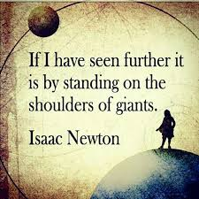
Science is Cumulative and Collective
If I have seen further, it is by standing on the shoulders of giants.
Notes:
1676 letter of Isaac Newton

Slide 8
3. Form a Hypothesis
A hypothesis is a testable statement linking two or more variables together in a relationship.
Usually framed like ‘the more X the more Y.’
Study time increases exam score.
Variables are what we’re measuring and by definition have to vary.
Two types: Independent (causes a change) and dependent (the thing that changes because of the IV’s presence)

Slide 9
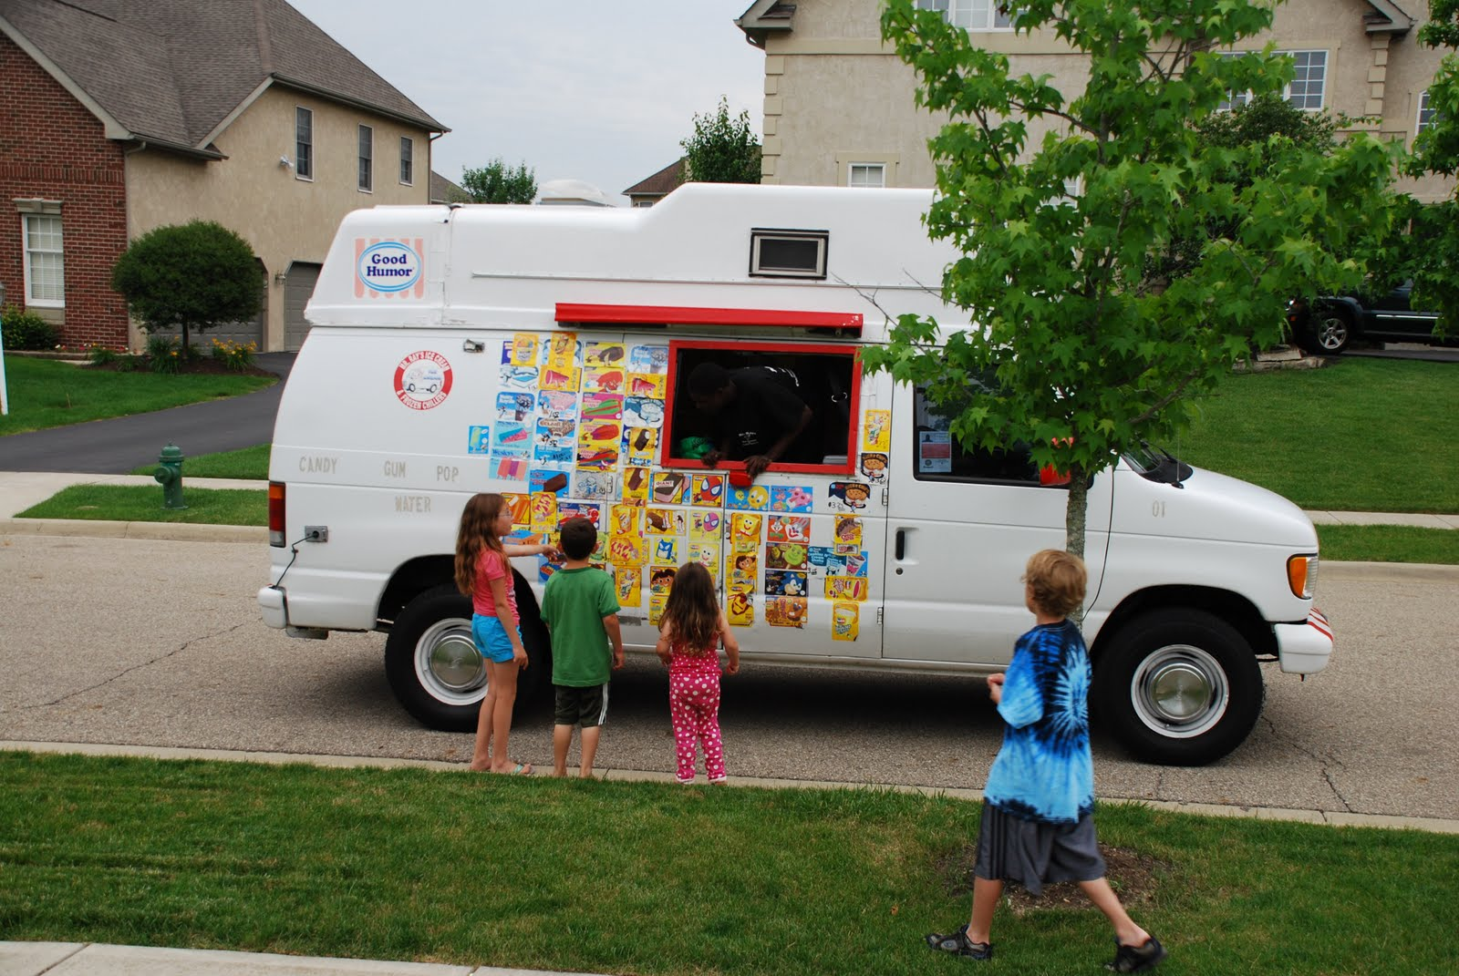
Correlation ≠ Causation
Correlation: a relationship between two variables
A ‘co-relation’
Causation: a relationship in which one variable causes another variable to change
Spurious correlation: a relationship that seems to exist between two variables, but is actually caused by some external, or intervening, variable.
When will we stop this menace?

Slide 10
Operationalization
Variables must be clearly defined so that they can be measured. Defining your variables as they’ll be used in your study makes them concrete and thus, measurable.
Variables must be operationalized, that is defined in such a way that can be measured.
Finally, data is collected and the hypothesis can be tested.

Slide 11
4. Choose a Research Design or Method
Quantitative research: translates the social world into numbers that can be studied mathematically.
Ex: surveys, experiments, content analysis
Qualitative research: uses nonnumerical data like texts, interviews, photos, and recordings to help us understand social life.
Ex: ethnography, participant observation, interviews.

Slide 12
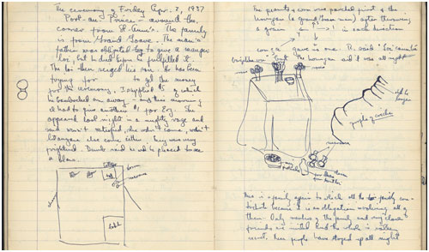
5. Collect Data
Administer the survey, input the data into SPSS, etc.
For qualitative research, ask the questions, take the detailed field notes, etc.

Slide 13
6. Analyze Data
The data you collected; what does it mean?
This is where you get a tentative answer to your research question!

Slide 14
7. Disseminate Findings
Sociology Journals
Annual Conference for the American Sociological Association in San Francisco 2014

Slide 15
Methods: How Do We Gather Data?
There are different ways to collect information about a topic, but each specific data collection method has benefits and limitations.
When beginning a research project, it is important to consider which method will work best. This is often guided by your research question.

Slide 16
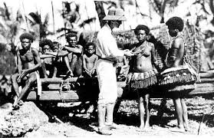
Qualitative: Ethnography
One way to collect to data is through ethnography—studying people in their own environments in order to understand the meanings they give to their activities.

Slide 17
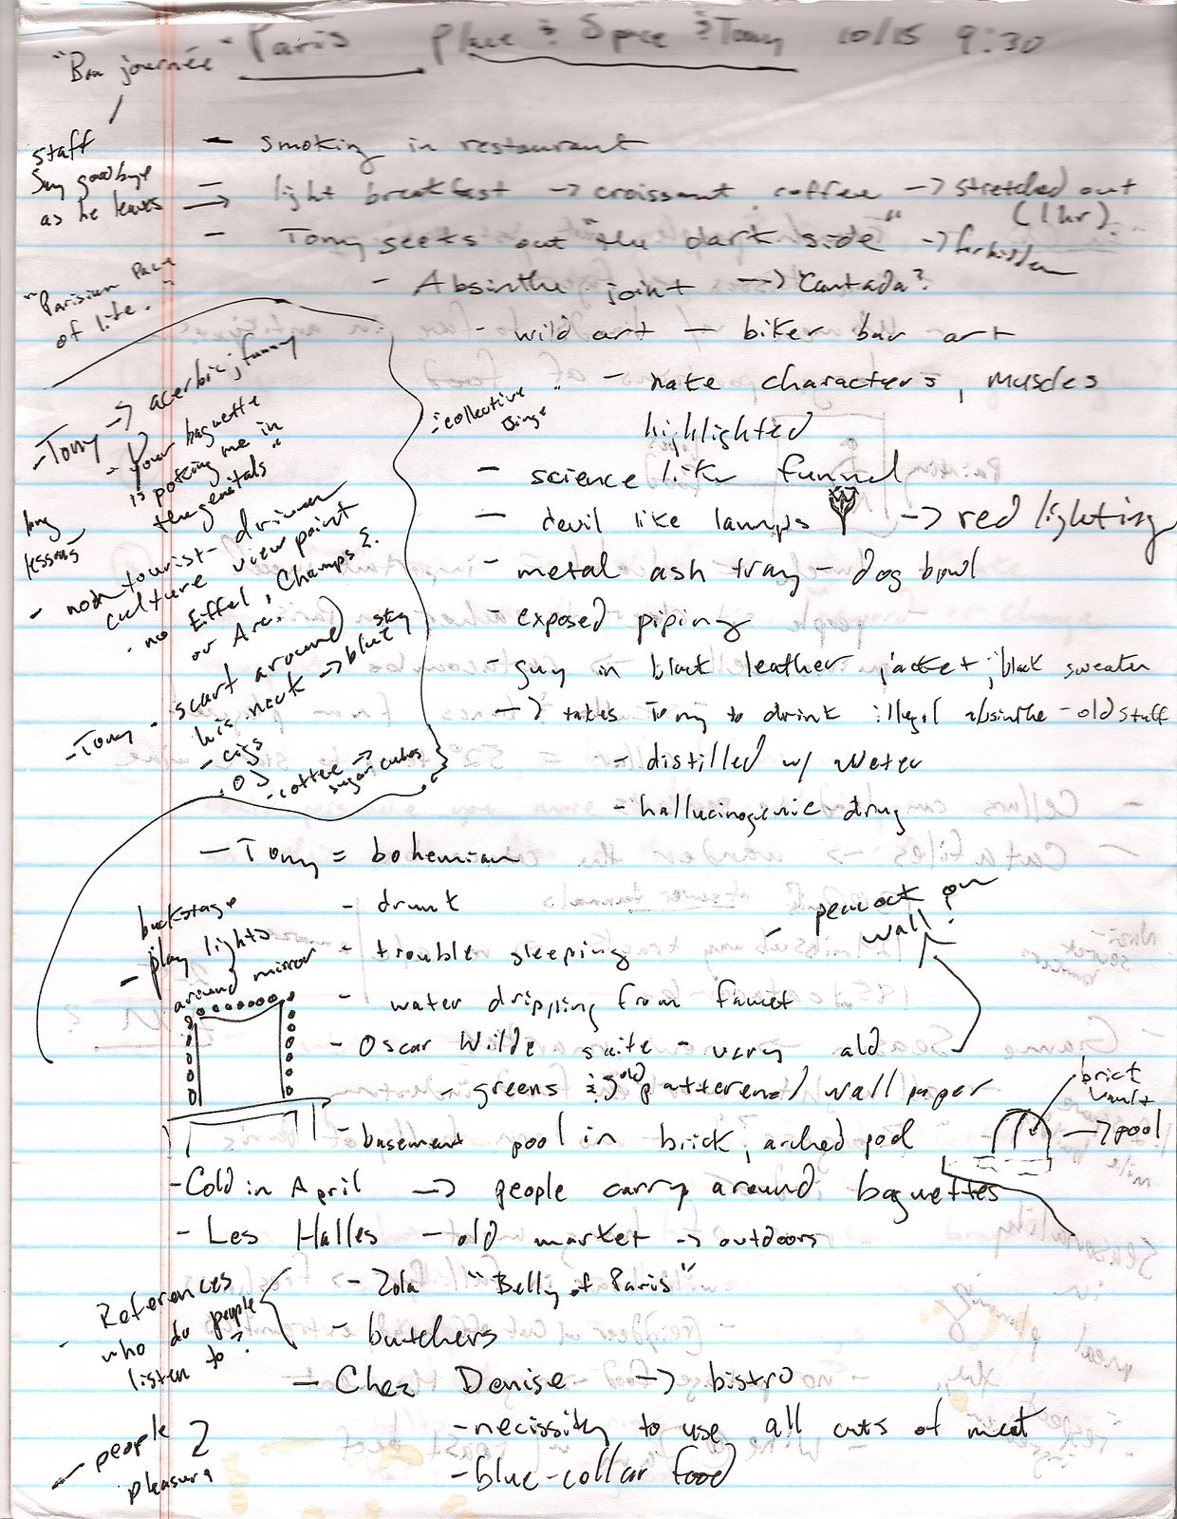
Ethnography
Ethnographies involve:
The researcher observing a setting.
The researcher making a written account, field notes, of what goes on there. The field notes become the data you analyze.
A jumbled mess of data.

Slide 18
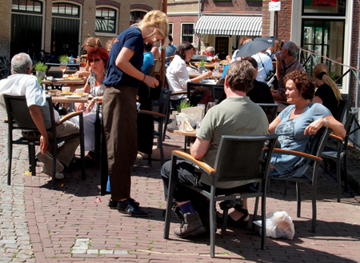
Qualitative: Participant Observation
In participant observation the researcher both observes and becomes a member in a social setting.
Pros and cons?

Slide 19
Qualitative: Interviews
Interviews usually involve direct, face-to-face contact with respondents.
Can generate large amounts of qualitative data

Slide 20
Interview Questions
Interviews can use open-ended questions or closed-ended questions.
Open-ended questions let respondents talk as much as they’d like about the question you asked, whereas closed-ended questions give respondents a choice of answers.
Don’t make poor questions, leading questions, etc.

Slide 21
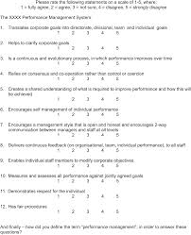
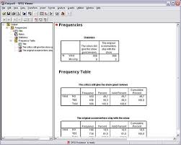
Quantitative: Surveys
Surveys are questionnaires that are administered to a sample of respondents selected from a target population. Survey research tends to look at large-scale social patterns and employs statistics and other mathematical means of analysis.
Most commonly used research in sociology.

Slide 22
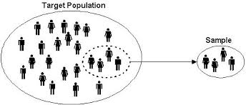
Samples from Populations
Researcher identifies the target population of interest, then selects a sample of people to be interviewed from that population

Slide 23
Quantitative: Experiments
Experiments are formal tests of specific variables and effects that are performed in a setting where all aspects of the situation can be controlled.

Slide 24
Experiments
Many experiments involve:
An experimental group—participants that receive the experimental treatment
A control group—participants that continue without intervention so they can be compared with the experimental group
Least commonly used method in sociology.
How come?

Slide 25
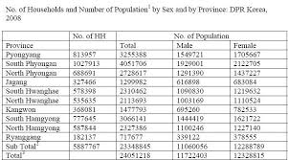
Existing Sources
Existing sources refer to any data that has already been collected by earlier researchers and is available for future research.

Slide 26
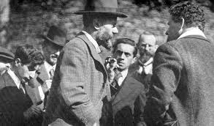
Weber and Being Value-Free
Most sociologists believe that they should not allow their personal beliefs to influence their research.
Max Weber coined the phrase value-free sociology, stating that researchers should identify facts without allowing their own personal beliefs or biases to interfere.

Slide 27
Don’t do This! What’s wrong here?

Slide 28
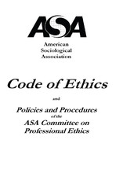
Ethics
Most universities where research is conducted also have an institutional review board, a group of scholars within a university who meet regularly to review and approve the research proposals of their colleagues and make recommendations for how to protect human subjects.
The American Sociological Association has developed its own code of ethics to help researchers avoid bias and adhere to professional standards and to protect respondents from harm.

Slide 29
Some Important Realizations
Sociology uses the scientific method to understand society.
This can be done either qualitatively (rich, detailed data and thick descriptions) or quantitatively (using data easily converted into numbers) or a combination of both.
Ethics plays a crucial role in the study of human social activity.

Slide 30
Lesson Quiz
1. The individuals that a sociologist interviews as part of a research project would be a part of the:
a. sample.
b. experimental group.
c. dependent variable.
d. control group.

Slide 31
Lesson Quiz
2. The following question, “What do you think about couples living in sin?” would be an example of a/an:
a. leading question.
b. informed question.
c. double-barreled question.
d. closed-ended question.

Slide 32
Lesson Quiz
3. What would the independent variable be in an experiment where a sociologist is testing whether or not watching television impacts a student’s grade on an exam?
a. the student
b. the researcher
c. the exam grade
d. the watching of television

Slide 33
Lesson Quiz
4. Who coined the phrase “value-free sociology?”
a. Karl Marx
b. Max Weber
c. Emile Durkheim
d. W.E.B. DuBois

Slide 34
Lesson Quiz
5. Each academic discipline has developed its own __________ to provide guidelines for researchers to consult as they design a research project.
a. review board
b. code of ethics
c. Nuremberg code
d. research review board

