Slide 1
Legislative Issues and Advocacy
Preparing for Success in the 2022 Session
Margaret Buckton, ISFIS Partner, RSAI Professional Advocate, UEN Executive Director, margaret@iowaschoolfinance.com
1201 63rd Street, Des Moines, IA 50311 (515) 201-3755 cell
Dave Daughton,
RSAI Grassroots Advocate
dave.daughton@rsaia.org
(641) 344-5205 cell
Retired Wayne CSD Superintendent

Slide 2



Slide 3
Priorities for 2021 Session: RSAI
Adequate Resources: SSA (3.75% based on strong FY 2021 surplus and inflation)
Poverty Opportunity: formula weighting, poverty study and MSA for waived fees (UEN also includes ISL proration issue)
Educator and Staff Shortage: substitutes, flexibility, hire retirees, sped generalist
Mental Health/Assessing and Addressing staff/Student Social, Emotional and Behavioral Health
Formula Equity (close gap over 9 years and RSAI still mentions transportation equity)
Quality PK: 1.0 weighting for full day, poverty factor, ELL weighting, and fix for 2020 COVID enrollment dip (create budget guarantee & on-time funding or base 2022 budget on Oct. 2019 enrollment)
District Authority/Home Rule
School safety: investments for training and safety personnel
Remote learning and instructional time: school board authority to decide if learning is remote and counting the time toward days/hours
Internet connectivity and Access: state and federal efforts to connect all staff and students to Internet. Poverty should not be a barrier. Sharing Incentives and Efficiencies: Extension, additional positions, increase the cap.
Bonding Capacity: 50% +1 for bond issues and apply 5% debt limitation to property tax-backed debt only (not state penny)

Slide 4
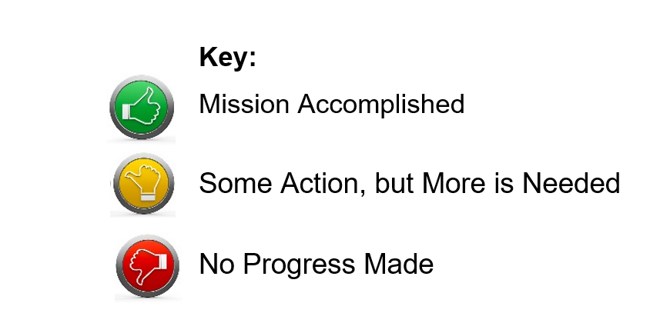
Status of 2021 Legislative Action

Slide 5


Adequate School Resources
SSA & Formula/Transportation Equity
SF 269 School Funding set the SSA rate set at 2.4%, for both regular program district cost and categorical supplements, which is the second highest in 12 years, yet still below the cost increases that schools typically experience.
Increased the base to promote formula equity by $10 per student, either more spending authority or property tax relief for school districts.
Continued property tax replacement by which the state assumes what would otherwise be a property tax increase due to the state cost per pupil increase.
Appropriated additional funds for transportation equity to reimburse all school districts for transportation costs above the state average.
The House passed the bill 56-36, Senate passed it 31-18. Governor Reynolds signed it on Feb. 23, 2021, just a few days past the statutory deadline for enacting school aid within 30 days of the release of the Governor’s budget.

Slide 6
Adequate School Resources
SSA & Formula/Transportation Equity
The total cost to the state of school aid and transportation and formula equity, however, after enactment of the Standings Appropriations bill which cut the AEAs by $15 million, was $28 million, well below the average state increase of $95 million experienced over the last decade.
No consensus on HF 532 which would have provided an additional $27 million for COVID-19 pandemic costs, distributed based on students served at school (not virtually) during the first semester of the 2020-21 school year. Still alive for 2022 Session.
RSAI opposed SF 269, since the 2.4% and total funding provided to public schools was below what was requested by Rural School Advocates of Iowa members.
RSAI supported the appropriation in HF 532, but opposed the formula, encouraging a per pupil distribution rather than the complicated formula of counting days of in-person instruction that was proposed.

Slide 8
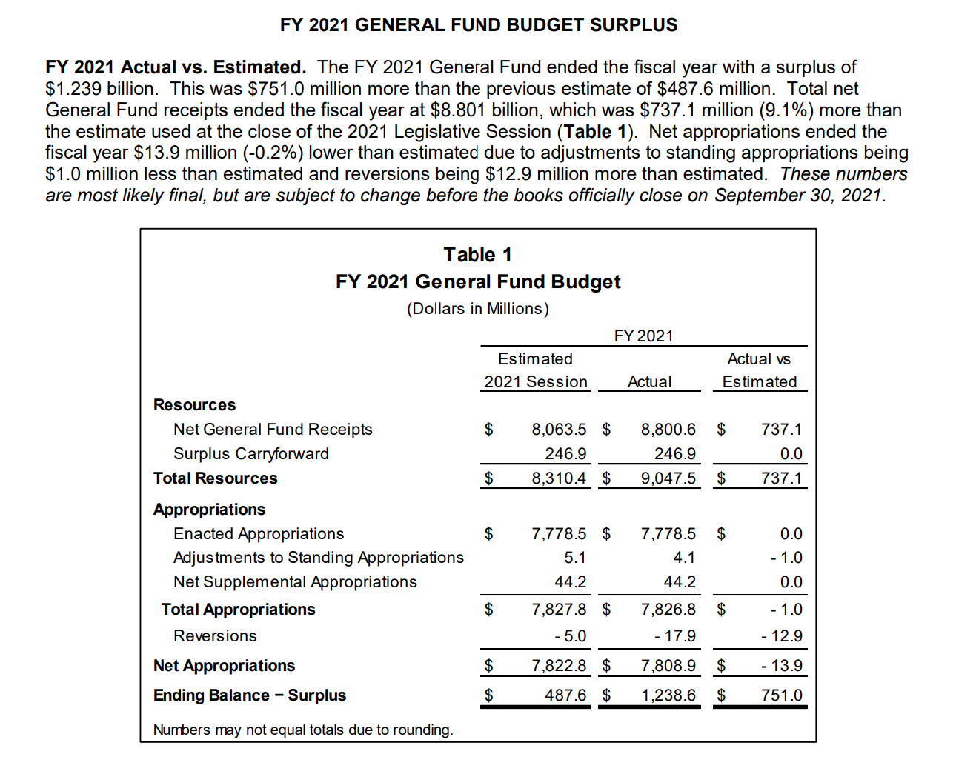
$1.2 Billion surplus
PLUS
Full EEF and CRF

Slide 9
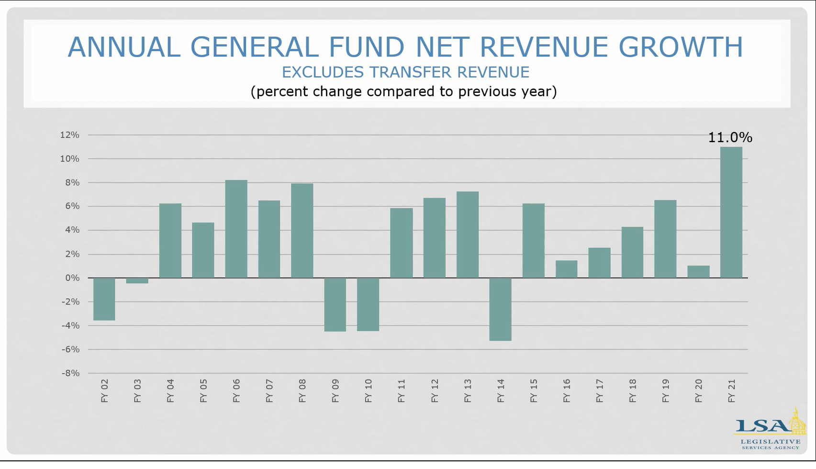
SSA rates:
4.0 4.0 4.0 4.0 4.0 2.0 0.0 2.0 2.0 4.0 1.25 2.25 1.11 1.0 2.06 2.3 2.4

Slide 10
SSA compared to State Revenue
Since FY 2016, state general fund revenue has grown by about $1,990 million ($1.99 Billion).
Since FY 2016, SSA state appropriations have grown by $449.9 million, or 23% of total revenue growth (well below the metric of Education funding at 40% of the state general fund budget.)
By FY 2023, the state pick up of the formula that would otherwise increase property taxes has grown to $86.6 million. (State dollar instead of property tax dollar for education). So of that $449.9 million, about one fifth of it is property tax relief, not additional dollars for students.
Gov. Reynolds and Republican leaders have publicly stated that the surplus positions Iowa for significant income tax cuts, despite the Oct. 18 REC estimate of 1.5% revenue growth in FY 2022 and FY 2023.

Slide 11
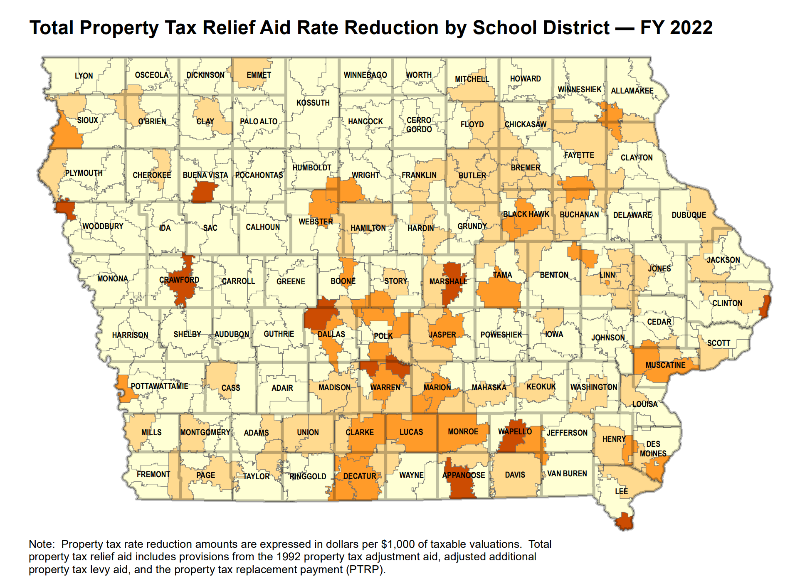
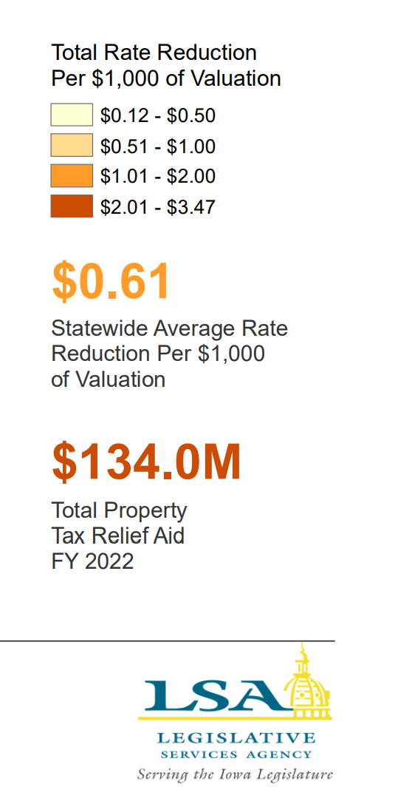
https://www.legis.iowa.gov/docs/publications/MOW/1230723.pdf

Slide 12
Resource Needs:
Adequate increase in SSA to fund:
  Inflation (costs go up). Arbitration ceiling will be 3%, but CPI-U calculation on PERB Website for arbitrations in January 2022 shows inflation at 5.9%.
  Continued programs and new expectations: computer science, dyslexia training, school safety and emergency plans, internships and college-level coursework
  Educators to teach and lead our schools; adequate salaries, benefits, training and ongoing support
  Bus drivers and support staff (paras, food service, custodians, secretaries)
  Course supports: science lab materials, career and technical education costs, fees to community colleges or other school districts for shared courses and content, music/art/drama opportunities for students
  Student needs: offset fees waived, provide instructional materials (online and at school), social workers and mental health supports, translators and ELL instructional materials and supports, behavior supports all the way up to therapeutic classrooms and mental health placements, talented and gifted content, library materials and technology
  Extra- and co-curriculars: not just the heart of the community, but in many cases where students find their passion and learn to set goals and work collaboratively with others. Connect to peers and caring adults.
  ______________________________________________________________
  ______________________________________________________________

Slide 13
Question of the day:
How many of our RSAI priorities would fall off the list if schools had been adequately funded in the past or were adequately funded going forward?

Slide 14

Student Mental Health

Slide 15

Action Comments
SF 2360 in 2020 Classroom Management/Therapeutic Classrooms mirrors federal law in Least Restrictive Environment and sets up a grant process for additional therapeutic classrooms. Funding of $2.1 million to implement these classrooms was included in HF 868 Education Appropriations. RSAI supported this bill and subsequent appropriation.
Funding to AEAs for mental health training and student supports and services was increased to $3.2 million, also included in HF 868. Of that, $83,936 goes to DE to collaborate with a statewide nonprofit health care organization a children’s grief and loss rural pilot program. The program is to submit a report about expenditures and outcomes by Sept. 30, 2022. RSAI supported this provision.
SF 619 Tax Omnibus included policy language requiring parity for insurance payments for telehealth services and state funds to reduce property taxes which currently fund Iowa’s mental health system. RSAI supported this provision, although registered opposed to the bill that provided significant tax relief which will challenge the ability of future legislatures to adequately fund public schools.
HF 868 Education Appropriations also included policy language for mental health professionals with a statement of professional recognition from the Board of Education Examiners (BOEE) to qualify for Operational Sharing Incentives. RSAI supported this provision.
SF 2360 was an RSAI priority in 2020 and is a good structural start. Helps to overcome geographic issues of services, but there’s still a shortage of MH professionals and gaps for those without insurance or Medicaid coverage. Although previously delayed funding is now in place, it’s just a pilot project. Many districts have students with extreme behavior needs and no place to serve them.
AEA training is a good start, but it’s not a one-time thing. Must be ongoing. This is the third year.
Parity for insurance coverage of MH services and telehealth in SF 619 were both good policy for Iowa, if there are enough providers.
New MH position for Operational Sharing, however, lowering the weighting for all positions (except sups) wasn’t helpful as many districts are already at the 21 student cap.

Slide 16

Educator Shortage and Quality Instruction
HF 2627 Licensure Reciprocity (2020 Session). Reciprocity w/states for teachers, admin, and other licensed staff with 1 year experience.
SF 466 Occupational Therapists: this bill expands the list of providers which are allowed to provide concussion services for extracurricular events.
SF 532 Licensed Behavior Therapists and Mental Health Professionals: this bill requires the BOEE to create a Statement of Professional Recognition for these positions.
HF 675 Substitute Authorization: this bill carries forward pandemic flexibility from the public health emergency declarations, allowing AA degree for subs or 60 hours of post-secondary credit. Has a process to extend the 10-day assignment to one classroom under certain circumstances.
HF 770 Professional Development CEU’s: this bill allows specified PD to count for ½ of required continuing education units (CEUs,) required for licensure renewal. The BOEE is required to allow either work on individual PD plan or courses offered by BOEE approved provider (AEAs, MISIC, etc.) to count for this credit.
RSAI supported all of these bills.

Slide 17
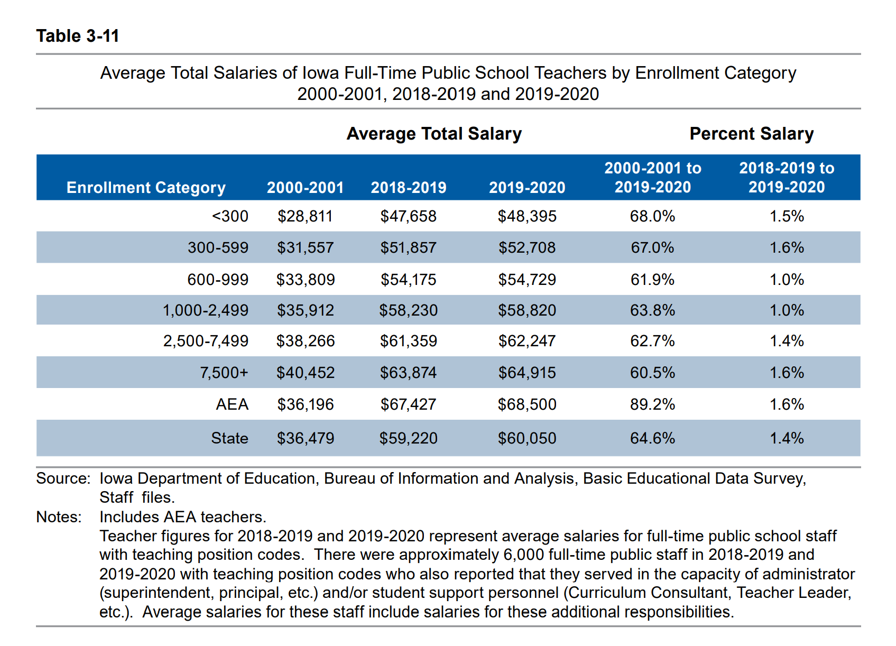
DE’s Annual Condition of Education Report shows average salary by school size (which is a good but not perfect predictor of rural districts), showing a growing difference in pay between the averages of the smallest and largest category of school size, now at $16,520, and more than $11,000 below the state average.
Rural schools tend to have younger teachers and lower class sizes, both of which can contribute to lower pay.

Slide 18
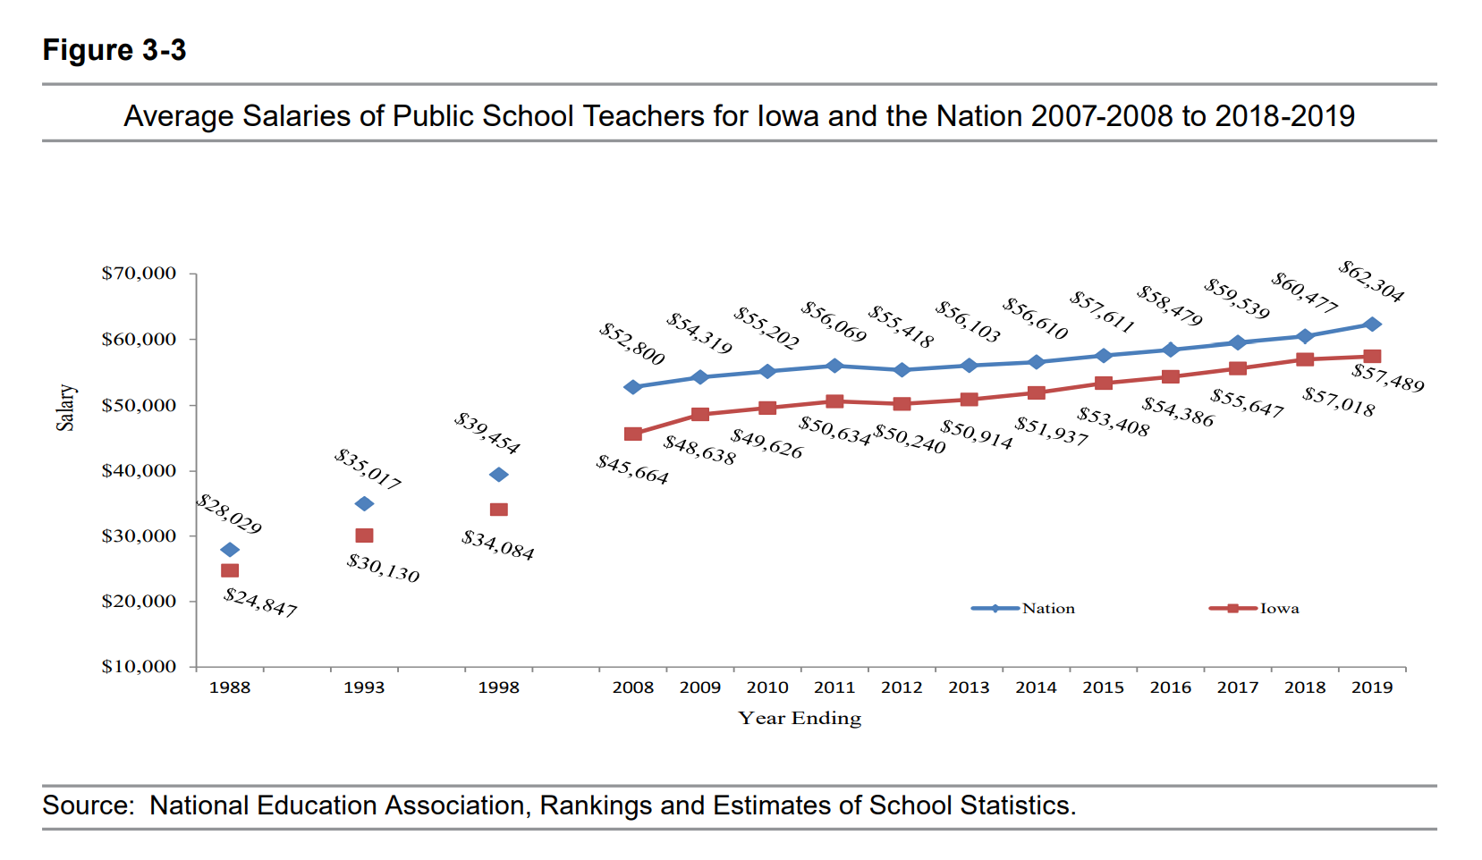
DE Annual Condition of Education 2020
Gap between Iowa Average Teacher Salary and the National Average in 2019 is $4,815 (in 1988, the gap was $3,182). With significant teacher shortages across the nation, beginning teacher pay is also a critical comparison.

Slide 19
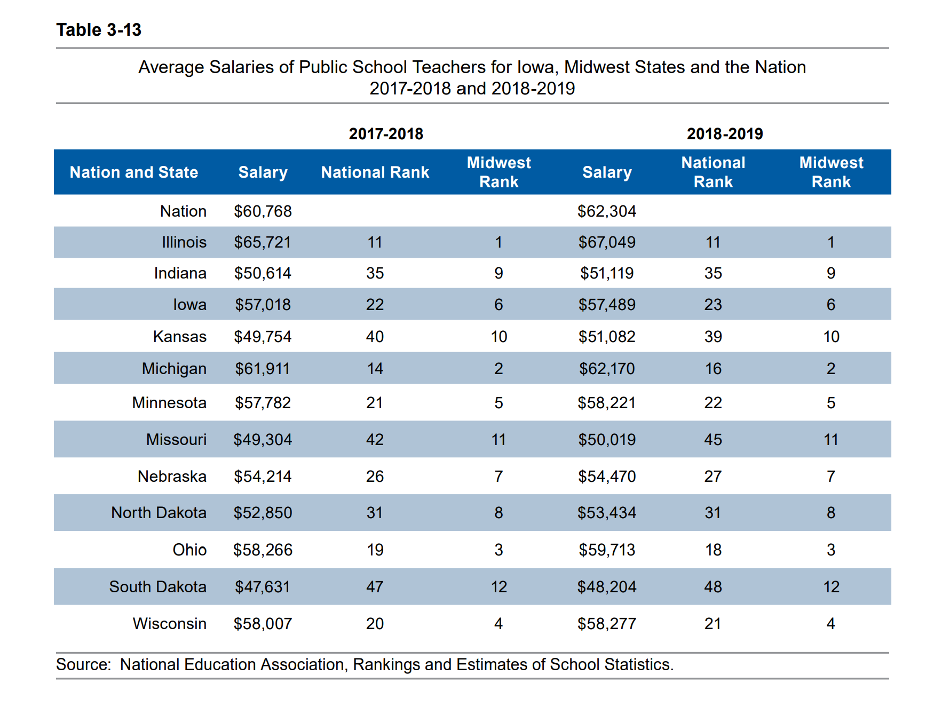
DE Annual Condition of Education 2020

Slide 20
Educator Shortages
Money isn’t everything, but competitive salaries are important
Culture and climate of the school district, adequate support and good leadership also matter to teacher retention
Iowa’s Teacher Leadership and Compensation is improving retention of teachers in Iowa schools* (see your own goals for retention in your TLC plan) *Reported prior to COVID-19 pandemic.
For young teachers, student loan debt requires a sufficient salary to make payments. Young teachers are also attracted to communities with amenities.
There’s a shortage if your school experiences either 1) not enough applicants and/or 2) no qualified applicants

Slide 21
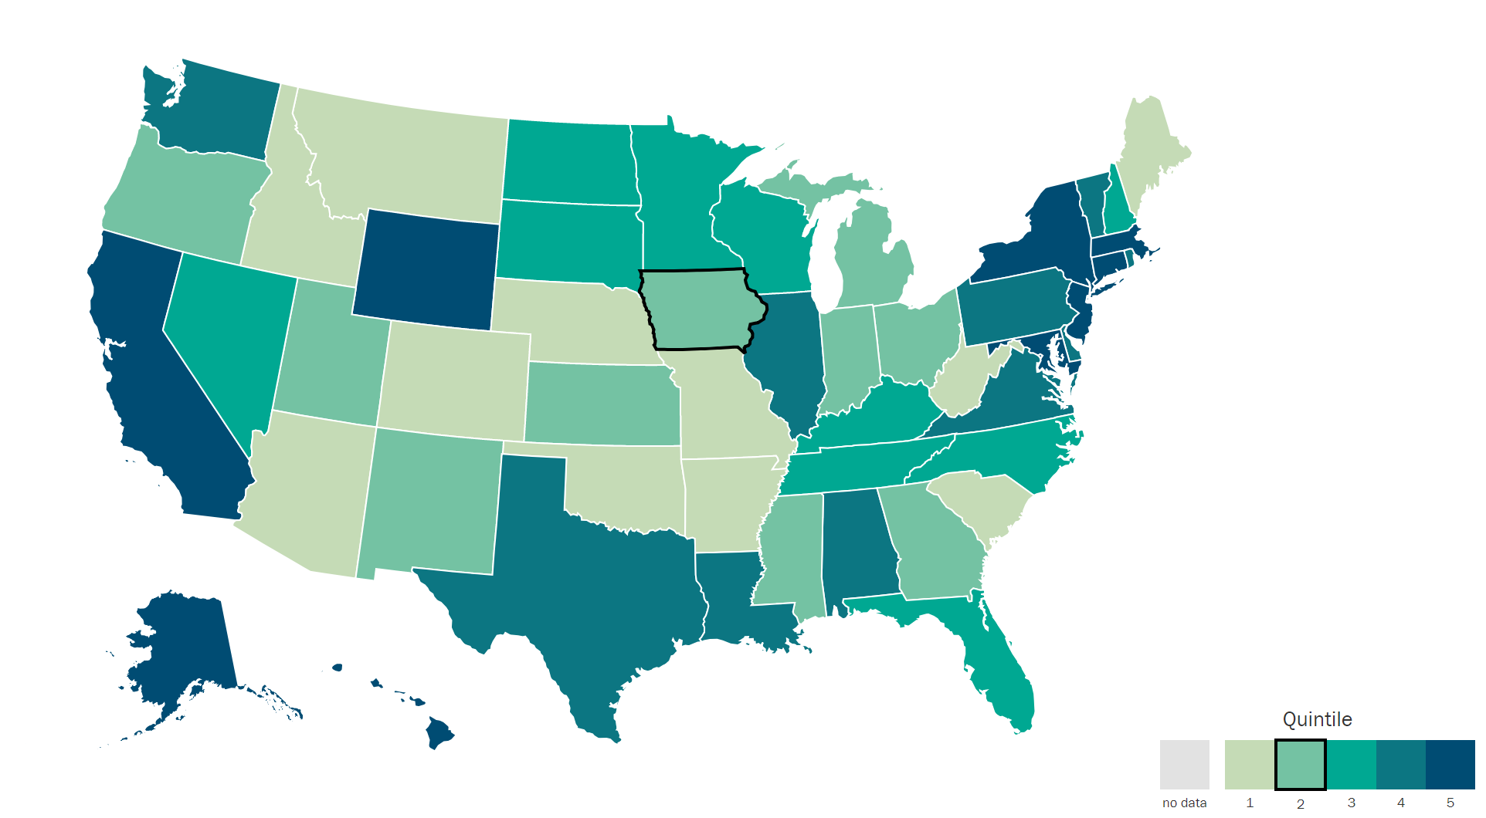
Understanding Teacher Shortages: 2018 Update
A State-by-State Analysis of the Factors Influencing Teacher Supply, Demand, and Equity https://learningpolicyinstitute.org/product/understanding-teacher-shortages-interactive
IL | $38,820
ND | $38,032
MN | $37,644
SD | $37,419
WI | $36,983
IA | $35,766
KS | $34,883
MO | $31,842
IA 6 out of 8 in Midwest.
IA is in the second to lowest quintile, ranking 30th in starting teacher pay.

Slide 22
Promising Practices
Indiana AA degree at High School Graduation, 2 years of University, articulated community college credits, plus support to attract diverse and talented high school students into teaching
Western Governor’s University, online program for Iowans in full time jobs, wanting to complete degree and transition to teaching. Allows rural districts to support and recruit paras and others connected to community into teaching.
Others?? Let us know.

Slide 23
Opportunity Equity for At-risk Students/Poverty

Slide 24

Student Inequities and At-risk Needs
Despite the School Finance Interim Committee recommending and the House Education Committee approving a bill, HF 2490, the study of the impact of poverty on education and funding formula options to meet the needs of students did not advance out of House Appropriations Committee in 2020 and no bills were prosed in 2021.
A bill also approved in the House Education Committee in 2020, HF 2497, would have allowed SBRC to grant spending authority up to 5% for Dropout Prevention (DoP), but died in the House Appropriations Committee and nothing further was discussed in 2021.
HF 847 School Choice and Flexibility, increased the threshold for low-income students below 200% of FPL for transportation assistance to open enrolled district. District of residence is responsible for transportation and deducts from tuition paid to receiving district.
COVID-19 negatively impacted low-income students, with greater literacy learning loss and math too (national level – your local mileage may vary.) Lower income families were more likely to have employment and education interruptions.
FYI: Children from families with incomes at or below 130% of the poverty level are eligible for free lunch those 130-185% eligible for reduced lunch.

Slide 25
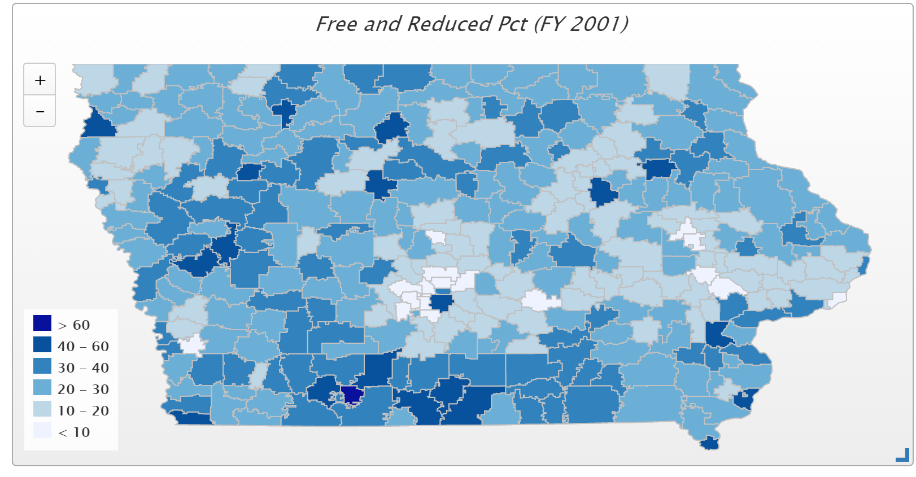
In 2001, only 4 districts had more than 50% of students eligible for FRPL (Waterloo, Keokuk, Wayne and Diagonal. Diagonal was the state high at 60.2% and the only district above 60%)

Slide 26
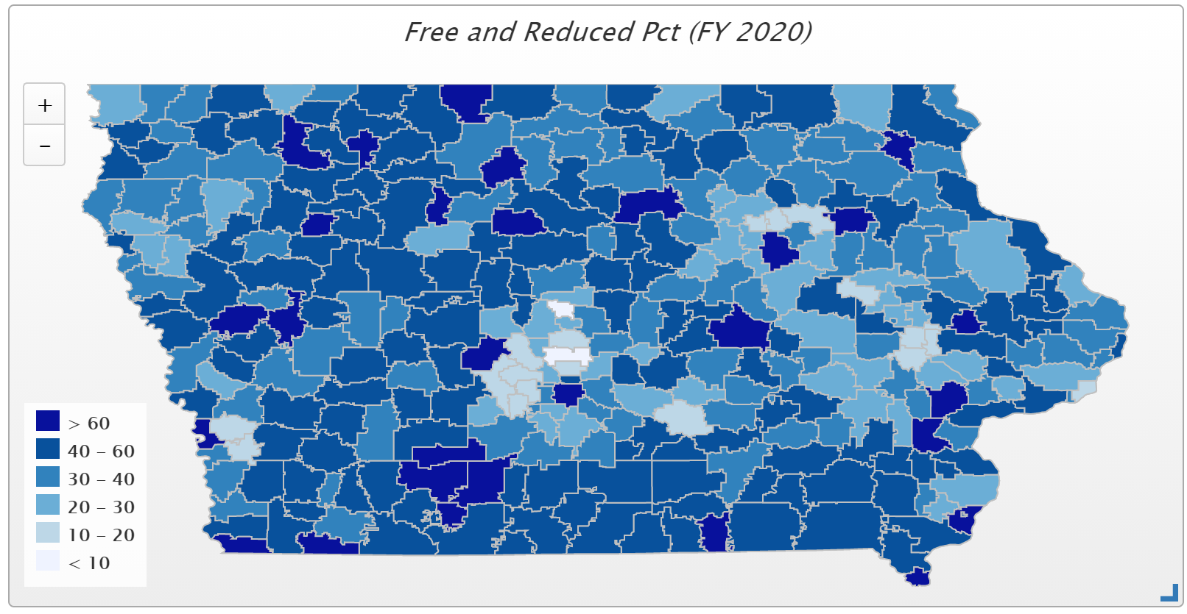
In FY 2021, 79 districts have more than half of their student on FRPL, and 31 districts have more than 60% of students eligible for FRPL. Those 14 districts above 70% include Council Bluffs, Sioux City, South Page, Hamburg, Storm Lake, Clay Central-Everly, Denison, Marshalltown, Waterloo, Des Moines, Lu Verne, Rock Valley, Postville, and Stratford.
Nine of the districts with more than 70% are rural.

Slide 27
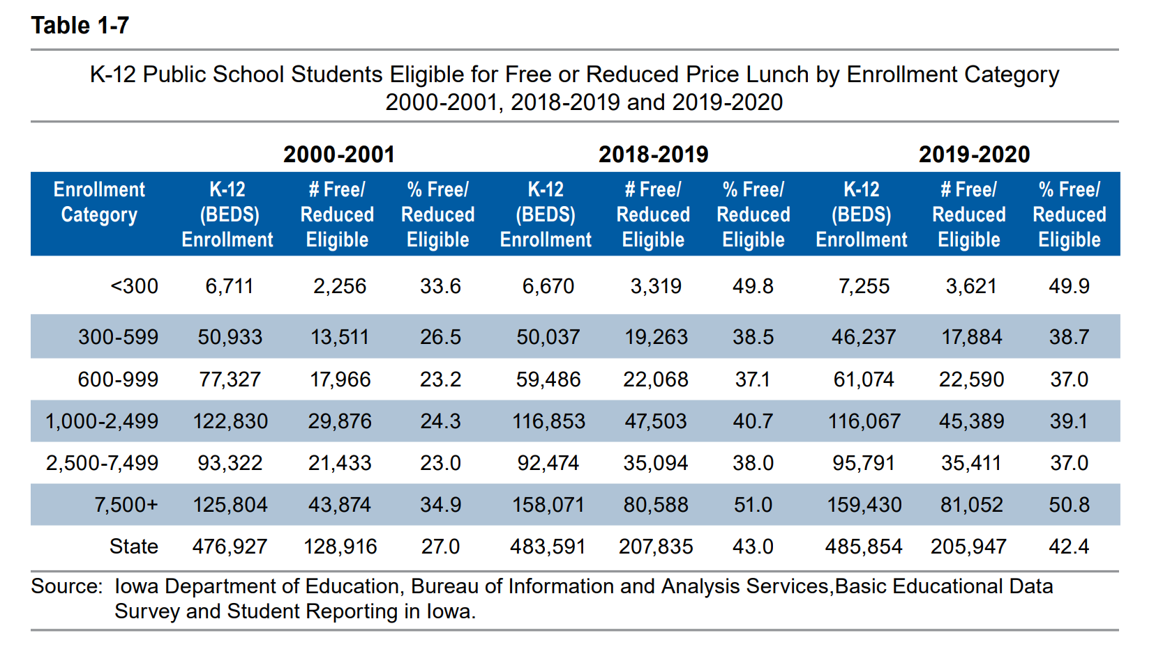
Districts in the largest and smallest enrollment categories had the highest percentage of students eligible for free or reduced price lunch
(DE Condition of Education Report 2020 Table 1-7).

Slide 28
COVID-19 Crinkles
Significant federal funding followed Title I distribution formula, based on census tract poverty.
20% of ESSER III/ARP is required to be spent on learning recovery.
Current Title I budget proposals in Washington show at least $16B increase compared to FY 2021. (Iowa is typically 1% of federal allocations, so $160 million estimated increase)
Advocacy challenge: invest these funds wisely in districts with high poverty to demonstrate results. Keep legislators apprised of your instructional progress in closing the gap and improving outcomes.

Slide 29
Sharing Incentives Extension
HF 847 Flexibility/Education Provisions added a work-based learning coordinator and a special education director position for operational sharing at 3 student weighting each. RSAI supported these provision.
HF 868 Education Appropriations added a mental health professional who holds SPR issued by the BOEE as an allowable operational sharing position at 3.0 student weighting. RSAI supported this provision by was registered as undecided on the bill which did many other things, too.
HF 847 also lowered all 3-student weighted positions to 2 and all 5 student-weighted positions to 4, for the remaining three years of the program (FY 2022-24), which first impacts school budgets in the 2022-23 school year.
SF 156 would add an information technology position to operational sharing and SF 74 would add a School Resources Officer position, both died in Senate Committees.
RSAI has concerns about lowering the weightings and supported these two bills which remained in committees at the close of the 2021 Session.

Slide 30
Sharing Incentives Extension
Timeline and Impact
  2018: Extension of Operational Sharing Incentives through budget year beginning July 1, 2024 (BEDS enrollment count Oct. 1, 2023)
  2019: Extension of WGS and Reorganization Incentives for reorgs effective no later than July 1, 2024
  Incentives provide an impetus for districts to work together to deliver greater educational opportunities for students through WGS, either one-way, which 43 districts used in the 2019-20 school year or with two-way agreements, which 14 districts used. Three districts that previously participated in whole grade sharing were reorganized effective July 1, 2019, lowering the total number of school districts in Iowa to 327.
  In the FY 2022 school year, a total weighting equivalent to 4,051 students, or $29.3 million, was generated through operational sharing for 264 school districts. 115 school districts generated the maximum of 21 student weighting. Six of Iowa’s AEAs also generated operational sharing weighting in the FY 2022 school year.

Slide 31
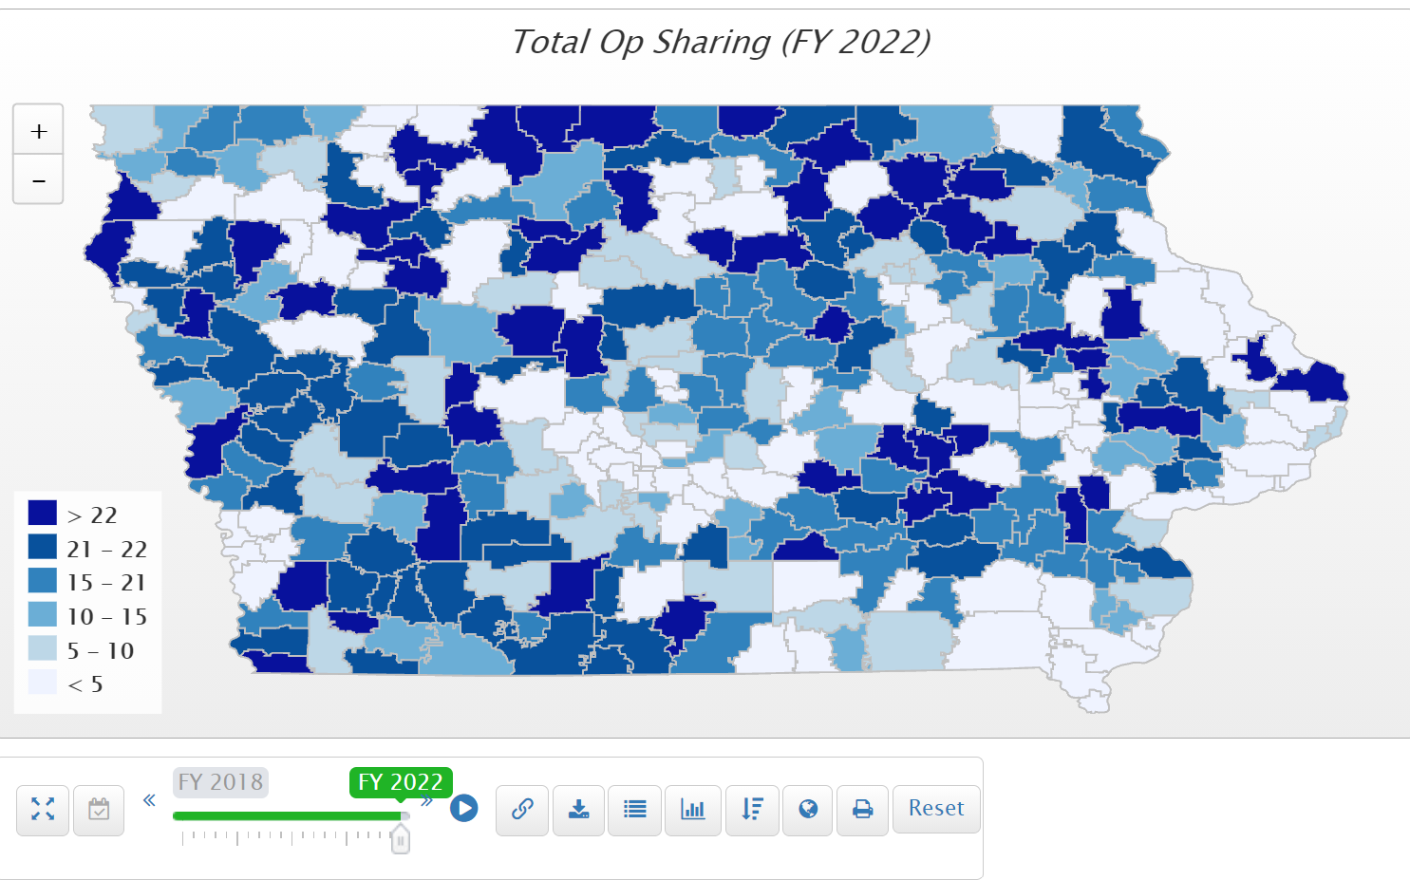
264 districts receive operational sharing incentives in the 2021-22 fiscal year (an increase of 29 districts). $29.3 million total (increase of $3.6 million).

Slide 32

Quality Preschool

Slide 33

Quality Preschool
HF 868 Education Appropriations allows districts with increased PK enrollment on Oct. 1, 2021 compared to Oct. 1, 2020 to apply to the SBRC for spending authority for the increased enrollment at the 0.5 PK weighting. Intention that GEERs federal funding will over the costs of the spending authority, but Governor has not yet announced. If federal funds are insufficient to cover the demand, the SBRC is required to prorate the amount.
Note: PK enrollment fell in the Fall 2020. PK does not have an on-time funding component or budget guarantee. DE guidance prohibits school districts from using general fund for PK expansion. Federal ESSER or ARP funds could be used for PK if funding from HF 868 process is not sufficient.
HF 318 would have allowed districts to serve and count young 5-year-olds in PK, was approved by the full House, Senate Education Committee and Senate Appropriations Committee, but died on the Senate Calendar. This bill remains alive for consideration in the 2021 Session. RSAI supports this bill.
No bills moved forward to increase the weighting to 1.0 or provide poverty factor weighting for lower income preschoolers.

Slide 34
FY 2019 Budget Enrollment (normal year), PK has 3,818 fewer enrollees than 1st Grade
Typical years FY 19 and FY 20 had comparison of 3,818 and 4,426 fewer PK students than 1st grade students, respectively. FY 2021 Budget Enrollment (COVID year), PK has 7,856 fewer enrollees than 1st Grade.

Slide 35
Why does PK matter?
Why does preschool matter? The Perry Preschool Project, 40 years later, documents $17 savings for every dollar invested (earlier findings of $8 saved for every dollar invested are also often cited). Once considered a strategy just to support working parents with child care needs, the majority of states now view access to high-quality PK programs as a critical long-term economic investment in the future workforce. Education Commission of the States, http://www.ecs.org/docs/early-learning-primer.pdf Oct. 2014: Six rigorous long term evaluation studies have found that children who participated in high-quality preschool programs were:
    25% less likely to drop out of school.
    40% less likely to become a teen parent.
    50% less likely to be placed in special education.
    60% less likely to never attend college.
    70% less likely to be arrested for a violent crime.
Sarah Daily, Initiatives from Preschool to Third Grade: A Policymaker’s Guide, shows reductions in costly outcomes that quality preschool prevents. (Denver, CO: Education Commission of the States, October 2014) http://www.ecs.org/docs/early-learning-primer.pdf. The National Conference of State Legislatures quotes studies on long term return on investment. http://www.ncsl.org/research/human-services/new-research-early-education-as-economic-investme.aspx

Slide 36
School Safety
Several bills were proposed regarding safety at school, but no action made it to the Governor’s desk.
SF 74 would have added a School Resource Officer position to operational sharing, but did not advance out of the Senate Education Committee.
SF 258, which would have allowed an increase in Instructional Support Levy (ISL) funding for the costs of a School Resource Officer (SRO) position, was approved by Senate Education Committee, but did not move forward out of the Ways and Means Committee. RSAI was registered in support of these two bills.
Identical “Safe and Sound at School” bills, authored by Iowa Department of Public Safety, were introduced in both chambers SSB 1070 and HF 585. These proposals would have set up a 24-hour anonymous hotline for tips, managed by the DPS, but would have created some expectations for schools to monitor and address complaints without any additional funding. RSAI opposed SSB 1070 and HF 585.

Slide 37
Bonding Capacity/Simple Majority
SF 568 Elections Omnibus: this bill originally required entities requesting the public measure on a special election date (not the school board election in November) to mail notifications to all households that include a registered voter eligible to vote on the public measure. The notification would have been required to include 1) Election date. 2) Hours during which the polls will be open. 3) Information on finding the voter’s polling place. 4) Internet site and telephone number of the county commissioner of elections. 5) Internet site of the State commissioner of elections.
RSAI was opposed to these provisions, which were removed from the bill in a late amendment in the process. No other legislation to address bonding capacity was advanced.

Slide 38
Internet Accessibility
HF 867 Administration and Regulation Appropriations included $100 million to the Empower Rural Iowa Broadband Grant Fund. Governor Reynolds signed HF 848 which creates a statutory framework for the grants, on April 28. Governor Reynolds made increasing upload and internet speeds in rural Iowa a priority for the session and asked for $150 million in funding for broadband grants in the first year, and $450 million over three years. On signing the bill, Governor Reynolds said:
“This bill provides a historic $100 million investment in broadband that will transform our infrastructure into a powerful network, enabling fast, high-quality connectivity statewide and opening doors to new opportunities for communities large and small. I want to thank the Legislature for their commitment to funding the broadband grant program and to the providers for their dedication to this initiative.”
RSAI supported the policy bill, HF 848, and the down-payment appropriation for it HF 867.
Announced Oct. 11: Gov. Reynolds and OCIO announced the awardees of the latest $100 million state-funded Empower Rural Iowa Broadband Grant Program. Due to the overwhelming need and interest in the program – OCIO received 178 applications requesting a total of $300 million – the State of Iowa is using $200 million in federal funds to build upon it.
This new grant program allows communications service providers, including telecommunication companies and local governments, to apply for up to 60 percent of their broadband project costs in eligible areas of the state. Questions about the opportunity may be submitted to the OCIO beginning on October 15, 2021. Applications may be submitted to the OCIO from October 25, 2021 through November 22, 2021.
Further information about the grant process for this funding opportunity is available on the OCIO website at https://ocio.iowa.gov/empower-rural-iowa-broadband-grant-program-notice-funding-availability-007

Slide 39
Remote Learning, Instructional Time, Local Control
Priority Action: The Governor’s interpretation and implementation of SF 2310 Return to Learn Plans from the 2020 Session inserted steps of state approval into the process of pandemic decision-making, after school districts had submitted their original RTL plans, which usurped local control. RSAI advocated for allowing school boards to make the best decision for their districts
SF 160 Instructional Time was signed by the Governor Jan. 29. This bill required schools to offer parents an option for 100% in-person learning beginning Feb. 15. The option for 100% virtual or hybrid less than 50% was still allowed by waiver from the DE due to COVID outbreak after Feb. 15 and additional metrics for the DE to consider a waiver included shortage of key staff (substitute teachers, bus drivers and food service workers). RSAI was registered as undecided on SF 160.
SF 467 On line Learning and Snow Days, was approved in the Senate but died the House Education Committee. The online learning flexibility provisions are moving forward with DE rulemaking. Note: There is no bill or statute requiring school districts to offer 100% virtual option to parents/students, which respects the local control of school districts to determine what is best for their communities. However, the authority for a local school board to allow up to five virtual learning days rather than make-up days at the end of the school year due to emergency or inclement weather did not move forward. This bill remains in the House Education Committee for consideration in the 2022 Session. RSAI supported SF 467.

Slide 40
Local School Board Authority
HF 847 Mandate Prohibiting Local Mask Mandates: an amendment on the final day of session to HF 847 included a last minute amendment prohibiting schools (and cities and counties) from requiring masks unless it was otherwise required by law. The amendment was filed to the bill on Wed., May 19, debated and approved in both the House and Senate, and the Governor signed the bill just after midnight. School leaders awoke on Thursday morning to changed law, confusion about CDC federal requirements on buses, and general disruption of processes that had been running smoothly. The process of amendment to signage in only a few hours does not respect the input of school leaders or local control decisions made to balance competing needs in communities and schools. RSAI opposed this provision but was registered as undecided on the bill.
HF 847 Education Flexibility Provisions: this bill included a new flexibility student and school support (FS3) program allowing school districts to define programs of innovation or targeted toward student needs, allowing waiver of regulations. The bill also expands the ability to transfer ending categorical fund balances for the flexibility account to include teacher leadership and compensation (TLC) ending balances. RSAI supported these provisions which expanded district flexibility for student centered programs, but was registered as undecided on the bill because we opposed other provisions such as significantly expanding STO’s and charter school amendments which didn’t go far enough.
HF 813 Charter Schools: RSAI opposed along with 37 other organizations. (In addition to Governor’s Office, 4 organizations were registered in support.) The bill allows an entity to charter a school without school board oversight and permission. Had charter regulations been eased, but the chartering entity remained as the local school board, we would have supported the bill. Charters in rural areas can be doubly problematic, drawing both students and staff away from local school district.

Slide 41
School Choice/Parent Choice
Tuition to private schools (vouchers), expanded open enrollment criteria (failure to meet academic needs of students), and new charter school law were all part of Gov. Reynolds School Choice proposal.
Expect these items to return.
Tax credits lower state revenue and when they encourage enrollment in private schools, reduce funding associated with enrollment count in public schools.
Fiscal Impact? Fiscal note to HF 847 shows the following:
Increases the STO limit by 33% to $20 million (reduces state GF revenue by $5 million)
Doubles the Tuition and Textbook Tax Credit, estimated reduction of state GF revenue by $11.1 million. However, new Fiscal Update Oct. 21, 2021 estimates $35 million increase.)
Reduces Operational Sharing Revenue by $2.5 million (due to weighting changes.)

Slide 42
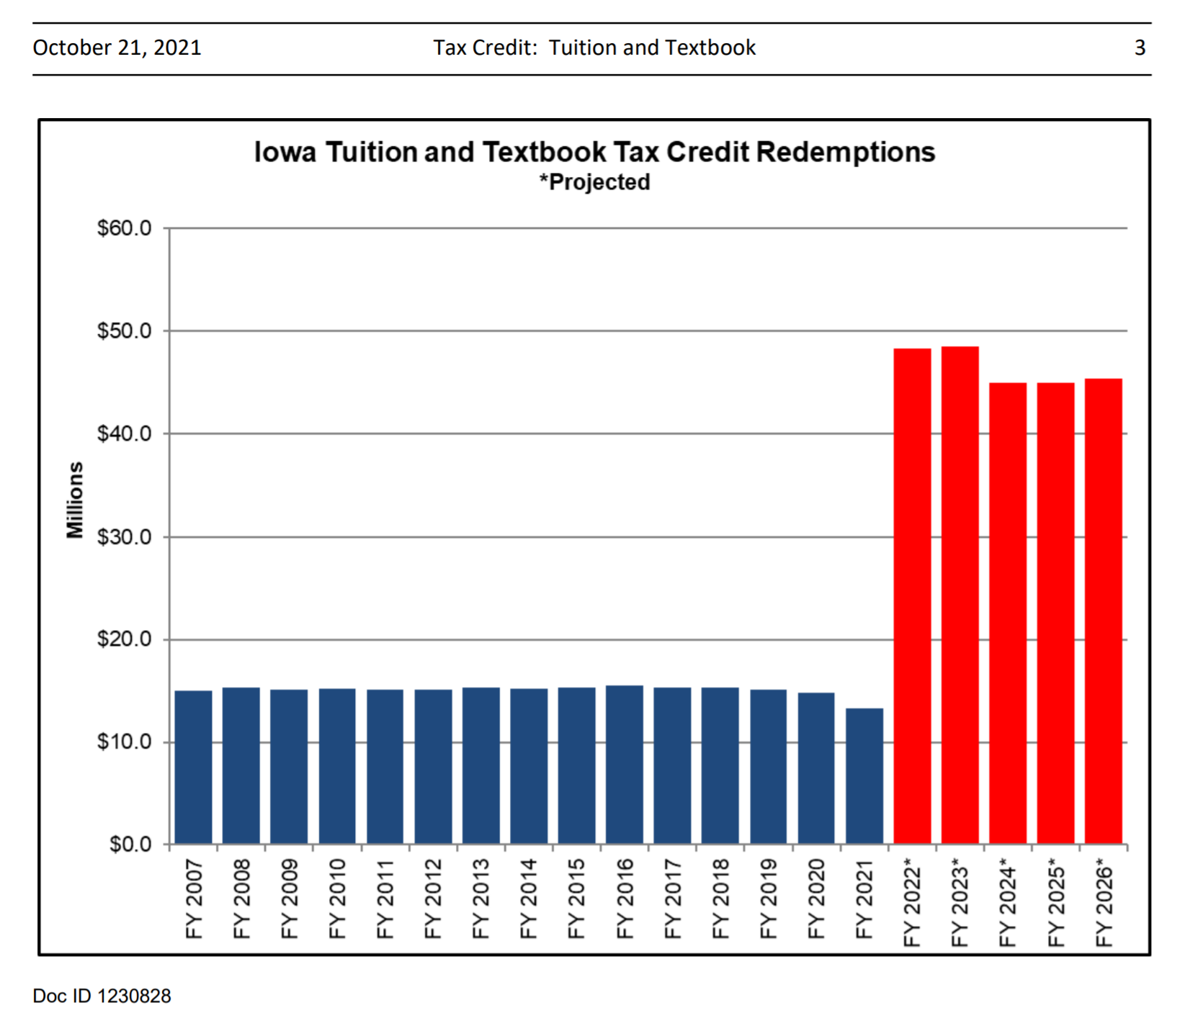
Department of Revenue (IDR) Tax Credit Brief providing information on the TTC for tax year 2016:
• 117,788 households claimed the credit, covering 219,779 dependents
• The average TTC claim per household was $130
• 8.2% of households claimed the maximum credit of $250 for that tax year
LSA Fiscal Topic Link:
https://www.legis.iowa.gov/docs/publications/FTNO/1230828.pdf

Slide 43
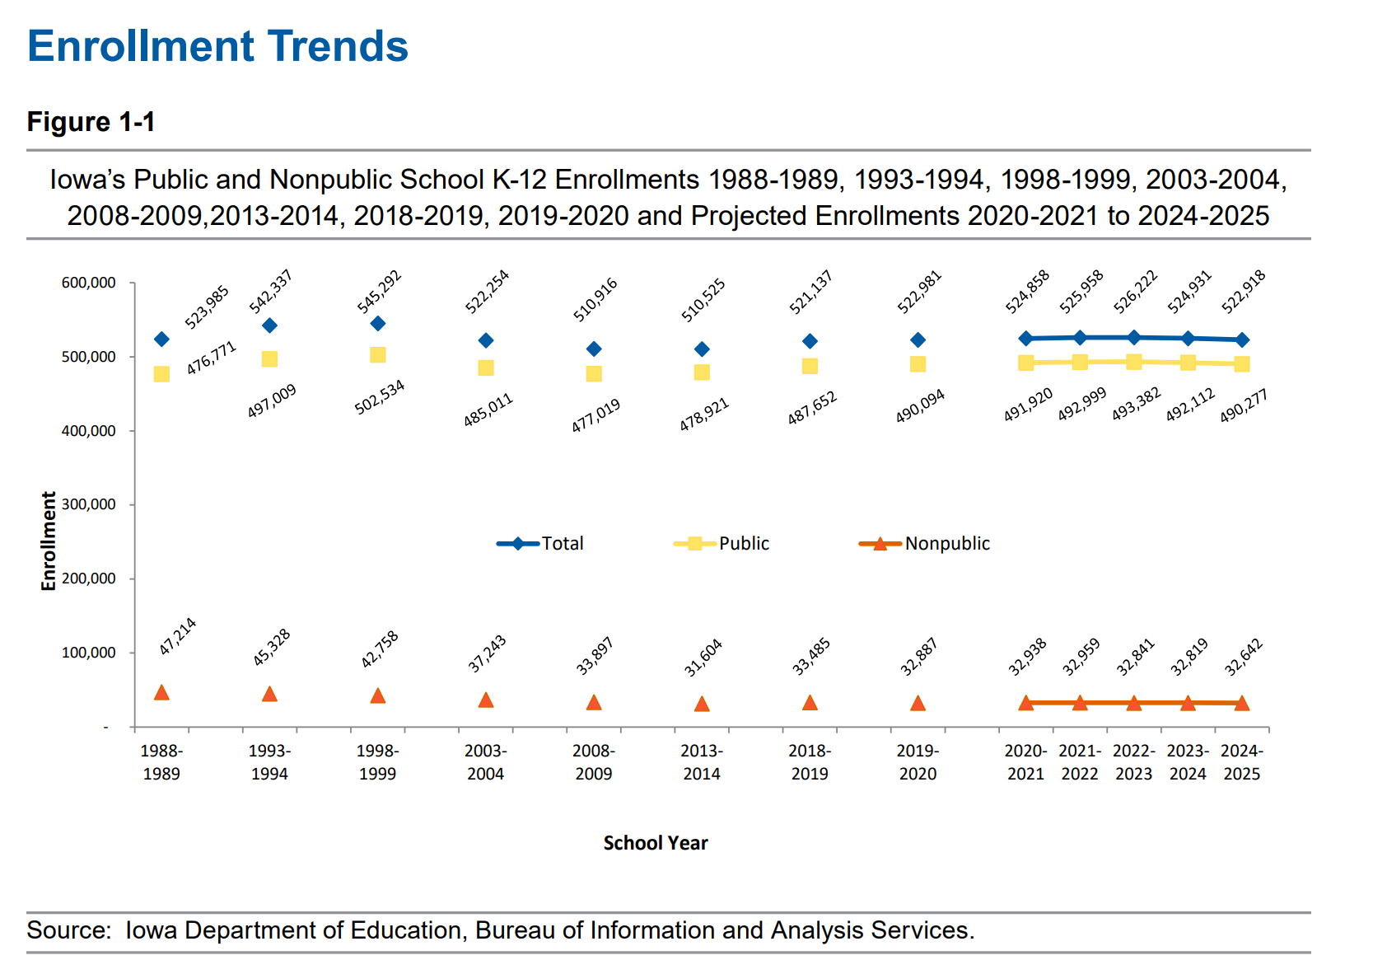

Slide 44
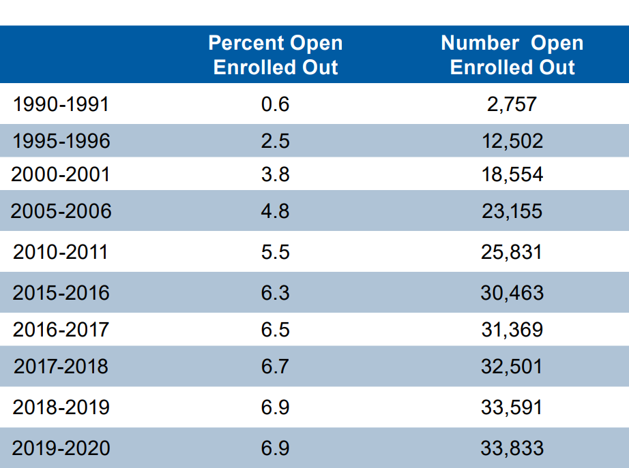
Table 1-5 DE Condition of Education Report 2020
Open Enrollment exceeds nonpublic enrollment beginning in 2018-19

Slide 45
RSAI Legislative Priorities
See the RSAI website meeting tab for more information such as RSAI Legislative Digest, Position Papers which will be updated after language is finalized at this meeting, Legislative Priorities, and this PPT on the annual meeting tab
http://www.rsaia.org/

Slide 46
Questions?

Slide 47
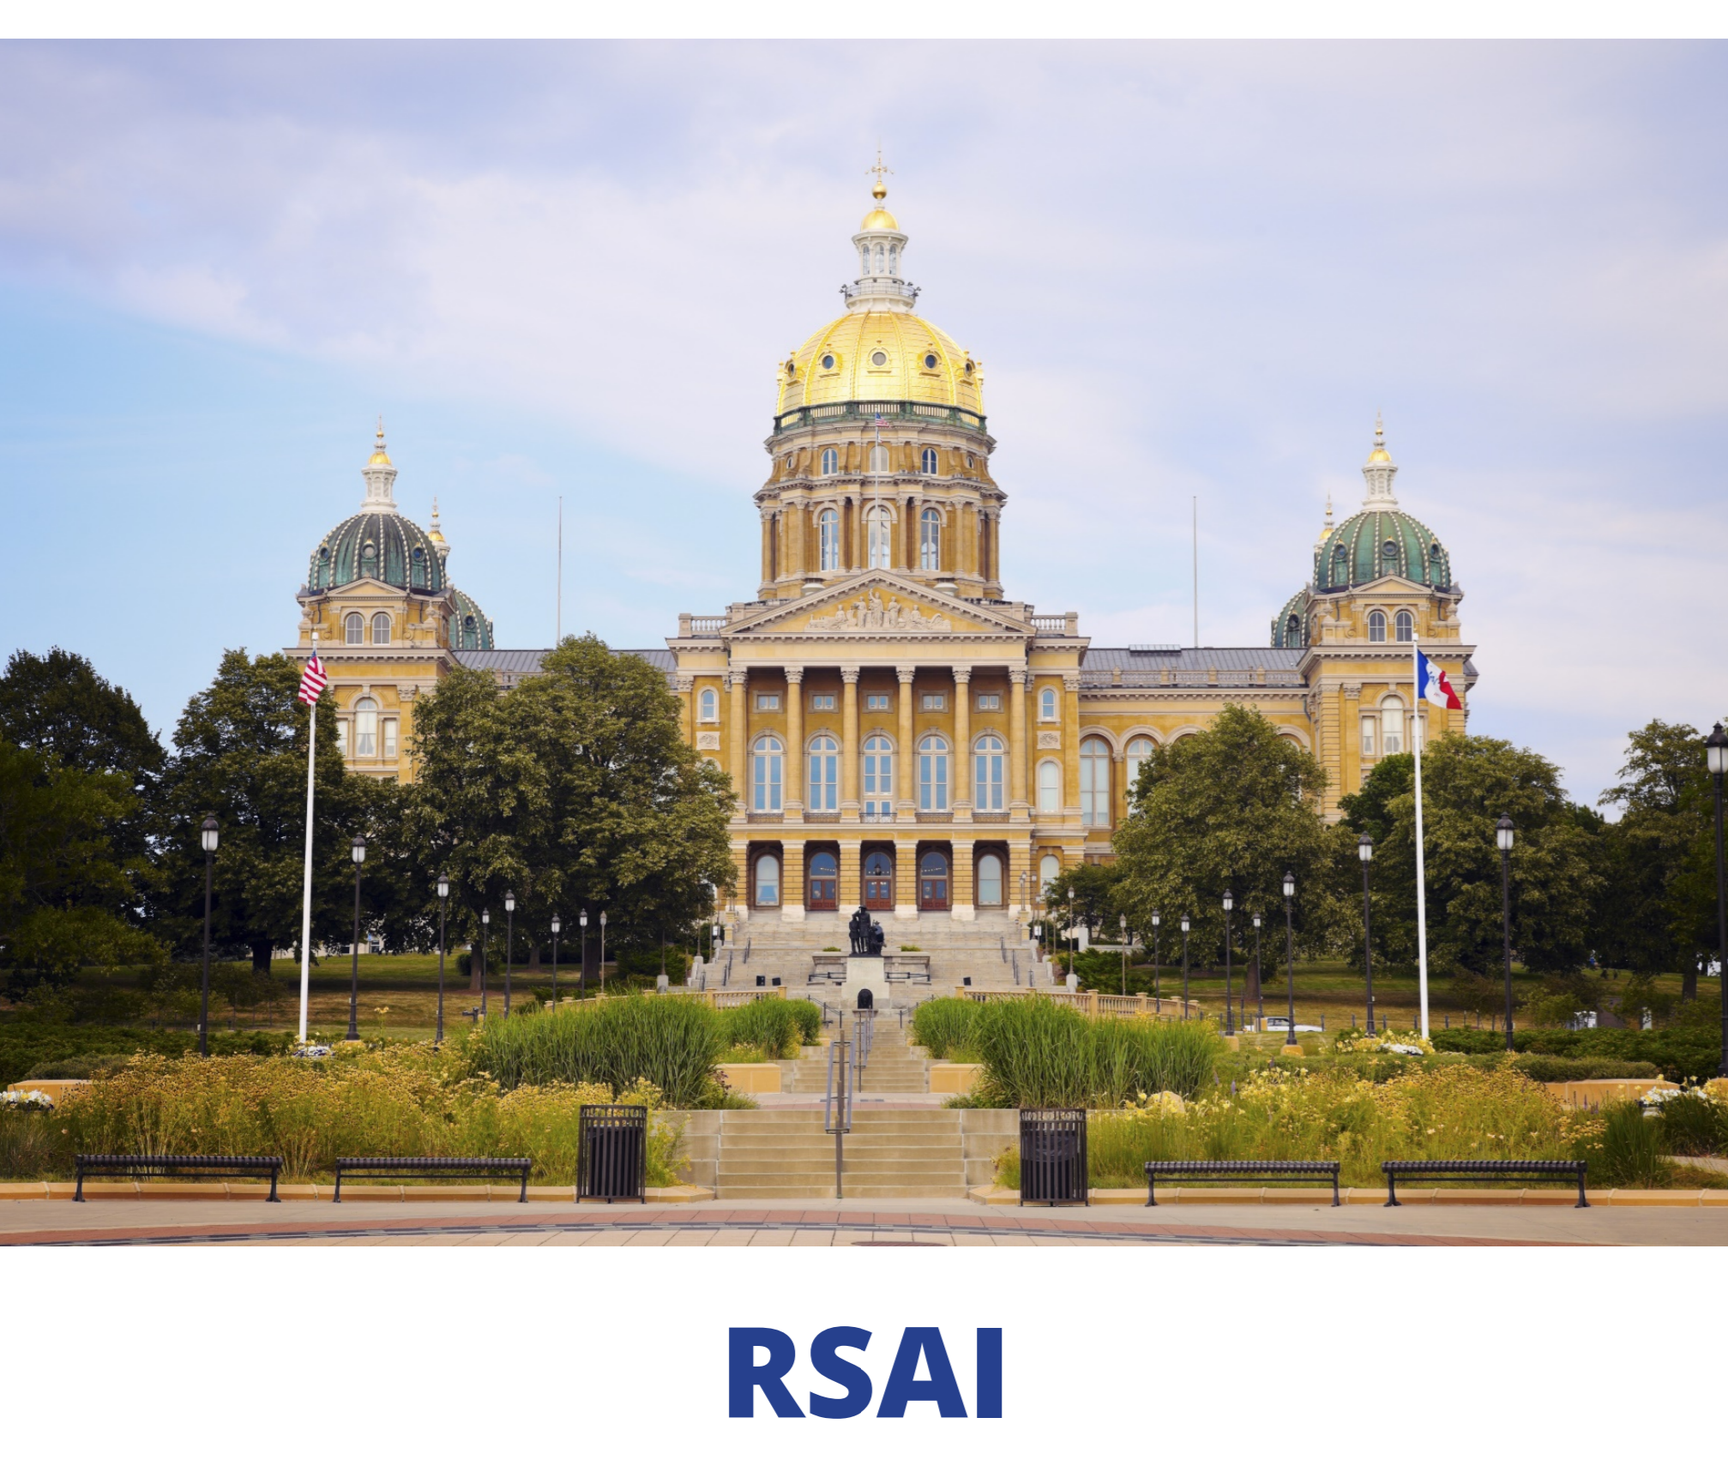
Advocacy Actions
See the RSAI Advocacy Handbook on Legislative Page of Website
https://www.rsaia.org/2021-legislative-session.html

Slide 48
Who else is at the party?
992 Registered Lobby Groups
Anti-tax organizations
Business groups
Farmers organizations
Unions
Utilities
Builders
Civil Liberties groups
Lawyers
Hospitals/Health Care
Law Enforcement
Cities and Counties
Colleges and Universities
Doves Hunters and PETA
Textbook Companies
Testing Companies
Environmental Groups
Insurance companies
Bus builders
Truckers
Religious groups
Nursing homes
Home schools/private schools
Media
Alcohol distributors
Gaming Institutions
Gun Owners
Gun Control Advocates

Slide 49
Is it worth it?
Joel Blackwell, the “Grassroots Guy”, says that so few people actually engage in the process, that those who do have disproportionate power.
If you can break through the social media noise and establish a good relationship, you can be one of those people.

Slide 50
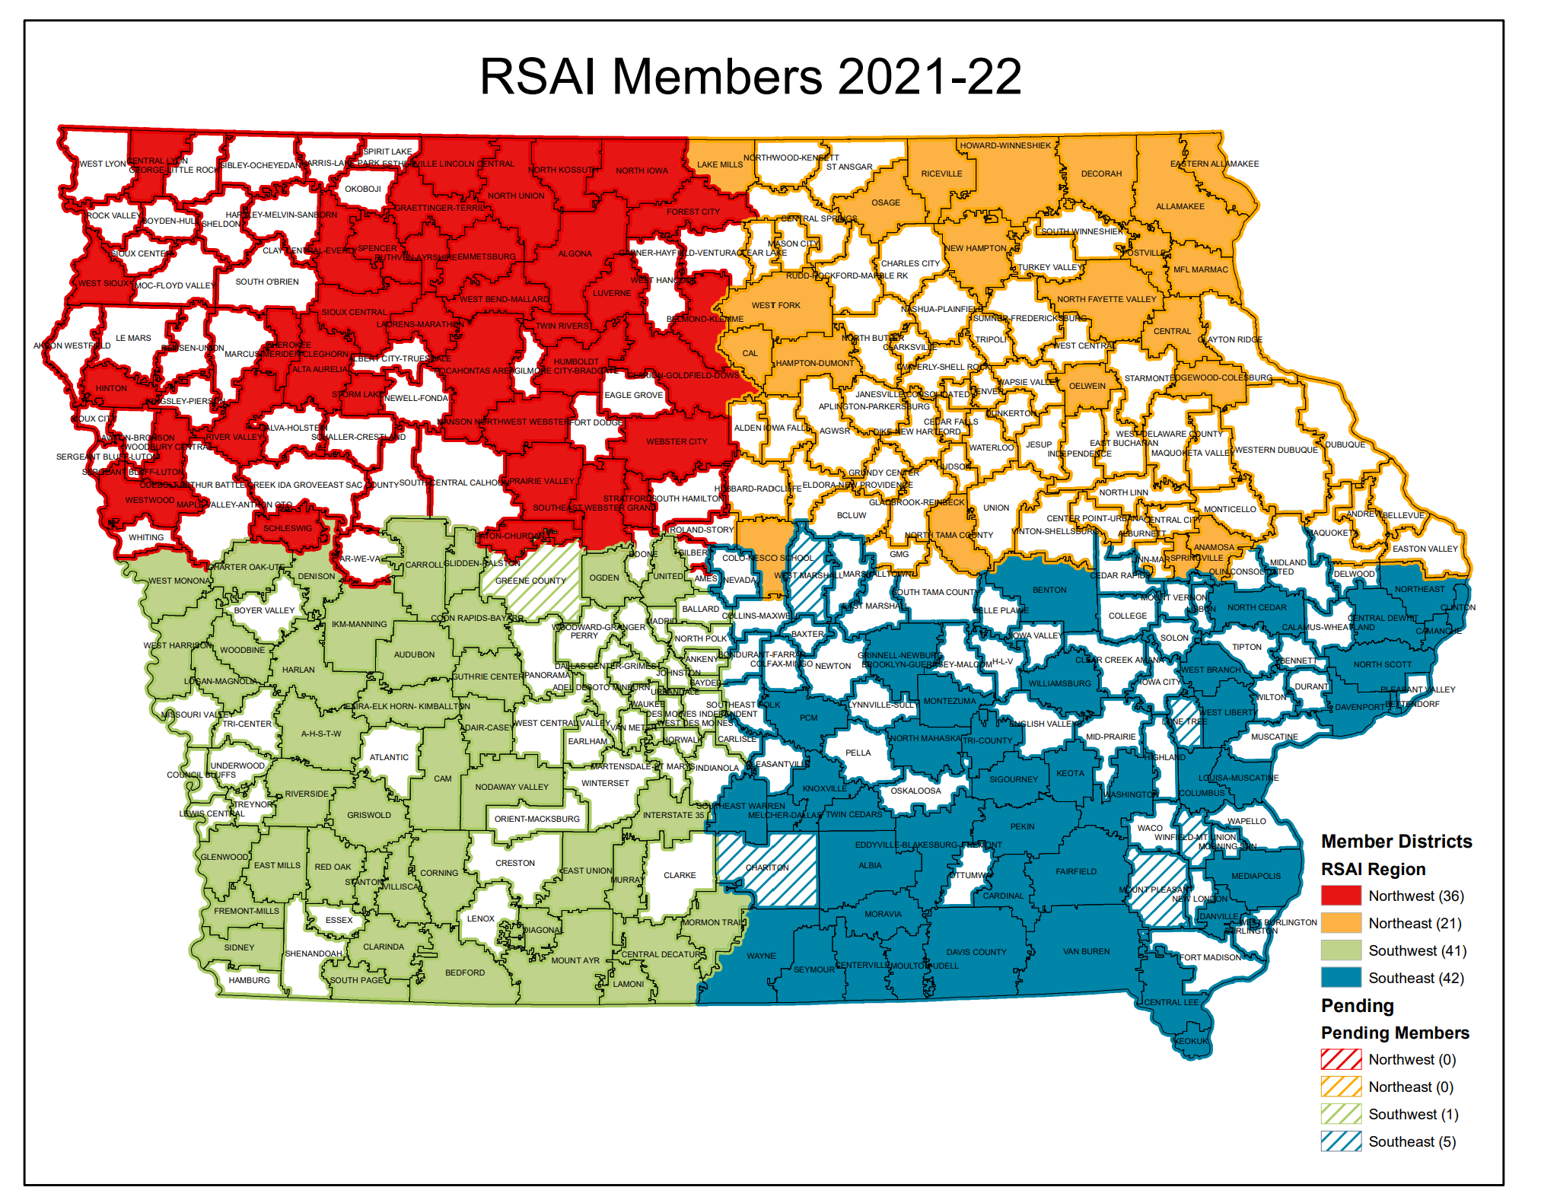
Strength in Numbers: Why join RSAI and recruit others to the effort?
Amplified advocacy
Value proposition
Shared experiences
Networking
Shared best practice

Slide 51



RSAI Annual Meeting Sponsors
Special thank you to the 2021 RSAI Annual Meeting Sponsors: Carl A. Nelson & Co., Boardworks, and SitelogIQ

Slide 52
First Steps
Send a note – include contact information and offer to be an informational resource (offer to review legislation for them, share impact of proposals on your district, staff, students or taxpayers, or just answer questions)
Share organizational priorities before the Session (caucuses set priorities for the Session typically in Nov/Dec, so don’t delay)
Find out what committees they are on – if education, local government, ways and means or appropriations are on that list, pay attention.
Get a meeting – zoom or coffee or DQ
  Introductions
  Exchange contact information
  Give them a position paper or two or ask about their priorities for education
  Learn something about them – where did they go to school? How about their children, or grandchildren? Anyone in their family ever teach or get elected to school board?

Slide 53
Next Steps: Create a coalition
Who could care?
Usual suspects: parents, teachers, board members, SIAC members.
Unusual suspects: Farm Bureau, Chamber of Commerce, Vendors, Taxpayer organization, city/county government, economic development, law enforcement (success examples include four-year-old preschool and the state penny)
Infiltrate and educate.
Find one or two persuasive voices from those groups
Be thinking about encouraging future school board candidates from these groups – the old two birds with one stone concept

Slide 54
First Month of Session
Joint effort with other school leaders, with school boards or individually.
Go to their home-based forums (eggs and issues) during the Session. Take someone with you who can ask a question.
Reach out to us to get resources before you go and get some timely questions to ask or updated materials to share.
School funding is typically decided (or supposed to be) within 30 days of release of the Governor’s budget, so ask about that up front.
Share the impact of various proposals on your budget, your students, and your community.
Send a thank you note whenever you can – even if you don’t agree on the vote or outcome, let them know you appreciate their work to represent your district and constituents (you can even say, I hope you’ll be able to support our position in the future.)

Slide 55
Finding Core Values/Common Ground
As Americans, we have more in common, despite all claims to the contrary in the current political environment, than you might think.
“Public decisions involve choices and public choices always involve values.”
  Liberty: freedom, autonomy, choice, opportunity, individuality, privacy;
  Community: safety, security, belonging, social order, quality of life;
  Equality: fairness, justice, tolerance, diversity, equal treatment, equal opportunity; and
  Prosperity: productivity, efficiency, growth, markets.
        Phillip Boyle, Local School Board Governance, Spring 2004
Which of these core values is critical in any particular policy choice?

Slide 56
Finding Core Values/Common Ground
Find out what is central to your legislators’ framework.
Tie your goals back to that central theme (translate your needs into their language)
Example: Prosperity/growing the Iowa Economy
  Future Ready Workforce: private sector needs good employees. Students need good teachers to teach prepare students in these classrooms.
  Investments in PK save tax dollars down the road (prevention is worth a pound of cure or efficient use of tax dollars)
  Quality schools prepare a quality workforce (prepared graduates become tax contributors rather than tax eaters)
  Economic market factors – what does it take for a quality teaching workforce? Sufficient salaries and benefits to compete for human capital.

Slide 57
Ask us for help
Data from mapping tool to explain history
Talking points specific to your district
Edit letters to legislators or your local paper
Help thinking about replies to email or questions from legislators
Prep for lobby days or local conversations
Quick resources to share with your board members to prepare them for advocacy moments.
Sample Press Release – get the word out to your stakeholders and media about these issues of importance to your students and families.

Slide 58

Page 18-19 of the Annual Meeting Packet

Slide 59
THANK YOU FOR YOUR VOICE on behalf of Iowa students!
Margaret Buckton, ISFIS Partner, RSAI Professional Advocate, UEN Executive Director, margaret@iowaschoolfinance.com
1201 63rd Street, Des Moines, IA 50311 (515) 201-3755 cell
Dave Daughton,
RSAI Grassroots Advocate
dave.daughton@rsaia.org
(641) 344-5205 cell
Retired Wayne CSD Superintendent
Stay connected through the Interim and into the Legislative Session
Let us know what you need to beef up your advocacy efforts.

