Slide 1
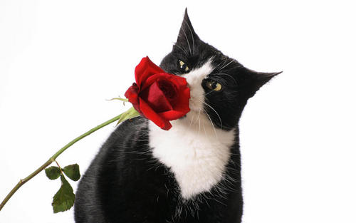
Alcohols, Penols, and Thiols

Slide 2
Basics
Widely found in nature
Ethanol—intoxicating part of wine, beer, spirits
2-phenylethanol—intoxicating smell of a rose
Cholesterol—needed, but dangerous in excess
Sucrose—table sugar

Slide 3
Basics

Slide 4
Basics
Alcohols R-OH
Phenols aromatic ring-OH
Thiols R-SH

Slide 5
Nomenclature of Alcohols
IUPAC name ends in “ol”
Common name ends with separate word “alcohol”
Unsaturated alcohols require two endings…one for unsaturated bond and one for alcohol…ROH takes precedence

Slide 6
Industrial Alcohols
Methanol
Wood alcohol…mostly used to make formaldehyde
CO + H₂ → CH₃OH
Blindness…converts to formaldehyde which prevents formation of rhodopsin
Ethanol
From black strap molasses (cane sugar)…grain alcohol
C₆H₁₂O₆ + H₂O → 4CH₃CH₂OH + 4CO₂
Proof is double the % alcohol
2-propanol
Rubbing alcohol…acid-catalyzed hydration of propene
ZnO—Cr₂O₃
400°C, 150 atm
yeast

Slide 7
Classification of Alcohols
Primary (1°)
R—CH₂OH
Secondary (2°)
R—CHOH
Tertiary (3°)
R—COH
R
R
R

Slide 8
Nomenclature of Phenols
Usually named as derivatives of the parent cpds
OH group named as substituent when with carboxylic acid, aldehyde, or ketone

Slide 9
Hydrogen Bonding in Alcohols and Phenols
ROH bp are much higher than similar MW ethers or HC’s
H-bonds form
H-bonds (20-40 kJ/mol) weaker than covalent bonds (480 kJ/mol) but still relatively strong
Since water has H-bonding, too, low MW ROH’s can replace H₂O molecules…complete miscibility
As organic chain lengthens, miscibility decreases

Slide 10
Acidity & Basicity
Brønsted-Lowry
Acid—reactant proton donor
Base—reactant proton acceptor
Conjugate Acid—product proton donor in reverse
Conjugate Base—product proton acceptor in reverse
K_{a}
pK_{a}
<K_{a}, >pK_{a}…weaker acid

Slide 11
Acidity & Basicity
Lewis
Acid—reactant electron pair acceptor
Base—reactant electron pair donor
Amphoteric

Slide 12
Acidity of Alcohols & Phenols
Weak acids…dissociate similar to that of water
Conjugate base is an alkoxide ion (methoxide from methanol, ethoxide from ethanol, etc.)
Phenol much stronger acid than alcohols due to resonance

Slide 13
pK_{a}’s of Selected Alcohols & Phenols
Name | Formula | pK_{a}
Water | HO—H | 15.7
Methanol | CH₃O—H | 15.5
Ethanol | CH₃CH₂O—H | 15.9
t-butyl alcohol | (CH₃)₃CO—H | 18
2,2,2-trifluoroethanol | CF₃CH₂O—H | 12.4
Phenol |  | 10.0
p-nitrophenol |  | 7.2

Slide 14
pK_{a}’s of Selected Alcohols & Phenols
2,2,2-trifluoroethanol is a much stronger acid than is ethanol
F is strongly EN
Each C-F is polarized
+ on C located near – on O…causes inductive effect that stabilizes ion

Slide 15
pK_{a}’s of Selected Alcohols & Phenols
All electron-withdrawing groups increase acidity be staiblizing the conjugate base.
Electron-donating groups decrease acidity because they destabilize the conjugate base.

Slide 16
Alkoxides
Conjugate bases to alcohols
Strong bases
Frequently used as strong bases in organic chemistry
Prepared by reacting alcohol with Na or K or metal hydride

Slide 17
Alkoxides
Treatment of alcohol with NaOH or KOH does not convert to alkoxide
Treatment of phenol with NaOH or KOH does convert to phenoxide

Slide 18
Basicity of Alcohols & Phenols
Function as weak bases, too
Have unshared electron pair on O…Lewis bases
Protonated by strong acids
1st step in dehydration to alkenes and conversion to alkyl halides
Product is analogous to oxonium, H₃O⁺

Slide 19
Dehydration of Alcohols to Alkenes
Heating with strong acid dehydrates alcohols
Reverse of hydration
Elimination rxn
Via E1 or E2 dependent on class of alcohol
3° via E1
1° via E2
Ease of dehydration is 3°> 2°> 1°, same as carbocation stability

Slide 20
Dehydration of Alcohols to Alkenes
Tertiary Alcohols via E1 Mechanism

Slide 21
Dehydration of Alcohols to Alkenes
Primary Alcohols via E2 Mechanism

Slide 22
Dehydration of Alcohols to Alkenes
Sometimes multiple alkenes can result
Alkene with the most alkyl groups on the doubly bonded C’s predominates

Slide 23
The Reaction of Alcohols with Hydrogen Halides
Substitution rxn gives alkyl halide
Rate and mechanism depend on classifcation
3° react the fastest
t-butyl alcohol reacts with HCl at RT to make t-butyl chloride by S_{N}1 mechanism
Same first two steps as dehydration
Third step is capture of carbocation by Cl

Slide 24
The Reaction of Alcohols with Hydrogen Halides
Tertiary Alcohols via E1 Mechanism

Slide 25
The Reaction of Alcohols with Hydrogen Halides
Primary alcohol like 1-butanol reacts slowly and must be heated for several hours with a mixture of HCl and a Lewis acid catalyst like ZnCl₂…occurs via S_{N}2

Slide 26
The Reaction of Alcohols with Hydrogen Halides
2° alcohols react at intermediate rates via both S_{N}1 and S_{N}2 mechanisms
Why does t-butyl alcohol react at equal rates with HI, HBr, and HCl?
Why does 1-butanol’s rate of reaction vary with HI, HBr, and HCl?

Slide 27
Oxidation of Alcohols to Aldehydes, Ketones & Carboxylic Acids
1° alcohols can be oxidized to aldehydes and then further oxidized to carboxylic acids
2° alcohols can be oxidized to ketones

Slide 28
Oxidation of Alcohols to Aldehydes, Ketones & Carboxylic Acids
Common oxidizing agent is chromic anhydride, CrO₃, dissolved in sulfuric acid…known as Jones Reagent
Acetone is solvent

Slide 29
Oxidation of Alcohols to Aldehydes, Ketones & Carboxylic Acids
1° alcohol can be stopped at the aldehyde stage with the addition of PCC (pyridinium chlorochromate)

Slide 30
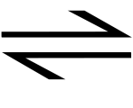
Oxidation of Alcohols to Aldehydes, Ketones & Carboxylic Acids
Enzymes accomplish oxidations similar to these together with a coenzyme: nicotinamide adenine dinucleotide (NAD⁺)
Oxidation occurs in the liver and is a key step in the body’s attempt to rid itself of alcohol
Resulting acetaldehyde is also toxic and is further oxidized to acetic acid and eventually to CO₂ and H₂O
CH₃CH₂OH + NAD⁺ CH₃CHO + NADH
alcohol
dehydrogenase

Slide 31
Biologically Important Alcohols & Phenols
4 metabolically important unsaturated primary alcohols
2 smaller are isoprene units that can combine to make the other 2 which are terpenes (10, 15, 20, or more C and formed by linking isoprenes
Geraniol—50% of rose oil
Farnesol—lily of the valley odor
2 farnesols combined leads to squalene
Squalene precursor to steroids

Slide 32
Biologically Important Alcohols & Phenols
Cholesterol is an important steroid stored in the livers of animals
27 carbons (loses 3 in the process of forming from squalene)
HO

Slide 33
Biologically Important Alcohols & Phenols
Phenols are less involved in metabolic processes than alcohols
3 phenolic alcohols form lignins (form woody parts of trees and shrubs along with cellulose)
coniferyl alcohol (R = OCH₃, R’ = H)
sinapyl alcohol (R = R’ = OCH₃)
p-coumaryl alcohol (R = R’ = H)

Slide 34
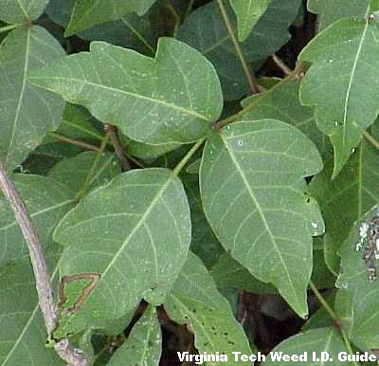
Biologically Important Alcohols & Phenols
Phenolic alcohols to be avoided are urushiols
Poison ivy and poison oak

Slide 35
Alcohols with More than One Hydroxyl Group
Cpds with 2 adjacent alcohol groups are called glycols
Ethylene glycol
Antifreeze
Raw material of Dacron
Glycerol
Syrupy, colorless, sweet
Shaving cream, cough drops
Triesters are fats and oils
Nitrated form is nitroglycerine
Sorbitol
Many hydroxyl groups
Sweet
Sugar substitute

Slide 36
Aromatic Substitution in Phenols
Phenols undergo electrophilic aromatic substitution under very mild conditions because the hydroxyl group is strongly ring activating
Nitration with dilute aqueous nitric acid
+ HONO₂ → + H₂O
Bromination with bromine in water
+ 3Br₂ → + 3HBr

Slide 37
Aromatic Substitution in Phenols
Write an equation for the reaction of p-methylphenol and HONO₂ (1 mole).

Slide 38
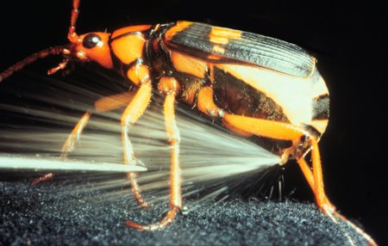
Oxidation of Phenols
1,4-dihydroxybenzene (hydroquinone ) is oxidized to 1,4-benzoquinone (quinone)
Bombardier beetle uses
quinones as a defense
mechanism
Na₂Cr₂O₇
H₂SO₄, 30°C

Slide 39
Phenols as Antioxidants
Substances sensitive to oxidation in air can be protected by phenolic additives because phenols are antioxidants
React with peroxy and hydroxy radicals to produce more stable phenoxy radical
BHA
Used in foods, especially meat products
BHT
Used in foods, animal feeds, vegetable oils, lubricating oils, synthetic rubber, various plastics

Slide 40
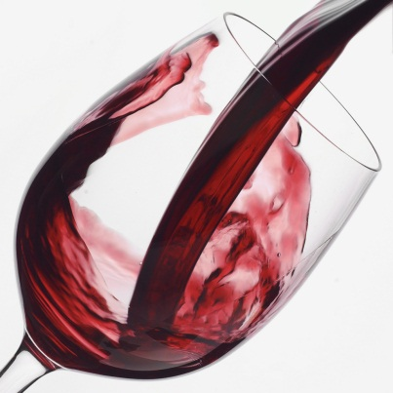
Phenols as Antioxidants
Vitamin E (α-tocopherol)
Natural phenolic antioxidant
Protects body against free radicals
Leafy veggies, egg yolks, legumes
Resveratrol
Natural phenolic antioxidant
Possible cancer chemopreventative agent
Peanuts, grapes, wine

Slide 41
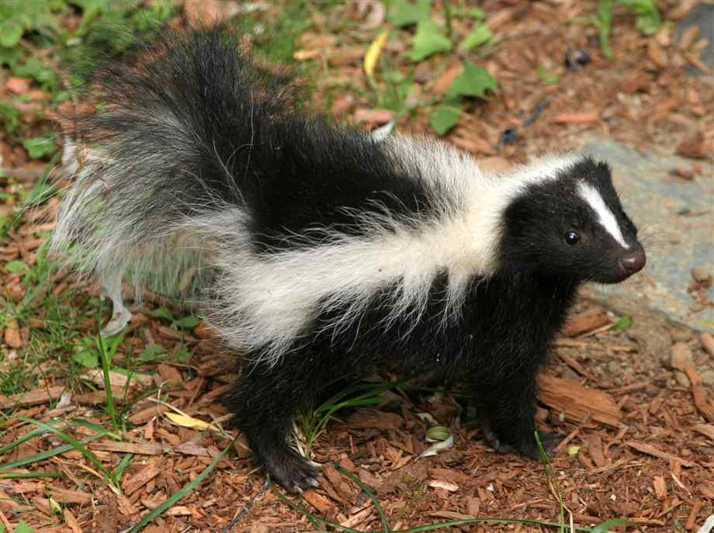
Thiols, the Sulfur Analogs of Alcohols & Phenols
CH₃SH
Intense disagreeable odor
-SH group takes place of –OH
Sulfhydryl group
Functional group of thiols
Sometimes called mercaptans
Due to rxn with Hg
CH₃CH₂CH₂CH₂SH
CH₃CH=CHCH₂SH
and
(CH₃)₂CHCH₂CH₂SH

Slide 42
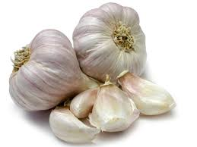
Thiols, the Sulfur Analogs of Alcohols & Phenols
More acidic than alcohols
pK_{a} is 10.6 for ethanethiol; ethanol’s is 15.6
React with bases to give thiolates
RSH + Na⁺OH⁻ → RS⁻Na⁺ + HOH
Easily oxidized to disulfides, with S-S
Natural disulfide,CH₂=CHCH₂S-SCH₂CH=CH₂
2RS-H RS-SR
oxidation
reduction

