Slide 1
football rules reminders
Weather

Slide 2
Suspending a game due to inclement weather
Develop criteria for suspension and resumption of play:
When thunder is heard, or a cloud-to-ground lightning bolt is seen, the thunderstorm is close enough to strike your location with lightning.
Suspend play and take shelter immediately.
Thirty-minute rule. Once play has been suspended, wait at least 30 minutes after the last thunder is heard or flash of lightning is witnessed prior to resuming play.
Any subsequent thunder or lightning after the beginning of the 30 minute count, reset the clock and another 30 minute count should begin.
Hold periodic reviews for appropriate personnel.

Slide 3
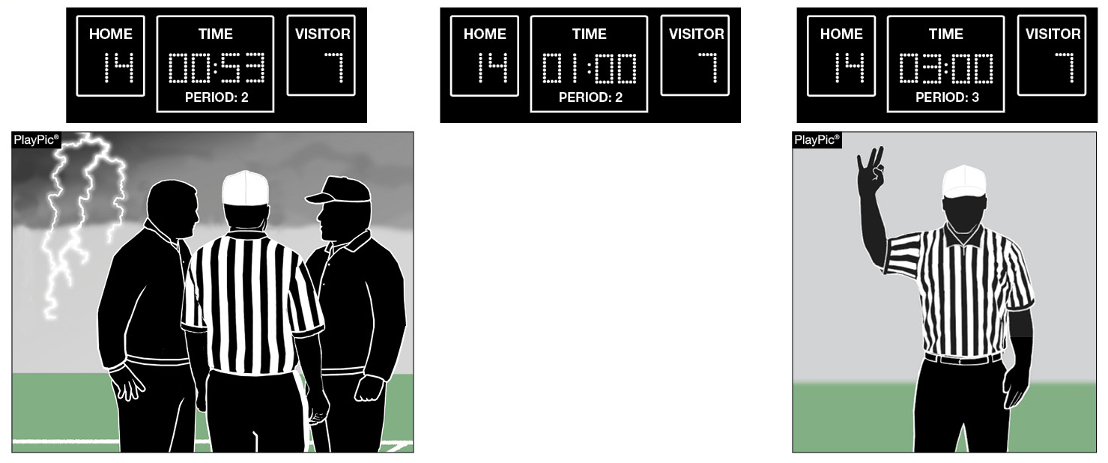
Halftime Intermission Option Following Weather DelaY RULE 3-1-6c EXCEPTION
HALFTIME INTERMISSION
A
B
If weather causes a delay of at least 30 minutes during the last three minutes of the second period, the opposing coaches may mutually agree to shorten the halftime intermission below the 10-minute minimum (PlayPic A). The mandatory 3-minute warm-up must take place before the third period begins (PlayPic B).
Notes:
Rules Reminder:
RULE 3 – SECTION 1 – LENGTH OF PERIODS – HALFTIME INTERMISSION
ART. 6 . . . State high school associations may determine the length of halftime intermission, provided it is not less than 10 minutes and not more than 20 minutes.
a. 15 minutes is normal for halftime intermission.
b. Halftime intermission may be increased to a maximum of 20 minutes, provided opponents have been notified no later than five minutes prior to the game.
c. By mutual agreement of the opposing coaches, the halftime intermission may be reduced to a minimum of 10 minutes (not including the mandatory warm-up period).
EXCEPTION: If the game is interrupted due to weather during the last three minutes of the second period, and the delay is at least 30 minutes, the opposing coaches can mutually agree to shorten halftime intermission, provided there is at least a one-minute intermission (not including the three-minute warm-up period).
Comment on Slide:
Rule change in 2020. The halftime intermission may be shortened by mutual agreement of opposing coaches if a weather delay occurs during the last three minutes of the second period.
Case Book: See SITUATIONS 3.1.1A, 3.1.1B

Slide 4
Game Officials’ Responsibility Referee
Record the Score
2. Record Timeouts Remaining
3. Record Coin Toss Choices

Slide 5
Game Officials’ Responsibility Umpire
Record Team in Possession
2. Record Goal Defended
Record Location of the Ball Between the
Hashmarks

Slide 6
Game Officials’ Responsibility Head Linesman
Record Visiting Team Sideline Warnings
2. Record Down & Distance to Line to Gain
3. Record Clip Location

Slide 7
Game Officials’ Responsibility Line Judge
Record Home Team Sideline Warnings
2. Record Period & Game Clock Time
3. Record Time of Last Lightning/Thunder

Slide 8
Game Officials’ Responsibility Back Judge
Record Players Removed For Major Injuries
and/or Concussion Like Symptoms
Record Any Disqualifications (Player & Non-
player
Record Any Unsportsmanlike Conduct
Penalties

Slide 9
Game Officials’ Responsibility All Officials
Give Your Recordings to the Referee
Referee – Prepare a Written Report
Referee – Send Report to the Assignor and Secretary for Use by Crew Assigned to the Continuation of the Game
Assignor or Secretary – Send Report to Game Administration Personnel from Teams

