Slide 1


NEW JERSEY LIONS EYEGLASS RECYCLING CENTER
Operating Center at Katzenbach School for the Deaf
320 Sullivan Way, West Trenton, NJ 08628
Mail To: P.O. Box 7263; West, Trenton, NJ 08628
Tel: 609-530-3485 www.NJLERC.org

Slide 2
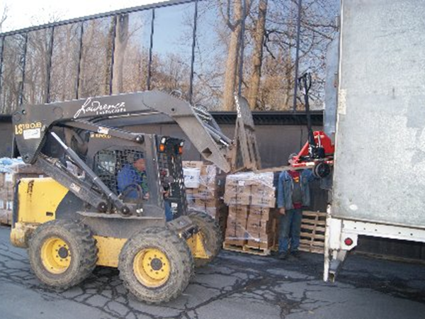
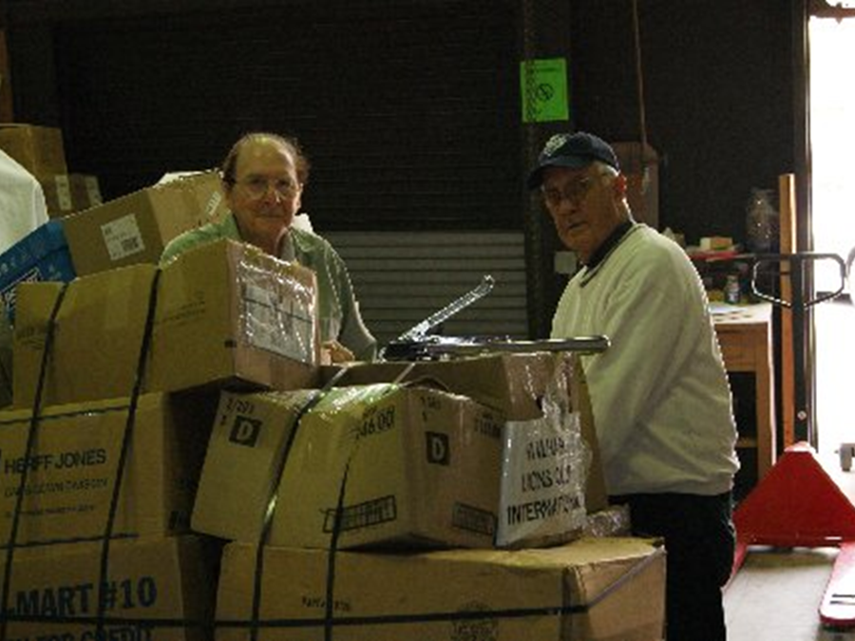
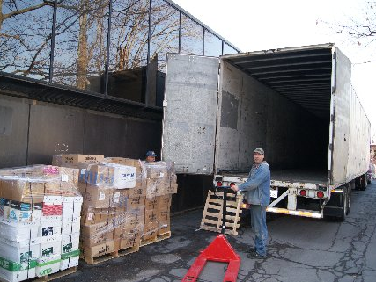
NJLERC Receives thousands of recycled eyeglasses to unload, and process each year

Slide 3
Fiscal Year | # Collected | # Distributed
1997-98 | 140,550 | 61,500
1998-99 | 629,650 | 53,400
1999-2000 | 363,400 | 107,069
2000-01 | 705,700 | 119,750
2001-02 | 403,850 | 97,675
2002-03 | 796,350 | 105,186
2003-04 | 574,900 | 105,526
2004-05 | 435,815 | 129,030
2005-06 | 806,800 | 71,351
2006-07 | 665,328 | 76,583
2007-08 | 562,960 | 40,846
2008-09 | 866,045 | 91,417
2009-10 | 1,458,580 | 57,971
2010-11 | 1,661,825 | 84,074
2011-12 | 573,500 | 23,953
TOTAL: | 10,645,253 | 1,225,331
Cumulative Totals for New Jersey
Lions Eyeglass Recycling Center
from 1997 to Present

Slide 4
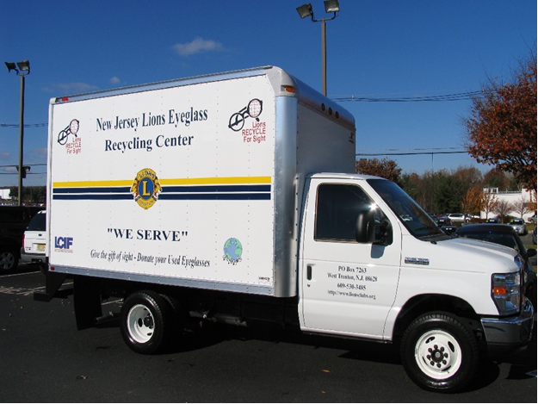
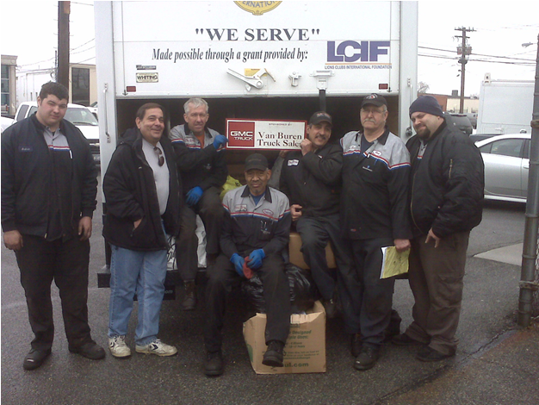
THANKS TO LCIF AND THE LIONS OF NJ
NJLERC has a van to pick up eyeglasses for recycling
We take our New Jersey Lions Eyeglass Recycling van throughout nearby states to pick up eyeglasses from fellow Lions. (on right at Farmingdale NY)

Slide 5
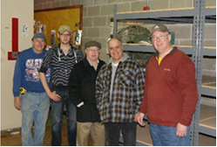
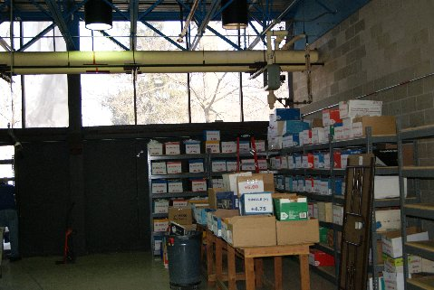
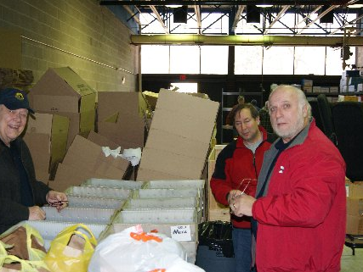
Lions Recycle Eyeglasses
“Hands On Service”

Slide 6
THE New Jersey Lions Eyeglass Recycling Center VOLUNTEERS
President
Lion Alan Brewer, PCC
First Vice President
Lion Ralph L. Sims
Second Vice President
Lion Al Tedesco, PRC
Treasurer
Lion Gill Halliez
Secretary
Lion Mary Devon O’Brien, PCC
Executive Committee
Lion Richard Chittum, PDG
Lion Judy Ferguson
Lion Karen Shapiro, PZC
Lion Steve Domovich, PDG
Lion Robert Losco, PDDG
Trustees
16-A
Lion Richard Chittum, PDG, Lion Robert Frank, PDG
Lion Robert Millea, PDG
16-B
Lion Judy Ferguson , Lion Gill Halliez, Lion Ralph L. Sims, CPA
16-C
Lion Karen Shapiro, PZC, Lion Stanley Shapiro, PDG
Lion Nancy Nelson , VDG
16-D
Lion Alan Brewer, PCC, Lion Steve Domovich, PDG
Lion Al Tedesco, PRC, Lion Antionette O’Neill
16-E
Lion Robert Hagenbush, Lion Robert Losco, PDDG
Lion Mary Devon O’Brien, PCC
Executive Director : Lion Mary Devon O’Brien, PCC

Slide 7
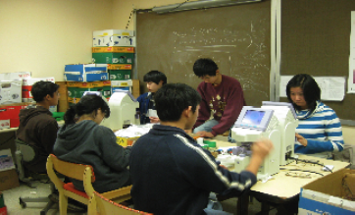
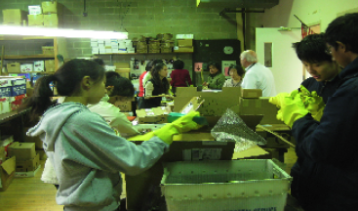
LEO Volunteers Recycle Eyeglasses
Leos sort and prepare recycled eyeglasses to be sent on medical trips and missions to bring the “Gift of Sight” to the visually impaired

Slide 8
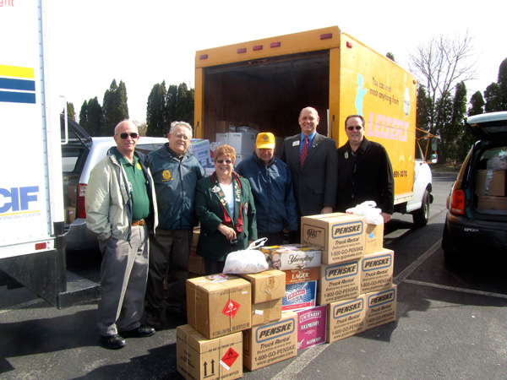
Volunteer Lions
Lions of 14-K and ID Gary Anderson provide support

Slide 9
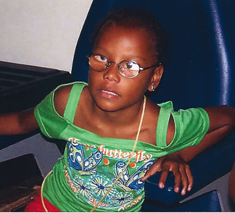
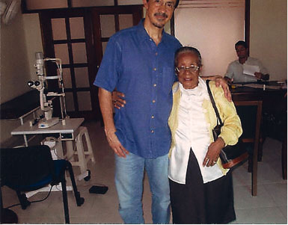
MEDICAL MISSION TO HAITI
Recycled Eyeglasses bring sight to a child, a man and a woman

Slide 10
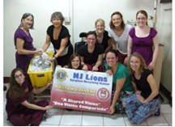
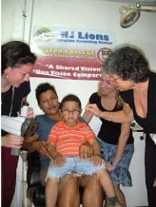
Boston College Nurses Mission to Nicaragua

Slide 11
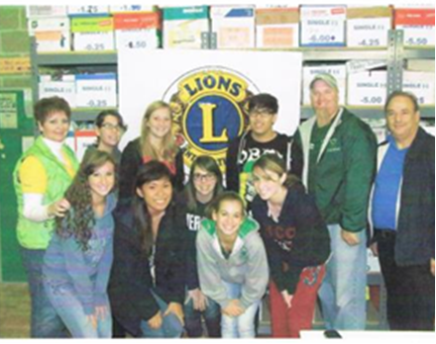
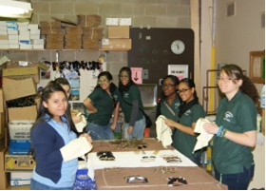
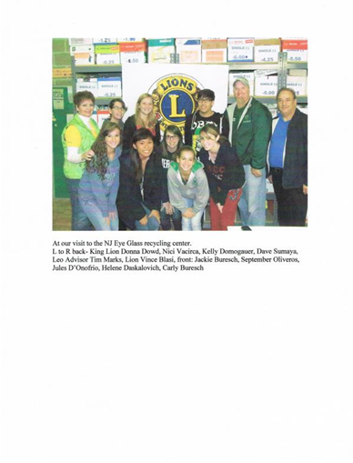
Students from the Brick Township High School Leo Club and the Grace Dodge High School volunteer at NJ LERC
Brick Township High School Leo Club visits New Jersey Lions Eyeglass Recycling Center
Grace Dodge High School
Students Volunteer at the New Jersey Lions Eyeglass
Recycling Center

Slide 12
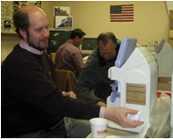
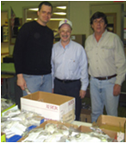
Allentown Lions Club Members Volunteer to recycle eyeglasses

Slide 13
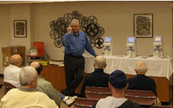
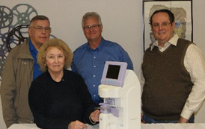
Teaching Volunteers to use the Lensometers

Slide 14
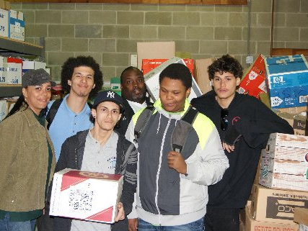
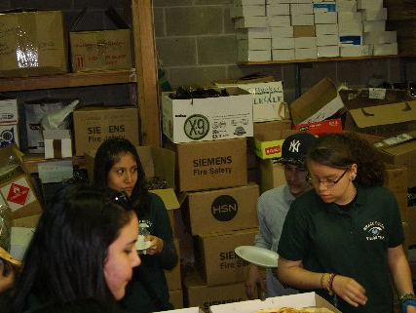
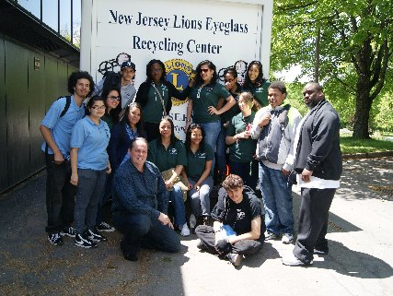
Youth Volunteers Recycle at NJLERC

Slide 15
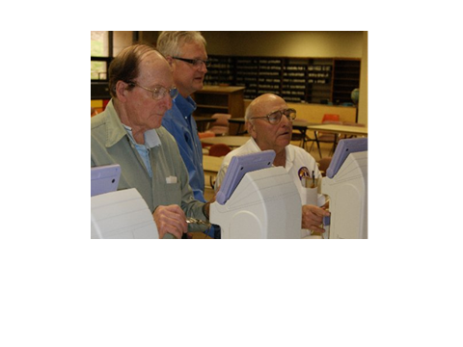
Lions from District 16A, 16B, and 16E work at the NJLERC

Slide 16
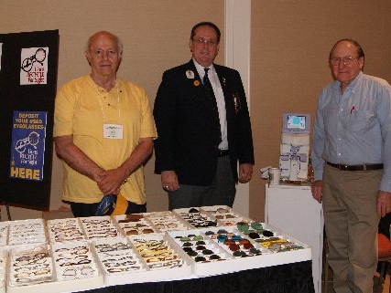
A COLLECTION OF EYEGLASSES ON DISPLAY AT THE STATE CONVENTION

Slide 17
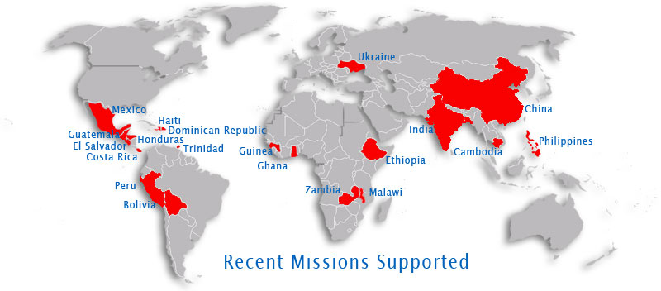
THE New Jersey Lions Eyeglass Recycling Center
VISION OF SERVICE
Hundreds of thousands of NJLERC recycled eyeglasses bring sight to the visually impaired throughout the world.

Slide 18
The last 4 Quarters between
July 1, 2011 and June 30, 2012
2011-2012 Number of Glasses Collected
NJ (MD16) 207,500
NY (MD20) 100,050
PA (MD14) 186,375
Non-Lions* 524,600
Total 1,018,525
* WalMart 55,700 (Included)

Slide 19
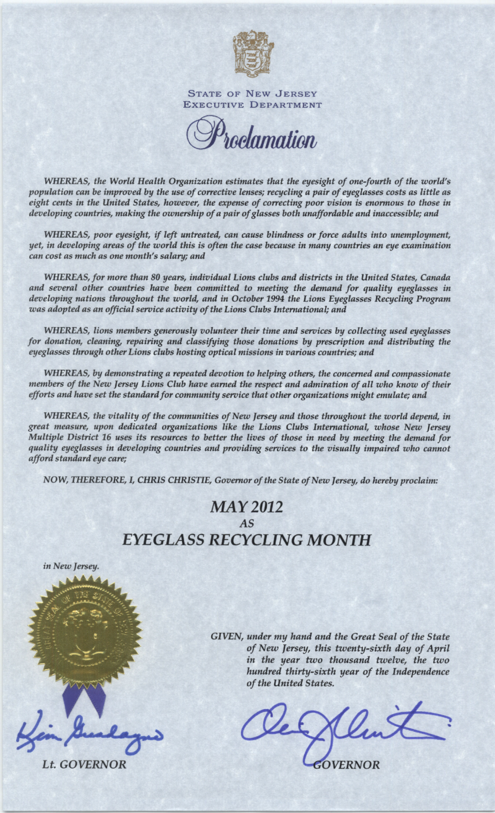
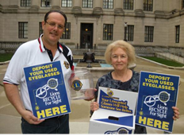
GOVERNOR CHRIS CHRISTIE’S ► PROCLAMATION for
Volunteer Eyeglass Recycling
Eyeglass Recycling Containers were delivered throughout the NJ State Offices

