Slide 1
State Apprenticeship Advisory Council
July 26, 2016
Ken Olsen, Program Director
Florida Department of Education
Division of Career and Adult Education – Apprenticeship Section
Ken.Olsen@fldoe.org
http://www.fldoe.org/academics/career-adult-edu/apprenticeship-programs/

Slide 2
Our Current Position
Current Calendar Year Jan. 1 thru
December 31, 2015, Florida
New Apprenticeship programs registered: 9
New Pre-Apprenticeship programs registered: 0
New On-the-Job training (OJT) programs:
Total active programs: 200
Total active apprentices: 9,172
Total new apprentices: 2,866
Total completions (DOE): 1,216
Current Calendar Year Jan. 1 thru
June 30, 2016, Florida
New Apprenticeship programs registered: 2
New Pre-Apprenticeship programs registered: 0
New On-the-Job training (OJT) programs:
Total active programs: 193
Total active apprentices: 8,957
Total new apprentices: 1,719
Total completions (DOE): 1,026

Slide 3
Staffing
Central Office Staff
Program Director
Government Operations Consultant I
Program Specialist IV – Standards Review & Registration
Field Staff
Program Specialist IV
Apprenticeship Training Representative (ATR)
(One ATR in each of the six regions in Florida)

Slide 4
State Registered Pre-Apprenticeship
June 2016
Pre-Apprentices Pre-Apprenticeship Programs
Adult 303 8
Youth 120 15

Slide 5
New Registered Apprenticeship Programs
AMSKILLS Apprenticeship Program GNJ – 6/16/16 New Port Richey (Stephen Seville)
ABC Institute Painters Apprenticeship Program GNJ – 3/7/16 Coconut Creek (Valvery Hillsman)

Slide 6
New Registered Pre-Apprenticeship Programs
None

Slide 7
Overview of Program Standards
(January 1, 2016 – June 30, 2016)
Summary
Program Standards Approved – 2
New Pre-Apprenticeship – 0
Revised – 1
Reinstated – 0
Program Standards Cancelled – 9

Slide 8
2014 thru 2015
National Averages of Completion, Cancellation, and Retention Rates
Based on Federal Workload Only (RAPIDS) From October 1, 2013 thru September 30, 2014
Fiscal Year | Completion Rate | Cancellation Rate | Retention Rate
2013 | 44% | 45% | 11%
2014 | 46% | 41% | 13%
2015 | 45% | 40% | 15%
Florida 2014-2015 Completion Rates by State (RAPIDS States)
Based on Federal Workload Only (RAPIDS) From October 1, 2013 thru September 30, 2014
Fiscal Year | Completion Rate | Cancellation Rate | Retention Rate
2013 | 46% | 47% | 7%
2014 | 48% | 44% | 8%
2015 | 48% | 47% | 5%
2016 data available after September from RAPIDS
Time Lag: Because apprenticeships require extensive on-the-job learning (OJL), OA adds a full calendar year to the expected date of “normal” completion. Completion Rate: The percentage of an apprenticeship cohort who receives a certificate of completion of apprenticeship within one-year of the expected completion date. Cancellation Rate: The percentage of an apprenticeship cohort that did not complete the program, for whatever reason, and exited after the probationary period. Retention Rate: The percentage of an apprenticeship cohort that did not complete the program, for whatever reason, during the program’s ECD plus one full year and are still active participants.

Slide 9
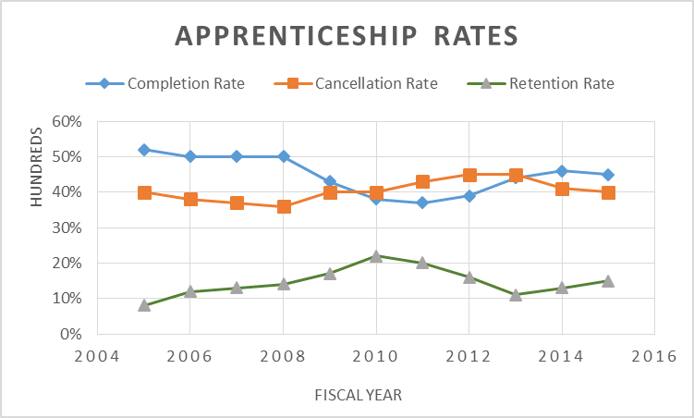
Date Source: RAPIDS as of 2015

Slide 10
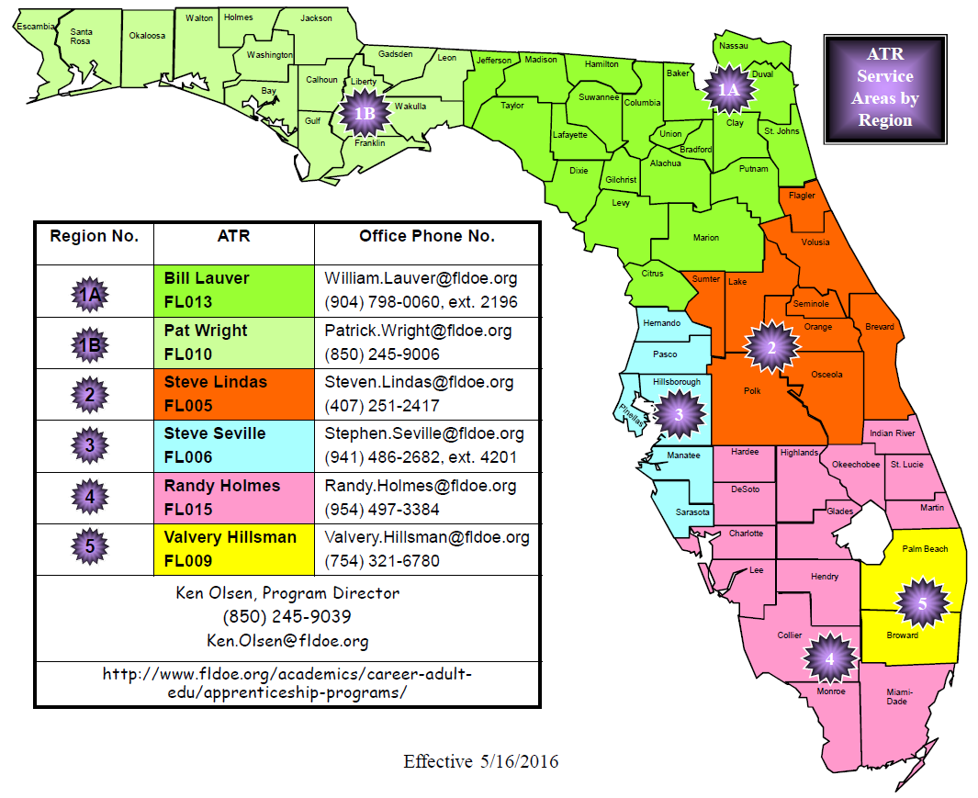

Slide 11
Ongoing Activities…
USDOL Compliance
SAA Recognition, Continued
State Functions
SAAC Structure
Quality/Provisional Assessment & Program Compliance, Reviews
RAPIDS
Changes made to some program functions = increased SAA workload
Certain reports have to be requested through (OA)
Website Information
Apprenticeship Certification
Davis-Bacon Instructions for Apprenticeship Certification
RAPIDS User Apprenticeship Agreement
Guideline (Instructional Purposes Only)
Action Reports
Action Form Instructions
Action Report
ApprenticeshipUSA Grants
State Accelerator Grant

Slide 12
Quality Assurance & Compliance Review
Apprenticeship, Quality/Provisional Assessment Reviews
14 Completed by Apprenticeship Training Representatives (ATR) January 1 - June 30, 2016
On-Site EEO, Program Compliance Review
12 Completed by Apprenticeship Training Representatives (ATR) January 1 - June 30, 2016

Slide 14
Training and Employment Notice 42-15
Announced the Release of the Workforce Innovation and Opportunity Act (WIOA) Final Rules and Information Collections for WIOA and additional DOL administered programs.
The purpose of this Training and Employment Notice (TEN) is to announce the advance posting of the WIOA final regulations.
This TEN also announces the information collections to implement WIOA, and to align performance accountability and information reporting for WIOA and additional Department of Labor programs.

Slide 16
Apprenticeship Fast Facts USDOL
Provides credential equivalent of a 2- or 4- year degree
Average starting salary: $ 50,000
Completing a Registered Apprenticeship program = $300,000 more over the course of a career
Increases workforce skill, productivity and morale
150,000 employers and labor management organizations participate
Nearly 400,000 apprenticeships [apprentices] are available nationwide in more than 1,000 occupations

Slide 19
How do employers become
apprenticeship sponsors?
Florida employers interested in sponsoring an apprenticeship program should contact the Apprenticeship Section within the Division of Career and Adult Education.
Will provide information about new and existing programs throughout the state.
Employers can participate in an existing program or can work with apprenticeship training representatives to develop a new program.
Sponsors of new programs define their own training standards with the assistance of experienced apprenticeship training representatives who monitor and coordinate the development and implementation of registered programs.

Slide 20
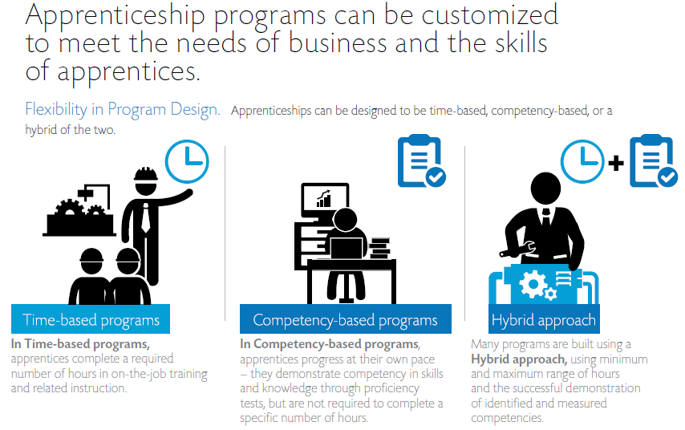

Slide 21
WIOA Represents a HUGE Opportunity
Five Key Points of Intersection between WIOA and Registered Apprenticeship
Performance Outcomes
Funding Support
ETPL
Board Membership
State and Local Plans

Slide 22
Types of Programs

Slide 23
Apprenticeship Program Enrollment, 2014-15

Slide 24
Workforce Education Top 10 Enrolled Apprenticeship Programs, 2014-15 - Update
Districts
Florida Colleges
Apprenticeship | 2014-15
Electrician | 2193
Air Conditioning, Refrigeration & Heating Technology | 837
Early Childhood Education | 824
Plumbing Tech | 713
Carpentry | 338
Fire Fighter | 269
Structural Steel Work | 261
Elevator Construction Mechanic | 193
Commercial Sign Design & Fabrication | 179
Painting & Decorating | 171
Apprenticeship | 2014-15
Electrician | 1067
Air Conditioning, Refrigeration and Heating Technology | 536
Fire Sprinkler System Technology | 229
Plumbing Technology | 191
Culinary Operations | 135
Industrial Pipefitter | 128
Early Childhood Education | 66
Carpentry | 36
Heavy Equipment Operation | 34
Brick and Block Masonry | 24

Slide 25
Program Information: Data is from - REGISTERED APPRENTICESHIP PARTNERS INFORMATION DATA SYSTEM (RAPIDS), the federal apprenticeship database and is for the Florida Fiscal Year (FY) of – July 1 thru June 30.
State of Florida (all numbers are approximate | 2012 Florida FY | 2013 Florida FY | 2014 Florida FY | 2015 Florida FY | 2016 Florida FY
Active Apprentices | 7,512 | 7,002 | 6,969 | 7,743 | 8,957
Completed Apprentices (DOE Data) | 1,343 | 1,476 | 1,365 | 1,134 | 1,026
New Apprentices | 1,024 | 1,508 | 1,452 | 1,603 | 1,719
Total Apprenticeship Programs | 228 | 225 | 215 | 209 | 193
New Apprenticeship Programs/Occupations (DOE Data) | 5 | 9 | 6 | 5 | 6/8
Updated: 7/8/2016

Slide 26
Website Resources
The Federal Resources Playbook for Registered Apprenticeship
doleta.gov/oa/federalresources/playbook.pdf
U.S. Department of Labor Employment and Training Administration
https://www.doleta.gov/
ApprenticeshipUSA Toolkit
https://www.dol.gov/apprenticeship/toolkit.htm
Florida Apprenticeship Grant
http://fscj.edu/professional-education/florida-apprenticeship
Florida Department of Education Apprenticeship Programs
http://fldoe.org/academics/career-adult-edu/apprenticeship-programs/

