Slide 1
JIAXING NEWTEX IMP. & EXP. CO., LTD
（GROUP）
HAIYAN XINCHUANG GARMENTS CO., LTD
Knitwear factory
JIAXING HENGTEX GARMENTS CO., LTD
Cut & sewn factory

Slide 2
Haiyan Xinchuang Garments Co.,Ltd
Haiyan Xinchuang was founded in 2003. in Ganpu town,
Jiaxing City, which is located between Shanghai and Hangzhou.
We mainly produce knitwear in women /men /kids …
Our knitting products are from 1.5GG to16GG.
Materials are In wool, cashmere, alpaca,cotton, linen, silk,viscose, recycled yarn,
blended yarn and fancy yarn…
In the factory there are 200 employees.
The monthly capacity is around 80000pcs.
We get the evaluation of qualification, passed social audit, such as WARP & BSCI.
We also get the certificate of RWS. RWS wool is very popular now.
From Jan 1st, 2021, fty was replaced with new knitting machines. using the Swiss Steiger system.
Our customers are mainly from Europe and USA,such as PINKO,PENNYBLACK,PATRIZIA PEPE, KAOS,ESSENTIEL, Lafayette,CAROLL,TED BAKER,marimekko,Yerse,Sita murt.
ROBERT GRAHAM,TRUSSARDI, REPLAY, PAUL TAYLOR,OLLYGAN,IKKS,DEVRED ，GUESS…
We have strict quality control internally, with professional QC team.
Welcome to collaborate with us!

Slide 3
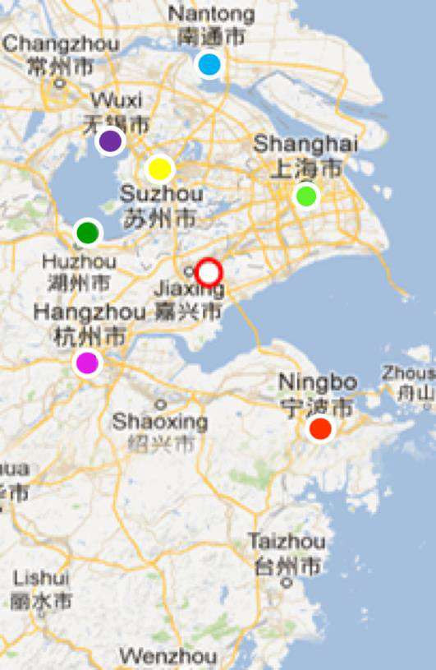
LOCATION
1.5h TO SHANGHAI
1h TO HANGZHOU

Slide 4
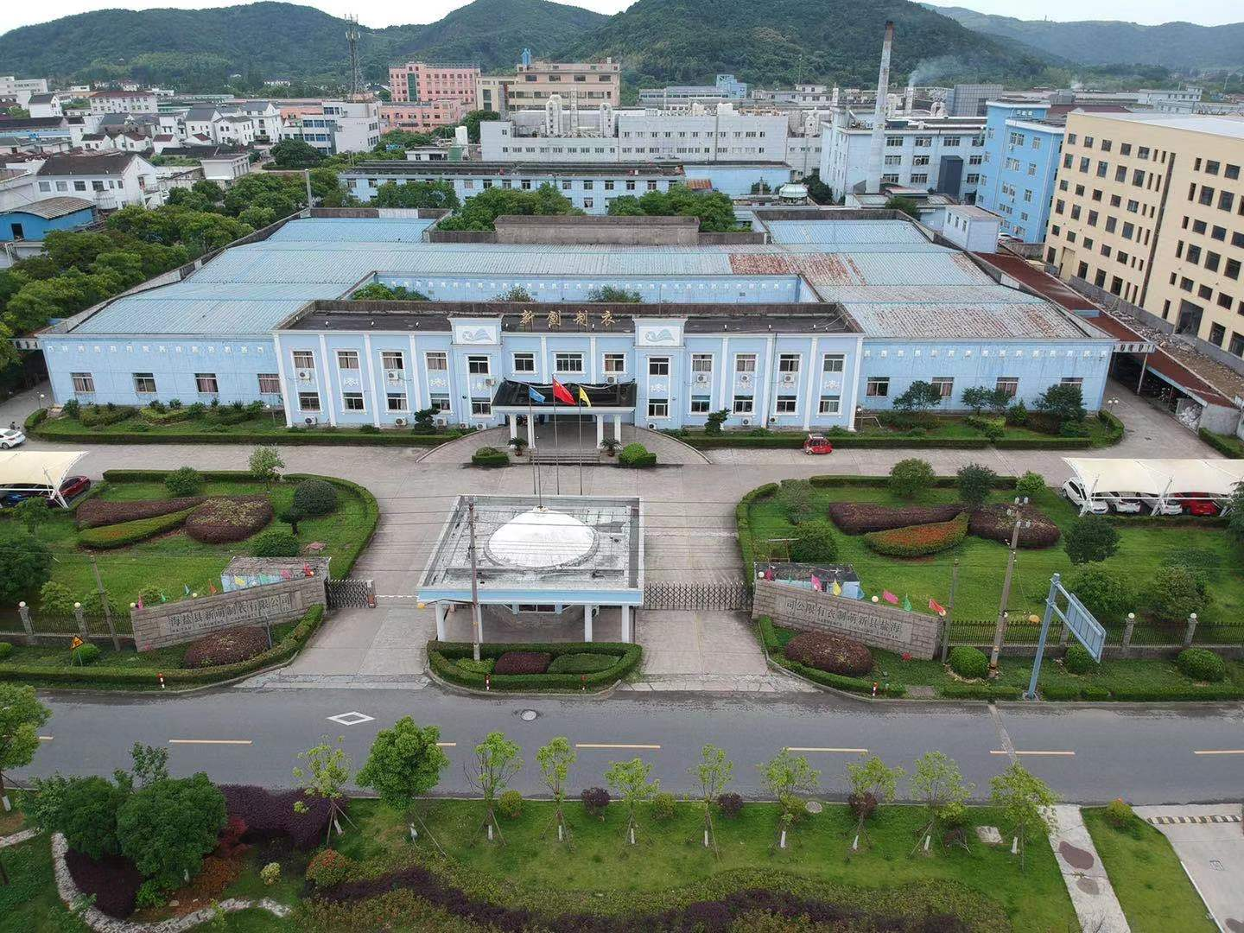
Haiyan Xinchuang Garments Co.,Ltd

Slide 5
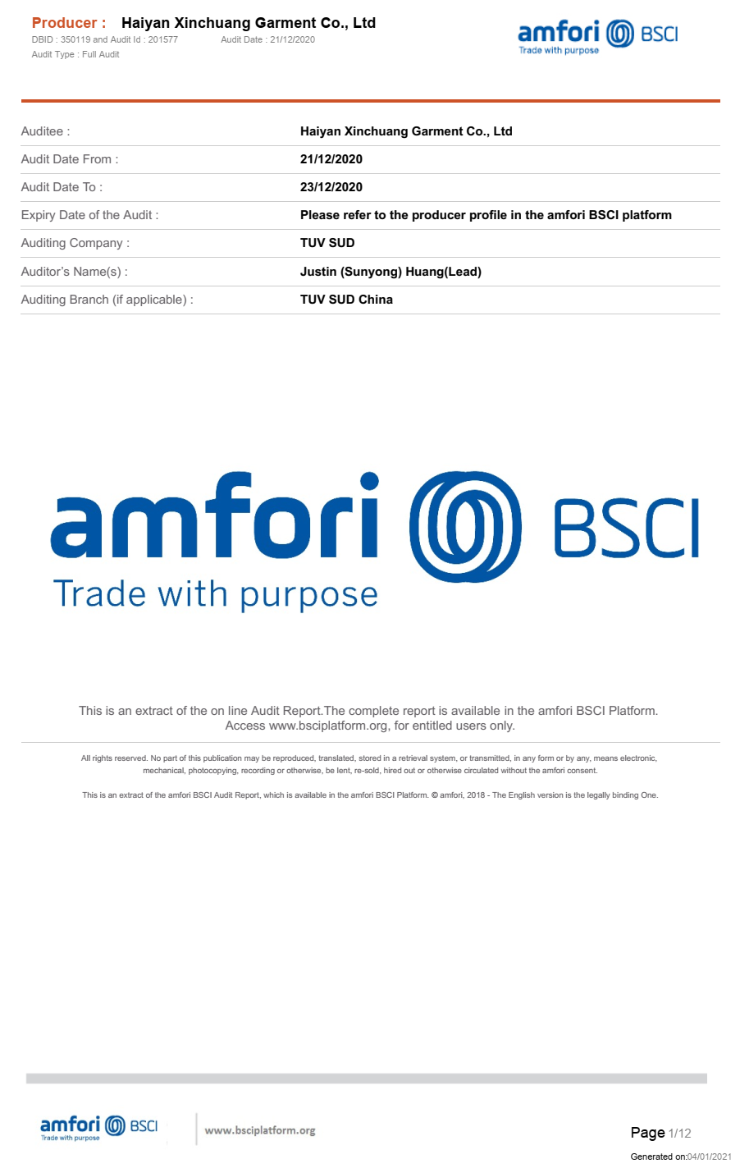
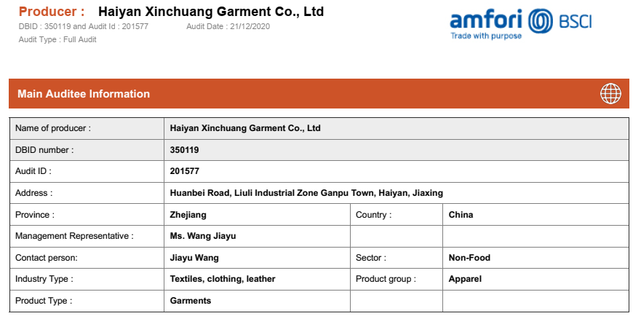
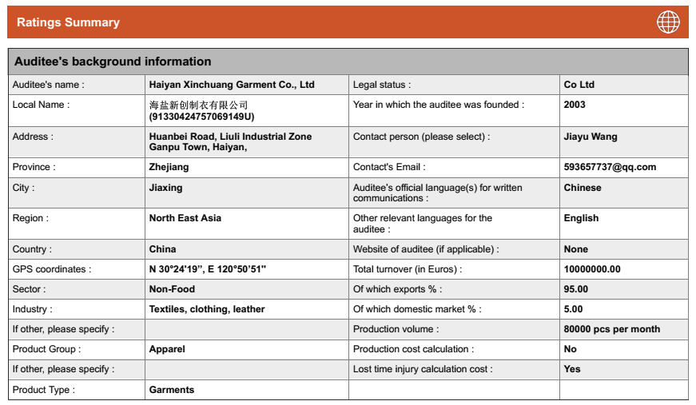
CERTIFICATES COPIES - BSCI

Slide 6
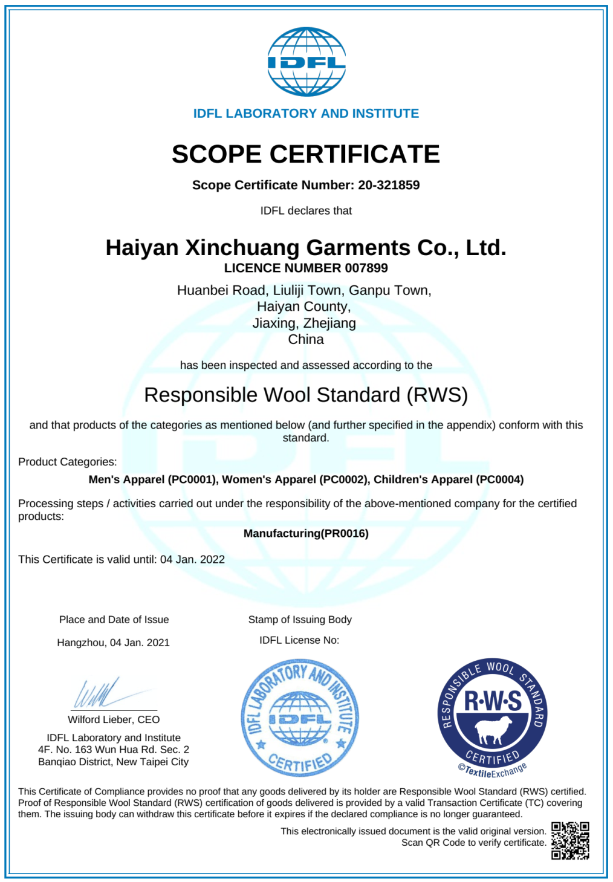
CERTIFICATES COPIES - RWS

Slide 7
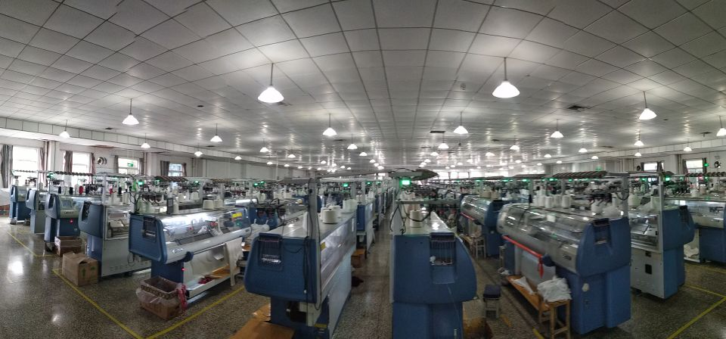
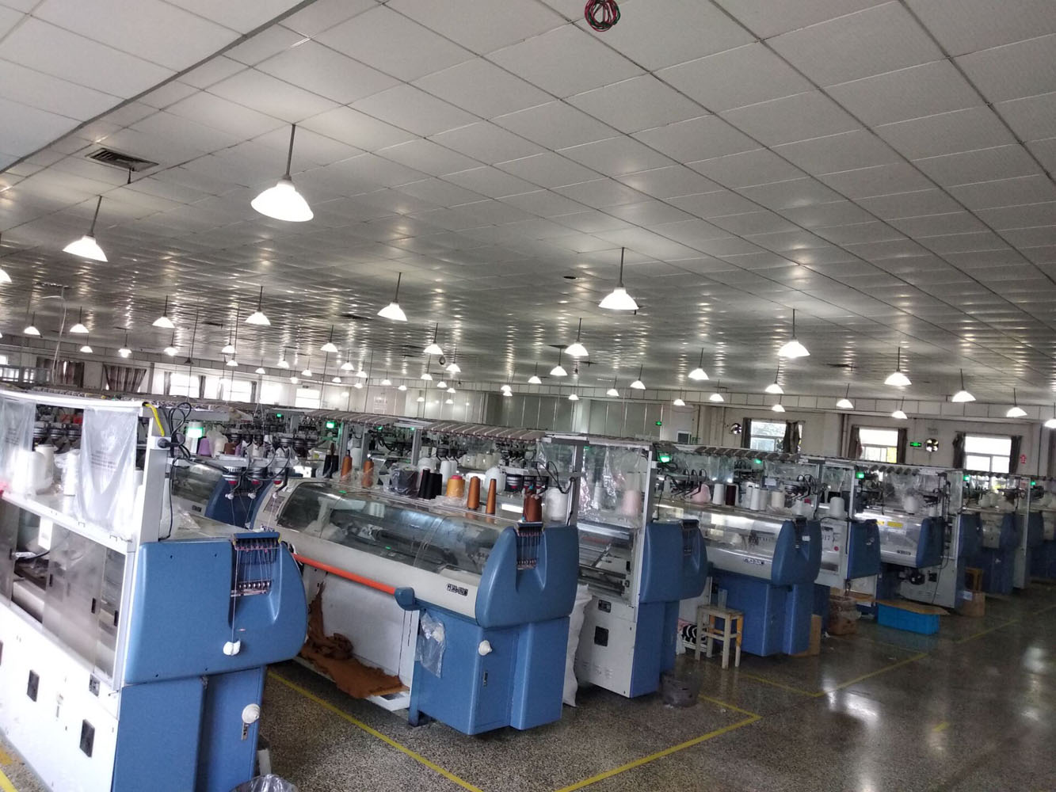
knitting area

Slide 8
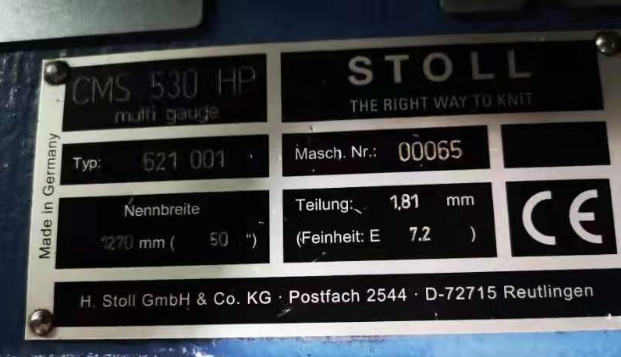
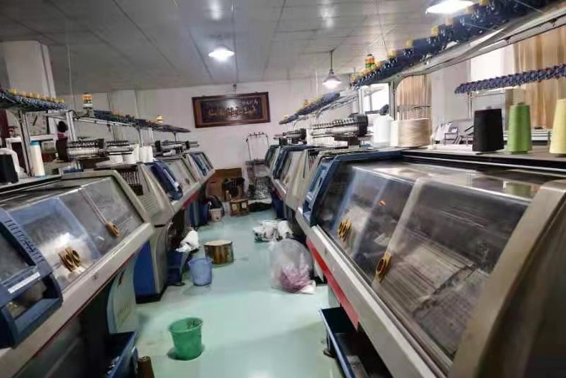
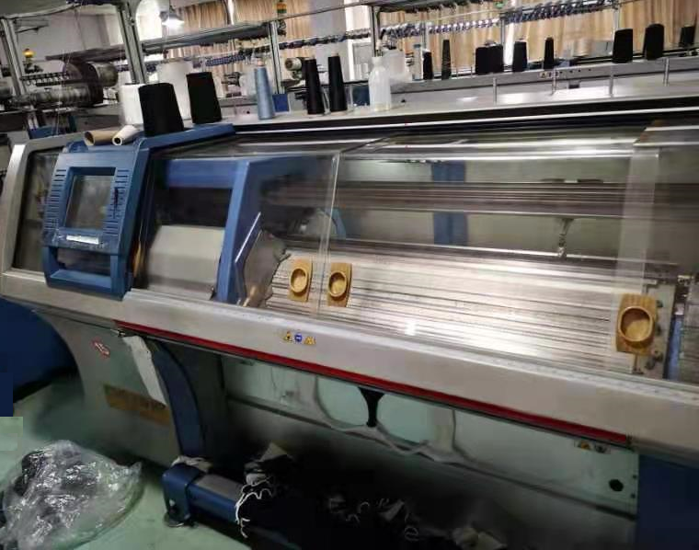
STOLL MACHINE

Slide 9
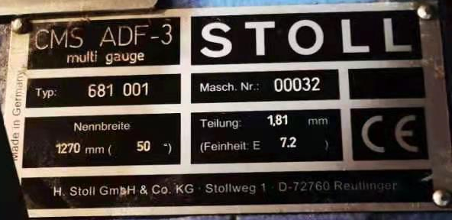
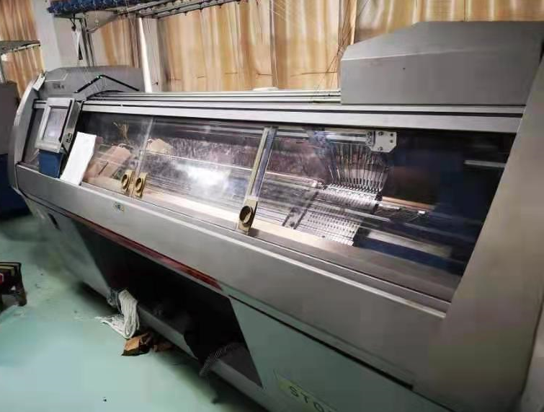
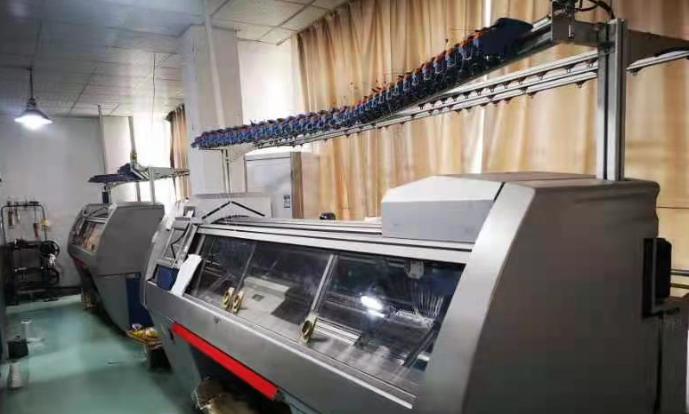
STOLL MACHINE(ADF)

Slide 10
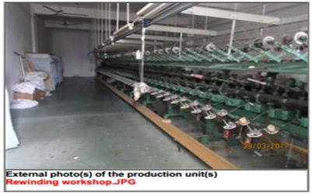
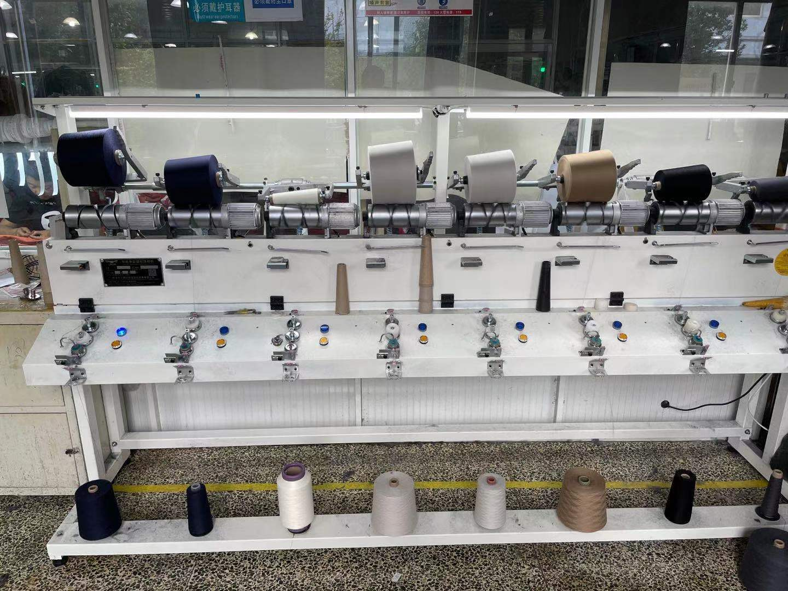
Special machine

Slide 11
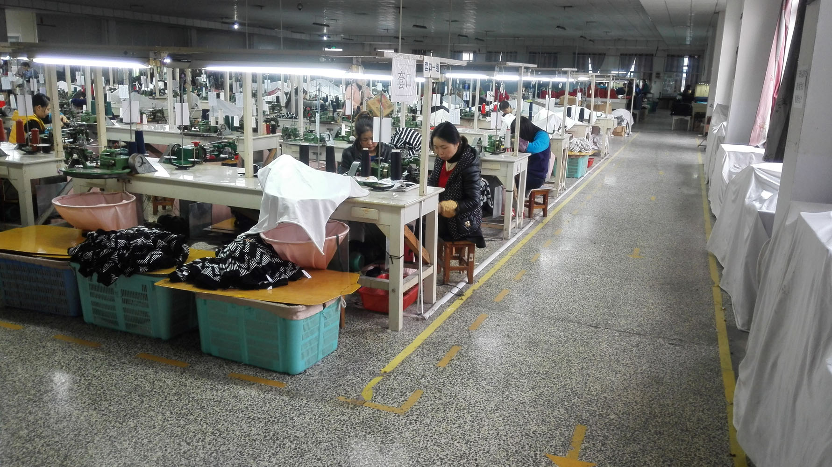
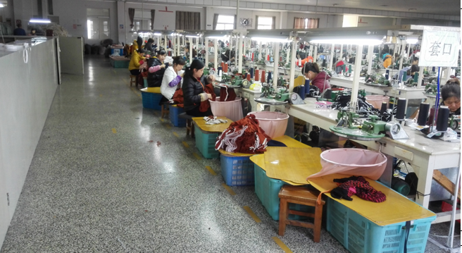
linking area

Slide 12
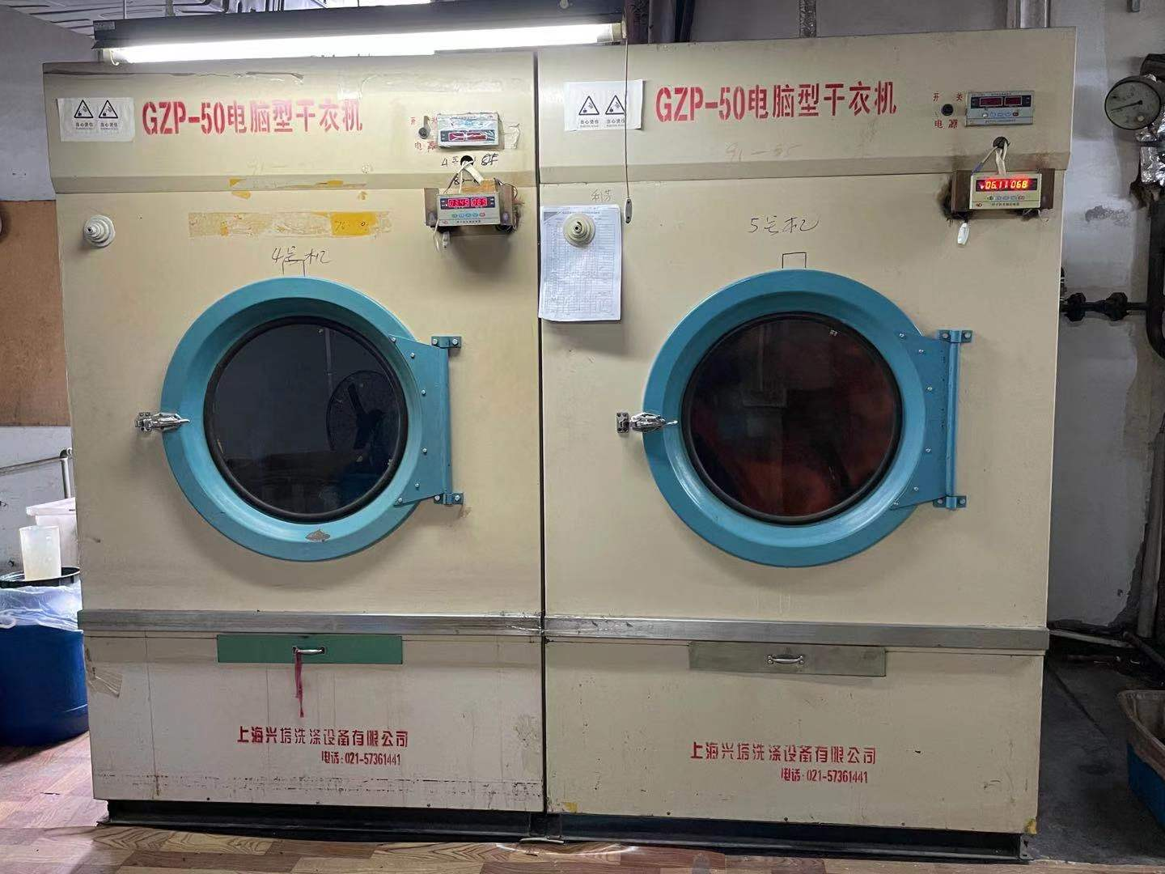
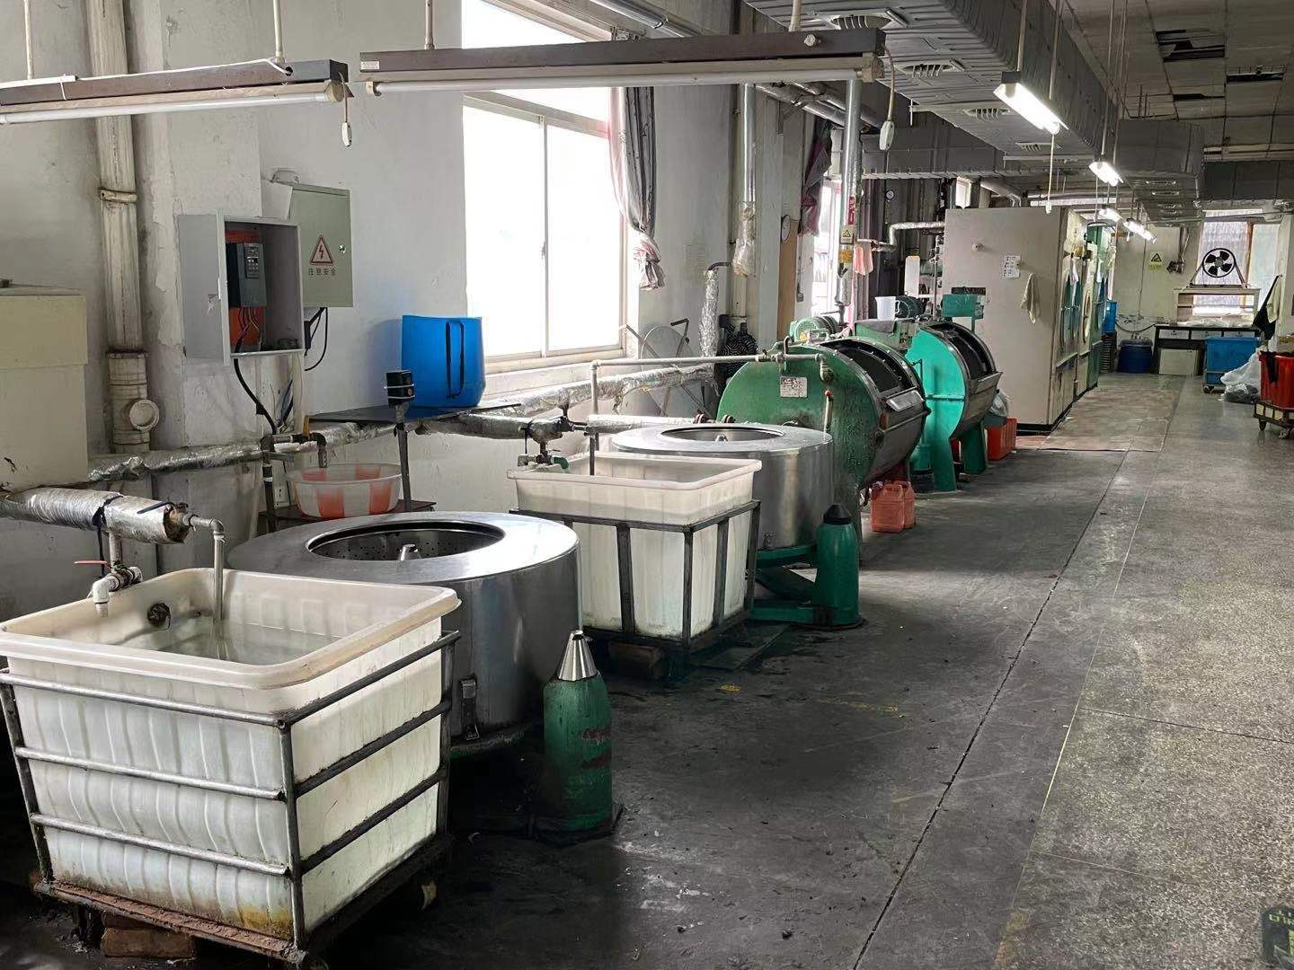
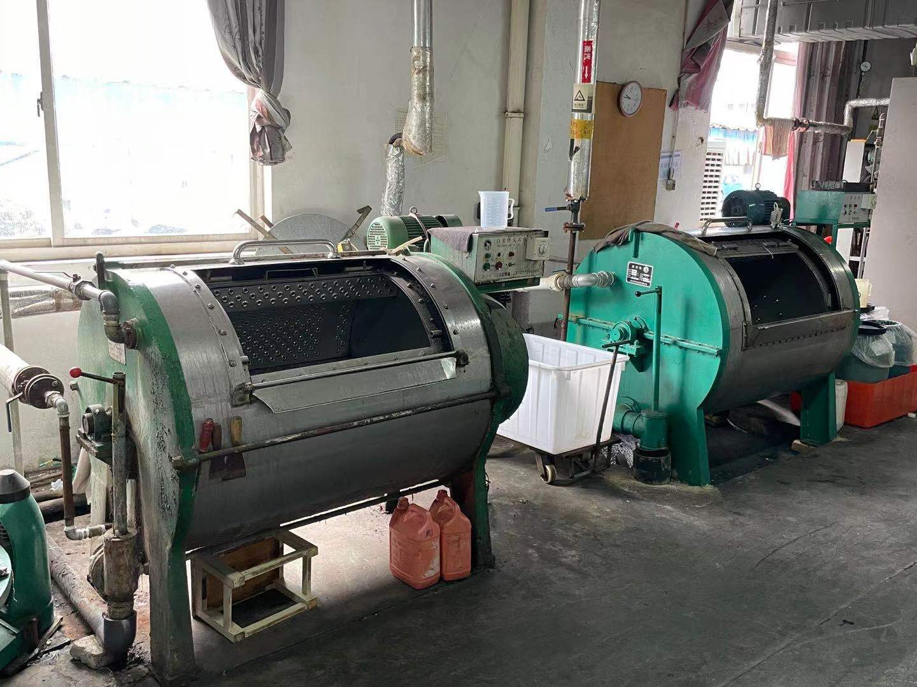
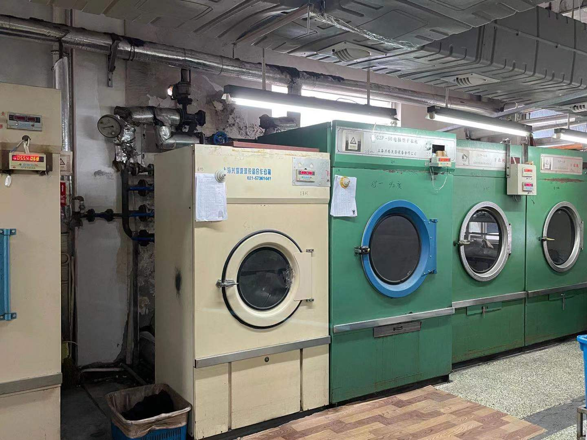
Treatment area

Slide 13
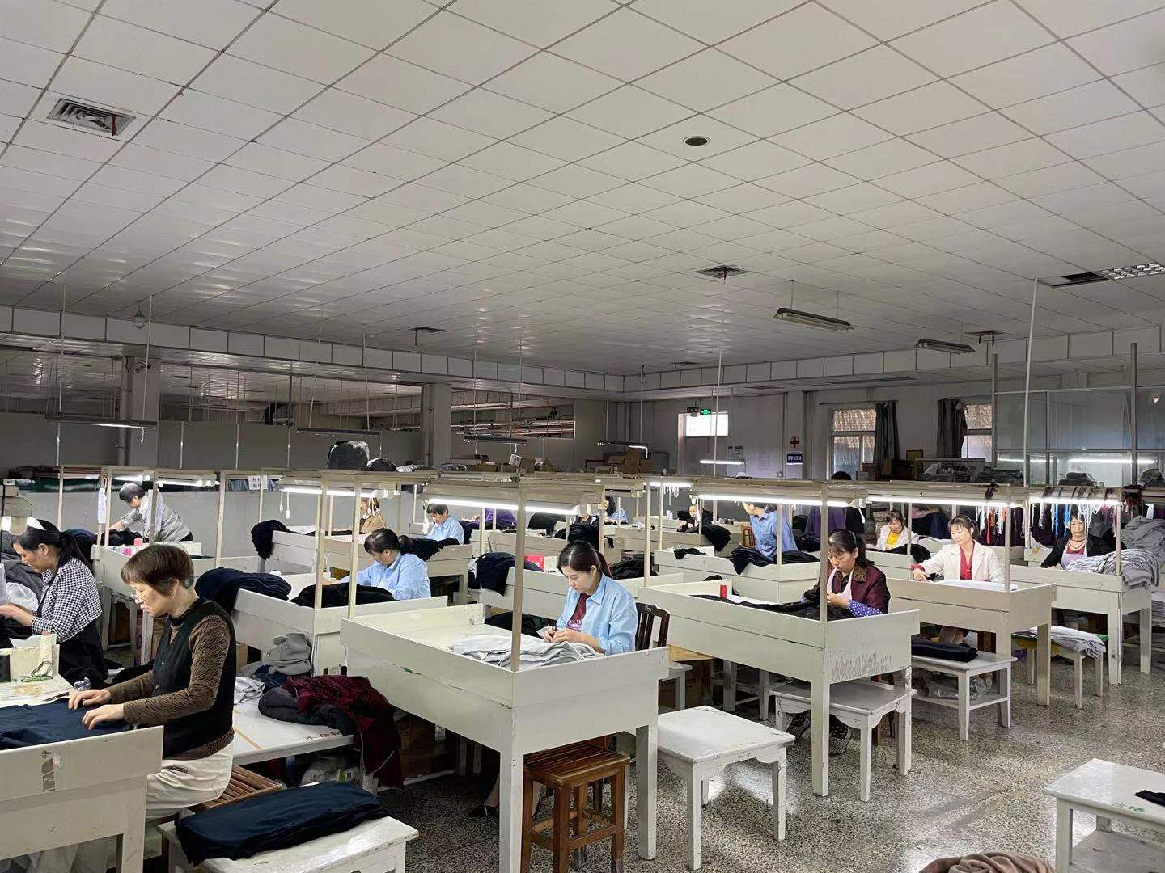
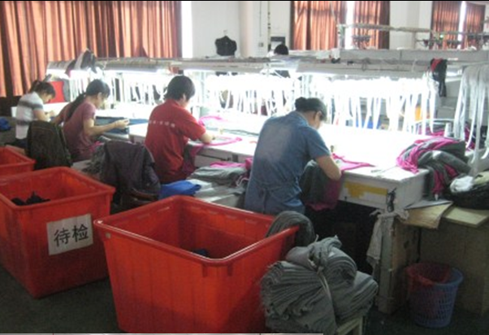
inspection area

Slide 14
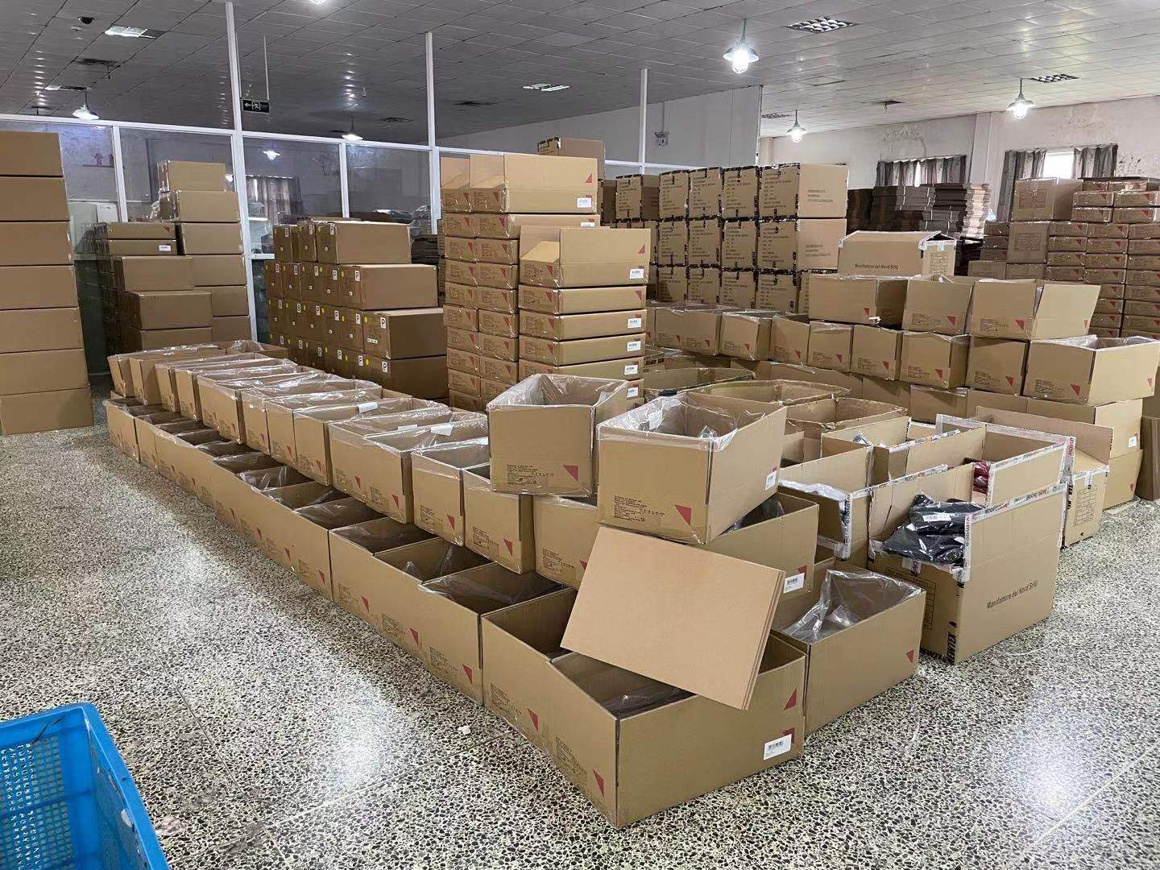
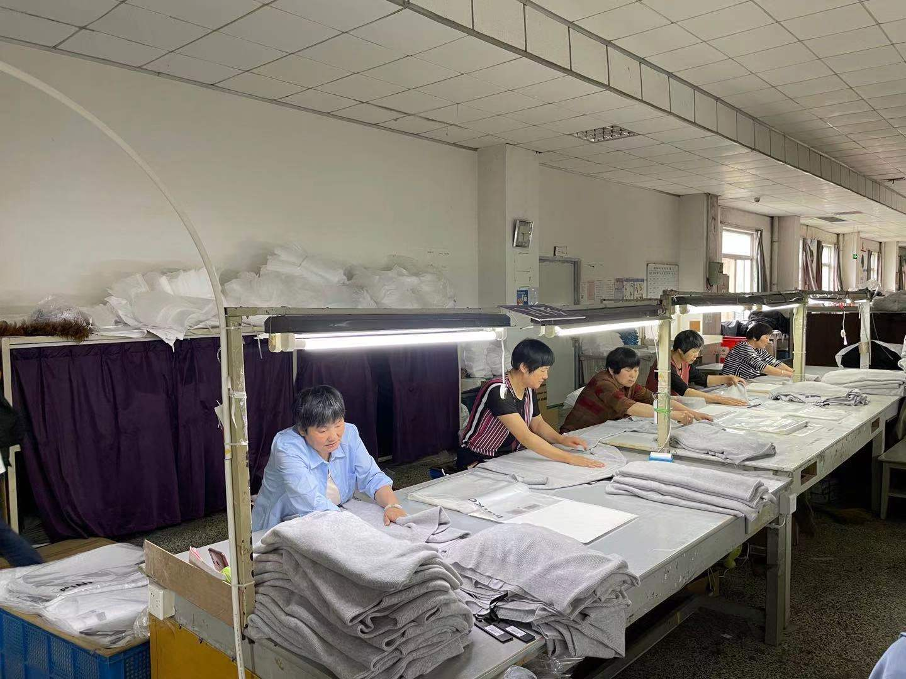
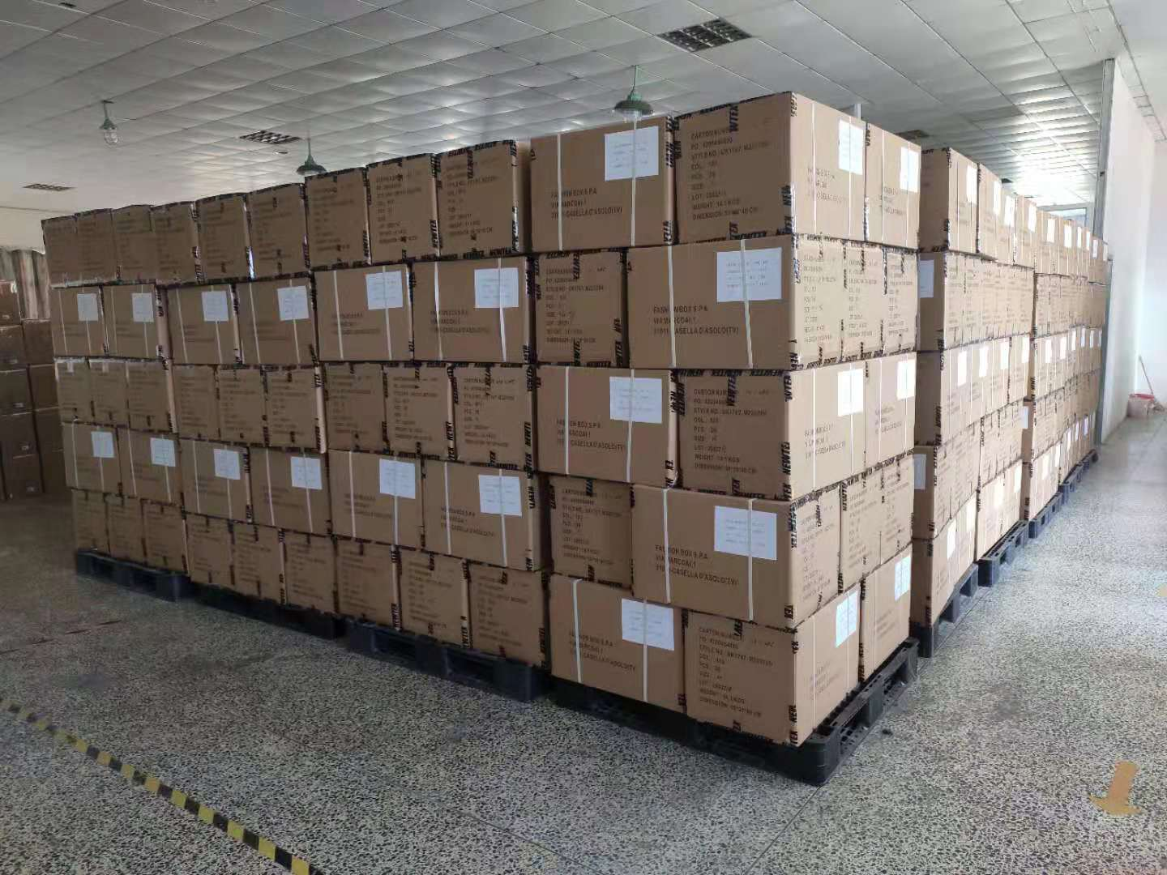
Packing area

Slide 15
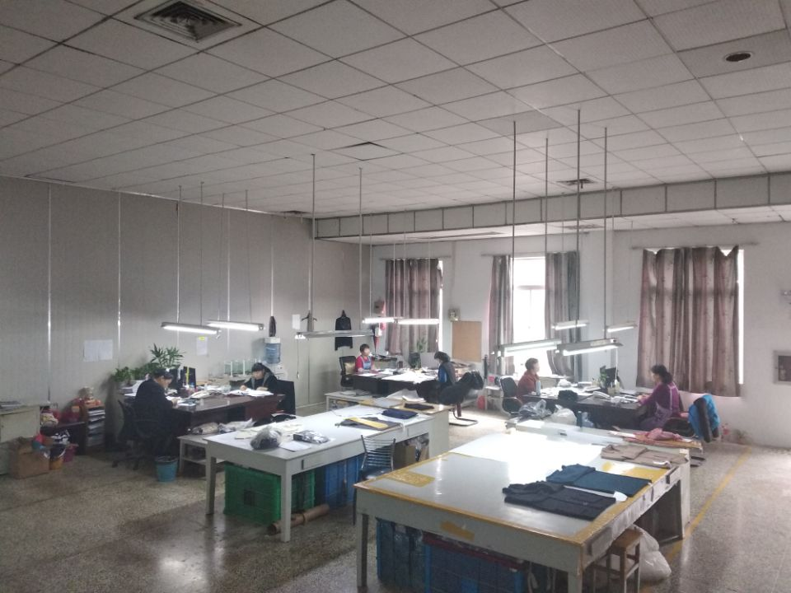
technician room

Slide 16
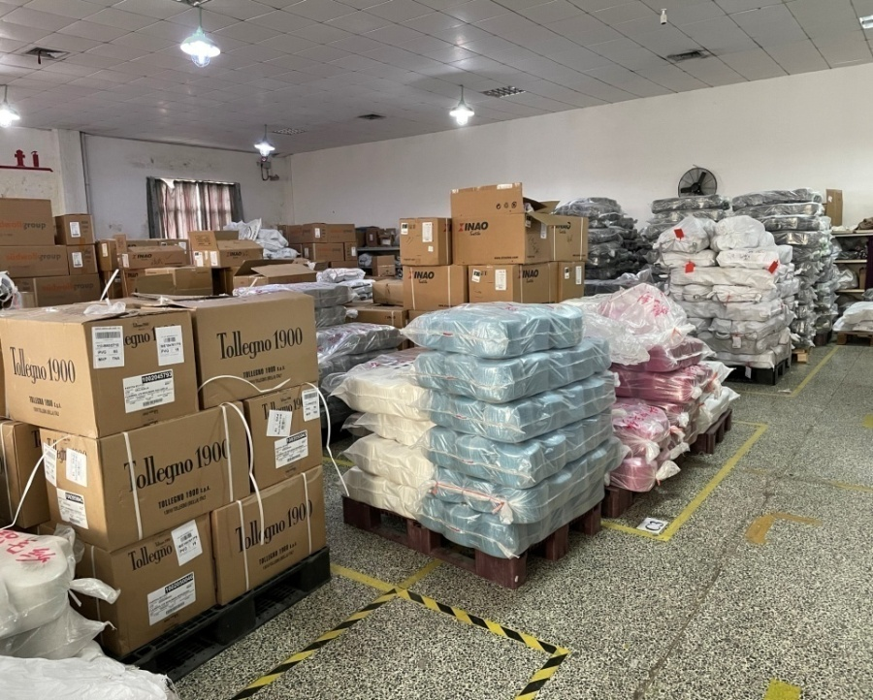
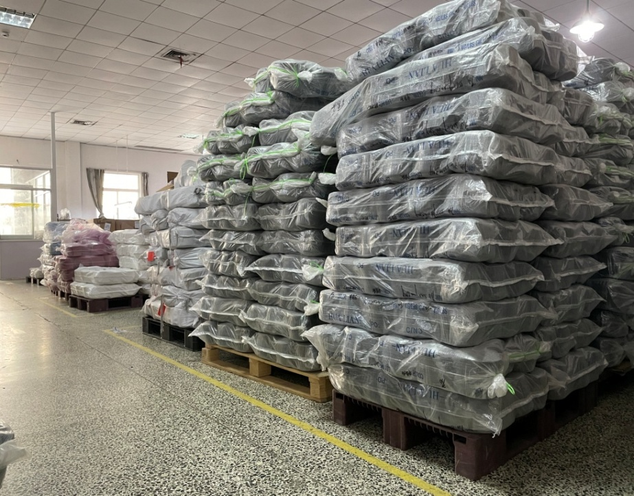
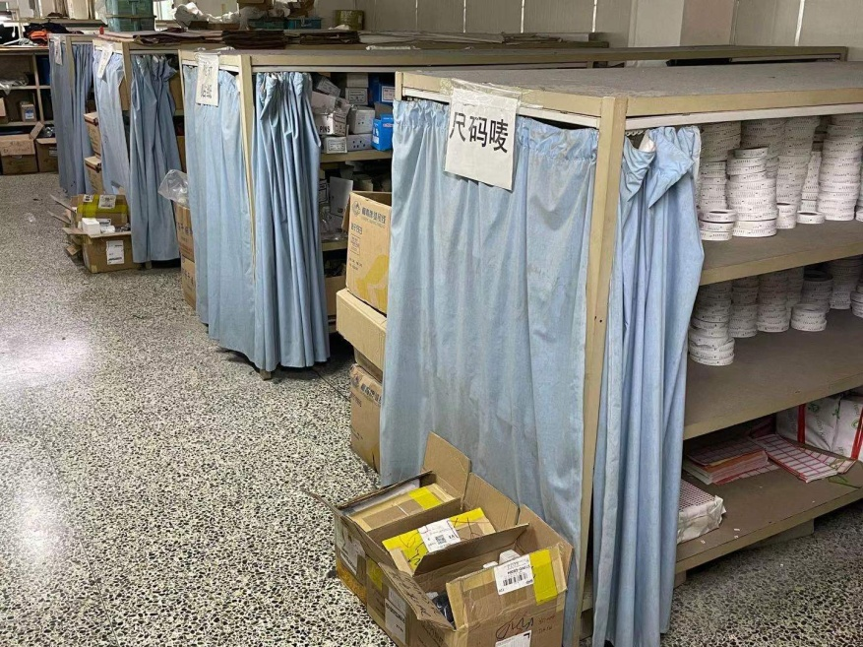
warehouse of yarns & accessories

Slide 17
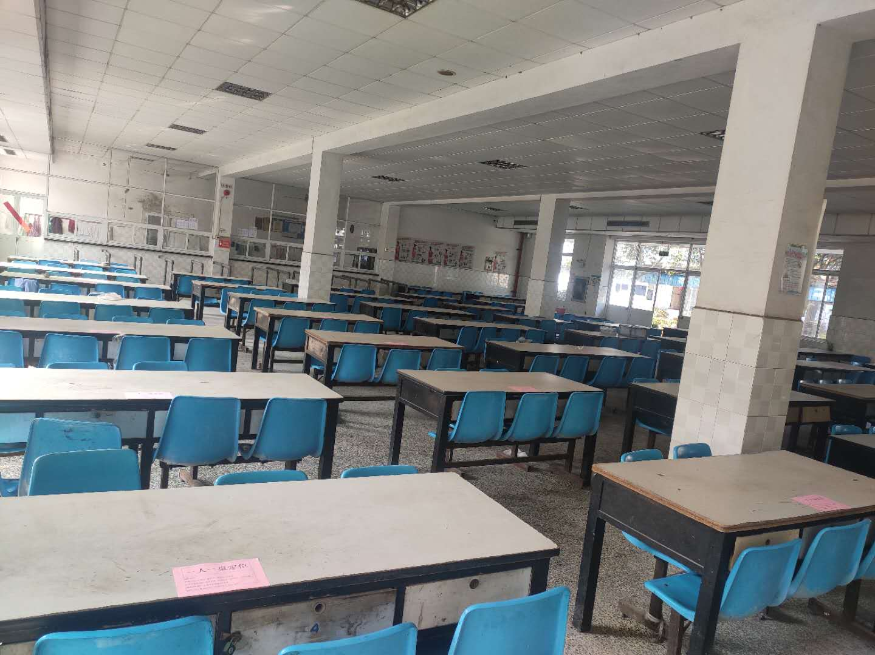
dining hall

Slide 18
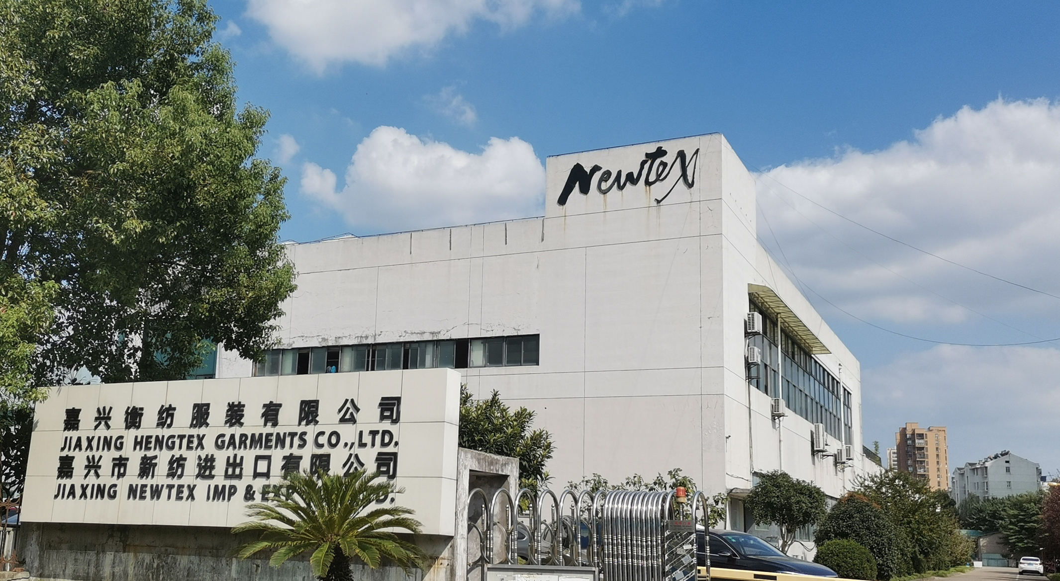
Jiaxing Hengtex Garments Co., Ltd

