Slide 1
Changes in Population
Chapter 1 Populations

Slide 2
Popultaion Changes
Birth rates and death rates influence the size of a population
How does a population get larger?
How does a population get smaller?

Slide 3
Population Growth
A population gets larger when the number of individuals born is greater than the number of individuals that die
Birth rate greater than death rate

Slide 4
Population Decrease (Decline)
A population will get smaller when the number of deaths is greater than the number of births
Death rate greater than birth rate

Slide 5
Population Changes
Example:
In one year, if 900 squirrels are born and 800 die. What is the effect on the rate of growth of the population?

Slide 6
Population Changes
The same holds true for human populations
Countries with faster population growth have birth rates that are higher than death rates
Countries with slower population growth birth rates are only slightly higher than death rates

Slide 7
Moving Around
Many populations move around
Brainstorm a list of how different organisms can move around. Make sure you include a mammal, a bird, a plant, and microscopic organisms.

Slide 8
Exponential Growth
Exponential growth means that the larger the population becomes the faster it will grow
When a population moves into an area with plenty of food, living space, and other resources, the population grows quickly in a pattern called exponential growth

Slide 9
Exponential Growth
What will happen over time if a population continues this pattern of exponential growth?
Can a population grow forever?

Slide 10
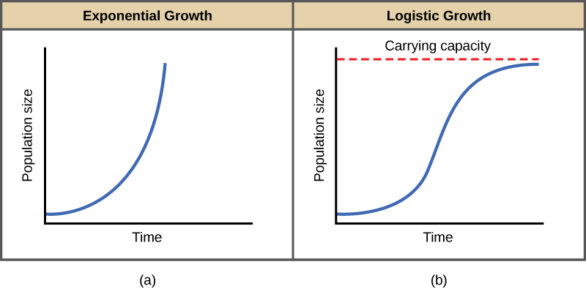
Exponential Growth

Slide 11
Exponential Growth
As a population approaches its ecosystem’s carrying capacity competition increases.
What are some of the resources that human will compete for in the future?
What are some of the problems causes by overpopulation?

Slide 12
Population Growth
Brain Pop Movie on Population Gowth
http://glencoe.mheducation.com/sites/dl/free/0078617464/160350/00050757.html

