Slide 1
BSA Troop 1147 Dearborn, MI
Feb 2nd Virtual Meeting
Agenda:
Opening: Pledge, Scout Oath And Scout Law- Ian Kennedy
Activity Recap
Ice Breaker
Hike Plan
Patrol Breakouts
  Patrol Contacts
  Patrol Name Ideas
  Advancement item- First Class 5b, 5c and 5d
  Play Among-us
Announcements
Closing

Slide 2

Opening

Slide 3
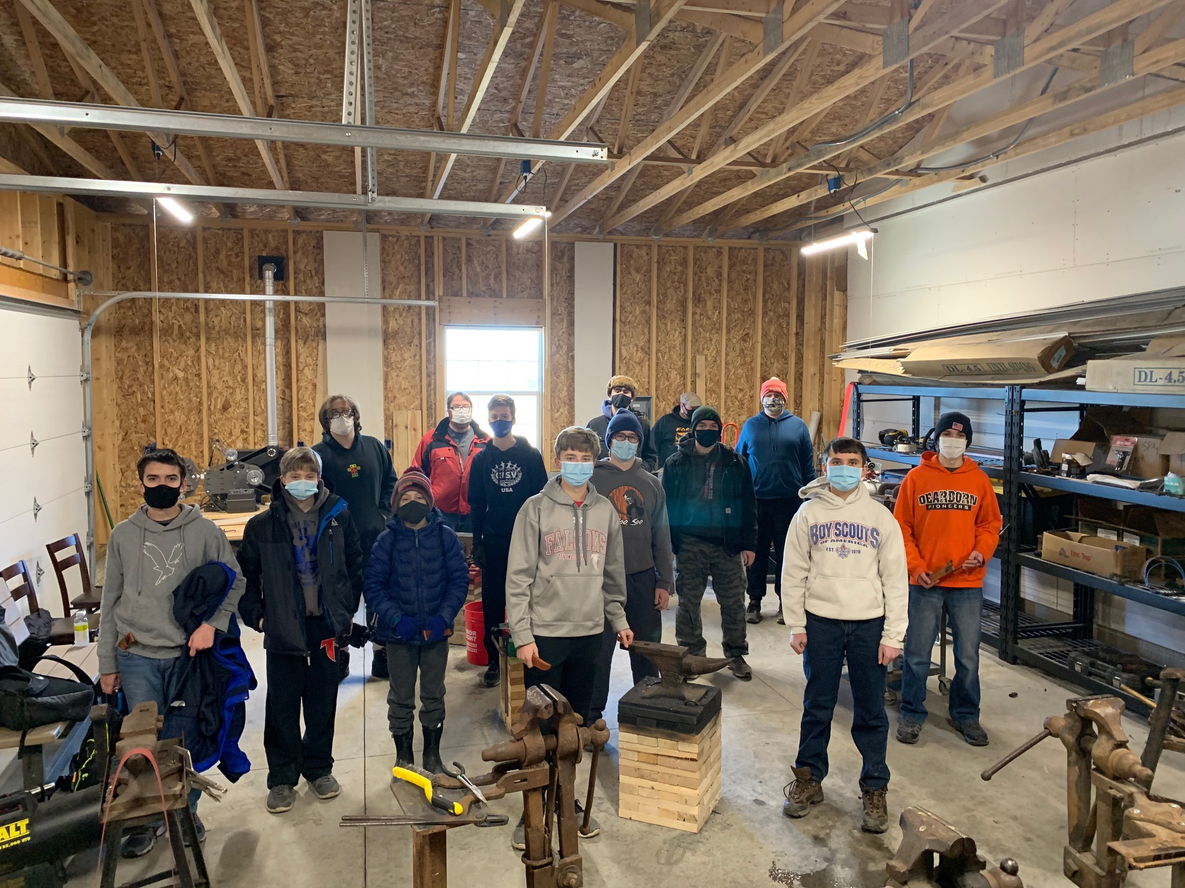
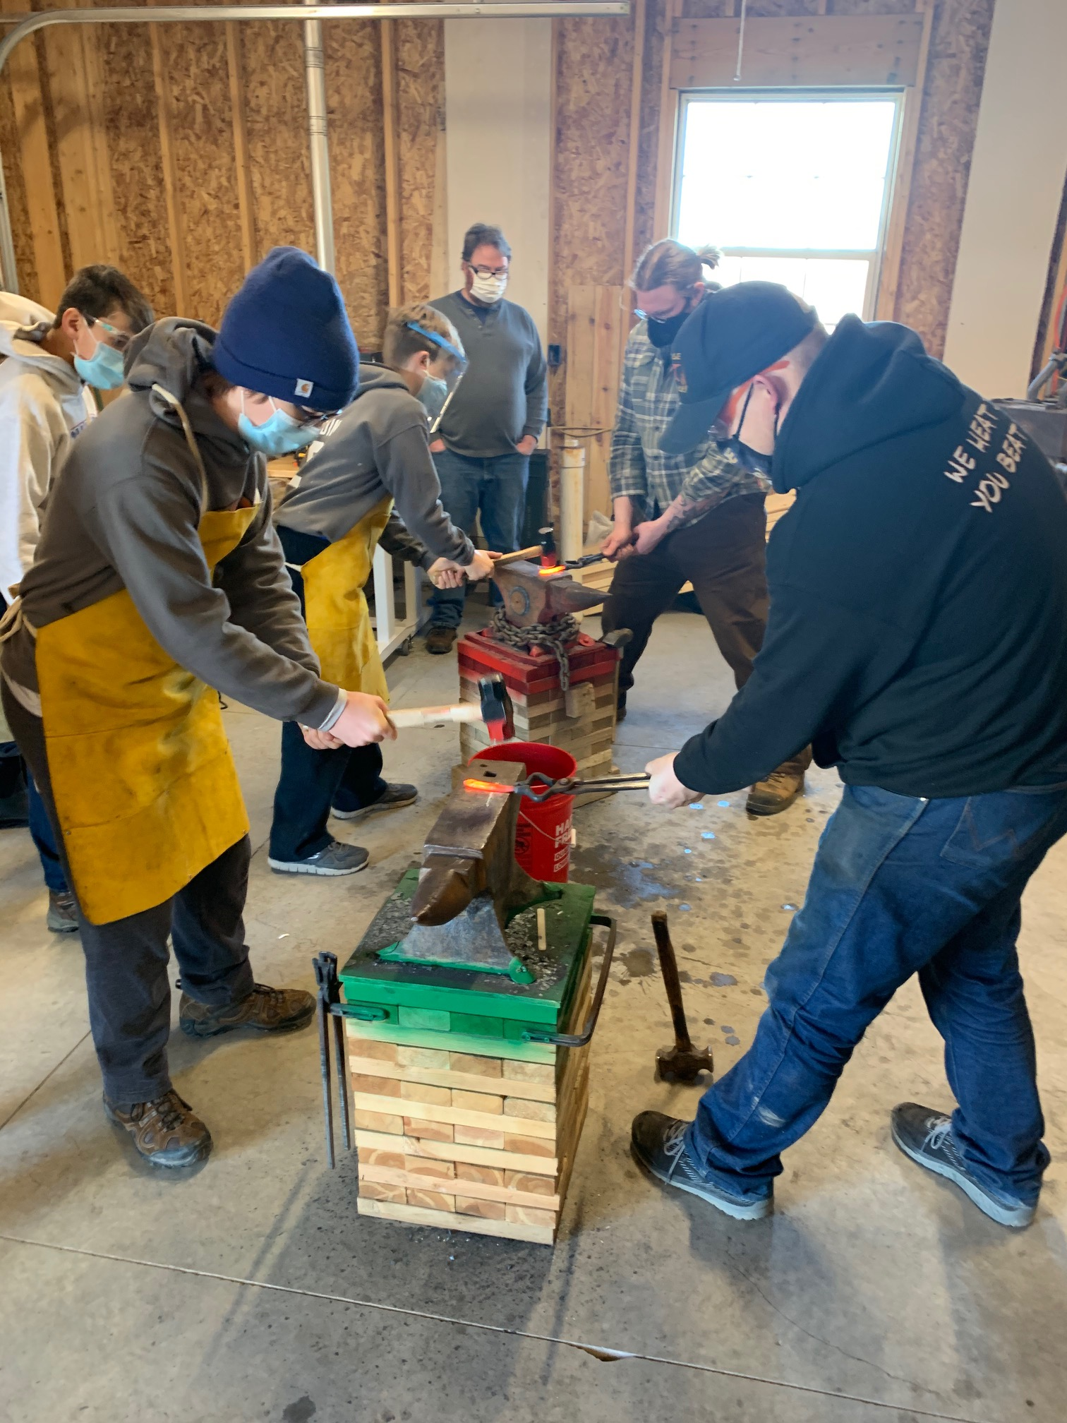
January Activity #1 Forging
Volunteer: Jason

Slide 4
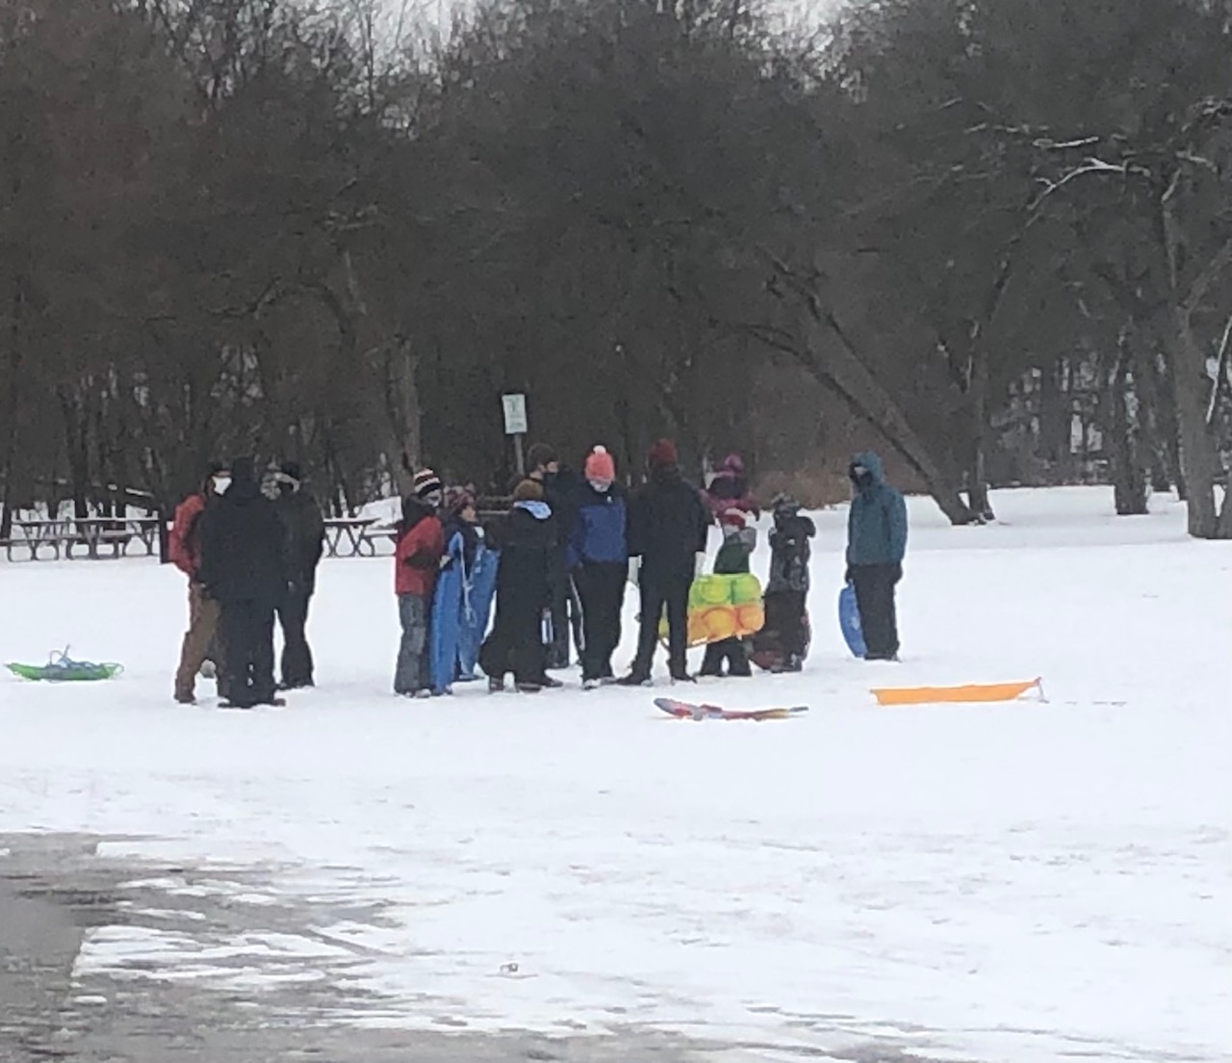
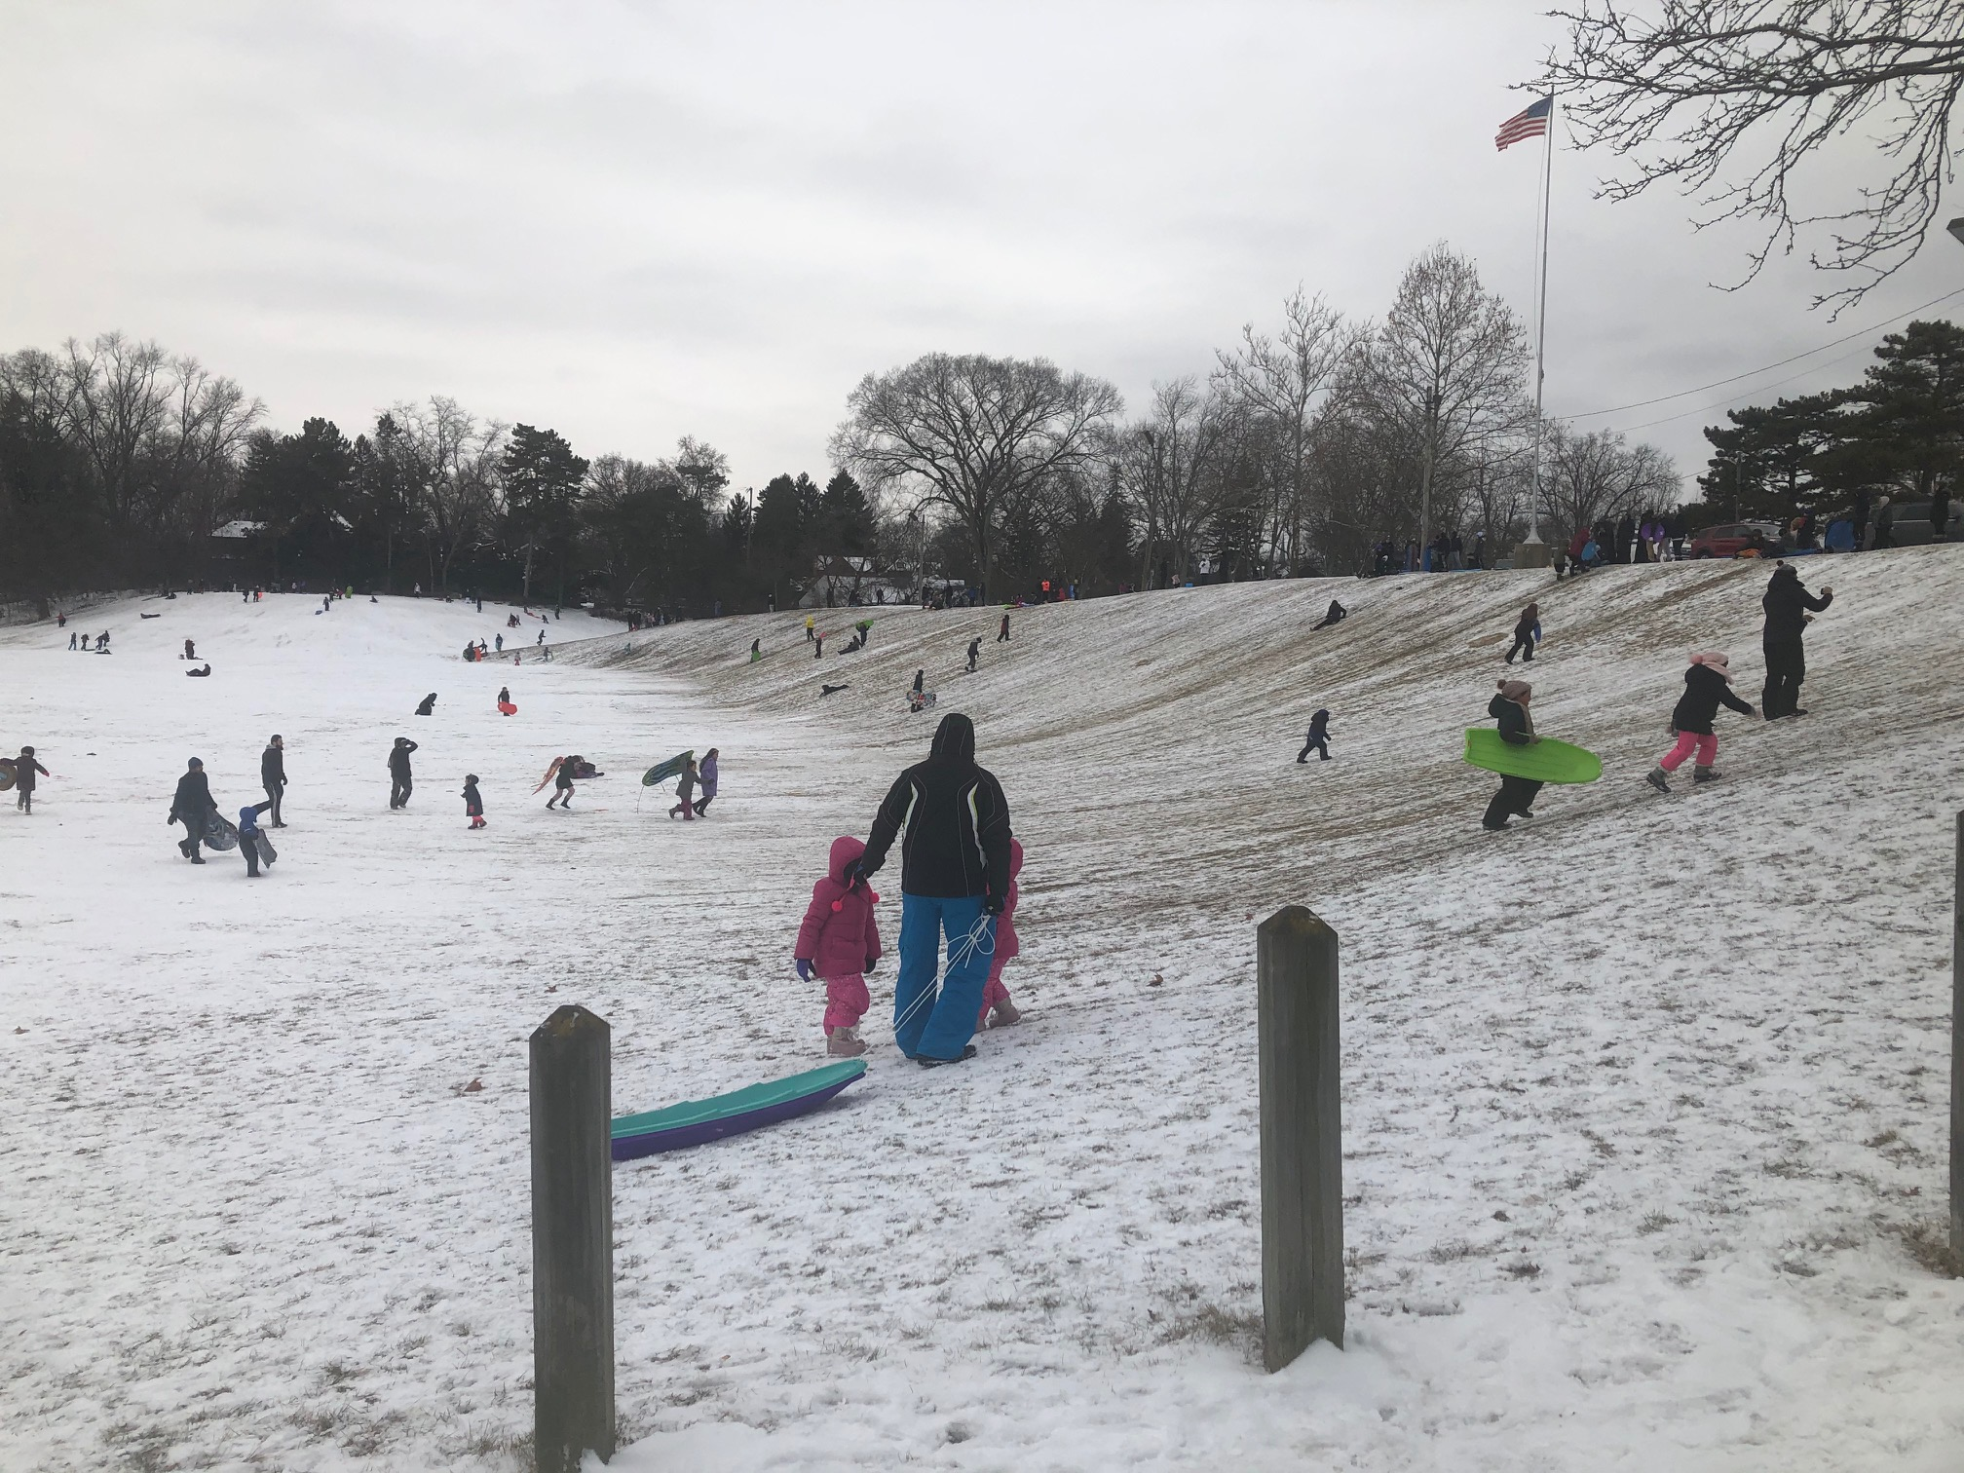
January Activity #2 Sledding
Volunteer: Owen
Thank you to Wyatt, Quin, Kyle, Glenn and Oliver for sticking around to sled with Pack 1127.

Slide 5

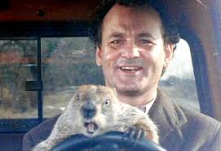
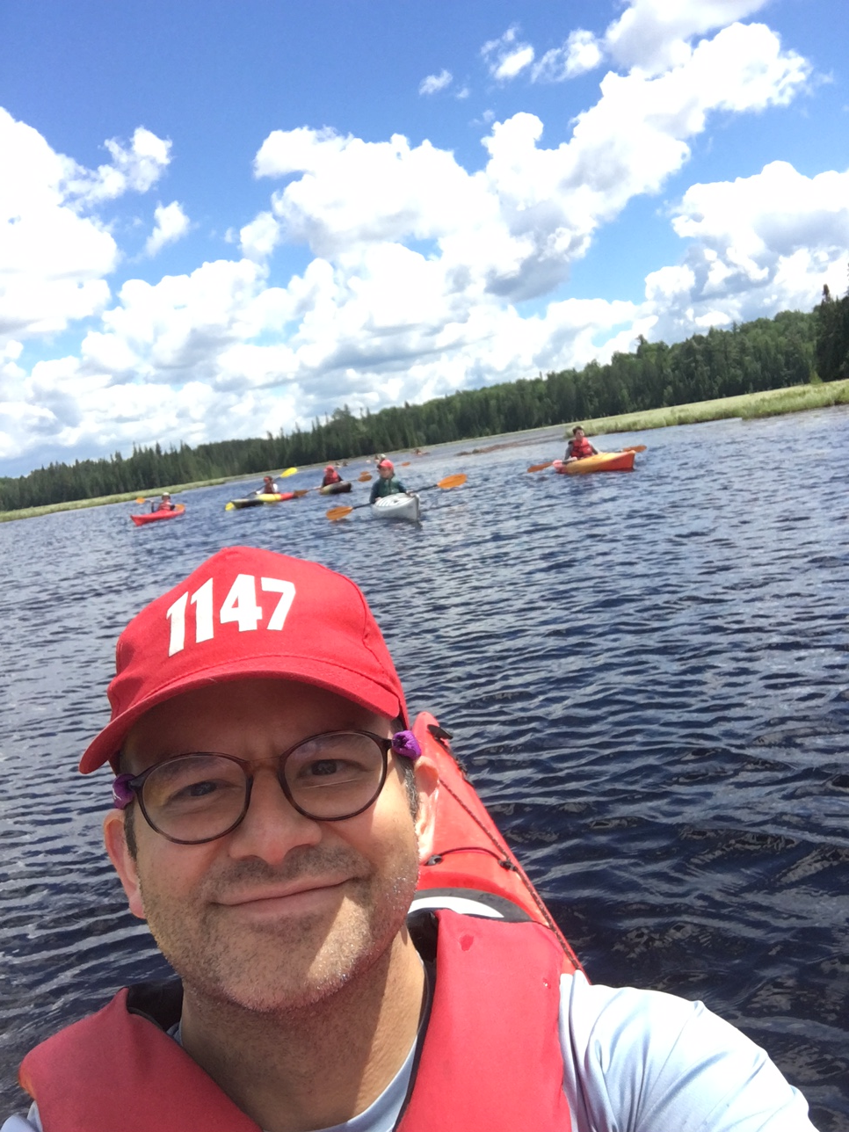

Groundhog Day Ice Breaker
Everyone shares:
Name
What Food You Would Eat Every Day
One thing you would do on your “Perfect Day”
What you plan to do with six more Weeks of winter

Slide 6
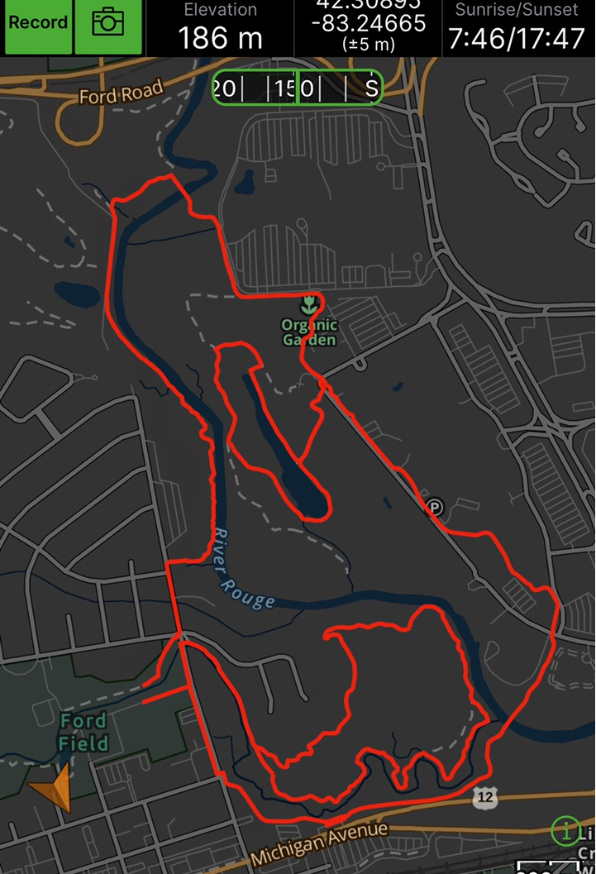
Hike Plan
Leader: Caden
When: February 6th 9 AM
Where: Ford Field
What: 5 Mile Hike and lunch
Who: Scouts who RSVP to Mr. Pfeiffer by Wednesday
What to Bring: Scout Essentials, Day Pack, Water

Slide 7
Patrol Meetings
First Name |  |  | Patrol | Job | Feb 2nd
Oliver |  |  | 1 | Guide
Benjamin |  |  | 1
Colin |  |  | 1
Alec |  |  | 1
Xavier |  |  | 1 |  | x
Nathaniel |  |  | 1
Caden |  |  | 1 |  | x
Wyatt |  |  | 1 |  | x
Quinn |  |  | 1 |  | x
Liam |  |  | 1 | Partol Leader | x
Grant |  |  | 2
Timothy |  |  | 2
Charles |  |  | 2
Liam |  |  | 2
Aidan |  |  | 2 | Patrol Leader | x
Owen |  |  | 2 | Webmaster | x
Jason |  |  | 3 |  | x
Connor |  |  | 3
Alex |  |  | 3
Eamon |  |  | 3 |  | x
Dane |  |  | 3 | Chaplain | x
Drew |  |  | 3
Daniel |  |  | 3
Jonathon |  |  | 3 |  | x
Glen |  |  | 3 | Patrol Leader | x
Jacob |  |  | Leadership Corps | ASPL | x-1
Ethan |  |  | Leadership Corps | ASPL
Ian |  |  | Leadership Corps | SPL | x-3
Kyle |  |  | Leadership Corps | ASPL
Patrol Breakouts:
Patrol Contact info- Share your address in the chat
Patrol Name Ideas- Must be able to buy a regular patch
Advancement item- First Class 5b, 5c and 5d
(Pages 212 to 218 in your scout books)
Play Among-us
http://usscouts.org/advance/boyscout/workbooks/First-Class.pdf

Slide 8
November and December Plans- Mr. Angel
January 26 6:30pm PLC – 1/31 and 2/2 Event Planning
January 31 3:00pm Ford Field Outing
February 2 6:30pm. Patrol Meeting (Patrol Name icebreaker, advancement and Among-us,)
February 9 PLC meeting (Webelo Meeting Planning)
February 14 Cardboard classic (Make your own sled)
February 16 Troop Meeting. 6:30pm Minecraft Server, Patrol Meeting (Vote patrol names)
February 28 X-country ski
March 2 Troop meeting TBD
Winter challenge- Merit Badges
The patrols will have a competition to see who earns the highest number of badges per scout before the March Court of Awards.
Partials count! Bring in your list of partials and we will find councilors to review your finished work.
February 1st Patrol Standing : Patrol 3 with .56 Badges/Scout
Patrol 2 with .5 Badges/Scout
Patrol 1 with .2 Badges/Scout

Slide 9
Closing

