Slide 1
Lesson 9: Race and Ethnicity
Robert Wonser
Introduction to Sociology

Slide 2
Reifications
Race and ethnicity are social constructions.
They are defined and maintained through interaction.
They do not exist biologically.
They are reifications, social constructions.

Slide 3
Race and Ethnicity Defined
Race is a socially defined category, based on real or perceived biological differences between groups of people.
Ethnicity is a socially defined category based on common language, religion, nationality, history, or another cultural factor.

Slide 4
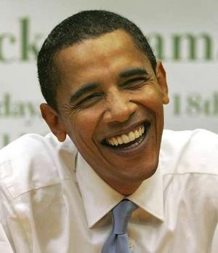
What Does “Black” and “White” Look Like Anyway?
What race is this man?
What marks him as Black?
A 2009 Pew Research Center poll showed that 52 percent of Americans said Barack Obama was of "mixed race," while 27 percent called him "black.”
Notes:
http://thesocietypages.org/socimages/2008/10/24/what-does-black-and-white-look-like-anyway/

Slide 5
What Does “Black” and “White” Look Like Anyway? Obama and his Grandfather

Slide 6
Race and Ethnicity Defined
Sociologists see race and ethnicity as social constructions because they are not rooted in biological differences, they change over time, and they never have firm boundaries.
Ex: white

Slide 7
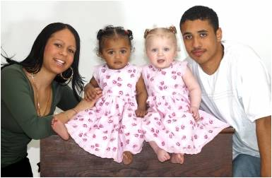
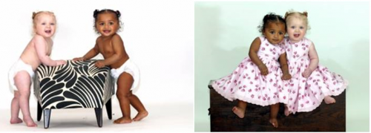
“BLACK AND WHITE TWINS” AND THE SOCIAL CONSTRUCTION OF RACE
The children in the images below — Kian and Remee Hodgson – are fraternal twins born to two bi-racial parents. What race are they?
Notes:
http://thesocietypages.org/socimages/2014/08/01/black-and-white-twins/

Slide 8
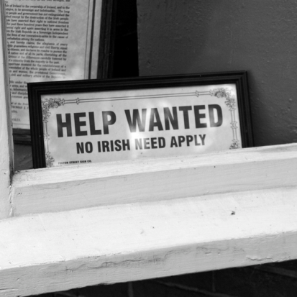
Defining Race and Ethnicity
The distinction between race and ethnicity is important because ethnicity can be displayed or hidden, depending on individual preferences, while racial identities are always on display.

Slide 9
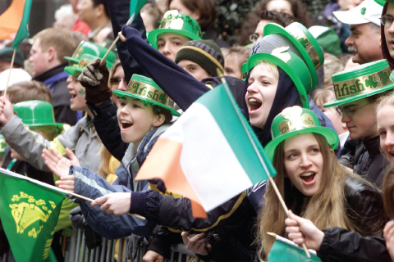
Race and Ethnicity Defined
Symbolic ethnicity is an ethnic identity that is only relevant on specific occasions and does not significantly impact everyday life.
Crowds line the streets at the St. Patrick’s Day Parade in New York City. How is this an example of symbolic ethnicity?

Slide 10
What Is a Minority?
A minority group is made up of members of a social group that is systematically denied the same access to power and resources available to the dominant groups of a society, but who are not necessarily fewer in number than the dominant group.

Slide 11
Racism, Prejudice, and Discrimination
Racism: a set of beliefs about the superiority of one racial or ethnic group.
Used to justify inequality
Often rooted in the assumption that differences between groups are genetic.
It is an ideology.

Slide 12
Racism, Prejudice, and Discrimination
Prejudice: (a thought process)
an idea about the characteristics of a group
applied to all members of that group
unlikely to change regardless of the evidence against it.
Discrimination: (an action)
unequal treatment of individuals because of their social group
usually motivated by prejudice

Slide 13
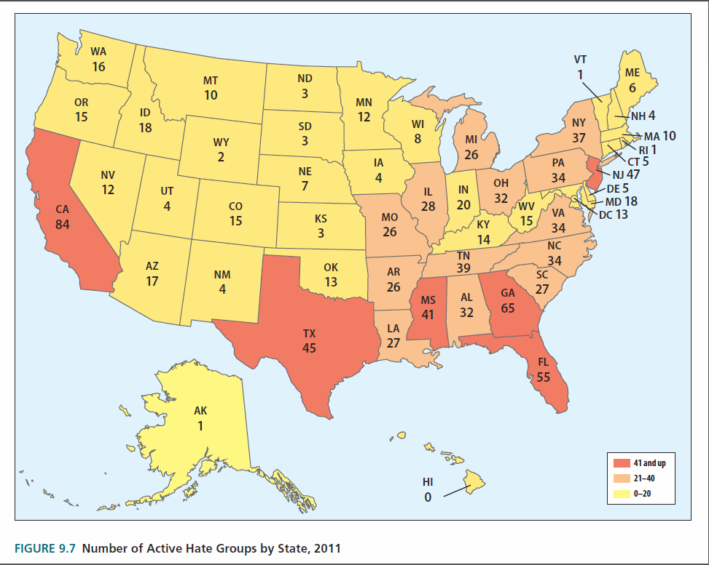

Slide 14
Racism, Prejudice, and Discrimination
Individual discrimination (or racism) is discrimination carried out by one person against another.
Institutional discrimination (or racism) is discrimination carried out systematically by social institutions (political, economic, educational, and others) that affect all members of a group who come into contact with it.

Slide 15
Racism, Prejudice, and Discrimination
Institutional racism is pervasive.
If all racist people went away racism would still exist because it is in our institutions.
It does not reside in any one person but is in the fabric and patterned interactions (social structure).

Slide 16
The Flipside to Disadvantage
Racism and discrimination disadvantages some but benefits others in the form of an invisible unseen privilege.
Invisible knapsack refers to the unearned resources (carried in the Invisible Knapsack) that are not in broad view or intended to be seen.
“White privilege is like an invisible weightless knapsack of special provisions, maps, passports, codebooks, visas, clothes, tools and blank checks.

Slide 17
What’s the Opposite of ‘Underprivileged’?

Slide 18
* I can be pretty sure that my neighbors in such a location will be neutral or pleasant to me.
* I can go shopping alone most of the time, pretty well assured that I will not be followed or harassed.
* I can turn on the television or open to the front page of the paper and see people of my race widely represented
* If a traffic cop pulls me over or if the IRS audits my tax return, I can be sure I haven’t been singled out because of my race.

Slide 19
Theoretical Approaches to Understanding Race in America
Functionalist theorists
Focus on the ways that race creates social ties and strengthens group bonds
Acknowledge that such ties can lead to violence and social conflict between groups

Slide 20
Theoretical Approaches to Understanding Race in America
Conflict theory focuses on the struggle for power and control over scarce resources.

Slide 21
Race as an Interactional Accomplishment
Symbolic Interactionists focus on the ways that race, class, and gender intersect to produce an individual’s identity.
They see race as an aspect of identity established through interaction.
There are several different ways that we project and receive our racial and ethnic identities.

Slide 22
Theories of Race in Review

Slide 23
An Ethnic Snapshot of America Today

Slide 24
Race, Ethnicity, and Life Chances
As bases for inequality, race and ethnicity influence all aspects of our lives, including health, education, work, family, and interactions with the criminal justice system.

Slide 25
Personal and Household Income, 2005

Slide 26
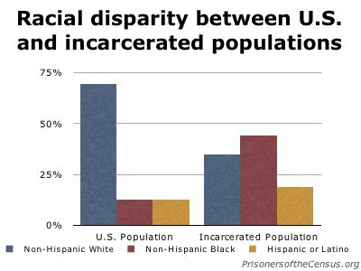
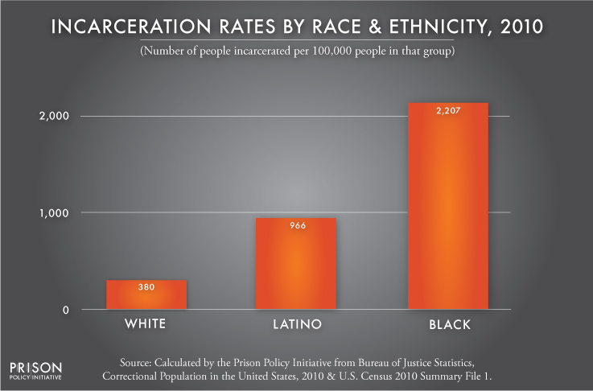
Incarceration Rates by Race & Ethnicity, 2010
Data Source: Statistics as of June 30, 2010 and December 31, 2010 from Correctional Population in the United States and from U.S. Census Summary File 1.. (Graph: Peter Wagner, 2012)
Notes:
http://www.prisonpolicy.org/graphs/race_us_prison.html

Slide 27
Number of Executions and Race of Prisoners Executed, 1976–2009

Slide 28
Race, Ethnicity, and Life Chances
Health care is an area in which we find widespread disparity between racial and ethnic groups.
Disparities in access to health care may help explain the life expectancy rates for men and women of different races.

Slide 29
Americans without Health Insurance by Race, 2007

Slide 30
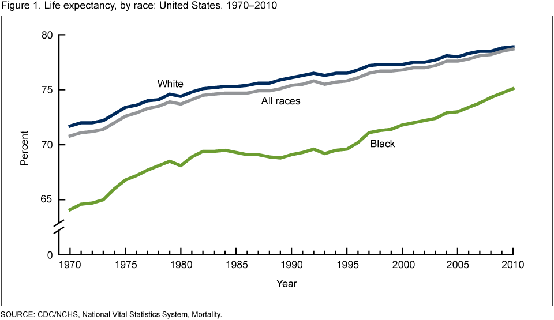
U.S. Life Expectancy by Race, 1970 – 2010
Notes:
http://www.google.com/imgres?imgurl=http%3A%2F%2Fwww.cdc.gov%2Fnchs%2Fdata%2Fdatabriefs%2Fdb125_fig1.png&imgrefurl=http%3A%2F%2Fwww.cdc.gov%2Fnchs%2Fdata%2Fdatabriefs%2Fdb125.htm&h=555&w=960&tbnid=TGlR0GySvTLNGM%3A&zoom=1&docid=SEvxsho78j5Q_M&ei=wQ1PVJTfHerX8AH2sIH4DA&tbm=isch&ved=0CB4QMygCMAI&iact=rc&uact=3&dur=1544&page=1&start=0&ndsp=12

Slide 31
Race, Ethnicity, and Life Chances
In U.S. education, the highest high school dropout rates are associated with those from economically disadvantaged and non-English-speaking backgrounds.

Slide 32
U.S. College Enrollment Rates by U.S. College Enrollment Rates by Race and Ethnicity, 2005
Notes:
http://www.prb.org/Publications/Articles/2007/CrossoverinFemaleMaleCollegeEnrollmentRates.aspx

Slide 33
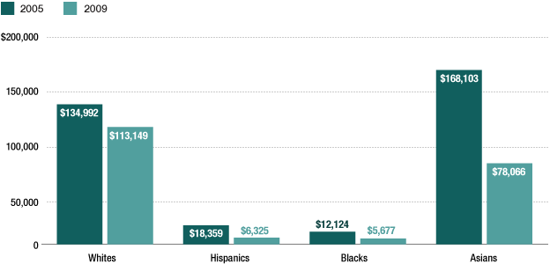
Median Net Worth of Households

Slide 34
Race, Ethnicity, and Life Chances
Finally, non-whites are more likely to interact with law enforcement.
Ex: crack versus cocaine

Slide 35
Lifetime Likelihood of Imprisonment by Race and Gender
Notes:
http://www.google.com/imgres?imgurl=http%3A%2F%2Fwww.sentencingproject.org%2Fimages%2Fphoto%2Fincarc%252520rate%252520by%252520race%252520%2526%252520gender%252520-%252520web.png&imgrefurl=http%3A%2F%2Fwww.sentencingproject.org%2Ftemplate%2Fpage.cfm%3Fid%3D122&h=1615&w=2392&tbnid=Wx40G3tdpsCzmM%3A&zoom=1&docid=YueSZAGEo09TSM&ei=rA9PVMvFDoGj8AG43YCwDQ&tbm=isch&ved=0CB0QMygBMAE&iact=rc&uact=3&dur=2045&page=1&start=0&ndsp=14

Slide 36
Race Relations: Conflict or Cooperation
Genocide is the deliberate and systematic extermination of a racial, ethnic, national, or cultural group.
Population transfer the forcible removal of a group of people from the territory they have occupied.

Slide 37
Race Relations: Conflict or Cooperation
Internal colonialism is the economic and political domination and subjugation of the minority group by the controlling group within a nation.
Segregation is the formal and legal separation of groups by race or ethnicity.

Slide 38
Race Relations: Conflict or Cooperation
Assimilation the minority group is absorbed into the mainstream or dominant group, making society more homogeneous.

Slide 39
Race Relations: Conflict or Cooperation
Pluralism (or multiculturalism) is a pattern of inter-group relations that encourage racial and ethnic variation within a society.

Slide 40
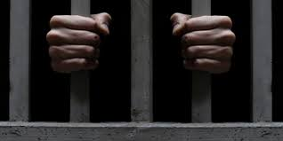
The New Jim Crow
Racism takes on new forms as society goes on
Slavery → Jim Crow → New Jim Crow
Alexander claims the U.S. criminal justice system uses the “War on Drugs” as a primary tool for enforcing traditional, as well as new, modes of discrimination and repression.
5% of the world's population, the U.S. incarcerates 25% of the world's prisoners

Slide 41
A Class Divided
A Class Divided video

Slide 42
Take Away Points:
Race and ethnicity are social constructions, or reifications.
They do not exist in the natural world but only in the social world.
They have real consequences and are used as the basis for inequality.
Like social class, they have effects on life chances.

Slide 43
Lesson Quiz
1. A socially defined category based on common language, religion, nationality, history, or another cultural factor is called:
a. ethnicity
b. symbolic ethnicity
c. symbolic race
d. race

Slide 44
Lesson Quiz
2. The unequal treatment of individuals because of their social group is called:
a. racism
b. Discrimination
c. prejudice
d. institutional racism

Slide 45
Lesson Quiz
3. Light-skinned African Americans who attempt to live as white in order to avoid the consequences of being black in a racist society are practicing:
a. racial passing
b. social fraud
c. ethnic cleansing
d. symbolic racism

Slide 46
Lesson Quiz
4. An idea about the characteristics of a group describes:
a. prejudice
b. assimilation
c. discrimination
d. stereotyping

Slide 47
Lesson Quiz
5. The pattern of intergroup relations that encourages racial and ethnic variation within a society is called:
a. pluralism
b. segregation
c. population transfer
d. assimilation

