Slide 1
Age-Related Macular Degeneration
Madhav Vempali
Vempali Medical Ltd

Slide 2
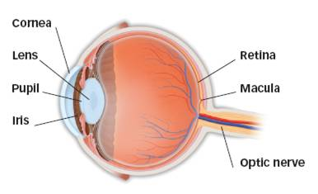
The healthy eye
Light rays enter the eye through the cornea, pupil and lens.
These light rays are focused directly onto the retina, the light-sensitive tissue lining the back of the eye.
The retina converts light rays into impulses sent through the optic nerve to your brain, where they are recognized as images.
Eye anatomy

Slide 3
The healthy eye
The retina, made of many layers sandwiched together into a smooth surface, consists of two areas: the macula and peripheral retina.
Macula
Small area in center of retina that allows you to see fine details clearly.
Allows activities like reading small print and recognizing a face.

Slide 4
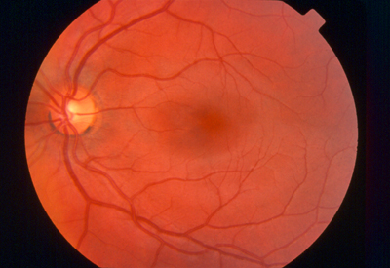
The healthy eye
Peripheral retina
Gives you side (peripheral) vision, not detail vision.
Helps you see someone standing off to your side, but you won’t see who the person is.
Normal retina

Slide 5
The healthy eye

Slide 6
What is age-related macular degeneration (AMD)?
A layer under the retina called the retinal pigment epithelium (RPE) is disrupted by deposits called drusen, or other age-related changes.
These changes, if severe enough, may cause vision to deteriorate.
When the macula breaks down, you lose your central vision, but it does not affect your peripheral (side) vision.

Slide 7
Symptoms of AMD
Early AMD may be hardly noticeable, and may only occur in one eye.
Words on a page may look blurred.
It may be difficult to recognize people’s faces.

Slide 8
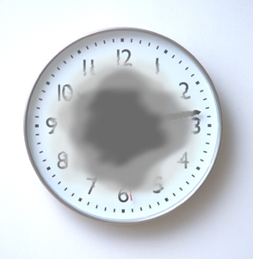
Symptoms of AMD
A dark or empty area may appear in the center of vision.
Straight lines may look distorted.
With AMD, dark areas may appear in your central vision.

Slide 9
Two types of AMD
Atrophic (“dry”) macular degeneration
Exudative (“wet”) macular degeneration

Slide 10
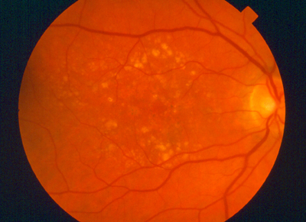
Types of AMD
Atrophic (“dry”) AMD
Caused by aging and thinning of macular tissues when drusen are present
Vision loss is usually gradual
Most common form
With AMD, drusen are seen
in the retina.

Slide 11
Dry AMD

Slide 12
Types of AMD
Exudative (“wet”) AMD
It is caused by abnormal blood vessels forming underneath the retina.
These vessels leak blood/fluid and blur central vision.
Vision loss may be rapid and severe.
With wet AMD, abnormal blood vessels are present under the retina.

Slide 13
Wet AMD

Slide 14
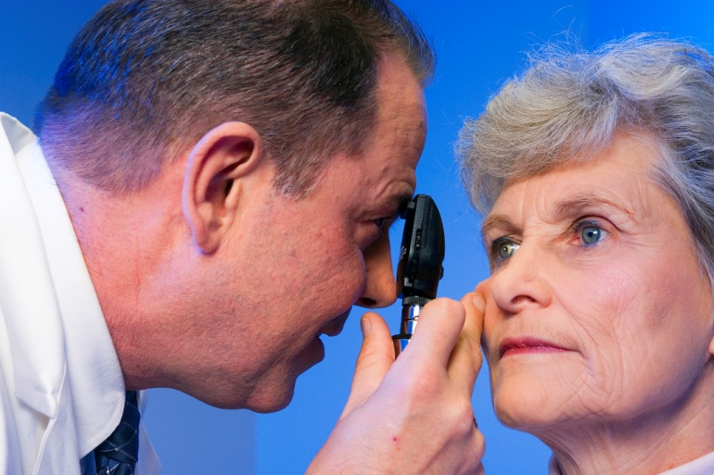
Diagnosing AMD
Many people do not realize they have a problem until vision blurs.
Your ophthalmologist can detect early AMD during an eye exam that includes:
Ophthalmoscopic examination
Fluorescein angiogram (if indicated)
Optical coherence tomography, also called OCT (if indicated)
Ophthalmoscope
examination

Slide 15
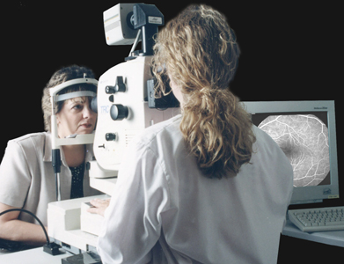
Diagnosing AMD
Fluorescein angiogram:
Dye is injected into your arm and travels through the body to the blood vessels in your eye.
Special photographs are taken of your eye; dye will highlight abnormal blood vessel growth under the retina.
Fluorescein angiogram

Slide 16
Fluorescein angiography

Slide 17
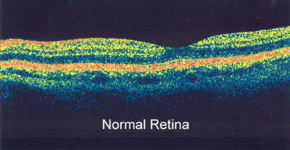
Diagnosing AMD
Optical coherence tomography:
The layers of the retina are scanned, focusing on the macula.
The scans measure the thickness of the macula and are able to show things such as fluid in or under the retina, which may indicate "wet" AMD.
Normal OCT scan

Slide 18
Treating dry AMD
There is no treatment for dry AMD.
Nutritional supplements may help slow the progression and impact of AMD:
Vitamins C, E
Beta carotene
Zinc

Slide 19
Treating dry AMD
Vitamin supplements are not cures for AMD, nor can they restore vision already lost from AMD.
Your ophthalmologist will discuss if supplements are recommended.

Slide 20
Treating wet AMD
Thermal laser therapy
Outpatient procedure
Used when abnormal blood vessel growth is not under center of macula
A high-energy, focused light beam treats a tiny area of retina by “burning” it; the laser beam destroys abnormal, underlying blood vessels, preventing further leakage, bleeding, and growth.

Slide 21
Treating wet AMD
Thermal laser therapy
Following treatment, your vision may be more blurred than before; it may stabilize within a few weeks.
A scar forms where treatment occurred, creating a permanent blind spot that might be noticeable in your field of vision.
It is likely that 50 percent of wet AMD patients who have the thermal laser procedure will need retreatment within three to five years.

Slide 22
Thermal laser therapy

Slide 23
Treating wet AMD
Anti-VEGF treatment
A certain chemical in your body is critical in causing abnormal blood vessels to grow under the retina. The chemical is called vascular endothelial growth factor, or VEGF.
There are several drugs (anti-VEGF) that can block the trouble-causing VEGF.
Blocking VEGF reduces the growth of abnormal blood vessels, slows their leakage, and helps to slow vision loss.

Slide 24
Anti-VEGF treatment
The anti-VEGF drug is injected into your eye with a very fine needle.
Your ophthalmologist will clean your eye to prevent infection and will administer an anesthetic to your eye to prevent pain.
Patients receive multiple anti-VEGF injections over the course of many months.

Slide 25
Anti-VEGF treatment
There is a very small risk of complications following anti-VEGF treatment, usually a result of the injection itself rather than the drug.
In some cases, your ophthalmologist may recommend combining anti-VEGF treatment with other therapies (i.e. some patients also receive photodynamic laser therapy).

Slide 26
Anti-VEGF treatment

Slide 27
Treating wet AMD
Photodynamic therapy (PDT)
If abnormal blood vessels grow under the center of the macula, PDT may be a treatment option.
PDT is an outpatient procedure.
PDT uses a combination of a light-activated (photo- sensitive) drug and a special low-power (cool) laser.

Slide 28
PDT
The photosensitive drug is injected into a vein in the arm, where it travels throughout the body; the drug attaches to molecules found in abnormal blood vessels.
Laser light is targeted directly on the abnormal vessels, activating the drug; the drug causes damage specifically to those unwanted blood vessels.
After PDT, abnormal blood vessels may reopen; multiple treatments may be required.

Slide 29
PDT

Slide 30
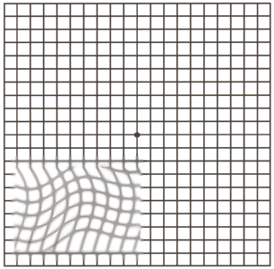
Make the most of your vision
If you have been diagnosed with AMD, you must monitor your vision every day with an Amsler grid.
With AMD, Amsler grid may contain blurry or wavy lines.
Amsler grid, as seen through a normal eye
Amsler grid, as might be seen through an eye with AMD

Slide 31
Amsler grid

Slide 32
What happens when AMD cannot be treated?
People with wet or dry AMD who cannot be treated will not become blind — they will still have peripheral (side) vision.
With low-vision rehabilitation, devices and services, people can often learn how to “see” again with their remaining vision.

Slide 33
Vision rehabilitation
Learn new strategies to accomplish daily activities
Skills, devices and techniques help people with advanced AMD regain confidence and live independently despite loss of central vision.

Slide 34
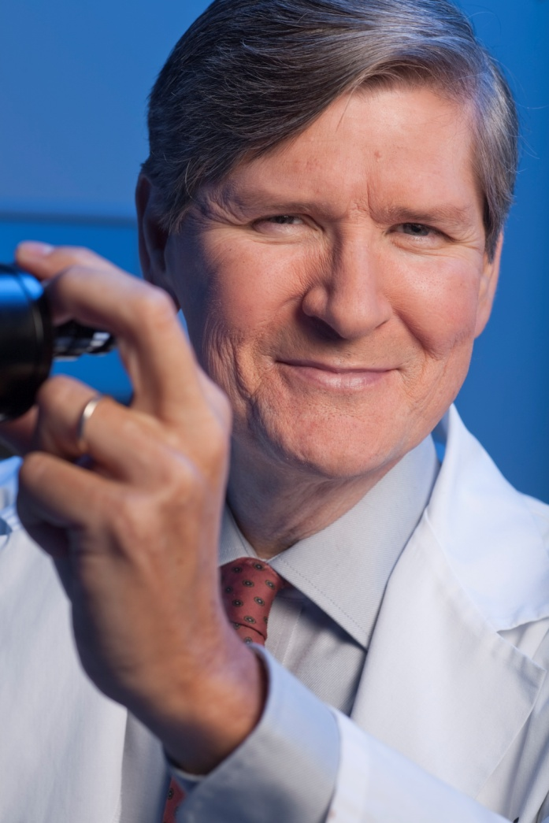
Vision rehabilitation
Team of professionals to help:
ophthalmologist
low-vision specialist
occupational therapist
rehabilitation teacher
orientation and mobility specialist
social worker
counselor

Slide 35
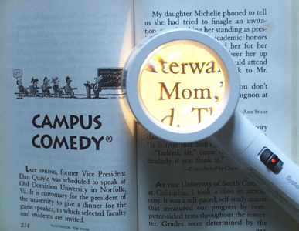
Low-vision aids
Optical low-vision devices use lenses to magnify objects:
magnifying spectacles
hand magnifiers
stand magnifiers
video magnifiers
telescopes
Illuminated magnifier

Slide 36
Low-vision aids
Other devices and techniques help make it easier to see:
Large-print books, newspapers, magazines, playing cards, checks
Writing and signing guides
High contrast and large number telephones, thermostats, watches, remotes
Talking books, watches, timers, medical devices

Slide 37
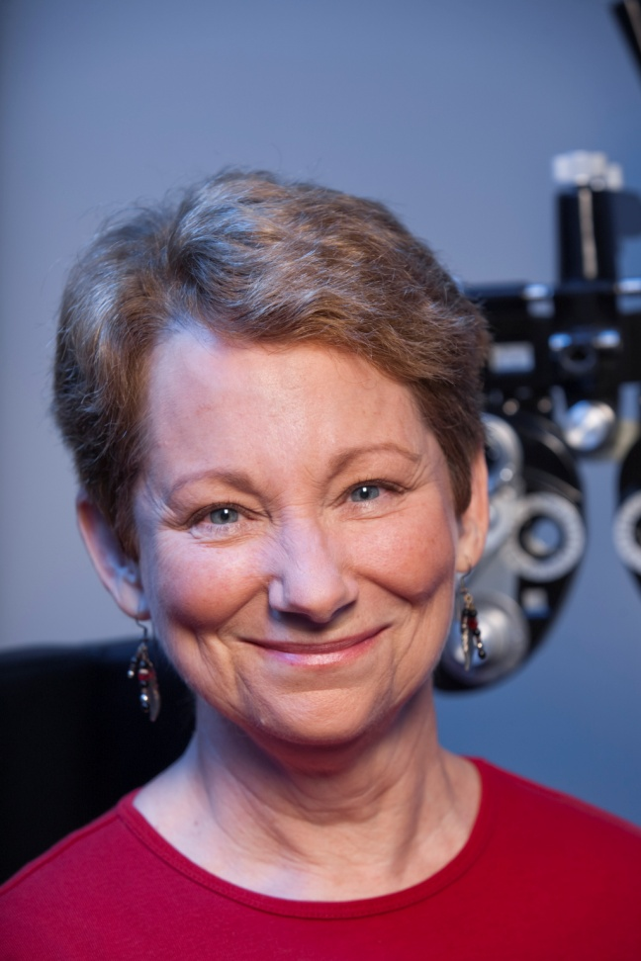
Aging adults should visit their ophthalmologists for vision screening
Adults with no signs or risk factors for eye disease should get a baseline eye disease screening at age 40 — the time when early signs of disease may start to occur. Based on the screening, an ophthalmologist will prescribe the necessary intervals for follow-up exams.

Slide 38
Aging adults should visit their ophthalmologists for vision screening
People at any age with symptoms of or at risk for eye disease — such as those with a family history of eye disease, diabetes or high blood pressure — should see an ophthalmologist to determine how frequently your eyes should be examined.

