Slide 1
Reducing Bag Waste in Springfield
Brad Verter
Mass Green Network

Slide 2

My Story

Slide 3
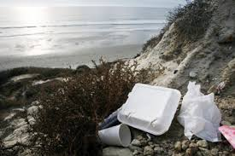

Slide 4


Slide 5
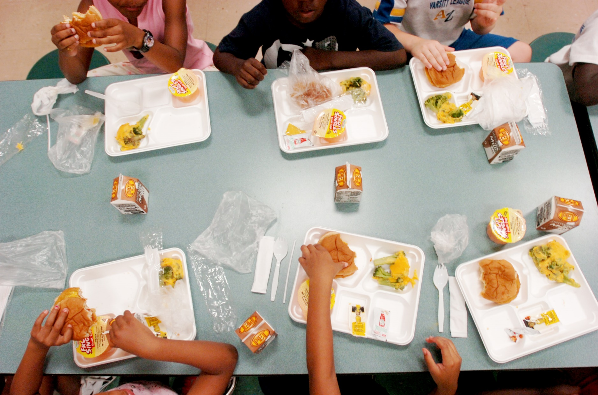

Slide 6


Slide 7
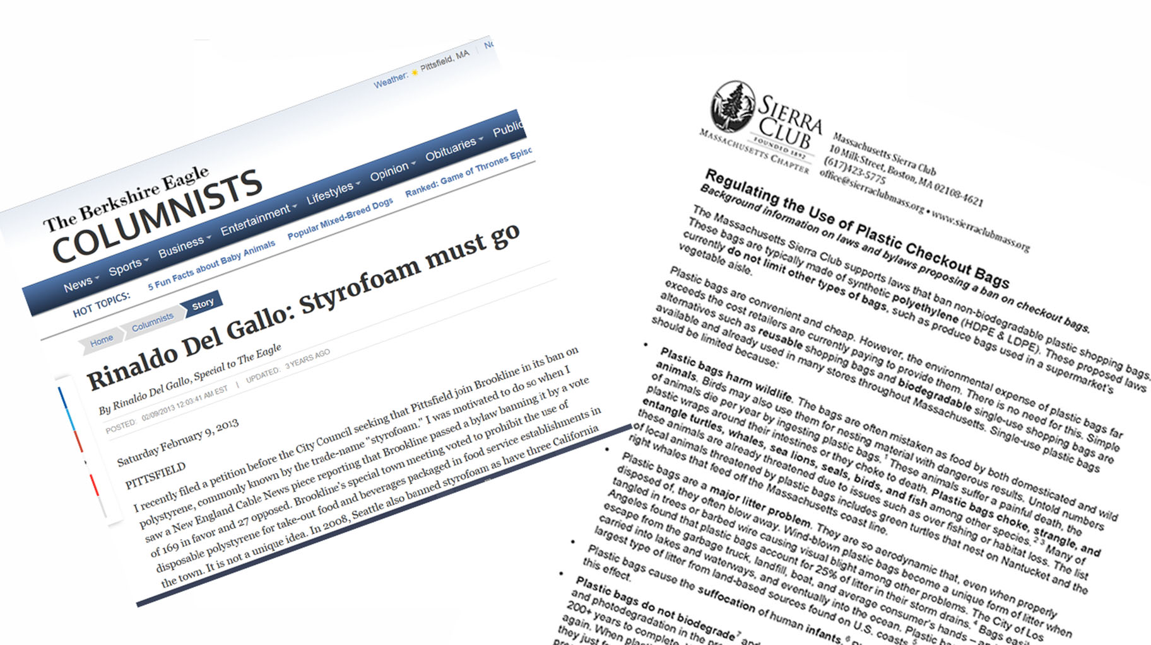
Notes:
An article in the local paper had alerted me to the fact that banning materials such as polystyrene and plastic bags was possible. I turned to the Sierra Club for help.

Slide 8
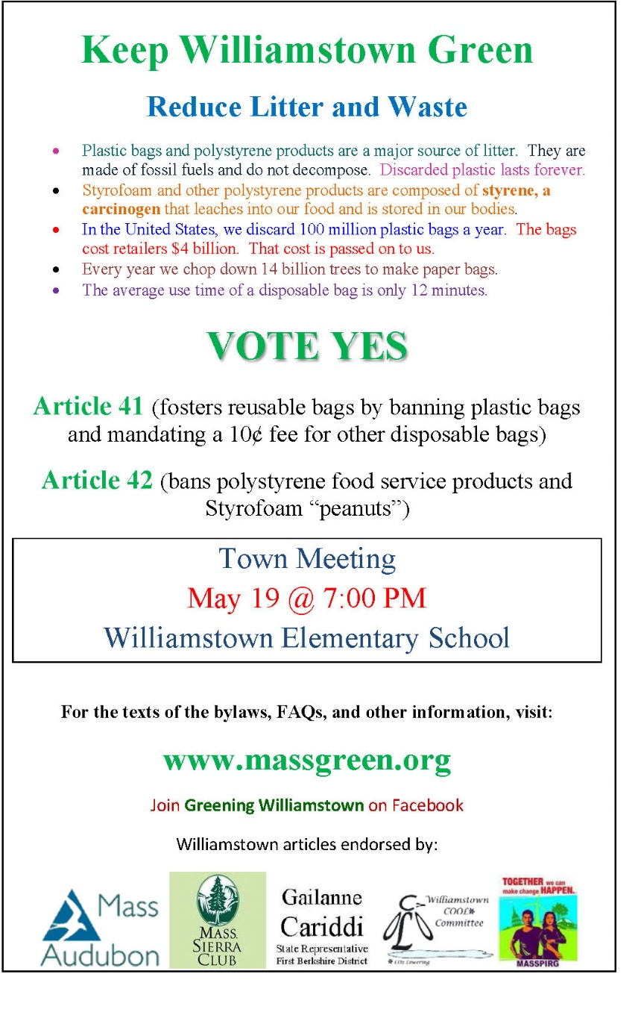


Slide 9
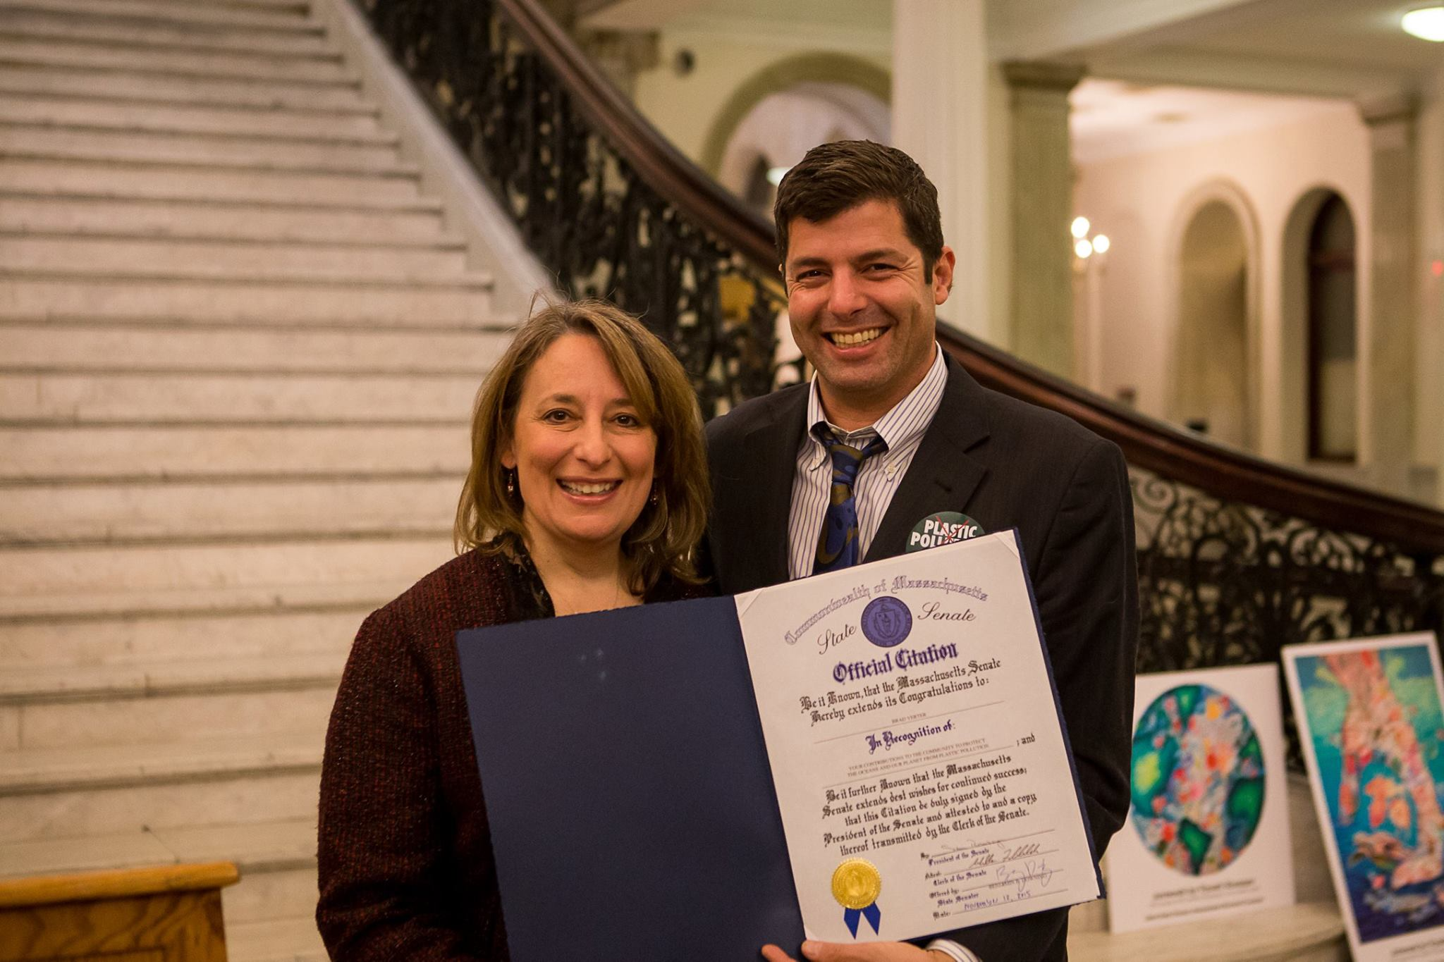

Slide 10
The Mass Green Network
Founded in October 2015.
Unites over 370 people across Massachusetts
Seeks to protect the earth, its resources, and its inhabitants by:
  connecting community groups
  fostering grassroots civic capacity
  catalyzing volunteer activism, and
  bridging demographic divides working to improve their communities
Membership is Free! Sign up at www.MassGreen.org

Slide 11
Why Should Springfield
Reduce Bag Waste?
Mass Green Network

Slide 12
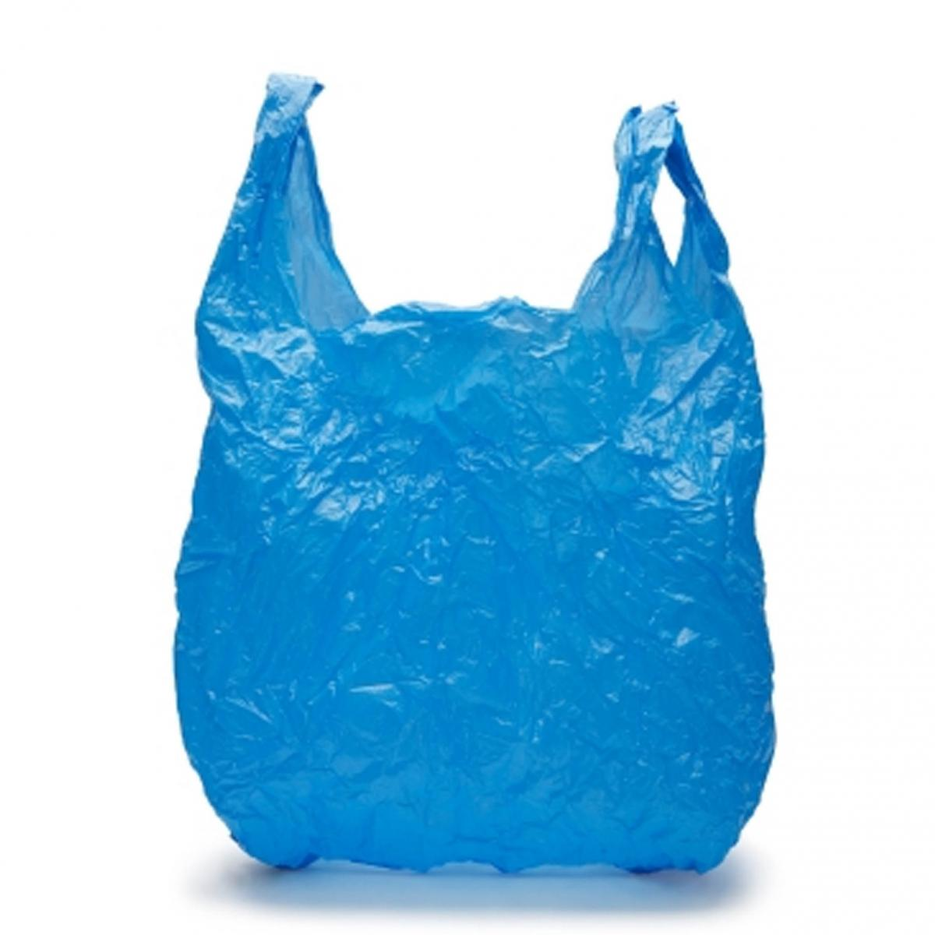
The Problem in a Nutshell
TOO MANY SINGLE USE BAGS
POLLUTE OUR ENVIRONMENT
SIGNIFICANT ECONOMIC COST
HARMFUL TO ANIMAL LIFE

Slide 13
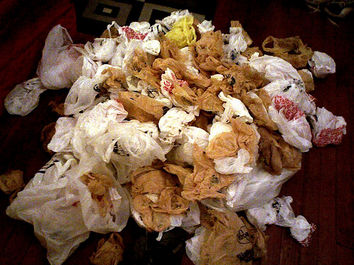
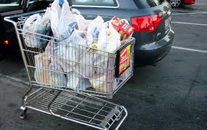
How Many is Too Many?
100 billion plastic bags are used in the U.S. every year.
Springfield uses 81,616,293 bags per year (531 bags/person, pop. 153,703)*
Most discarded after one use, average use time is 12 minutes
On average, 15 plastic bags per trip to the grocery store
*Constant from the 2013 EIR report produced by Parsons Brinckerhoff for the City of Los Angeles. Springfield pop. 2013.
Notes:
According to The Wall Street Journal, the U.S. goes through 100 billion plastic shopping bags annually.
According to a Mass Food Association survey, in 2012 the average supermarket in Massachusetts dispensed over two and one half million disposable bags – 2,682,643.
The average family shopper returns home with 15 bags per trip to the grocery store, and by some estimates, each plastic shopping bag is in use for an average of 12 minutes and approximately 90% are discarded after one use.

Slide 14
Bags Cost Consumers
There’s no such thing as a free bag!
Plastic checkout bags cost between 2 and 5 cents each
Average Supermarket pays at least $1000 every week for plastic bags
In Springfield, local retailers spend about $3,264,651.72 per year for bags
This hidden cost gets passed on to consumers
*Using average price of 4 cents/bags
$

Slide 15
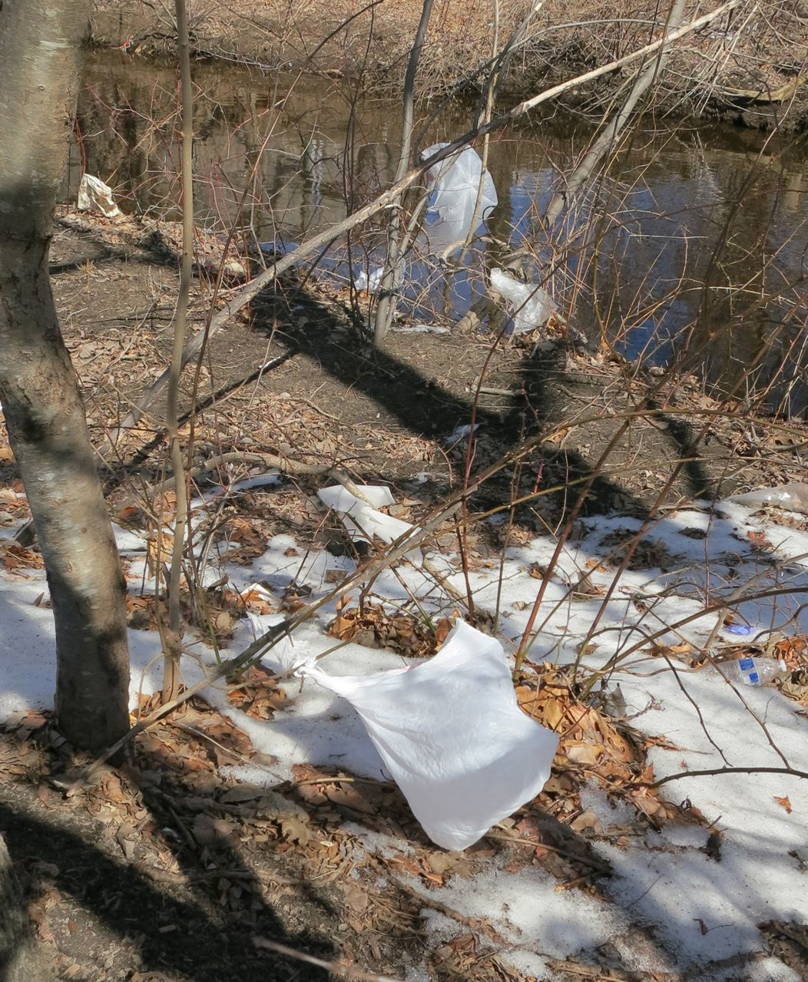
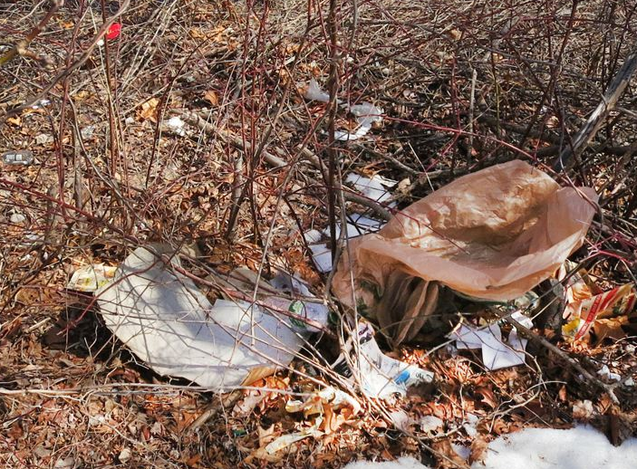
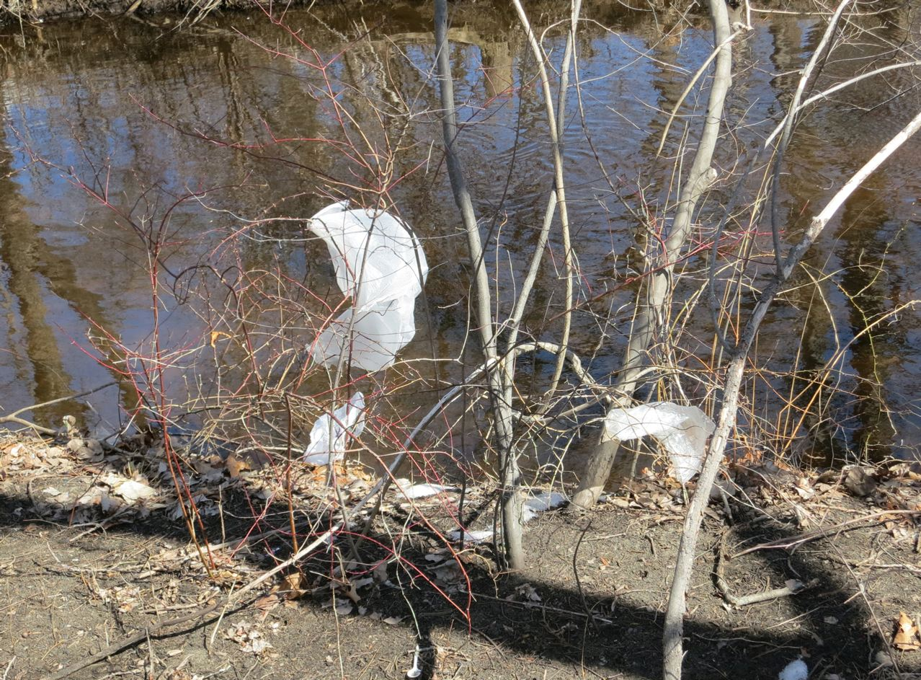
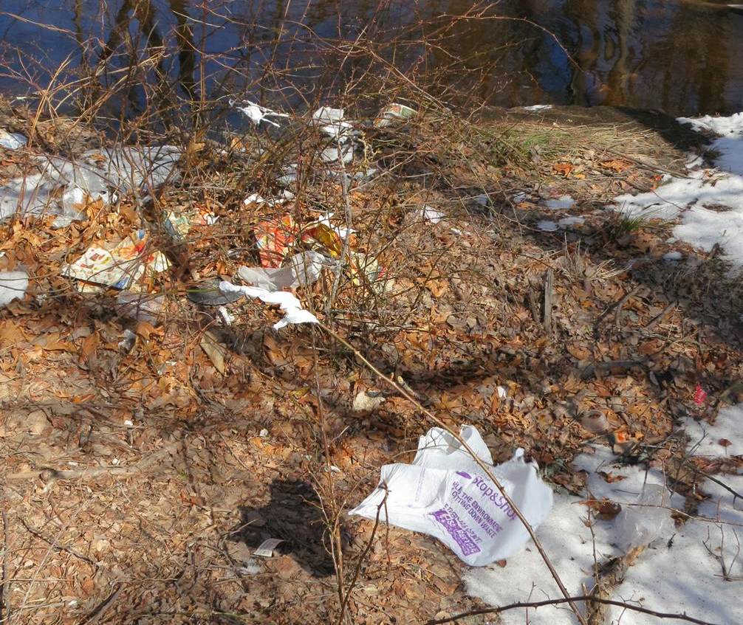
Notes:
Here are some recent views from local woods and waterways right here in town…

Slide 16
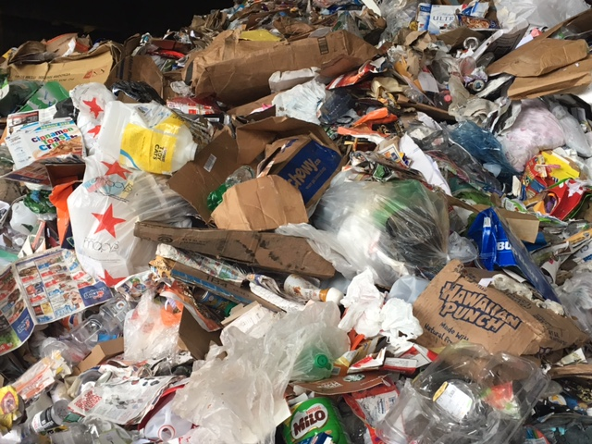
Bags Cost Municipalities
Municipalities expend needless resources cleaning up bag litter on streets, streams, woodlands, and storm drains.
Single-use bags are not recyclable in Massachusetts
Casella Recycling reports 100-125 tons of bag waste in Mass. per month
Bags at MRFs result in decreased throughput, increased maintenance, risk exposure, and materials contamination
Funds squandered on bag waste might be better spent on much needed social programs
Recyclables at Materials Recovery Facility (MRF) in Auburn, MA.
March 2017
Notes:
Years of efforts to educate the public and encourage recycling have failed to increase recycling rates for plastic bags, which are estimated to be between 3-10% nationwide.
Recycling is not particularly cost-effective - it actually costs more to recycle a bag than make a new one.
Plastic bags also can’t be recycled in our municipal curbside recycling bins. Those that are disposed of improperly get entangled every day in recycling machinery, causing ongoing labor and repair costs for these facilities.

Slide 17
Bags clog and damage the mechanisms of recycling machinery.
Here is a sorter used at Materials Recovery Facilities (MRFs) in Massachusetts…

Slide 18
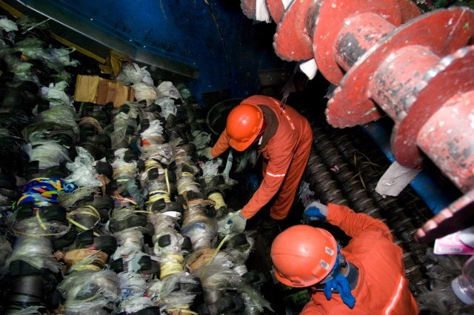
This is the sorter after an 8-hour shift
Being cleaned by hand, with utility knives
Notes:
10 - Recycling Problems
Plastic Bags require special recycling
When put into the standard stream they have become the #1 contaminate according to the Framingham DPW and EL Harvey.
They get caught in the sorting machines and it requires manual effort to get them out as you see here.
Even when properly recycled in most cases it costs more to deliver the plastic to a recycling facility than the plastic is worth.
Recycling is not the answer.

Slide 19
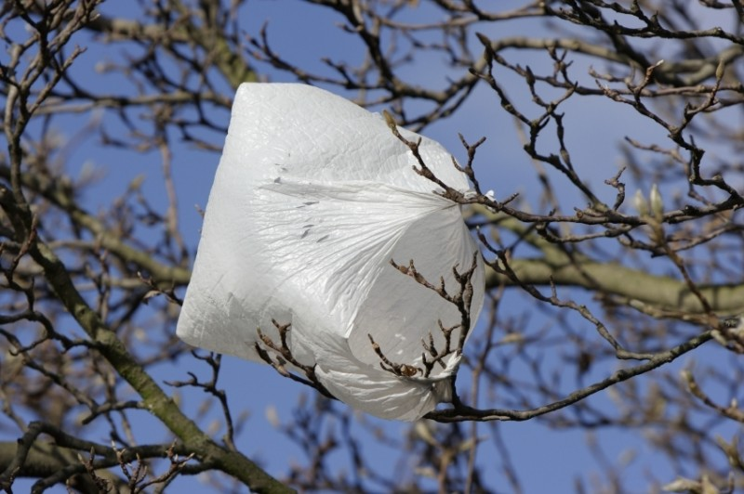
Bags Pollute our Environment
On land, bags take 500 to 1000 years to decompose. In water, they last forever.
Light weight – windblown debris can easily reach far- away woods and waterways
In landfills, release CO₂ which promotes the leaking of other gases including methane
Contaminate terrestrial, freshwater and marine habitats
Notes:
On land, plastic bags take 500 to 1000 years to decompose
Light weight – windblown debris can easily reach far- away woods and waterways
In landfills – release CO2 which promotes the leaking of other gases including methane
Contaminate a wide range of natural terrestrial, freshwater and marine habitats

Slide 20
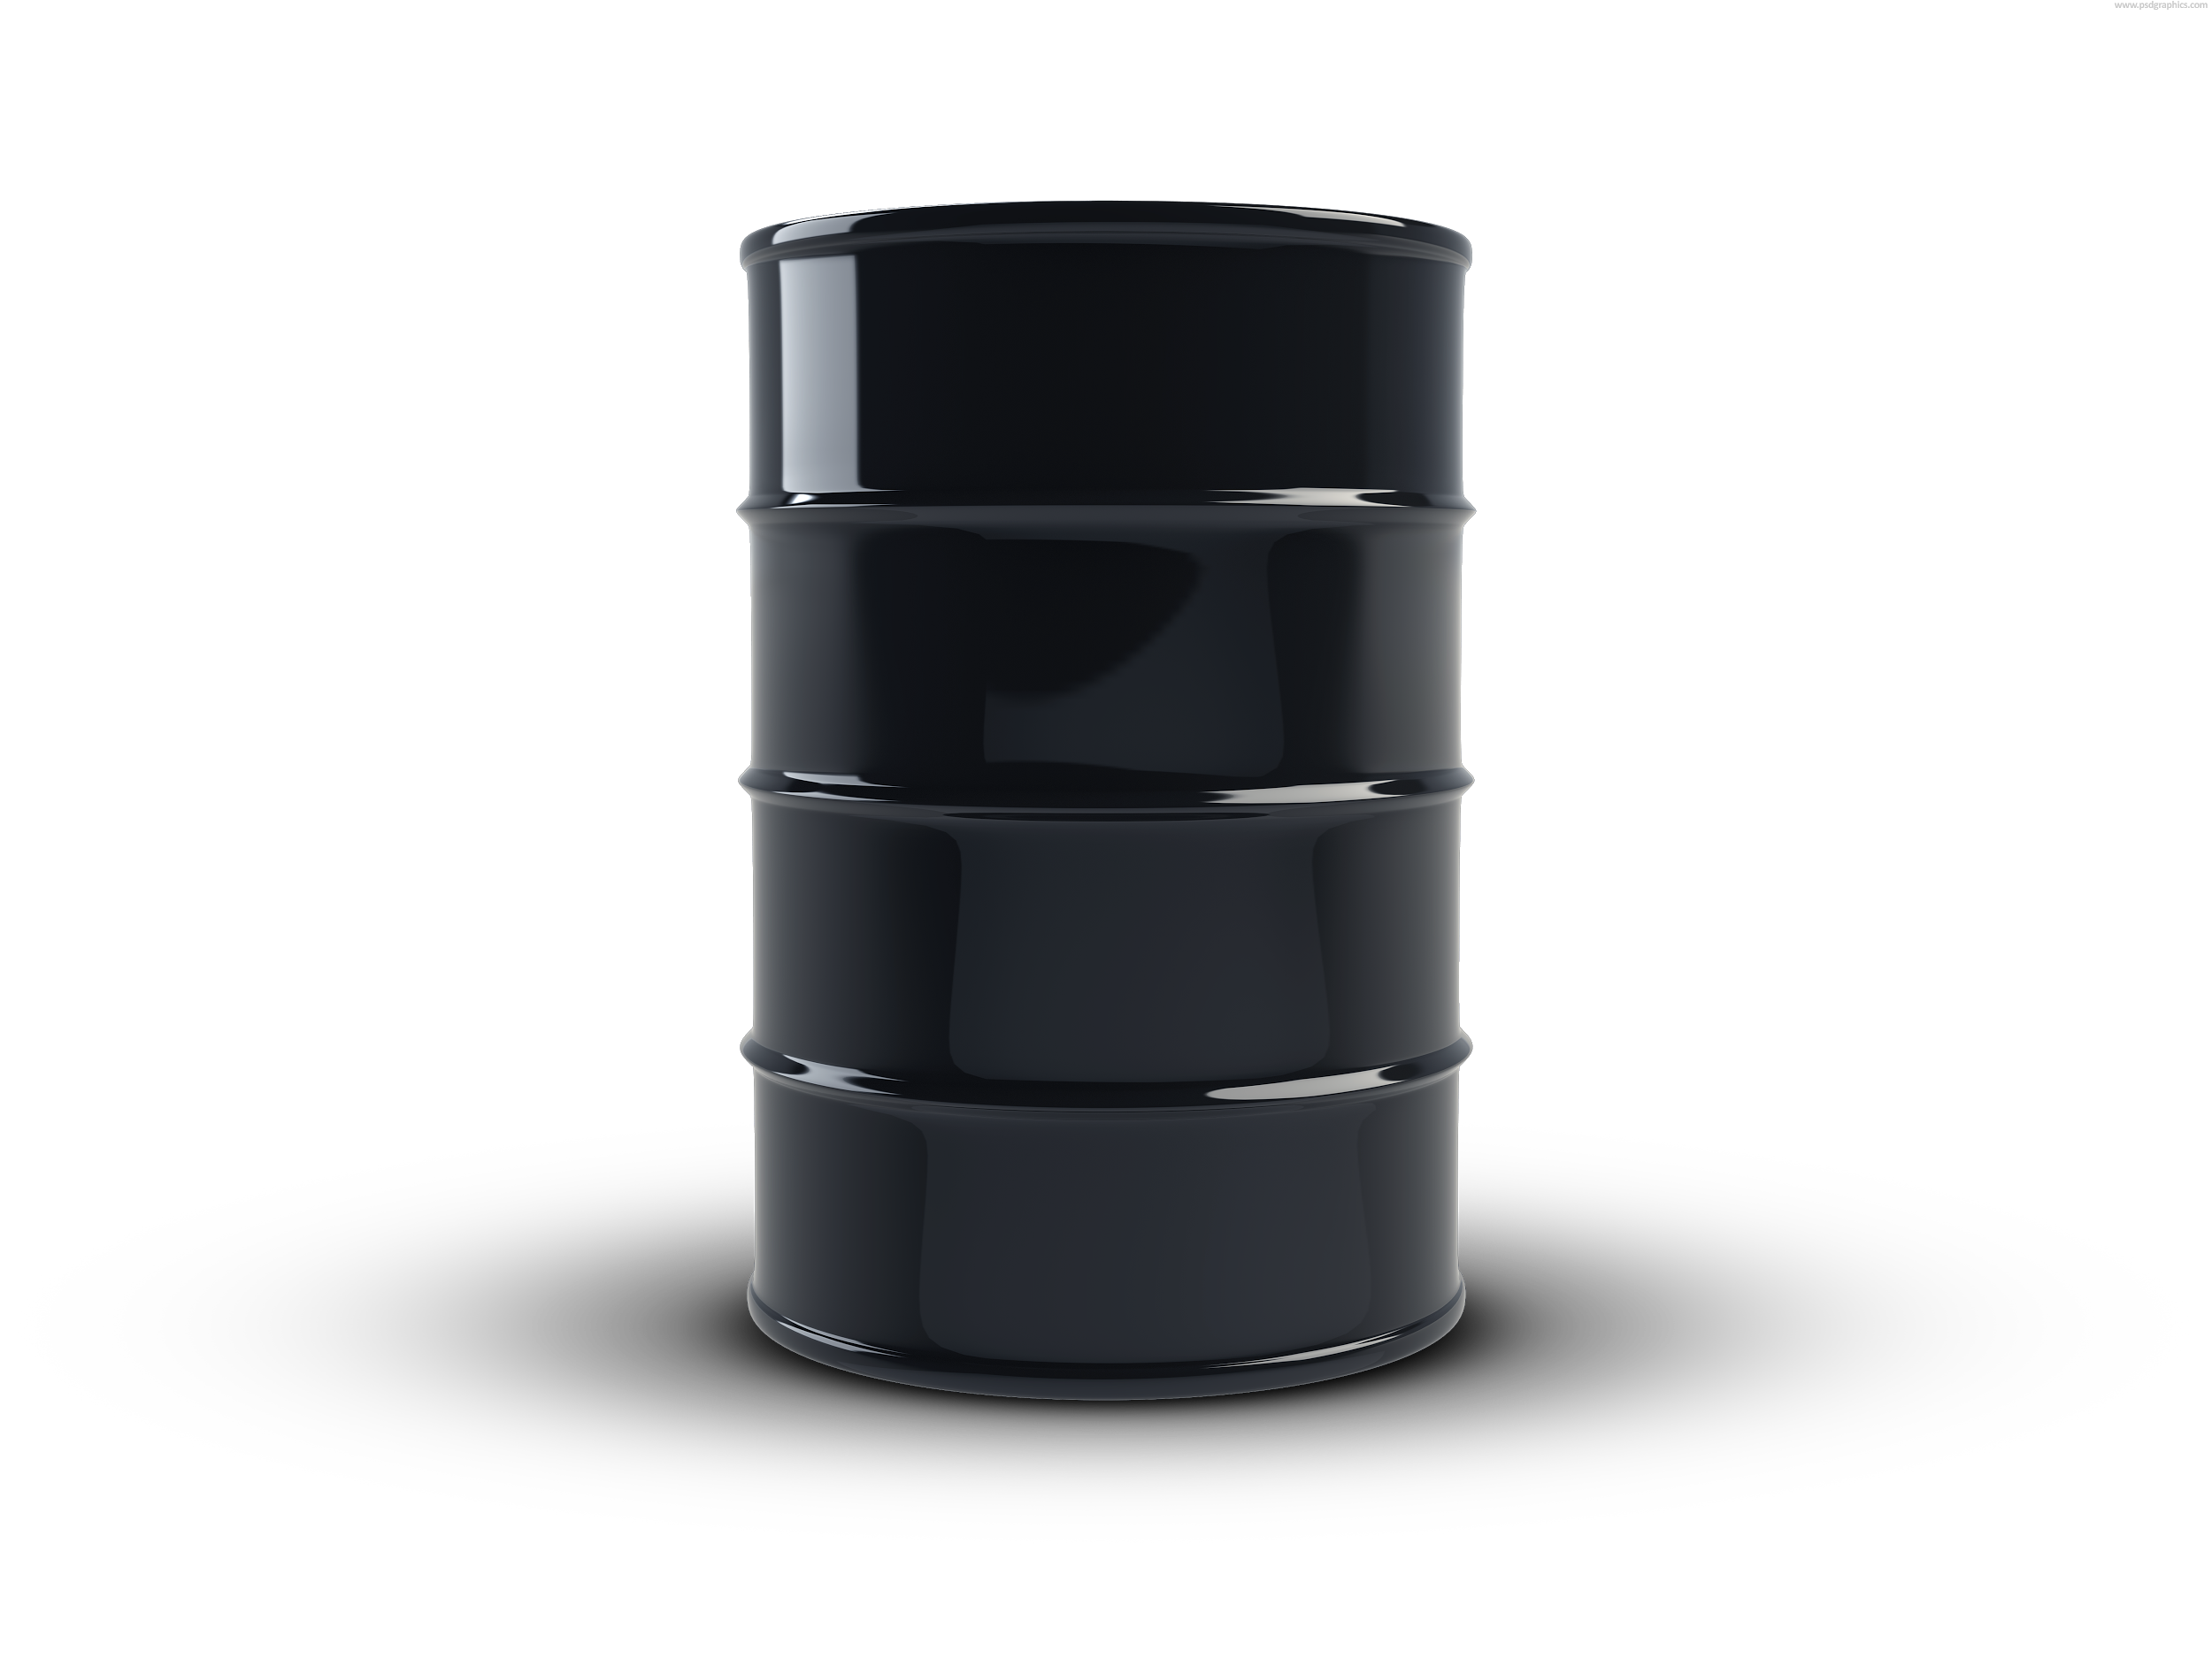
Bags Contribute to Global Warming
Plastic bags require non-renewable fossil fuels to create
Bags used in Springfield produce
2,176.4 metric tons of CO₂ per year
(0.04 metric tons per 1500 bags)*
*The GHG constant accounts for manufacturing, distribution, and disposal, and is taken from the Boustead Report, commissioned by the Progressive Bag Alliance, an industry group.
Notes:
6 - Non renewable
There are a number of environmental issues with these bags.
Plastic bags require non renewable fossil fuels to create.

Slide 21


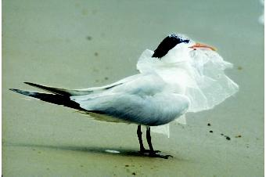
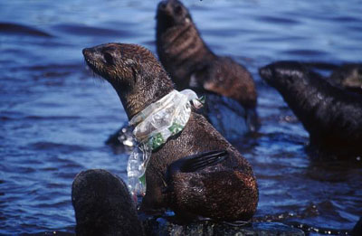
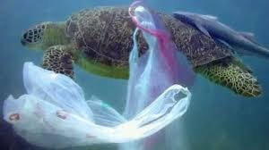
Bags harm birds and aquatic wildlife
Notes:
The harm plastic bags do to the environment is well known. Researchers in Australia estimate that ALL of the worlds sea birds have plastic in their systems, and plastic bags are estimated to cause over 100,000 sea turtle and other marine animal deaths every year.

Slide 22
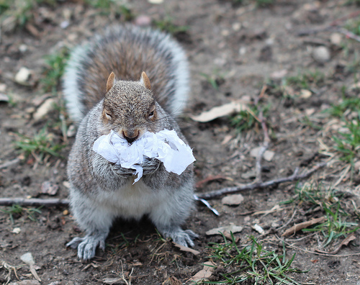


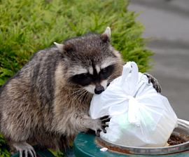
Bags Harm Terrestrial Wildlife and Pets
Notes:
Terrestrial wildlife, farm animals, and pets are also harmed by plastic bags. When plastic bags accumulate in animals’ stomachs, intestinal blockages can lead to starvation and death.

Slide 23
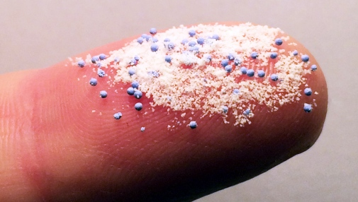
Microplastics and Human Health
Plastic bags do not biodegrade. Instead, they break down into tiny pieces (microplastics)
Microplastics enter waterways and flow into the ocean.
Marine life absorbs and concentrates pollutants present in the water. Zooplankton mistake microplastics for food. Thus pollutants bioaccumulate, and move up the aquatic food chain.
The extent of possible harm to the environment and human health is a matter of grave concern, and the focus of a great deal of current research.
Source: Environmental Health Perspectives • vol. 123, no. 2 • Feb. 2015
Notes:
There is also reason to be concerned about the accumulation of plastics in our seafood. When plastics break up into tiny pieces, they wash away into our waterways and ultimately reach the ocean, where they absorb pollutants already present in the water.
These pollutants bioaccumulate in marine animals when they mistake plastic for plankton, and move up the food chain to the fish that we eventually eat.
EPA chemist Richard Engler concluded, “While current research cannot quantify the amount, plastic in the ocean does appear to contribute to [persistent, bioaccumulative, and toxic substances] in the human diet.”1

Slide 24
MYTH!
Don’t Believe the Bag Industry’s Hype!
“Plastic is better than paper”
MYTH!
No. This claim comes from a misunderstanding of Life Cycle analyses that do not take into account the larger effects of plastic. Plus the ideal is reusable bags, not disposable paper bags.
“Reusable Bags cause disease”
MYTH!
No. This claim comes from a ridiculous story about a norovirus outbreak among a girls’ soccer team that had nothing to do with reusable bags. Washing reusable bags will kill any germs.
“Austin’s bag law resulted in more trash”
Yes, but this was because of a flaw in the law, which allowed retailers (specifically the grocery chain H-E-B) to give away heavy-duty plastic bags free of charge, and customers to discard what they should have been reusing. Generally, bag laws are super effective, reducing bag waste 60-80%, and over 90% once a modest fee is included.
“Bag laws hurt local businesses”
MYTH!
No. It is true that paper bags are more expensive than plastic. But multiple studies have shown that once a bag law is in place, consumers become more conscientious, and bring reusables – saving businesses money. No one has ever gone out of business because of a bag law.
“Bag laws hurt the poor”
MYTH!
No. In fact, disadvantaged communities suffer disproportionately from environmental degradation. Cutting the amount of resources spent on solid waste frees municipal funds for much-needed social programs.

Slide 25

What About Our Freedom of Choice?
This is an important philosophical question.
Americans have always struggled to find a balance between personal choice and responsibility to our communities and to future generations. This is the foundation of social contract theory.
One does not need to be a Libertarian to believe that over-regulation, just like anything done to excess, can be wasteful and harmful, and is a legitimate concern.
On the other hand, good regulations are important to protect human health and welfare, and to preserve the environment. (Take the ban on DDT, for example.)
Everyone who values his or her personal freedom needs to find a balance between freedom of choice and the responsible exercise of freedom.
The question here is whether the unregulated distribution of bags, which harm the earth and its inhabitants, and which impose significant costs to the community and to future generations, represents a responsible choice.
And for those concerned about the intrusions of “big government,” remember: in Massachusetts, government is organized according to democratic principles. Citizens in assembly determine for themselves what standards their community wishes to live by.
Do we wish to live responsibly and frugally, serving as stewards of the earth? Or do we want to live wastefully and cry, “Give me convenience, or give me death!”
John Locke (1632-1704) argued that our natural rights to life, liberty, and property were limited by our duty to do no harm to “the life, the liberty, health, limb, or goods of another”

Slide 26

Bag Laws Make Us More Mindful
Industry lobbyists commonly point out that bags comprise only a small percent of the waste stream, so why bother?
While 100 to 125 tons of discarded plastic bags a month in Massachusetts alone is hard to ignore, it is true that compared to other trash, they are just a drop in the bucket.
But bag laws have an impact that cannot be measured in tonnage. They make us more mindful about our other consumer choices.
The debate alone has served to raise consciousness significantly. Retailers used to ask “paper or plastic?” Now they usually ask, “Do you need a bag with that?”
Bag laws serve as a daily reminder that our everyday choices affect the planet. They help us to live more deliberately and more sustainably.

Slide 27
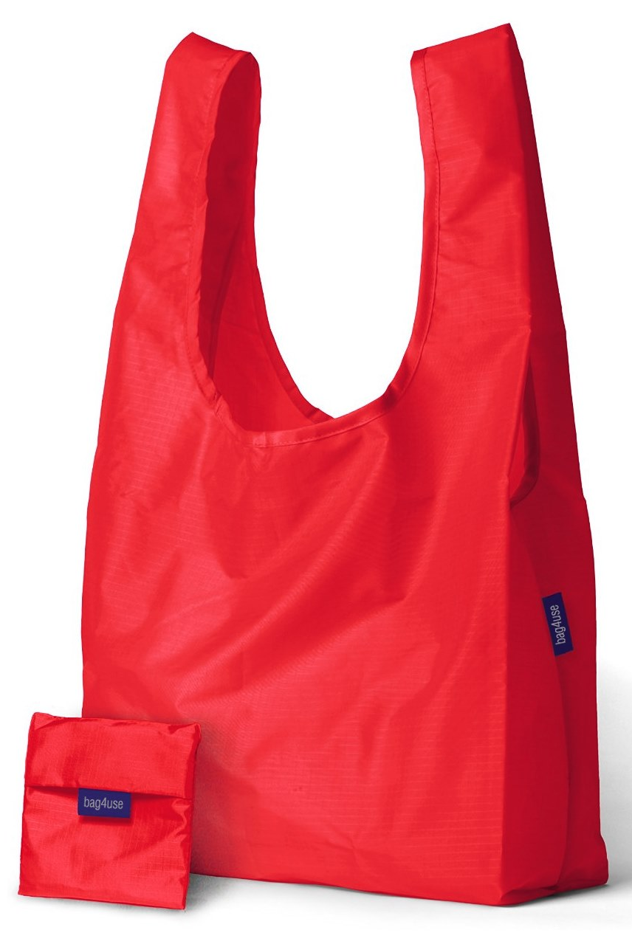
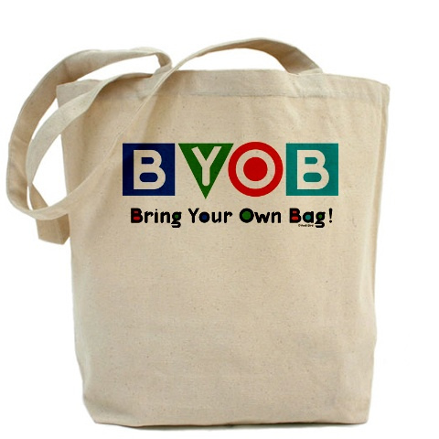
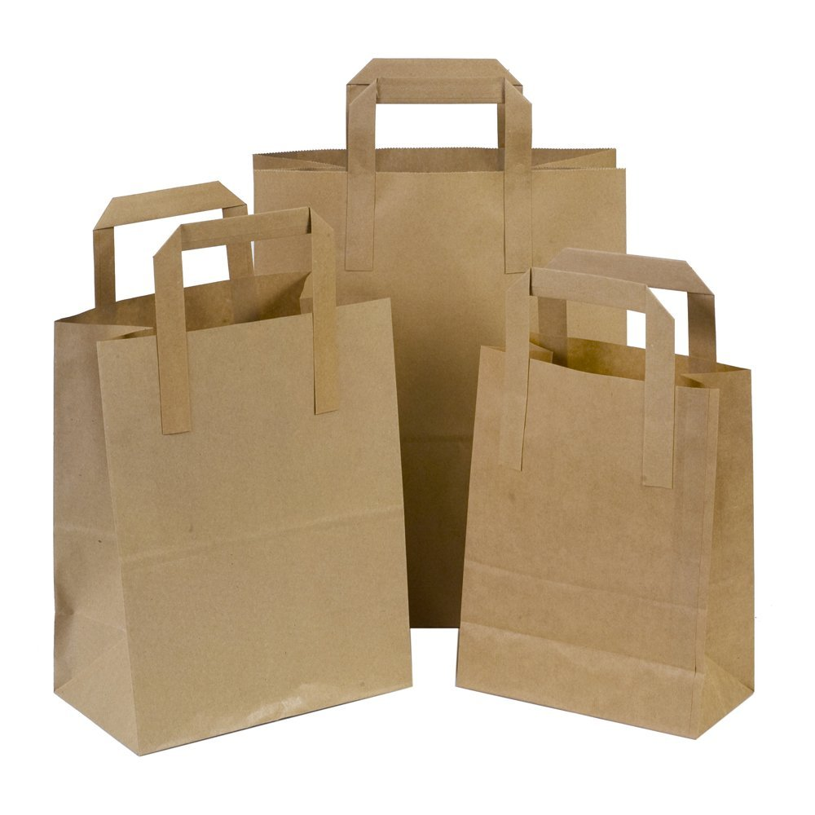
There Are Many Alternatives
Notes:
There are many alternatives to single-use plastic bags available, and under our proposed bylaw, businesses may provide thicker plastic bags that can be reused multiple times, or they may choose to follow the lead of Trader Joe’s and Whole Foods and only provide paper.
Customers are also encouraged to bring their own bags, whether canvass, paper or recycled plastic – and if having a light-weight bag with handles is important to you, there are nylon bags, such as the red one on the left of this slide, and this one I brought to show you tonight, which folds up conveniently into this little pouch, that are essentially identical in size and shape to the single-use plastic bags, but much sturdier and infinitely reusable.

Slide 28
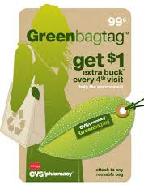
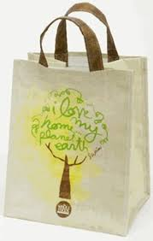
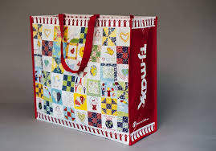
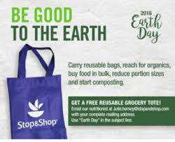
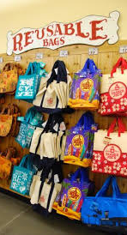
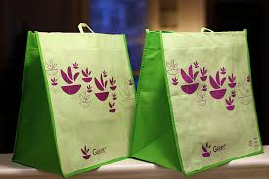
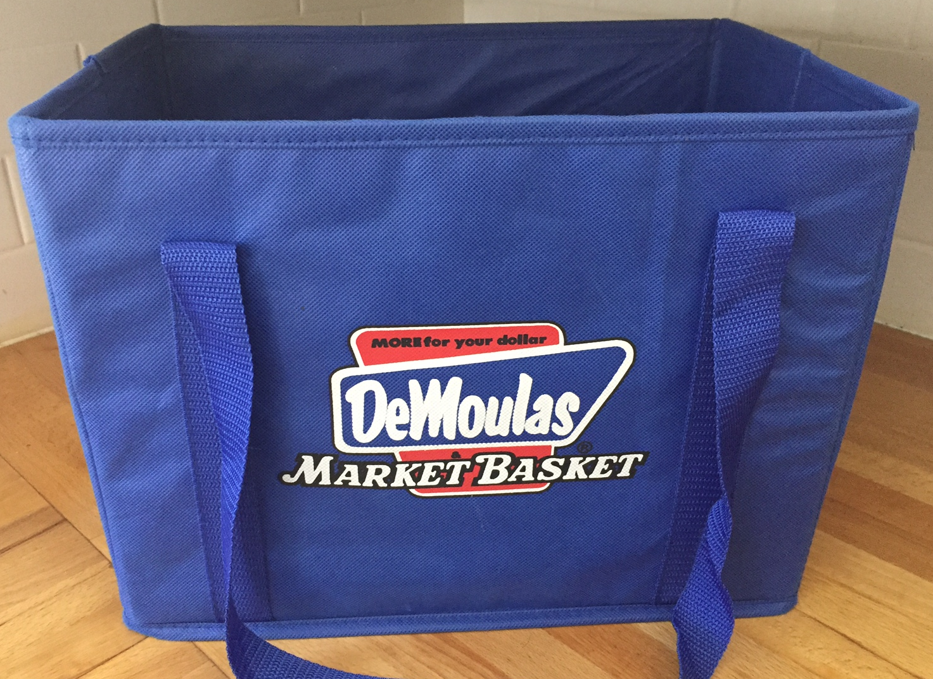
Retailers offer inexpensive options
Notes:
A whole range of retailers and grocery stores already make available to shoppers a variety of bag and basket options, and often promote these reusable items with incentives, rebates and bag giveaways.
Here’s an assortment from local stores: CVS, TJ Maxx, Whole Foods, Stop and Shop, Market Basket and Trader Joe’s.

Slide 29
47 Cities and Towns have approved Bag Laws
Adams
Amherst
Aquinnah
Arlington
Athol
Barnstable
Bedford
Boston
Bourne
Bridgewater
Brookline
Cambridge
Chatham
Chilmark
Concord
Dennis
Duxbury
Edgartown
Falmouth
Framingham
Gloucester
Grafton
Great Barrington
Hamilton
Harwich
Ipswich
Lee
Lenox
Manchester b.t. Sea
Marblehead
Mashpee
Nantucket
Natick
Newburyport
Newton
Northampton
Oak Bluffs
Pittsfield
Provincetown
Plymouth
Salem
Sandwich
Shrewsbury
Somerville
South Hadley
Springfield
Sudbury
Tisbury
Truro
Watertown
Wayland
Wellesley
Wellfleet
Weston
West Tisbury
Williamstown
* (PROPOSED)
Notes:
Plastic bag bans are becoming much more mainstream, around the country, around the world, and right here in Massachusetts.
Here is a list of the 43 Massachusetts cities and towns that have already passed these sorts of regulations, plus 9 more that are in the process of considering them.
This puts our efforts, which might seem insignificant considering our small size, into the context of a larger movement to address plastic bag pollution at a local and state level.

Slide 30
Join the Mass Green Network
Membership is free. Sign up at:
www.MassGreen.org
Brad Verter
Brad@MassGreen.Org
(413) 281-0522
Mass Green Network

