Slide 1
Montgomery County Volunteer Fire and Rescue Association

Slide 2
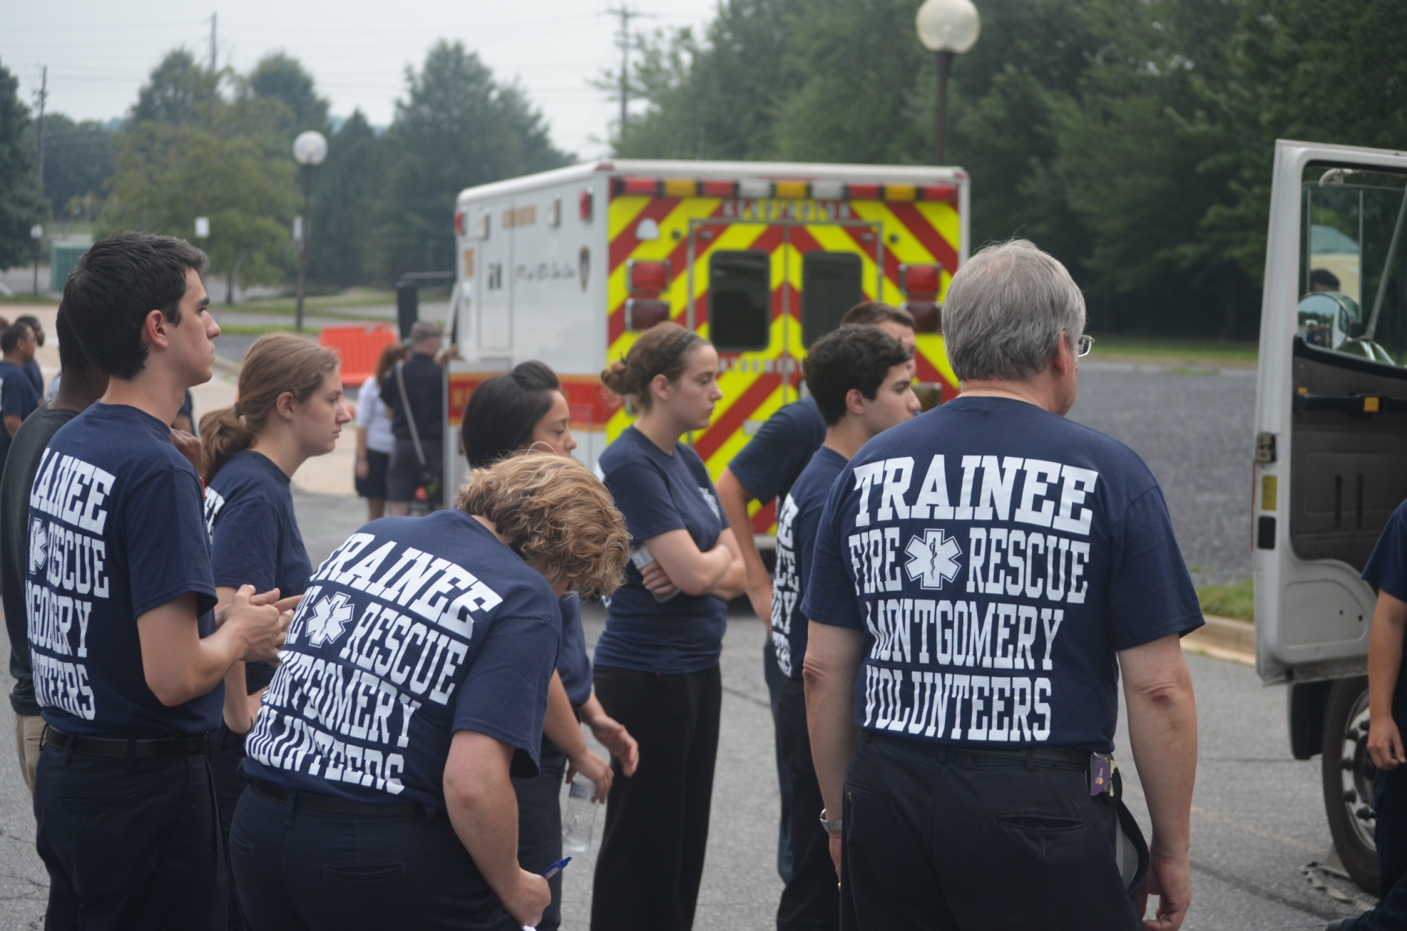
Fast Facts
18 Operational Volunteer Fire Departments
35 Fire Stations throughout the county
Volunteers can start at age 16
SSL Approved
Fire / EMS or EMS Only
Training equal to career firefighters
MCFRS is a combination system comprised of over 2400 personnel

Slide 3
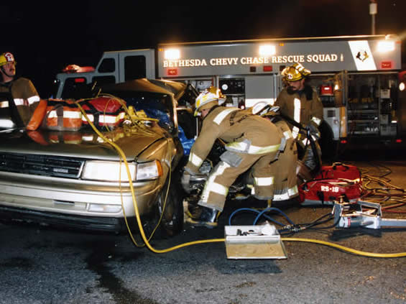
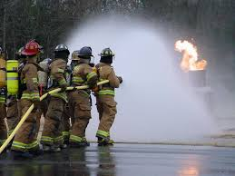
Firefighter
Also an EMT
Responds to a variety of incidents
Fires
Car Collisions
Trained to be interior qualified to NFPA Standards
Staffs apparatus including engines, squads, trucks

Slide 4
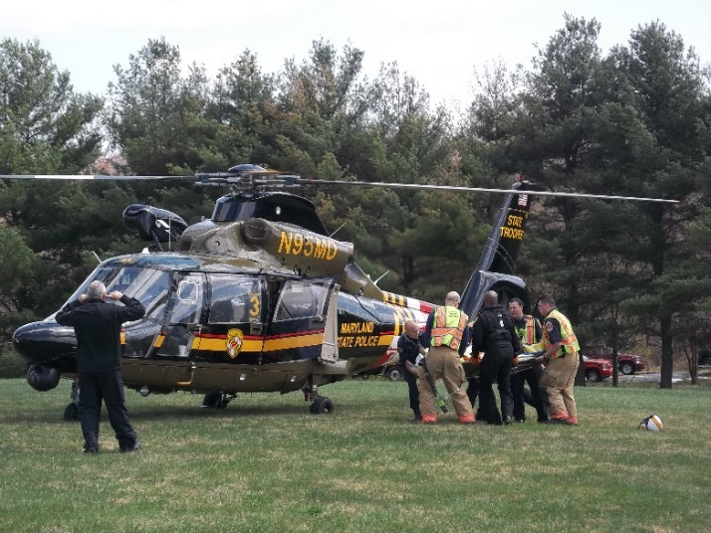
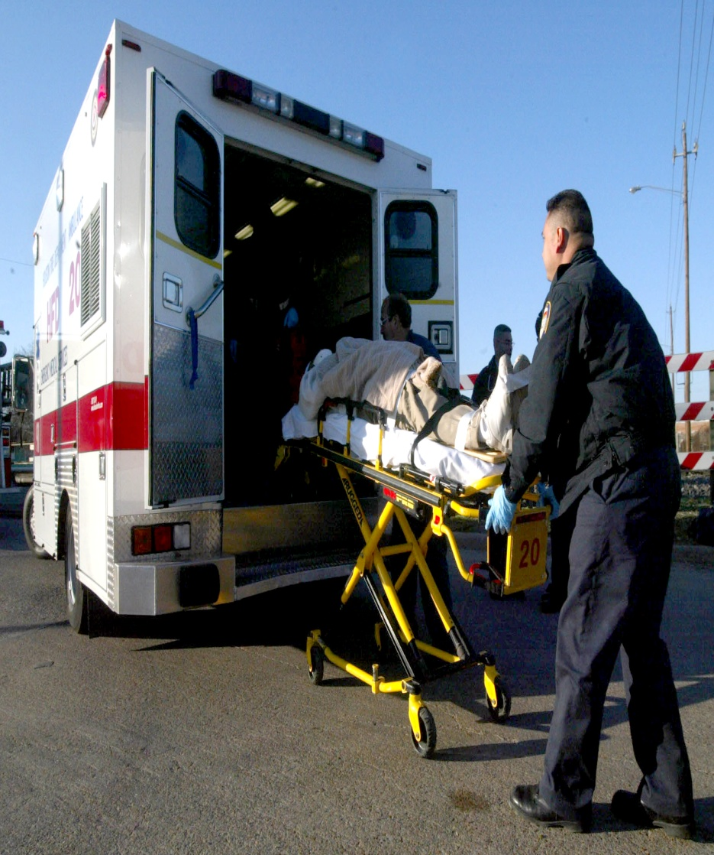
Emergency Medical Services
Generally an EMT (BLS)
Paramedics (ALS)
Responds to a variety of incidents
Medical Emergencies
Traumatic Incidents
Trained to Maryland State and National Registry Standard
Staffs apparatus including ambulances, medic units, chase cars

Slide 5
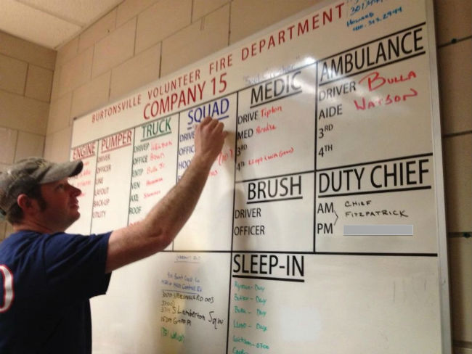
Administrative / Auxiliary
Recruitment and Retention
Fundraising
Marketing (social media management)
Antique Apparatus Support
Ad-Hoc Activities

Slide 6
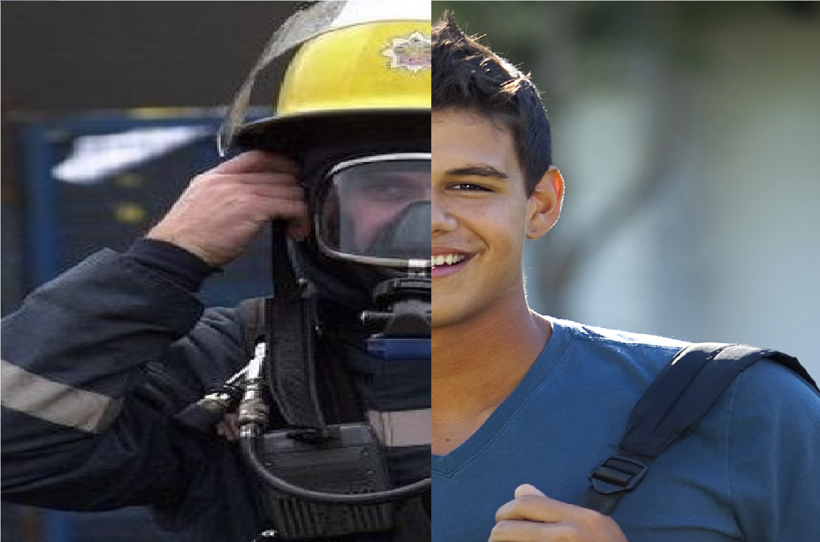
Benefits
Free training (EMT, Fire, Paramedic)
College credits
Tuition Assistance
State Tax Deduction
Ride-On Bus Pass
Bike Share Reduction
Small yearly stipend ($600ish)

Slide 7
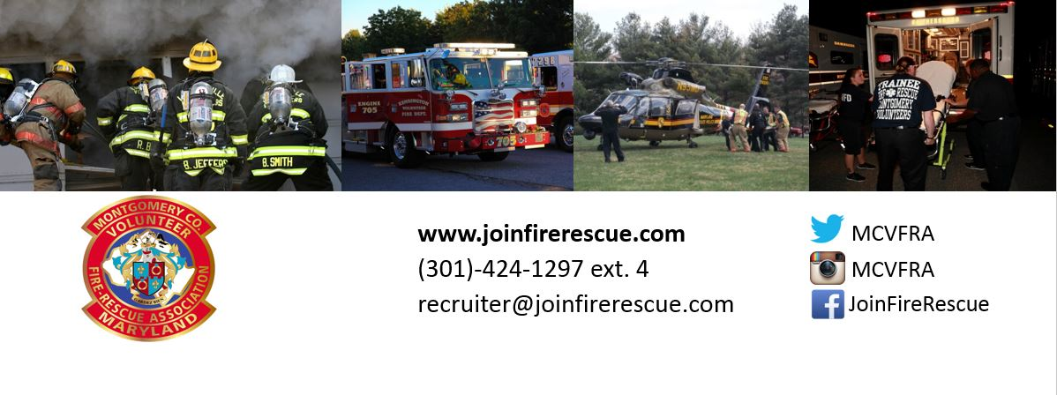
Questions
(240)-543-9454
skornfeld@mcvfra.org

