Slide 1

Everything College Admissions
Jed Applerouth
MS Professional Counseling
PhD Student Educational Psychology

Slide 2


Admissions Factors
What are colleges looking for?

Slide 3

Understand the Needs of Colleges and Universities
If you understand institutional priorities, you can craft an application that makes you more appealing.

Slide 4

Key Institutional Needs When Constructing a Class
Financial Health
  Managing discount rate
  Development
  Legacy
Rankings: Staying on Par with Peer Schools
  Academic strength of
  applicants

Slide 5
Key Institutional Needs Cont’d…
  Diversity
  Ethnic
  Geographic
  Serving first-generation students
  Activities and Campus Life
  Athletics
  Fine and performing arts

Slide 6
NACAC Admissions Trends Survey 2012: Factors Influencing Admissions decisions
Importance | Considerable | Moderate | Limited | None
Grades in college prep | 86.5% | 11.5% | 1.6% | 0.3%
Strength of curriculum | 70.7 | 22.0 | 5.9 | 1.3
Admission test scores | 57.8 | 32.0 | 9.2 | 1.0
Grades in all courses | 45.6 | 43.9 | 9.8 | 0.7
Essay or writing sample | 26.4 | 37.5 | 19.9 | 16.3
Demonstrated interest | 20.7 | 27.0 | 27.6 | 24.7
Teacher recommendation | 17.4 | 47.7 | 23.7 | 11.2
Counselor rec. | 17.1 | 50.0 | 22.0 | 10.9
Class rank | 16.3 | 42.2 | 31.7 | 9.8
Extracurricular activities | 8.9 | 43.9 | 34.3 | 12.9
Subject test scores (AP, IB) | 7.0 | 27.2 | 33.6 | 32.2
Extracurricular activities | 8.9 | 43.9 | 34.3 | 12.9
Interview | 6.6 | 26.3 | 31.9 | 35.2
SAT II scores | 5.0 | 11.0 | 28.0 | 56.0

Slide 7

Admissions Process
What happens to my application after I submit it?

Slide 8
Application “Gates”
High School GPA, considering strength of schedule and school
SAT
ACT
SAT Subject Tests
Admissions Essays
Teacher/Counselor Recommendations
Activities (Leadership, Depth)
Academic Index: Quantitative Components
How will they read your application?
Qualitative Components
Have you told a cohesive story?

Slide 9
How Most Colleges Evaluate Applicants
Step 1: Academic Indexing
Applications are indexed through an algorithm that typically includes:
  Course rigor
  Grades in core classes
  Test scores
  School strength
Schools assign different weights to these factors, but core GPA and course rigor often trump testing

Slide 10
The Academic Index Impacts the “Read” a Student Receives
Is there a compelling reason not to give an offer to these students?
class size
Top of the index
The real work for the admissions committee – the kids in the middle
Is there a compelling reason to take a risk on these students?
Bottom of the index

Slide 11
How Most Colleges Evaluate Applicants Continued…
Step 2*: Involvement/Leadership Evaluation
Student résumé
Extra Curricular Activities
Leadership positions (depth) trump variety (breadth)
*The factors in Steps 2 and 3 are considered only if the student’s academic index justifies a holistic read

Slide 12
How Most Colleges Evaluate Applicants Continued…
Step 3: Consider Other, Qualitative Factors
Adversity
Contributions to the community
Diversity
Awards and recognitions
Personality and voice
Student’s self-awareness or insights, as demonstrated through the essays or letters of recommendation

Slide 13

Academics
How will colleges view my transcript?

Slide 14

Balance Course Rigor and GPA
Encourage students to take a challenging curriculum in the context of your school
To strike the right balance, consider:
  Past performance
  In-school commitments
  Other commitments

Slide 15

Grade Trends are Essential
It is never too late to improve your grades. It may be tough to change your cumulative GPA first semester senior year, but an upward trend can help with admissions -- especially if you can explain the change with a compelling narrative.

Slide 16

Competition within Cohorts
You are compared to other students
at your school; you are also compared within ethnicity and gender bands

Slide 17
Calibrate the Relative Importance of GPA
Grade inflation is rampant in the US
With so much aid money on the line, many teachers feel that giving a C is like taking money out of a student’s pocket
Some students get too caught up in GPA, an unstandardized metric, and ignore testing, which is standardized

Slide 18

Testing
Should I take the SAT or the ACT?

Slide 19
How Important are the Tests?
Over the last decade, the tests have become a more significant part of the application process, affecting both admissions and merit-based scholarship decisions.

Slide 20
NACAC Admissions Trends Survey 2012: Factors Influencing Admissions decisions
Importance | Considerable | Moderate | Limited | None
Grades in college prep | 86.5% | 11.5% | 1.6% | 0.3%
Strength of curriculum | 70.7 | 22.0 | 5.9 | 1.3
Admission test scores | 57.8 | 32.0 | 9.2 | 1.0
Grades in all courses | 45.6 | 43.9 | 9.8 | 0.7
Essay or writing sample | 26.4 | 37.5 | 19.9 | 16.3
Demonstrated interest | 20.7 | 27.0 | 27.6 | 24.7
Teacher recommendation | 17.4 | 47.7 | 23.7 | 11.2
Counselor rec. | 17.1 | 50.0 | 22.0 | 10.9
Class rank | 16.3 | 42.2 | 31.7 | 9.8
Extracurricular activities | 8.9 | 43.9 | 34.3 | 12.9
Subject test scores (AP, IB) | 7.0 | 27.2 | 33.6 | 32.2
Extracurricular activities | 8.9 | 43.9 | 34.3 | 12.9
Interview | 6.6 | 26.3 | 31.9 | 35.2
SAT II scores | 5.0 | 11.0 | 28.0 | 56.0

Slide 21

Why Testing Has Increased in Importance
Standardized, which allows for easy comparison across geographic & demographic lines
A hedge against grade inflation
Efficient way to make big cuts
Moderately useful predictor of success in college

Slide 22

Quick Intro to the Assessments
Aptitude
Achievement

Slide 23
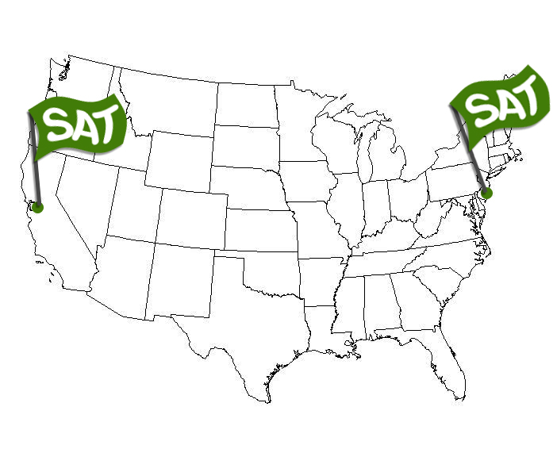
SAT/ACT Geographic Origins
Berkeley, CA.
First ETS branch 1948
Princeton, NJ.
ETS HQ 1947
The SAT was first on the scene.

Slide 24
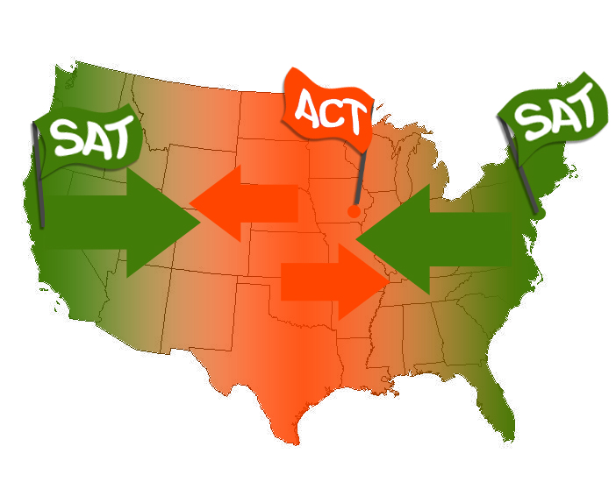
SAT/ACT Geographic Origins
1959
Iowa City, IA
ACT HQ
1948
Berkeley, CA.
First ETS branch
1947
Princeton, NJ.
ETS HQ
The ACT claimed the Heartland.

Slide 25
Today the SAT and ACT are universally accepted
Colleges will accept either test without prejudice.
Any college will take either the SAT or ACT without prejudice

Slide 26
The ACT Has Rocked the SAT’s World!
 | SAT | ACT | Gap
2005 | 1,475,623 | 1,186,251 | 289,372
2006 | 1,465,744 | 1,206,455 | 259,289
2007 | 1,494,531 | 1,300,599 | 193,932
2008 | 1,518,859 | 1,421,941 | 96,918
2009 | 1,530,128 | 1,480,469 | 49,659
2010 | 1,597,329 | 1,568,835 | 28,494
2011 | 1,647,123 | 1,623,112 | 24,011
2012 | 1,664,479 | *1,666,209 | -1,730
Any college will take either the SAT or ACT without prejudice
Aligning with the Common Core has made the ACT the big winner!

Slide 27


A Quick Anatomy of the Tests
SAT
ACT
Abstract
Foreign
Easier to coach
Learn the language of, solve
the mysteries of the test
Concrete
Familiar
Comparatively less coachable
Practice, get more familiar
with the test

Slide 28
Deeper Comparison: Reading
SAT
ACT
Abstract
Analogous Thinking
Interpretation
How might the author respond?
Vocabulary matters
Straightforward
Content-based
What did I read?
What happened to the character?
Vocabulary relatively less important
Geometry
Algebra I
Trigonometry
Simple,
straight forward,
more academic

Slide 29
Deeper Comparison: Math
SAT
ACT
Covers Geometry, Algebra I, and Algebra II (advanced functions and graphs)
Unique language, trick-filled questions
Covers Geometry, Algebra I, Algebra II, and Trigonometry
More straight-forward and familiar question types
Geometry
Algebra I
Trigonometry
Simple,
straight forward,
more academic

Slide 30
Deeper Comparison: English/Writing
SAT
ACT
Counts for most students
Essay is lumped together with the multiple choice to get the total writing score
Counts for all students
Essay is optional (but you should complete it)
Geometry
Algebra I
Trigonometry
Simple,
straight forward,
more academic

Slide 31
Deeper Comparison: Science
SAT
ACT
Does not exist.
Primarily graph and table analysis
Counts towards composite score
Geometry
Algebra I
Trigonometry
Simple,
straight forward,
more academic

Slide 32
Deeper Comparison: Timing
SAT
ACT
This is the marathon. Speed is relatively less important, but the test is 10 sections and 3.75 hours long!
This is the sprint. The test is only 4 sections and just under 3 hours long (without the optional essay); however, many students have trouble finishing.
Geometry
Algebra I
Trigonometry
Simple,
straight forward,
more academic

Slide 33
Deeper Comparison: Guessing
SAT
ACT
Students lose a quarter of a point for each question they miss, so blind guessing is penalized on the SAT
Students lose nothing for missed questions, so it’s a good idea to “Christmas tree” questions they can’t answer in time
Geometry
Algebra I
Trigonometry
Simple,
straight forward,
more academic

Slide 34
Deeper Comparison: Scoring
SAT
ACT
Section scores range from 200-800
Overall score ranges from 600-2400
Overall score equals sum of the section scores
Section scores range from 9-36
Overall scores range from 9-36
Overall score equals average of the section scores
Geometry
Algebra I
Trigonometry
Schools are more likely to “superscore” the SAT!

Slide 35
GA and Regional Schools
25-75% Ranges | Critical Reading |  | Math |  | Writing |  | ACT
GA Southern | 510 | 590 | 510 | 600 |  |  | 21 | 24
GSU | 490 | 590 | 490 | 590 |  |  | 21 | 25
UGA | 560 | 660 | 570 | 660 | 560 | 660 | 24 | 29
GA tech | 590 | 690 | 650 | 730 | 580 | 670 | 27 | 31
Emory | 640 | 740 | 670 | 760 | 650 | 740 | 30 | 33
Charleston | 570 | 650 | 570 | 650 |  |  | 23 | 26
Furman | 590 | 690 | 590 | 680 | 590 | 680 | 26 | 30
Clemson | 550 | 640 | 590 | 680 |  |  | 25 | 30
Wake Forest | 610 | 690 | 630 | 710 |  |  | 27 | 31
Duke | 660 | 750 | 680 | 790 | 680 | 780 | 29 | 34
The middle 50% will give you a range of scores

Slide 36
Which Test Should I Try First?
Both, ideally, to establish dual baselines
Three-Step Analysis:
  1. Start with your STRENGTH. If none,
  2. Prep to your PREFERENCE. If still none,
  3. Choose the more COACHABLE test, the SAT.
If SAT prep is not yielding results, switch to the ACT. If you have to switch, 80% of the content transfers

Slide 37
What about the PSAT?

Slide 38
Does the PSAT Matter?
Only if you are a junior on the cusp of the National Merit Scholarship.
If you earn a 180+ on the PSAT in your sophomore year, it might be worthwhile to prep before you take the test as a junior.
If not, look at the PSAT as practice.

Slide 39
PSAT
vs.
SAT
Subject |  | Questions | Minutes |  | Questions | Minutes
Critical Reading |  | 48 | 50 |  | 67 | 70
Sentence completions |  | 13 |  |  | 19
Reading comp. |  | 35 |  |  | 48
Math |  | 38 | 50 |  | 54 | 70
Pre-Algebra/Algebra
Geometry
Algebra 2 |  | - | -
Writing |  | 39 | 30 |  | 49 | 60
Grammar |  | 39 |  |  | 49
Essay |  | - | -
Experimental |  | - | - |  |  | 25
Total |  | 125 | 2:10 |  | 170 | 3:45

Slide 40
Translating PSAT to SAT Score
11th-Grade PSAT Score | Estimated 11th-Grade SAT Score Ranges*
 | SAT Critical Reading | SAT Math | SAT Writing
20 | 230-330 | 220-310 | 230-330
25 | 250-360 | 250-350 | 260-370
30 | 290-400 | 280-390 | 300-410
35 | 330-450 | 330-440 | 340-450
40 | 370-490 | 370-480 | 380-500
45 | 420-530 | 420-530 | 420-540
50 | 460-600 | 460-600 | 470-630
55 | 510-650 | 510-650 | 510-680
60 | 550-690 | 560-690 | 550-720
65 | 600-740 | 600-740 | 590-750
70 | 650-780 | 640-770 | 630-780
75 | 690-800 | 680-790 | 670-800
Rule of Thumb: To get an SAT score from a PSAT score, add a zero. A 210 on the PSAT is like a 2100 on the SAT.
*Data from The College Board

Slide 41
National Merit Scholarship Selection Index:
CR + M + W
For Georgia, the 2012 Selection Index for National Merit was 218.
Example: 72CR + 74M + 72W
This is a very competitive score! Roughly top 2% of students in the state.

Slide 42
How do I prep most effectively?

Slide 43

Momentum: Go in Strong
Don’t spread this out evenly over the year; kids can and do burn out on testing
Go hard before the actual tests
Take a mock test within a month of every real test
Give students breaks and time away from prep

Slide 44

Allow Enough Time to Prep
This is a process, not a one-shot deal.
Cram jobs almost never work.
Plan on taking the test 3 times.
It’s smart to start early!

Slide 45

Mock Tests: You MUST Practice
These tests reveal:
Wrong answer patterns (carelessness)
Time management
Mental fatigue
Guessing efficacy
It’s not JUST about the content. The process is about 50%!

Slide 46
No Easy or Hard test Dates!
Historic SAT Data 2006-2012
 |  | Reading |  | Math |  | Writing |  | Total |  | Students
October |  | 592 |  | 595 |  | 596 |  | 1782 |  | 1359
November |  | 585 |  | 603 |  | 609 |  | 1797 |  | 522
December |  | 582 |  | 593 |  | 588 |  | 1763 |  | 621
January |  | 588 |  | 593 |  | 597 |  | 1777 |  | 1263
March |  | 585 |  | 598 |  | 604 |  | 1786 |  | 1351
May |  | 580 |  | 584 |  | 586 |  | 1750 |  | 1000
June |  | 584 |  | 594 |  | 594 |  | 1773 |  | 1285
Averages |  | 586 |  | 594 |  | 596 |  | 1776 |  | 7401

Slide 47
No Easy or Hard Test Dates!
Historic ACT Data 2007-2012
 |  | English |  | Math |  | Reading |  | Science |  | Total |  | Students
September |  | 27.6 |  | 26.6 |  | 27.0 |  | 25.9 |  | 26.8 |  | 485
October |  | 26.9 |  | 26.1 |  | 26.9 |  | 25.5 |  | 26.4 |  | 305
December |  | 26.6 |  | 25.7 |  | 26.3 |  | 24.9 |  | 25.8 |  | 246
February |  | 26.1 |  | 26.1 |  | 26.3 |  | 25.2 |  | 25.9 |  | 458
April |  | 27.0 |  | 26.1 |  | 26.1 |  | 25.3 |  | 26.2 |  | 653
June |  | 26.5 |  | 26.0 |  | 26.3 |  | 25.0 |  | 25.9 |  | 765
Averages |  | 26.8 |  | 26.1 |  | 26.4 |  | 25.3 |  | 26.2 |  | 2912

Slide 48
What do I need to know about the tests for colleges?

Slide 49
Trends
Super-scoring the SAT and ACT
Taking multiple tests
Sending all scores (elite schools only)
Students taking (and sending!) both SAT and ACT

Slide 50
Accommodations
If you need them, APPLY. But start early. If you have to appeal, DO IT!! Persistence is key.

Slide 51
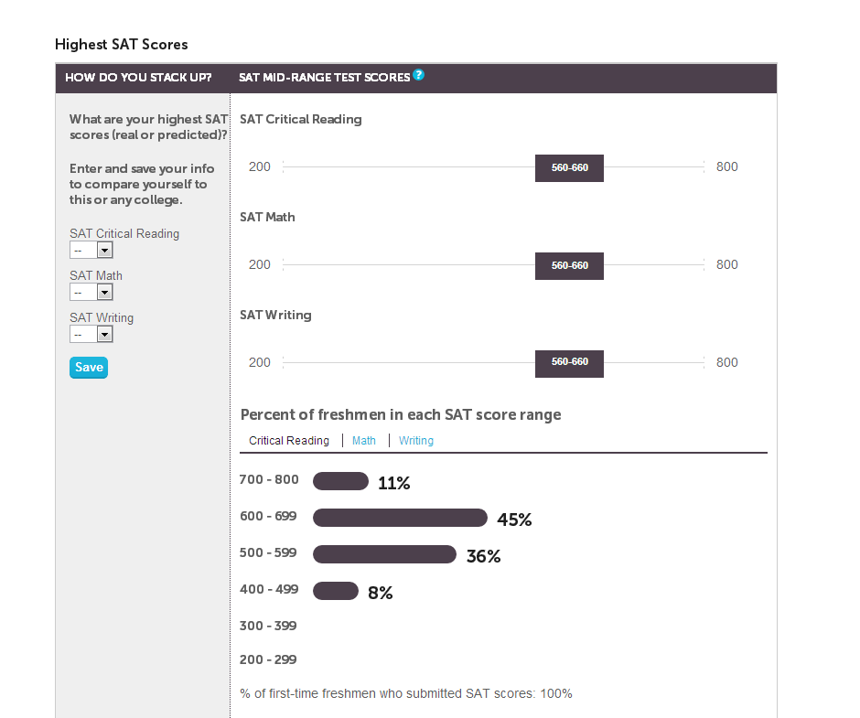
Get More Information Online
Use the College Board.com site to see what the average applicant’s scores are and how you measure up.

Slide 52
Prep for the SAT Subject Tests
20% of schools Assign Considerable to Moderate Importance to SAT IIs
3,000 + US colleges, roughly 100 use Subject Tests for admissions
How many to take: 2. Harvard, Georgetown, Princeton: 3
Timing: May and June are ideal, aligned with APs
Some schools accept the ACT as a replacement for the SAT+ SAT subject tests: Yale, Brown, Penn, and Duke
Math 1: easier questions, harder curve.
Math 2: harder questions, easier curve, ideal post Pre-Cal.
UC Systems dropped Subject Tests for class of 2012 and beyond.
Starting in 2010, NYU will accept 3 SAT Subject Test scores in non-language tests INSTEAD of the SAT or ACT

Slide 53

Admissions Essays
How do I describe myself in 650 words or less?

Slide 54
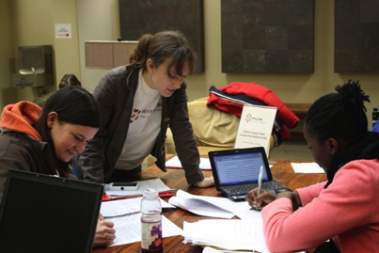
College Admissions Essay
The personal statement is the single most important essay most students will write in high school
Students often need specific help with essay writing instruction

Slide 55
Why the Essay Matters
Offers the student a chance to come alive as a human being and share something not found anywhere else in the application
A well-crafted essay can turn an application reader into a vocal advocate in committee
For students on the margin, the essay can be a deciding factor in admissions

Slide 56
Tips to Write a Better Essay
Write the essay only you could write.
Write in your own voice.
Keep the scope narrow; focus on a “thin slice” of life.
Be specific.
Hook your reader. Use a dynamic introduction or cut the intro altogether. Start in medias res.
For a full article on writing successful essays, go to www.applerouth.com Resources- Experts Corner- Jed Said- Writing the College Essay

Slide 57

Activities
Should I join every club in school?

Slide 58
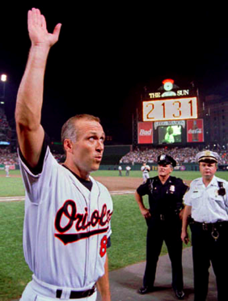
How Do Activities Factor into Admissions?
Admissions officers look for continuity, depth, and contribution
Doing the activity consistently over multiple years is key; do not switch every year
It’s good to have involvement beyond sports, if possible. Admissions officers are asking, “what will this student bring to campus?”

Slide 59

Demonstrated Interest
Why should I go on college visits?

Slide 60
Demonstrated Interest May Improve Admissions Chances
Interact with college admissions officers, even if you cannot visit their schools.
Students from less academically sophisticated households may especially benefit from these meetings
D. I.
Yield
Demonstrated interest is a plus, but it’s not essential for low SES students

Slide 61



College Visits Demonstrate Interest and More
Increases your motivation to apply
Informs your application (why Oberlin?)
Helps you narrow your list
Provides a chance for an on-campus interview

Slide 62
Interviews Demonstrate Interest
Why Interview
  Can help borderline students with admissions
  Helps you get information about the school
Interview Tips
  Convey enthusiasm and interest
  Have an answer to the question “Why our school?”
  Be prepared to ask questions
  Always follow-up with a thank you note

Slide 63

Leveraging Diversity
What does “diverse” mean to colleges?

Slide 64
Colleges Want Diverse, Balanced Classes
The Admissions Office has directives from the Board of Directors to craft a class with:
  Gender balance
  Racial balance
  Geographic balance
You are generally competing within your own pool, which may help or hurt you. It’s easier to get into Boston College if you’re from Nebraska than if you’re from Boston.

Slide 65

Suggested Timelines
How do I do the right things at the right time?

Slide 66
Sophomore Year Timeline
First mock SAT/ACT exams
PSAT
Sep
Oct
Nov
Dec
Jan
Feb
Mar
Apr
May
Take a challenging schedule, possibly with your first AP classes. GET INVOLVED with extra curricular activities.
Oct: Take the PSAT. It’s practice this year, but if you score a 180+ you’ll probably want to do some prep before next year.
Feb – May: Take your first mock SAT/ACT exams to determine which test you prefer.
Apr – May: Look into summer programs. Internships, meaningful work experiences, enrichment camps, etc. could all help on college applications.

Slide 67
Junior Year Timeline (first half)
First SAT/ACT
PSAT
Jun
Jul
Aug
Sep
Oct
Nov
Dec
Jan
Summer: Stay involved in extracurricular activities. Show consistency and depth.
Aug: Take a challenging schedule. Add as many APs as you can realistically handle. Junior grades must be solid.
Oct: PSAT. PSAT prep course if you are a potential National Merit Scholar or want to jumpstart SAT prep.
Nov – Jan: Take first SAT or ACT. Prepare 8 to 12 weeks prior to scheduled test date.

Slide 68
Junior Year Timeline (second half)
Testing, Testing, Testing
Feb
Mar
Apr
May
Jun
Jan – Feb: Register for spring AP exams (if schools don’t register the students).
Dec – May: Explore financial aid/ scholarships/ grants for college.
May – Jun: Take APs, SAT subject tests, ACT, SAT (prep courses as needed).
Jun – Aug
  Make a college list and collect applications
  Begin applications/essays
  Set up interviews and college visits

Slide 69
Senior Year Timeline (first half)
Final SAT/ACT Tests for EA/ED,
ED/EA Applications Due
College Visits
Jun
Jul
Aug
Sep
Oct
Nov
Summer: Stay involved in extracurricular activities.
Aug: Strong academic schedule. APs are ideal. Keep grades solid.
Sep – Nov
  SAT/ACT final push if needed
  Meet with your guidance counselor for application advice
  Finish early applications
  October: ED deadlines

Slide 70
Senior Year Timeline (second half)
Finish Apps
Yay!!
Dec
Jan
Feb
Mar
Apr
May
Jun
Nov – Dec: Complete remaining applications
Dec: ED responses arrive
Mar – Apr: Responses from colleges
May: Deposits due
Jun: Graduate and send final transcript to your school of choice!

Slide 71
Our Services
Tutoring and Test Prep for:
  PSAT, SAT, & ACT
  SAT subject tests
  AP exams
  High school classes
  Study skills
  Essay coaching
Visit www.applerouth.com or fill out a contact card to learn more.

Slide 72

Questions?
We’ll stick around after the program. Come find us, or
fill out a
contact card.

