Slide 1

Immunization Update
Immunizing Adults
March 2019
Notes:
Educating Physicians In their Communities is:
A peer-to-peer immunization education program presented in the practice setting for practitioners and staff or in a classroom for students.
Presented by a team of 2 professionals: physician or other primary care provider (nurse practitioner, physician's assistant) and a nurse or office manager.
Our Beginnings…
EPIC is now in its 17th year of immunization education. The first EPIC Immunization Education program was developed and implemented in Pennsylvania (a joint venture between public health and the PA chapter of the American Academy of Pediatrics). The program has been replicated in several states - Georgia most closely resembling the Pennsylvania program. Georgia was first to add adult vaccines to the program. In 2009 the Georgia Chapter created a separate Women’s Health Immunization Education program for obstetricians and gynecologists. Presentations are also available for students in healthcare training. Presentation on Coding are available to members of the Georgia Chapter of AAP
In 2003 the National Vaccine Advisory Committee (NVAC) approved and published updated standards for adult and child/adolescent immunization practices.
EPIC programs are designed to meet Standard #10 of the Standards for Child and Adolescent Immunization Practices:
"Persons who administer vaccines and staff who manage or support vaccine administration are knowledgeable and receive on-going education"
And
Standard #8 of the Standards for Adult Immunization Practices: “Persons who administer vaccines are properly trained."

Slide 2
EPIC® is presented by:
Georgia Chapter - American Academy of Pediatrics
Ga. Dept. of Public Health/Immunization Program
In Cooperation with:
Georgia Academy of Family Physicians
Georgia Chapter - American College of Physicians
Georgia OB/Gyn Society
EPIC® (Educating Physicians & Practices In their Communities) is a registered trademark of the Georgia Chapter of the American Academy of Pediatrics. All rights reserved.
Notes:
The EPIC immunization education program is developed and updated annually, and more frequently when necessary, by the Georgia Chapter of the American Academy of Pediatrics in partnership with the Georgia Immunization Program and in cooperation with the Georgia Academy of Family Physicians, the Georgia Chapter of the American College of Physicians/American Society of Internal Medicine, and the Georgia OB/GYN Society.
EPIC education programs utilize information from the Centers for Disease Control and Prevention, ACIP Recommendations, The Immunization Action Coalition and other reliable resources. When there is more than one vaccine manufacturer for a specific type of vaccine the presenter utilizes the generic name (i.e. Tdap, hepatitis b etc.)

Slide 3
Faculty Disclosure Information
In accordance with ACCME* and ANCC-COA* Standards, all faculty members are required to disclose to the program audience any real or apparent conflict of interest to the content of their presentation.
This presentation will include the most current ACIP recommendations for frequently used vaccines but is not a comprehensive review of all available vaccines.
Some ACIP recommendations for the use of vaccines have not currently been approved by the FDA.
Detailed information regarding all ACIP Recommendations is available at www.cdc.gov/vaccines/acip/recs/index.html
*Accreditation Council for Continuing Medical Education
*American Nurses Credentialing Center Commission on Accreditation
Notes:
Presenters for the EPIC program do not discuss vaccines that are not licensed by the FDA or any pending vaccines that are still undergoing clinical trials. Sometimes an ACIP recommendation may not be listed as an indication for a specific vaccine or a specific age group on the manufacturers package insert. Therefore, the recommendation is considered “off label” use of the vaccine. The presenters will discuss the most recent ACIP recommendations during this presentation. All new ACIP Recommendations discussed have been published in MMWR.

Slide 4
Objectives
Hello,
At the end of this presentation, you will be able to:
Recall the role vaccines have played in preventing diseases
Discuss the importance of vaccines for adolescents and adults
Summarize the most recent CDC recommendations for storage and handling of vaccines
List at least 2 reliable sources for immunization information
Notes:
These are the objectives for the 2019 EPIC presentation.

Slide 5
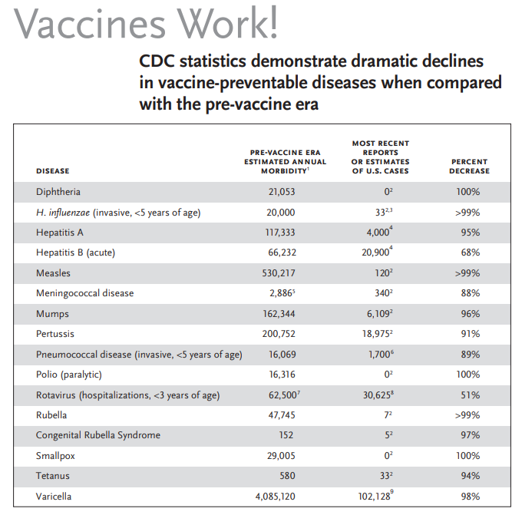
Notes:
CDC. JAMA November 14, 2007; 298(18):2155–63.
2. CDC. National Notifiable Diseases Surveillance System, 2017 Annual Tables of Infectious Disease Data. Available at www.cdc.gov/nndss/infectious-tables.html. NNDSS finalized annual data as of November 28, 2018.
3. An additional 10 cases of Hib are estimated to have occurred among the 203 reports of Hib (<5 years) with unknown serotype.
4. CDC. Viral Hepatitis Surveillance – United States, 2016. 5. CDC. MMWR October 6, 1995; 43(53):1–98. 6. CDC. Active Bacterial Core Surveillance, 2016 data (unpublished). 7. CDC. MMWR, February 6, 2009; 58(RR-2):1–25. 8. CDC. New Vaccine Surveillance Network, 2017 data (unpublished); U.S. rotavirus disease now has a biennial pattern. 9. CDC. Varicella Program, 2017 data (unpublished).
Technical content reviewed by the Centers for Disease Control and Prevention
www.immunize.org/catg.d/p4037.pdf • Item #P4037 (2/19)

Slide 6

Advisory Committee on
Immunization Practices (ACIP)
15 voting members with expertise in one or more of the following:
Vaccinology
Immunology
Infectious diseases
Pediatrics
Internal Medicine
Preventive medicine
Public health
Consumer perspectives and/or social and community aspects of immunization programs
ACIP develops recommendations and schedules for the use of
licensed vaccines
Notes:
The dramatic reduction of vaccine preventable diseases in the United States can be attributed to the availability of vaccines, as well as recommendations and an organized vaccine schedule developed by the Advisory Committee on Immunization Practices (ACIP).
The overall goals of the ACIP are to provide advice which will assist the Department and the Nation in reducing the incidence of vaccine preventable diseases and to increase the safe usage of vaccines and related biological products.
For more information: http://www.cdc.gov/vaccines/acip/index.html
For more details about all the vaccine preventable diseases reviewed in this presentation, refer to: Epidemiology and Prevention of Vaccine-Preventable Diseases (The Pink Book), 13th edition. 2015. HHS, CDC.

Slide 7
Community Immunity
Formerly known as “Herd Immunity”
Transmitting case
Immune
Immune
Immune
Immune
Immune
Susceptible
(Indirectly
Protected)
Immune
Susceptible
(Indirectly
Protected)
Reference: Presentation from Immunize Georgia, September 9, 2016 by Walt A. Orenstein, MD
Professor of Medicine Global, Health, Epidemiology and Pediatrics
Emory Department of Medicine, Associate Director, Emory Vaccine Center Director
Vaccine Policy and Development, Emory University, Atlanta, GA
Notes:
It is probably unrealistic to believe we can immunize everyone appropriately. There will always be young infants who have not received all recommended vaccines because of age and there are a significant number of adults who are not adequately immunized. Herd immunity was the term used previously that refers to a situation in which a high percentage of a population is immune to a disease, essentially stopping the disease in its tracks because it cannot find new hosts.
The preferred term now is Community Immunity.
The threshold for community immunity varies, depending on the disease, with more virulent infectious agents requiring vaccination of a higher percentage of the population to create the desired community immunity. Most vaccination policies are focused on creating community immunity. The creation of community immunity is especially important in crowded environments which facilitate the spread of disease, like schools. It is also extremely important to receive regular boosters, as some vaccines lose their efficacy over time, leaving people vulnerable to an outbreak. Herd immunity led to the eradication of smallpox, and it explains why diseases such as polio and diphtheria are rare in developed nations with established vaccination policies.
EPIC 2018

Slide 8
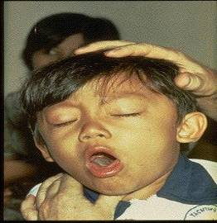
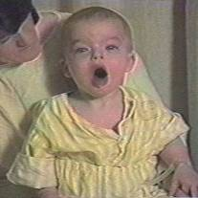

Diphtheria
©AAP
Tetanus
Pertussis
Notes:
Diphtheria, Tetanus and Pertussis (Whooping Cough) are all toxin mediated diseases. This means that the toxin or toxins produced by the bacteria are responsible for the symptoms of the disease.
DIPHTHERIA
Slide shows a child with diphtherial membrane in nasopharynx
Diphtheria is caused by a bacteria (Corynebacterium diphtheriae) that produces a toxin.
The bacterial growth and toxin cause local tissue destruction & membrane formation in nasopharynx & larynx & possible obstruction of respiratory tract.
Most common complications are myocarditis & neuritis (motor nerves).
TETANUS
Slide shows a child with muscle rigidity from tetanus.
Tetanus spores that are found everywhere in soil usually enter body through contaminated puncture wounds, lacerations or abrasions. Spores germinate and bacteria (Clostridium tetani) begin to multiply and produce an exotoxin. Toxin affects the neuromuscular junction and produces generalized rigidity and convulsive spasms of skeletal muscles, starting with the jaw and muscles of swallowing (lockjaw).
PERTUSSIS
Slide shows two children with pertussis (whooping cough) with paroxysmal coughing. (Sound is the typical pertussis cough and whoop. Pertussis, caused by a bacterium (Bordetella pertussis), produces multiple antigens and biologically active components that cause inflammation of the respiratory tract, paralysis of the cilia of the respiratory tract and lung damage resulting in pooling of secretions and characteristic cough lasting up to 12 weeks. Humans are the only reservoir. Transmission is by direct contact with respiratory droplets.
For more details about these 3 diseases refer to: Epidemiology and Prevention of Vaccine-Preventable Diseases, 13th edition. 2015 HHS, CDC.

Slide 9
Tetanus, Diphtheria, and Pertussis Vaccines
(Tdap)
ACIP Recommends:
One dose of Tdap:
  For all adolescents and adults. Give Td every 10 yrs. after that.
Boostrix is licensed for persons 10 years and older
Adacel is licensed for persons 10 through 64 years
For adults 65 years and older Boostrix should be used, when feasible; however, either vaccine product provides protection and is considered valid.
  There is no minimum interval between the last dose of Td and Tdap.
MMWR, September 23, 2011, Vol 60, #37 MMWR, January 14, 2011, Vol 60, #01 MMWR, June 29, 2012, Vol 61, #25
Notes:
Because of the epidemic of pertussis in California and other states during 2010 the ACIP revised the recommendations for the use of Tdap.
Ref: Updated Recommendations for Use of Tdap Vaccine from ACIP,
MMWR Weekly, September 23, 2011 / 60(37);1279-1280
(April 1, 2014)
The Food and Drug Administration has expanded the approved age range for Sanofi Pasteur's Adacel active booster immunization for tetanus, diphtheria and pertussis to ages 10 to 64 years. An open-label, multi-center Phase IV trial found that a single dose of the drug--which was approved for people ages 11 through 64 in 2005--had similar antibody responses and rates of adverse reactions in 10-year-olds as it does in 11-year-olds.

Slide 10
Pertussis
Natural infection and vaccines do not confer life long immunity.
Complications – apnea, pneumonia, weight loss, seizures, death.
    - Most deaths occur in infants younger than 6 months
    (1% die from pertussis)
    - Adolescents/adults usually have milder disease; disease is hard to distinguish from other cough illnesses.
Immunization is the best way to prevent pertussis.
Ref: Yeh, S and Mink, CM. Bordetella pertussis infection in infants and children: Clinical features and diagnosis. Post TW (Ed), UpToDate, Waltham, MA. (Accessed on March 6, 2014.)

Slide 11
Tdap for Pregnant Women
ACIP recommends:
One dose of Tdap during each pregnancy, irrespective of a prior history of receiving Tdap.
Optimal timing for Tdap administration is between 27 and 36 weeks gestation. ACIP guidance and current data suggest that vaccinating earlier in the 27 through 36 week window will maximize passive antibody transfer to the infant. This has been shown to be 80%-91% effective.*
If Tdap is not given during pregnancy, and has not been given previously, administer Tdap immediately postpartum.
According to ACIP, pregnant women and some
adolescents may receive additional doses of Tdap. Consult appropriate 2019 Immunization Schedule.
Ref: Advisory Committee on Immunization Practices. Updated ACIP statement for pertussis, tetanus and diphtheria vaccines presented by Jennifer L. Liang, October 19, 2016.
MMWR, February 7, 2017, Vol. 66
*MMWR, Recommendation and Reports/Vol. 67/No. 2
Notes:
Guidance on use of Tdap products for pregnant women:
All pregnant women should receive a dose of Tdap during each pregnancy, irrespective of prior history of receiving Tdap. Optimal timing for administration is between 27 and 36 weeks gestation. If a dose is given early in that same pregnancy, do NOT repeat it at 27-36 weeks. If not given during pregnancy, give Tdap immediately postpartum³.
References:
1.MMWR, February 22, 2013, Vol 62, #7
2. www.immunize.org, Ask the Experts, Tetanus section, IAC, Sept. 2013

Slide 12
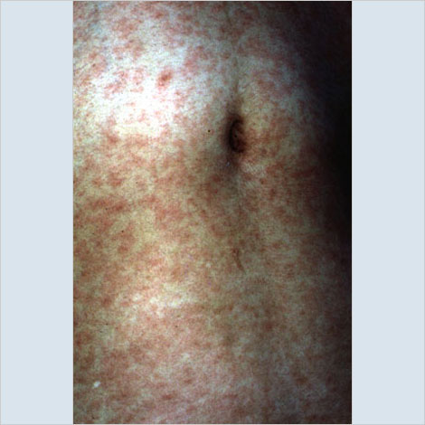
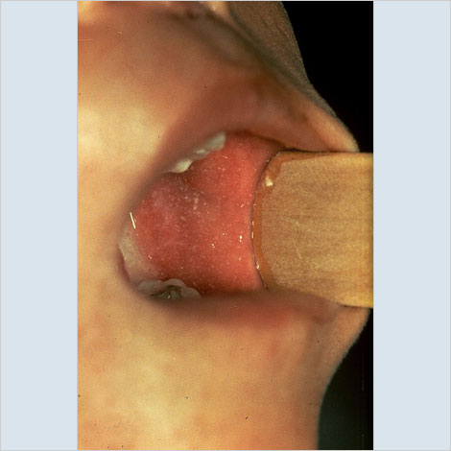
MEASLES
Incubation period generally 8 to 14 days from exposure to onset of symptoms.
Symptoms are fever, cough, coryza, conjunctivitis, maculopapular rash and Koplik spots.
Complications include otitis media, pneumonia, croup, & diarrhea.
Acute encephalitis occurs in 1 out of 1,000 cases.
Death occurs in 1 to 3 of every 1,000 cases.
Subacute sclerosing panencephalitis (SSPE) occurs in 1 to 609 infants
Measles Vaccine
95% of people develop serum
measles antibody after one
dose.
99% after 2 doses.
5% or less may lose protection
after several years.
Koplik Spots
AAP Red Book, 30th Edition 2015
Source: Immunization Action Coalition
Source: Immunization Action Coalition
Notes:
Subacute Sclerosing Panencephalitis (SSPE) is a neurological disorder that can appear years after a person is infected with measles and is always fatal. It is characterized by behavioral and intellectual deterioration and seizures that occur 7-11 years after measles infection. In rare cases the virus spreads to the brain, but then becomes dormant. Eventually it can lead to SSPE, resulting in deterioration and death. Researchers don’t know what causes the virus to reactivate.
There is no cure for SSPE and the only way to prevent it is to vaccinate everyone against measles.
Reference: Infection Diseases Society of America. Always Deadly Measles Complication more Common than Believed. October 29, 2016.

Slide 13
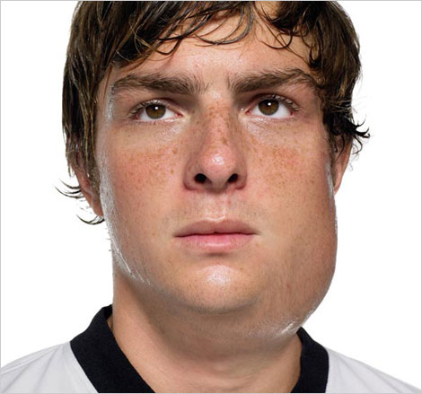
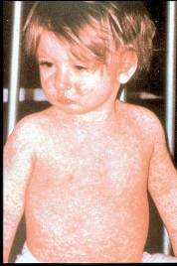
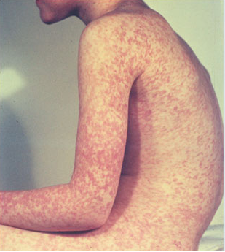
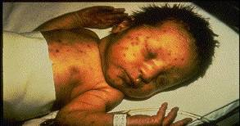
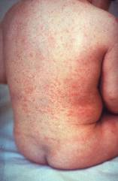
Measles, Mumps, Rubella
Measles (M)
Mumps (M)
Source: Creative Commons
Source: American Academy of Pediatrics
Red Book On Line Visual Library
Rubella (R)
Congenital Rubella (R)
Notes:
MEASLES (caused by paramyxovirus)
Slide shows two children with typical measles rash and conjunctivitis in younger child
Initial symptoms are runny nose, followed by increasing fever (103º-105º), cough, conjunctivitis, Koplik spots, and a maculopapular rash that lasts 5-6 days
Complications include otitis media (7%), pneumonia (6%), and acute encephalitis (0.1%) 1 in 1000 cases, death (0.2%) Although measles elimination was declared in the United States in 2000 , importation of measles cases continues to occur.
MUMPS (caused by paramyxovirus)
Slide shows an adolescent with parotitis due to mumps
Parotitis occurs in 30-40% of infected persons, 40-50% have only nonspecific or respiratory symptoms
Complications include aseptic meningitis, & deafness
Post pubertal individuals may have orchitis, ovarian inflammation, & pancreatitis
RUBELLA (Caused by togavirus)
In children, the rash may be the first manifestation of infection. Adults may have low-grade fever, malaise, URI, and lymphadenopathy prior to rash. Arthralgia and arthritis is common in adults, especially women. Complications include encephalitis and hemorrhagic manifestations
Rubella is no longer endemic in the U.S. However, it is still present in other countries and can be imported
CONGENITAL RUBELLA
Slide shows an adult and child with a typical rash from rubella and an infant with congenital rubella syndrome Infant was infected in utero and has “blueberry muffin spots” on skin due to petechial lesions, cataracts, hearing loss and congenital heart lesion and will most likely be developmentally delayed.
All woman of child bearing age should be certain they are immune to rubella.
For additional information refer to: Epidemiology and Prevention of Vaccine-Preventable Diseases, 13th edition 2015. HHS, CDC.

Slide 14
MMR Vaccine
  Travelers to foreign countries should be appropriately immunized with MMR prior to leaving U.S.
Acceptable presumptive evidence of MMR immunity
Documentation of age appropriate vaccination with MMR
vaccine
Laboratory evidence of immunity
Laboratory confirmation of disease
Birth before 1957 *
* Birth date not acceptable evidence of rubella
immunity for women who could become pregnant
MMWR, June 14, 2013, Vol 62, #RR-04 MMWR, January 12, 2018, Vol 67(1);33–38
Notes:
MMR vaccine has been successful in reducing the cases of measles in the United States and many young physicians, physician’s assistants and nurse practitioners have never seen an acute case of measles. The symptoms of measles are more than a rash and include conjunctivitis, fever and white lesions (Koplik spots) on the buccal mucosa. Practitioners who have not seen a case of measles sometimes make a diagnosis solely on the basis of a rash. Serologic testing is now required to confirm a case of measles.
Infants 6-12 mos. of age travelling abroad should receive 1 dose of MMR. This dose must be repeated.

Slide 15
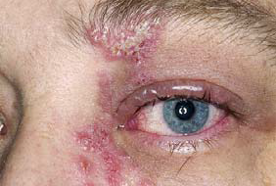
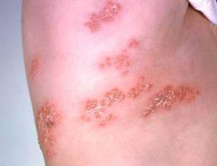
Herpes Zoster
Herpes zoster (HZ), or shingles, occurs through reactivation of latent varicella-zoster virus
Typically characterized by prodromal pain and an acute vesicular eruption (rash) accompanied by moderate to severe pain
One in three persons will develop zoster during their lifetime
Post-herpetic neuralgia (PHN) is a common consequence of zoster. PHN is defined as nerve pain persisting longer than 3 mos. after disappearance of the rash.
Risk for zoster and PHN increases with age
Photo courtesy of www.webmd.com
Notes:
The picture on left shows zoster (shingles) on the upper chest and back.
The picture on right shows zoster on the face involving one of the cranial nerves.

Slide 16
Zostavax® (ZVL)
Licensed for persons 50 yrs. and older—preferred age is 60 yrs.
Store at appropriate freezer temperatures
1 dose SC
Efficacy
51% fewer episodes of zoster and less severe disease
66% less postherpetic neuralgia
Duration of protection presumed to be 10 years
It is not necessary to ask patient about a history of varicella or to do serologic testing for immunity.
MMWR, August 22, 2014, Vol 63, #33 MMWR (RR) June 6, 2008, Vol 57 #05; 1-30
ACIP Meeting Minutes, October 25-26, 2017
Notes:
Herpes zoster vaccine (Zostavax [Merck & Co., Inc.]) was licensed in 2006 and recommended by the Advisory Committee on Immunization Practices (ACIP) in 2008 for prevention of herpes zoster (shingles) and its complications among adults aged ≥60 years. The Food and Drug Administration (FDA) approved the use of Zostavax in 2011 for adults aged 50 through 59 years based on a large study of safety and efficacy in this age group.
Please not the storage and administration highlights for this vaccine.

Slide 17
Shingrix® (RZV) from GSK
Licensed for adults ≥ 50 years of age
Store at appropriate refrigerator temperatures
2 doses given IM, 2-6 months apart
Give only 0.5 cc, not full contents of the vial.*
Efficacy
  91% in preventing zoster in all age groups
  88% in preventing PHN
  85% vaccine effectiveness >4 yrs. post vaccination
ACIP Recommendations
  1. RZV (recombinant zoster vaccine) is recommended
  for prevention of shingles and related complications
  RZV is recommended for immunocompetent adults who previously received ZVL (Zostavax™)
  RZV is preferred over ZVL
  RZV should not be given < 2 months after receipt of ZVL
  Can be administered at same visit as other vaccines
*https://www.cdc.gov/vaccines/hcp/acip-recs/general-recs/administration.html
MMWR/January 26,2018/Vol. 67/No. 3
Notes:
Please note the storage and administration guidelines for this vaccine.

Slide 18
Pneumococcal Conjugate Vaccine for Adults (PCV13)
ACIP recommends 1 dose of PCV13 for:
Adults 19 years and older with the following (PCV13 should be given first followed by PPSV23 8 weeks later):
Immunocompromising conditions
Functional or anatomic asplenia
Sickle cell disease
CSF leaks
Cochlear implants
Adults 65 years and older (PCV13 should be given first, followed by PPSV23 1 year later).
MMWR 2014;Vol. 63 #37:822-5 MMWR, 2015 , Vol. 64, #34:944-7
Notes:
Two randomized, multicenter, immunogenicity studies conducted in the United States and Europe among older adults showed that PCV13 induced an immune response as good as or better than that induced by PPSV23. In two randomized studies, Immunocompetent adults aged 50 years and older received a single dose of PCV13 and PPSV23. In adults aged 60-64 years older, PCV13 had comparable antibody titers or higher than the antibody responses to PPSV23. In adults aged ≥70 years who previously had been immunized with a single dose of PPSV23 ≥5 years before enrollment, PCV13 elicited antibody responses that were comparable with those elicited by PPSV23 for two serotypes and higher for 10 serotypes.
Individuals who were given PCV13 1 year after receiving PPSV23 had lower antibody responses compared to the ones that received PCV13 as the initial dose.
Approximately, 20%–25% of IPD cases and 10% of community-acquired pneumonia cases in adults aged ≥65 years are caused by PCV13 serotypes and are potentially preventable with the use of PCV13 in this population (3,4).
Broader protection is expected to be provided through use of both PCV13 and PPSV23 in series
MMWR, September 19, 2014 / 63(37);822-825.
MMWR. September 4, 2015 / 64(34);944-947

Slide 19
Pneumococcal Polysaccharide Vaccine for Adults (PPSV23)
ACIP recommends 1 dose of PPSV23 for:
  Adults 65 years and older
  Persons aged 2 through 64 years with medical conditions that increase their risk for pneumococcal infection
  Persons 19 and older with
    Chronic heart, lung, or liver disease
    CSF leaks or cochlear implants
    Diabetes
    Alcoholism
    Cigarette smoking
  Revaccination not recommended for most persons until they reach age 65
Persons at highest risk, such as those with immunocompromising conditions, and/or functional or anatomic asplenia, who received a dose before age 65, should receive a 2nd dose 5 years after Dose 1, and a 3rd dose at age 65.
MMWR, September 3, 2010, Vol 59, #34 MMWR, October 12,2012, Vol 61 #40
Notes:
Updated recommendations for administration of 23-valent pneumococcal polysaccharide vaccine (PPSV23) among adults aged ≥19 years — Advisory Committee on Immunization Practices (ACIP), United States
• PPSV23 should be administered to adults aged 19–64 years with chronic or immunosuppressing medical conditions, including those who have asthma.
• Adults aged 19–64 years who smoke cigarettes should receive PPSV23 and smoking cessation guidance.
• All persons should be vaccinated with PPSV23 at age 65 years. Those who received PPSV23 before age 65 years for any indication should receive another dose of the vaccine at age 65 years or later if at least 5 years have passed since their previous dose. Those who receive PPSV23 at or after age 65 years should receive only a single dose.
• ACIP does not recommend routine revaccination for most persons for whom PPSV23 is indicated.
ACIP does recommend a third dose of PPSV23 in addition to PCV13 for some persons at increased risk for pneumococcal infection.
Ref: Updated Recommendations for Prevention of Invasive Pneumococcal Disease Among Adults Using the 23-Valent Pneumococcal Polysaccharide Vaccine (PPSV23) MMWR 2010; 59(34);1102-1106 September 3, 2010

Slide 20
FDA Recommended Influenza Antigens
for 2018-2019 Season in the U.S.
Trivalent Vaccines (IIV3):
A/Michigan/45/2015 (H1N1)
A/Singapore/INFIMH-16-0019/2016 (H3N2)
B/Colorado/06/2017
Information below pertains to children 6 mos. through 8 yrs. of age
Quadrivalent Vaccines (IIV4 & LAIV4) also include:
B/Phuket/3073/2013-like virus
ACIP recommends annual influenza vaccine for all persons 6 months of age and older who do not have contraindications.
If the child has received a total of 2 doses of vaccine in any prior flu season(s), even if not consecutive:
Give 1 dose this season
If they have not or it’s not known:
Give 2 doses, administered
≥ 4 wks. apart
MMWR Recommendations and Reports Vol. 67 / No. 3
August 24, 2018
Notes:
The Food and Drug Administration's Vaccines and Related Biologics Advisory Committee (VRBPAC) endorsed the WHO-recommended vaccine viruses for use in all U.S. seasonal flu vaccines for the 2018-2019 flu season.
Centers for Disease Control and Prevention, National Center for Immunization and Respiratory Diseases (NCIRD)

Slide 21
Influenza Vaccines for 2018-2019 Season
≥ 6 months | ≥ 3 years | ≥ 4 years | ≥ 5 years | ≥ 18 years | ≥ 65 years
Fluzone (IIV4) 6-35 mos.--2 doses, either 0.25 ml. or 0.5 ml. The schedule can be completed as: (1) two 0.25 ml. doses ≥4 wks. apart (2) two 0.5 ml. doses ≥4 wks. apart OR (3) any combination of 2 doses of either 0.25 ml. or 0.5 ml given ≥4 wks. apart. | Fluzone (IIV4) 36 mos. And older---0.5 ml | Fluvirin (IIV3) | Afluria (IIV3) | FluBlok (RIV3 & RIV4) ** | Fluzone High-Dose (IIV3)
FluLaval (IIV4) 0.5 ml dose |  | Flucelvax (ccIIV4)* |  | Afluria (IIV4) | Fluad (aIIV3)
Fluarix (IIV4) 0.5 ml. dose |  |  |  | Fluzone Intradermal (IIV4) Ages 18-64 yrs. (Not available in 2018-2019)
*Cell-cultured **Recombinant
Ref: (1)Centers for Disease Control and Prevention, (NCIRD). (2) https://www.cdc.gov/mmwr/volumes/66/rr/rr6602a1.htm (3) https://www.vaccineshoppe.com/image.cfm?doc_id=14051&image_type=product_pdf
Notes:
Flu vaccines for 2018-2019.
Text in red on the table indicates changes in dosages for infants >6 months of age; also that intradermal is not available for the 2018-2019 flu season.

Slide 22
Live, Attenuated Influenza Vaccine (LAIV4)
  FluMist® MedImmune (Nasal Spray)
  Licensed for healthy persons 2 through 49 years of age
ACIP recommendation
LAIV4 MAY be used in the 2018-2019 season.
Contraindications to LAIV:
  Children 2-4 yrs. of age with a diagnosis of asthma
  Persons who are immunocompromised, by medication or disease, have a CSF leak or cochlear implant, or asplenia
  Close contacts and caregivers of severely immunosuppressed persons
  Pregnant women
  Persons who have received influenza antiviral medications within the previous 48 hrs.
MMWR Recommendations & Reports/Vol. 67/No. 3 August 24, 2018
Notes:
Studies demonstrated that LAIV did not work in the 2013-'14 influenza season when the primary strain was the 2009 pandemic influenza A(H1N1) strain, in 2014-'15 when the primary circulating strain was a drifted A(H3N2) virus, or the 2015-'16 season when the primary circulating strain was again the 2009 pandemic influenza A(H1N1) strain. With knowledge that LAIV had no protective benefit during three previous influenza seasons, ACIP does now state that LAIV may be used in the 2018-2019 season.

Slide 23
Influenza Vaccination of Persons with a History of Egg Allergy
Persons with a history of egg allergy of any severity may receive any licensed, recommended, and age-appropriate influenza vaccine (IIV, RIV4, or LAIV4). IIV and RIV4 have been previously recommended.
A previous severe allergic reaction to influenza vaccine is a contraindication to future receipt of the vaccine.
MMWR Recommendations and Reports / Vol. 67 / No. 3 August 24, 2018
Notes:
Recent studies with IIV and LAIV have indicated that a severe allergic reaction to egg-based influenza vaccine in a person with an egg allergy is very unlikely. Numerous studies have looked at egg-allergic patients receiving IIV3, LAIV in which mild allergic reactions occur and no anaphylactic reaction occurrences.
Reference: MMWR. Prevention and Control of Seasonal Influenza with Vaccines Recommendations of the Advisory Committee on Immunization Practices-United, 2016-17 Influenza Season. August 26, 2016, Vol. 65; No. 5
MMWR Recommendations and Reports / Vol. 67 / No. 3 August 24, 2018
EPIC 2018

Slide 24
Hepatitis A Vaccine for Adults
ACIP recommends hepatitis A vaccine for adults who are at high-risk of acquiring hepatitis A infection:
      Those traveling or working in countries with high or intermediate endemicity of infection
      Men who have sex with men
      Users of injecting and non-injecting drugs
      Persons with chronic liver disease or on dialysis
      Persons working with HAV positive primates or with HAV in research laboratory settings
      Should be administered to all persons ≥ 12 mos. for post exposure prophylaxis (PEP)
      Should be administered to infants 6-11 mos. traveling outside the U.S. when protection against HAV is recommended
      Contact with adoptees from countries with high rates of hepatitis A if contact will be within 60 days of arrival in U.S. The first dose of the 2-dose series should be given as soon as adoption is planned.
MMWR, May 19, 2006, Vol 55, #RR-07 MMWR, September 18, 2009, Vol 58 #36 MMWR, November 2, 2018, Vol. 67, No. 43
Notes:
The Advisory Committee on Immunization Practices of the Centers for Disease Control and Prevention has recommended hepatitis A vaccine for all previously unvaccinated persons who will have close contact with international adoptees from countries with high or intermediate hepatitis A endemicity. The vaccine should be given during the first 60 days following the adoptee’s arrival in the United States.³
For healthy persons 40 years of age or younger, 1 dose of single antigen vaccine administered at any time before departure can provide adequate protection.
New additions:
--Persons with chronic liver disease or on dialysis
--Healthy persons through age 40 who have recently been exposed to Hepatitis A virus
disease or on dialysis
References:
1. Prevention of Hepatitis A Through Active or Passive Immunization - Recommendations of the Advisory Committee on Immunization Practices (ACIP) MMWR Vol. 55/No. RR-7 May 19, 2006
2. Notice to Readers: FDA Approval of an Alternate Dosing Schedule for a Combined Hepatitis A and B Vaccine (Twinrix®) MMWR 56(40);1057 October 12, 2007
3. Updated Recommendations from the Advisory Committee on Immunization Practices (ACIP) for Use of Hepatitis A Vaccine in Close Contacts of Newly Arriving International Adoptees MMWR 58(36);1006-1007 September 18, 2009
4. Epidemiology and Prevention of Vaccine-Preventable Diseases, 13th edition. 2015 HHS, CDC.
sons working with HAV positive primates or with HAV in research laboratory settings
Healthy persons through age 40 who have recently been exposed to Hepatitis A virus

Slide 25
Hepatitis B
Transmission:
1. Percutaneous or mucosal exposure to blood or body fluids including contaminated surfaces, or exposure by sexual contact
ACIP Recommendation:
  Persons with history of or current drug use.
  Persons with Hepatitis C infection or other liver disorders or HIV
  Incarcerated persons
All adults at risk for hepatitis B infection, including those aged 19- 59 yrs. with diabetes mellitus
Persons of any age at risk for infection by sexual exposure.
All other adults seeking protection from HBV infection.
MMWR, December 23, 2005, Vol 54, #RR16, MMWR, December 8, 2006, Vol 55, #RR16 , MMWR, December 22, 2011 Vol 60 , #50 Recommended Immunization Schedule for Persons Age 0 Through 18 Years, United States, 2017 MMWR April 20,2018/Vol. 67/No.15
Notes:
Incubation period from time of infection to onset of symptoms is 45 to 160 days (average, 90 days)
Approximately 10% of acute hepatitis B infections progress to chronic Hepatitis B infection.
90% of infants and 30-50% of children 1-5 years of age with acute hepatitis B infection become carriers
Many with chronic infection are asymptomatic. Chronic infection may progress to cirrhosis, liver failure & hepatocellular carcinoma
All pregnant women should be tested routinely for HBsAg
90% of healthy adults & 95% of infants, children & adolescents develop adequate antibody response after a complete series
If no antibody response after 6 doses, person is a non-responder and is susceptible to hepatitis B
Booster doses NOT recommended for any age group
References:
1. A Comprehensive Immunization Strategy to Eliminate Transmission of Hepatitis B Virus Infection in the United States. Recommendations of the Advisory Committee on Immunization Practices (ACIP) Part 1: Immunization of Infants, Children and Adolescents MMWR Vol. 54/ No. RR-16 December 23, 2005
2. A Comprehensive Immunization Strategy to Eliminate Transmission of Hepatitis B Virus Infection in the United States. Recommendations of the Advisory Committee on Immunization Practices (ACIP) Part 2: Immunization of Adults MMWR Vol. 55/ No. RR-16 December 8, 2006

Slide 26
HEPLISAV-B®
Administration:
  2-dose vaccine series (0, 1 month)
  Licensed for use in persons ≥ 18 years
Interchangeability and Dosing Schedule:
  The 2-dose series ONLY applies when both doses are Heplisav
  A series consisting of 1 dose of Heplisav and a different Hep B vaccine, should consist of 3 total doses using the 3-dose schedule minimum intervals.
Postvaccination Serologic Testing recommended 1-2 months after final dose for:
    Hemodialysis patients
    Immunocompromised persons including those with HIV
    Healthcare personnel
    Partners of HBsAg-positive persons
MMWR/April 20, 22018/Vol. 67/No. 15

Slide 27
Polio Vaccine Recommendations for Travel to
Countries Experiencing Polio Outbreaks
As of the end of 2018, polio remains endemic with 33* cases in 2 countries: Pakistan and Afghanistan.
If travel will be less than 4 weeks:
  Individuals <18 years – no additional dose if polio
  series has been completed
  Individuals ≥18 years – one dose prior to travel
  If travel will be for more than 4 weeks:
  Long-term travelers should receive the polio vaccine between 4 weeks and 12 months before departure.
Proof of polio vaccination is needed upon leaving infected countries.
MMWR, July 11, 2014, Vol 63/ # 27
Clinical Update: Interim CDC Guidance for Travel to and from Countries Affected by the New Polio Vaccine Requirements. August, 2016.
*http://polioeradication.org/polio-today/polio-now/this-week/
Notes:
Polio, also called poliomyelitis and infantile paralysis is caused by an Enterovirus (Serotypes 1,2,3)
Infection acquired through mouth, virus replicates in pharynx and GI tract, then spreads to lymphatics and other tissues.
Clinical response to infection is varied:
Up to 95% of polio infections are inapparent and asymptomatic;
4-8% non specific illness; 1-2% cause aseptic meningitis - full recovery;
<1% of infections result in flaccid paralysis
Attacks motor neurons in spinal cord & brain stem
Persons with impaired muscles of respiration or involvement of respiratory center require a ventilator
(“Iron lung” used in the 1940s and 1950s)
Most persons with paralytic polio recover completely
Muscle weakness or paralysis for more than 12 months after acute infection is usually permanent
25-40% of people who had paralytic polio in childhood develop “Post-polio Syndrome” (new muscle
pain, exacerbation of existing weakness or new weakness) 30-40 years after the acute infection
Last endemic polio case in the US in 1979; last indigenous case in Western Hemisphere in 1991
in 2015, Nigeria was removed from the list of polio-endemic countries The only 2 polio endemic countries now are Pakistan and Afghanistan.
In 2015, Africa marked an entire year without wild polio virus.
Type 2 polio virus declared eradicated.
80% of the world’s birth cohort will now start receiving IPV to boost their immunity.
Global Eradication Initiative: http://www.polioeradication.org/Portals/0/Document/Media/Newsletter/PN201512_EN.pdf
For additional information about polio refer to: Epidemiology and Prevention of Vaccine-Preventable Diseases, 13th edition 2015. HHS, CDC.

Slide 28
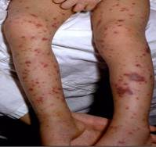
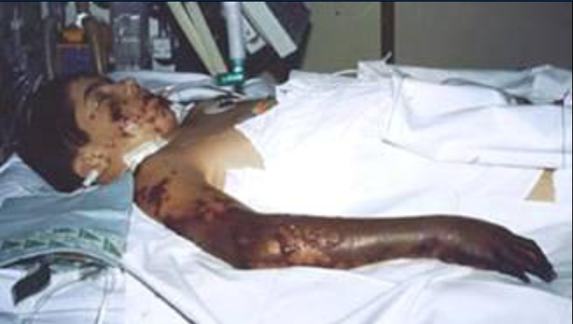
Meningococcal Disease
(caused by N. meningitidis)
Meningitis
~50% of cases 9-10% fatality rate
Meningococcemia
5%-20% of cases Up to 40% fatality rate
Rash
Vascular damage
Disseminated intravascular coagulation
Multi-organ failure
Shock
Death can occur in 24 hours
Photo courtesy CDC: Dr. Brodsky & Mr. Gust
11-19% of survivors have permanent sequelae
Ref: 1. Epidemiology and Prevention of Vaccine-Preventable Diseases. 13th Edition, 2015.
2. AAP Red Book 2015
Notes:
The most common clinical presentations of meningococcal disease are meningitis and meningococcemia.
Neisseria meningitides contains 13 serogroups, the most common being A, B, C, W, and Y.
About 5-10% of adults are asymptomatic nasopharyngeal carriers of this organism.
Individuals with meningococcemia may die within 24 hours of the onset of symptoms even with prompt treatment with appropriate antimicrobials and supportive care in an intensive care unit.
Reference: 1. Epidemiology and Prevention of Vaccine-Preventable Diseases, 13th edition. 2015 HHS, CDC.
2. AAP Redbook 2015
3. Meningococcal Disease. About the Disease. http://www.cdc.gov/meningococcal/about/index.html

Slide 29
Meningococcal Conjugate Vaccine (MCV4)
(Men A,C,Y, W-135)
Menactra™ licensed for 9 mos. through 55 years
Menveo® licensed for ages 2 mos. through 55 years
ACIP recommends:
  First dose at age 11 or 12 years and a booster dose at 16 years.
  If first dose is at 13-15 years, give booster dose 5 years after the first dose or sooner, but after age 16 if entering college or technical school.
  If first dose is received ≥ 16 years of age, a 2nd dose is not needed.
  Persons aged 21 years or younger attending school or college should have documentation of one dose of MVC4 not more than 5 years before enrollment.
Persons aged ≥56 years who are recommended meningococcal vaccination because they are at increased risk for meningococcal disease should receive MenACWY conjugate vaccine.
MMWR, March 22, 2013, Vol 62, #RR02
Advisory Committee on Immunization Practices (ACIP) Summary Report February 22-23, 2017
Notes:
Recommendation for Routine Vaccination of Persons Aged 11 Through 18 Years
After a booster dose of meningococcal conjugate vaccine, antibody titers are higher than after the first dose and are expected to protect adolescents through the period of increased risk through age 21 years. Persons who receive their first dose of meningococcal conjugate vaccine at or after age 16 years do not need a booster dose. Routine vaccination of healthy persons who are not at increased risk for exposure to N. meningitidis is not recommended after age 21 years.
CDC Guidance for Transition to an Adolescent Booster Dose
Some schools, colleges, and universities have policies requiring vaccination against meningococcal disease as a condition of enrollment. For ease of program implementation, persons aged 21 years or younger should have documentation of receipt of a dose of meningococcal conjugate vaccine not more than 5 years before enrollment. If the primary dose was administered before the 16th birthday, a booster dose should be administered before enrollment in college. The booster dose can be administered anytime after the 16th birthday to ensure that the booster is provided. The minimum interval between doses of meningococcal conjugate vaccine is 8 weeks.
No data are available on the interchangeability of vaccine products. Whenever feasible, the same brand of vaccine should be used for all doses of the vaccination series. If vaccination providers do not know or have available the type of vaccine product previously administered, any product should be used to continue or complete the series.
Recommendations for Adults 56 years and older
Persons aged ≥56 years who are recommended meningococcal vaccination because they are at increased risk for meningococcal disease should receive MenACWY conjugate vaccine.
Advisory Committee on Immunization Practices (ACIP) Summary Report February 22-23, 2017

Slide 30
Meningococcal Vaccines for High Risk
Persons 6 weeks – 55 years
Menveo® (Men A,C,Y, W-135) licensed for ages 2 mos. through 55 years
Menactra^{™ (}(Men A,C,Y, W-135) licensed for 9 mos. through 55 years
Recommended for persons 6 weeks through 55 years:
human immunodeficiency virus (HIV)
complement component deficiency
functional or anatomic asplenia (sickle cell disease)
microbiologists exposed to isolates of N. meningitidis
part of a community outbreak due to vaccine serogroups
persons traveling internationally to regions with endemic meningococcal disease
For details on doses and schedule refer to the current Immunization Schedule
MMWR, June 20, 2014, Vol 63 #24 MMWR, March 22, 2013, Vol 62, #RR02 MMWR, November 4, 2016, Vol 65 #43
Notes:
June 2016, ACIP recommended routine use of meningococcal conjugate vaccine for persons ages >2 months with human immunodeficiency virus infection. The majority of meningococcal disease among HIV-infected persons is caused by these four serogroups.
The same vaccine product should be used for all doses. ACIP recommends HIC-infected infants 2 through 23 months should receive MenACWY-CRM (Menveo). HIV-infected children < 2 years should not receive MenACWY-D(Menactra) due to immune interference with PCV13.
Reference:
MMWR, November 4, 2016, Vol 65(43).

Slide 31
Serogroup B Meningococcal Vaccine
Bexsero® licensed for ages 10 through 25 years (2 dose)
Trumenba® licensed for ages 10 through 25 years (3 dose)
ACIP recommends serogroup B meningococcal vaccine for:
Persons with persistent complement component deficiencies
Persons with anatomic or functional asplenia
Microbiologists routinely exposed to isolates of Neisseria meningitidis
Persons identified to be at increased risk because of a serogroup B meningococcal disease outbreak
The 2 vaccine products are not interchangeable.
(Category B – Permissive recommendation)#
A Men B vaccine series may be administered to adolescents and young adults 16 through 23 years of age to provide short-term protection against most strains of Men B. Preferred age is 16-18 years.
MMWR; June 12, 2015 ,Vol. 64 #22; 608-611
# MMWR; October 23, 2015, Vol .64 #41; 1171-1176
Notes:
“MenB vaccine should be administered as either a 2-dose series of MenB-4C or a 3-dose series of MenB-FHbp. The same vaccine product should be used for all doses.“
On February 26, 2015 the ACIP approved for MenB vaccines be recommended for the use among persons aged >10 years at increased risk for serogroup B meningococcal disease. This recommendation was designated a Category A (recommended for all persons in the age-based risk factor group).
The ACIP determined that insufficient evidence existed to routinely recommend that all adolescents be vaccinated with MenB vaccines. ACIP agreed that the information provided would allow each individual health care professional to use clinical decision making when recommending the vaccine. A Category B recommendation was made. MenB vaccine series may be administered to yourg adults 16-23 years of age to provide short-term protection against most strains of MenB.
References: MMWR; October 23, 2015, Vol .64 #41; 1171-1176.
MMWR: June 12, 2015, Vol. 64 #22; 608-611.

Slide 32
Serogroup B Meningococcal
Vaccine Administration
Bexsero® licensed for ages 10 through 25 years (2 dose)
Trumenba® licensed for ages 10 through 25 years (2 dose or 3 dose)
MenB-FHbp (Trumenba®)
  2 dose schedule – administered at 0, 6 months
  Given to healthy adolescents who are not at increased risk for meningococcal disease
  3 dose schedule – administered at 0, 1-2, 6 months
  Given to persons at increased risk for meningococcal disease and for use during serogroup B outbreaks
MenB-4C (Bexsero®)
  2 dose schedule – 0, 1-2 months

Slide 33
Types of Human Papilloma Virus (HPV)
(More Than 200 Types Identified)
Mucosal/Genital
~40 types
Cutaneous
High risk types
16, 18, 31, 33, 45, 52, 58
(and others)
Low risk types
6, 11 and others
Cervical cancer
Anogenital cancer
Oropharyngeal Cancer
Cancer precursors
Low grade cervical disease
Genital Warts
Laryngeal Papillomas
Low grade cervical disease
Skin warts
Hands and Feet
Ref: 1.Epidemiology and Prevention of Vaccine Preventable Diseases 13th Edition, 2015
2. Red Book – AAP 2015 Report of the Committee on Infectious Diseases
3. MMWR, August 29, 2014, RR Vol. 63, No. 5
Notes:
.
More than 200 types have now been identified.
Virtually all cases of cervical cancer are caused by HPV viruses
Cervical cancer is the 2nd leading cause of cancer death in women in the world.
Reference: cancer.gov (accessed 2-17-18)

Slide 34
HPV Vaccine
Gardasil 9® (9vHPV) HPV types 6, 11, 16, 18, 31, 33, 45, 52, 58
ACIP recommends HPV vaccine starting at age 11 or 12 years for:
  All females through 26 years of age
  All males through 21 years of age
  Men 22 through 26 years who have sex with men or have an immunocompromising condition.
  All other males 22 through 26 years.
Series can be completed with 9vHPV if started with 2v or 4v.
Gardasil 9 is now also licensed for all persons 9 through 45 yrs. of age, using the 3-dose schedule for ages 15 – 45.*
ACIP recommendations forthcoming.
MMWR, March 27, 2015, Vo1 64, No. 11
MMWR, December 16, 2016, Vol 65, No. 49 *https://www.merck.com/product/usa/pi_circulars/g/gardasil_9/gardasil_9_pi.pdf
Notes:
Recommendations for Use of HPV Vaccines
ACIP recommends that routine HPV vaccination be initiated at age 11 or 12 years. The vaccination series can be started beginning at age 9 years.
† Vaccination is also recommended through age 26 years for men who have sex with men and for immunocompromised persons (including those with HIV infection) if not vaccinated previously.
References:
2017 Supplement to Epidemiology and Prevention of Vaccine-Preventable Diseases, 13th Edition (the Pink Book)
MMWR, December 16, 2016, Vol 65, No. 49

Slide 35
Strategies to Avoid Missed Opportunities
Provider Prompts
  Automatic pop-up alerts through your EHR system
  These can sometimes be pre-installed and then customized in your office
Family-friendly office hours
  Occasional evening or Saturday hours
  “No-appointment-required” if needing immunizations only
Immunization Champion in your practice
  Manage vaccine supply and schedule periodic updates
  Any member of the staff could fill this role
Source: https://www.aap.org/en-us/advocacy-and-policy/aap--health-initiatives/immunizations/Practice- Management/Pages/office- strategies.aspx

Slide 36
Strategies (cont’d)
Include all recommended vaccines at each visit
Schedule periodic team meetings with all personnel to:
  Improve patient flow
  Improve quality of care
  Discuss problems within the framework of the practice
Bottom line: NOT receiving a healthcare provider’s recommendation for HPV vaccine was one of the main reasons parents reported for not vaccinating their adolescent children.
Sources: https://www.aap.org/en-us/advocacy-and-policy/aap--health-initiatives/immunizations/Practice-Management/Pages/office-
strategies.aspx
http://www.immunize.org/askexperts/experts_hpv.asp
www.immunize.org/catg.d/p3090.pdf

Slide 37

Critical Elements for
Immunization Services
Celebrating 16 years

Slide 38
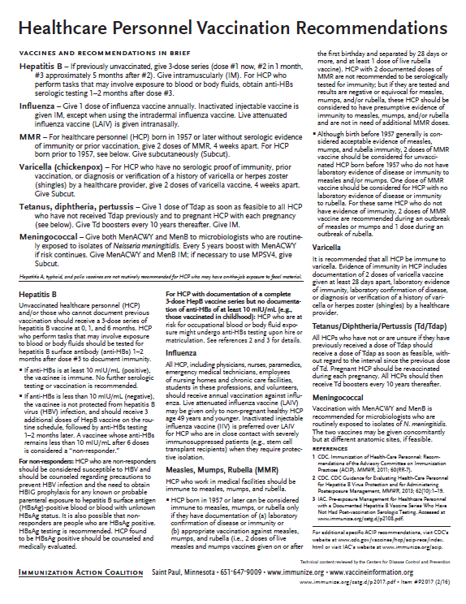
Recommended Healthcare Personnel Vaccinations
Hepatitis B
Influenza
Measles, Mumps, Rubella (MMR)
Varicella (Chickenpox)
Tetanus, Diphtheria, Pertussis (Tdap)
Meningococcal (recommended for microbiologists who are routinely exposed to isolates of N. meningitidis).
Are YOU up to date?
Available at www.immunize.org, P#2017
Notes:
Un-immunized HCP
Un-immunized healthcare workers are at risk of infecting patients, family members and community contacts
Immunized HCP
Protect patients from VPD’s
Help offices avoid potential liability cases. (The practice can be liable if an unimmunized HCP becomes infected with a vaccine preventable disease and infects a patient.)
Maintain productivity
Reduce illness and illness-related absenteeism
Evidence of Immunity to MMR
Documented administration of two doses of measles and mumps vaccine and one dose of rubella vaccine OR
Laboratory evidence of immunity or laboratory confirmation of disease (measles, mumps and rubella) OR
Born before 1957 (measles, mumps and rubella)
Because of their contact with patients or infective material from patients, many HCP are at risk for exposure to (and possible transmission of) vaccine-preventable diseases. Employers and HCP have a shared responsibility to prevent occupationally acquired infections and avoid causing harm to patients by taking reasonable precautions to prevent transmission of vaccine-preventable diseases.
Optimal use of recommended vaccines helps maintain immunity and safeguard HCP from infection, thereby helping protect patients from becoming infected. The recommendations for vaccination of HCP are presented in two categories: 1) th7se diseases for which routine vaccination or documentation of immunity is recommended for HCP because of risks to HCP in their work settings and, should HCP become infected, to the patients they serve and 2) those diseases for which vaccination of HCP might be indicated in certain circumstances. Vaccines recommended in the first category are hepatitis B, seasonal influenza, measles, mumps, and rubella, pertussis, and varicella vaccines. Vaccines in the second category are meningococcal, typhoid, and polio vaccines.
1. General Recommendations on Immunization, Recommendations of the Advisory Committee on Immunization Practices (ACIP). MMWR (RR-2); January 28, 2011
MMWR; November 25, 2011 / 60(RR07);1-45

Slide 39
PRE-EXPOSURE EVALUATION FOR HEALTH-CARE PERSONNEL
PREVIOUSLY VACCINATED WITH COMPLETE, 2 or 3 DOSE HEP B VACCINE
SERIES WHO HAVE NOT HAD POSTVACCINATION SEROLOGIC TESTING
Measure antibody to hepatitis B surface antigen (anti-HBs) anti-HBs ≥10 mIU/mL
Below adequate level
anti-HBs ≥10mIU/mL
1 dose of HepB vaccine,
4-6 wks.--- serologic testing
No Action for
Hepatitis B prophylaxis
(regardless of source patient hepatitis B surface antigen status)
Below adequate level
At or above adequate level
1 or 2 more doses of HepB vaccine, depending on brand
4-6 wks.--- serologic testing
Vaccinated HCP whose anti-HBs remains <10 mIU/mL after revaccination (i.e., after receiving a total of 2 complete series) should be tested for HBsAg and anti-HBc to determine infection status.
Below adequate level
At or above adequate level
HCP need to receive hepatitis B evaluation for all exposures
MMWR, April 20, 2018/ Vol 67/No. 15
Notes:
Postvaccination Serologic Testing
HCP who can’t provide documentation of 3 doses of HepB vaccine should be considered unvaccinated and should complete the vaccine series. If inadvertently tested before receiving the 3 doses and anti-HBs ≥10 mIU/mL, they should NOT be considered immune. The test level is based on receipt of a documented 3 dose series.
Testing unvaccinated HCP for HBV infection is not generally indicated for persons being evaluated for hepatitis B protection because of occupational risk.
Prevaccination serologic testing is indicated for:
all persons born in geographic regions with HBsAg prevalence of ≥2% (e.g., much of Eastern Europe, Asia, Africa, the Middle East, and the Pacific Islands)
certain indigenous populations from countries with overall low HBV endemicity (<2%)
persons with behavioral exposures to HBV (e.g., men who have sex with men and past or current injection drug users)
persons receiving cytotoxic or immunosuppressive therapy
persons with liver disease of unknown etiology.
Testing HCP at risk for HBV infection should consist of a serologic assay for HBsAg, in addition to either anti-HBc or anti-HBs. For unvaccinated HCP at risk for previous HBV infection, blood should be drawn for testing before the first dose of vaccine is administered.
HCP who have written documentation of a complete, ≥3-dose HepB vaccine series and subsequent postvaccination anti-HBs ≥10 mIU/mL are considered hepatitis B immune. Immunocompetent persons have long-term protection against HBV and do not need further periodic testing to assess anti-HBs levels.
All HCP recently vaccinated or recently completing HepB vaccination who are at risk for occupational blood or body fluid exposure should undergo anti-HBs testing. Anti-HBs testing should be performed 1–2 months after administration of the last dose of the vaccine series when possible. HCP with documentation of a complete ≥3-dose HepB vaccine series but no documentation of anti-HBs ≥10 mIU/mL who are at risk for occupational blood or body fluid exposure might undergo anti-HBs testing upon hire or matriculation. Testing should use a quantitative method that allows detection of the protective concentration of anti-HBs (≥10 mIU/mL) (e.g., enzyme-linked immunosorbent assay [ELISA]).
Completely vaccinated HCP with anti-HBs ≥10 mIU/mL are considered hepatitis B immune. Immunocompetent persons have long-term protection and do not need further periodic testing to assess anti-HBs levels.
Completely vaccinated HCP with anti-HBs <10 mIU/mL should receive an additional dose of HepB vaccine, followed by anti-HBs testing 1–2 months later. HCP whose anti-HBs remains <10 mIU/mL should receive 2 additional
vaccine doses (usually 6 doses total), followed by repeat anti-HBs testing 1–2 months after the last dose. Alternatively, it might be more practical for very recently vaccinated HCP with anti-HBs <10 mIU/mL to receive 3 consecutive additional doses of HepB vaccine (usually 6 doses total), followed by anti-HBs testing 1–2 months after the last dose.
Ref: (1) CDC Guidance for Evaluating Health-Care Personnel for Hepatitis B Virus Protection and for Administering Post Exposure Management MMWR Recommendations and Reports /Vol. 62/No. 10 December 20, 2013 (2) MMWR, Recommendations & Reports/Vol.67/No.1, January 12,2018

Slide 40
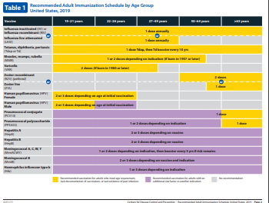

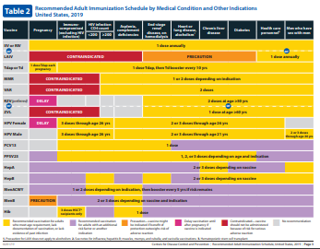
2019 Recommended Immunization Schedule for Adults Aged ≥19 Years
Recommended adult schedule by age group
Recommended immunization schedule for adults aged 19 years or older by medical condition and other indications
READ THE FOOTNOTES!
CDC Bulletin, February 5, 2019
Notes:
Persons previously vaccinated with 2 doses of a mumps virus-containing vaccine who are identified by public health authorities as being part of a group or population at increased risk for acquiring mumps because of an outbreak should receive a third dose of a mumps virus-containing vaccine to improve protection against mumps disease and related complications.
MMWR, Recommendation of the Advisory Committee on Immunization Practices for Use of a Third Dose of Mumps Virus–Containing Vaccine in Persons at Increased Risk for Mumps During an Outbreak
Weekly / January 12, 2018 / 67(1);33–38

Slide 41
Indications
Recommendations
Requirements
Indication
  Information about the appropriate use of the vaccine
Recommendation
  ACIP statement that broadens and further delineates the Indication found in the package insert
  Basis for standards for best practice
Requirement
  Mandate by a state that a particular vaccine must be administered and documented before entrance to child care and/or school
Notes:
EXAMPLES OF AN INDICATION
ADACEL vaccine is indicated for active booster immunization for the prevention of tetanus, diphtheria and pertussis as a single dose in persons 11 through 64 years of age.
EXAMPLE OF A RECOMMENDATION
Recommendations by ACIP for the routine administration of vaccines. May include other information and guidance on epidemiology of the disease, appropriate timing, dosage, contraindications to the vaccine and guidance for use in special populations.
EXAMPLE OF VACCINE REQUIREMENTS FOR ENTRY INTO CHILD CARE FACILITIES IN GEORGIA
Consistent with the Recommended Childhood and Adolescent Immunization Schedule
Children are required to be age appropriately immunized against each of these diseases: Hepatitis B, Diphtheria, Tetanus, Pertussis, Polio, Hib, Pneumococcus, Measles, Mumps, Rubella, Varicella, Hepatitis A, and meningococcal disease.

Slide 42


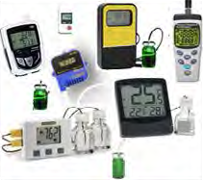
Updated Vaccine Storage and Handling Recommendations
Use stand-alone refrigerator and stand-alone
freezer units. If combined, use only refrigerator part.
Do not store any vaccine in a dormitory-style or
bar-style combined refrigerator/freezer unit.
Use a bio-safe glycol-encased probe
or a similar temperature buffered probe.
Use digital data loggers.
Do not store ANYTHING ELSE in refrigerator.
Review vaccine expiration dates and rotate
vaccine stock weekly.
Ref: Vaccine Storage and Handling Toolkit, JANUARY, 2018
Notes:
It is estimated that 17-37% of immunization providers expose vaccines to improper storage temperatures. More commonly, refrigerators are kept too cold rather than too warm. The potency of vaccines stored at incorrect temperatures may be irreversibly reduced. A physical change in the vaccine may not be apparent.
https://www.cdc.gov/vaccines/hcp/admin/storage/toolkit/index.html to view and print:
-Vaccine Storage and Handling Toolkit
-Vaccine Storage and Handling Guide
-Interim Storage and Handling Guidance
Remember: if you find temperatures out of range, TAKE ACTION, DO SOMETHING ABOUT IT!

Slide 43
Maintaining Appropriate
Vaccine Storage & Handling
Assign a primary and alternate vaccine coordinator.
Store all vaccines as recommended by manufacturer and IN ORIGINAL PACKAGING.
Monitor and record temperatures of refrigerator and freezer twice daily.
Maintain temperature log records for 3 years.
Take immediate action for all out-of-range temps.
Implement a vaccine emergency system.
If it is necessary to transport vaccine, do NOT use dry ice.
Ref: Vaccine Storage and Handling Toolkit, January 2018
Notes:
Remember: if you find temperatures out of range, TAKE ACTION, DO SOMETHING ABOUT IT!
The June 2016 toolkit reflects an adjustment to the Fahrenheit temperature range for storing refrigerated vaccines. The new recommended range is between 36 and 46 degrees F (previously between 35 and 46 degrees F).

Slide 44
Check Expiration Date of Vaccines and Diluents
Vaccine Expiration Date is 12/10/19
Use through December 10, 2019
Do NOT use on or after December 11, 2019.
Vaccine Expiration Date is 12/19
Use through December 31, 2019
Do NOT use on or after January 1, 2020.
12/19
12/10/19
Note: Some multidose vials have a specified time frame for use once the vial is entered with a needle. This may vary from the expiration date printed on the vial.
Notes:
Ref: Vaccine Storage and Handling Toolkit, June, 2016.

Slide 45
General Best Practice Guidelines for Immunization
(formerly General Recommendations on Immunization)
Timing and Spacing
Contraindications and Precautions
Prevention and Management of Adverse Reactions
Vaccine Administration
Storage and Handling of Immunobiologics
Altered Immunocompetence
Special Situations
Vaccination Records
Vaccination Programs
Vaccine Information Sources
Errata available at https://www.cdc.gov/vaccines/hcp/acip-recs/general-recs/general-recs-errata.html
Kroger AT, Duchin J, Vázquez M. General Best Practice Guidelines for Immunization. Best Practices Guidance of the Advisory Committee on Immunization Practices (ACIP). [www.cdc.gov/vaccines/hcp/acip-recs/general-recs/downloads/general-recs.pdf].
Notes:
Specific administration guidelines have been established for each vaccine. Minimum age and intervals for vaccines are set by manufacturers during clinical trials; too young an age or too close together may alter effectiveness of a vaccine.
There is a 4-day grace period – vaccines given during the 4-day window before the recommended age/interval may be counted as valid. It is suggested that MMR and Varicella, not be given before one year of age. GRITS tables have been set up to calculate this correctly when a vaccine history is entered.
The updated version is entitled General Best Practice Guidelines for Immunization. It will not be available to order but can be accessed on the ACIP Recommendations pg. or downloaded. The bullets list the chapters in the document, plus the location of the errata.
EPIC 2018

Slide 46
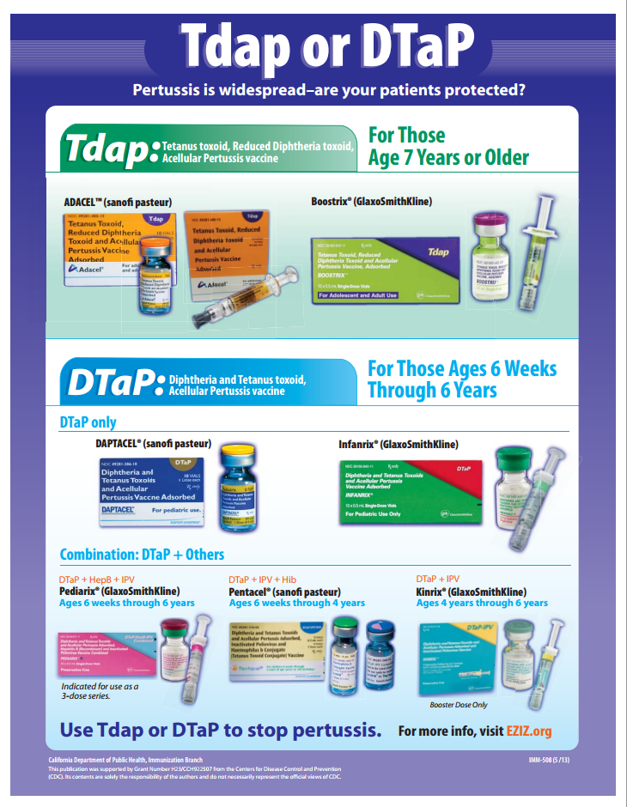
Check the vial 3 times!

Slide 47
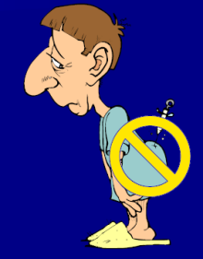
The 7 Rights of Vaccine Administration
Right Patient
Right Vaccine or Diluent
Right Time*
Right Dosage
Right Route, Needle Length, Technique
Right Site for route indicated
Right Documentation
* Correct age, appropriate interval, and administer before vaccine or diluent expires
Ref: Epidemiology and Prevention of Vaccine-Preventable Diseases. 13th Edition, 2015.
Notes:
Be sure to check package insert for correct route, correct sites for the route and correct needle length.
Much of this information is available in the ACIP General Recommendations document.
*Make a chart of this information for use in your office*. Or have a VACS FACS available in your office.
Ref: General Recommendations on Immunization MMWR 2011; 60 (No. RR-2) Jan 28, 2011
REMINDER:
Vaccines should never be given in the gluteus muscle
If it is discovered that Hepatitis B or rabies vaccine has been given there, all such doses must be repeated at appropriate sites.

Slide 48
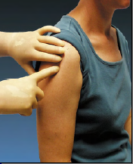
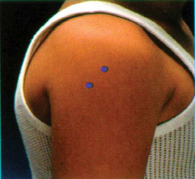
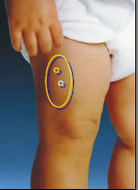
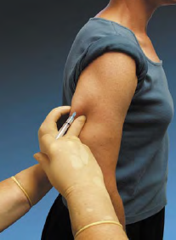
Sites for Vaccine Administration
Intramuscular (IM)
  DTaP, Tdap, Hib, Td, Hep A, Hep B, PCV13, IIV, MCV4, HPV , Herpes Zoster (2-dose vaccine)
Subcutaneous (SQ, SC, or sub-Q)
  MMR, MMRV, Varicella, MPSV4,
  Herpes Zoster (1 dose vaccine)
Either intramuscular or subcutaneous
  IPV, PPSV23
Intranasal
LAIV
Intradermal
IIV3, IIV4 (Fluzone)
(not available for 2018-2019 flu season)
Orally (PO)
Rotavirus
Notes:
Be sure to check package insert for correct route and then make a chart for use in your office.
Revaccination is recommended if:
hepatitis B vaccine is administered by any route other than IM or in any site of an adult other than deltoid or anterolateral thigh
rabies vaccine is administered in gluteal site
if a partial dose of a parenteral vaccine is administered because the syringe or needle leaks or the patient jerks away
Ref: Epidemiology and Prevention of Vaccine-Preventable Diseases. 13th Edition, 2015

Slide 49
Improper Immunization Administration Practices
DO NOT re-use needles or syringes. This has resulted in:
  Transmission of blood-borne viruses (HCV, HBV, HIV)
  Referral of providers to licensing boards for disciplinary action
  Malpractice suits filed by patients
You MAY use the same needle to withdraw a diluent, inject this into a lyophilized vaccine vial, and then administer to a patient, providing the needle or syringe has not otherwise been contaminated.
Types of Vaccine Errors:
Wrong vaccine (23%) Wrong dose (19%)
Expired or contaminated vaccine (19%) Wrong age (17%)
Wrong interval (8%) Diluent errors (4%)
Wrong route (2%)
Wrong patient (1%)
Ref: 1.Epidemiology and Prevention of Vaccine Preventable Diseases 13th Edition, 2015
2. CDC, NCEZIZ, DHQP. Injection Safety Information for Providers: www.cdc.gov/injectionsafety/providers.html
3. http://www.immunize.org/askexperts/administering-vaccines.asp
4. ISMP National Vaccine Error Reporting Program, June 14, 2018, Volume 23, Issue 12
Notes:
Changing needles between drawing vaccine from a vial and injecting it into a recipient is not necessary unless the needle has been damaged or contaminated.
General Best Practice Guidelines for Immunization: Best Practices Guidance of the Advisory Committee on Immunization Practices (ACIP), Vaccine Administration chapter. Published 4-20-17.
EPIC 2018

Slide 50
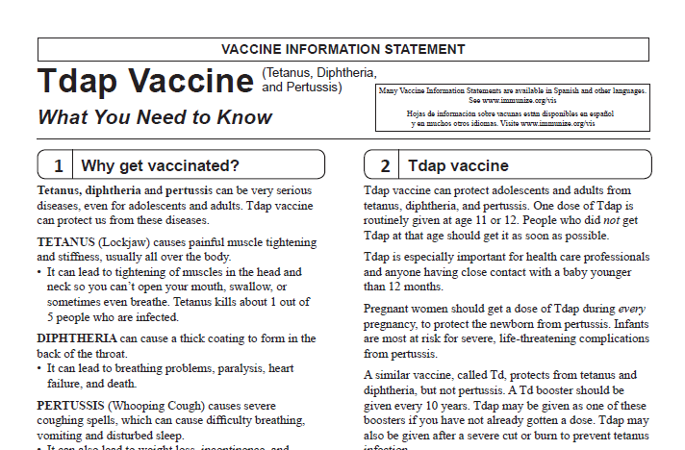
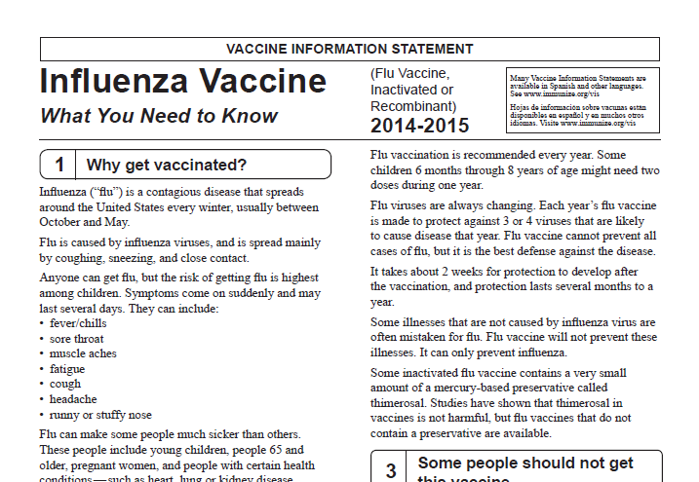
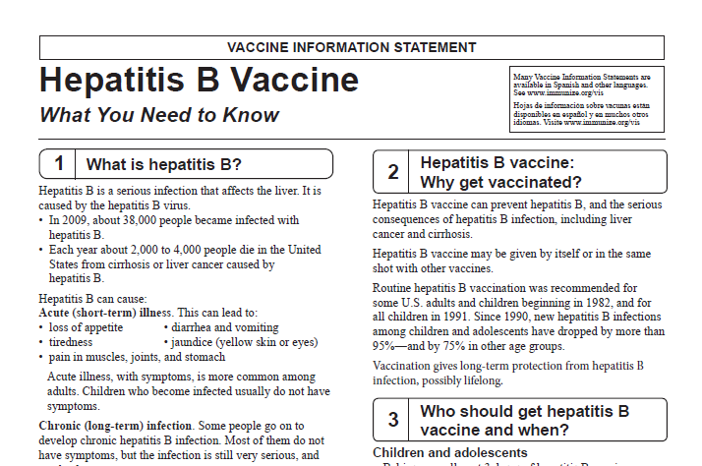
Always Document…
Accept only written documentation of prior immunizations
Provide VIS prior to administration of vaccine
After vaccine administration, document:
  Publication date of VIS & date VIS given
  Date, site, route, antigen(s), manufacturer, lot #
  Person administering vaccine, practice name and address
  Vaccine refusals with a signed “Refusal to Vaccinate Form”
  GA law does not require signed consent for immunizations
Notes:
Vaccine Information Sheets
VIS required by law for each vaccine given and each time that vaccine is given. The most current VIS must be used. For VIS statements in English and many other languages: www.immunize.org; www.cdc.gov/vaccines/ or call the National Immunization Program Information Hotline at
800-CDC-INFO (800-232-2522).
Document all information listed on slide. Information will also be helpful if a specific lot of vaccine is recalled in the future.
Refusal to consent for an immunization should be documented for liability purposes and chart completeness. There is no way to document this in GRITS.
Georgia recognizes only medical and religious exemptions. Medical exemptions must be re-evaluated every year.
Georgia law does not require signed consent for immunization. Patients, parents or legal guardians may verbally consent to immunization. However, some practices may require written consent for all medical care.

Slide 51

A ‘Birth to Death’ Immunization Registry
Providers administering vaccines in Georgia must provide appropriate information to GRITS.
GRITS personnel can work with your EHR/EMR vendor to create an interface between your system and GRITS that will drastically decrease data entry time for your practice.
Contact the GRITS Training Coordinator at (404) 463-0807 or e-mail : dph-immreg@dph.ga.gov
Notes:
In 2004, House Bill 1526 was passed making the Georgia Immunization Registry a birth to death registry mandating that providers of immunizations in Georgia report those immunizations into the registry database. Immunization data may now be shared by all providers of immunizations to Georgians of any age, and to schools, daycares, colleges and universities, and long term care facilities. The patient (age 18 or older) or parent or legal guardian may OPT-OUT of the registry.
Contact GRITS to enroll: 1-888-223-8644
Benefits of GRITS include: accurate immunization records, inventory tracking, reduction in missed opportunities or over-immunization, generation of school entrance forms/college immunization forms, reminder/recall notices for parents, assistance in generating reporting of immunizations to HEDIS/COCASA, and elimination of phone calls to providers for immunization records. The GRITS program is web-based. New users to the system will have to attend a training session and receive a password. UNIFIED FONT SIZES OF WHOLE PAGE
Advantages of a statewide registry are as follows:
Benefits to the Community
Enhance the overall health status by facilitating identification of inadequately immunized segments of the population
Decrease occurrence of over-immunization due to inability to locate past records
Assist in issuing reminders to patients for pending and overdue immunizations
Benefits to Healthcare Providers
Reduce staff time needed to obtain complete immunization history of patients
Provide printouts of school certificates
Provide vaccine information and simplify complex and dynamic immunization schedules
Streamline vaccine inventory process
Generate HEDIS and other reports
Reinforce the concept of a medical home
Benefits to Public Health Officials
Provide an accurate measure of immunization rates for districts, counties, and the state
Allow Georgia healthcare providers to update and exchange immunization information about their patients in a confidential manner
Facilitate community outreach programs
The Georgia Code 31-12-3.1, which took affect July 1, 1996 and House Bill 1526, which took affect July 1, 2004 states:
Any person who administers a vaccine or vaccines licensed for use by the United States Food and Drug Administration to a person shall, for each such vaccination, provide to the department such data as are deemed by the department to be necessary and appropriate for purposes of the vaccination registry established pursuant to subsection (a) of this Code section…
At the present time the mandatory use of GRITS is not being strictly enforced but will be sometime in the future.

Slide 52
Vaccine Adverse Events
Local
- pain, swelling, redness at injection site
- common with inactivated vaccines
- usually mild and self-limited
Systemic
- fever, malaise, headache
- nonspecific symptoms
- may be unrelated to vaccine
Allergic
- anaphylaxis
- serious but rare
Ref: Epidemiology and Prevention of Vaccine-Preventable Diseases. 13th Edition, 2015
Notes:
The most common type of adverse reactions are local reactions, such as pain, swelling, and redness at the site of injection, occurring within a few hours of the injection and are usually mild and self-limited. These may occur with up to 80% of vaccine doses, depending on the type of vaccine. They are most common with inactivated vaccines, particularly those that contain an adjuvant (DTaP). On rare occasions, local reactions may be very exaggerated or severe. These are often referred to as hypersensitivity reactions, although they are not allergic, as the term implies. These reactions are also known as Arthus reactions, and are most commonly seen with tetanus and diphtheria toxoids. Arthus reactions are believed to be due to very high titers of antibody, usually caused by too many doses of toxoid.
Systemic adverse reactions are more generalized events and include fever, malaise, myalgia (muscle pain), headache, loss of appetite, and others. These symptoms are common and nonspecific; they may occur because of the vaccine or may be caused by something unrelated to the vaccine, like a concurrent viral infection, stress, or excessive alcohol consumption. Systemic adverse reactions were relatively frequent with DTP vaccine, which contained a whole-cell pertussis component. However, comparison of the frequency of systemic adverse events among vaccine and placebo recipients shows they are less common with inactivated vaccines currently in use, including acellular pertussis vaccine. Systemic adverse reactions that follow live attenuated vaccines, such as fever or rash, represent symptoms produced from viral replication and are similar to a mild form of the natural disease. Systemic adverse reactions following live vaccines are usually mild, and occur 7–21 days after the vaccine was given (i.e., after an incubation period of the vaccine virus). LAIV replicates in the mucous membranes of the nose and throat, not in the lung. As a result, LAIV may cause upper respiratory symptoms (like a cold) but not influenza-like symptoms.
An anaphylactic (allergic) reaction may be caused by the vaccine antigen itself or some other component of the vaccine, such as cell culture material, stabilizer, preservative, or antibiotic used to inhibit bacterial growth. Severe allergic reactions may be life-threatening. Fortunately, they are rare, occurring at a rate of less than one in half a million doses. The risk of an allergic reaction can be minimized by good screening prior to vaccination. All providers who administer vaccines must have an emergency protocol and supplies to treat anaphylaxis.
Reference: Epidemiology and Prevention of Vaccine-Preventable Diseases, 13th edition. May 2015 HHS, CDC.

Slide 53
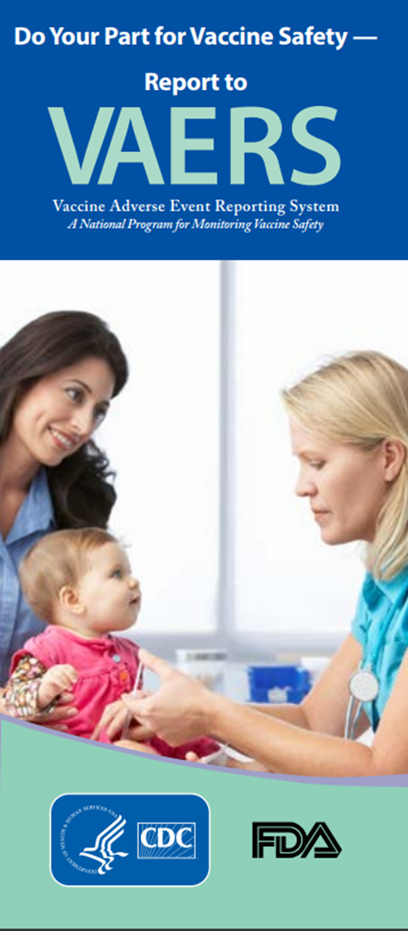
Monitoring Vaccine Safety
VAERS
Option 1 - Report Online to VAERS (Preferred)
Submit a VAERS report online. The report must be completed online and submitted in one sitting and cannot be saved and returned to at a later time. Your information will be erased if you are inactive for 20 minutes; you will receive a warning after 15 minutes.
Option 2 - Report using a Writable PDF Form
Download the Writable PDF Form to a computer. Complete the VAERS report offline if you do not have time to complete it all at once. Return to this page to upload the completed Writable PDF form by clicking here.
If you need further assistance with reporting to VAERS, please email info@VAERS.org or call 1-800-822-7967.
FDA and Vaccine Data Link Safety Project
VERP: VACCINE ERROR REPORTING SYSTEM
  On line reporting at http://verp.ismp.org/
  Report even if no adverse events associated with incident
  Will help identify sources of errors to help develop prevention strategies
Notes:
Nothing is 100% risk free. Most reactions to vaccines are mild with very small risk of severe allergic reactions (anaphylaxis).
Systems in place to monitor safety include the FDA (pre and post licensure monitoring) and the Vaccine Safety Datalink (VSD) Project. This large project links 4 HMO's at 10 sites with the CDC to monitor adverse events possibly caused by vaccines.
FDA monitors vaccines for safety before issuing licenses - very stringent licensing involving laboratory and human testing; vaccine safety is also monitored after licensure to ensure each vaccine lot is effective and pure. Vaccine manufacturers also do post-licensure monitoring.
The Institute of Medicine reviews research related to vaccine safety and publishes a report periodically.
VAERS
Updated system. Two options for reporting are outlined in the gray box.
Passive reporting system to monitor vaccine adverse events established by the National Childhood Vaccine Injury Act 1986
Mandates patients/ parents are educated about risk of vaccines and compensated for any injury caused by vaccine.
Emphasize there is no penalty for reporting an “adverse event”. The healthcare provider is only reporting that a specific event occurred after administration of a specific vaccine and is not claiming that the event was caused by the vaccine.
VERP – There is relatively little data available on why vaccine administration errors occur. The Institute for Safe Medication Practice (ISMP) has launched a national patient safety reporting program to capture the unique causes and consequences of vaccine –related errors. The ISMP National Vaccine Error Reporting Program (ISMP VERP) allows healthcare practitioners to report errors and near misses in confidence.
Sources of Vaccine Safety Information:
https://www.cdc.gov/vaccines/hcp/vis/index.html www.cdc.gov/vaccinesafety/
www.idsociety.org www.vaccinesafety.edu
www.acponline.org www.aap.org
www.aafp.org www.immunize.org
www.vaccine.chop.edu www.vaers.hhs.gov
EPIC 2018

Slide 54

Why do we miss opportunities to immunize?
Physician or patient unaware of the need
Visits for mild illness, injury, or follow-up
Need for multiple vaccines
Invalid contraindications
Inappropriate clinic policies
Reimbursement deficiencies
Notes:
The CDC definition of a missed opportunity is, “A health care encounter in which a person is eligible to receive vaccination but is not vaccinated completely.” (Epidemiology and Prevention of Vaccine-Preventable Diseases, 13th edition. 2015 HHS, CDC. )
Missing an opportunity to immunize may leave you vulnerable to a lawsuit. Patients who developed vaccine-preventable disease after failing to be immunized (missed opportunities) have filed lawsuits. [see Needletips (1), 1,1994]
To avoid missed opportunities:
Vaccination records: Keep accurate immunization records in a prominent location in the chart so immunization status can be easily checked at each visit.
Mild illness/injury visits/follow-up visits: The CDC recommends immunization with all vaccines for patients even those with low-grade fever, mild diarrhea, mild ear infections, mild acute illness, or upper respiratory infections. There is no evidence of increased risk of adverse events associated with immunizations during the course of a minor illness. The decision to defer immunizations results in a missed opportunity. The procedure for assessing immunization status and giving immunizations at follow-up and sick/injury visits may require more time, necessitating change in your office practice.
Multiple vaccinations per visit: More than one vaccine can be administered at one time. There is no limit to the number of vaccines that can be given at one visit.
Know the schedules: Post the current schedule and keep staff updated on any changes.
Know Contraindications: Be aware of the true/valid contraindications, precautions and invalid contraindications. There are few truly valid contraindications to vaccine administration.
Adolescents: Adolescents are a large and healthy part of our population who seek medical care infrequently. Immunization status needs to be assessed at each visit.
Adults: Some adults who are healthy may be seen infrequently. Other adults may have multiple medical problems. Immunization status of all adults needs to be assessed at each visit.
Some barriers to be overcome regarding adolescents include:
Parents may be unaware that there are now more vaccines recommended for adolescents
Infrequent medical encounters for adolescent preventive medical services leaves fewer opportunities to immunize
Lack of awareness by both physicians and parents that VFC provides recommended vaccines free for the uninsured and underinsured (in Georgia) through age 18. SPACING ADJUSTED
Obtaining parental consent for vaccines is a challenge
Failure to vaccinate during sports physicals
Lack of reminder/recall systems for adolescents
Studies have shown that eliminating missed opportunities can help to increase vaccination coverage by 20 percent.

Slide 55
Invalid Contraindications to Vaccine
Mild illness or injury
Antibiotic therapy
Disease exposure or convalescence
Pregnancy or immunosuppression in household
Family history of an adverse event to a vaccine
Breastfeeding
Prematurity
Allergies to products not in vaccine
Need for TB skin testing
Need for multiple vaccines
Ref: General Recommendations on Immunization - MMWR January 28, 2011, Vol 60 # RR02)
Notes:
ANTIBIOTIC THERAPY
Antibiotics do not have an effect on the immune response to a vaccine. [Exception: The growth of the live Ty21, a strain of typhoid vaccine, is inhibited in vitro by various antibacterial agents. Some antibacterial agents may interfere with efficacy of Ty21 vaccine. CDC Yellow Book (Health Information for Travelers) recommends delaying vaccine >72 hours after any antibacterial agent. The Typhoid VIS recommends a delay of >24 hours.]
DISEASE EXPOSURE OR CONVALESCENCE
There is no evidence that either disease exposure or convalescence will affect the response to a vaccine or increase the likelihood of an adverse event.
PREGNANCY OR IMMUNOSUPPRESSION IN THE HOUSEHOLD OR BREASTFEEDING
Most vaccines, including live vaccines (MMR, varicella, and yellow fever) can be given to infants or children with pregnant or immunosuppressed household contacts, as well as to breast-feeding infants. Breastfeeding does not decrease the response to routine childhood vaccines and does not extend or improve passive immunity to vaccine-preventable disease provided by maternal antibody.
PREMATURE BIRTH
Vaccines should be started on schedule based on the child's chronological age. Studies demonstrate that decreased seroconversion rates might occur among certain premature infants with low birth weights (i.e., <2,000 grams) after administration of hepatitis B vaccine at birth. However, by one month chronological age, all premature infants, regardless of initial birthweight or gestational age are as likely to respond as adequately as older and larger infants.
NEED OR REQUIREMENT FOR TUBERCULOSIS SKIN TEST (PPD)
All vaccines, including MMR, can be given on the same day as a TB skin test, or any time after a TB skin test is applied. MMR vaccine may decrease the response to a TB skin test, potentially causing a false negative response in someone who actually has an infection with tuberculosis. If MMR has been given and one or more days have elapsed, in most situations it is recommended to wait 4-6 weeks before giving a routine TB skin test. No information on the effect of varicella vaccine on a TB skin test is available. It is prudent to apply rules for spacing measles vaccine and TB skin testing to varicella vaccine."
ADMINISTERING VACCINES TO HOUSEHOLD MEMBERS OF IMMUNOCOMPROMISED PATIENTS
Immunocompetent individuals who live in a household with immunocompromised patients can safely receive inactivated vaccines. They may also receive live virus vaccines such as MMR, varicella, rotavirus, zoster, yellow fever, and oral typhoid vaccines if indicated. LAIV should be avoided in some instances. (See Footnote 3).
1. General Recommendations on Immunization, Recommendations of the Advisory Committee on Immunization Practices (ACIP). MMWR 2011; 60 (No. RR-2) January 28, 2011
2. Epidemiology and Prevention of Vaccine-Preventable Diseases, 13th edition 2015. HHS, CDC. (Pink Book).
3. IDSA Guidelines, “2013 IDSA Clinical Practice Guideline for Vaccination of the Immunocompromised Host,” Clinical Infectious Diseases Advance Access published December 4, 2013

Slide 56
Vaccine Risk Perception
Many patients are not familiar with vaccine-preventable diseases and perceive the risks of vaccines outweigh the benefits.
Concerns
  Immune system overload
  Vaccines have side effects (adverse reactions)
  Immunity from the disease is better than immunity from a vaccine (ie. chicken pox)
  Vaccines cause autism
Notes:
Vaccine Concerns
-One quarter of parents mistakenly believe that vaccines weaken the immune system.
-One quarter of parents believe that children get more immunizations than are good for them.
-On the plus side, the child's health care provider is seen as the most important source for immunization information. (Gellin, B., et.al. "Do parents understand immunizations? A national telephone survey." Pediatrics, 106(5); 1097-1102).
Answers to common concerns about vaccines
Vaccines do not weaken the immune system (we give a small antigen load even at peak times/ages in the vaccine schedule)
Natural immunity is not better than vaccines (ex: shingles in those who have had chicken pox natural illness)
Vaccine-preventable diseases are serious illnesses with the possibility of complications and even death
Well controlled studies during the past 10 years have failed to show any association between MMR vaccine or thimerosal and autism. However, many anti-vaccine groups continue to promote the association of autism and MMR vaccine and the dangers of thimerosal.
For more information about these topics (and others of concern to parents/patients) visit http://www.cdc.gov/vaccinesafety/

Slide 57
Response to Vaccine Safety Concerns
Vaccines are among the most thoroughly tested and safest things we put into our bodies
Refusing a vaccine means taking the risks of the disease and of spreading the disease to others
“Natural immunity” (from disease) may come with complications, permanent damage, or death
In Georgia, an unimmunized student may be prohibited from attending school during an epidemic*
Consistent reproducible research has shown that autism is NOT caused by:
— Thimerosal
— Multiple vaccines at one time
— MMR vaccine
* State of Georgia -Rules of Department of Human Services: Public Health 290-5-4-.07
Notes:
Studies have found no link between autism and MMR vaccine.
The Story of Dr. Andrew Wakefield and MMR – Autism Link
Original “study”, published in UK medical journal, Lancet, in 1998, proposing MMR - autism link was based on 12 children.
This resulted in decreased use of MMR vaccine and outbreaks of measles in the United Kingdom.
A press investigation revealed that Dr. Wakefield had falsified patient data and relied on laboratory reports that he had been warned were incorrect.
Larger studies, done later by other researchers, failed to establish any link between MMR and autism.
In 2010 Dr. Wakefield was found guilty of “serious professional misconduct” and his medical license was revoked.
The editors of Lancet took the unusual step of retracting his article from the scientific literature on the grounds that it was the product of dishonest and irresponsible research.

Slide 58




Anti-Vaccine Movement
Promotes the idea that there is less evidence of disease today and immunizations are no longer needed
Sends confusing & conflicting information
Uses stories, personal statements, and books to play on the emotional side of concerned parents
Encourage patients to:
  Get the facts
  Consider the source
  Discuss their concerns with you
Notes:
Anti-vaccine issues have been around since the early 1800's.
Most patients/parents haven't seen the diseases so are more concerned about vaccine risk
Media portrays tragedies with emotional appeal
Web sites with anti-immunization information are plentiful with little scientifically-based vaccine information
Address any concerns and questions your patients may have
Anti-Vaccine web sites:
This is just a small list of the many sites available on the internet for anti-vaccine promotion. Please be sure to check some of these locations so that you are aware of the type on information that can be obtained from these sites.
http://www.thinktwice.com/global.htm
http://www.gval.com/
http://www.nvic.org
For “Evaluating Information on the Web”
go to http://www.vaccineinformation.org/internet-immunization-info/

Slide 59










Resources for Factual & Responsible
Vaccine Information
Notes:
These are sources for scientific and credible information
See information sheet in participant packet
https://www.cdc.gov/vaccinesafety/index.html
www.idsociety.org/Immunization/
www.who.int
www.gaaap.org
www.aap.org
www.cispimmunize.org
www.aafp.org
www.acponline.org
www.immunize.org/resources This site is a good resource for healthcare providers and for information written specifically for patient and parents.
www.nfid.org Great resources for immunization for healthcare professionals; Webinars
www.pkids.org (support and counseling for children with infectious diseases)
www.vaccine.org

Slide 60
Important Office Practices
Use reminders on medical records and notify patients when vaccines are needed
Use of automatic text-messaging systems to remind patients of needed or scheduled appointments
Recall patients when vaccine is available after a shortage
Assess your immunization rates using GRITS to improve patient care, HEDIS¹ scores, and identify problem areas
Use current codes for vaccines and vaccine administration
1. Health Plan Employer Data and Information Set®
Notes:
Reminders and Recall
For providers: A reminder communicating to the health care provider that a patient needs an immunization can be as simple as a chart clip, “sticky note” on the immunization record/ patient record, or a flag on the electronic medical record
For patients: A reminder is a message notifying a patient/parent of an upcoming appointment and/or a need for an immunization
A recall is a message notifying a patient that they are past due for an appointment and/or immunization
These can be automated or manual, computerized, telephonic, or written
If one member of a family is scheduled for an appointment, be sure and check all family member records for up to date immunizations and send reminder home at that time!
Reference: General Recommendations on Immunization, Recommendations of the Advisory Committee on Immunization Practices (ACIP). MMWR 60(RR-2); January 28, 2011
The CDC support for CoCasa is “going away,” as they are encouraging use of similar systems available in IIS programs and registries. GRITS has this capability.*
*Per email to NIPINFO@cdc.gov, 2/2/18---“While the tool is still available, it is the intention of CDC to have programs move toward IIS and registries to determine coverage. Support for CoCasa has been going away for a couple of years. I don't know when it will be officially finished.”

Slide 61

Stay Current!
Sign up for listserv sites which provide timely information pertinent to your practice www.immunize.org/resources/emailnews.asp
  AAP Newsletter
  CDC immunization websites (32 in all)
  CHOP Parents Pack Newsletter
  IAC Express, Needle Tips and Vaccinate Adults
  Websites specific to particular vaccines

Slide 62

YOU ARE ALL PART OF THE TEAM THAT CAN
MAKE SURE YOUR PATIENTS RECEIVE THE
IMMUNIZATIONS THEY NEED!
AND REMEMBER………….

Slide 63
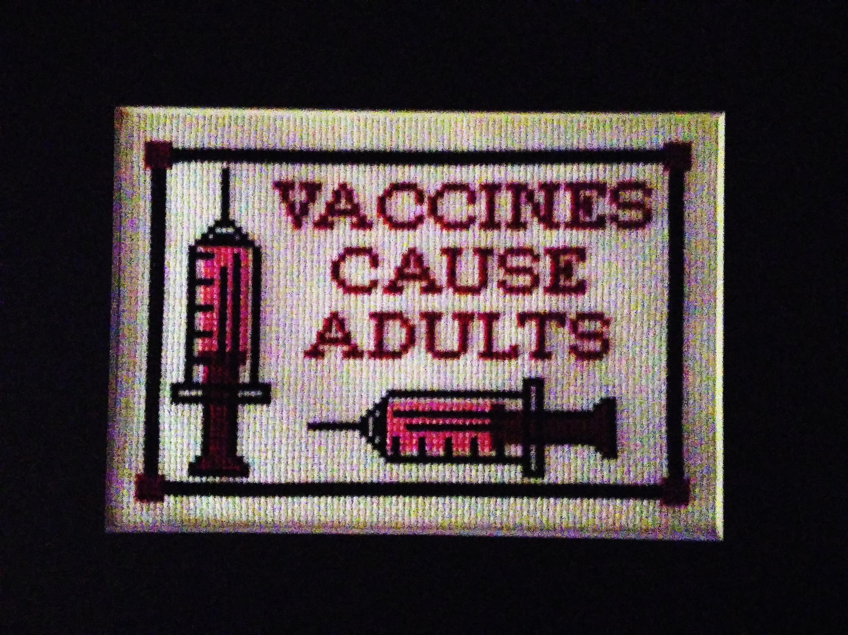

Slide 64
Questions?
Check out these links for more immunization information and resources!
National Immunization Program
E-mail ► NIPInfo@cdc.gov
Hotline 800.CDC.INFO
Website http://www.cdc.gov/vaccines
Georgia Immunization Program
E-mail DPH-Immunization@dph.ga.gov
Hotline 404-657-3158
Website http://dph.georgia.gov/immunization-section
Immunization Action Coalition
E-mail admin@immunize.org
Phone 651.647.9009
Website www.immunize.org
Notes:
With a second click of the mouse presenters can highlight NIPInfo@cdc.gov, an Email site that can provide answers to specific questions about immunizations. Experts from the CDC will respond to questions Monday through Fridays in 24 to 48 hours or sooner. It is not a practical source of information if the practitioner has a patient in an exam room waiting for an immunization. However, it a great source for information you can not find in the Pink Book or on the CDC web site.

Slide 65
Test Your Knowledge!
EPIC 2019

Slide 66
Test Your Knowledge!
Ben is a 25 year old plumber. Three months ago he had a motorcycle wreck causing
multiple fractures, lacerations, and a ruptured spleen. His spleen was removed. He
received Td in the ER.
He had chicken pox when he was 6 years old but has no idea if he ever had MMR.
What vaccines do you recommend?

Slide 67
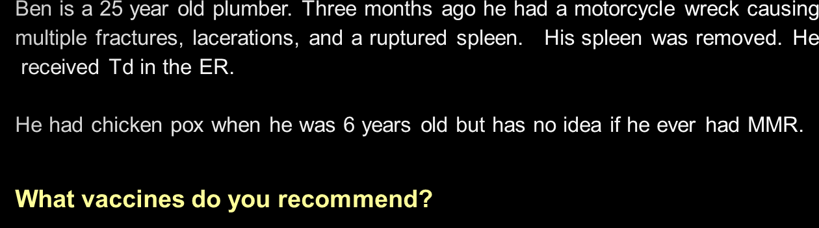
Test Your Knowledge!
Tdap, MCV4, MenB, PCV13, PPSV23, MMR, consider Hib
Influenza vaccine (in fall)
HPV?
Ref: Adult Immunization Schedule
Notes:
Answer: Tdap. MCV4, MenB, PCV13, and PPSV23 because he is asplenic. He can be offered HPV (this is an ACIP permissive recommendation)
Excerpt from Ask the Experts
What vaccines are indicated for someone who has had a splenectomy, and is there concern that they may have a less than optimum response to vaccines?²
Regarding which vaccines are indicated: People who do not have a functioning spleen or who have had a splenectomy do not handle encapsulated bacteria well and, therefore, are at increased risk for infection with encapsulated bacteria, especially Neisseria meningitidis, Streptococcus pneumoniae, and Haemophilus influenzae type b. They should be vaccinated with age-appropriate pneumococcal, meningococcal, and possibly Hib vaccines. Regarding immune response to vaccines: Immunosuppression is not an issue unless the patient has other health issues or treatments that are suppressing the immune system. Their response to vaccination should not be affected by the lack of a functioning spleen. In addition to receiving their routine vaccinations, children and adults without a functioning spleen who are age 2 years and older should receive 1 dose of pneumococcal polysaccharide vaccine (PPSV) and 1 dose of meningococcal conjugate vaccine (MCV4). MPSV4 should be used for adults age 56 and older who have not previously received meningococcal vaccine and anticipate requiring a single dose, such as international travelers and persons at risk as a result of a community outbreak of meningococcal disease. ACIP recommends off-label use of MCV4 for persons age 56 years and older who were previously vaccinated with MCV4 and require revaccination or for whom multiple doses are anticipated, such as persons with asplenia and microbiologists. Men B is also recommended because he is asplenic. Although Haemophilus influenzae type b (Hib) vaccine generally is not recommended for people age 5 years and older, studies suggest good immunogenicity in patients who have had a splenectomy. Giving 1 pediatric dose of Hib vaccine to these patients who have not previously received Hib vaccine is not contraindicated. Ideally, PPSV, meningococcal, and Hib vaccines should be administered at least 2 weeks before a scheduled splenectomy, if possible. If vaccines are not administered before surgery, they should be administered as soon as the person’s condition stabilizes post-operatively.
Reference: 1. General Recommendations on Immunization, Recommendations of the Advisory Committee on Immunization Practices (ACIP). MMWR 60(RR-2); January 28, 2011
2. Ask the Experts- Needle Tips; September 2009 www.immunize.org

Slide 68
Test Your Knowledge!
Paige is 24 years old. She has well controlled diabetes. She will be getting married in 3 months. Paige has received 2 doses of MMR and her last Td was 4 years ago. She denies ever having chicken pox but her 2 younger siblings had chicken pox.
What vaccines are recommended now?

Slide 69
Test Your Knowledge!
Paige is 24 years old. She has well controlled diabetes. She will be getting married in 3 months. Paige has received 2 doses of MMR and her last Td was 4 years ago. She denies ever having chicken pox but her 2 younger siblings had chicken pox.
What vaccines are recommended now?
Tdap, PPSV23, hepatitis B, HPV, varicella
Influenza vaccine (in fall)
Ref: Adult Immunization Schedule
Notes:
Tdap
Pneumococcal (PPSV23) and hepatitis B vaccine because of her diabetes.
HPV
Seasonal Influenza
Varicella
MMR? No.
Hepatitis A? No
Meningococcal? No
One point for discussion:
Before administering a two dose series of varicella vaccine the health-care provider should suggest that Paige ask her parent(s)/other relative if she had chicken pox as a child. If her two younger siblings had chicken pox and she did not develop chicken pox at the same time it is likely she had chicken pox previously. If her parents do not remember her having the disease or the history of chicken pox is not reliable or questionable she should be immunized with varicella vaccine.
The ACIP recommends Hepatitis B vaccine for unvaccinated adults with diabetes mellitus ages 19 through 59 years. Hepatitis B vaccine may be administered to those age 60 years and older at the discretion of the treating clinician. (MMWR/December 23, 2011/Vol.60/No. 50)

Slide 70
Test Your Knowledge!
Sam is a 32 year old carpenter. He punctured the palm of his hand with one of his tools at 6pm Friday. The injury caused minimal bleeding and he says it doesn’t need stitches.
Does he need tetanus toxoid tonight or can he wait until Monday when your office is open?

Slide 71
Test Your Knowledge!
Sam is a 32 year old carpenter. He punctured the palm of his hand with one of his tools at 6pm Friday. The injury caused minimal bleeding and he says it doesn’t need stitches.
Does he need tetanus toxoid tonight or can he wait until Monday when your office is open?
The decision to delay a booster dose of tetanus toxoid following an injury should be based on the nature of the injury and likelihood that the injured person is susceptible to tetanus. If a tetanus toxoid booster is recommended he should receive Tdap if he has not received Tdap previously.
Ref:Updated Recommendations for Use of Tetanus Toxoid, Reduced Diphtheria Toxoid and Acellular Pertussis (Tdap) Vaccine from the Advisory Committee on Immunization Practices, 2010 MMWR / January 14, 2011 / Vol. 60 / No. 1
Notes:
Answer:
ACIP has not addressed this issue specifically. Puncture wounds, however, should be attended to as soon as possible. The decision to delay a booster dose of tetanus toxoid-containing vaccine following an injury should be based on the nature of the injury and likelihood that the injured person is susceptible to tetanus. The more likely the person is to be susceptible, the more quickly that tetanus prophylaxis should be administered. A person with a tetanus-prone wound (e.g., punctures, wounds contaminated with soil or fecal material) and who has no history of tetanus immunization must be vaccinated with an age-appropriate dose of DTaP, Td, or Tdap and given tetanus immune globulin (TIG) as soon as possible. He should then complete the other doses of the vaccine series per schedule. A person with a documented series of at least three tetanus toxoid-containing products, with a booster dose within the previous 10 years ago is less likely to be susceptible to tetanus, and the need for a booster dose is not as urgent, particularly if the wound can be thoroughly cleaned. The more likely a person is to be completely susceptible to tetanus (i.e., unvaccinated or incompletely vaccinated), the sooner that TIG and Td/Tdap should be administered, even if it means a trip to the emergency department.
Ref: Immunization Action Coalition Ask the Experts (As of January 18, 2012)

Slide 72
Test Your Knowledge!
A 45-year-old patient will be traveling to Haiti for a mission trip. She doesn't recall ever getting an MMR booster. She was immune to rubella when pregnant 20 years ago. Her measles titer is negative.
Would you recommend an MMR booster?

Slide 73
Test Your Knowledge!
A 45-year-old patient will be traveling to Haiti for a mission trip. She doesn't recall ever getting an MMR booster. She was immune to rubella when pregnant 20 years ago. Her measles titer is negative.
Would you recommend an MMR booster?
ACIP recommends 2 doses of MMR given at least 4 weeks apart for any adult born in 1957 or later who plans to travel internationally. There is no harm in giving MMR vaccine to a person who may already be immune to one or more of the vaccine viruses.
IAC Ask the Experts - Reviewed July 2014

Slide 74
Test Your Knowledge!
Lillian, a 50 year old grandmother, was given DTaP instead of Tdap.
Does she need to receive one dose of Tdap?

Slide 75
Test Your Knowledge!
Lillian, a 50 year old grandmother, was given DTaP instead of Tdap.
Does she need to receive one dose of Tdap?
Lillian received the appropriate amount of tetanus toxoid and MORE diphtheria toxoid and pertussis antigen than is recommended. Count the dose as Tdap. The patient does not need a repeat dose of Tdap.
Take measures to prevent this error in the future.
IAC Ask the Experts - Reviewed July 2014

Slide 76
Test Your Knowledge!
Morris is a 59 year old accountant. He is an alcoholic with chronic liver disease and smokes 1 pack of cigarettes per day. No other significant medical problems. His last tetanus booster was 12 years ago. He states he has never had measles or chicken pox.
What vaccines does he need?
Ref: Adult Immunization Schedule

Slide 77
Test Your Knowledge!
Morris is a 59 year old accountant. He is an alcoholic with chronic liver disease and smokes 1 pack of cigarettes per day. No other significant medical problems. His last tetanus booster was 12 years ago. He states he has never had measles or chicken pox.
What vaccines does he need?
Tdap, hepatitis A, hepatitis B, PPSV23(alcoholic, liver disease and smoker) , Shingrix® since born before 1980.
MMR (if he has no documentation of MMR)
Influenza vaccine (in fall)
Ref: Adult Immunization Schedule

Slide 78
Test Your Knowledge!
Hazel is 61 years old. She had major surgery one month ago requiring a blood transfusion. During her visit to your office today she tells you she would like to get the shingles vaccine.
How would you respond to her request?

Slide 79
Test Your Knowledge!
Hazel is 61 years old. She had major surgery one month ago requiring a blood transfusion. During her visit to your office today she tells you she would like to get the shingles vaccine.
How would you respond to her request?
Zoster vaccine can be given to persons who have recently received blood products. The amount of antigen in zoster vaccine is so substantial that it overpowers any antibody to herpes zoster that may be in the blood product.
Ref: Immunization Action Coalition - Ask the Experts – September 2011

Slide 80
Dr. Brown treats many patients for shingles and post-herpetic neuralgia. He is encouraging all his patients 60 years and older to get zoster vaccine.
Should he ask his patients if they had chickenpox or shingles before administering zoster vaccine?
Test Your Knowledge!

Slide 81
Dr. Brown treats many patients for shingles and post-herpetic neuralgia. He is encouraging all his patients 60 years and older to get zoster vaccine.
Should he ask his patients if they had chickenpox or shingles before administering zoster vaccine?
Test Your Knowledge!
No. All persons age 60 years or older-whether they have a history of chickenpox or shingles or not-should be given zoster vaccine unless they have a medical contraindication to the vaccine. It is also not necessary to test for varicella antibody prior to giving the vaccine.
IAC Ask the Experts - Reviewed July 2014

Slide 82
Test Your Knowledge!
Sixty five year old Nadine requests the shingles vaccine. In addition, she needs pneumococcal and influenza vaccine.
Should she receive all 3 vaccines on the same day?

Slide 83
Test Your Knowledge!
Sixty five year old Nadine requests the shingles vaccine. In addition, she needs pneumococcal and influenza vaccine.
Should she receive all 3 vaccines on the same day?
Yes.
ACIP states that either shingles vaccine may be given at the same visit along with other appropriate and recommended vaccines, such as pneumococcal and/or influenza.
1. Immunization Action Coalition - Ask the Experts – February, 2018

