Slide 1


Slide 2
THE PROBLEM

Slide 3

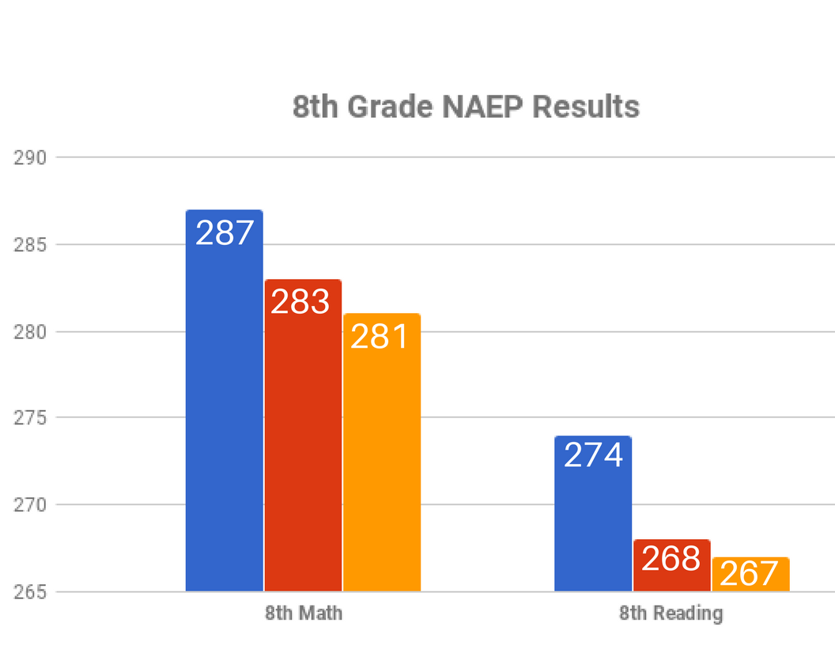
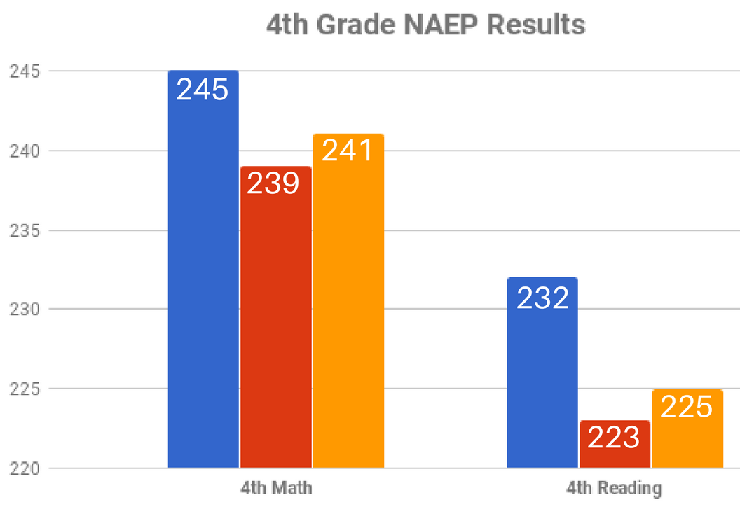
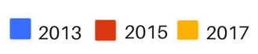
Maryland’s Report Card
Maryland is the only state where average scores in math and reading at grades 4 and 8 decreased between 2013 and 2015.

Slide 4
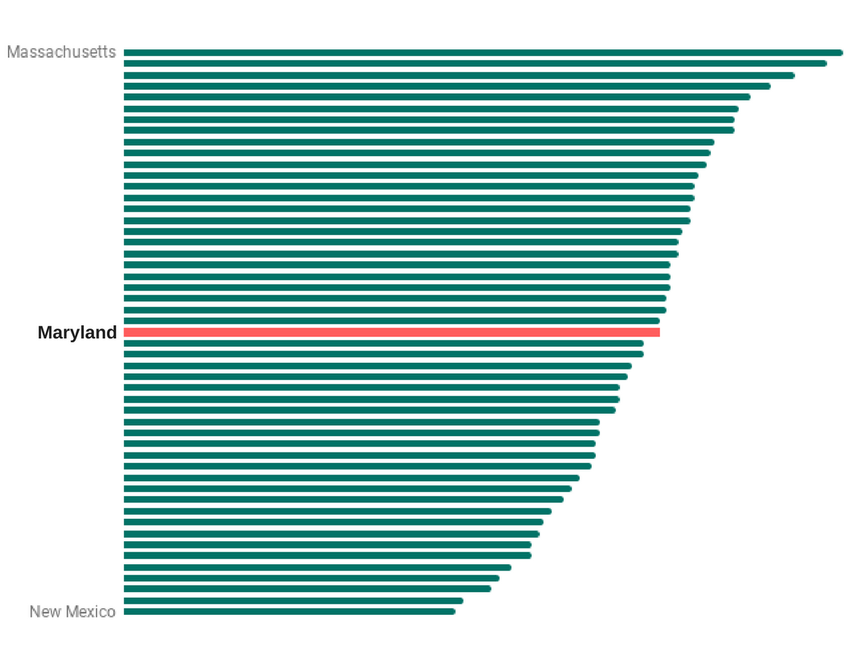
Maryland’s Report Card
2017 NAEP scores showed that Maryland ranks
28th in Math
19th in Reading
29th in Science (2015)
26th Overall
NAEP Composite Score 2017 (Math/Reading 4th and 8th)

Slide 5
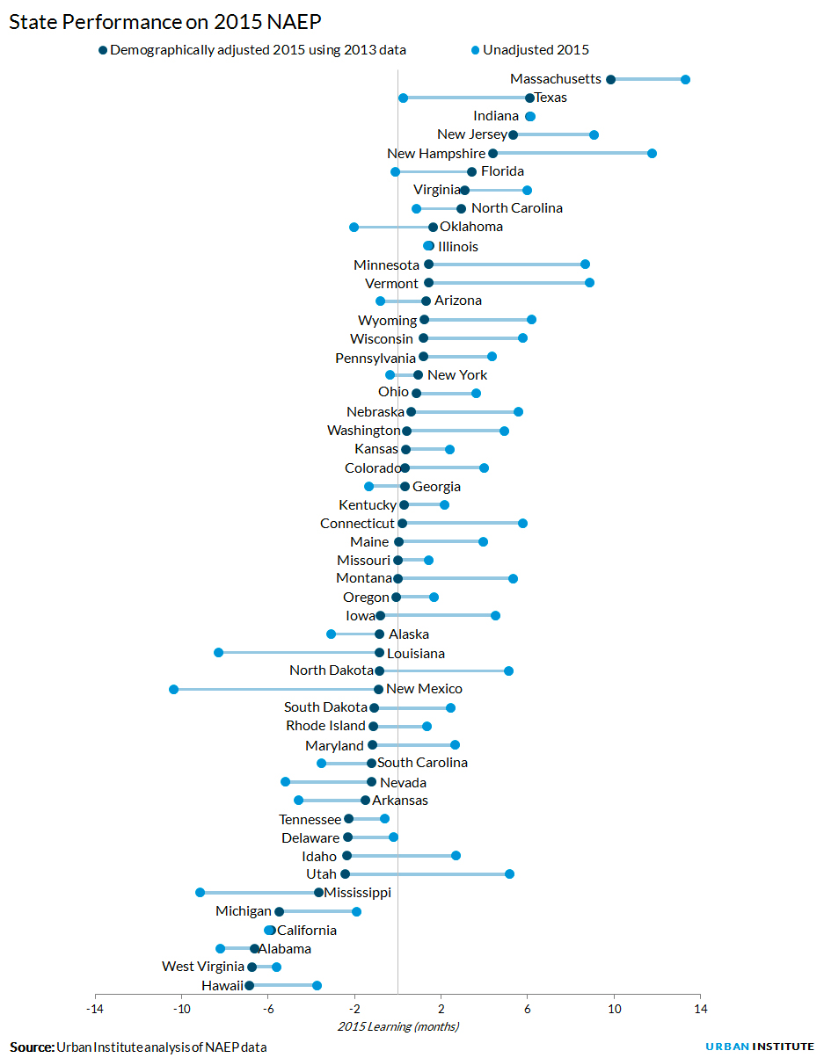
Maryland’s
National Ranking
After adjusting for differences in students’ background, Maryland falls from to 37th among states.
Among mid-Atlantic states, only Delaware ranks lower.

Slide 6
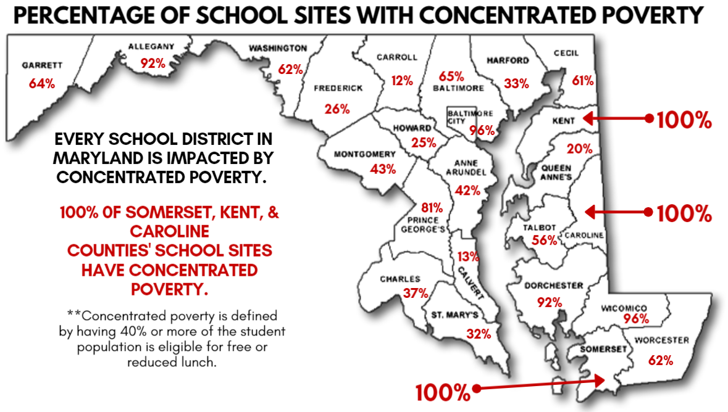

Slide 7
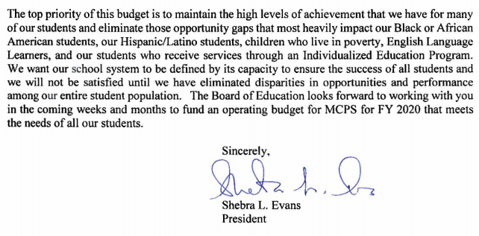

Slide 8
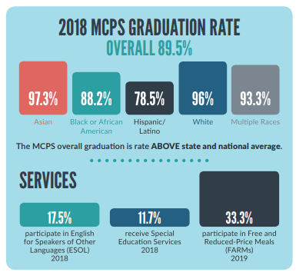

Slide 9
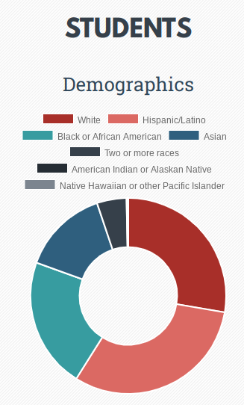
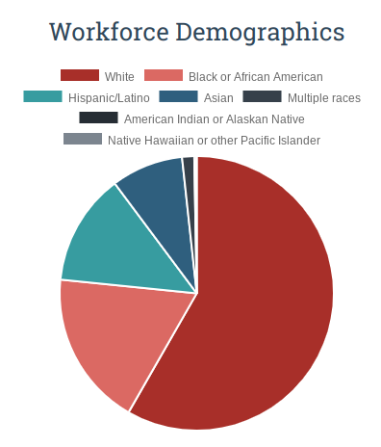
Montgomery County

Slide 10
Why is this important?
58% of schools in Maryland are considered to be in “concentrated poverty”
Maryland schools are underfunded by $2.9 billion
Only 4 out of 24 jurisdictions have adequate funding levels
10% of Americans between 18 and 24 met a standard of “informed engagement” according to the Harvard Institute of Politics
By 2020, 2 out of every 3 jobs in Maryland will require more than a high school diploma.
Economics
Equity
Civics
Notes:
informed Engagement - which we defined as registering, voting, answering at least one (out of two) campaign knowledge question correctly, answering four or more general political knowledge questions correctly, voting consistently with one’s personal opinion on a campaign issue of one’s choice, and following the news fairly or very closely during the election season.

Slide 11
THE OPPORTUNITY

Slide 12
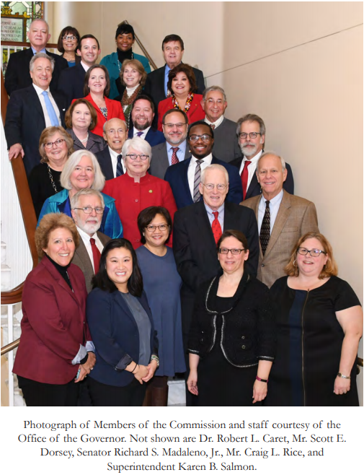
This is a once in a generation opportunity
Maryland is in the midst of a once in a generation opportunity to change our state education system.
In 2016, the state of Maryland created the “Kirwan Commission,” tasked with making recommendations to make Maryland’s education system world-class.
The commission is chaired by Dr. William “Brit” Kirwan and they produced a 200+ page report after two years of expert testimony and study.
If fully implemented and funded the recommendations will lead to Maryland’s public school system becoming world-class.
Strong Schools Maryland formed to be the only grassroots, Kirwan focused organization in the state with the explicit goal of getting the Kirwan recommendations passed into law.

Slide 13

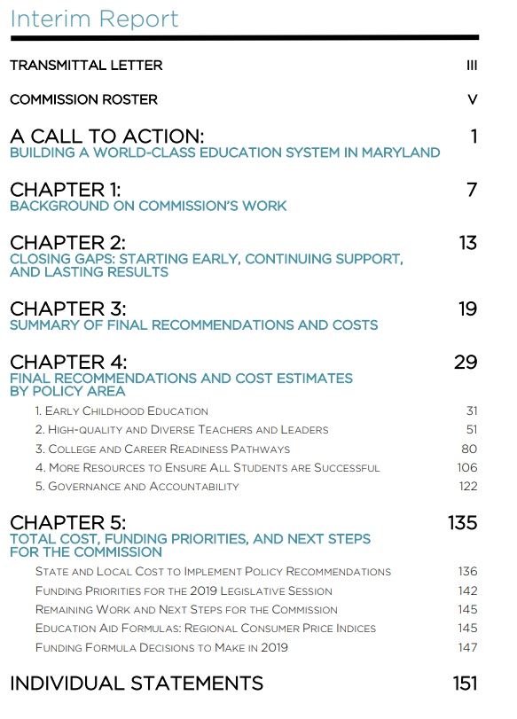

Slide 14
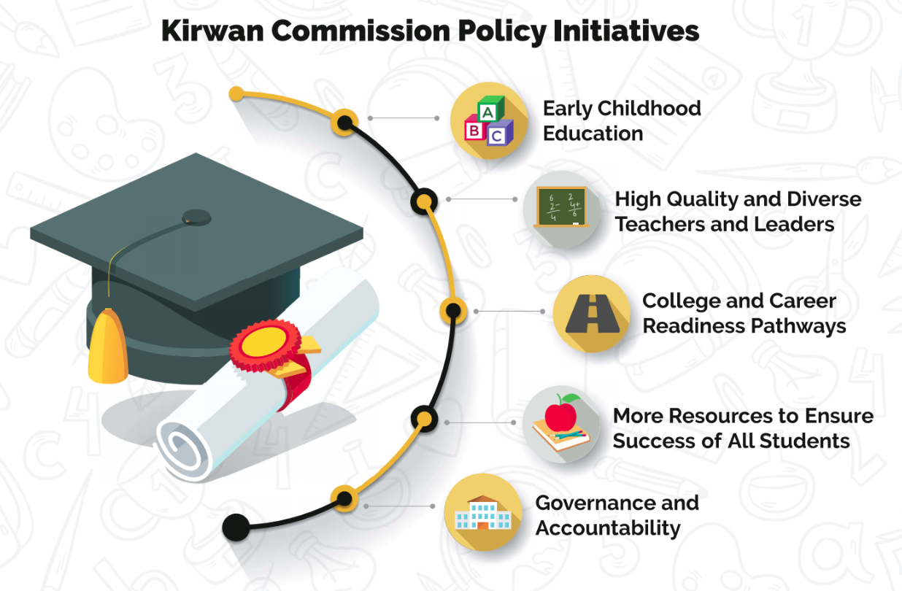
Notes:
Cr

Slide 15
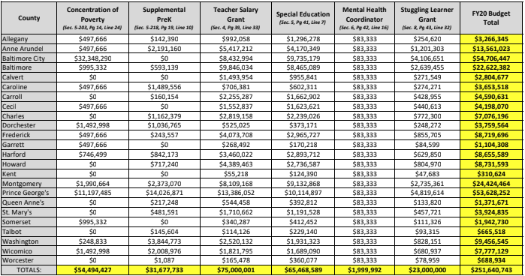

Slide 16
Strong School Maryland

Slide 17


Slide 18
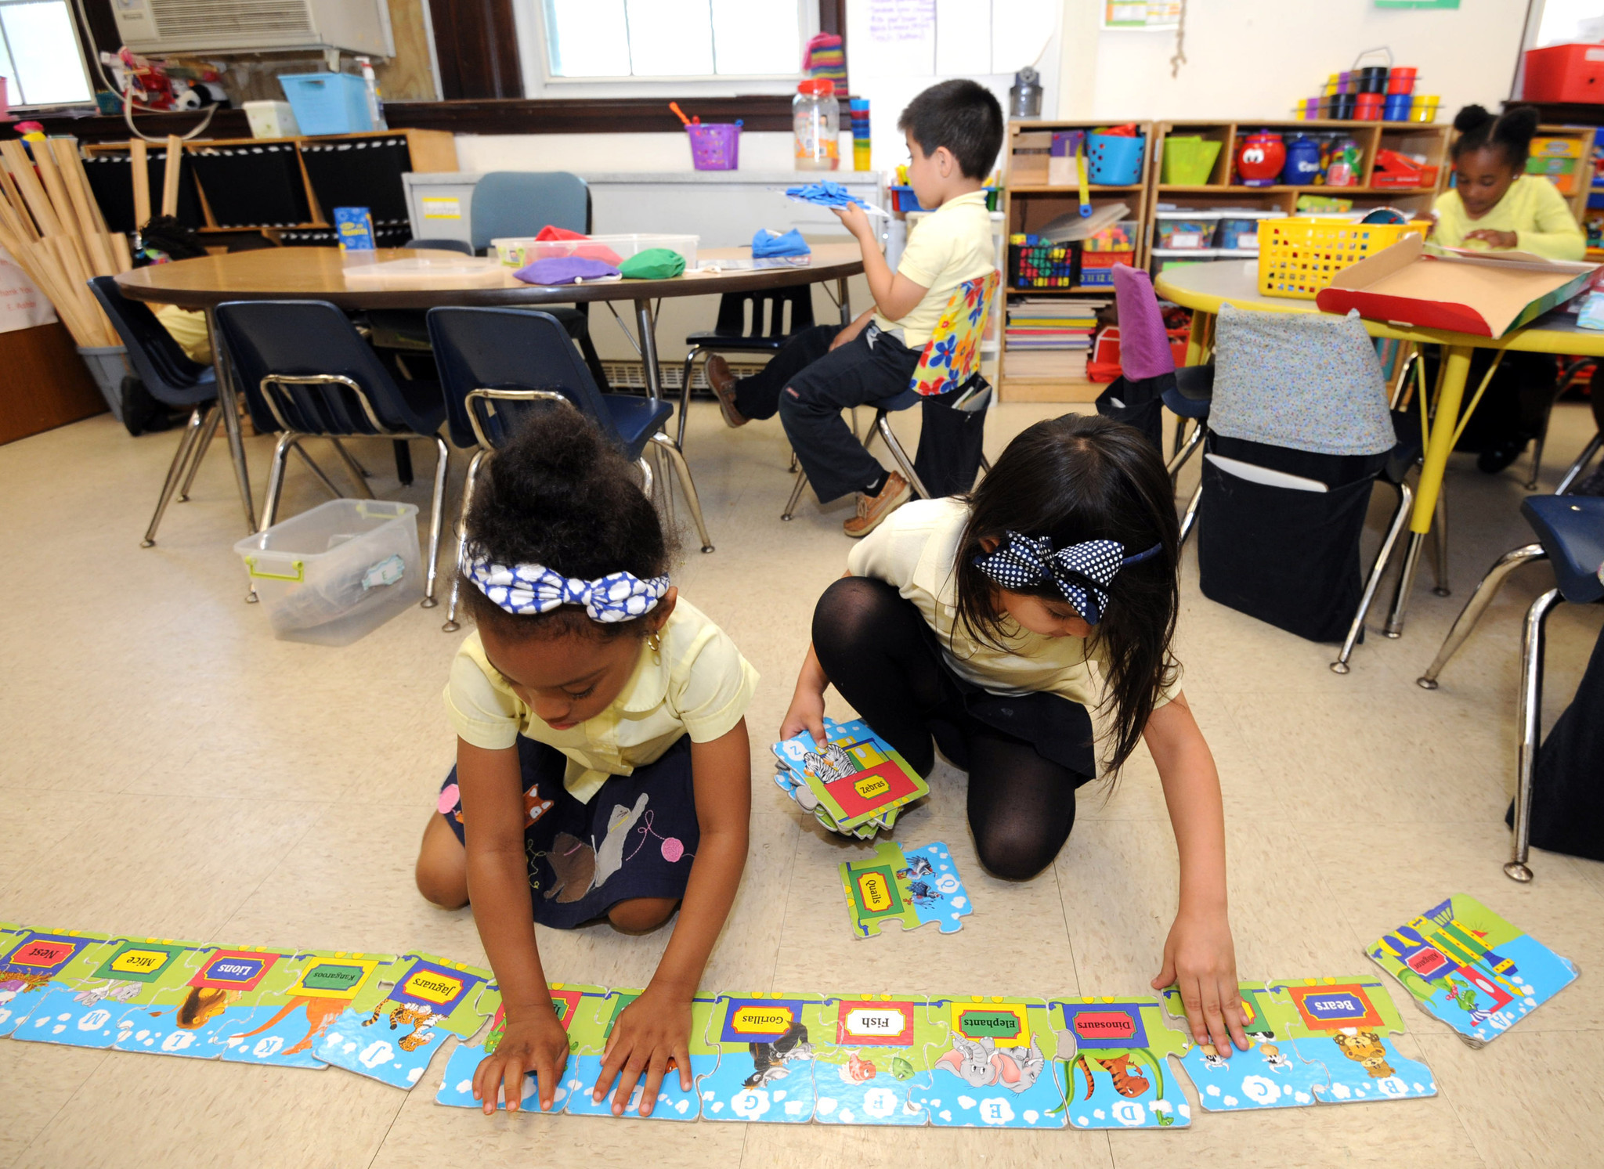


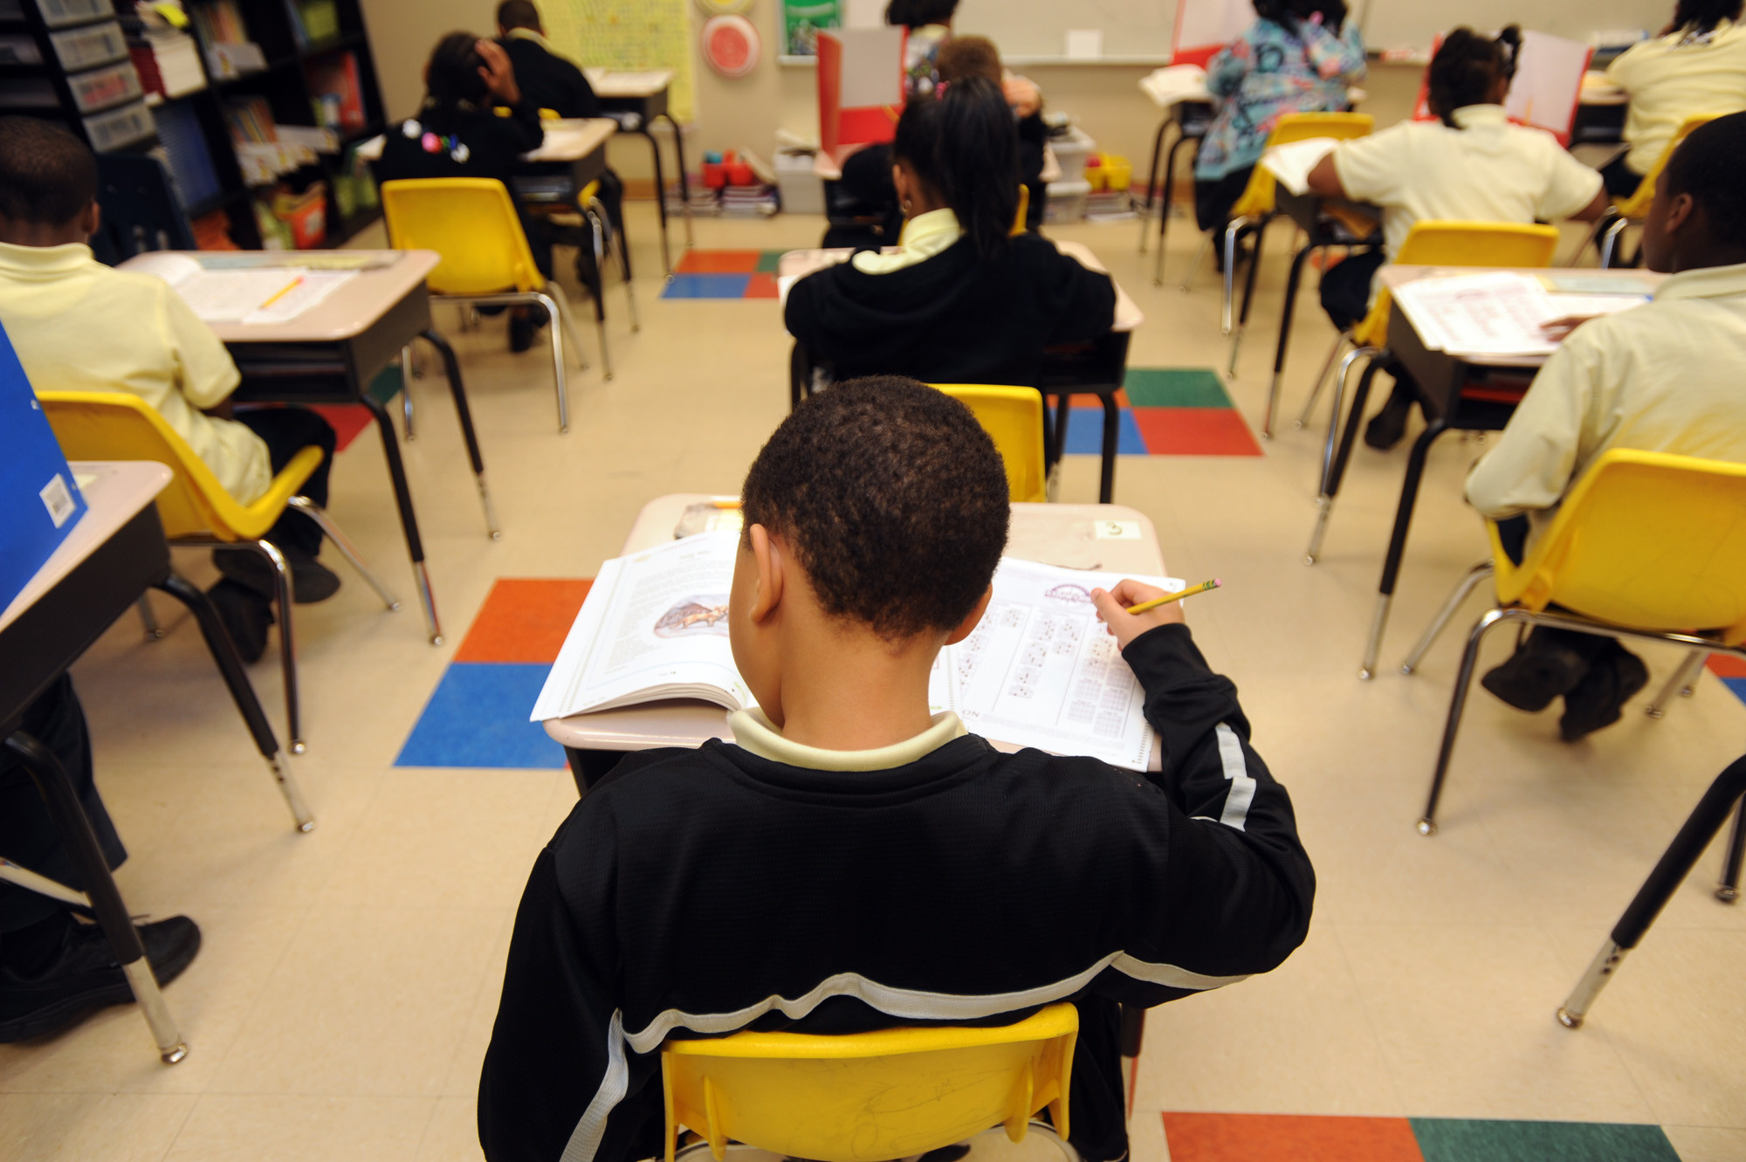
Who are we?
We are seizing a once in a generation opportunity, as a time limited campaign, to establish a WORLD-CLASS EDUCATION for all of Maryland's children.
Notes:
Goal:

Slide 19

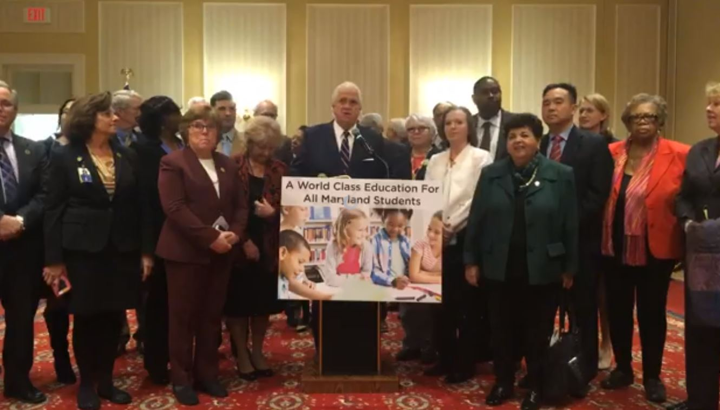
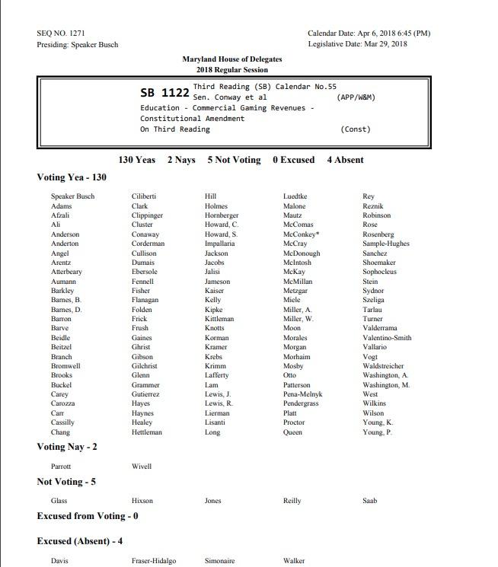
Example of Immediate Impact & Setting the Stage
August 2017:
SSM Polling
February 2018:
Leadership Adopts Policy
April 2018:
Ballot Question Passes
Notes:
We’ve already had an impact.
This novem voters will be voting on a constitutional amendment
Let us tell you how that happened.
Aug 2017: poll (thanks to the Abell Foundation) informal and formal make education #1 issue
lock box- constitutional amendment- conversation happened at SSM after the poll was completed
Got leadership on board: took polling to leadership - Maggie showed her polling, made the case and she said we are going to do this. Maggie on board. Leadership hestinatnt- turned on the SSM engine, focused on leaderhsip to make this election about education. Leadership recognized something had to happen. Feb Joan carter-conway, joint press conference both chambers
April- bill paseed and is now on the ballot
not happen spotaneously- organized people, organized $ and an organized plan to influence a policy outcome
This is a taste of what’s possible. Version 2.0, next session is infinitely harder. Why we are here today. We need support to max moment to truly create a world class education for MD students

Slide 20
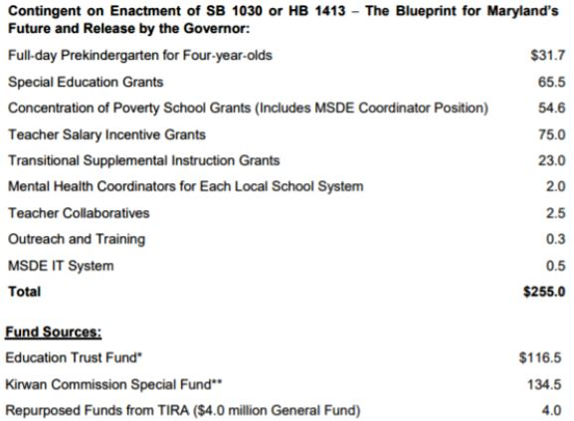
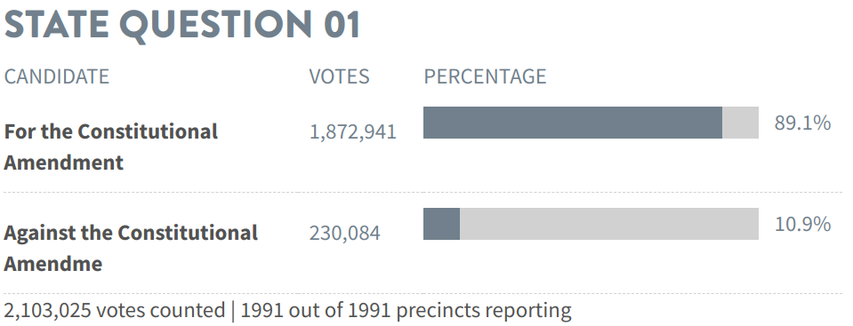
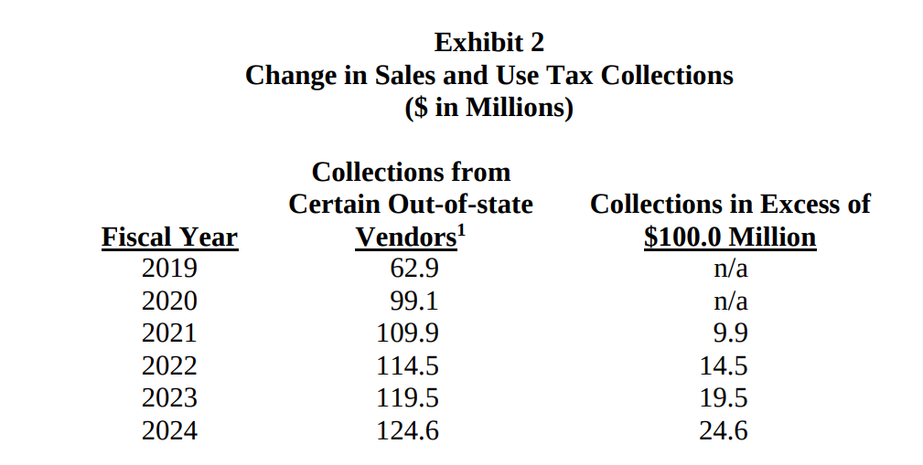
Examples of 3 wins
Changing the Maryland Constitution to close the Education Trust Fund loophole (beat polling estimates)
Pass the initial phase in for the Kirwan recommendations (2020 will be the session for full phase in plus funding streams)
Secured part of a future Kirwan funding source

Slide 21
Photos of
Strong Schools Maryland in Action

Slide 22
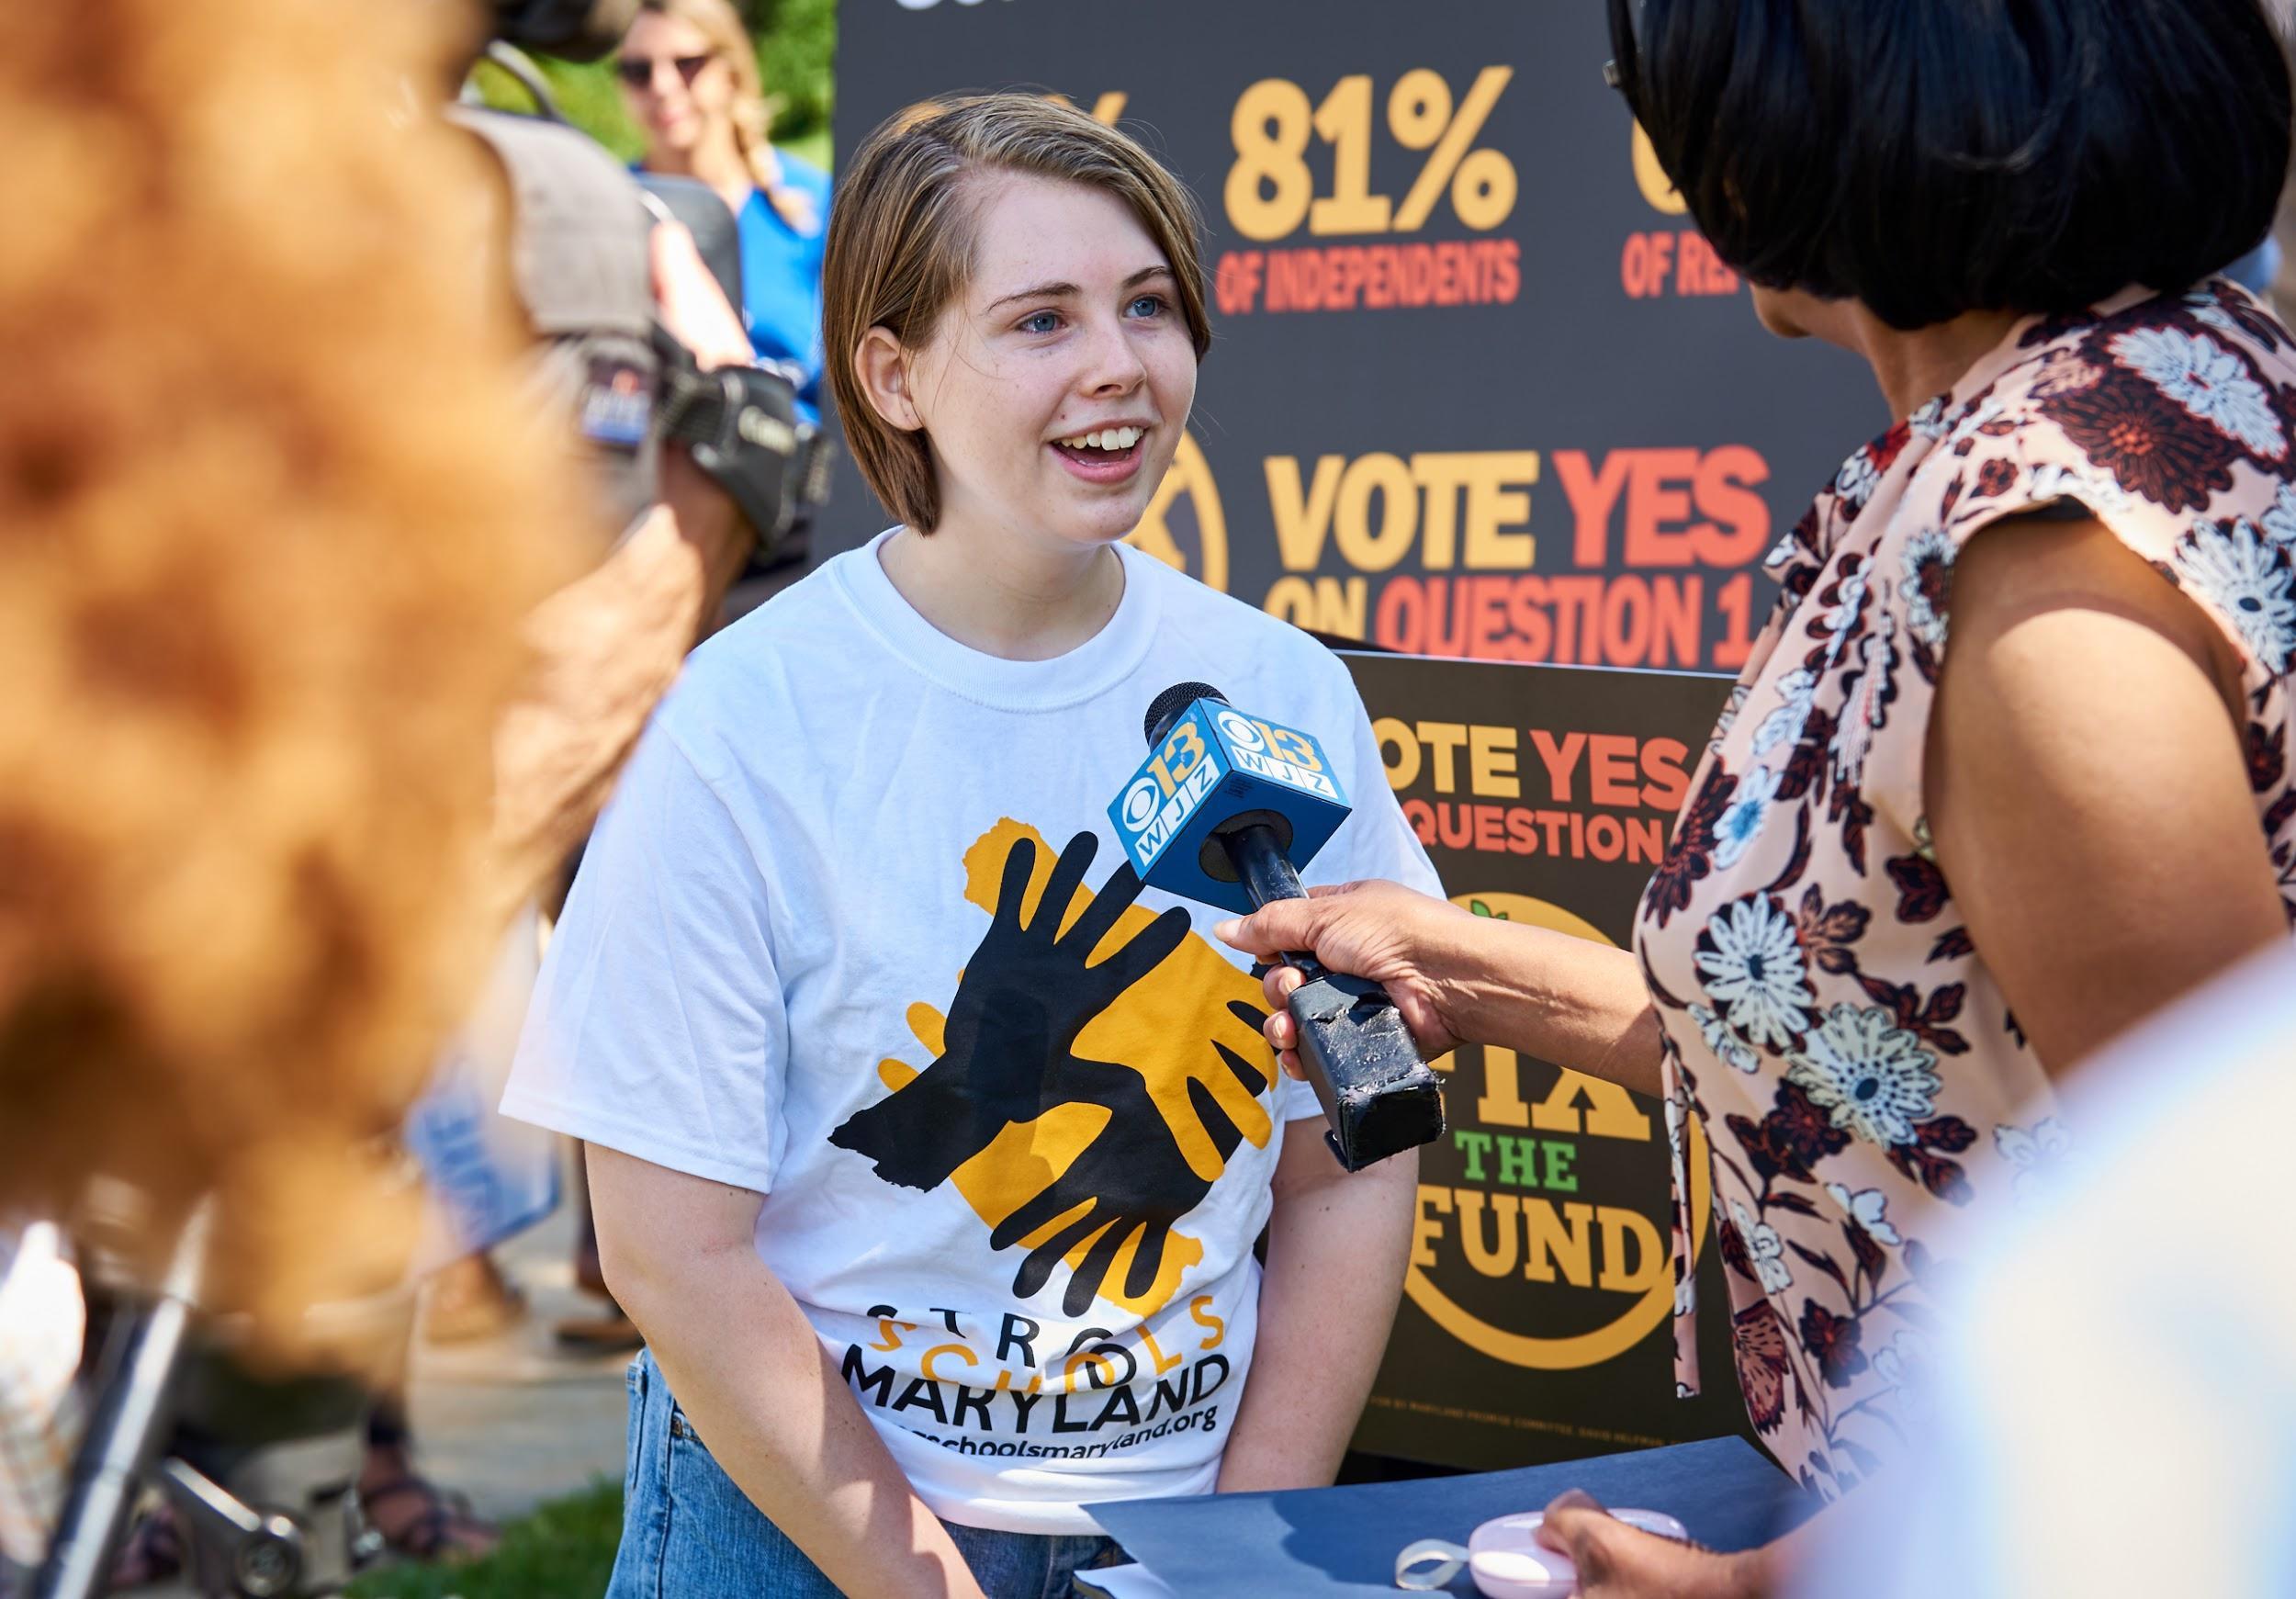
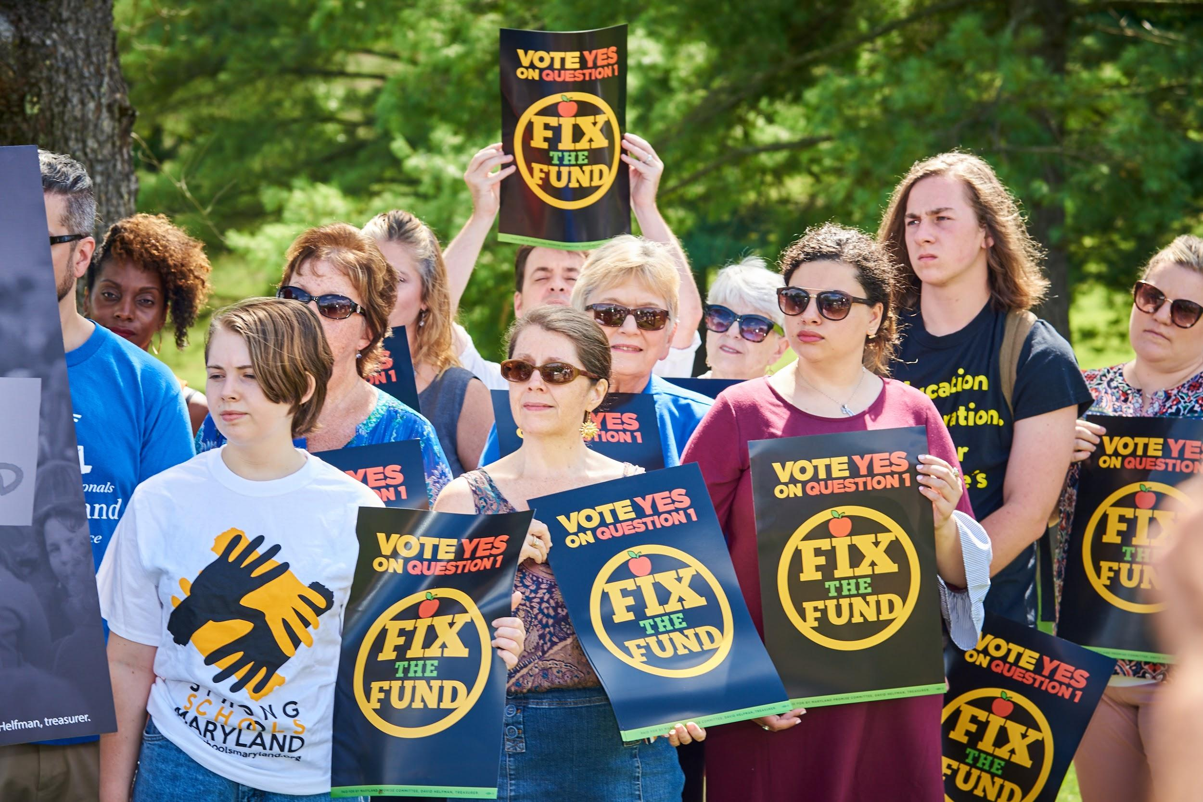
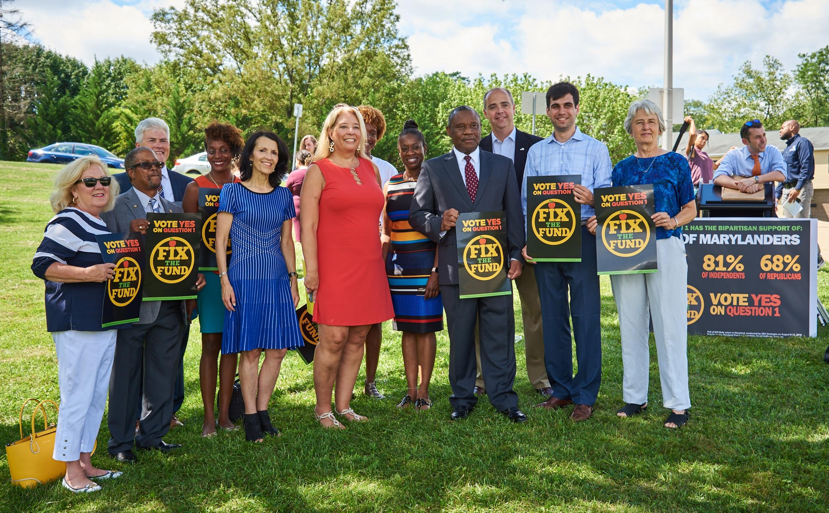

Slide 23
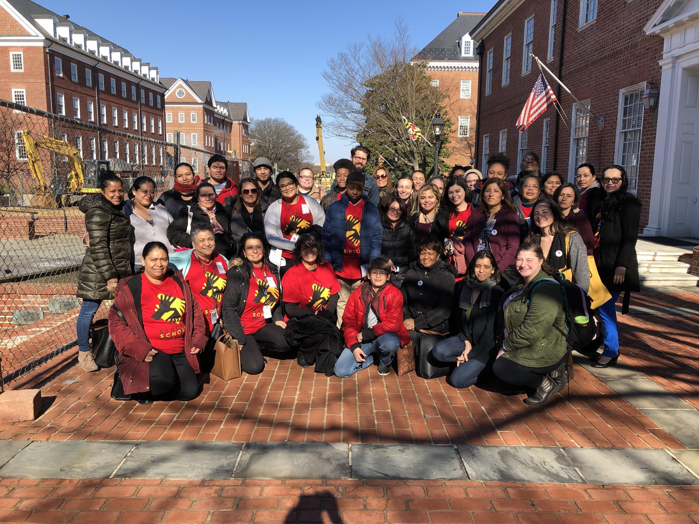

Slide 24
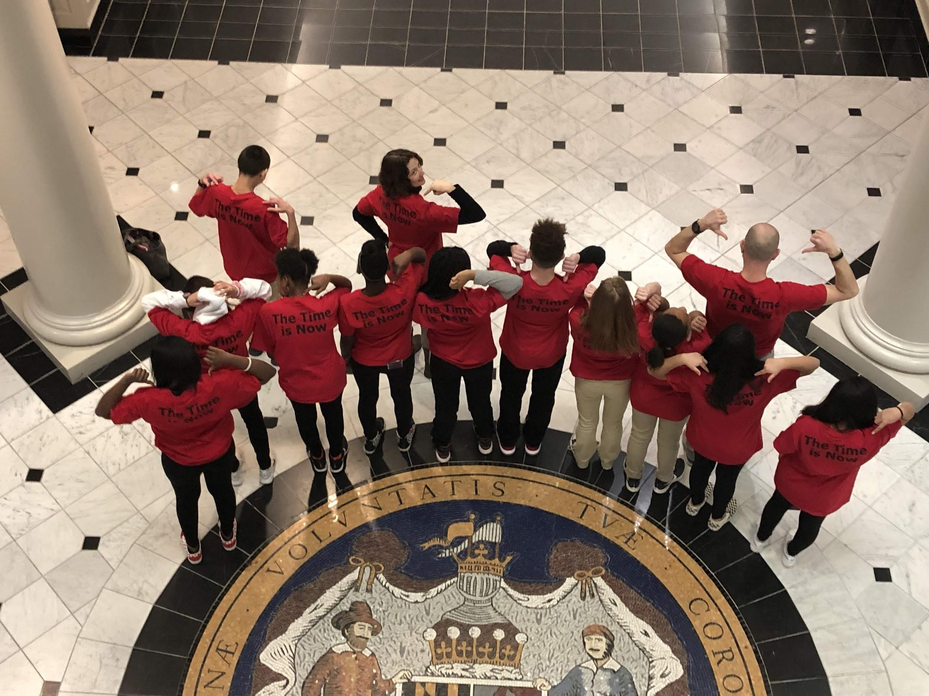

Slide 25
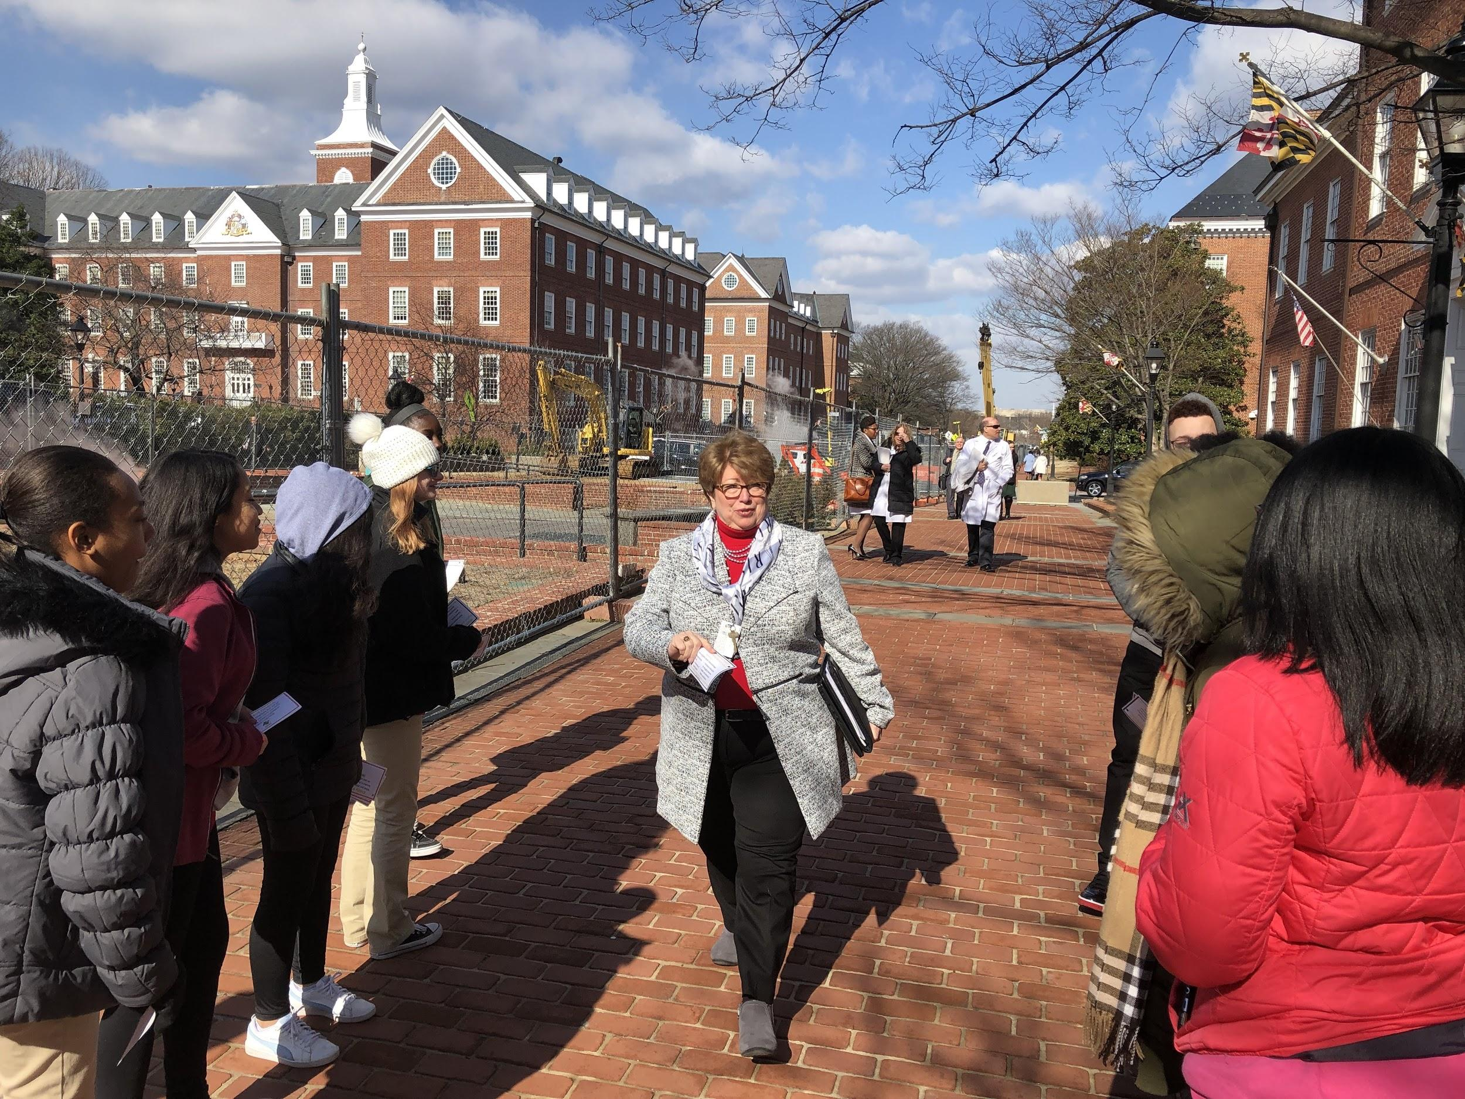

Slide 26
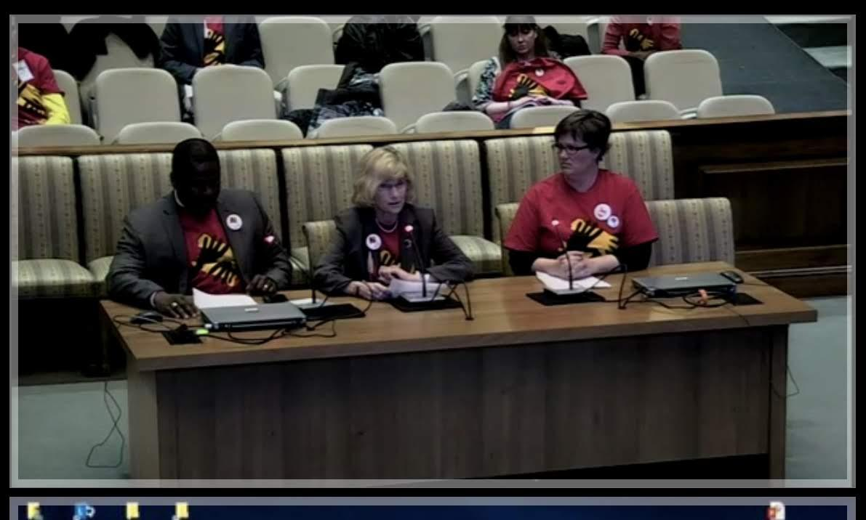
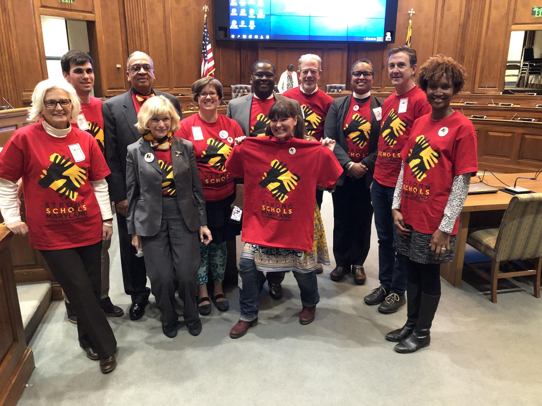
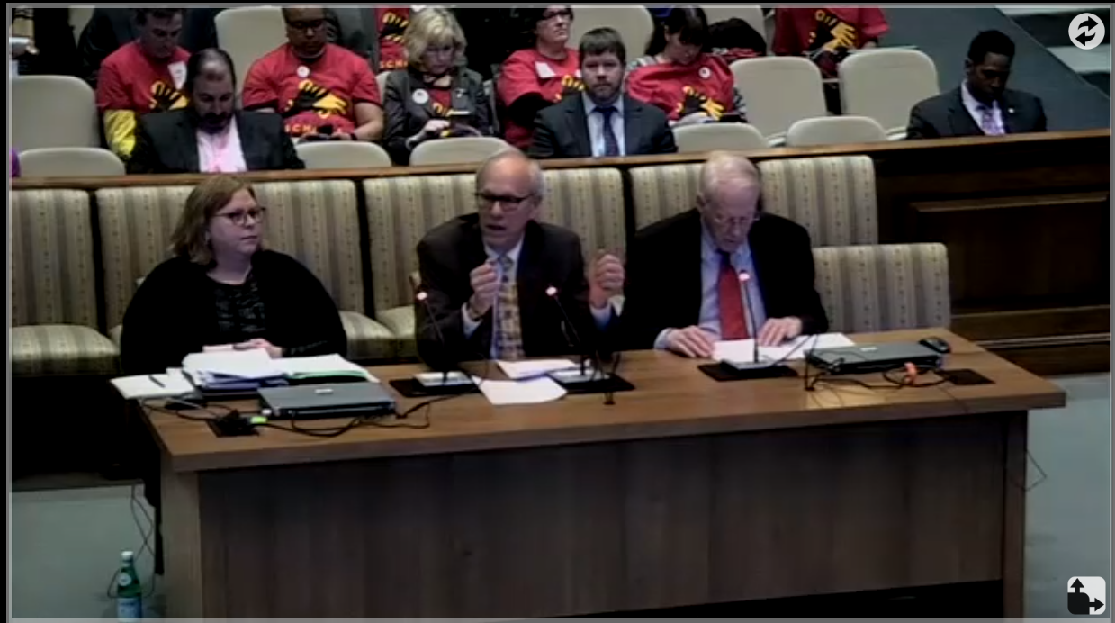

Slide 27
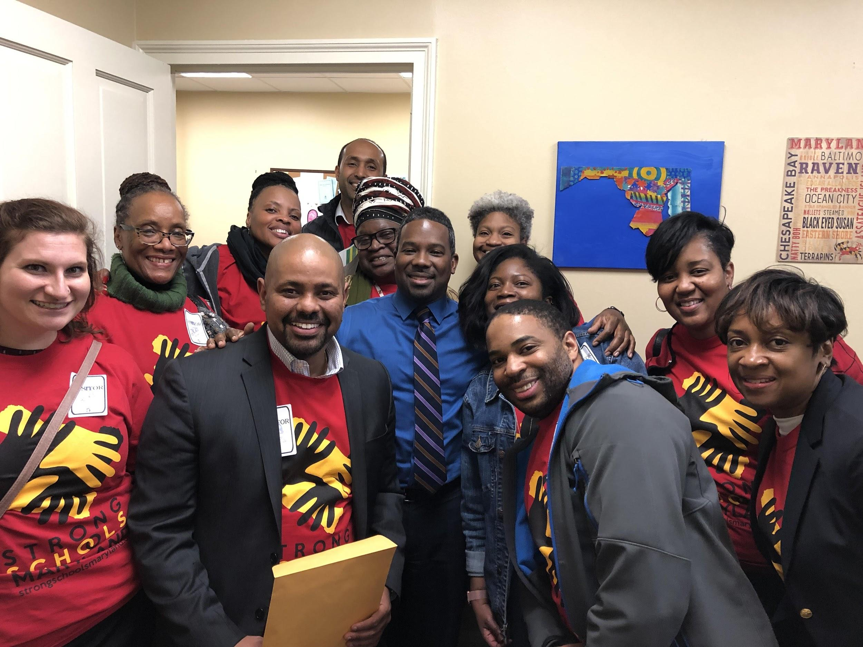
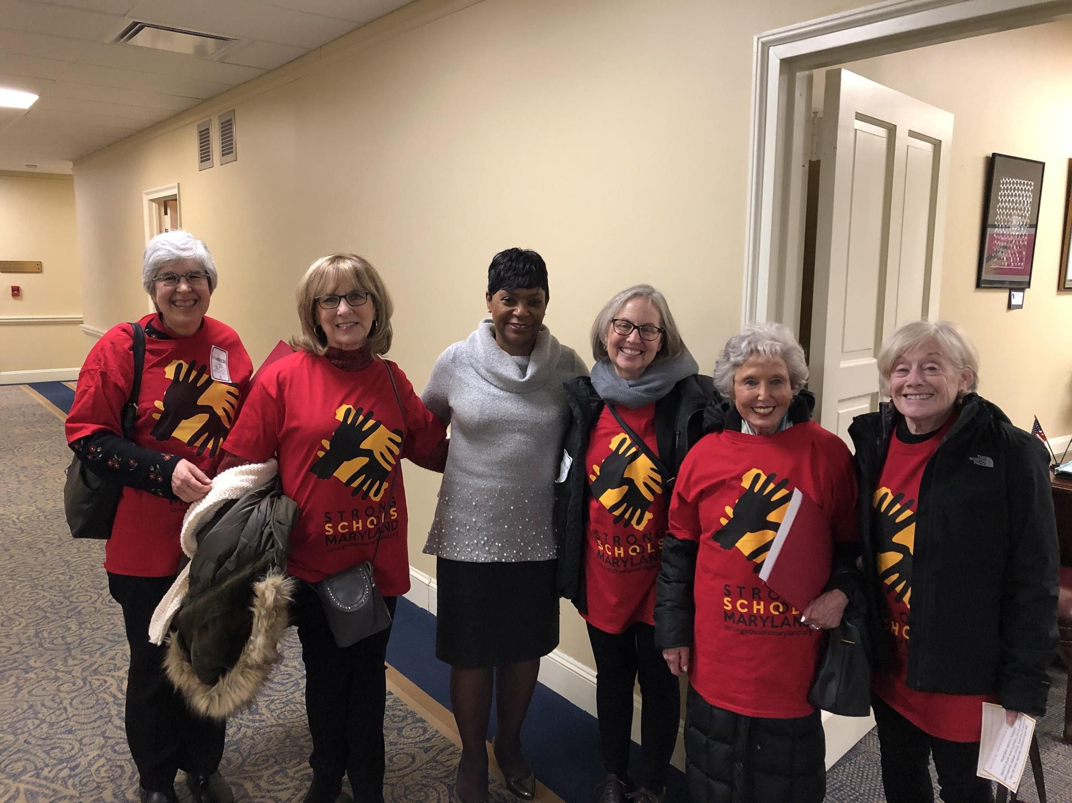
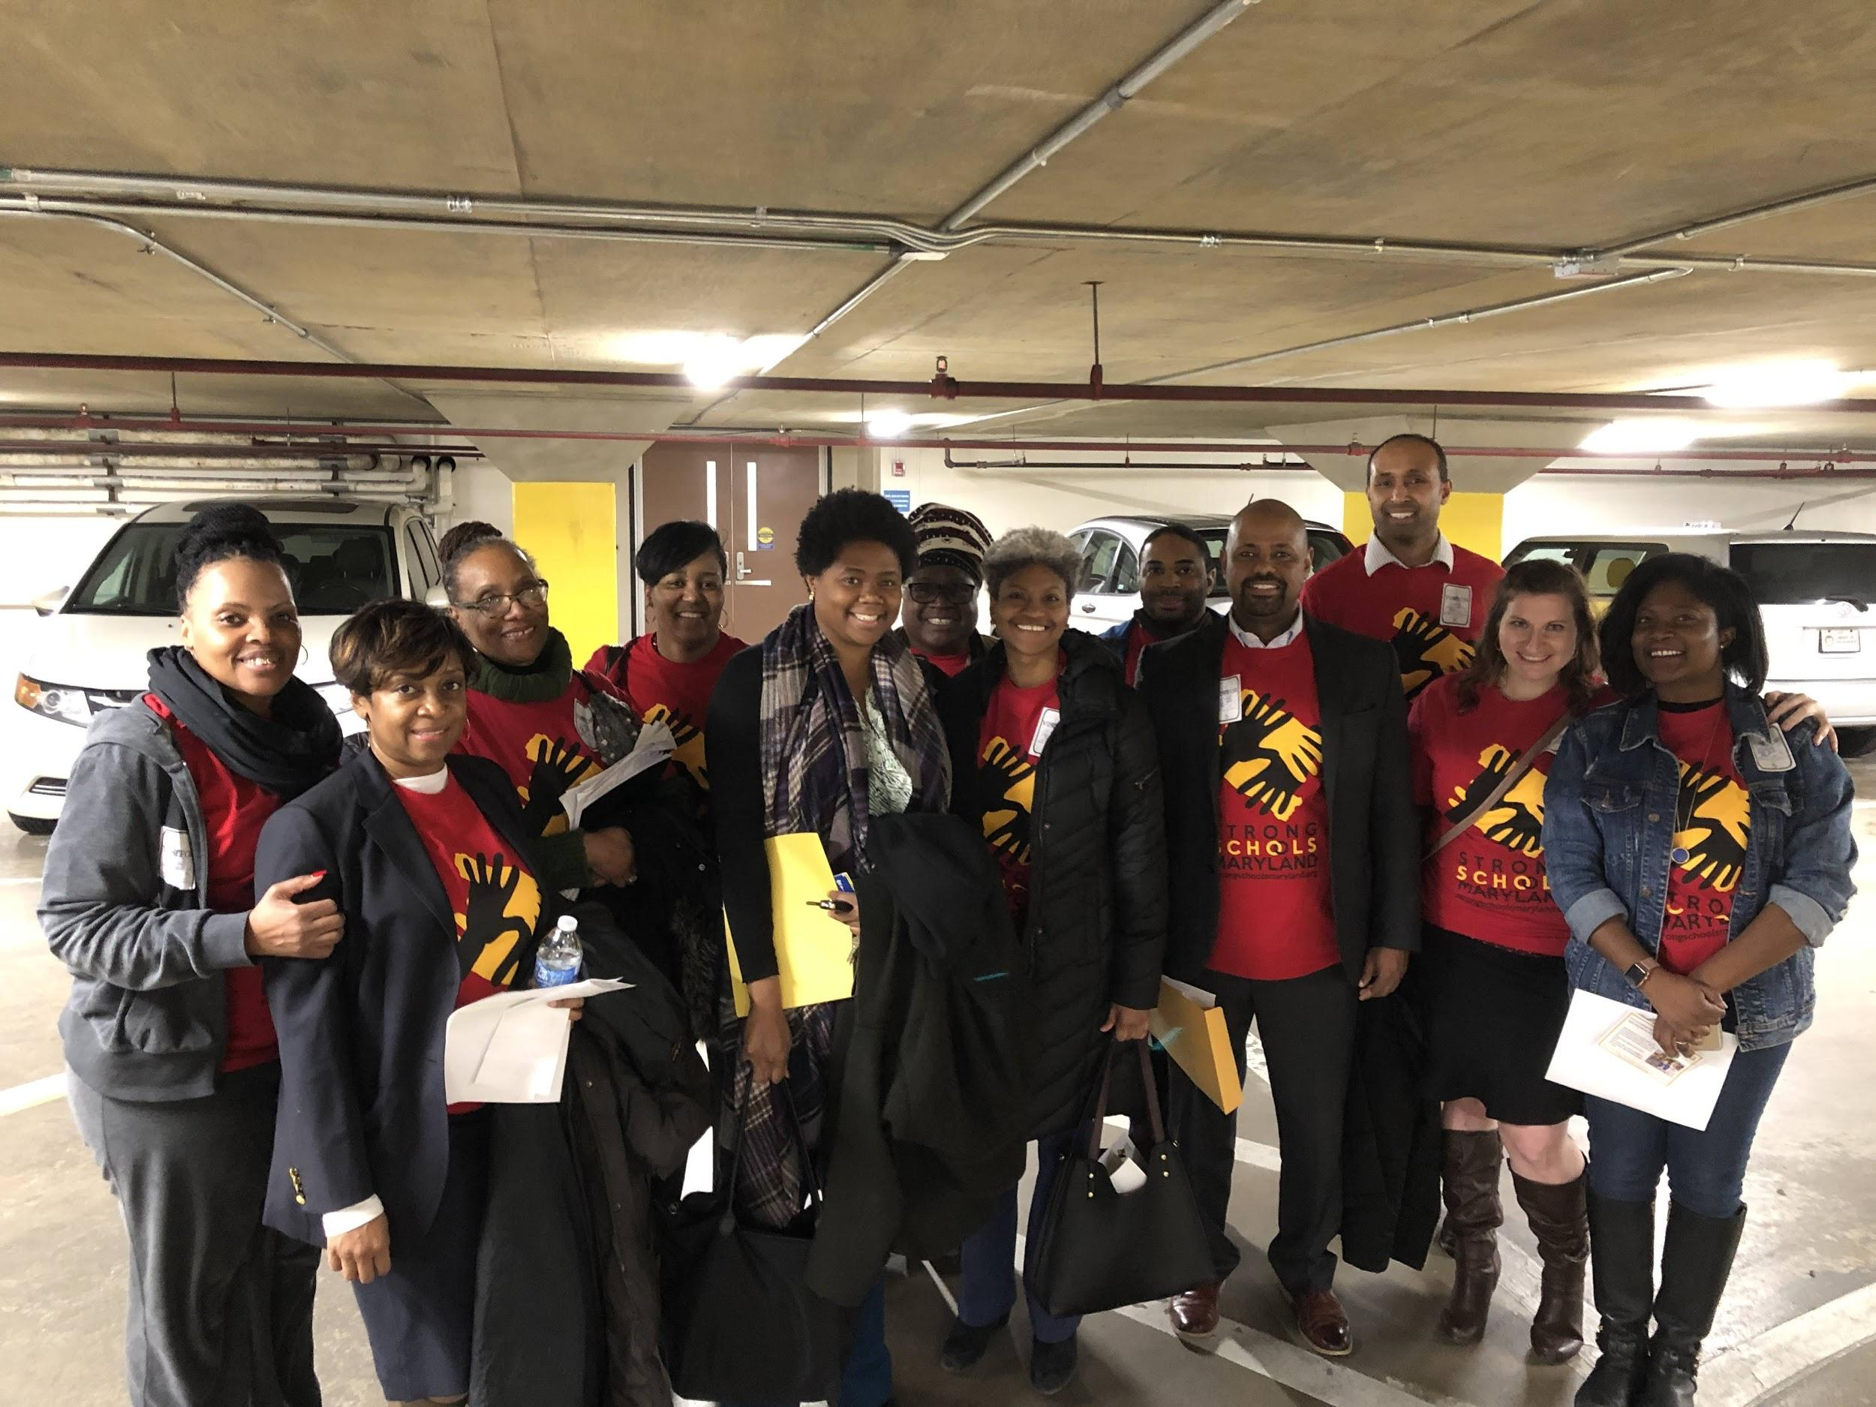
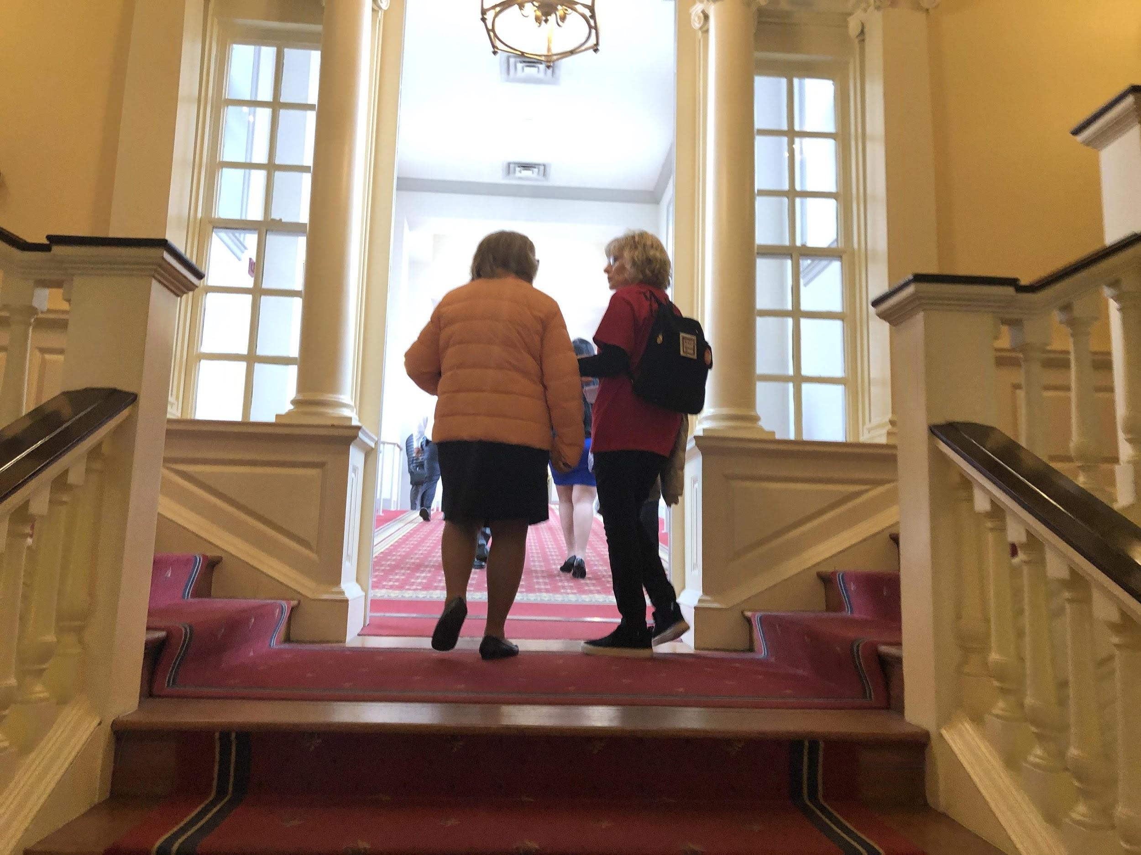
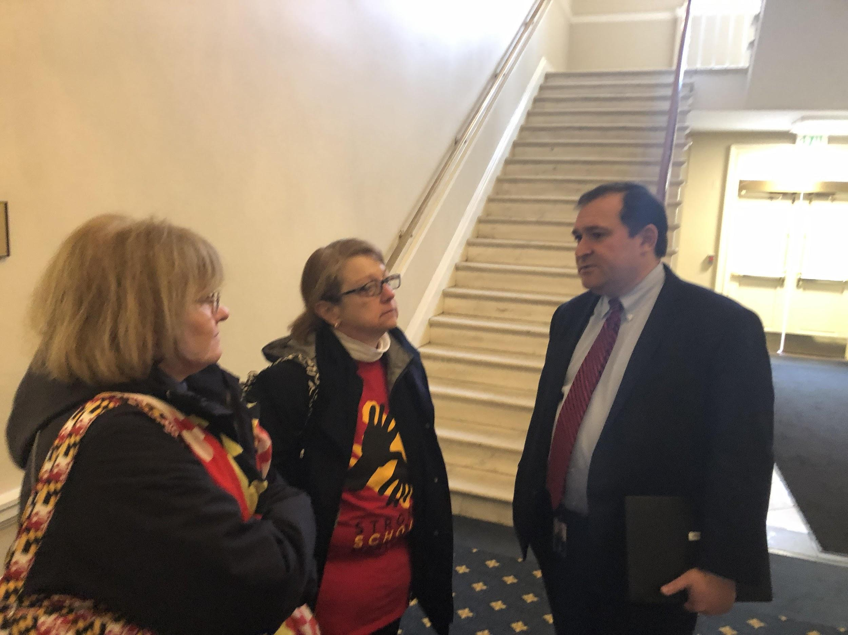
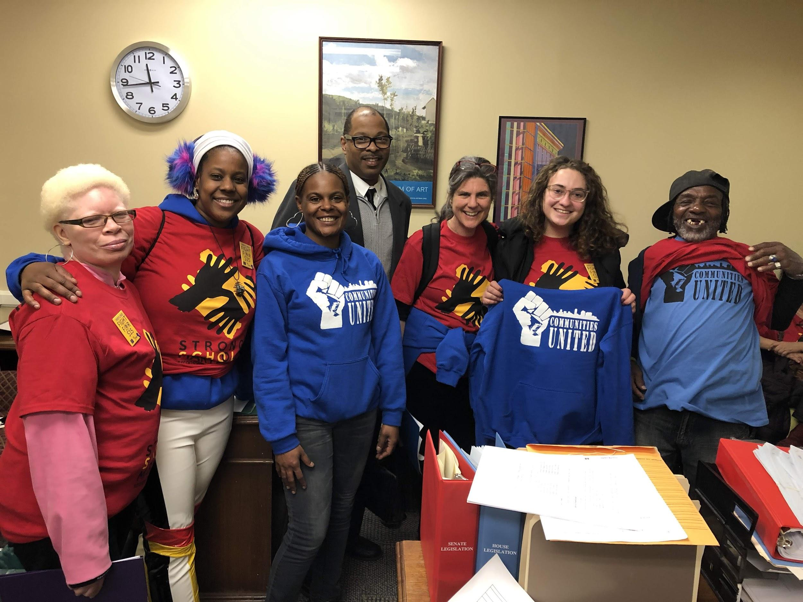
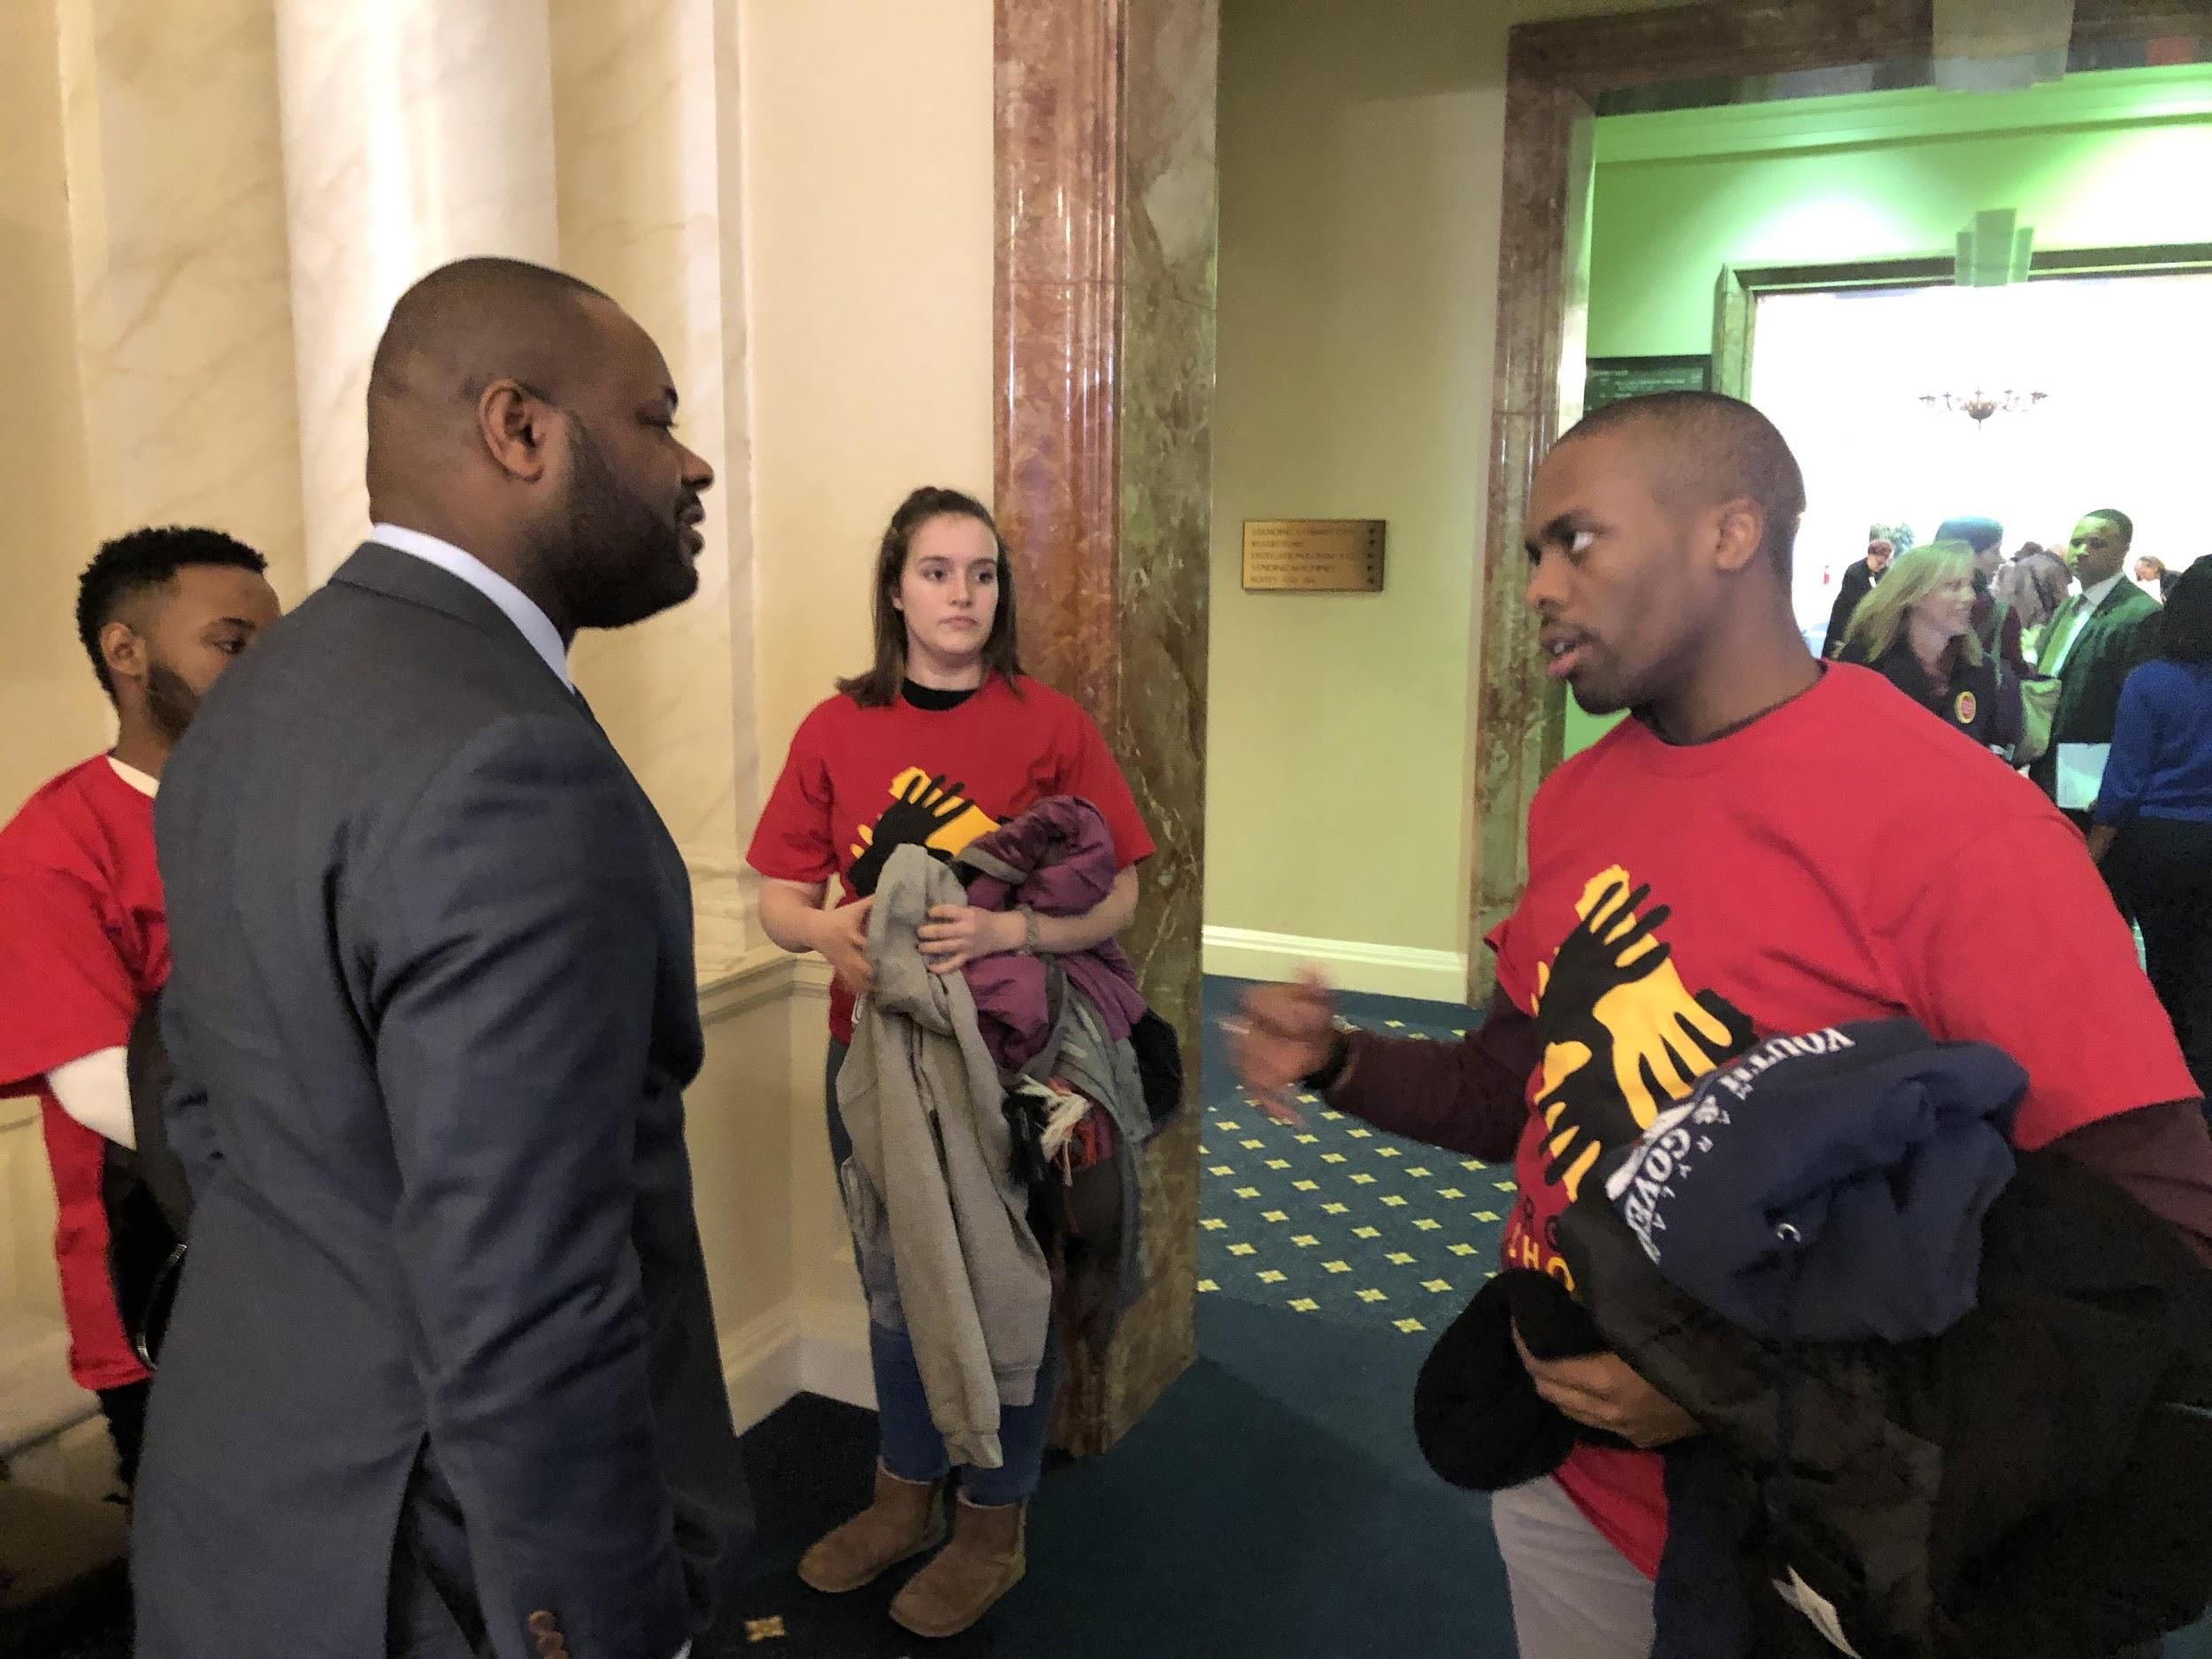
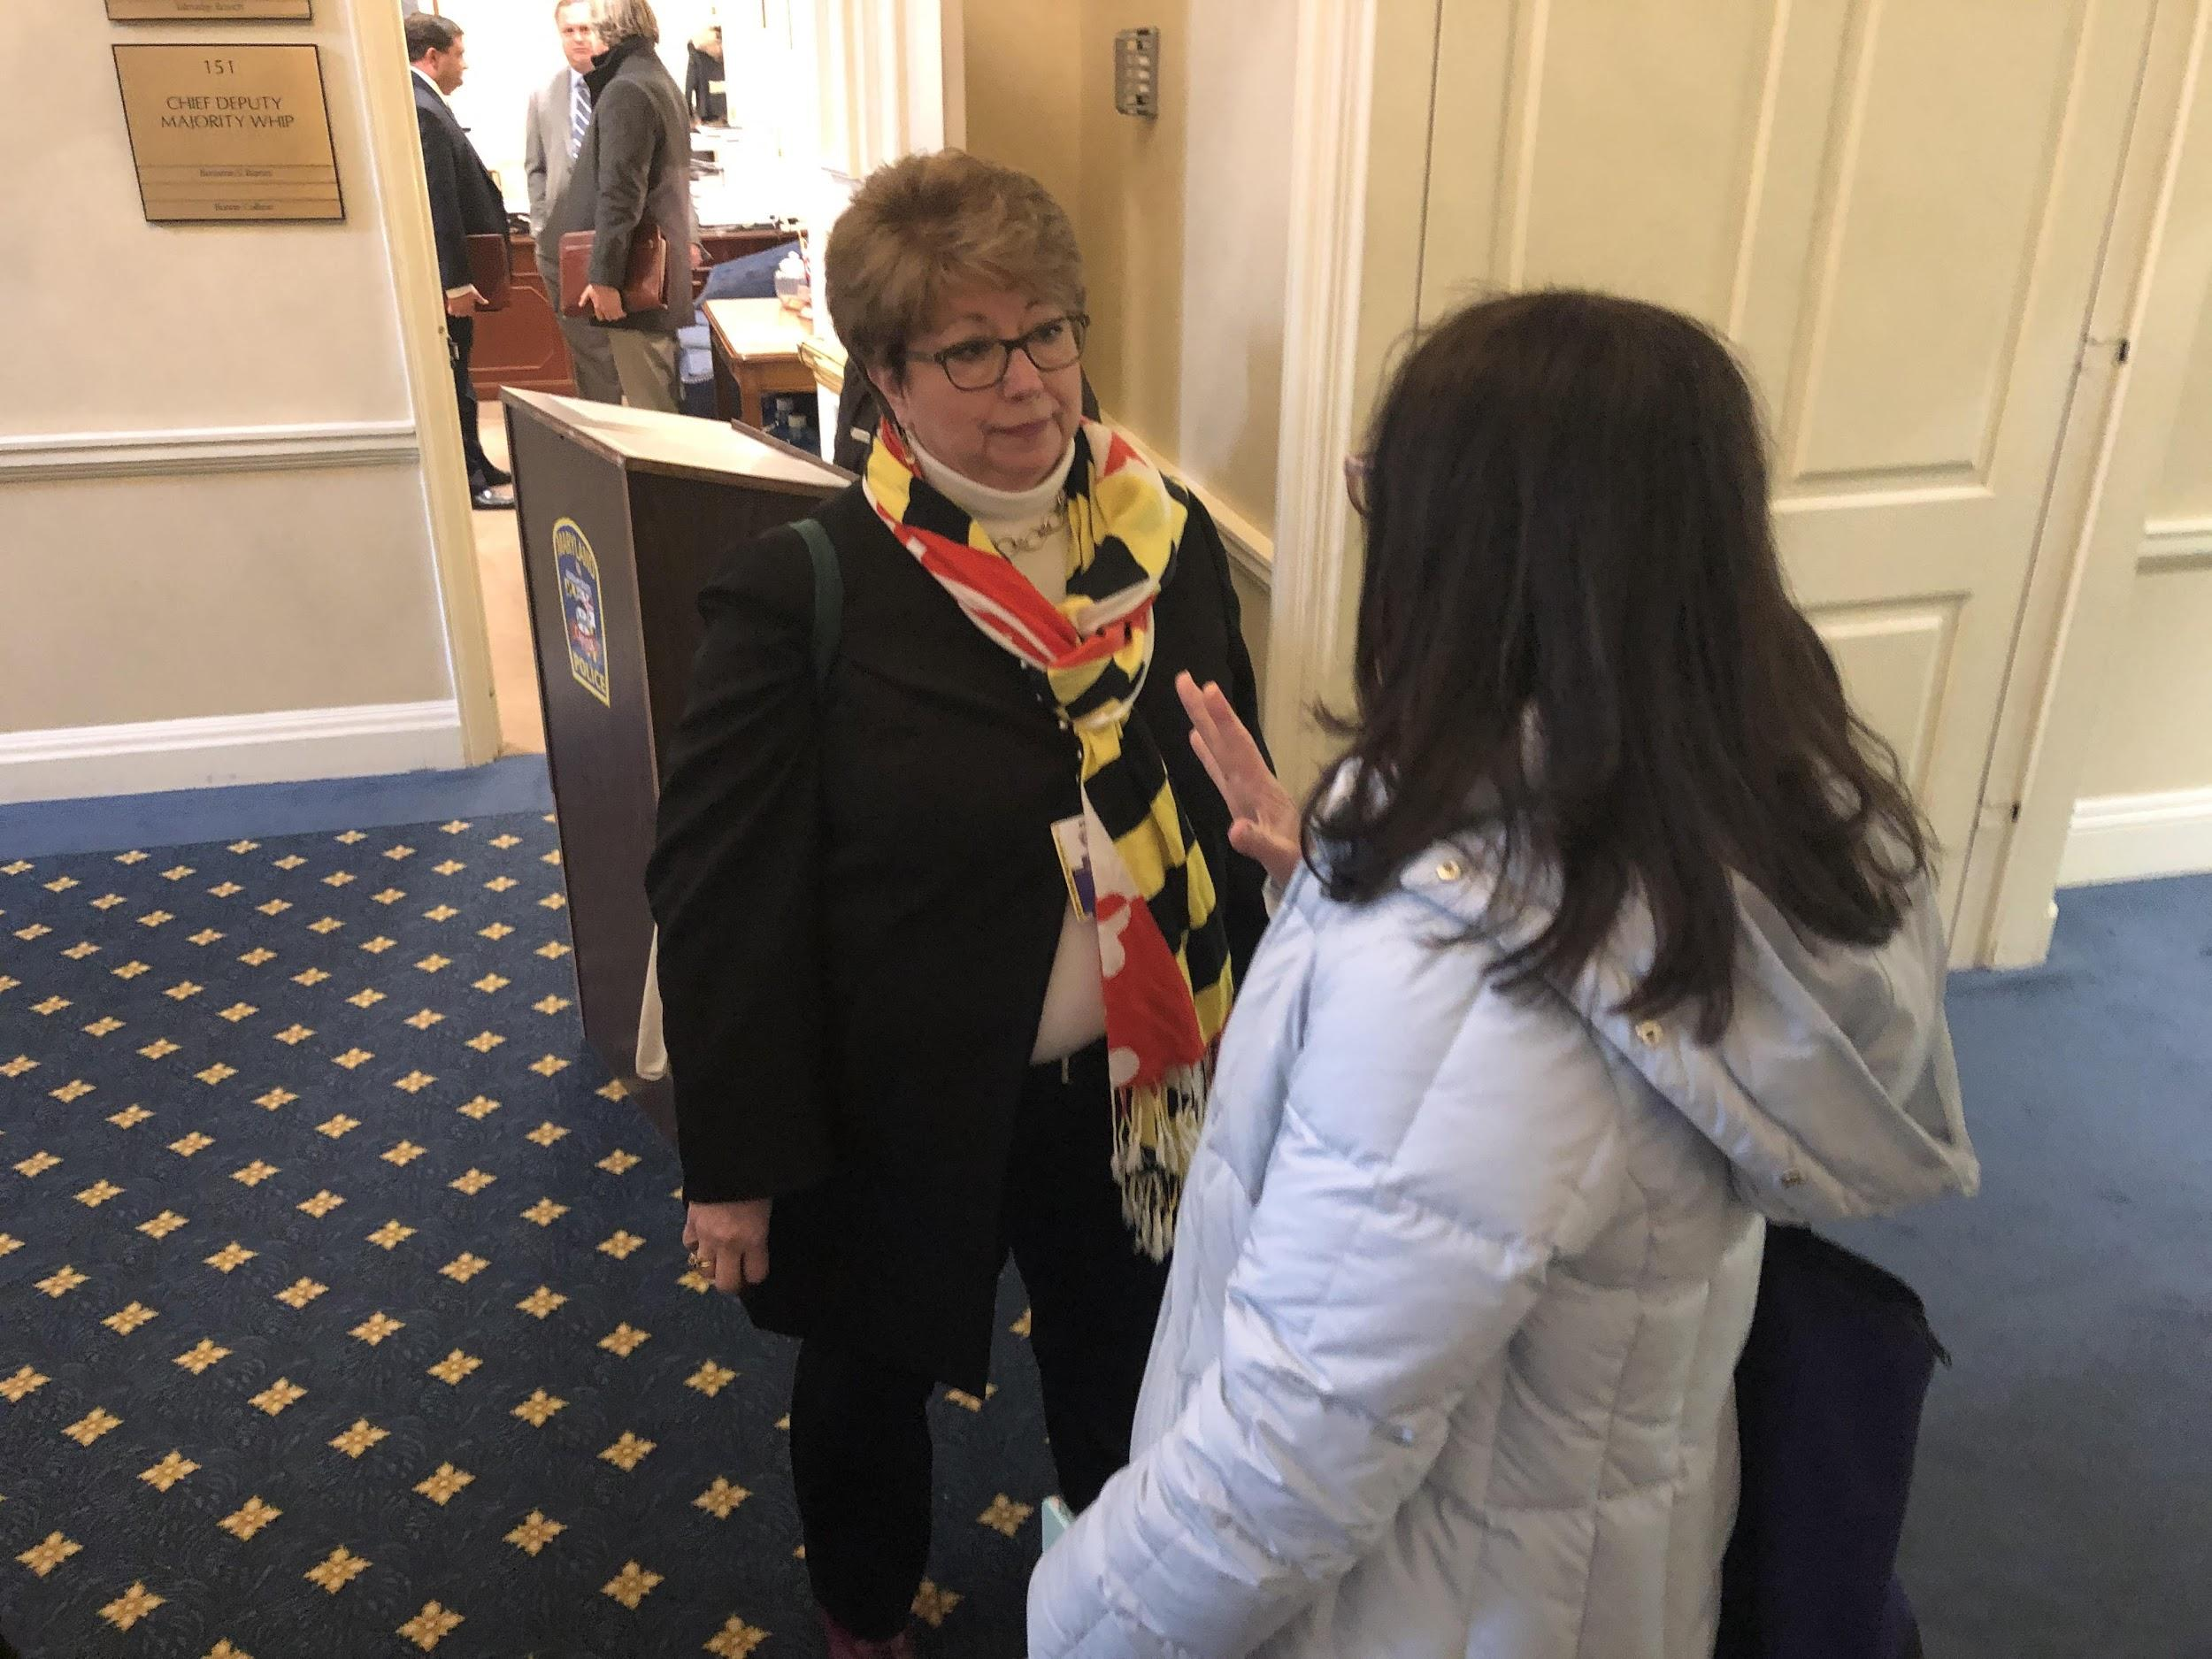

Slide 28
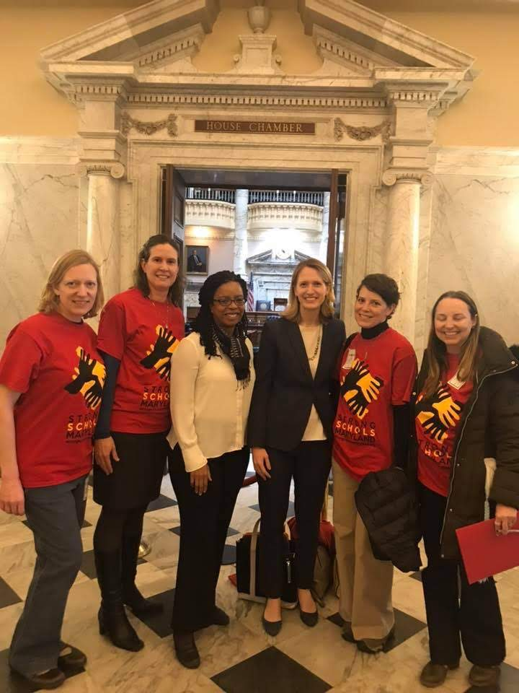
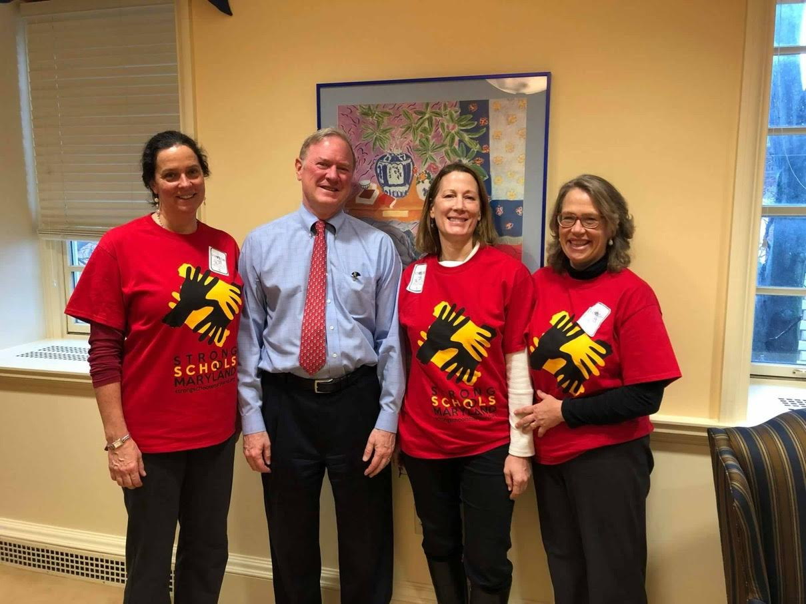
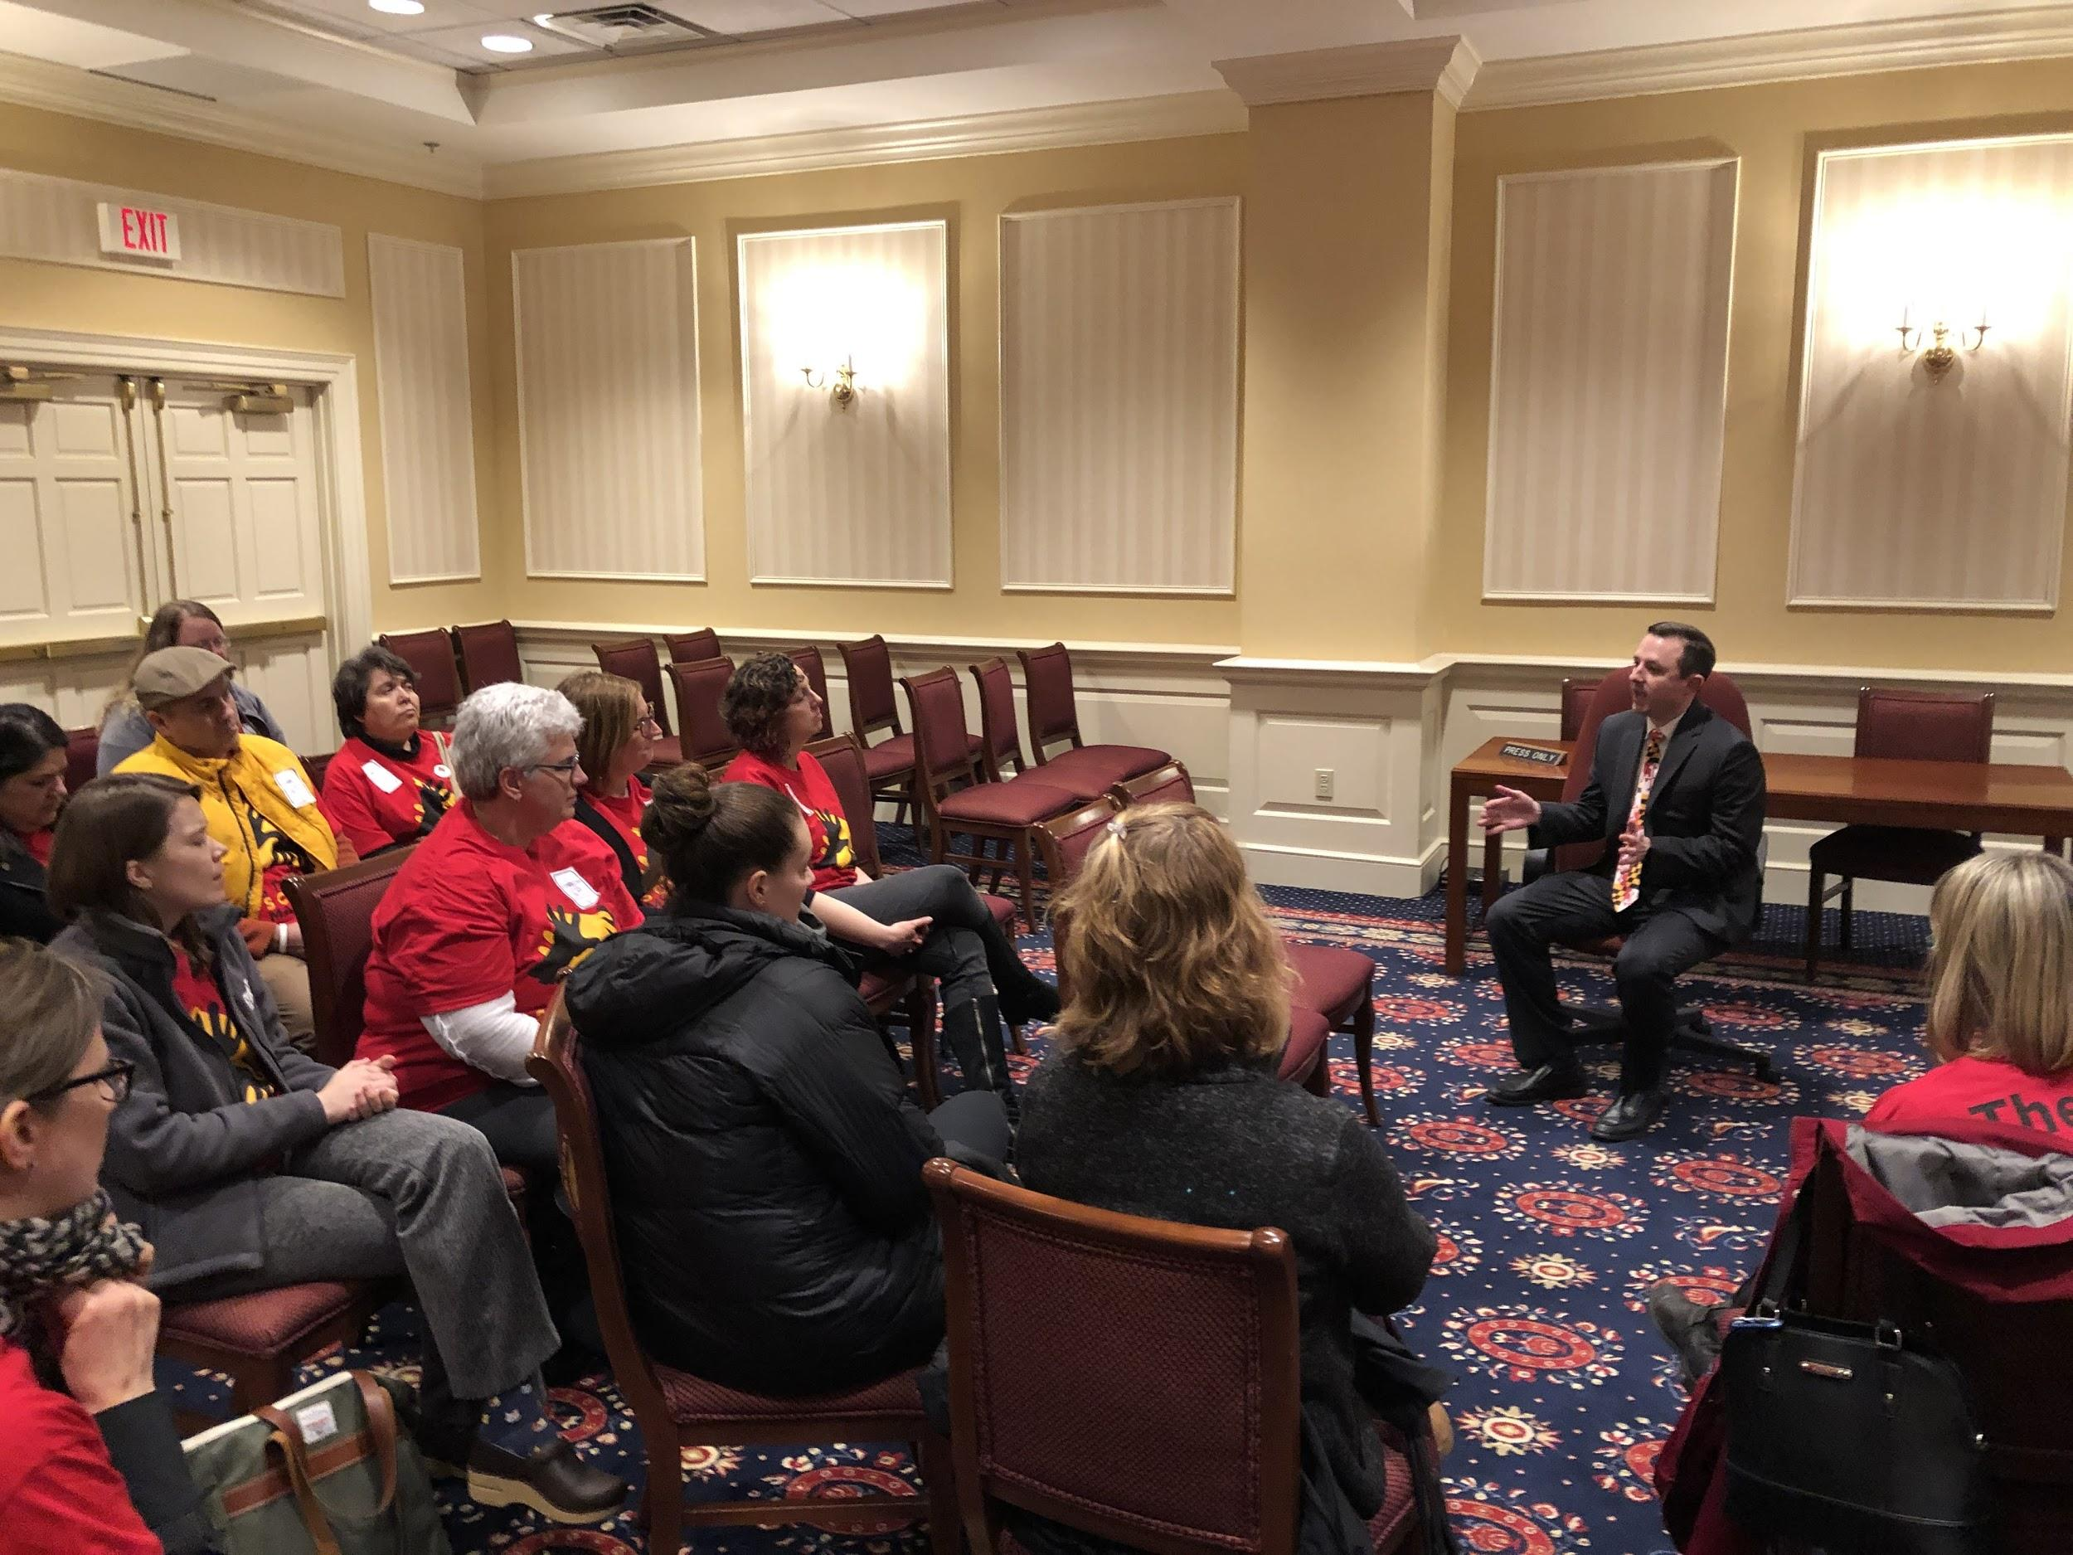
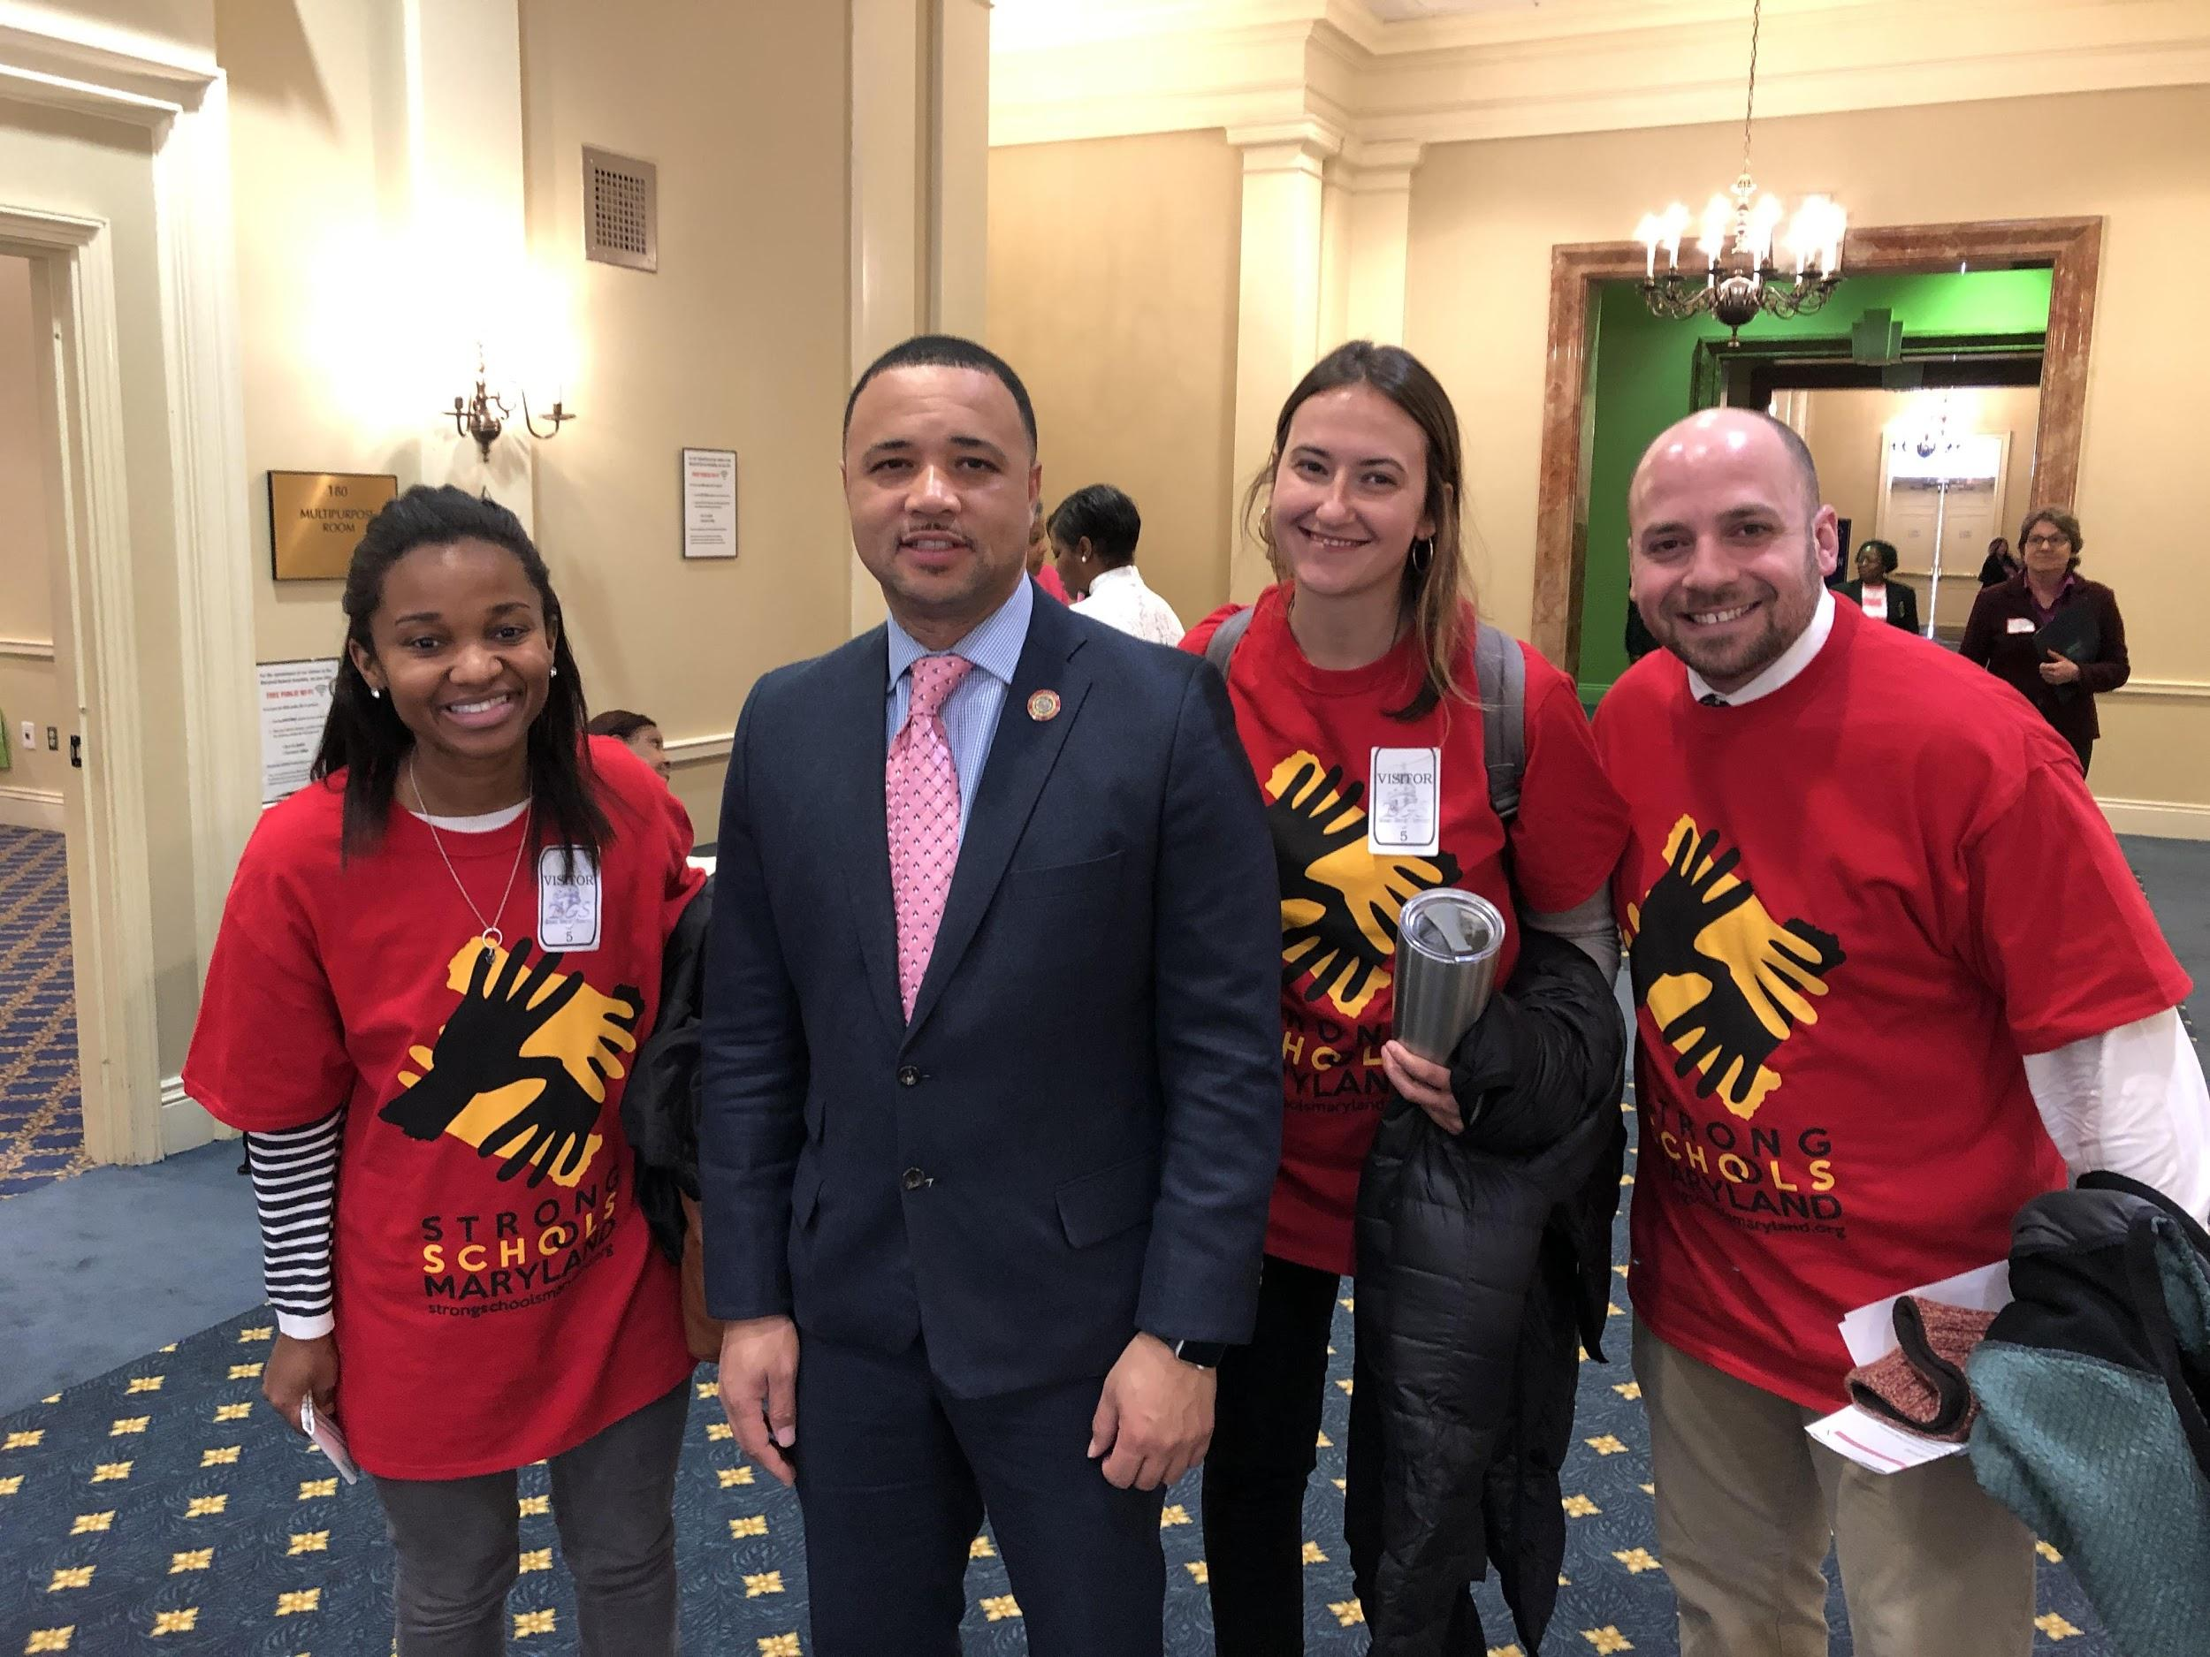
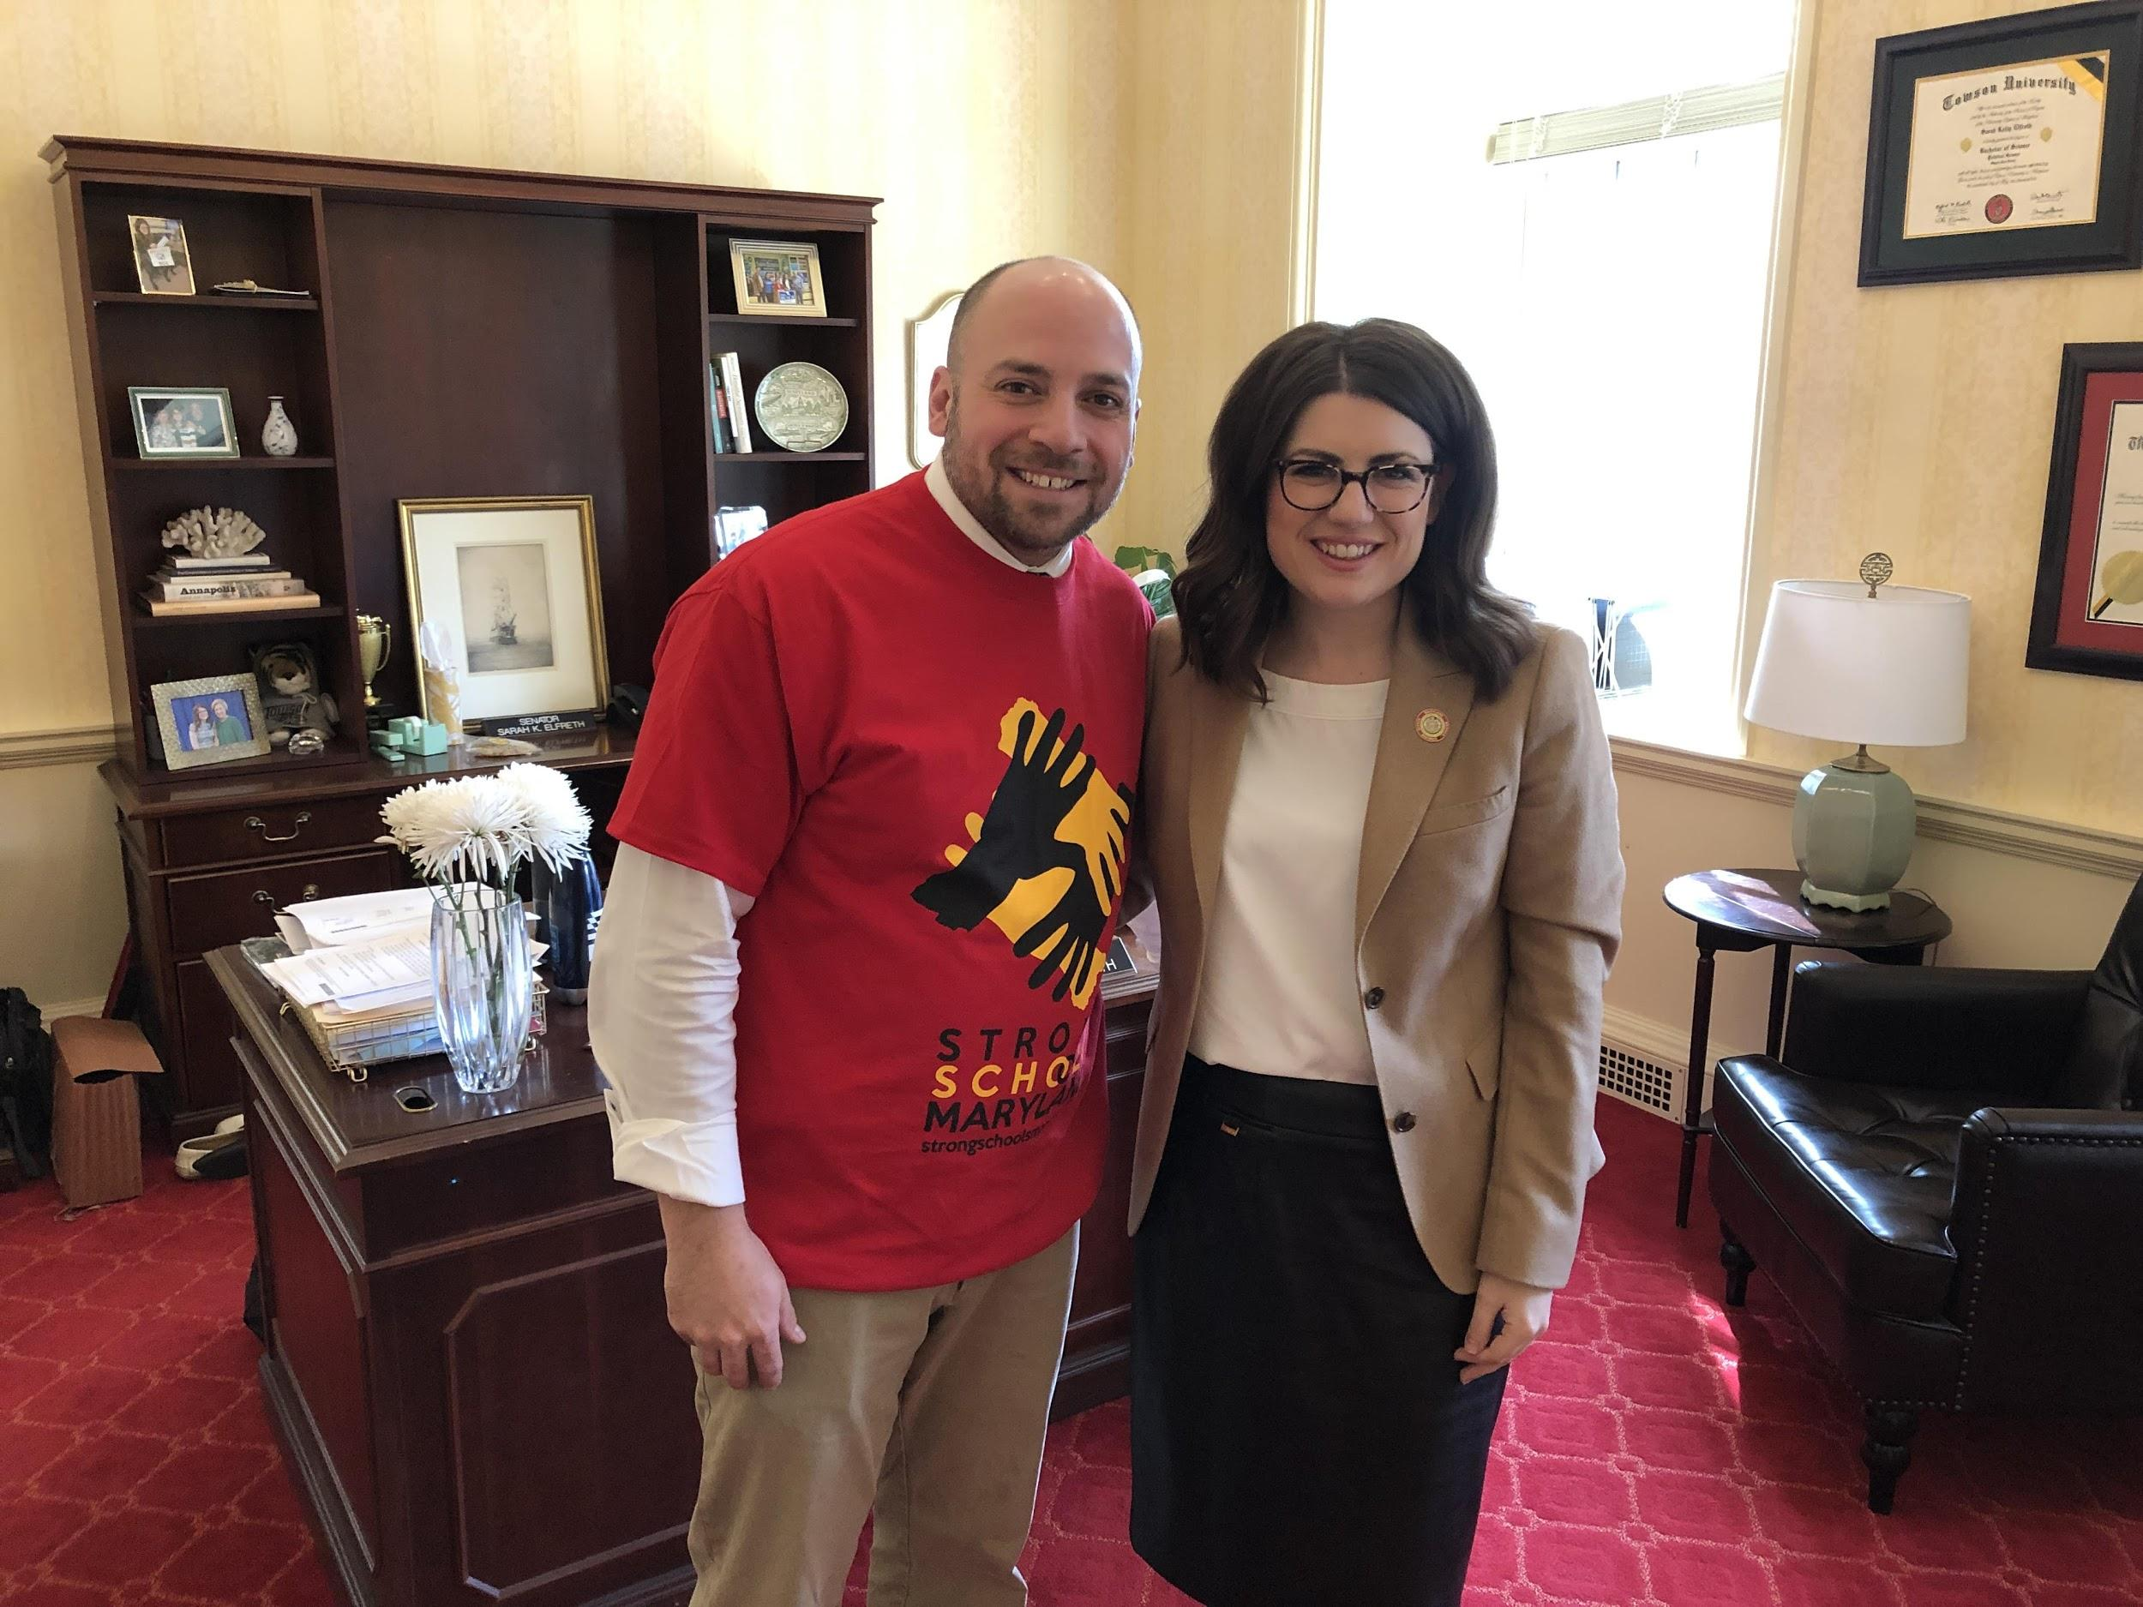
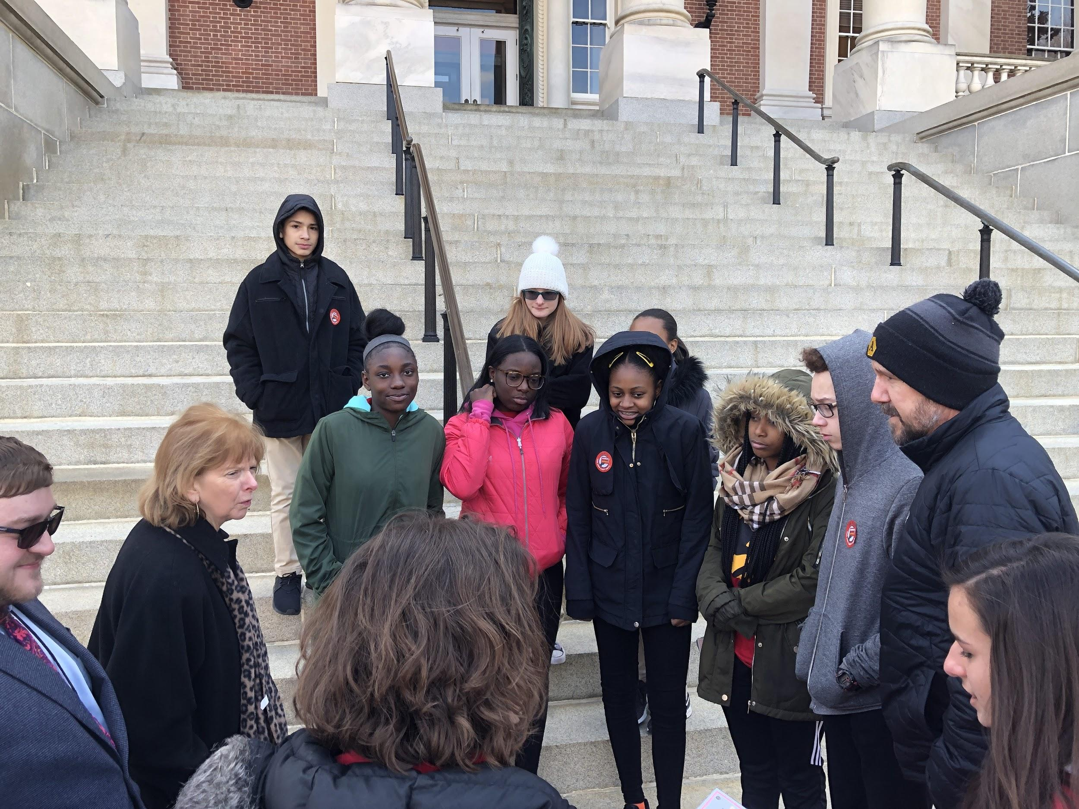
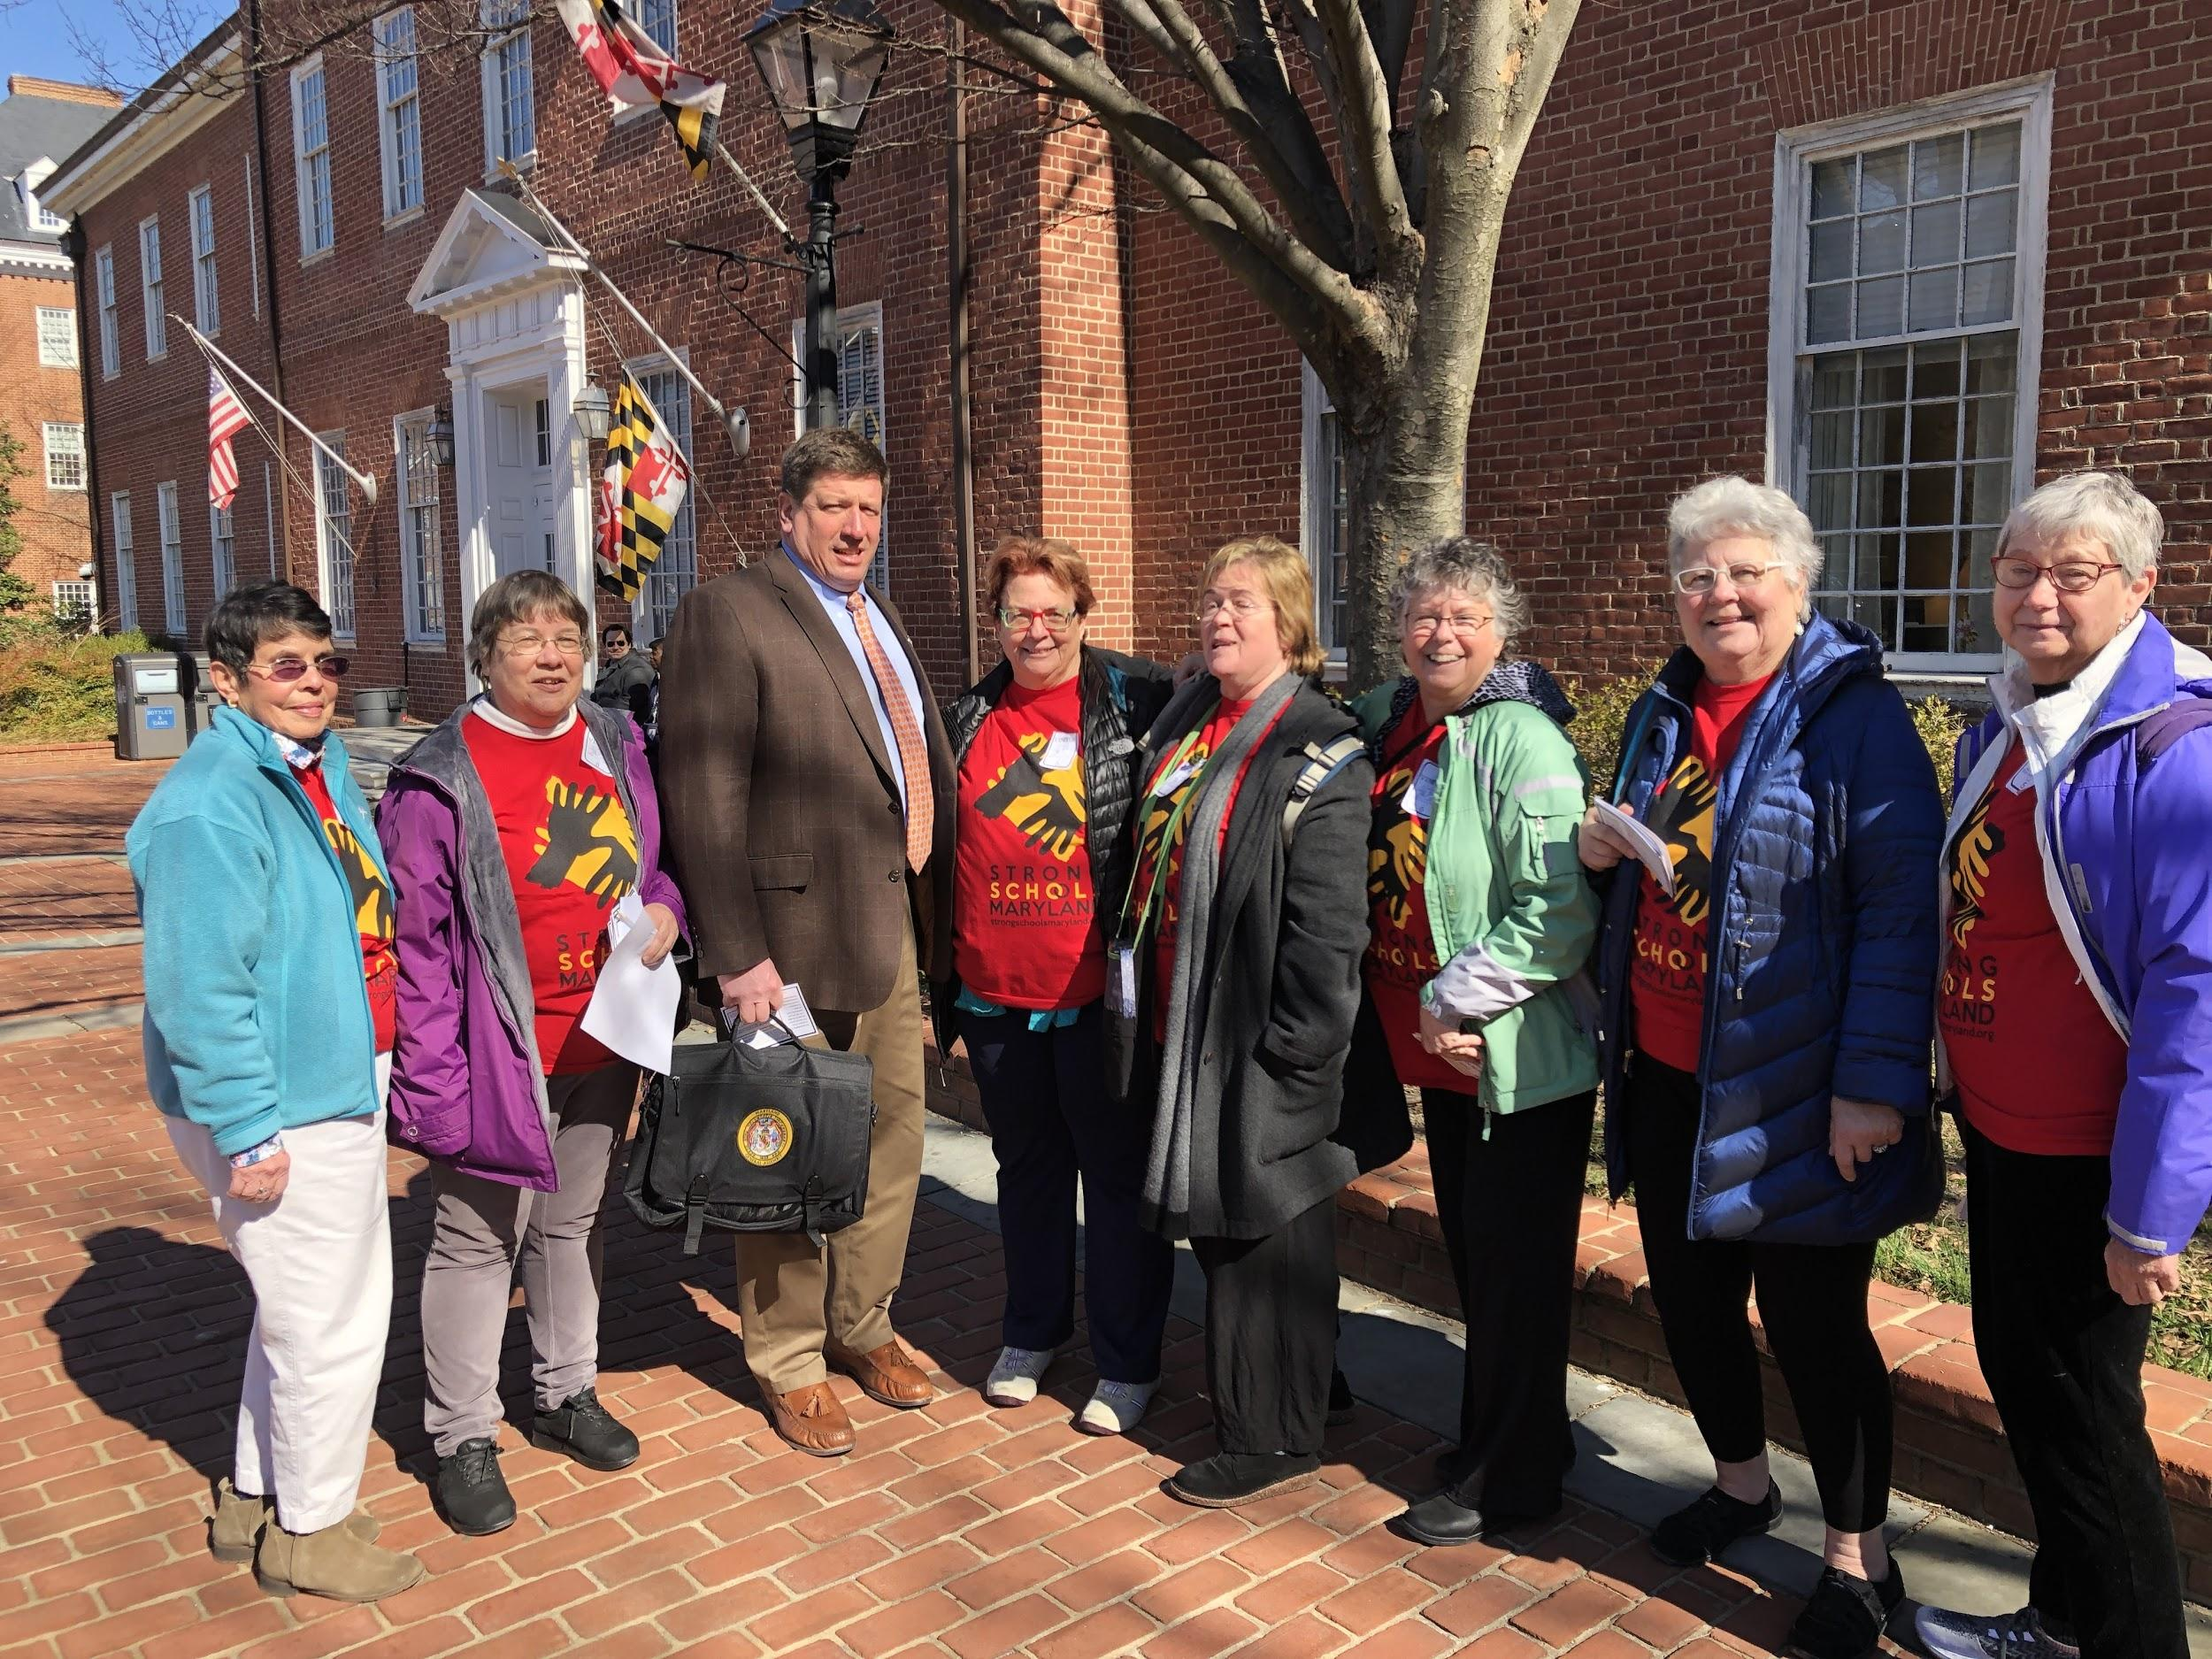

Slide 29
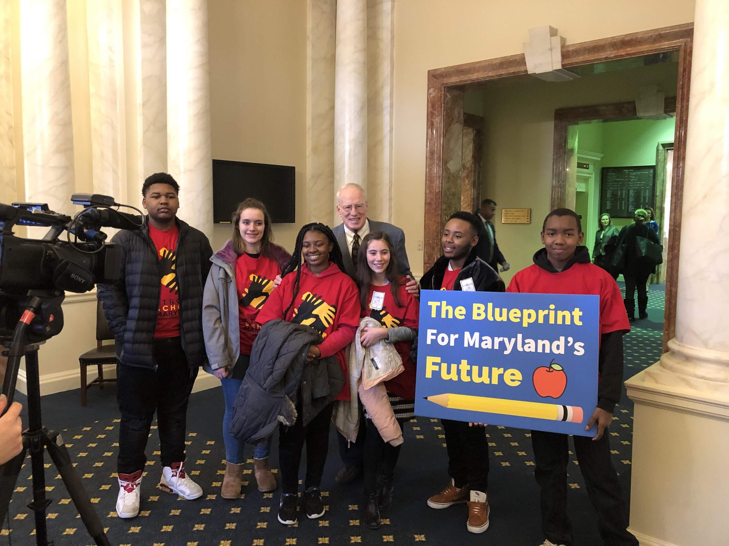

Slide 30
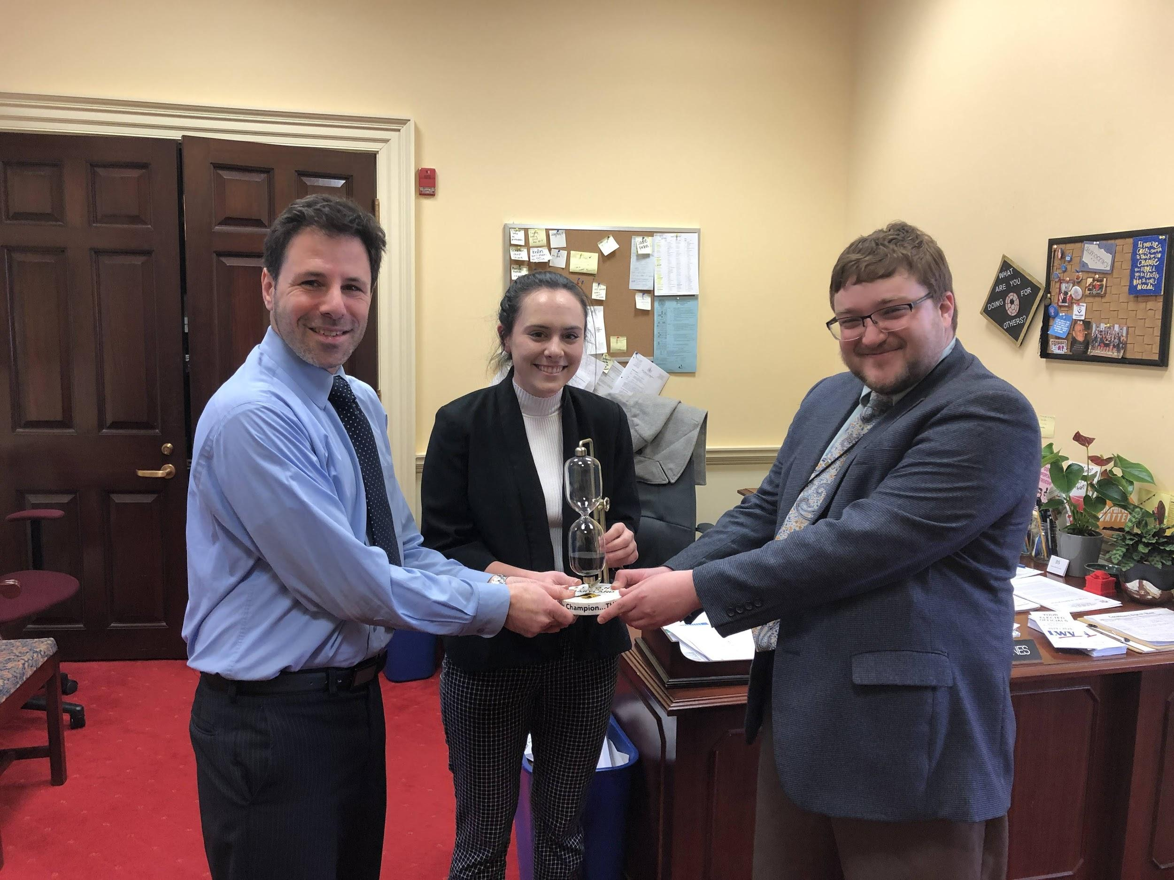

Slide 31
