Slide 1
Coral Reef Explorers
A Web Quest to Discover the Mysteries of the Coral Reefs
Created by Marisa Boan
Ecology

Slide 2
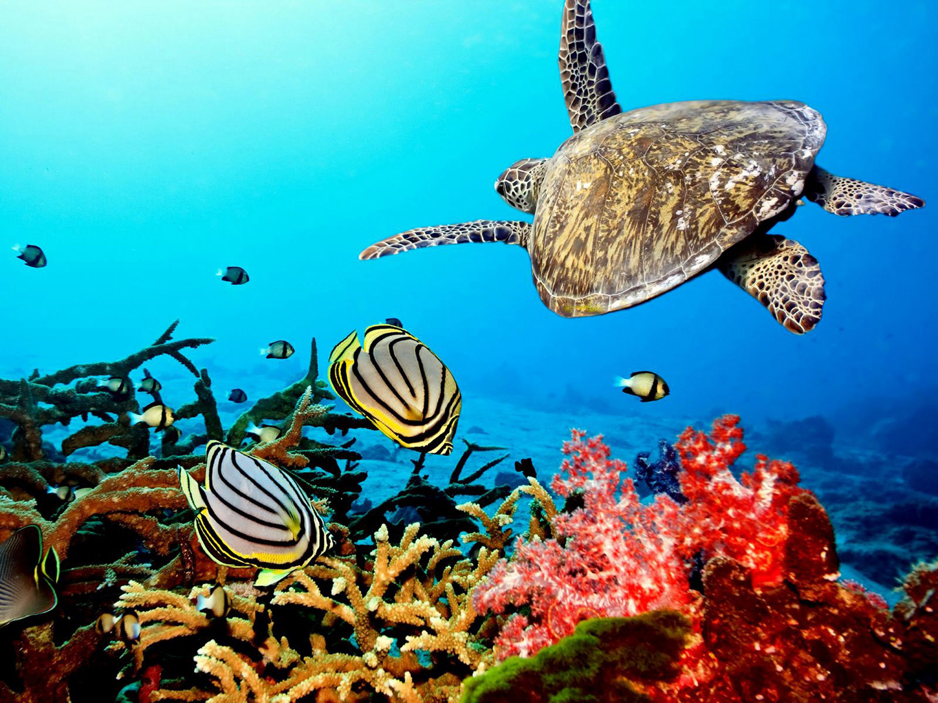
Coral Reef Explorers
Video Introduction
Press Play

Slide 3
Coral Reef Explorers
Introduction to Mission
Special Missions
You and your team have been selected to be part of a team of elite deep sea divers on the ship, Coral Reef Explorer.
You will be exploring the oceans to learn about coral reef ecosystems. Each crew member will participate in all of the parts of the mission. These parts are listed at the right.
You will need to keep a journal/notes of your notes, pictures and drawings, and answers to the questions and the investigations. You will then use your journal notes and present your findings in a PowerPoint slideshow and children’s book .
When you complete all the parts of this mission you should be able to:
Describe coral reefs: what they are, their location, how they are built, their importance as an ecosystem and a resource.
Identify organisms that live in and around coral reefs.
Identify adaptations that help specific organisms survive.
Describe problems that are currently impacting the coral reefs.
Learning About Coral Reefs
Adaptations in the Coral Reefs
Creatures of the Deep
Coral Reefs in Danger
Mystery in the Coral Reef
Mission Accomplished – Presenting Your Research
Resources
Websites
Project Requirements
Rubrics

Slide 4
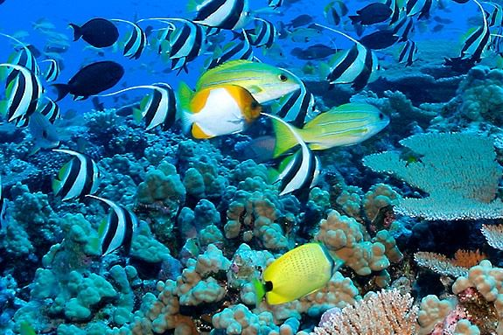
Coral Reef Explorers

Slide 5
Mission 1: Learning About Coral Reefs
You and your team have been selected to be part of the dive team on the ship, Coral Reef Explorer. You will be exploring the oceans to learn about coral reef ecosystems. When you complete this mission you should be able to:
Describe coral reefs:
Location
How they are built and what they are made of
Why they are important as an ecosystem and as a resource.

Slide 6
Mission 1: Coral Reef Questions
Coral Reef Questions: Use the links to help you answer these questions about coral reefs. Write the answers in your ocean journal.
What are coral reefs?
How are coral reefs formed?
What type of animals live in coral reefs?
List/Describe 2 types of corals.
Where are coral reefs located? What parts of the world can they be found?
List 3 different types of coral reefs
What are the names of some plants that are located in coral reef ecosystems?
What are zooxanthellae? What do zoozanthellae provide for the coral?
What is symbiosis? Describe symbiosis in a coral reef ecosystem
Why are coral reefs important? List 3 reasons.
Resource Links
Enchanted Learning – Coral Reefs
Kids Do Ecology – Coral Reefs
Eco Kids – Coral Reefs
KIDS Discover – Coral Reefs
Seaworld – Coral Reefs for Kids
Link to Coral Reef Research Journal

Slide 7
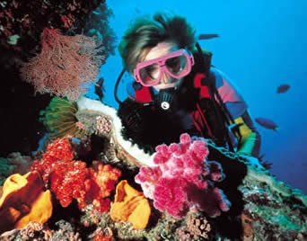
Coral Reef Diver School Challenge
Click to Take the Challenge

Slide 8
Mission 2: Adaptations in the Coral Reef
When you complete this part of the mission you should be able to:
Identify and describe adaptations that help specific ocean organisms survive.
Identify symbiotic relationships in which both organisms benefit.
Design a new marine organism, a predator or prey. Give it adaptations such as specialized body parts or abilities that help it live in the coral reef.
Create a model or a drawing of your organism.

Slide 9
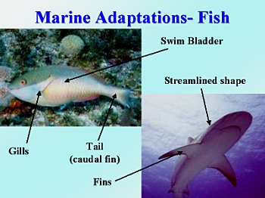
Marine Adaptations
First, let's look at some general adaptations that help many marine organisms live in the ocean.
Fish have several important adaptations that allow them to live in their ocean environment.
Gills take oxygen out of the water so that the fish can "breathe" underwater. (Many other marine organisms, like shrimp and sea slugs also have gills.)
Most fish have a streamlined shape as well as a tail and fins to help them move easily and quickly through the water.
A swim bladder (or the liver) helps the fish control its buoyancy and stay at a certain depth.

Slide 10
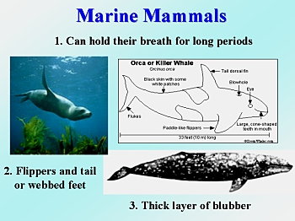
Marine Mammals Adapatations
Marine mammals also have adaptations for life underwater.
Mammals do not have gills and cannot breathe underwater; however, they can hold their breath for long periods of time. Some seals can hold their breath for 45 minutes and some whales can hold their breath for over an hour!
Most marine mammals have either tails or webbed feet and their "arms" have evolved into flippers. Their bodies also have a streamlined shape.
Mammals are warm-blooded and need insulation to keep their body temperature from dropping. They have either a thick layer of blubber (fat) or very thick fur.

Slide 11
Specialized Adaptations
Now we will investigate some specialized adaptations.
1. Camouflage
2. Venom or poison, stinging cells
3. Armor
4. Specialized Appendages: fins, tentacles, claws, etc.
5. Symbiotic relationships in which both organisms benefit.
6. Scuba- Specialized equipment to adapt divers to the underwater environment.
7. Get Creative!

Slide 12
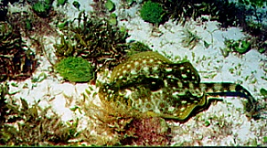
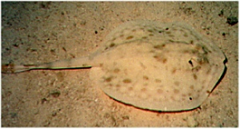
Camouflage
Many ocean organisms use camouflage to ambush prey or to hide from predators.
Camouflage allows creatures to blend into their backgrounds
The Golden Stingray can change colors to blend in with its surroundings.
The Golden Stingray can change colors to blend in with its surroundings.
The Golden Ray is difficult to see on the sandy bottom.

Slide 13
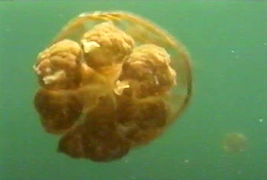
Venom and Poison
Jellyfish have tentacles that hang down from its bell.
The tentacles contain stinging cells called nematocysts that stun or paralyze prey.

Slide 14
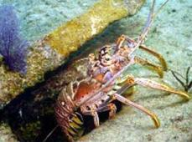
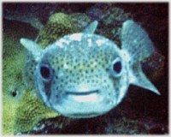
Armor
Some creatures have a hard shell to protect themselves from predators
The Porcupine fish puffs up and sharp spines stick out
when it is disturbed or frightened.
The Reef Lobster's hard shell protects it.

Slide 15
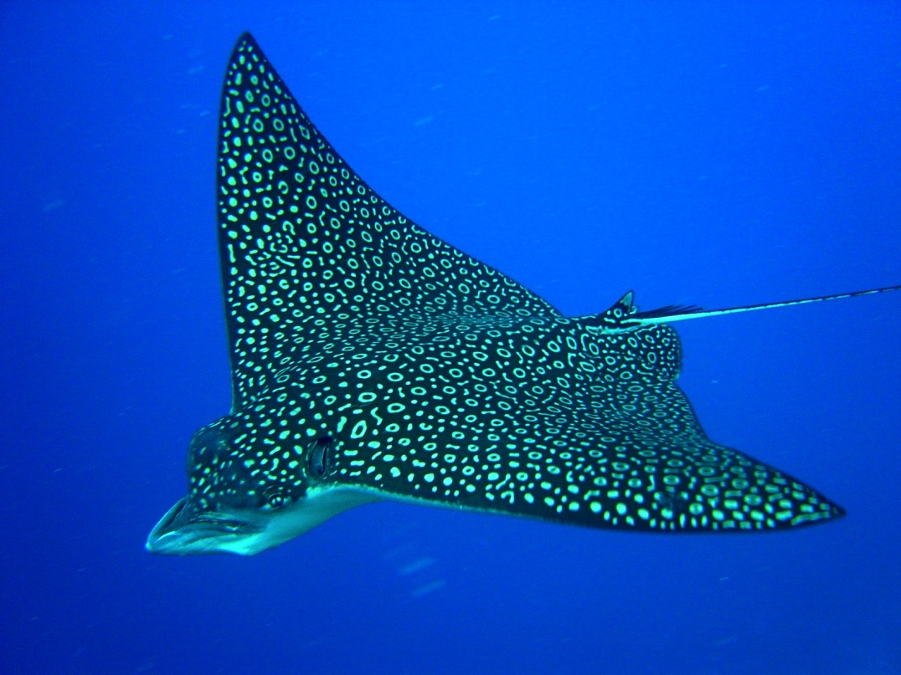
Specialized Appendages
The graceful Eagle Ray has elongated fins that act like wings helping it to glide and "fly" through the water.

Slide 16
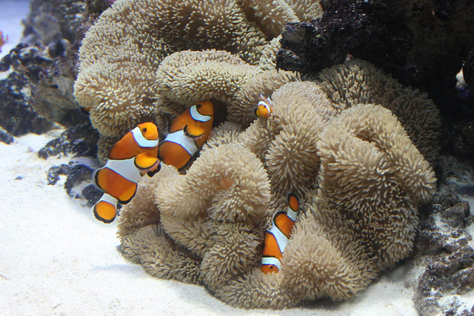
Symbiotic Relationships
In symbiotic relationships, each organism benefits from the other.
The benefit can be protection from predators, the removal of parasites or diseased tissue or can be a source of food for one or both organisms.

Slide 17
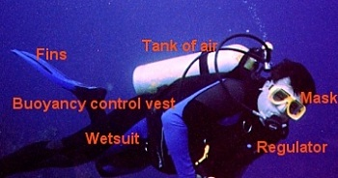
Scuba Equipment as Special Adaptations
When human beings explore the ocean environment, they need to add specialized equipment to be able to move and breathe underwater.
Divers use several pieces of specialized equipment.
A regulator and a tank of air allow the diver to breathe underwater.
A mask helps the diver see clearly.
Fins help the diver move more quickly and with less effort.
A buoyancy control vest (along with a weight belt) help the diver control his/her depth. The diver can put air into or let air out of the vest. This allows the diver to hover or "float" at certain depths without sinking or going up.
A wetsuit helps keep the diver warm by adding a layer of insulation.

Slide 18
Design a New Organism
Let's Get Creative!
Now that you know about various adaptations you can design a new marine organism, a predator or a prey. Give your organism specialized body parts or abilities that help it live in the coral reef. Create a model or a drawing of your organism.
Use your Coral Reef Journal to Design Your Organism

Slide 19
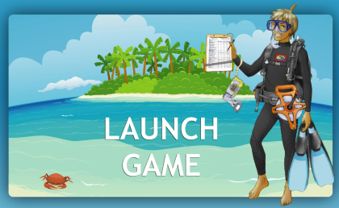
Coral Reef Diver Training

Slide 20
Mission 3: Creatures of the Deep
When you complete this part of the mission you should be able to:
Identify organisms that live in and around coral reefs.
Identify adaptations that help specific organisms survive.
Create a food web that shows the relationships between several organisms in a coral reef.
Use the chart in your Research Journal to identify the organisms.

Slide 21
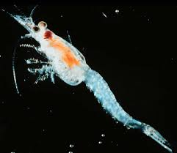
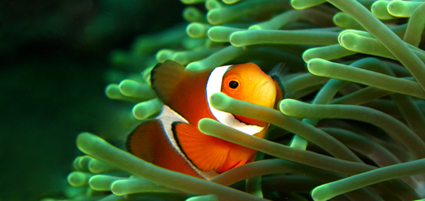
Identify the Organisms
Identifying Organisms
Coral Reef diver teams should work together to identify each of the organisms in the pictures below.
#1
#2

Slide 22
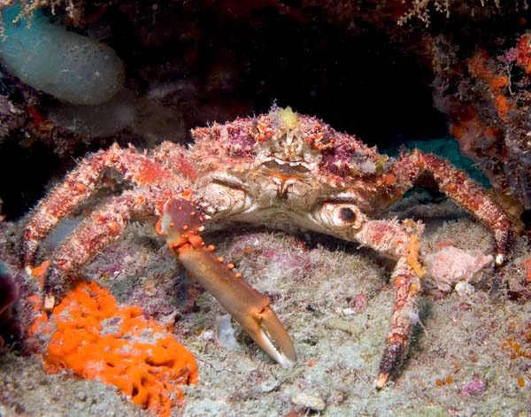
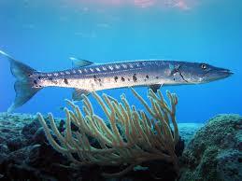
Identify the Organisms
Identify the creature in each photo
#3
#4

Slide 23
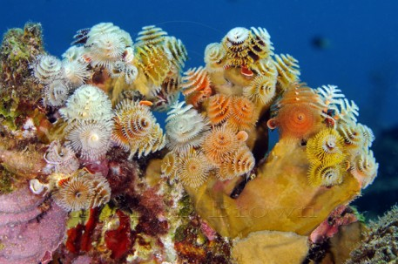
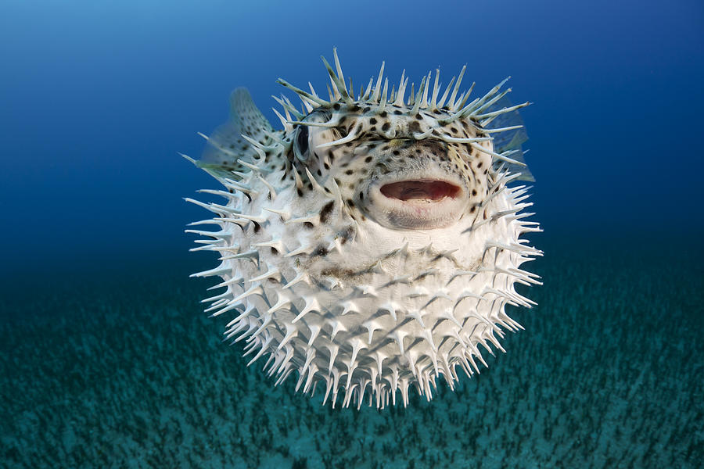
Identify Organisms
#5
#6

Slide 24
Links for Organisms
Secrets of the Ocean Realm
1. City in the Sea: grouper, reef shark, turtle, barracuda, stingray
2. Venom: nudibranch, clown anemonefish, jellyfish, lionfish
3. Survival: sea turtle, octopus
4. Star Gardens: sea stars, sea urchin
5. Darkness: brain coral, lobster
Enchanted Learning – Coral Reefs
The Shedd Aquarium - Explore by Animal
Scroll down the list on the left side
The Shedd Aquarium - Shedd Educational Adventures - Explorer's Guide
Click on Plants and Animals and Places: Land and Sea
Enchanted Learning/ Oceans
Click on the pictures of ocean animals to get more information. Queen conch, krill, plankton, lobster, shrimp, Portuguese Man o War (jellyfish), clams, crabs, dolphins, cuttlefish, angelfish, sea stars
Reef News- Fishes
Angelfish, trumpetfish, Queen Triggerfish, Sergeant Major,lionfish, stingray, parrotfish,
Red Hind fish, reef shark, King Angelfish, Blue Tang, yellow goatfish, Nassau Grouper, Garibaldi, Black Jack, soldierfish, needlefish
Reef News- Critters
dolphin, loggerhead turtle, green turtle, lobster, Christmas Tree worm, Flamingo Tongue snail, Vase sponge, Tube Sponge, Barrel sponge, Feather Duster Worm
Ocean Link
Click on the inks listed.
National Marine Sanctuaries - Photo Galleries
Click on the links for each sanctuary.
Try Florida Keys, Channel Islands, Gray's Reef, Monterey Bay
Photos with short descriptions: lobster, sea grass, Elkhorn coral, sea fan, shrimp on brain coral, Christmas Tree Worm, Yellowtail Snapper, Spotted Eagle Ray, Queen Angelfish, butterflyfish
Fish Identification Pictures
Photos of many types of fish: angelfish, butterfly fish, etc.
Plankton- Nature Works
Information about plankton
Florida Fishing Guide
Many types of fish with pictures and descriptions-
groupers, yellowtail snapper, red snapper, jacks, jewfish, sea bass

Slide 25
Research an Organism
Researching An Organism
Each coral reef diver team member should pick one of the pictured organisms or one from the list of additional organisms. Each team member should choose a DIFFERENT organism to research.
For the organism you have chosen, use this template and:
Draw or insert a picture.
Write the name of the organism.
Identify the group to which it belongs. (fish, mollusk, algae, crustacean, plant, reptile, etc.)
List its diet and diagram its place in a food chain or web. (what it eats and what eats it)
Describe how it is adapted to its environment. (examples: adaptations to catch prey or to hide, escape or protect itself; adaptations for movement; helpful relationship with another organism)

Slide 26
Research an Organism
Additional List of Organisms
Lionfish
Manta Ray
Brain coral
Clown Anemone fish
Shrimp or Banded Coral
ShrimpVase or Tube Sponge
Entermorpha (sea grass)
Phytoplankton
Butterfly fish
Caribbean Reef Shark
Octopus
Garibaldi fish
Queen Conch
Sea Urchin
Seahorse
Triggerfish
Nurse shark
Goatfish
BlueTang
Krill
Dolphin
Stingray
Sea Turtle (Green, Leatherback, etc.)
Coral Spotted Eagle Ray

Slide 27
Links for Research
Secrets of the Ocean Realm
1. City in the Sea: grouper, reef shark, turtle, barracuda, stingray
2. Venom: nudibranch, clown anemonefish, jellyfish, lionfish
3. Survival: sea turtle, octopus
4. Star Gardens: sea stars, sea urchin
5. Darkness: brain coral, lobster
Enchanted Learning – Coral Reefs
The Shedd Aquarium - Explore by Animal
Scroll down the list on the left side
The Shedd Aquarium - Shedd Educational Adventures - Explorer's Guide
Click on Plants and Animals and Places: Land and Sea
Enchanted Learning/ Oceans
Click on the pictures of ocean animals to get more information. Queen conch, krill, plankton, lobster, shrimp, Portuguese Man o War (jellyfish), clams, crabs, dolphins, cuttlefish, angelfish, sea stars
Reef News- Fishes
Angelfish, trumpetfish, Queen Triggerfish, Sergeant Major,lionfish, stingray, parrotfish,
Red Hind fish, reef shark, King Angelfish, Blue Tang, yellow goatfish, Nassau Grouper, Garibaldi, Black Jack, soldierfish, needlefish
Reef News- Critters
dolphin, loggerhead turtle, green turtle, lobster, Christmas Tree worm, Flamingo Tongue snail, Vase sponge, Tube Sponge, Barrel sponge, Feather Duster Worm
Ocean Link
Click on the inks listed.
National Marine Sanctuaries - Photo Galleries
Click on the links for each sanctuary.
Try Florida Keys, Channel Islands, Gray's Reef, Monterey Bay
Photos with short descriptions: lobster, sea grass, Elkhorn coral, sea fan, shrimp on brain coral, Christmas Tree Worm, Yellowtail Snapper, Spotted Eagle Ray, Queen Angelfish, butterflyfish
Fish Identification Pictures
Photos of many types of fish: angelfish, butterfly fish, etc.
Plankton- Nature Works
Information about plankton
Florida Fishing Guide
Many types of fish with pictures and descriptions-
groupers, yellowtail snapper, red snapper, jacks, jewfish, sea bass

Slide 28
Mission 4: Coral Reefs in Danger
Three coral reefs have been damaged and are in trouble! You and your team have been selected to be part of the crew on the ship, Coral Reef Explorer. You will be investigating these reefs to discover the cause of the reef damage.
When you complete this mission you should be able to:
Describe problems that are currently endangering the coral reefs.
Determine the suspect (cause) in each of these cases.
Research methods for protecting coral reefs and develop a plan to stop the damage at these sites.
Present your findings in a multimedia presentation (PowerPoint)
Rubric for this section can be found in your Research Journal.

Slide 29
Mystery in the Coral Reef
Coral Reef Mystery Questions Use the links to the right to help you find clues to identify the suspect (cause) in the above cases.
Write your clues and answers in your ocean journal. You will use your journal notes to create your presentation when you are finished with your detective work.
Work with your team to identify each of the 9 suspects (problems) that endanger reef ecosystems. List all the suspects in your journal.
Then you will try to determine which of these suspects are what caused the problems in case A, case B, and case C. Write your answers in your journal.
Finally, you will describe possible solutions to stop or fix the damage.
Ocean World – Coral Reefs in Danger
The Coral Reef Alliance- About Coral Reefs Click on "Coral Reef Threats" and "Why Care?“
The Coral Reef Alliance- Guides and Best Practices Find out what everyone, businesses and tourists can do to help preserve coral reefs
Florida Keys Marine Sanctuary- Resource Protection Go to both of these:
1. Mooring Buoys
2. Coral Reef Restoration
Broward County, Fl- Mooring Buoy Program Read about how using mooring buoys helps protect coral reefs
Seaworld – Coral Reefs for Kids

Slide 30
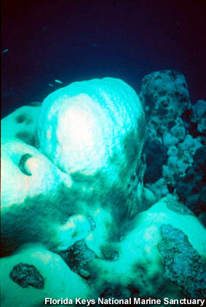
Mystery in the Coral Reef
Case A
Identify the possible problem.
What do you think happened to this coral reef?

Slide 31
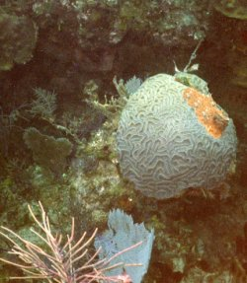
Mystery in the Coral Reef
Case B
Identify the possible problem.
What do you think happened to this coral reef?

Slide 32
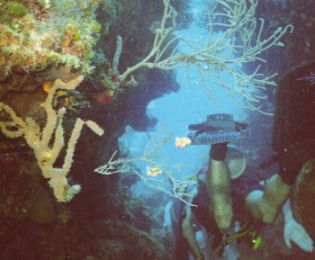
Mystery in the Coral Reef
Case C
Identify the possible problem.
What do you think happened to this coral reef?

Slide 33
Suspect List
1. W- - - r P - - luti – n
2. Sedi - - - - - - - - n
3. Coast - - D- v-l - - ment
4. Careless D - v - - g and Sn- - - - - ing
5. B - at A n - h - - s
6. Ov - - f - s - - - g
7. Fishing With Cy - - - d - or Ex - - - - - v—s
8. Global W - - - - - - and C - r - l B- - a - - ing
9. Coll - - - - -g and S - - - - - g of C - - - l, F - sh, Sh - lls and Other Animals

Slide 34
Mission 5: Solve the Mystery
Were you able to identify the suspect in each case? Write your answers in your Research Journal.
Case A
Case B
Case C

Slide 35
Mission Accomplished
Now your team has accomplished this mission (and learned a lot about coral reefs) you will present your findings in a series of reports.
Each student will work independently on the following projects:
Presentation 1: Coral Reef Organism
Presentation 2: Threats to the Coral Reefs
Presentation 3: Coral Reef Children’s Story Book or Fact Book
Game 1: Coral Reef Crossword Puzzle
Game 2: Coral Reef Word Search

Slide 36
Presentation 1
You need to present your findings on coral reef organisms and on the coral reef mysteries. When you complete this part of the mission you should be able to:
Highlight your organism in a multimedia presentation.
Presentation 1: My Coral Reef Organism (10-20 slides)
You need to show the following in your slides or web page:
A title slide or title section of the web page. This should include the title of the project and your name and class.
The name of the organism and a picture. (If you use a picture from one of the links, list the site to give credit.
Identify the group to which it belongs. (fish, mollusk, algae, crustacean, plant, reptile, etc.)
Reproduction System: Describe how it reproduces
List its diet and diagram its place in a food web. (what it eats and what eats it) You may use pictures (with labels) and arrows to show this or just type in the name of the organisms in a food web.
Describe how it is adapted to its environment. (examples: adaptations to catch prey or to hide, escape or protect itself; adaptations for movement; helpful relationship with another organism)

Slide 37
Presentation 2
Highlight one of the threats to coral reefs using one of the above programs. You may choose one of the "cases of reef damage" or one of the other suspects (causes). Describe how this threat damages reefs and give possible solutions.
Presentation 2: Threats to Coral Reefs (5-10 slides)
You need to show the following in your slides or web page:
A title slide or title section of the web page. This should include the title of the project and your name and classroom.
Identify the threat or suspect and show a picture. (If you use a picture from one of the links, list the site to give credit.
Describe how this threatens or damages the reef or reef organisms.
Describe possible solutions to the problem.

Slide 38
Presentation 3
Create a children’s story book or non-fiction book based on coral reefs.
Fiction: You may be creative and think up a great underwater adventures or a story about one creature like Sponge Bob, Finding Nemo, or some other story as long as it takes place in a coral reef. It could even be about a class trip to a museum to see a coral reef. Just include lots of facts and details about coral reefs.
Non-Fiction: You may want to create a small handbook of coral reef creatures, or a short book about the dangers to the coral reefs. This book will be full of facts and pictures.
Books will be created using online picture book making software.
During class, your teacher will show you how to use these programs.

Slide 39
Games 1 and 2
Create a coral reef crossword puzzle and word search puzzle using online puzzle-making software.
Game 1: Coral Reef Crossword Puzzle
Game 2: Coral Reef Word Search
Puzzles will be created using online picture puzzle making software.
During class, your teacher will show you how to use these programs.

Slide 40
Rubric: Coral Reefs in Danger
Scoring Rubric Mysteries Solved
4 – Exceeds Standards
Identified all the suspects in the list. Researched and described a problem that affects coral reefs. Very good writing! Correctly identified the suspect in each reef case.
Developed or reported on possible solutions to the problems.
3 – Meets Standards
Identified all the suspects in the list. Researched and described a problem that affects coral reefs. Correctly identified the suspect in at least two of the reef cases. Developed or reported on possible solutions to the problems.
2 – Approaching Standards
Identified 2-3 of the suspects in the list. Researched and described one problem, but the report has many errors or omissions. Identified the suspect in one of the reef cases. Report on possible solutions is too short or has many errors or omissions.
0-1 Below Standards
Identified less than 2 of the suspects in the list. Did not complete research or correctly identify the villains. Did not develop possible solutions.

Slide 41
Rubric: Presentations
4 – Exceeds Standards
Organism presentation includes a picture, information on group, diet, food web and adaptations.
Information is accurate and there are few or no errors in spelling and grammar.
Presentation is creative and attractive.
Presentation has additional pages and interesting facts that enhance the presentation.
3 – Meets Standards
All of the parts of the presentation are included.
Most of the information is accurate, but some parts need additional work or editing.
There are some errors in spelling and grammar.
Presentation is creative and attractive.
2 – Approaching Standards
One or two parts of the presentation are may be missing.
Information may lack accuracy or may have been plagiarized
Some of the parts of the presentation need more work or more information.
There are multiple errors in spelling and grammar
0-1 Below Standards
Did not complete the presentation.
Many parts are missing or information is incorrect.
Little or no effort shown.

Slide 42
Games and Activities
Word Search
Zooxanthellae Making Words Game
Coral Reef Jeopardy
A fun way to test your knowledge of coral reef environments. Note: in presentation mode, click on squares on the game board slide to show questions. Click on forward arrow at bottom of screen or hit forward arrow key to advance to the answer. Click 'home' icon on answer slide to return to game board. Southeast Florida Coral Reef Initiative
Coral Reef Jeopardy as a PDF File: A fun way to test your knowledge of coral reef environments. Note: click on squares on the game board page to show questions. Hit the forward arrow key to advance to the answer. Click 'home' icon on the answer page to return to the game board.

Slide 43
Websites
Secrets of the Ocean Realm
1. City in the Sea: grouper, reef shark, turtle, barracuda, stingray
2. Venom: nudibranch, clown anemonefish, jellyfish, lionfish
3. Survival: sea turtle, octopus
4. Star Gardens: sea stars, sea urchin
5. Darkness: brain coral, lobster
Enchanted Learning – Coral Reefs
The Shedd Aquarium - Explore by Animal
Scroll down the list on the left side
The Shedd Aquarium - Shedd Educational Adventures - Explorer's Guide
Click on Plants and Animals and Places: Land and Sea
Enchanted Learning/ Oceans
Click on the pictures of ocean animals to get more information. Queen conch, krill, plankton, lobster, shrimp, Portuguese Man o War (jellyfish), clams, crabs, dolphins, cuttlefish, angelfish, sea stars
Reef News- Fishes
Angelfish, trumpetfish, Queen Triggerfish, Sergeant Major,lionfish, stingray, parrotfish,
Red Hind fish, reef shark, King Angelfish, Blue Tang, yellow goatfish, Nassau Grouper, Garibaldi, Black Jack, soldierfish, needlefish
Reef News- Critters
dolphin, loggerhead turtle, green turtle, lobster, Christmas Tree worm, Flamingo Tongue snail, Vase sponge, Tube Sponge, Barrel sponge, Feather Duster Worm
Ocean Link
Click on the inks listed.
National Marine Sanctuaries - Photo Galleries
Click on the links for each sanctuary.
Try Florida Keys, Channel Islands, Gray's Reef, Monterey Bay
Photos with short descriptions: lobster, sea grass, Elkhorn coral, sea fan, shrimp on brain coral, Christmas Tree Worm, Yellowtail Snapper, Spotted Eagle Ray, Queen Angelfish, butterflyfish
Fish Identification Pictures
Photos of many types of fish: angelfish, butterfly fish, etc.
Plankton- Nature Works
Information about plankton
Florida Fishing Guide
Many types of fish with pictures and descriptions-
groupers, yellowtail snapper, red snapper, jacks, jewfish, sea bass

