Slide 1
Symbiotic Relationships
SAMPLE

Slide 2

Mutualism
A Mutualistic Relationship is when two interacting species derive to benefit without depending on one another; without full depending on the other species.
# teamwork

Slide 3
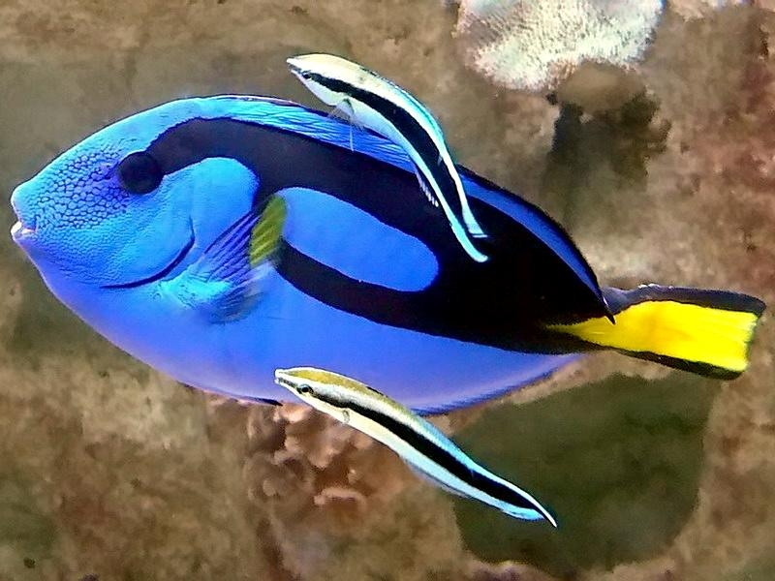
Mutualistic Relationship
Blue Streak cleaner wrasse(fish)
Palette surgeonfish
The relationship between a blue cleaner wrasse and palette surgeonfish(dory) is simple…. The cleaner fishes sets up a cleaning station for were dory arrives to be cleaned/ eat unwanted parasites found within or on the client's body.
This relationship benefits both parties the larger fish gets rid of any unwanted things hanging around and the cleaner wrasse gets all the nutrient they need to survive

Slide 4
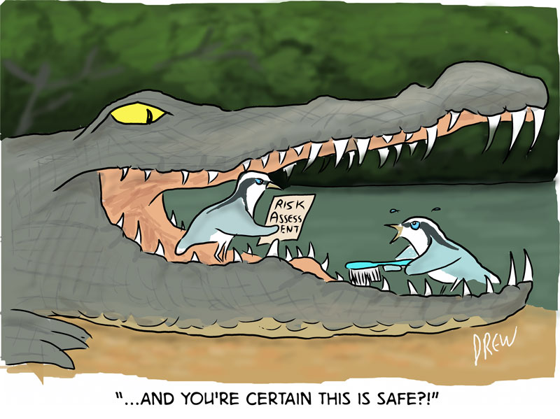
Mutualism
Crocodile
Egyptian Plover
The crocodile and Egyptian has a very significant relationship a risky but very beneficial relationship. The crocodile opens its mouth up wide inviting the Egyptian Plover to enter and eat any leeches that happen to be latched on.
Despite the risk of being eaten by the big crocodile most egyptian plovers takes the risk.

Slide 5
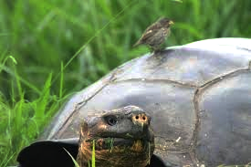
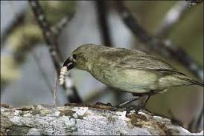
Mutualism
Finches
Diet consist of insects and seeds, flowers, fruits, shoot, spider, and a wide variety of insect
Some finches catch rides all the back of a tortoise eating all the insects that happen to be on its shell and in return tortoise get a rodent free back and the company of the finch….. Sounds like a win, win to me.

Slide 6
Commensalism
Commensalistic Relationships are described as a relationship where only one organism derive benefit without harming the other species.
#Everymanforhimself

Slide 7
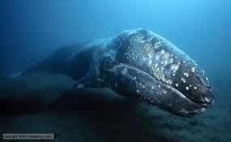
Barnacle & Whale
Barnacle are “sticky little crustaceans” that latch onto objects “undersides of vessels, to other sea life, to each other, and to pretty much anything they come in contact with” for a free ride and an opportunity to eat anything floating by.
Whales on the other hand are too big to notice the barnacle latching on to them within time; and to be honest they couldn't really do anything if i did bother them Barnacles(a rare chance they will get a skin infection) and in fact barnacles tend to roll over when there carrier is under attack, which provides protection.

Slide 8
Parasitism
A parasitism relationship where only one organism derive benefit while harming the other species. A relationship between parasite and its host.

Slide 9
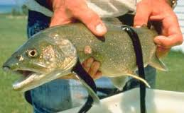
Parasitism
Leech are segmented worms that live underwater. Leeches are predators that latch on to near by creatures in search of food. Leeches diet consist of blood from all warm blooded species that happen to cross paths with it. But unfortunately for some neighboring fish they become victims of a leech attack. Sucking their blood, causing them a lot of pain

Slide 10
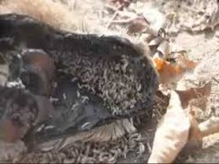
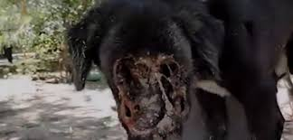
Parasitism
Dogs happen to be one of many that have been victimized by maggots. Maggots are meat eating pest that cause a lot of pain on the host of the attack. Causing dogs to lose fur, blood, and flesh.

