Slide 1
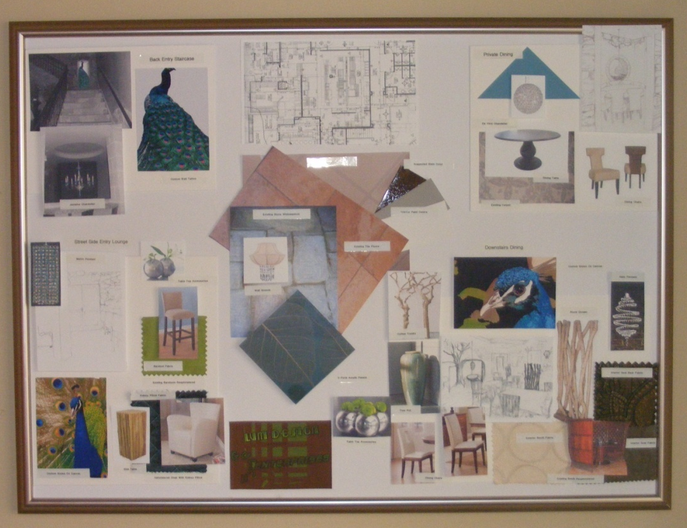
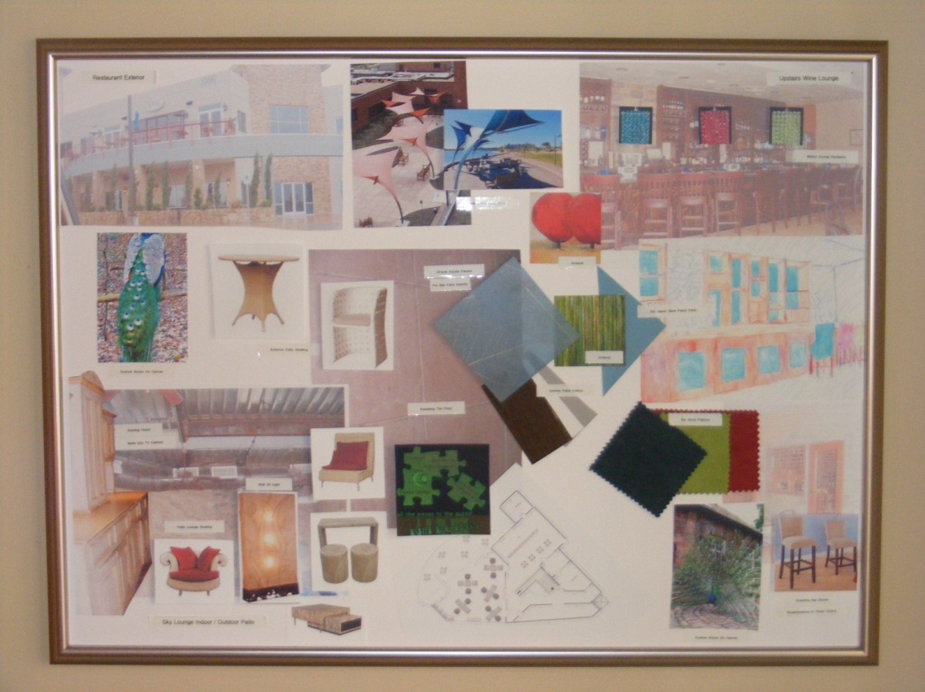
Tuscany Restaurant

Slide 2
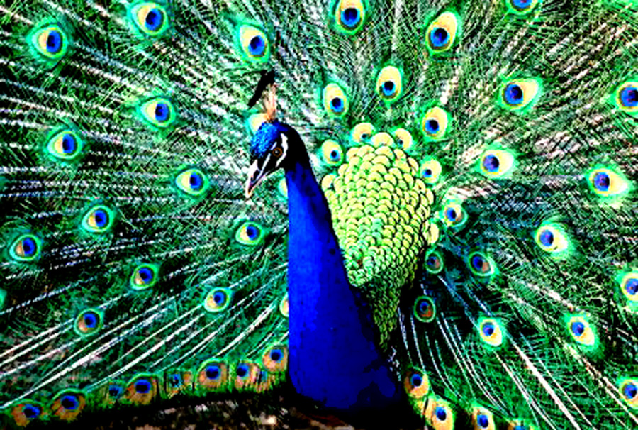
Blu Pavone

Slide 3
Tuscany Restaraunt
Creating a new environment ……
Inspiration - The “blu Pavone” or blue peacock serves as the inspiration for this project in that ,it is said and taught that to achieve a true Tuscan design one must first study the peacock. True Tuscan design is all about the details and color.
Color Palette – Think white, a soft creamy white with taupe accents on soffits , old whitewashed Tuscan stones with color splashed into the space on furnishings ,accessories and art work.
The theme for our new environment is one of a new more contemporary updated Tuscany of today . Like the bones of our project (exterior & surrounding interior spaces) a perfect blend of contemporary meets “old world”.

Slide 4
You never get a second chance to make a first impression, with that in mind we create a new space plan that adds a custom acrylic knee wall (3 Form)moved back behind the first window in the dining area to divide the space and will create a light, airy, sophisticated place to lounge in and more importantly begins our journey …...

Slide 5
Downstairs – Fine Dining & Patio Entry Lounge Space Plan
3 Form

Slide 6
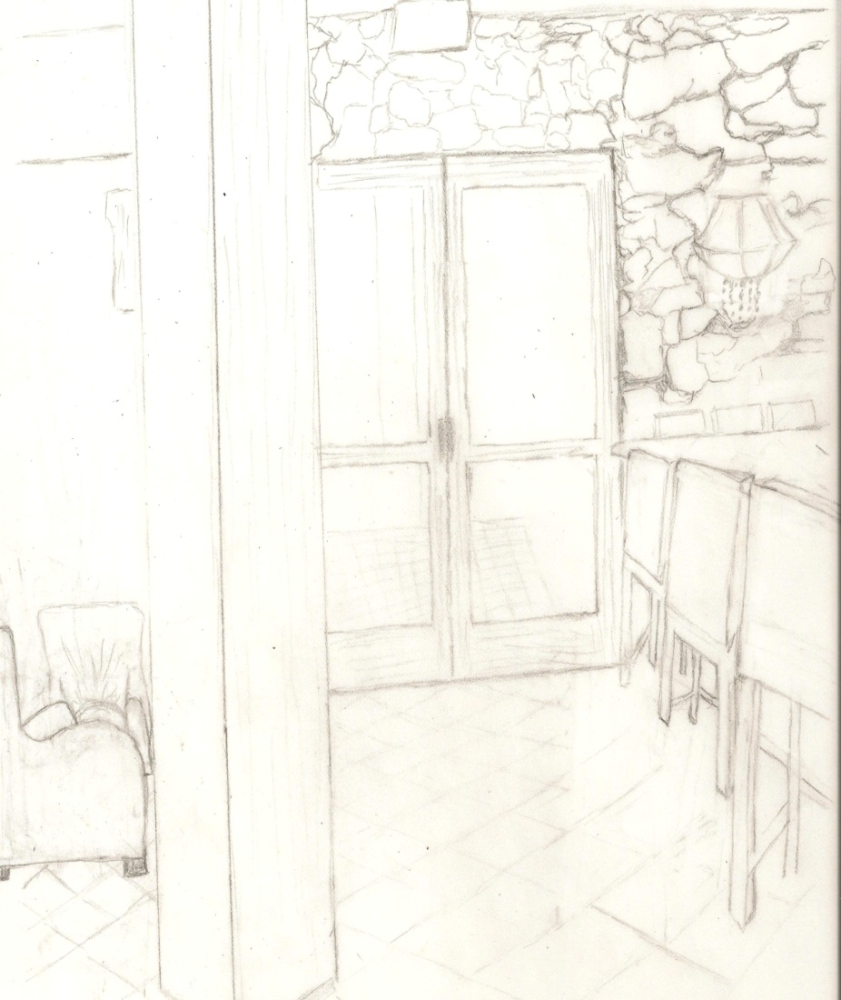
Patio Entry Lounge
In the current space there is a pole which blocks the main patio entry and cramps the space. By adding 3Form moved back into the dining area we create a new slightly larger open space in which the pole becomes an architectural feature of the space instead of an obstruction.
Concept

Slide 7
Patio Entry lounge - Colorization

Slide 8
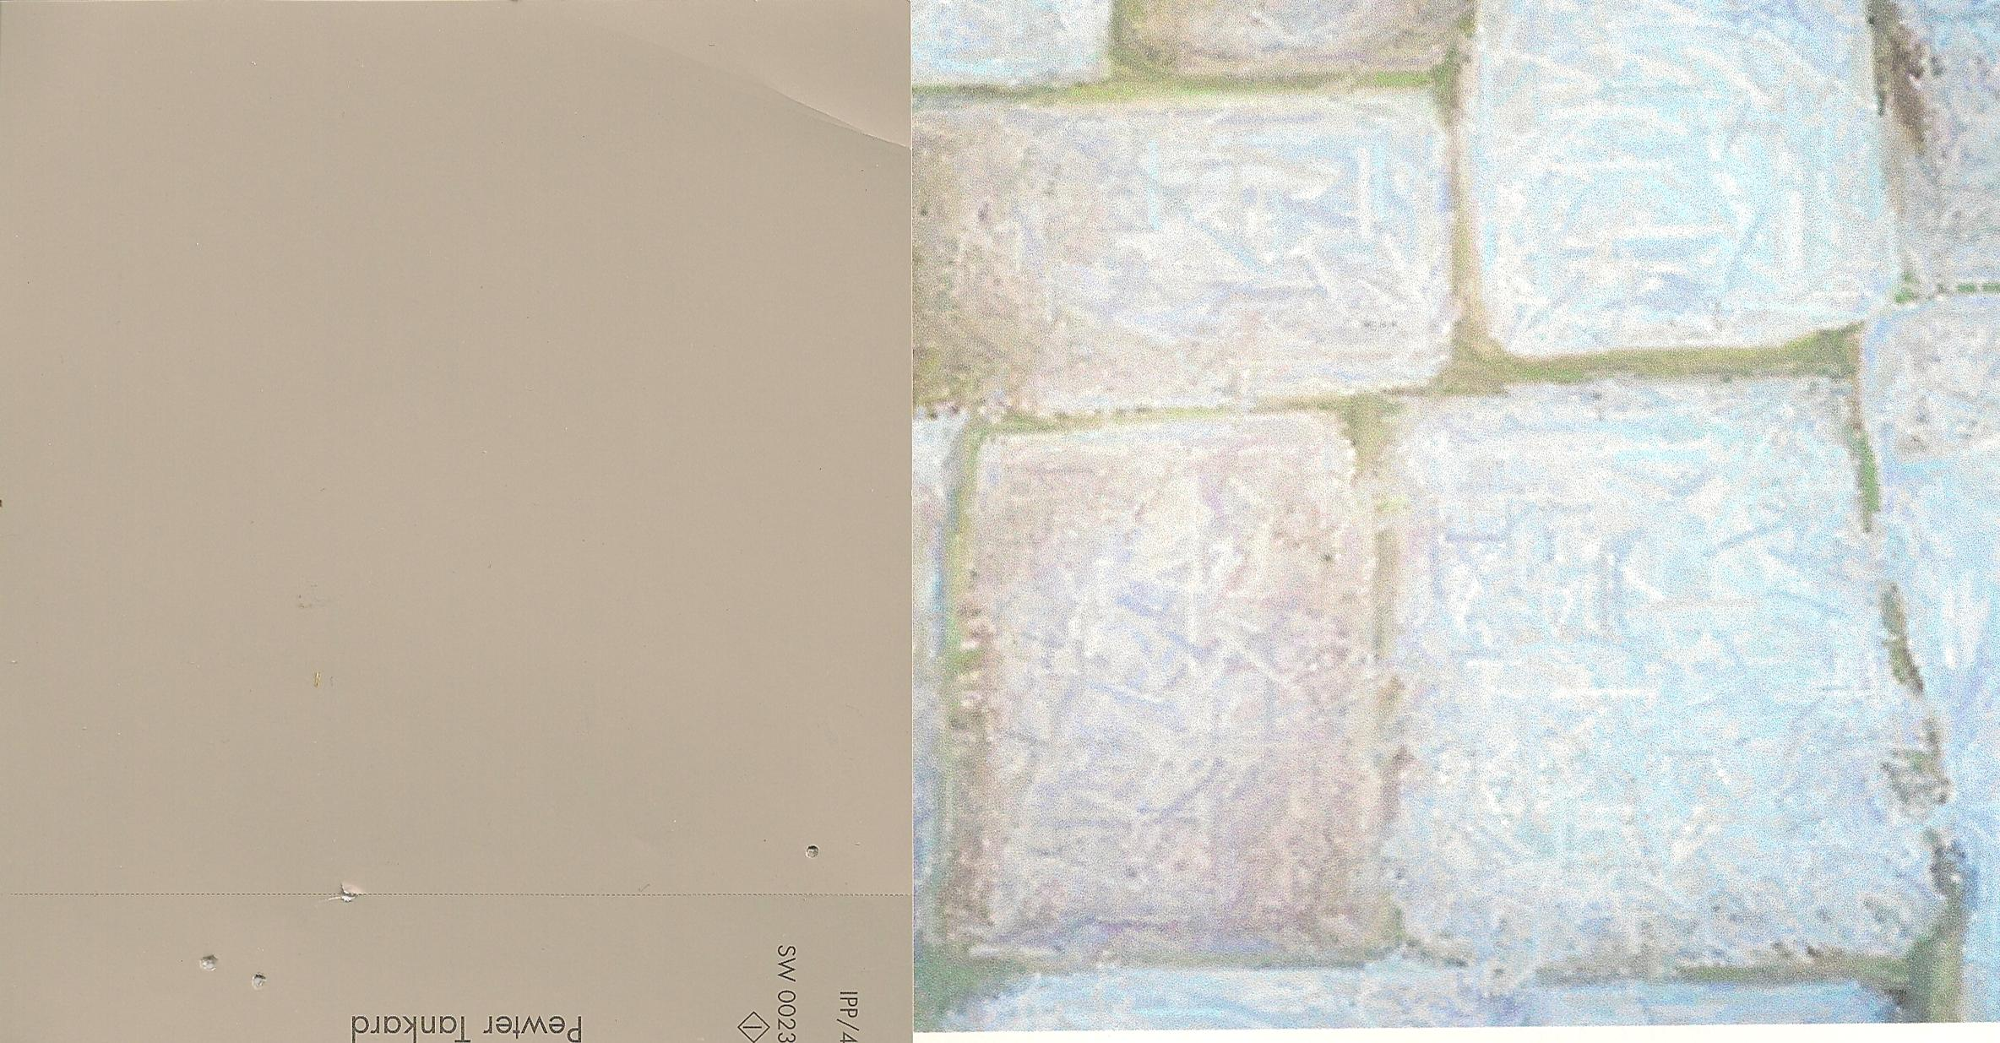
New Finishes
Trims & Soffits
Wall Color
Existing stone – White washed

Slide 9
3 Form acrylic 48"H knee wall to separate main dining area from lounge
Semi transparent 4x8 sheets

Slide 10
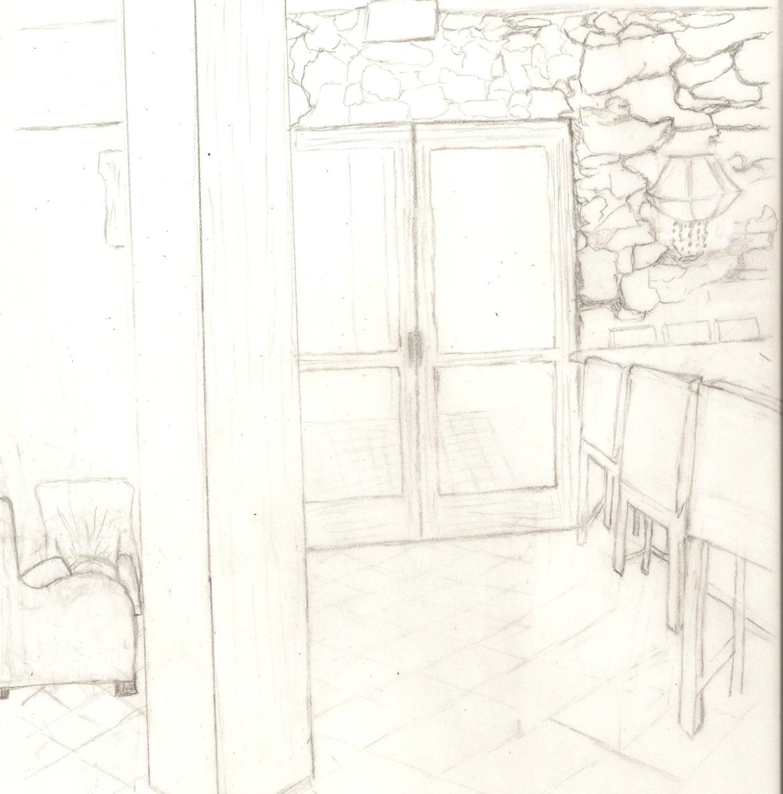
Crystal & Silk Wall Sconces
Enhance the space with soft organic texture & contrasting sparkle.
2- 60 watt bulbs
13W x 14H 6.5 D
ADA Compliant

Slide 11
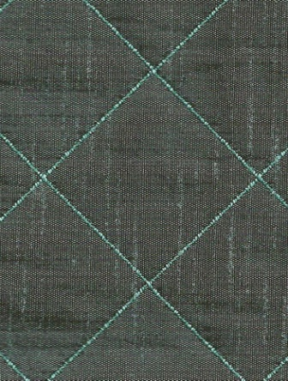
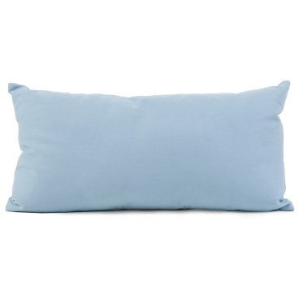
Cream commercial nagahide Lounge chairs
Kidney pillows
Wizenbeek method 50,000 Double Rub s

Slide 12
Obi Pedestal
Obi wood pedestals used as end tables in the lounge space tie in the organic features from the main dining area maintaining continuity throughout.
20 x 20 x 30
Un -finished Obi wood

Slide 13
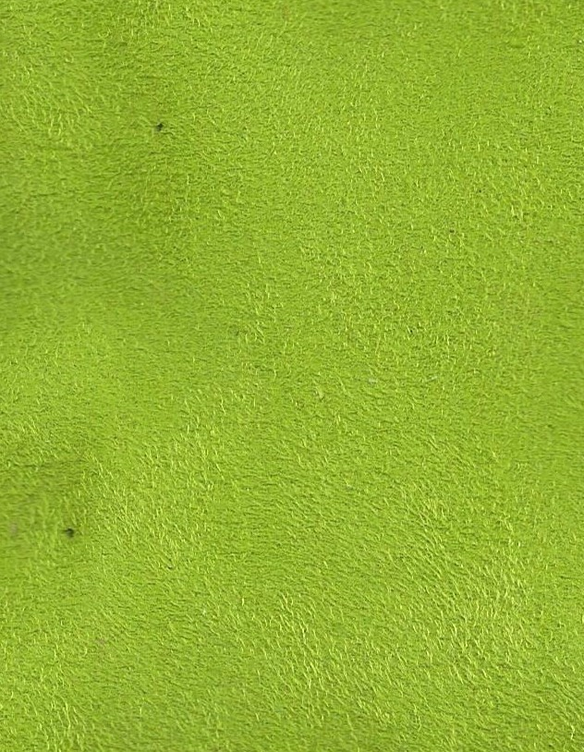
Here we add an upholstered seat to the exsisting barstools. This brings a pop of color to the creamy space adding drama.
Crypton Suede
100,000 Double Rubs
Wizenbeek Method

Slide 14
Next…. We add sophicated color themed chandeliers from the now taupe curved soffit's to enhance both the dining and lounge areas.

Slide 15
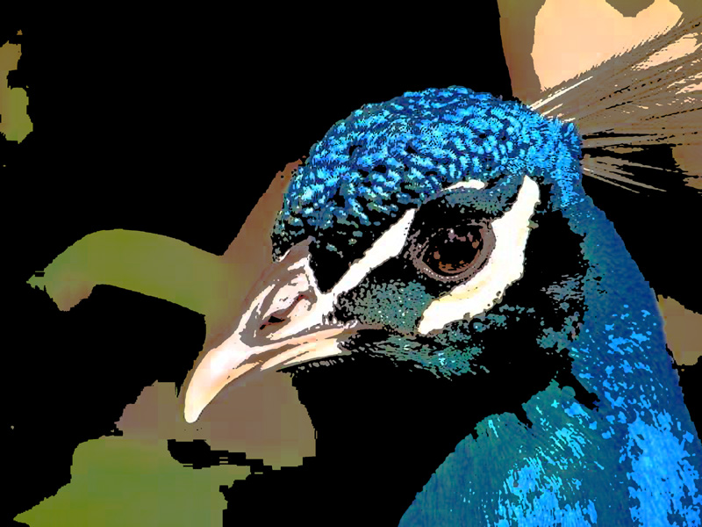
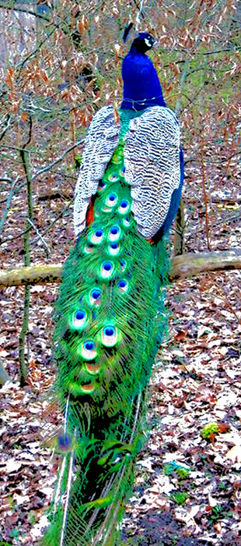
The themed artwork blends all the spaces, by mixing the old world in with a new contemporary flair .
Custom Giclees on canvas

Slide 16
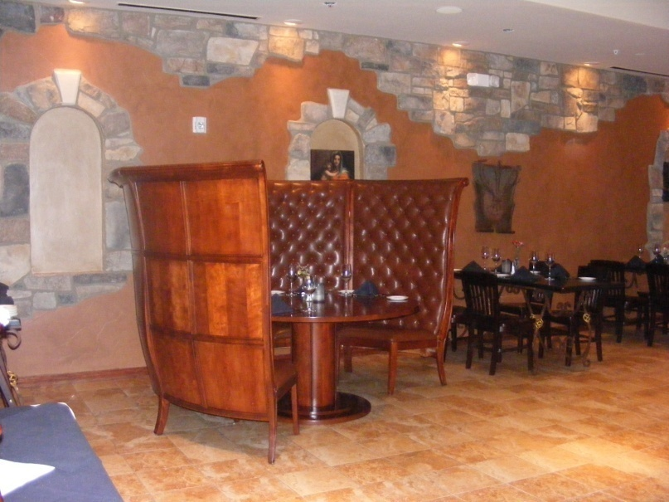
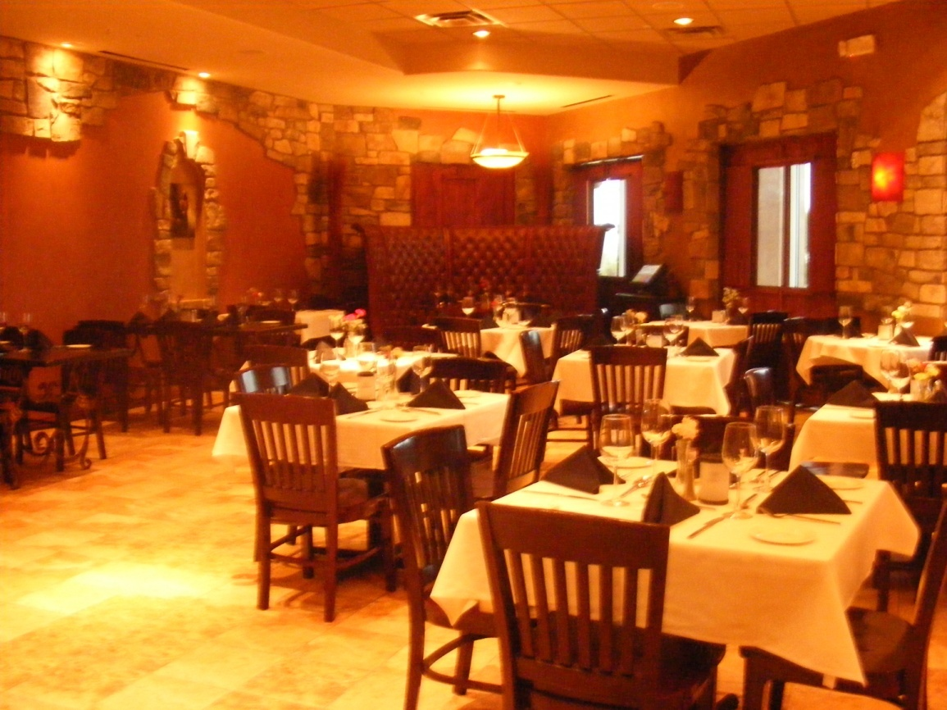
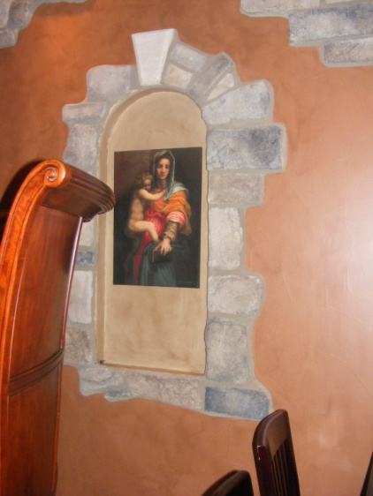
Currently……….
There is no continuity to this space, no theme , no ambiance. Awesome architectural features that need to be played up. Lighting is an issue as well as the different style , finish and scale of the furnishings.

Slide 17
The Dining Room……
The New Concept

Slide 18
Main Dining Colorization

Slide 19
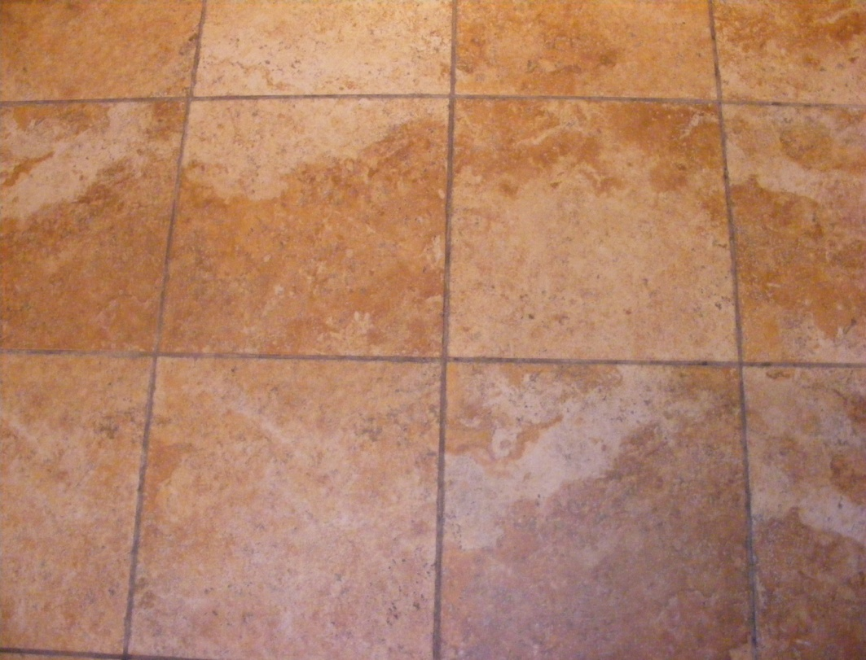
Main dining area finishes
Existing Floor
Trims & Soffits
Existing stone – White washed
Wall Color

Slide 20
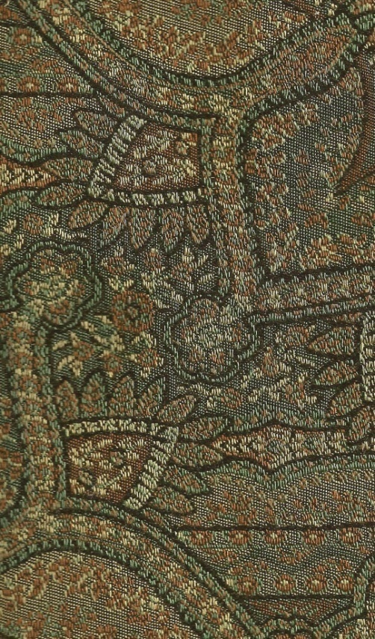
RE- Upolster existing booths
Inside back of booth fabric
All of the colors in the flooring , new paint finishes and furnishings can be found in this fabric creating the perfect tie for our environment.
The mix of patterns and textures on the fabric also help blend & creates another connection to our new updated Tuscan style.
Out side back of booth Fabric
Seat cushion fabric
All Fabrics meet or exceed Wizenbeek Method 50,000 Double Rubs

Slide 21
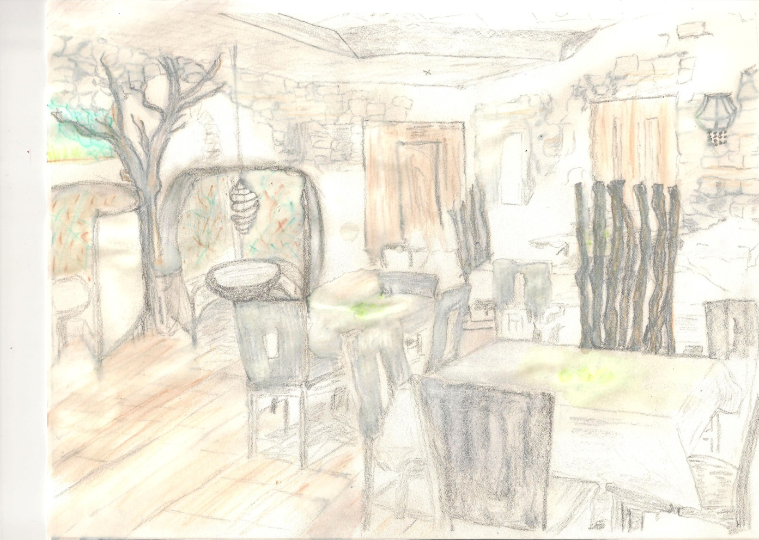
Crystal Helix Chandeliers
At 8” W x 12” H these chandelier pendants bring the perfect compliment to the now contemporarily upholstered booths . Contrasting with all the organics adding elegance to the entire space.

Slide 22
6' – 7' Coffee Trunks
Coffee trunks rescued from the burn pile of an old coffee plantation bring a whimsical organic feel to the space

Slide 23
Tides Jar for coffee trunks
22W x 46H
Ceramic primitive fired
These large Jars will be placed in the entry corridor niches as well as between booths to house trees.

Slide 24
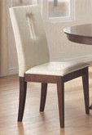
New Dining Seating
Cream nagahide
Wizenbeek 50,000
Double Rubs
In the main dining area we add new contemporary seating only, keeping the existing dining tables. This allows us the ability to continue with the change of our environment while still keeping the budget in mind.

Slide 25
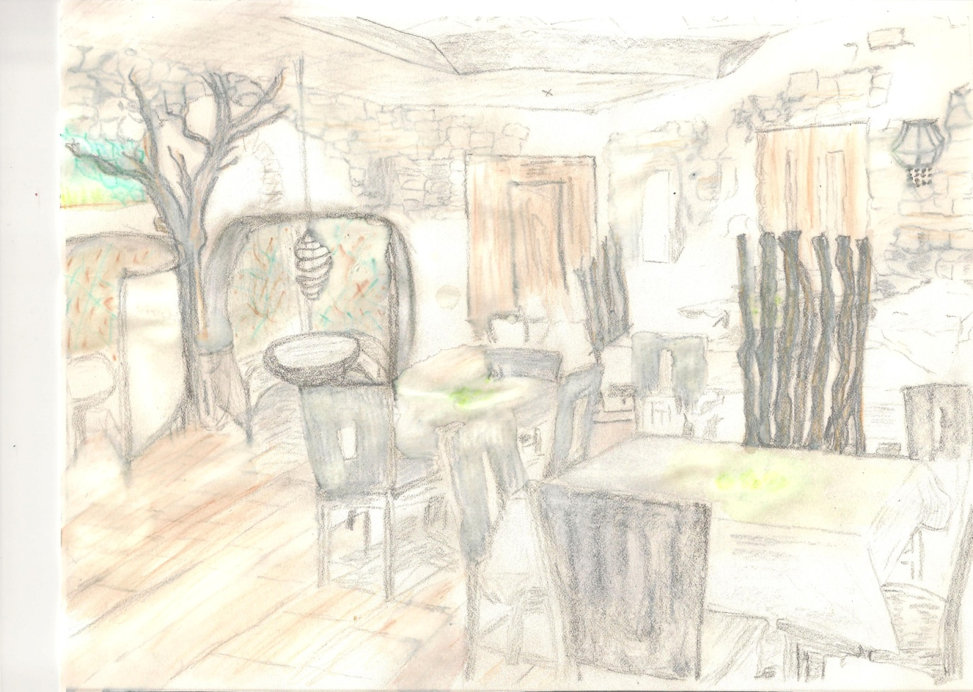
Root space divider
63H x 28W x 6” D these root dividers set about the space continue to bring in organics while giving diners a sense of privacy.

Slide 26
Crystal & Silk Wall Sconce
Continuing to enhance the space with soft organic texture & contrasting sparkle as well as adding a tie in to the helix chandeliers above each booth.

Slide 27
Interior Tabletop accessories

Slide 28
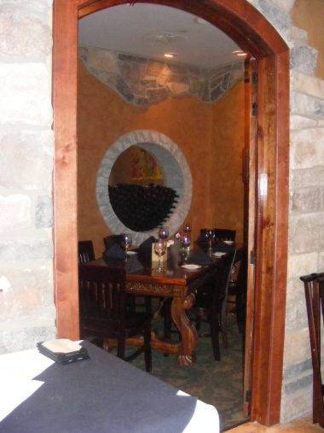
Private dining up & down stairs
Elegantly appointed,
organic / contemporary Seating,
Old world Charm and a crystal ball to bring it all together. The once dark over crowded room becomes a colorful and sophisticated space.

Slide 29
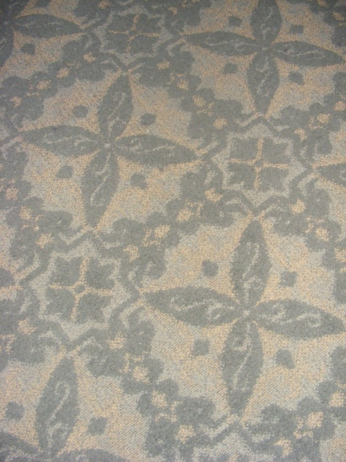
Private Dining Finishes
Ceiling color
Existing
Carpet
Wall Color
Existing stone – White washed

Slide 30
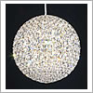
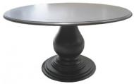
Private Dining - Furnishings
The Da Vinci
10”x 10” pendant chandelier
Bulbs – (6) halogen G9 Watt
Boiled peel- Teakwood
Natural black burn.
Solid Mahogany table,
Antique rubbed black finish

Slide 31
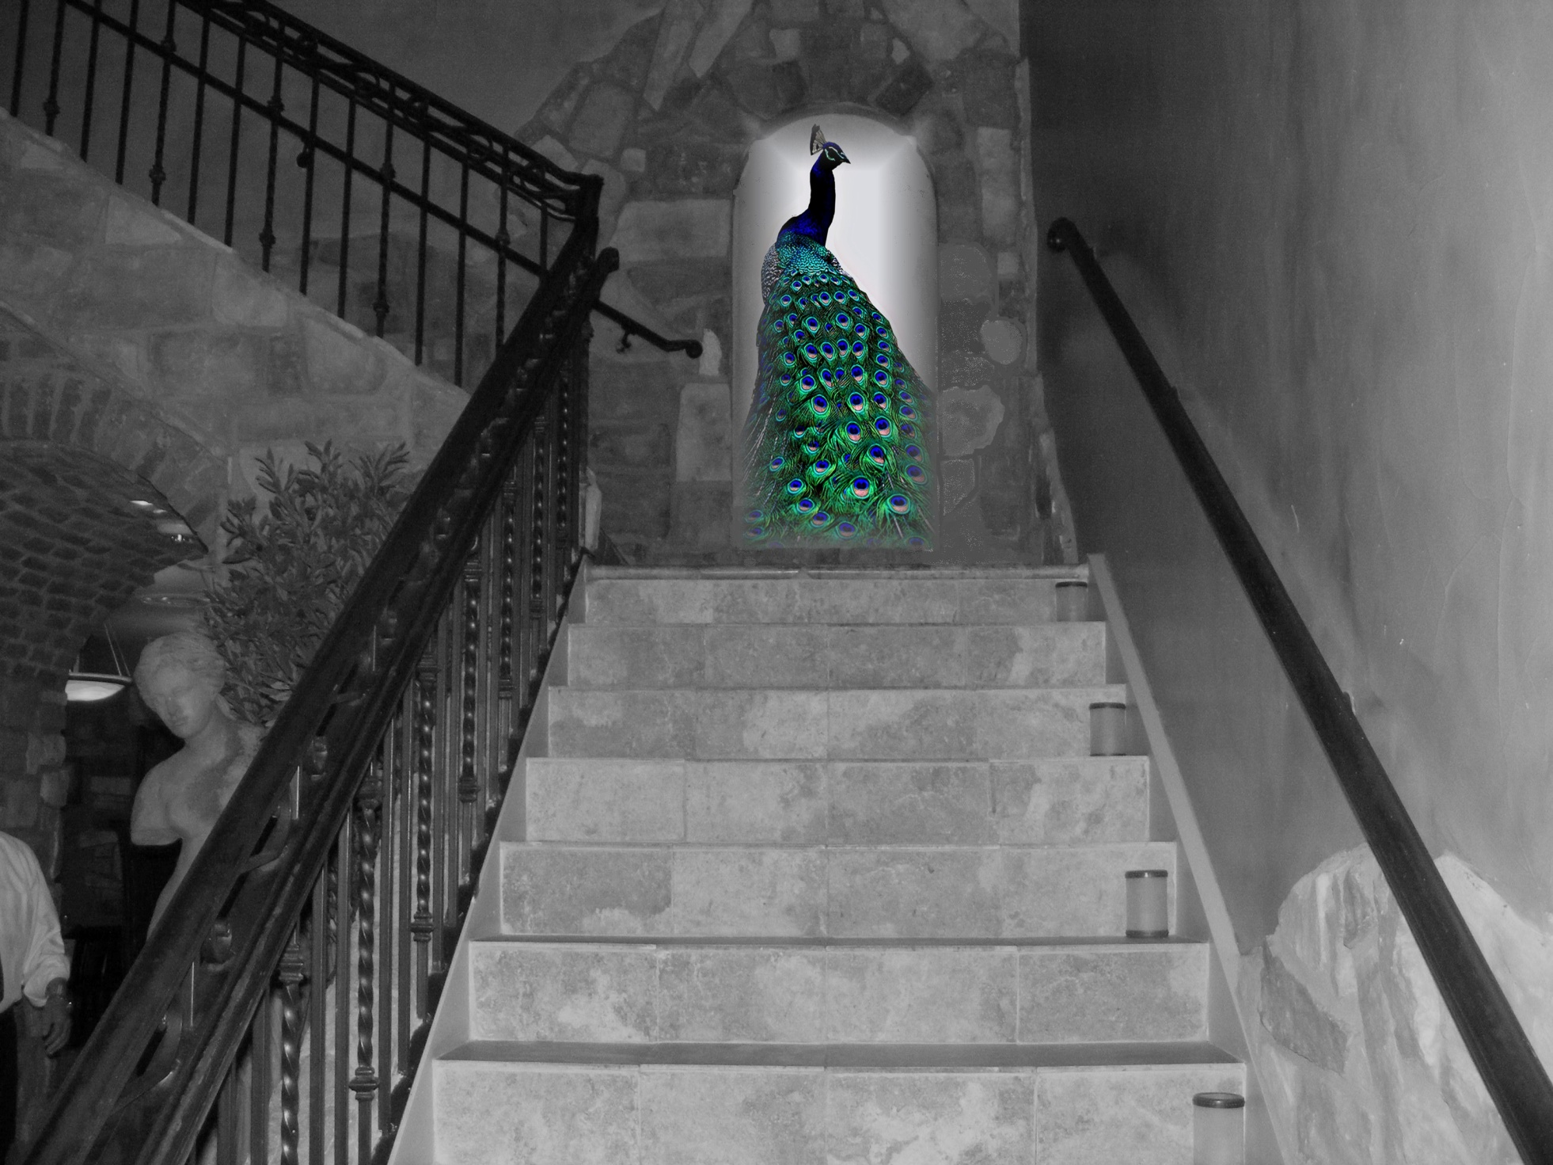
Going Up ?
Our theme continues and winds it’s way upstairs
to the colorful lounge and Sky bar ….

Slide 32
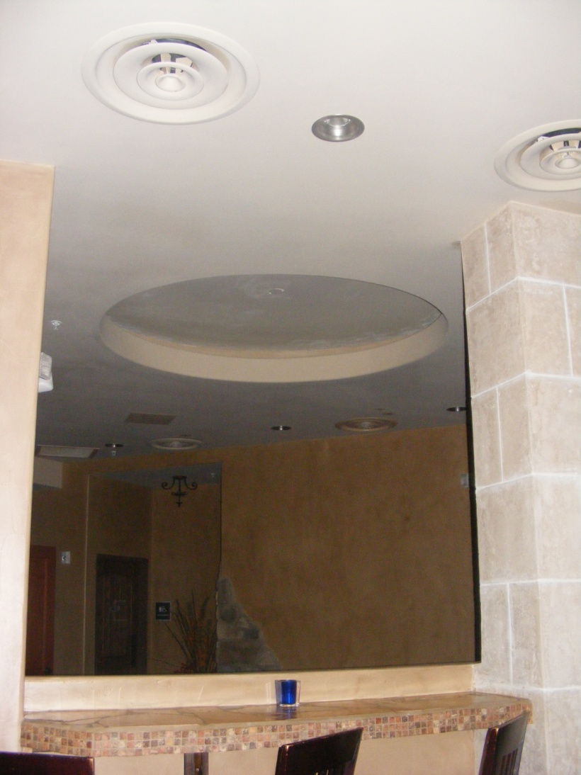
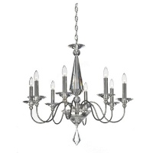
Staircase Chandelier

Slide 33
Up Stairs Sky Lounge & Wine Bar Space Plan

Slide 34
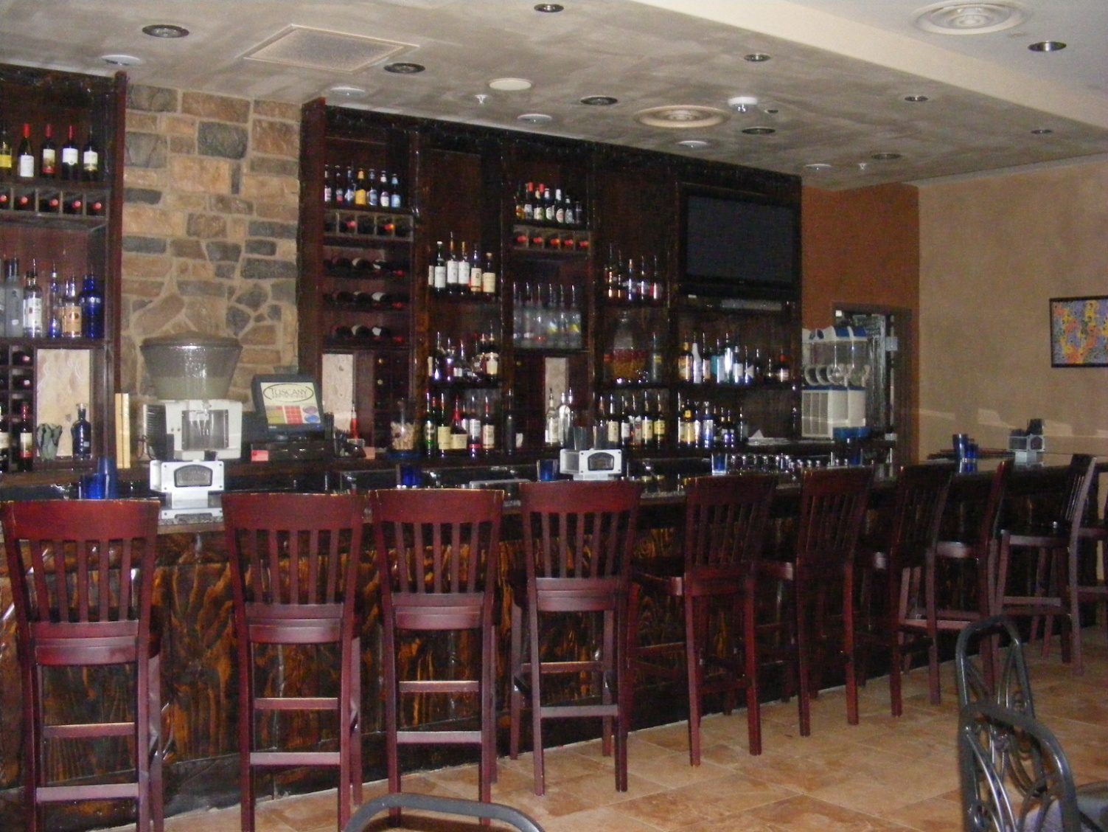
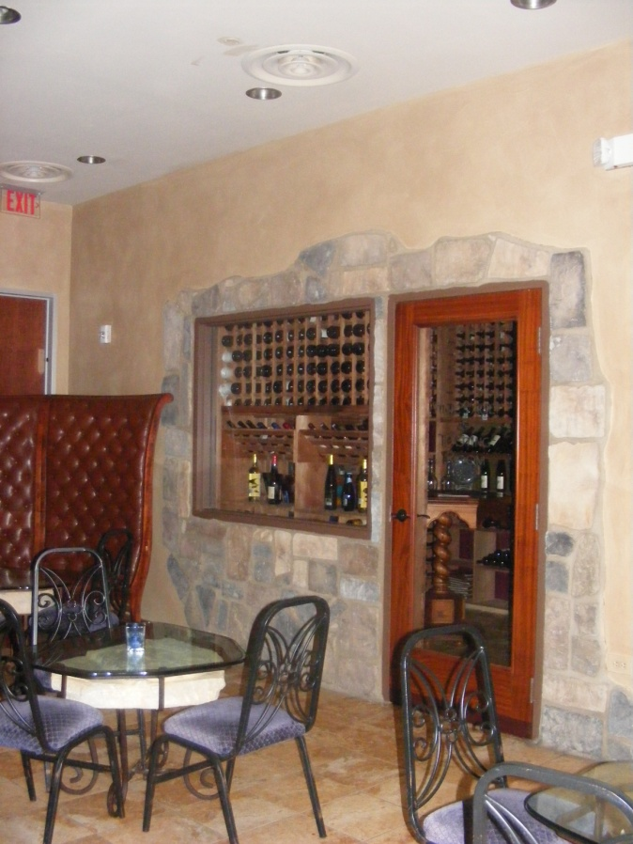
Currently………
This space has too many different stain finishes and too many different styles of furnishings with no continuity or tie to the other spaces.

Slide 35
Existing Floor
Upstairs Wine Lounge
finishes
Trims & Soffits
Existing stone – White washed
Wall Color

Slide 36
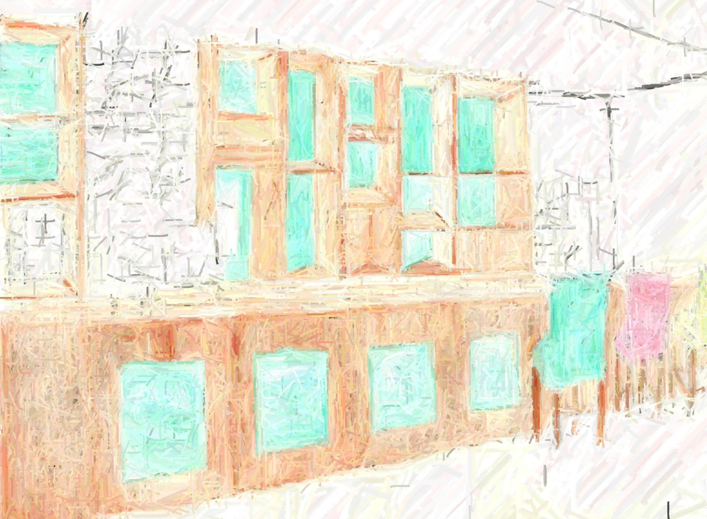
Upstairs Wine Lounge
Paint color
3-Form Acrylic panels
By adding paint color to the back wall of bar shelving and inserting
Back lit 3-form we update the space and add interest in keeping with our theme

Slide 38
Here again we add upholstered seats to the exsisting barstools and existing wood chairs in 3 crypton suede colors that all work to create atmosphere and blend the entire space.
Crypton Suede
100,000 Double Rubs
Wizenbeek Method

Slide 39
GeoMatrix crystal pendants
These 4.5”W x 5” H Matrix mini pendants , 2 of each in our three colors carry on the theme and bring a sense of contemporary refinement to our old world space.

Slide 40
The "blu Pavone "
This Custom Giclee tells the entire story of our space. Bright detailed elegant colors against old world organic textures all with a contemporary Flair.
Main Wine lounge Wall

Slide 41
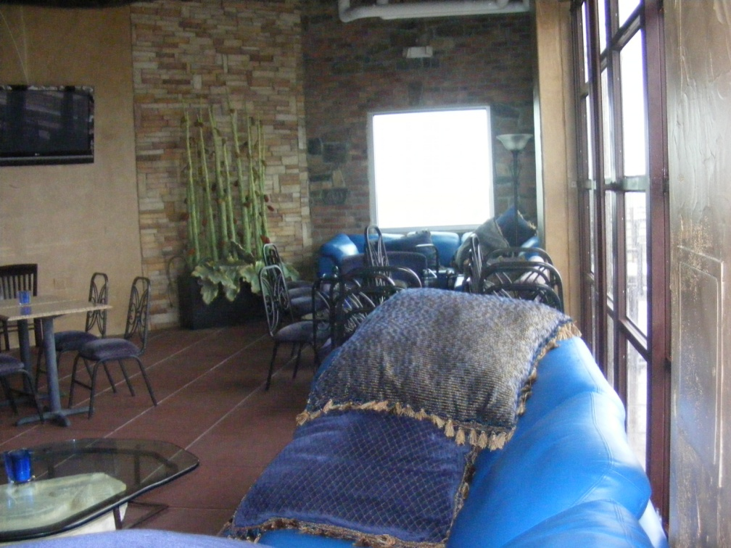
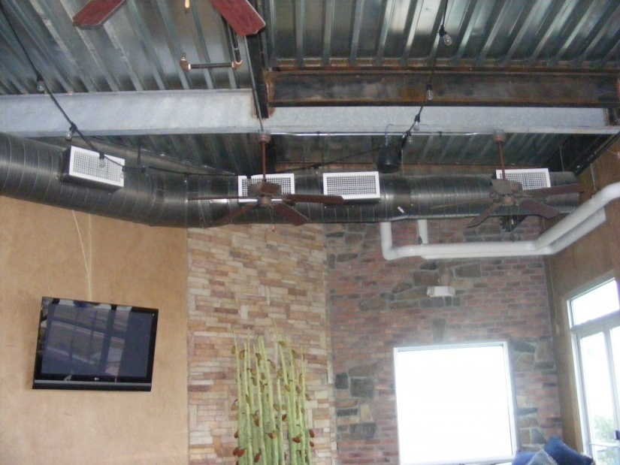
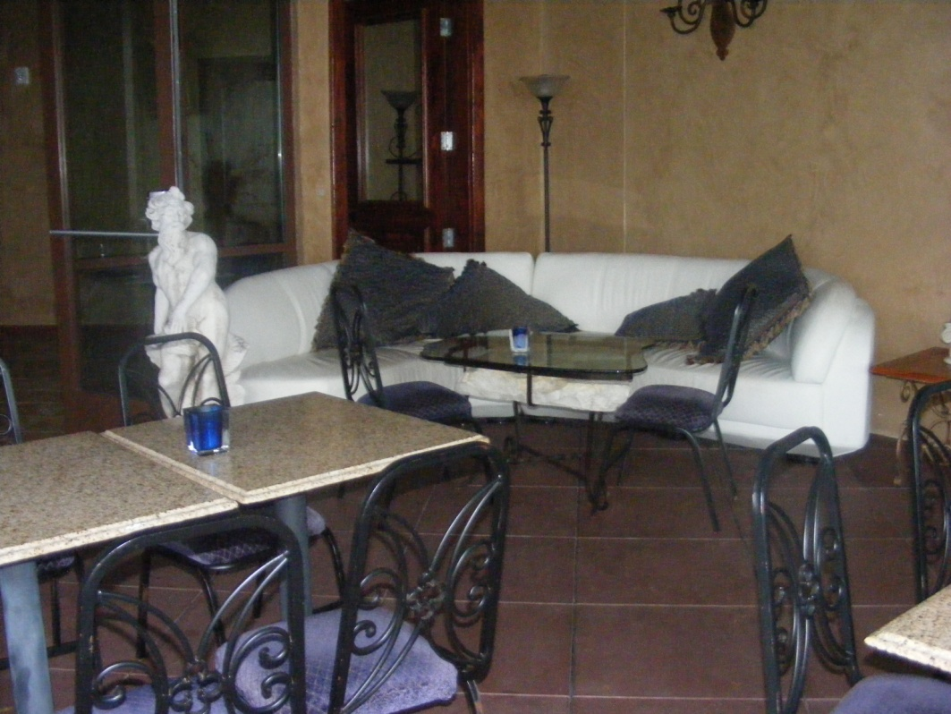
Currently……..
The different styles and scales of furnishings make this space look a little mixed up, unplanned and again no continuity or tie to the other spaces of the building be it interior or exterior.

Slide 42
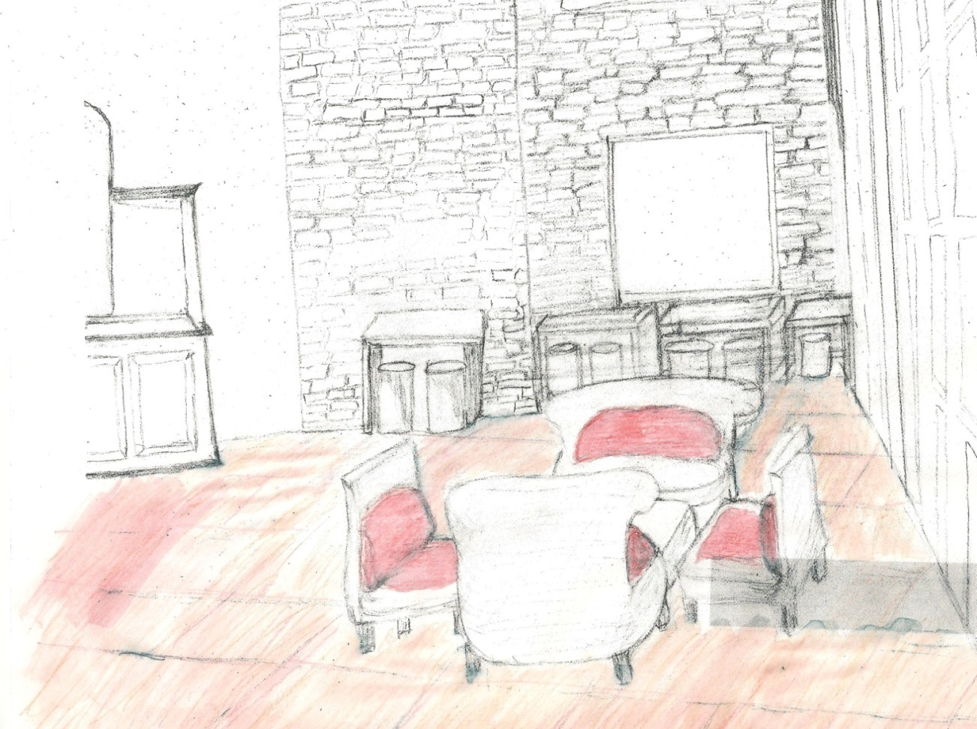
Sky bar Lounge Indoor/Outdoor Patio
Imagine a funky, hip environment that ties in with all the other spaces surrounding it, yet stands alone. Transitional seating that serves for both casual dining and conversation. Deep, saturated colors that bring both fun and elegance to the creamy , earthy space.

Slide 43
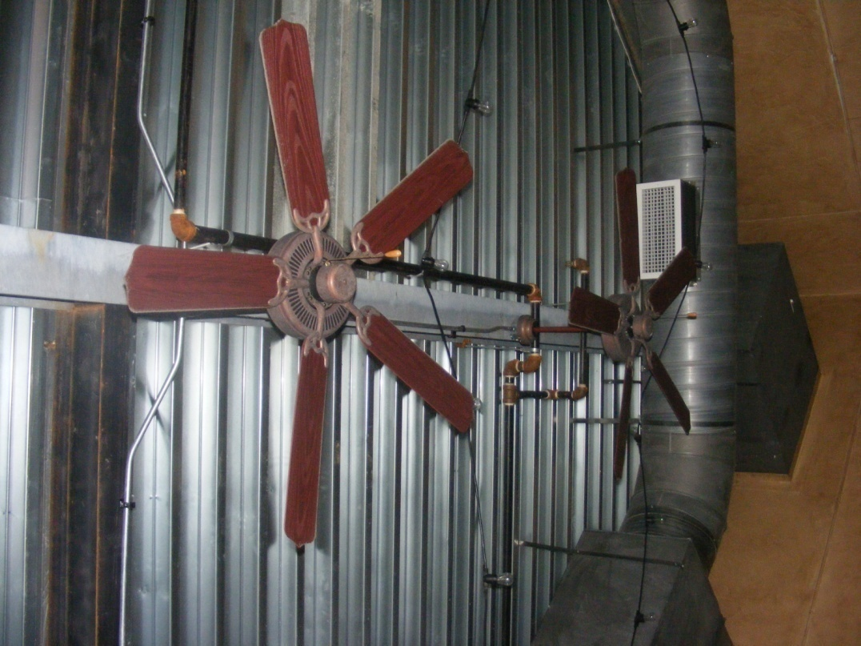
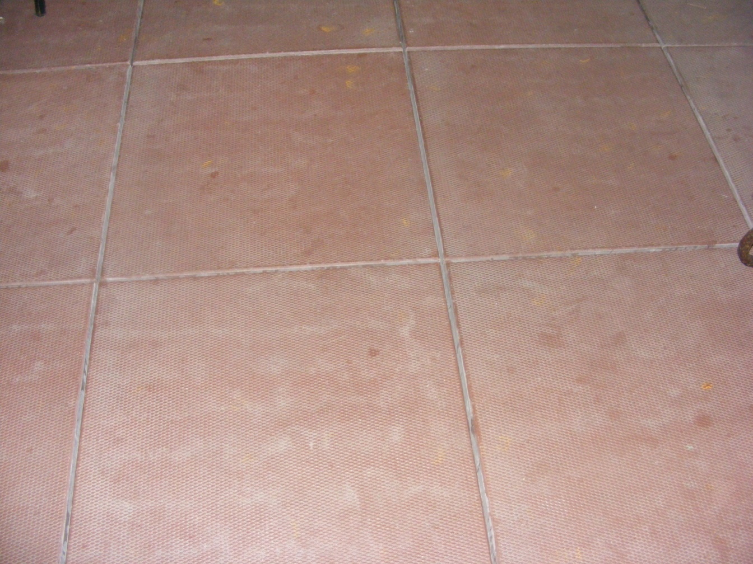
Sky bar Lounge Indoor/Outdoor Patio
Finishes
Trim Color
Wall Color
Existing Tile Floor

Slide 45
Rosalio Arm Chair
Natural white washed wicker with stainless feet and red indoor /outdoor fabric bring Italian Urbanity to the space, blending the patio finishes with the interior, yet creating a separate statement all of it’s own.

Slide 46
Luna Side Chair
Again, the natural white washed wicker with stainless feet and red indoor /outdoor fabric bring Italian Urbanity to the space, blending the patio finishes with the interior, yet creating a separate statement all of it’s own.

Slide 47
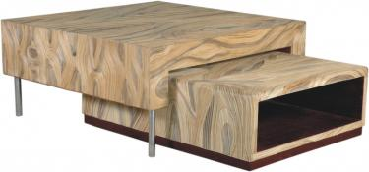
Ratu Coffee Table with slide out
Natural 2mm laminated wicker
39 x93 18H

Slide 48
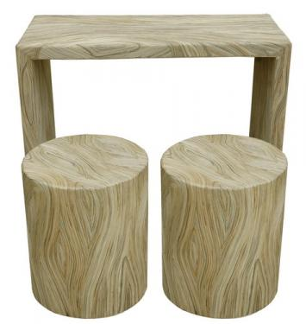
Ratu Console Bar Sets
Natural 2mm laminated wicker
36 x 16 x 30

Slide 49
Minoru Partition Lamp
39W x 71H x 8” D
Iron, Fiber, Natural Antiqued Doft

Slide 50
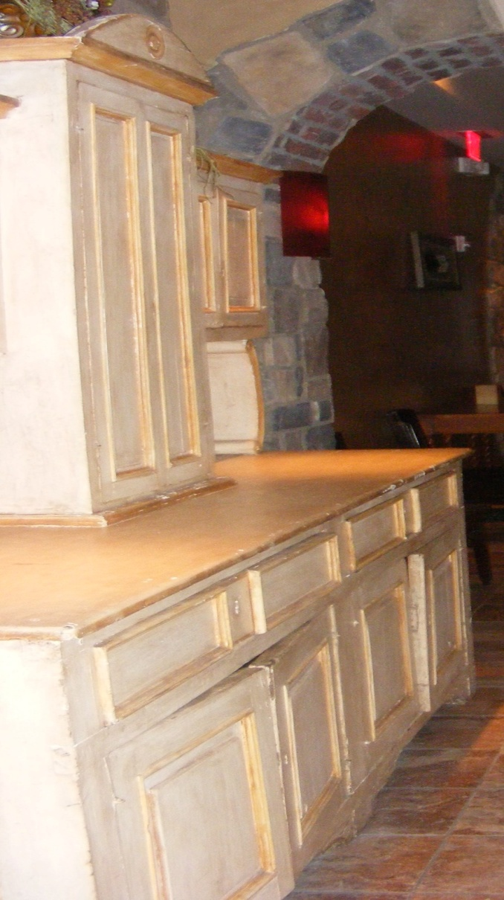
Refurbish existing cabinet to conceal TV

Slide 51
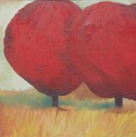
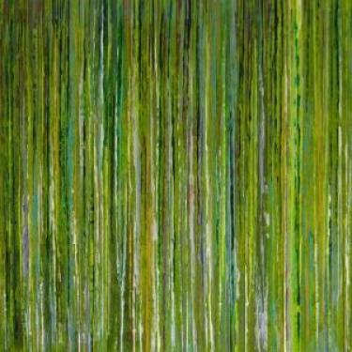
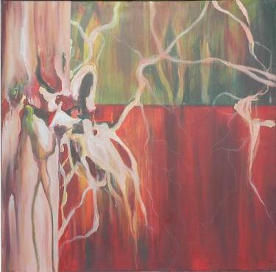
Acrylic on canvas
Indoor/outdoor artwork

Slide 52
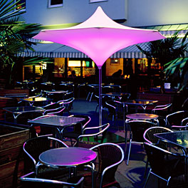
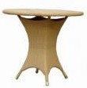
Exterior Patio Furnishings

Slide 53
Lighted Outdoor Umbrella
Light rotates through 3 different colors

Slide 54
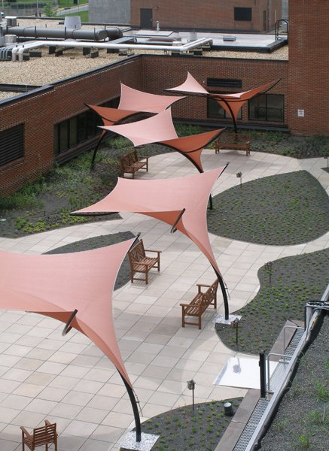
Alternate outdoor Sail structures

Slide 55
Icarus Chair
20 x24x 31
Polypeel wood grain
Exolux Super white

Slide 56
Marina Round Dining Table
35 x 35 x 30
Polypeel Anyaman Biasa
Antiqued Honey

Slide 57
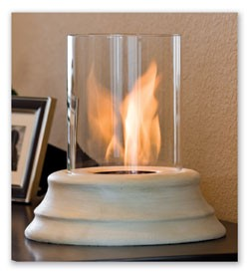
Tabletop Personal Fireplace
Bringing ambiance to our indoor / outdoor spaces this 10” diameter x 11.5” high tabletop centerpiece adds so much warmth and charm to our space.
Concrete base with hurricane glass chimney, burns low heat safe gel fuel.

