Slide 1
The President & Principal Partnership
An Open & Evolving Identification of Best Practices
February 13, 2019

Slide 2
Themes
Through collected feedback from principals the following drivers of best practice were identified:
Consistency
Frequent two-way communication
Joint collaboration on key interests and topics
Innovation—Alternate meeting structures to increase engagement
Appropriate representation of individual and collective interests

Slide 3
Actions
Successful partnership often involves these actions on the part of the principal & the school staff:
Principal and PTA President establish and commit to a standing monthly meeting
Staff liaison to PTA is identified
Existing school communication methods to promote PTA events (i.e. Connect Ed, school newsletter, etc.) is utilized
PTA president or his/her designee is welcomed, along with other parent leaders, as a member of the Instructional Leadership Team
Principal attends and encourages staff to attend as many PTA events as possible
Principal publicly thanks the PTA for their efforts whenever possible.
Principal openly welcomes parent volunteers in the classroom, lunch, recess, and after-school events

Slide 4
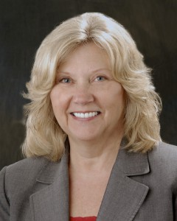
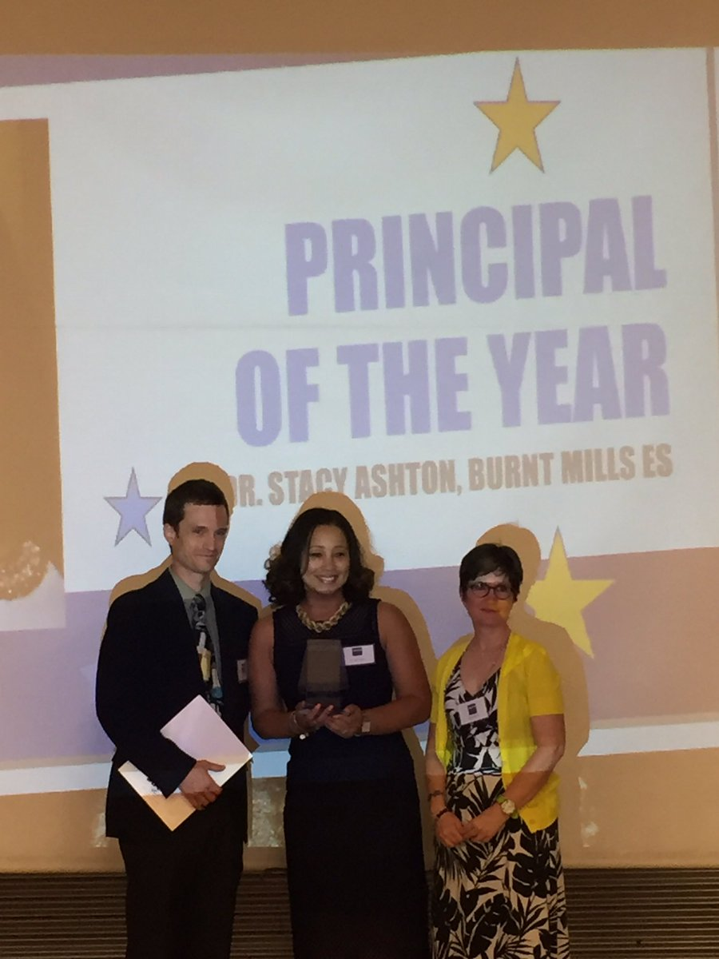
impact
When school and Parent leaders come together . . . Children Thrive!

