Slide 1
Microsoft EES Overview NC Community Colleges October 23, 2012 Presented by: Kelly Spencer, Account Manager Jessika Graham, Licensing Specialist

Slide 2
NC Community Colleges Agenda
♦Academic Volume Licensing @ a Glance
♦What is the Enrollment for Education Solutions (EES)
♦Overview of the Volume Licensing Service Center
♦Resources
♦Q&A
♦Appendix

Slide 3
Academic Volume Licensing – At a Glance
Enrollment for Education Solutions (including OVS-ES)
School Enrollment
Select Plus for Academic
Open License for Academic
Count employees (FTE)
Institution-wide commitment for desktop platform products
Add additional products in any quantity as needed
12 or 36 month subscription term
Software Assurance included
5 FTE minimum
Student Option with free ESD*
Tiered pricing levels for platform products
Primary/secondary and higher education institutions
2 ways to buy depending on size of the organization
Subscription licenses
Count PCs
Institution-wide commitment
Software Assurance included
12 or 36 month subscription term
300 unit minimum order (mins vary by region)
Student Option with free ESD*
2 pricing levels for platform products
Primary and secondary schools only
Online Services
Enrollment under the Campus and School Agreement
Subscription licenses
Count PCs
No institution-wide commitment
Software Assurance optional
500 points minimum order per pool
Perpetual licenses
No student option available
One price level
5-license minimum order
No institution-wide commitment
Software Assurance optional
2-year agreement term
Perpetual licenses
No student option available
One price level
* Student Option provides free Electronic Software Download (ESD) for student software.

Slide 4
Enrollment for Education Solutions (EES)

Slide 5
Who is EES for?
The Enrollment For Education Solutions offer is available to all qualifying academic organizations including Educational Institutions, Administrative Offices, and Boards of Education.
(The Qualified Educational User Definition varies by region.)
Defining the organization:
An “organization” may be defined across the spectrum, from the entire institution to a school district to a specific school site or department, and in cases where such definitions are not possible, an “organization” could simply be a logical group within the institution.

Slide 6
EES Benefits
Easy Compliance
Customized Solutions
Simplified Asset Management
Count your employees once per year and you’re fully covered for all on-premises platform products licensed .
Add additional products, either institution-wide, departmental-wide, or for individual devices at any time
Easily track and manage your software assets with self-service online tools such as Microsoft Volume Licensing Service Center (VLSC)
Low Administration
Lower Total Cost of Ownership (TCO)
Cloud on Your Terms
Subscription licensing eliminates the need to track your licenses for the selected desktop platform products on every PC
Maximize the value of your investment with access to current technology, Work at Home (WAH) rights, student licensing, evaluation rights, Software Assurance, and more
Free* access to Office 365 Plan 2, plus the ability to subscribe to additional Microsoft Online Services through your EES
*No license fee; doesn’t include deployment or support costs associated with the service.

Slide 7
Additional Benefits Included With EES
STRETCH YOUR BUDGET WITH VALUABLE BENEFITS
Cloud Services
Work at Home Rights
Home Use Program
Free* access to Office 365 Plan 2
* No license fee; doesn’t include deployment or support costs associated with the service.
Permit your faculty and staff to use application, system, and CAL products on a personally owned computer for work-related purposes.
Discounted software for educators’ home use.
Electronic delivery (eHUP) eliminates need for WAH administration, reduces deployment cost & import duties, and is a “green” alternative.
DreamSpark
Windows VDA
Roaming Use Rights
eLearning
Access to Microsoft developer tools, platforms, and servers in labs, classrooms and on student computers for research and instructional purposes.
Windows Virtual Desktop Access (VDA) with your Windows upgrade license allows access to software in VDI environments and to remotely access virtual desktops from third-party devices such as home PCs.
Allow your users to remotely access software on their virtual desktops from third-party devices such as home PCs and internet kiosks.
Roaming rights + VDA reduce the need for WAH deployment.
Self-paced trainings help you faculty, staff, and students learn to use the latest software and improve productivity and classroom learning while reducing your support costs.

Slide 8
EES Includes Software Assurance
Software Assurance Benefits
New Products | New Product Versions
 | Windows 7 Enterprise
Deployment | Home Use Program (HUP)
Training | E-Learning
Support | Extended Hotfix Support
Specialized | Cold Backups for Disaster Recovery
 | Windows Thin PC
 | Spread Payments
“Our Microsoft volume licensing agreement is a key component of our strategy to provide consolidated, low cost, high value services to the faculty, staff, and students…. It simplifies administration, lowers costs, and improves security and compliance.”
Mike Conlon, Ph.D, Associate CIO, IT Architecture, University of Florida
Note: Software Assurance benefits are subject to change. Please refer to the Microsoft Volume Licensing Product List at http://www.microsoft.com/licensing/userights/ to verify current benefits.

Slide 9
Home Use Program vs Work at Home Program
Available for Office Product Only
Entitled to one purchase for the lifecycle of the product
Not entitled to both Mac 2011 and Office 2011, only one
Activated via the VLSC website
No use restrictions
License is temporary
Available for a multitude of products
Entitled to run one copy of licensed product on home PC
Only entitled to same product the Institution is licensed to run
Institution only entitled to one benefit, HUP or WAH
Media purchased thru reseller
Restricted for work related purposes only
License is temporary

Slide 10
Microsoft IT Academy Program
The Microsoft IT Academy Program provides learning solutions for educators, students and staff including Official Microsoft E-Learning courses (Information Worker, IT Professional, Developer), academic exam pricing discounts, and marketing resources.
Save Educators’ Time with Curriculum
Keep Current with Professional
Development
Validate Skills with Certification
Access Partnership Resources
E-Learning
MOAC
MOC
Office Lesson Plans
Digital Literacy
E-Reference Library
Microsoft Certified Trainer Program
E-Learning Access
Academic Pricing
Second Shot Campaign
Testing Center Discounts
Marketing resources
Private Member Site
Locator Tool
Program Logo
Welcome Kit
IT Academy Public Site: http://www.microsoft.com/education/msitacademy/default.mspx
Microsoft Confidential – For Partner Use Only

Slide 11
The Student Option
The EES Student Option provides a convenient and cost-effective way you to license selected products for use by your students on a personally owned computer or an institution-owned computer designated for the student’s exclusive use.
Choose the Student Option to:
License students to use software on their home/personal computer or an institution-owned computer checked out to them
Standardize software for students
Provide smarter tools for learning
Requirements:
License 100% of students in your organization for at least one Desktop Platform Product based on FTE student count*
Students in the Cloud
Give students the power of the cloud with the free Plan A2
Free Electronic Delivery
Eliminate the cost of delivering physical media, remove the burden of inventory management & program administration.
Full-time students
Part-time students ÷ 3
Total FTE students
*Office Professional Plus Subscription is also a DPP, however, unlike other DDPs which are licensed based on the FTE students, it requires a User Subscription License (USL) for each individual student organization-wide.

Slide 12
Education Server Platform Licensing Option
License org-wide for all FTE employees and students
And license this server platform
Deploy UNLIMITED instances of these server products*
SQL Server CAL
+
SQL Server Platform Academic
=
Microsoft SQL Server (all editions)
Microsoft BizTalk Server (all editions)
=
Exchange Server External Connector
SharePoint Server for Internet Sites Standard
Lync Server Standard External Connector
Windows HPC Server
Core CAL Suite
+
Core Server Platform Academic
Windows Server (all editions)
Microsoft SharePoint Server (all editions)
Microsoft Exchange Server (all editions)
Microsoft Lync Server (all editions)
Windows Sever External Connector
Enterprise CAL Suite
+
Enterprise Server Platform Academic
=
Microsoft System Center 2012 Datacenter
Forefront Unified Application Gateway (UAG) Server
Forefront Threat Management Gateway 2010 Standard and Enterprise Server
FAST Search for SharePoint
Windows RMS External Connector
SharePoint Server for Internet Sites Enterprise
Lync Server Enterprise External Connector
Forefront UAG External Connector (EC)
Forefront Protection Suite EC Add-Ons
*This product list is subject to change as CAL products are updated or as new server versions are introduced. This option requires licensing a minimum of 1,000 faculty FTE and 1,000 student FTE. Server Platform Products licensed under this licensing option may only be used by licensed faculty, staff and students and by licensed external users using the Server Platform Products for the benefit of the institution.

Slide 13
CASA/EES/OVS-ES Comparison
Feature Area | CAMPUS/School ENROLLMENT | EES/OVS-ES
Minimums | 300 Units (regional variances exist) | EES : 1000 FTE Minimum OVS-ES: 5 FTE Minimum Schools Enrollment: 300 Units (with regional variances)
Counting Mechanism | Campus Enrollment: Count Faculty/Staff FTE School Enrollment: Count Devices | EES: Count Faculty/Staff FTE OVS-ES: Count Faculty/Staff FTE School Enrollment: Count Devices
Term | 1 and 3 year enrollment terms | 1 and 3 year term
Channel Model | EMEA: Campus via LARs, Schools via Distis RoW: Campus & School via mixed Disti / VAR (AER) / LAR Channel | EES via LAR channel only (one tier) OVS-ES via Disti-VAR channel only (two tier) Schools Enrollment (no change)
Platform Products | Windows OS Upgrade, Office Pro Plus 2010, Core CAL & ECAL Suite. | Windows OS Upgrade, Office Pro Plus 2010, Core CAL & ECAL Suite, Office 365 A3, Office 365 A4
Additional Products | Institution-wide commitment for both campus and schools | EES/OVS-ES allows institutions to license institution-wide, department-wide or for individual license
Pricing Levels | Enterprise Products: Level A, Level B (Campus A: Less than 3000, B: 3000 or above Schools A: Less than 2500, B: 2500 or above) | EES: Levels A, B, C & D (A: 1000-2999, B: 3000-9999, C: 0000-24999, D: 25,000 & above) OVS-ES: Levels E and F only (E: 5-999 , F: 1000 and above)
Work At Home Rights | Organization wide offer limited Work at Home (WAH) rights to their faculty and staff members only with no additional license charge | Organization wide offer limited Work at Home (WAH) rights to their faculty and staff members only with no additional license charge
True Downs | No true downs; license count in years 2 and 3 cannot fall below count in year 1 | EES/OVS-ES: No true downs; license count in years 2 and 3 cannot fall below count in year 1
Student Licensing | Student Option | EES/OSV-ES: Student Option, ESD option available

Slide 14
Volume License Service Center (VLSC)

Slide 15
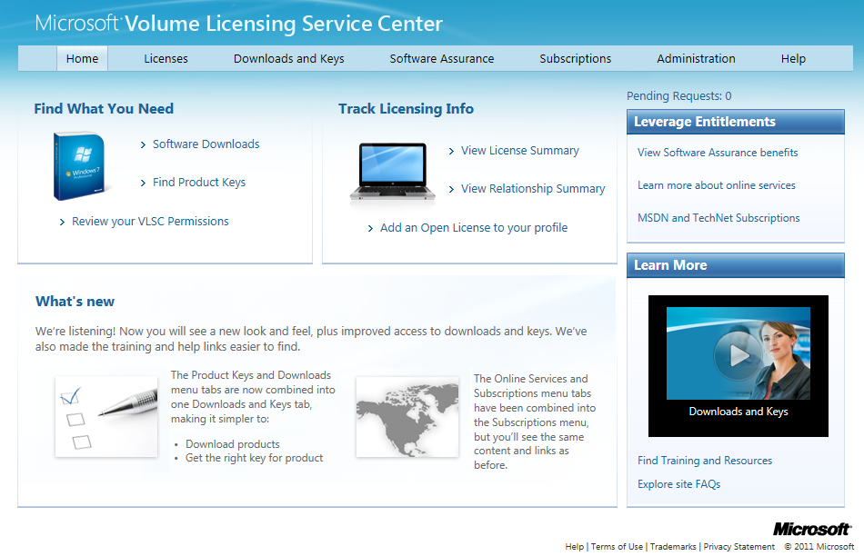
Volume Licensing Service Center
The single location for Microsoft Volume Licensing customers to view Licensing information, download Microsoft software , manage Volume Licensing benefits and subscriptions
https://www.microsoft.com/licensing/servicecenter

Slide 16
Volume Licensing Service Center Features
A convenient online resource for users to manage their Volume Licensing agreements and products.
Intuitive User Interface
Product names and descriptions are simple so that you can easily find the right product.
Microsoft License Statement
View your consolidated agreements, license transactions, and calculated license entitlements (by product and version) across all Microsoft Volume Licensing programs.
License Reporting Dashboard
Easy-to-navigate dashboard gives you a cross-organization view of agreement and purchases down to the order level, plus access to an electronic proof of license.

Slide 17
Volume Licensing Service Center Features
A convenient online resource for users to manage their Volume Licensing agreements and products.
Improved Product Download Experience
Access licensed product downloads quickly for Open License, Open Value, Open Value Subscription, Select License, Select Plus, Enterprise Agreement (EA), Enterprise Subscription Agreement, Online Subscription, and Campus and School Agreement, Academic, charity, and government programs are included where available—with download options for language, platform, and file format.
Access to Product Activation Keys
View Volume License Keys for eligible Volume License software products, including pre-assigned KMS and MAK product keys.
Software Assurance Benefit Summary
View aggregated Software Assurance benefits based on Software Assurance eligibility profile.

Slide 18
Volume Licensing Service Center Features (cont’d)
A convenient online resource for users to manage their Volume Licensing agreements and products.
What’s New Notification Center
New features and services relevant to VLSC and Microsoft Volume Licensing are highlighted to improve using and managing Volume Licensing agreements.
Secure Access
VLSC is available to registered users only. First time users need a Windows Live™ ID and a business email address, thereafter only a Windows Live ID.
Localized User Interface
Localized user interface is provided in twenty-four (24) languages.
Application Support
Phone and e-mail support is available through Microsoft Customer Service call centers worldwide.

Slide 19
Menu Options by User Role
This table shows the menu options available by user role:
Role | Licenses | Software | Software Assurance | Services | Subscriptions | Settings | Help
Administrator | a | a | a | a | a | a | a
Download | - | a | - | - | - | a | a
Product Key | - | a | - | - | - | a | a
Licensing Info | a | - | a | a | a | a | a
Software Assurance Manager + Software Benefits sub-role | a | a | a | - | - | a | a
Software Assurance Manager | a | - | a | - | - | a | a
Subscriptions Manager | a | - | a | - | a | a | a
Online Services Manager | a | - | - | a |  | a | a
Registered User, no role | - | - | - | a | a | a | a
Notes:
Chart shows which roles have access to what information on VLSC.

Slide 20
Resources

Slide 21
Resources
Product List – published monthly
http://www.microsoft.com/licensing/about-licensing/product-licensing.aspx#tab=2
Product Use Rights – published quarterly
http://www.microsoft.com/licensing/about-licensing/product-licensing.aspx#tab=1
Volume Licensing Briefs
http://www.microsoft.com/licensing/about-licensing/volume-licensing-briefs.aspx
Education customer website
http://www.microsoft.com/education/en-us/buy/Pages/index.aspx
Volume Licensing Service Center Site
https://www.microsoft.com/licensing/servicecenter/default.aspx
Software Assurance Benefits
http://www.microsoft.com/licensing/software-assurance/default.aspx
Home Use Program
http://www.microsoft.com/licensing/software-assurance/home-use-program.aspx

Slide 22
Resources (cont’d)
Volume Activation Planning Guide
http://technet.microsoft.com/en-us/library/dd878528.aspx
Microsoft Activation Center
http://www.microsoft.com/licensing/resources/vol/numbers.mspx
Windows Deployment Resources and Videos
http://www.technet.com/volumeactivation
Office Deployment Resources
http://activateoffice.com/
Office 2010 Volume Activation Planning Site
http://technet.microsoft.com/library/ee624358(office.14).aspx#section2

Slide 23
Q & A

Slide 24
© 2012 Microsoft Corporation. All rights reserved. Microsoft, Windows and other product names are or may be registered trademarks and/or trademarks in the U.S. and/or other countries. The information herein is for informational purposes only and represents the current view of Microsoft Corporation as of the date of this presentation. Because Microsoft must respond to changing market conditions, it should not be interpreted to be a commitment on the part of Microsoft, and Microsoft cannot guarantee the accuracy of any information provided after the date of this presentation. Partners should refer to their agreements for a full understanding of their rights and obligations under Microsoft’s Volume Licensing programs. MICROSOFT MAKES NO WARRANTIES, EXPRESS, IMPLIED OR STATUTORY, AS TO THE INFORMATION IN THIS PRESENTATION.

