Slide 1
OCEANSIDE TECHNICAL SALES INC.
2023
Factory Direct
Manufacturer Rep Firm
Latin America
North /South Carolina
Georgia, Florida, S.E. USA
Always work hard to serve all our customer product needs.
Since 2001
www.Oceansidetech.com

Slide 2
  Oceanside Technical Sales Inc. represent manufactures worldwide for our factory design/sales/ services .
AD Metro- Capacitive, Projective Capacitive, Armored Resistive, S.A.W. Custom Touch Screen factory builds.
Luminary Optics- High Bright Industrial TFT/LCD displays and filters plus optical Bonding
Tech Print- Custom Printing, Membrane and Silicon Key Pads, Labels, Name Plates, Aerospace, Defense
Advance Data Technology-Test Labs, Standard and Obsolete IC’s Standard and Military IC circuits testing
Promate Display, Industrial LCD/TFT and custom Standard Plus high bright Open Frame Displays
Electronic Solutions Technologies- Memories, Custom embedded applications
DRA Component Services-Test Labs- Testing Aerospace, Defense, Medical, STD.
Precision Metals- Metal Fabrication, Machining, Painting, Silk-screening, Aerospace, Defense, Homeland Security
Foam Factory- Complete custom customer packaging manufacture, Aerospace, Defense, Homeland Security
Edge Electronics- Top 50 U.S. Distributers of Electronic Components and Display assemblies and enhancements.
.

Slide 3
Key Design Products
ADMetro, Ruggedized Touch screen touch sensor, Controllers, Pcap, Pcap Multi Touch ,
ULTRA Resistive, Resistive, S.A.W
  Luminary Optics, Optical Bonding TFT/LCD offers the widest range of optical enhancement services including:
optical bonding, HEA 2000 AR film lamination, circular polarizers, custom PCAP
touch windows with AR coating, optically bonded EMI filters, EMI filters laminated to touch screens, smudge-free, print-free oleophobic/hydrophobic coatings, high bright LED lighting and display assembly services.
Precision Metals- Metal Fabrication, Machining, Painting, Silk-screening, Aerospace, Defense, Homeland Security precision custom Machined Part and Sheet Metal Laser Cut Precision Enclosures, custom test pins, shells, Plastics
Test Labs- Testing for components plus complete assemblies Aerospace, Defense, Medical, STD
TechPrint,
Custom Printing, Membrane and Silicon Key Pads, Labels, Name Plates, Aerospace, Defense
Complete customer packaging manufacture, Aerospace, Defense, Homeland Security, Foam Factory.
IC Semiconductors, Fans, TFT/LCD’s, Connectors, Relays, much more.

Slide 4
Oceanside Customers Base
1. Military; BAE, Lockheed Martin, Textron,
Northrop Grumman, DRS-Tactical, Raytheon,, DTX, DME, Harris, Honeywell & NCR, many more
Displays and touchscreens, single Board PC, Flex Circuits, PCB’s, Inverters, Metal Works
2. Contract Manufactures;
Jabil, AP Labs, Spartan, Tropical Assemblies, Bolivia, Delta Group, Applied Concept Manufactures. Millennia Group and Many More
PCB’, Flex Circuits, Display, Touch, Metal Fab, our complete line card.
3. OEM Manufactures, Complete Line Card
A. Medical
B. Computer
C. Consumer
D. Industrial
E. Governmental and Military
F. Kiosk and ATM
G. Marine
H. Automotive
I. Banking
DESIGN CYCLES
FIRST WITH ENGINEERING

Slide 5
38 Years of Customer Calls
We know our customer base as a direct sales rep firm from information we have collected in all our area’s we cover for the past 38 years !
We keep a data base of 4300+ Engineers and Buyers at each company we call upon, email and position status and phone extensions.
We update both engineering and purchasing with all new product info from any of our manufactures added to their product lines for quick exposure.
We believe in service and follow-up with any of our customer requirements and making sure our manufacture is aware of their competition if any for quoting/ bookings.
Oceanside Technical Sales Inc. prides ourselves on having the reputation of being one of the best service Reps in all the area’s we cover and always making sure our customer are receiving the best products at a globally competitive cost.
We keep our website up to date with links back to manufactures sites for any engineering, purchasing questions.
Last but least we want to be the manufacture choice when choosing the best Reps for all their product Design Needs.
PLEASE VISIT OUR WEBSITE FOR MORE INFO http//www.oceansidetech.com

Slide 6
A D Metro – Company Highlights
Touch Screen Sensor Manufacturer
  Innovative engineering and custom touch screen solutions
Private company headquartered in Ottawa, Canada
  Established in 1993
      History – POS reseller, touch screens, curved CRT touch manufacturer, flat resistive and capacitive, armored resistive, S.A.W. multi touch Projective Capacitive
Over 400,000 Touchscreen sensors deployed world wide
Easy to install at a great cost built shipped from North America
Notes:
6

Slide 7
A D Metro - Products
Projective Capacitive Multi- Touch Screen sensors and controllers
Glass to Glass 10 point touch
Touch Sensors
  Resistive
    ULTRA – armored resistive
    Absolute ULTRA and Ultimate ULTRA
    4/5/8-wire regular resistive
    Custom configurations
  Capacitive
    10.4” to 24” with/without rear ITO back shield
Touch Controllers
    USB, RS232, PS/2
    Driver support for Windows, Linux, Mac and many more
Notes:
7

Slide 8
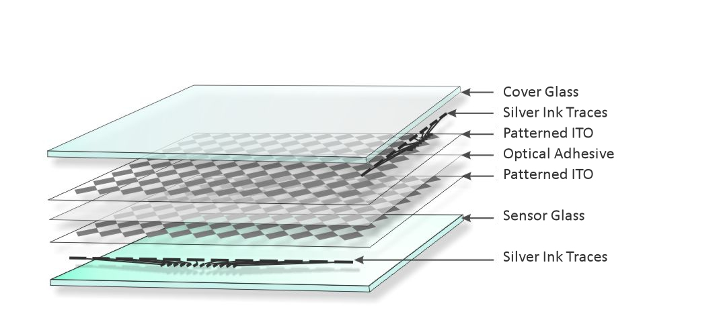
Projected Capacitive
10-Point Multi-Touch
Glass-Glass Construction
Excellent Optical Clarity
Scratch Resistant
Water & Chemical Resistant
Common Controller for a wide range of sizes.

Slide 9
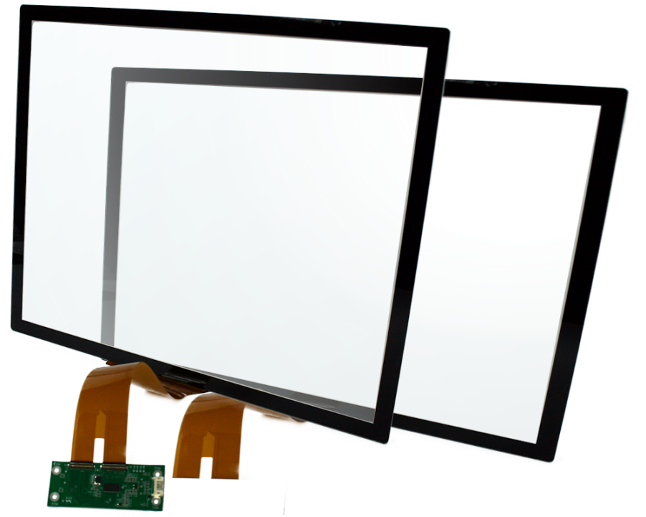
Projected Capacitive
Available sizes from 4.2” to 53”, with more to come.
Little to no MOQs on current designs, 50pcs on new designs.
NRE Ranging from $1000-$2400 (refundable on production orders of 100pcs)

Slide 10
Projected Capacitive
Great for many Applications including, but not limited to:
Interactive Digital Signage
Kiosks
Industrial Control Panels
Monitors

Slide 11

Projected Capacitive
Controller Specifications
Part Number | CC-02-102WL-02
Size Range | 7”-23.6”
Operating Voltage Range | 3.5 – 5.5 [V]
Current – Operating Mode | 60 [mA]
Current – Suspend/Sleep Mode | 40 [mA]
Current – Sleep Mode | <5 [mA]
Operating Temperature | -40°C to +85°C
Storage Temperature | -40°C to +90°C
Relative Humidity | 90%
Physical Dimensions | 75x30x8.3 [mm]

Slide 12
Projected Capacitive
Controller Specifications
Number of Touches | Up to 10
Touch Refresh Rate | >100 [Hz]
Response Time | <25 [mS]
RoHS | Yes
UL | Compliant
FCC | Compliant
Interface | USB 2.0
Powering | USB
OS Driver Support | Windows XP, 7, 8, 10;
 | Windows CE.net/5.0/6.0/7.0
 | Windows Embedded
 | Linux Debian 5 Kernel 2.6.34.7

Slide 13
Projected Capacitive
Sensor Mechanical Specifications
Size Range | 4.3” – 52”
Formats | 4:3 or 16:9, Custom Ratios Available
Cover Glass Thickness | 2.0 [mm]
Cover Glass Hardness | ≥ 6.5 [Mohs]
Sensor Glass Thickness | 1.1 [mm]
Total Sensor Thickness | 3.3 [mm]
Light Transmission [Clear] | ≥85%
Sealing Compatibility | NEMA 4, 12; IP65

Slide 14
Projected Capacitive
Sensor Mechanical Specifications
Input | Finger, Conductive Stylus, Tipped Gloves
Number of Touches | 10
Touch Force | 0 [g]
Operating Temperature | 10ºC to +60ºC, ≤90% RH
Storage Temperature | -10ºC to +65ºC, ≤90% RH
Chemical Resistance | ATSM-D-1308 and ASTM-F-1598-95
Optional Cover Glass Thicknesses | 0.7, 1.1, 3.0, 4.0 [mm]
Optional Sensor Glass Thickness | 0.7 [mm]

Slide 15
What is ULTRA?
Resistive based touch sensor with highly durable glass outer surface
Ultra-thin borosilicate glass/polyester lamination provides 6.5 Mohs flexible glass top sheet that is incredibly strong and resistive to scratching, chemical solvents, dirt, water, flames, etc.
Available 100 gloss anti-glare or clear versions available
Pressure activated technology that provides tactile sense
Utilizes standard 4 or 5-wire controllers
Can be applied from small to large format touch screens
Internal surface anti-Newton Ring type A/G coating
Notes:
15

Slide 16
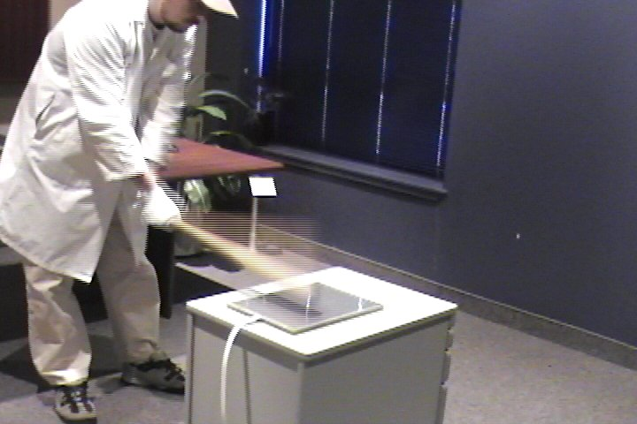
ULTRA Specs, continued
Optical
Light Transmission | 84% +/–5% at 550 nm wavelength
Haze and Clarity (Typical Values) | ULTRA - Haze 2%, Clarity 95%
Second surface coating | Anti-Newton ring type A/G
Durability
Surface Hardness | 6.5 Mohs’
Vandal Proof | Will continue to operate after deep scoring with knife or other metal implement.
Fire proof | Surface unaffected by open flames, cigarettes burns or sparks.
Sensor Life | 70 million touches per point
Shock Vibration | In accordance with UL291 when installed in a suitable correct bezel
Impact Resistant *enhanced substrate versions | Meets UL-60950 and CSA C22.2 No. 60950 ball drop test (0.5 kg, 50 mm diameter ball dropped from height of 1.3 m) with enhanced backplane.
Backplane strengthening | Optional laminations of chemical strength, tempered glass and polycarbonate substrates to meet vandal proof, explosion proof housing and industrial specifications.
Water | Resistant to water droplets on the surface and impervious to moisture and humidity.
Weather | Resistant to snow, ice, rain, sleet, hail, wind, etc.
Warranty | Touchscreen: 5-year limited warranty
Notes:
16

Slide 17
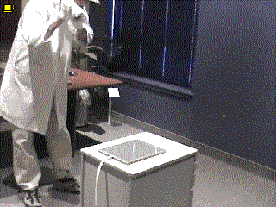
AD Metro ULTRA
Can your Touch Screen
Take this beating?
Works with Glove
Works wet
Toughest Resistive

Slide 18
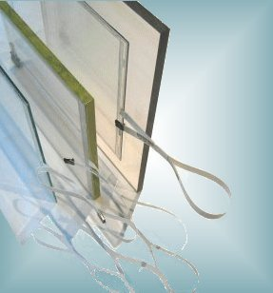
ULTRA Differences
ULTRA Variants
With such a durable outer layer, ULTRA lends itself to implementations that will be exposed to extreme abuse. Applications such as public kiosks that are prone to vandalism, systems deployed into heavy engineering or mining environments, general ruggedized equipment, etc. To meet the demands of these kinds of applications A D Metro has developed a process to laminate various backplane substrates to the ULTRA touch sensors:
Absolute ULTRA
Absolute ULTRA employs a polycarbonate backplane lamination. This option was designed to meet the needs of explosion proof rated equipment, typically for the oil and gas industry. This sort of equipment already protects computer displays with 12mm polycarbonate panels. Absolute ULTRA is the first touch sensor suitable for deployment in such explosion proof rated equipment.
UltimateULTRA
Ultimate ULTRA employs chemically strengthened or heat tempered glass backplane laminations. For applications that require additional durability and protection of the display itself, then UltimateULTRA is the solution

Slide 19
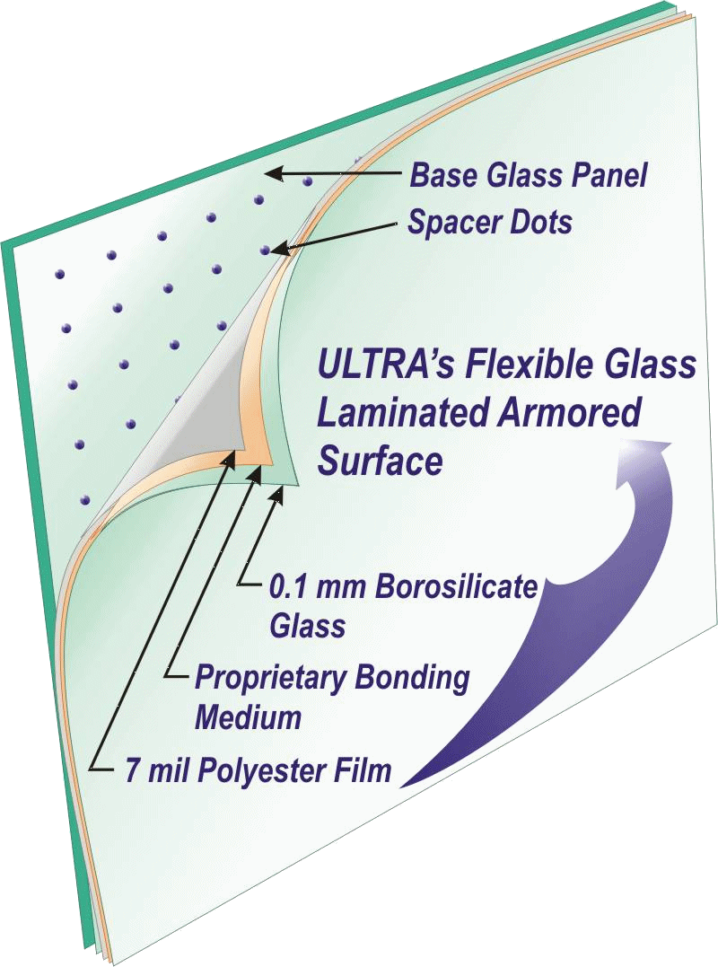
Key Innovation
Advanced material engineering
O.1mm borosilicate glass laminated to .7mm ITO coated polyester in an optically perfect fashion
Patent protected bonding process that overcomes the difficulties of different coefficients of thermal expansion and contraction
Result is a flexible membrane for use in a resistive touch sensor that is incredibly tough and impervious to moisture, chemicals and the elements
Notes:
19

Slide 20

Benefits of ULTRA
Abrasion and scratch resistant
Impervious to chemicals, solvents, flame, etc.
Provides a complete moisture barrier – ideal for very humid environments. Over time, moisture will permeate the polyester in a conventional resistive sensor
Top-sheet does not shatter and continues to operate even after extreme abuse such as deep scoring, repeated hammer blows and other vandalism
Contributes to public safety and reduces liability by keeping broken display or substrate glass behind the outer membrane
Maintains all typical benefits of resistive technology; glove or stylus activation, good EMI/EMF profile, simple/inexpensive controllers, tactile feedback, accurate, cost effective
Eliminates “pillowing” effective common to regular resistive sensors
The slightly stiffer membrane significantly extends the operational life of 4 and 5-wire sensors by reducing fracturing of the ITO coated polyester, which is the most common failure for standard resistive sensors
Notes:
20

Slide 21
ROI Considerations
Significant reduction in replacement and field maintenance costs
Compatible with standard 5-wire controllers and controller chips-sets. Much less costly than capacitive electronics
No retraining of field technicians required on new technology
When used with A D Metro drivers; capacitive, regular resistive and ULTRA sensors are interchangeable – reducing logistic, support and maintenance costs
Notes:
21

Slide 22
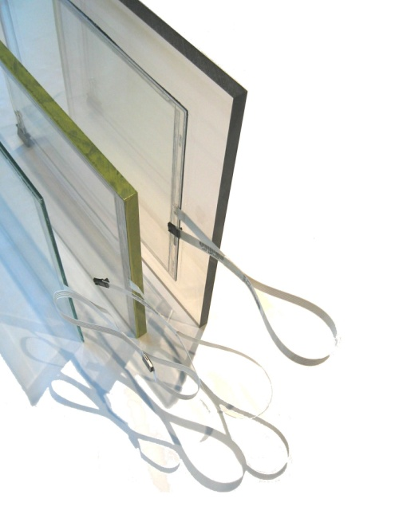
ULTRA Options
  For improved impact resistance, ULTRA is offered with re-enforced substrates – additional glass or polycarbonate panels are optically bonded to rear of standard ULTRA sensors.
      Ultimate ULTRA
        Various thickness tempered or chemically strengthened glass
      Absolute ULTRA
        Lamination of 12mm polycarbonate backplane
        Suitable for use in explosion proof rated equipment
  Custom
    sizes up to 23”
      NRE and minimum order required
  ULTRA Conversion Program
    ULTRA lamination can be applied to finished polyester sensors
    Enables conversion of existing spec’d product to ULTRA
    4 and 8-wire conversions
Notes:
22

Slide 23
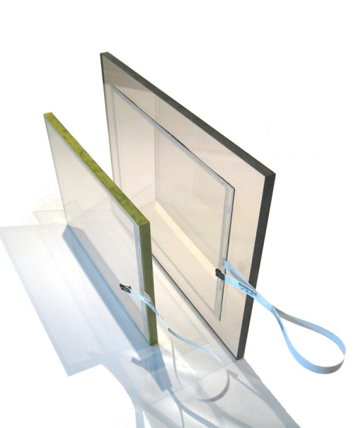
ULTRA Option cont.
EMI Shielding
  Rear surface ITO coating, 100, 20 Ohm/sq/in
  4 or 8 Ohm/sq/in conductive film
  <2 Ohm/sq/in micro mesh window
IR, Privacy and other film laminations
8/4-Wire sensors utilizing anti-reflective polyester and rear surface treatments reduce internal surface reflection
    Enhances contrast and clarity for sunlight and bright overhead light applications
Notes:
23

Slide 24
Custom Sensor Development
ULTRA sensors are ideally suited to difficult to solve touch applications that often require customization and low volume production.
    Laminating enhanced glass or polycarbonate backplanes to increase impact resistance
    Providing various ITO coatings or mesh laminations for RFI/EMI shielding, including sensors for MIL-461 rated environments
    Infra-red shielding to help reduce solar heating and protect LCD panels in outdoor locations
    Specific optical configurations such as A/G, A/R, anti-Newton ring and others
    Custom cable location and length
Notes:
24

Slide 25
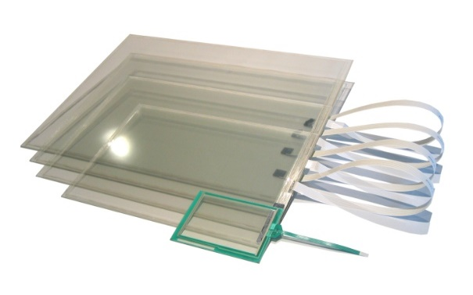
ULTRA – 5-wire Production Specs
Electrical
Type | 5-Wire resistive
Positional Accuracy | + / - 2.5mm
Corner to Corner Ohms | 40 - 60 ohms depending on size
Controller | Serial RS232 or USB 2.0
Isolation | >= 15 M Ohms
Cable Termination | 5 Pin AMP .1" centers
Electrostatic | Laminated glass assembly complies with EN 60950, UL 60950, and UL 544
 | Per EN 61000-4-2, 1995: Withstands 20 discharges up to 15 kV
Resolution | Touch point density is based on controller resolution. Typically 4096x4096
Mechanical
Available sizes | 6.4”, 10.4", 12.1", 15.0". 14.1”, 17.1", 19.1" 20.1 23, 24” and custom sizes
Finish | Polished Glass or Anti-Glare
Surface Material | Borosilicate Glass
Sensor Thickness | 2.64mm or 3.64mm
Cable Length | 455mm
Activation Force | 85 grams
Input Methods | Finger, glove, stylus
Sealability | Can be sealed to meet NEMA 4 and 12 and IP 65 standards
Environmental | 5 Year Warranty
Operating Temperature | -10 C to 55 C
Storage Temperature | -40 C to 70 C
Relative Humidity | Operating: 90% RH non-condensing at max 35°C
 | Storage: 90% RH at max 35°C for 240 hours, non-condensing
Altitude | Operating: 10,000 ft (3,048 m)
 | Storage/transport: 50,000 ft (15,240 m)
Chemical Resistance | Impervious to all chemicals and solvents that do not affect glass
Notes:
25

Slide 26

Contact Info direct USA factory design/sales
A D Metro/Oceanside Technical sales
PO Box 802 Cowpens S.C. 29330
Canada & USA:
Telephone: 864 406-0479
Email ken.beuck@oceansidetech.com
Web: ww.oceansidetech.com
For Appointments and quotes call today
Notes:
26

Slide 27
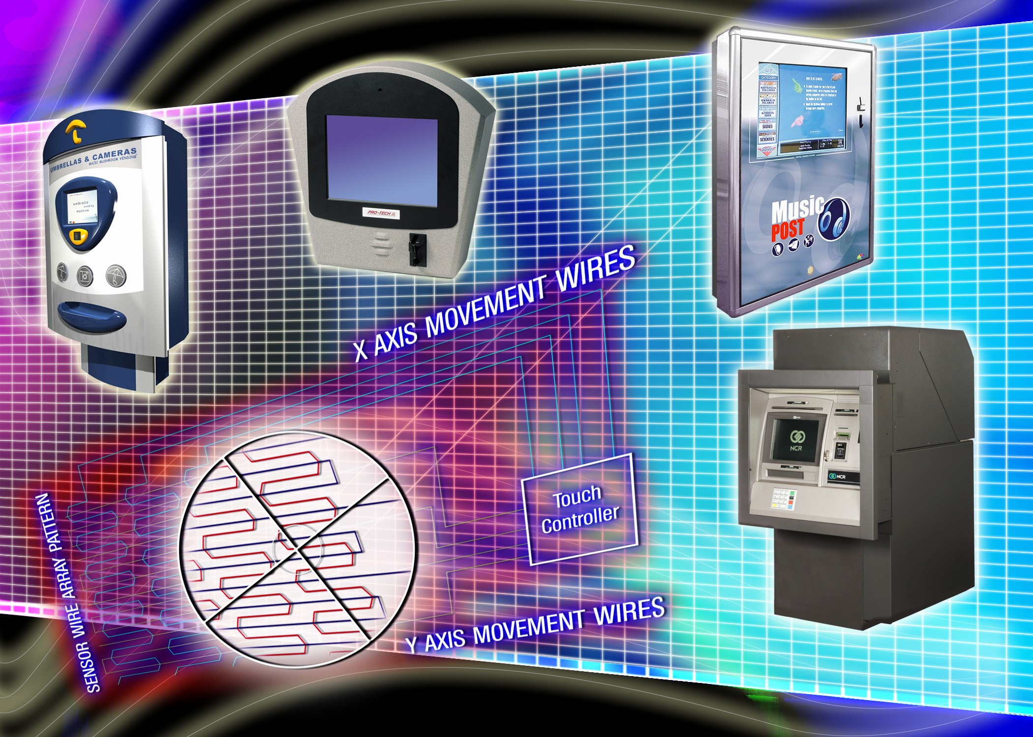




Slide 28
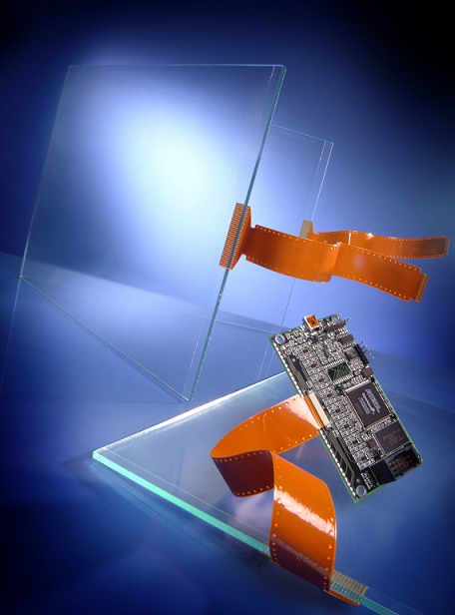

Slide 29
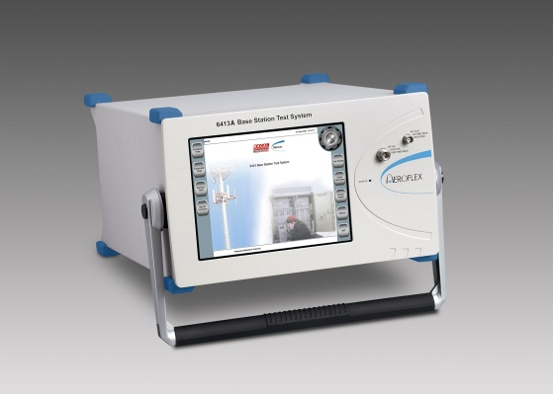
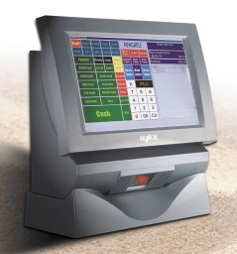
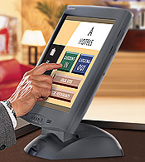
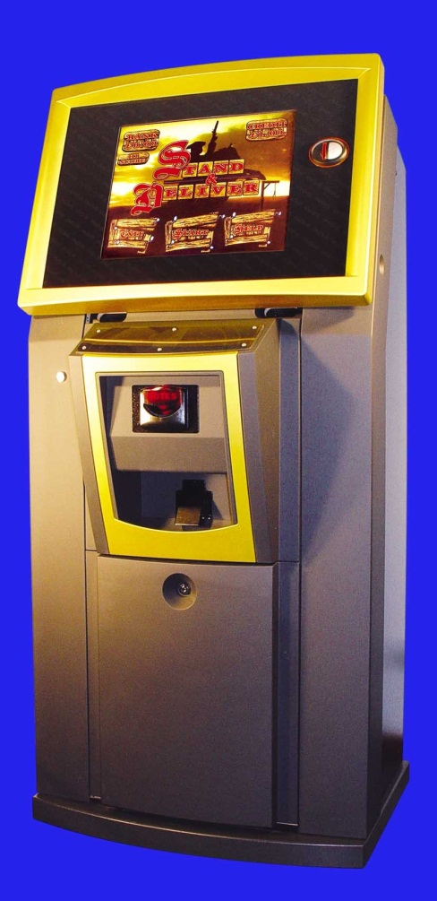
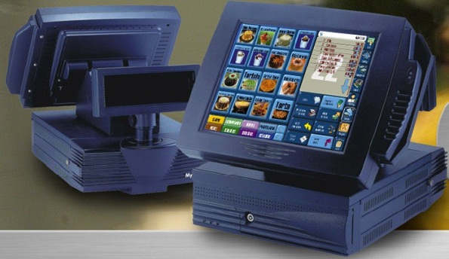
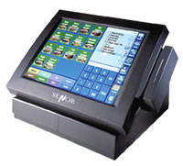
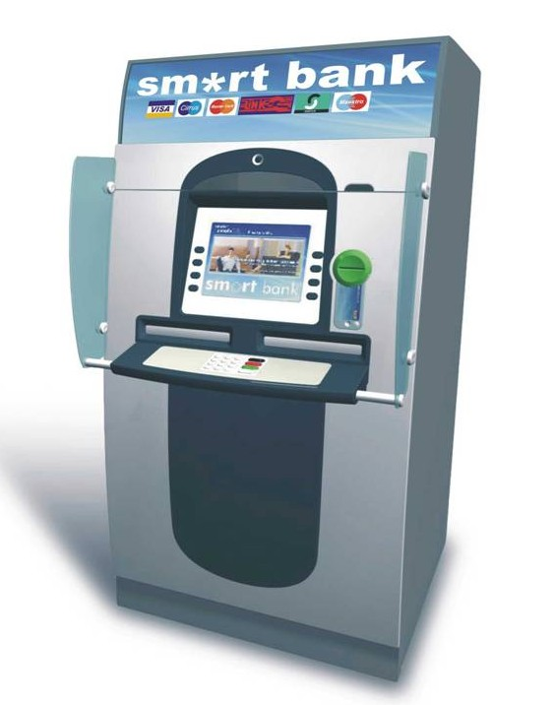
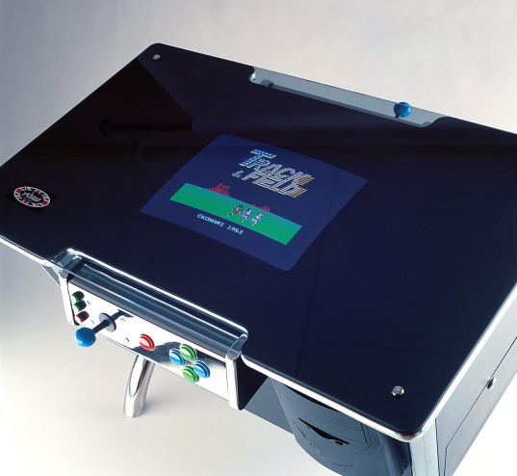
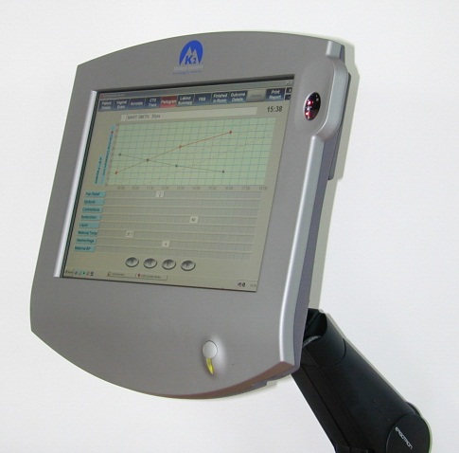
APPLICATIONS

Slide 30
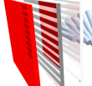
Luminary Optics
As a supplier of optical bonding and display enhancements, Luminary offers a wide range of products and services that increase the performance of displays, making them perform in the most demanding applications. Our unique approach to the industry is what sets us apart from the others. Luminary Optics follows the philosophy of "Spec Standards". Simply put, Luminary engineers unique solutions for our customers by creating designs built to their "specs" but by utilizing "standard" optical components and materials.
Luminary Optics array of display enhancements can be applied on most sizes of displays, from 3" to 80+". The work is performed in our new 5500 sq. ft. facility, that has a 1000 sq. ft. cleanroom and a display bonding area with a capacity of 2000+ displays per month.
    Luminary optics
offers the widest range of optical enhancement services including:
optical bonding, HEA 2000 AR film lamination, circular polarizers, custom PCAP touch, windows with AR coating, optically bonded EMI filters, EMI filters laminated to touch screens, smudge-free, print-free oleophobic/hydrophobic coatings, high bright LED lighting and display assembly services.

Slide 31
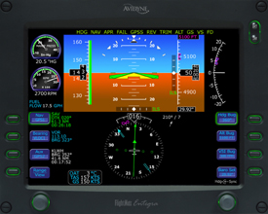
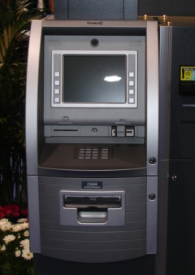
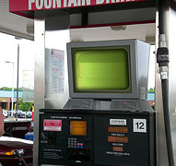
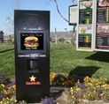
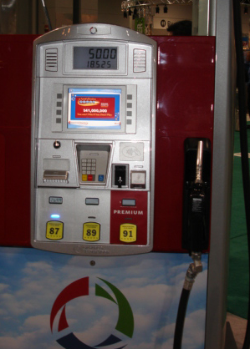
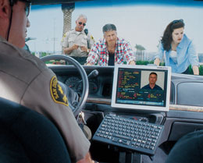
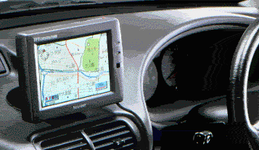
High Ambient Applications and Markets
Automotive / GPS
Avionics
Kiosks / ATMs
Gas Pump POS
Outdoor Kiosk
In-Vehicle Computers

Slide 32
Contrast ratios: two methods, two results
350nits
Intrinsic Contrast Ratio
On the surface, the display, may read a 300:1 contrast ratio. This does not take into account ambient lighting. In addition, the light meter is measuring total flux regardless of angular distribution
Extrinsic Contrast Ratio
A reading from a distance, taking into account ambient light and reflections. A good extrinsic contrast ratio is 10 :1.

Slide 33
How LCDs work
The transistor applies an electrical field across the cell. The LCD molecules align to the direction of the flow. This prevents the LCD from twisting. No twist, no light transmission

Slide 34
How LCDs work
Rear Polarizer
Cell Gap
Alignment Layer
Front Polarizer
Transistors on rear glass
Color filter on front glass
Light from the backlight is polarized and then twists 90 degrees through the LC material allowing it to pass through the front polarizer.

Slide 35
Contrast ratios: two methods, two results
350nits
Intrinsic Contrast Ratio
On the surface, the display, may read a 300:1 contrast ratio. This does not take into account ambient lighting. In addition, the light meter is measuring total flux regardless of angular distribution
Extrinsic Contrast Ratio
A reading from a distance, taking into account ambient light and reflections. A good extrinsic contrast ratio is 10 :1.

Slide 36
What is a nit?
1 meter
1 meter
1 meter
A nit is a unit of projected light energy from one candle, measured from its source,measured one meter away, measured over a one meter square area. A footlambert is the same light measured one foot away, over a one foot square area. 1 ft lambert is the same as 3.426 nits

Slide 37
High ambient / outdoor applications have unique requirements
Outdoor applications require sunlight readability.
Protective overlays are often used.
Touch switches are common options.
High Bright Backlights are popular options but cause heat and draws excess power
Outdoors is a harsh environment

Slide 38
Brightness versus Contrast
The human visual system includes both the eyes and complex information processing in the brain. This is called the “visual system”.
The human eye “sees” brightness differences. We call these brightness differences contrast.
The human visual system can “see” over 1 billion levels of contrast

Slide 39
Brightness versus Contrast
“Brightness” lightens or darkens the image. “Contrast” changes the distinction between the light and dark areas.
Humans can “perceive” roughly 100 levels of brightness.
Humans can “see” roughly 1 billions levels of contrast.
The human eye eventually becomes saturated with brightness and becomes more responsive to contrast.
Contrast ratio is much more significant than brightness in high ambient illumination environments.
The human visual system amplifies the difference in contrast: lateral inhibition

Slide 40
Lateral Inhibition Test
You should only see a monochrome gray bar

Slide 41
Lateral Inhibition Test
The human visual system will amplify the contrast differences

Slide 42
Contrast Example
This is a test
High contrast, easy to read
This is a test
Very low contrast but it is readable

Slide 43
Luminance, Illuminance and Reflection
10,000 ft Candles
Ambient light is “illuminance”
5% reflection
Reflective loss is what lower display performance in bright conditions
500- 1500 nits
Light coming from the display is “luminance”

Slide 44
Formula for Contrast
Reflection = 5% x # of surfaces x ambient light
Luminance + Reflection
= Contrast Ratio
Reflection

Slide 45
Reflected light causes loss of Contrast
Reflection = 10K ftC x 13%
R= 1500 nits
Reflection is caused by an impedance mismatch between air and glass
Reflection is “garbage” light, which is added to the display’s projected light
Reflection makes White brighter, but dilutes Black and other colors
This vastly decreases contrast
4.5%
4.5%
4.5%
1500 + 1300
= 2.15 :1 Contrast
1300

Slide 46
Changes in Brightness and Contrast
The U.S Air Force has deemed 3 : 1 contrast as the minimum acceptable level for proper human interface
3000
2750
2500
2250
2000
1750
1500
1250
1000
750
500
250
1500 Nits display
1500 / 5 = 300:1 Intrinsic CR
Reflected light adds to both White and Black
Less light output in White does not necessarily mean lower contrast

Slide 47
Changes in Brightness and Contrast
The U.S Air Force has deemed 3 : 1 contrast as the minimum acceptable level for proper human interface
3000
2750
2500
2250
2000
1750
1500
1250
1000
750
500
250
1500 nit ,10K fC Ambient
LCD 4%of 10K
= 400 nit refl.
1900/400 = 4.75 :1 Extrinsic CR
1500 Nits display
1500 / 5 = 300:1 Intrinsic CR
Reflected light adds to both White and Black
Less light output in White does not necessarily mean lower contrast

Slide 48
Changes in Brightness and Contrast
The U.S Air Force has deemed 3 : 1 contrast as the minimum acceptable level for proper human interface
3000
2750
2500
2250
2000
1750
1500
1250
1000
750
500
250
1500 nit ,10K fC Ambient
LCD 4%of 10K
= 400 nit refl.
1900/400 = 4.75 :1 Extrinsic CR
1500 Nits display
1500 / 5 = 300:1 Intrinsic CR
1500 nit display
w/window- 3 X 400 nit
reflection = 1200
2700/1200 = 2.25 :1
Reflected light adds to both White and Black
Less light output in White does not necessarily mean lower contrast

Slide 49
Changes in Brightness and Contrast
The U.S Air Force has deemed 3 : 1 contrast as the minimum acceptable level for proper human interface
3000
2750
2500
2250
2000
1750
1500
1250
1000
750
500
250
1500 nit ,10K fC Ambient
LCD 4%of 10K
= 400 nit refl.
1900/400 = 4.75 :1 Extrinsic CR
1500 Nits display
1500 / 5 = 300:1 Intrinsic CR
700 nit display
w/bonded window
2% or 200 nits reflection
700 / 200 = 3.5 : 1
1500 nit display
w/window- 3 X 400 nit
reflection = 1200
2700/1200 = 2.25 :1
Reflected light adds to both White and Black
Less light output in White does not necessarily mean lower contrast

Slide 50
Changes in Brightness and Contrast
The U.S Air Force has deemed 3 : 1 contrast as the minimum acceptable level for proper human interface
3000
2750
2500
2250
2000
1750
1500
1250
1000
750
500
250
1500 nit ,10K fC Ambient
LCD 4%of 10K
= 400 nit refl.
1900/400 = 4.75 :1 Extrinsic CR
1500 Nits display
1500 / 5 = 300:1 Intrinsic CR
1500 nit display
w/bonded window
2% reflection = 200nits
1700/200 = 7.5 : 1
700 nit display
w/bonded window
2% or 200 nits reflection
900 / 200 = 4.5 : 1
1500 nit display
w/window- 3 X 400 nit
reflection = 1200
2700/1200 = 2.25 :1
Reflected light adds to both White and Black
Less light output in White does not necessarily mean lower contrast

Slide 51
Two approaches display enhancements
Display enhancement has two approaches: Brightness and Contrast. Outdoor LCD displays require both in order to make them readable in high ambient light.
Brightness: Increasing Luminance
Active- Adding more lights
Passive- Collects and focuses the available light
Contrast: Removing reflective loss
Direct Bonding AR glass
Air gap AR film and windows
For outdoor viewability, one must increase both!

Slide 52
Active Brightness Enhancement
LED Rails
Dual edge-lit CCFL
Multiple rear-lit CCFL

Slide 53
Passive Brightness Enhancement
Reflective Polarizer
50% of the light will transmit in either of these orientation
No light will get through at this orientation
50% of the backlight light never gets out the front

Slide 54
Passive Brightness Enhancement
Reflective Polarizer-
Reflective Polarizer transmits all light in its orientation direction but will reflect back any light not in alignment. Additionally, the light is rotated slightly, to be reflected off the rear reflector.

Slide 55
Passive Brightness Enhancements
BEF- Brightness Enhancement –
Vertically aligned BEF- Collects light going left and right and directs it to the front
Horizontally aligned BEF- Collects light going up or down and channels it forward

Slide 56
Passive Brightness Enhancements
Transflective Film- Mirror film
Light from the outside comes in, and is reflected off the rear wall

Slide 57
Passive Brightness Enhancement
ELG- Enhanced Light Guide
Light from the CCFLs is non-directed and bounces in all directions. Some light never makes out the front.

Slide 58
Passive Brightness Enhancement
ELG- Enhanced Light Guide
Light returning from reflective polarizer
Light from CCFT
Micro-prisms internal to light guide
ELG with the Reflective Polarizer is very effective in converting non-collimated light to collimated light

Slide 59
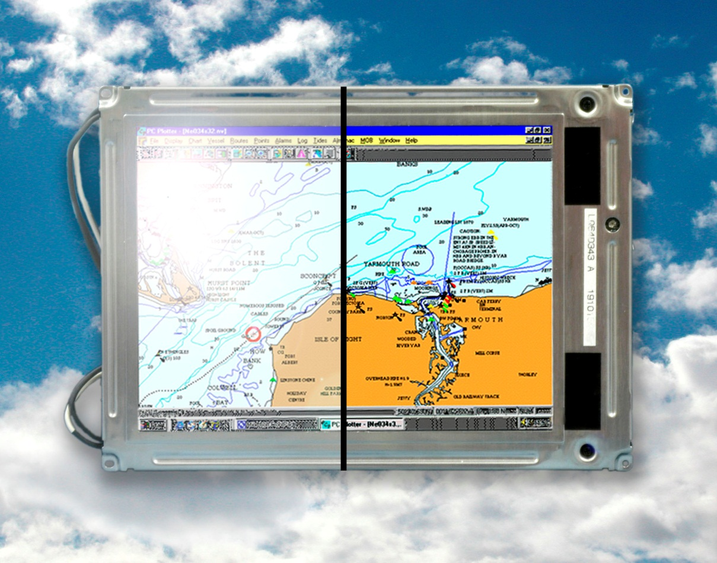
Contrast Enhancement with anti-reflecting technology
Whether with glass bonding or film, AR coatings eliminate reflective loss

Slide 60
Contrast Enhancement with Air Gap
Air Gap uses AR film on the display front and double sided AR coated glass
Air Gap has a higher surface reflection
Air Gap allows moisture and contamination under the glass
It does not support the glass or minimize breakage
Lower cost on <15” displays
.4%
.4%
.85%

Slide 61

Contrast Enhancing with Optical Bonding
Optical Bonding completely couples the light behind the window, yield virtually zero reflection.
Optical Bonding seals the front glass completely to the front of the display.
No contamination, moisture is possible
Reinforced glass resists breakage and if broken, the shards are “glued” in.
Bonding cost less on displays >15”
1000-1500 nits
.4%

Slide 62
Optical Bonding Benefits
Low reflective loss means higher contrast in high bright environments
  Display are daylight readable at 500 nits, sunlight readable at 800 nits
  Backlight power can be lowered to reduce overall power draw and less heat production
No air gap eliminates “greenhouse” effect heat rise.
  Solid bond will conduct heat out of the display
  Cooler displays will not “clear”or go isotropic as quickly.

Slide 63
Optical Bonding Benefits
No air gap prevents moisture from forming under the window.
  Fog formation is impossible
No air gap prevents particles and contamination from collecting under the window
Ruggedizes the display
  Bonding material reinforces the glass and dampens the shock to minimize breakage of both the display and the front glass
Safety
  Bond will hold glass in place should if break from abuse.
Removable Process
  Bonding can be reversed to reclaim either the display or overlay window/touch screen

Slide 64
Optical Bonding Benefits
Reworkable through production process
  High yields
Reworkable in post-production
  Display can be saved
Low toxicity, environmentally friendly materials.
Excellent UV resistance
Excellent optical properties
Excellent mechanical properties
Low glass transition temperature

Slide 65
Additional Window Enhancement Options
AR Glass:
  Heat or Chemically Strengthened
  Diffusion levels between 90 and 105 Gloss
  Up to 6mm in thickness
  IR Rejecting
ITO and Heater:
  ITO: 13 ohms/sq. or 4 ohms/sq.
  AR and Heater glass
  AR and ITO glass
  AR and ITO and Heater
Privacy Film
Quarter Wave Retarder Film
  Polaroid sunglass proof
Touch Screens
  Projective Capacitive
  Resistive
  Capacitive
  SAW
  IR Touch

