Slide 1
Ecology
Chapter 1
Interactions of Life

Slide 2
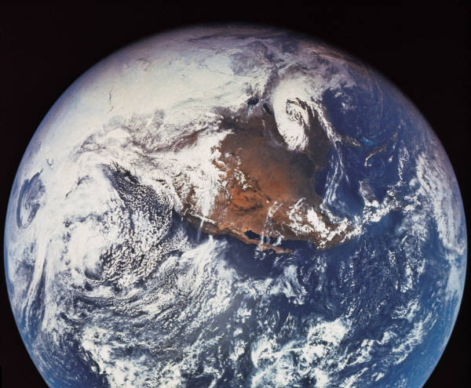
Living Earth
What makes the Earth different from other planets in the solar system?

Slide 3
Biosphere
Biosphere: Part of Earth that supports life
3 Things make up the biosphere:
1. top portion of the Earth’s crust
2. all the waters that cover the Earth’s surface
3. the atmosphere that surrounds the Earth

Slide 4
Different Environments
The biosphere is made up of many different environments that are home to different kinds of organisms
Let’s look at a few environments…..

Slide 5
Desert

Slide 6
Tropical Rain Forest

Slide 7
Coral Reefs

Slide 8
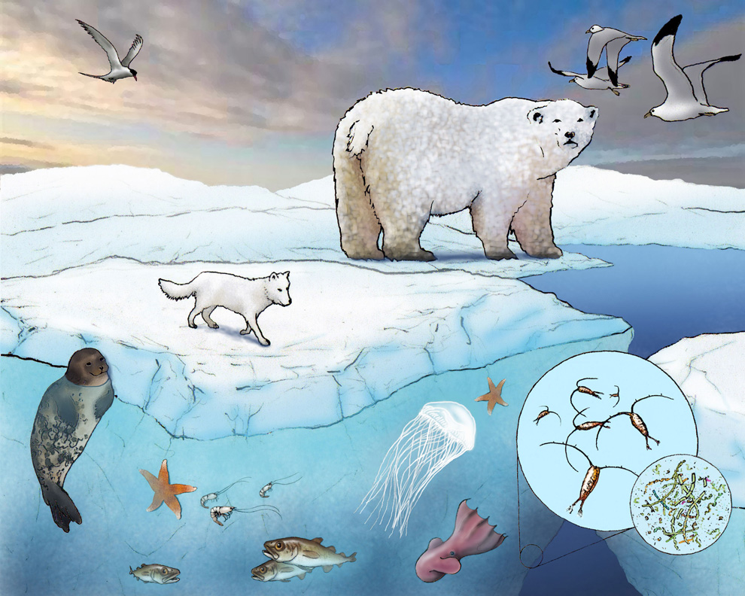
Arctic

Slide 9
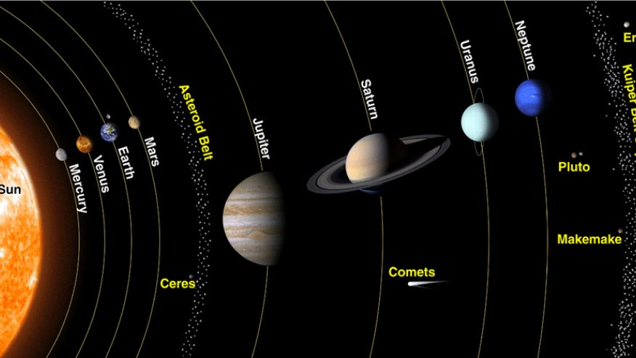
Life on Earth
Solar System and Life

Slide 10
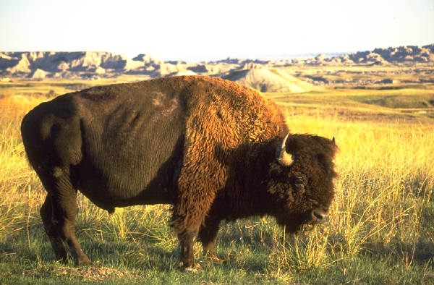
Ecosytems
What is an Ecosystem?
Yellowstone National Park in Wyoming

Slide 11
Ecosystem
An ecosystem consists of all the organisms living in an area AND all non-living parts of that environment.
Includes on LIVING and NON-LIVING

Slide 12
Living vs Non-Living
What are the living and non-living parts of this prairie environment?

Slide 13
Organisms
Living: bison, coyote, rabbit, birds, insects
Non-Living: water, temperature, sunlight, soil, and air

Slide 14
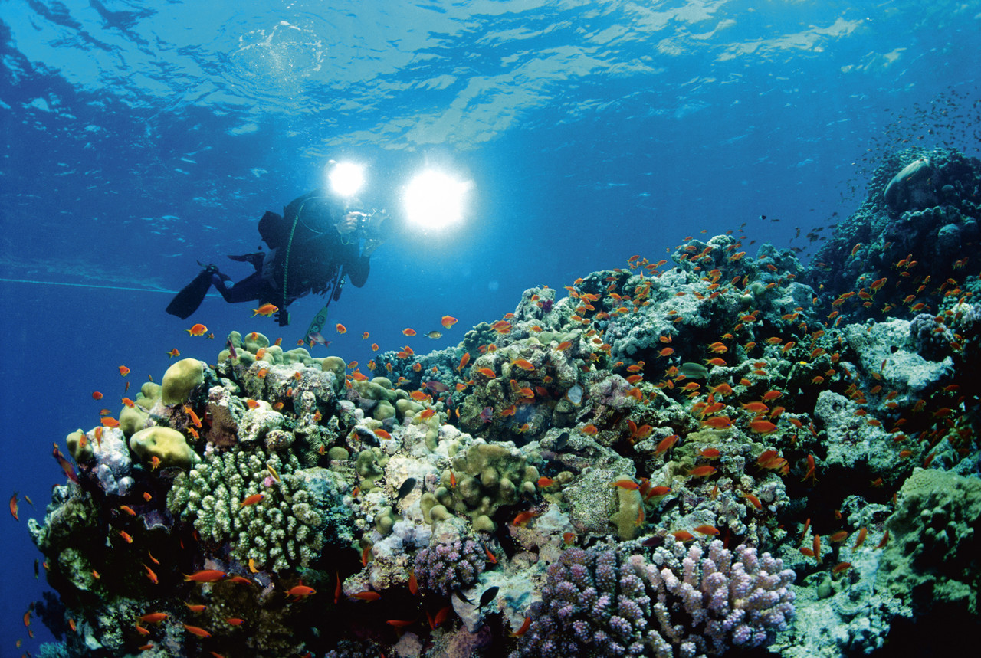
Coral Reef

Slide 15
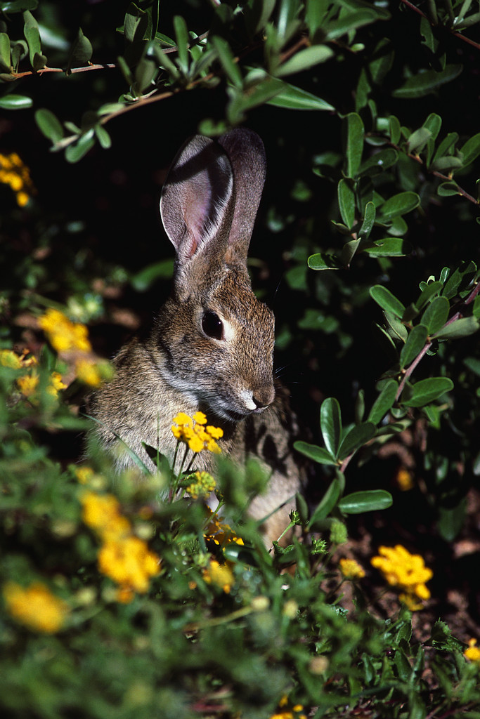
Ecosystem
Let’s review:
What is an Ecosystem?

Slide 16
ECO
Ecosystem: consists of all the living organism and non-living things in an environment
Ecology: the study of the interactions that occur among organisms and their environment
Ecologist: scientist who study interactions in the environment

Slide 17
Tropical Rain Forest

Slide 18
Organism

Slide 19
Populations
A population is made up of all the organisms of the same species that live in an area at the same time.

Slide 20
Populations

Slide 21
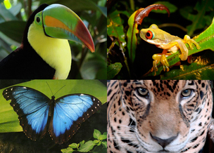
Community
A community is all the populations of all species living in an ecosystem

Slide 22
Ecosystem

Slide 23
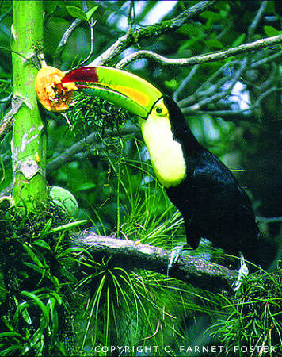
Habitat
The place in which an organism lives is called a habitat
An organisms habitat provides the kinds of food and shelter, the temperature, and the amount of moisture the organism needs to survive

Slide 24
What makes up the biosphere?

Slide 25
Create Your Own Model

Slide 26
Create Your Own Model
Biosphere

