Slide 1
SALT LAKE CITY 2018 SIGNAL RETIMING
Salt Lake City Traffic Control Center
UDOT

Slide 2
GOALS
Reduce travel times
Reduce delay
Reduce emissions
And do this at as many City signals as possible

Slide 3
CORRIDORS
The entire Downtown Area (North Temple to 900 S & 600 W to UofU
1300 East (3300 S to South Temple)
1300 South (500 W to 1300 E)
2100 South (700 W to 2300 E)
Glendale Area (900 W; SR-201 to 800 S and
1300 S; Redwood to I-15)
300 West (2100 S to 600 S)
California Ave (Redwood Rd to Bangerter Hwy)

Slide 4
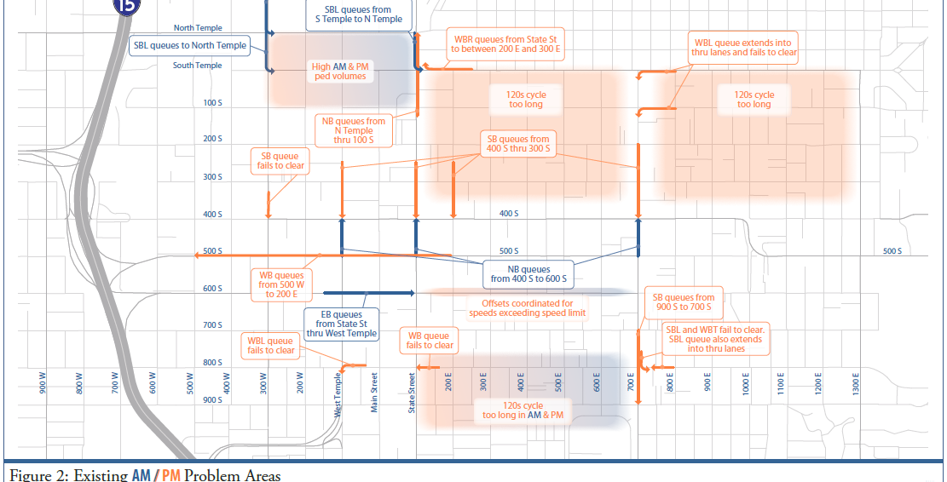

Slide 5
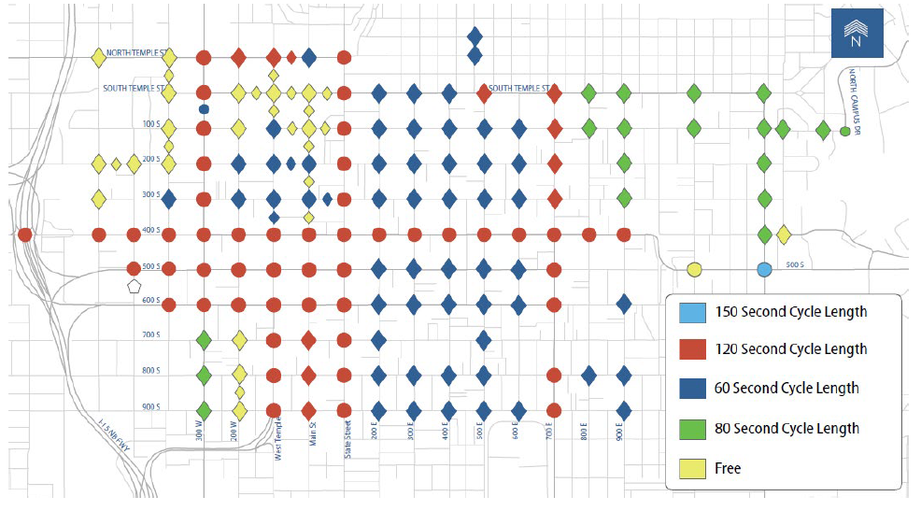
AM

Slide 6
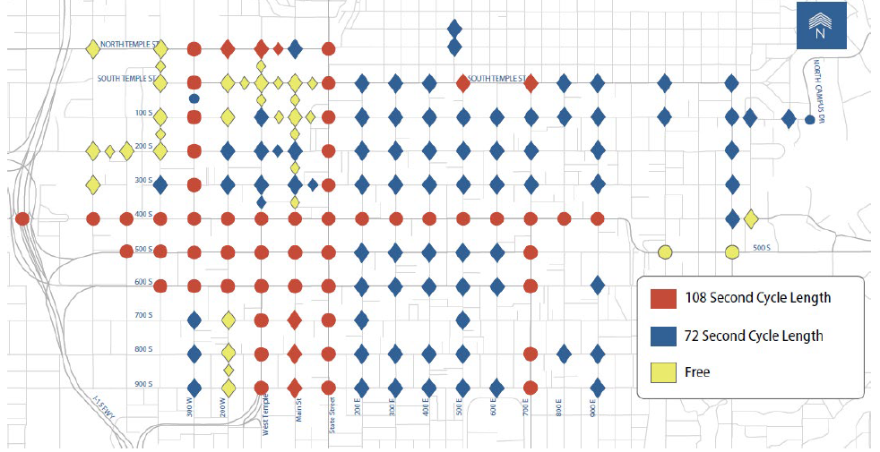
MD

Slide 7
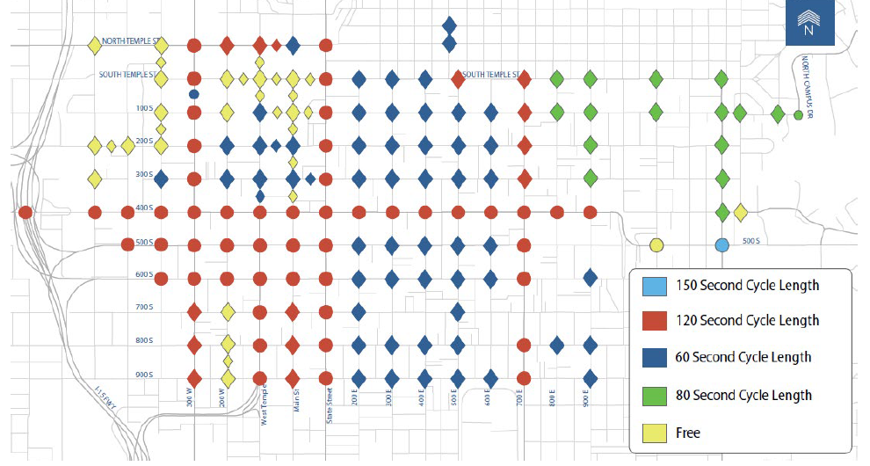
PM

Slide 8
AFTER
The new traffic signal timings were implemented in the Downtown Area (DA) and at six other corridors in SLC
New timings are helping to meet the city’s goal to reduce emissions, reduce delay for all modes, and provide better coordination between traffic signals operated by SLC and by UDOT.
Review of the changes show a ruduction on average by 54 seconds for the DA and by 33 seconds for the corridors retimed.

Slide 9
BENEFIT/COST RATIO
Based on a 250 day work year and 1.25 people per vehicle
Corridor travel time savings – 4 million per year
DA travel time savings 14 million per year
Project Cost $300,000
Benefit/Cost ratio 61:1

