Slide 1
Crucial Conversations in Oncology Nursing: Management Considerations for the AML Patient

Slide 2
Faculty
Laura Zitella, MS, RN, ACNP-BC, AOCN
Hematology/Oncology Nurse Practitioner
Clinical Associate Professor
University of California, San Francisco

Slide 3
Commercial Support Disclosure
This activity is supported through an educational grant from Pfizer.

Slide 4
Faculty Disclosures
Advisory Board – for scientific information (Abbvie, Amgen, Array BioPharma Inc, Astra Zeneca, Gilead)
Shareholder- Kite Pharmaceuticals

Slide 5
Learning Objectives
Upon completion of this educational activity, learners should be better able to:
Review recently approved agents for patients with newly diagnosed and relapsed AML and their implications for patient selection and nursing care
Evaluate patients with AML receiving treatment with recently approved agents in order to identify early indications of adverse events and implement appropriate interventions
Outline key education points for the patient and family/caregiver to prevent infection, identify signs of bleeding, and perform other assessments to improve early identification and management of adverse events

Slide 6
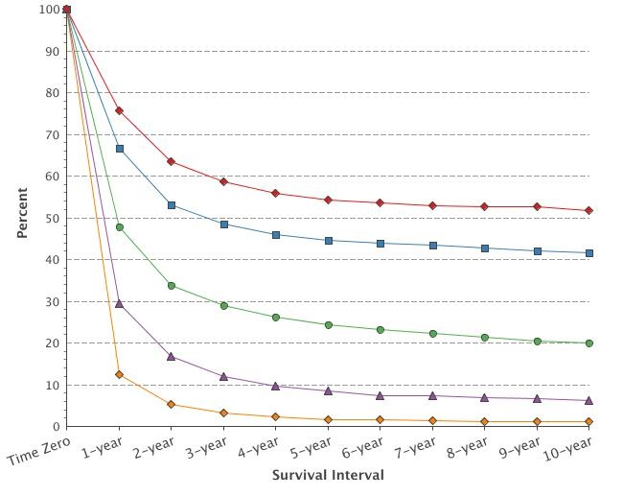
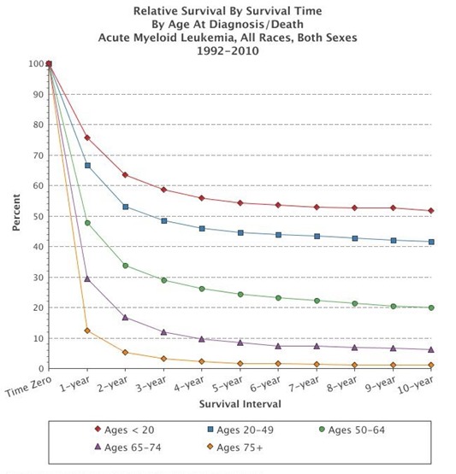
AML At-A-Glance
Estimated New Cases in 2018 | % of All New Cancer Cases | Estimated Deaths in 2018 | % of All Cancer Deaths | % Surviving 5 Years
19,520 | 1.1% | 10,670 | 1.8% | 28%
Median Age at Diagnosis:
68 years
AML in older adults is a major challenge
NCI Cancer Stat Facts: Acute Myeloid Leukemia https://seer.cancer.gov/statfacts/html/amyl.html
Notes:
Noone AM, Howlader N, Krapcho M, Miller D, Brest A, Yu M, Ruhl J, Tatalovich Z, Mariotto A, Lewis DR, Chen HS, Feuer EJ, Cronin KA (eds). SEER Cancer Statistics Review, 1975-2015, National Cancer Institute. Bethesda, MD, https://seer.cancer.gov/csr/1975_2015/, based on November 2017 SEER data submission, posted to the SEER web site, April 2018.

Slide 7
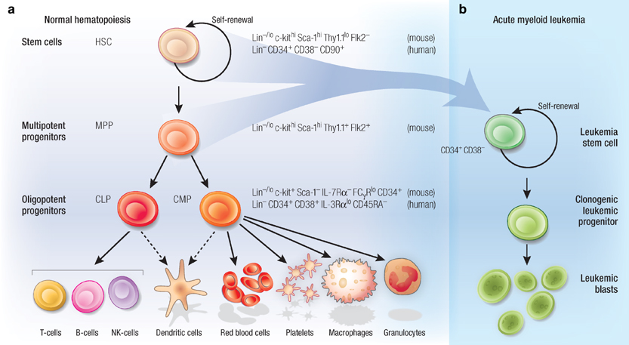
What is AML?
Complex hematologic malignancy driven by multiple acquired genetic mutations that evolves over time
Normal hematopoiesis is driven by stem cells.
AML is driven by leukemia stem cells rendered malignant by
driver mutations
Clonal expansion of leukemia cells leads to bone marrow failure and related complications:
severe infections, anemia, and
bleeding
CD34+CD38+
CD34-
Tan BT et al. et al. Lab Investig. 2006;86(12):1203-1207.
Notes:
The translucent blue arrows are drawn to indicate candidate progenitor cells in which transformation occurs.
AML is characterized by clonal expansion of undifferentiated myeloid precursors, resulting in impaired hematopoiesis and bone marrow failure.
Normal hematopoietic stem and progenitor cells (a). The HSC is a unique hematopoietic cell by virtue of its ability to self-renew as well as generate all cells of the hematopoietic system. HSCs generate the multitude of hematopoietic cells by giving rise to MPPs and progressively lineage-restricted progenitors that have limited capacity to divide. Leukemia stem and progenitor cells (b). Similar to the HSC, the LSC has the unique ability to self-renew. LSCs give rise to clonogenic leukemic progenitors that differentiate into leukemic blasts and more differentiated progeny. Although the cell of origin of the LSC has not been elucidated, investigators hypothesize that LSCs arise from immature hematopoietic progenitors or possibly the HSC. The translucent blue arrows are drawn to indicate candidate progenitor cells in which transformation occurs.
Tan, B. T., Park, C. Y., Ailles, L. E., & Weissman, I. L. (2006). The cancer stem cell hypothesis: a work in progress. Laboratory Investigation, 86(12), 1203–1207. https://doi.org/10.1038/labinvest.3700488

Slide 8
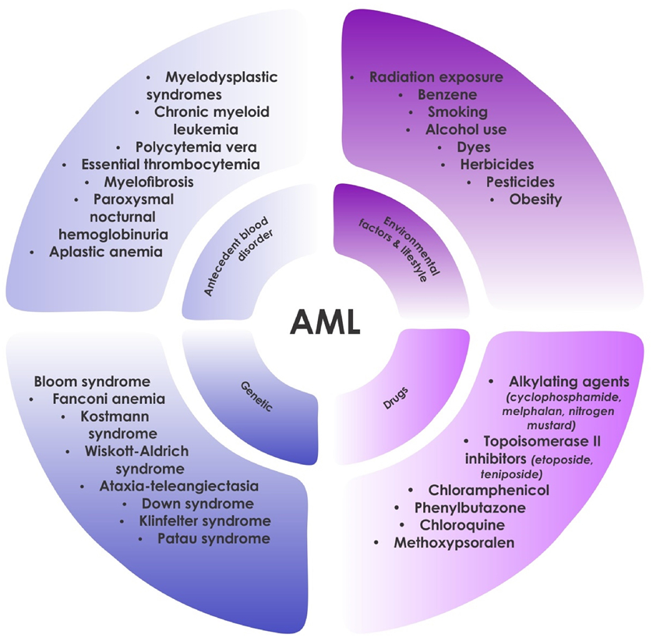
Predisposing Factors in AML
Tamamyan G et al. et al. Crit Rev Oncology. 2017;110:20-34.
Notes:
Tamamyan , G., et al. Critical Reviews in Oncology / Hematology 2017 110, 20-34DOI: (10.1016/j.critrevonc.2016.12.004)
Increased risk of AML 5–7 years after radiation exposure, 4–8 years after exposure to alkylating agents (commonly associated with chromosome 5 and/or 7 abnormalities), and 1–3 years after topoisomerase II inhibitors (specifically, the French-American-British Cooperative Group [FAB] M4 and M5 subtypes, which are typically is associated with MLL gene rearrangements)

Slide 9
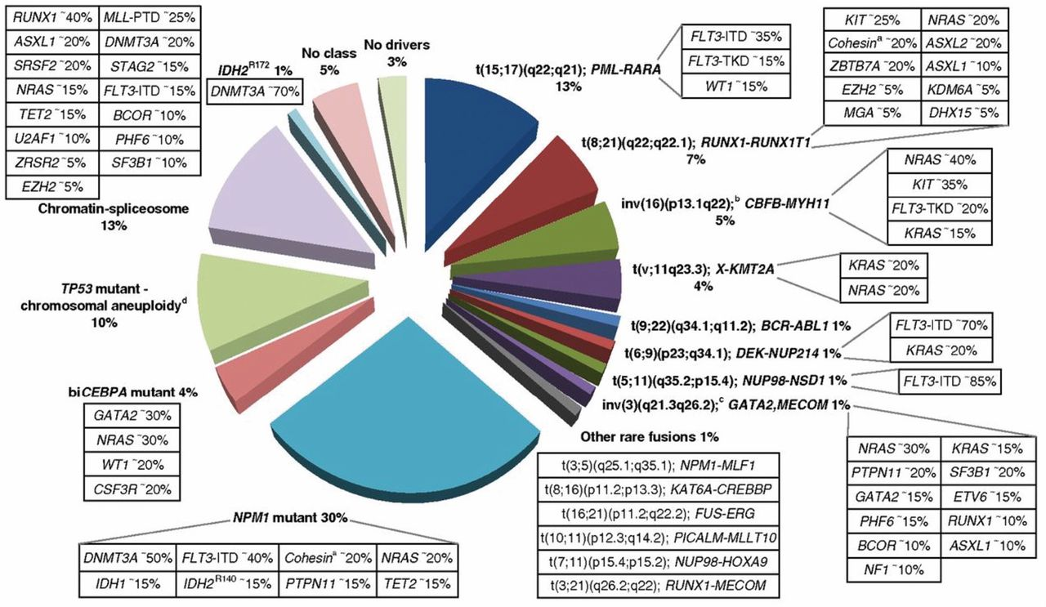
AML is a Heterogenous Disease that Develops from Driver Mutations
Dohner H et al. et al. Blood. 2017;129:424-447.
Notes:
Döhner H, Estey E, Grimwade D, et al: Diagnosis and management of AML in adults: 2017 ELN recommendations from an international expert panel. Blood 2017;129:424–447

Slide 10
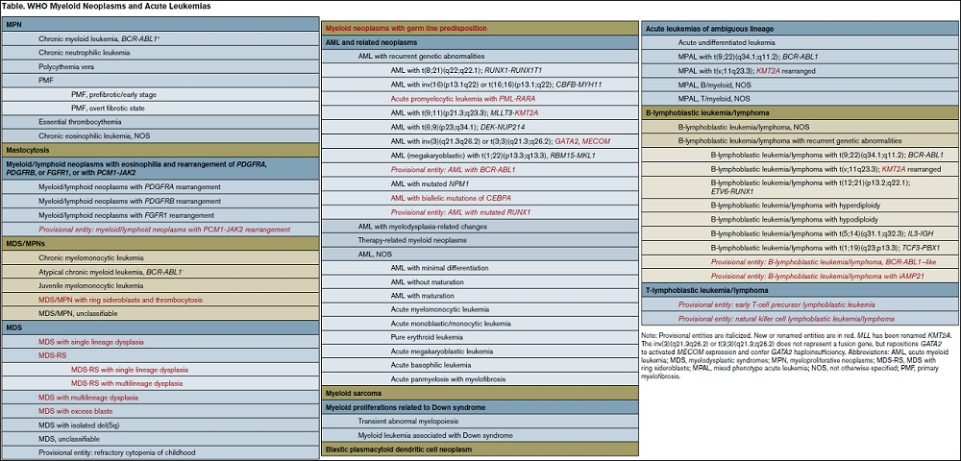
2016 WHO Classification of AML
Classification of AML by the causative genomic changes
aids treatment decisions and informs prognosis
Arber DA et al. Blood. 2016;127(20):2391-2405.
Notes:
AML is caused by somatically acquired driver mutations. Classification of cancers based on causality is most clinically relevant to guide research, treatment decisions and inform prognosis.
Arber, D. A., Orazi, A., Hasserjian, R., Thiele, J., Borowitz, M. J., Le Beau, M. M., … Vardiman, J. W. (2016). The 2016 revision to the World Health Organization classification of myeloid neoplasms and acute leukemia. Blood, 127(20), 2391–405. https://doi.org/10.1182/blood-2016-03-643544

Slide 11
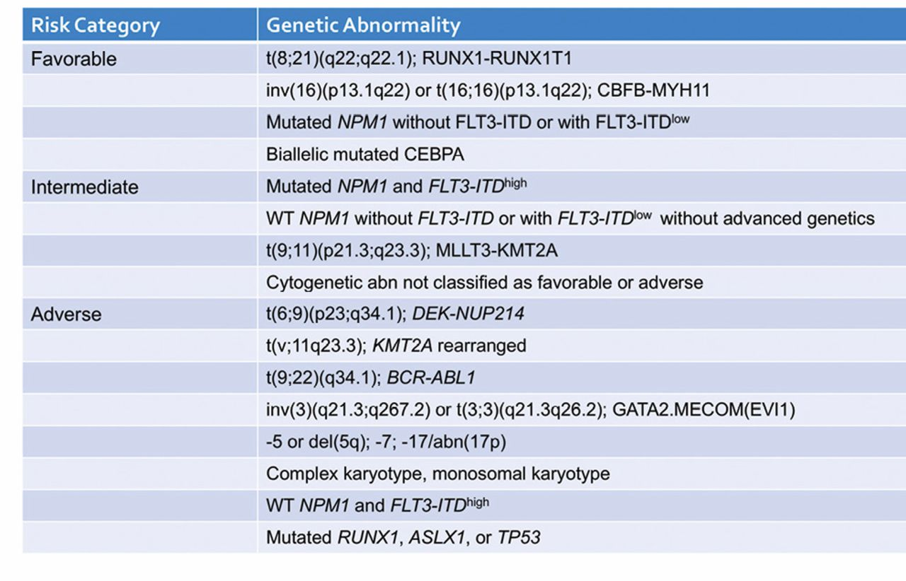
Genomic Changes and Age are the Most Important Predictors of Prognosis
2017 European Leukemia Network (ELN)
Risk Stratification by Genetics
Dohner H et al. et al. Blood. 2017;129:424-447.
Notes:
There has been a shift from a morphologic classification scheme (FAB classification) to one informed by causative genomic changes; 2016 WHO.

Slide 12
Simplified Way to Think About AML
Chemo-sensitive AML
  Core Binding Factor leukemias (without c-KIT mutation)
    t(8;21), t(16;16), inv(16)
  Diploid AML with NPM1 and CEBPα mutation (without FLT3 mutation)
  Dose intensification of chemotherapy may be helpful
Chemo-resistant AML
  AML with adverse cytogenetics
    Complex karyotype, monosomal karyotype, TP53 gene mutation
  AML with FLT3-ITD
  Secondary AMLs
    Treatment-related AML
    AML with myelodysplasia-related changes
  Older patients
  New agents are needed
Notes:
Karyotype: conventional cytogenetics
Complex karyotype: Three or more unrelated chromosome abnormalities in the absence of one of the WHO-designated recurring translocations or inversions [ie, t(8,21), inv(16); t(16,16), t(9,11), t(v,11)(v,q23.3), t(6,9), inv(3); or t(3,3), AML with BCR-ABL1].
Monosomal karyotype: Defined by the presence of one single monosomy (excluding loss of X or Y) in association with at least one additional monosomy or structural chromosome abnormality (excluding core binding factor AML).

Slide 13
How Do Patients with AML Present?
Neutropenia
  Infections
Leukocytosis
Fever
Anemia
  Pallor, fatigue, weakness, palpitations, dyspnea on exertion
Thrombocytopenia
  Easy bruising, petechiae, epistaxis, gingival bleeding, conjunctival hemorrhages
Hepatomegaly or splenomegaly
Symptoms due to impaired production of normal cells from leukemic infiltration of the bone marrow

Slide 14
Case Study
66 year-old male presented to ED for evaluation of fevers, chills, headache and worsening fatigue
CBC
  WBC 23,000 with 34% circulating blasts
  Hb 9
  Platelets 45,000
What is the next step in diagnostic evaluation?

Slide 15
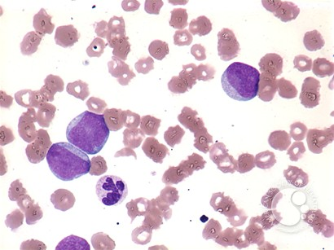
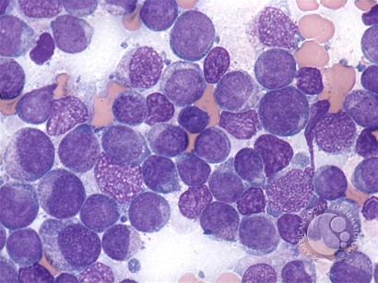
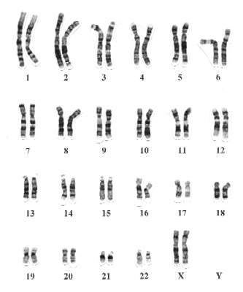
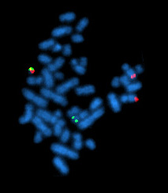
Diagnostic Evaluation
Peripheral Blood
Bone Marrow
Cytogenetics
  Molecular Studies
  NPM1, CEBPA, RUNX1, FLT3, TP53, ASXL1, PML-RARA, CBFB-MYH11, RUNX1-RUNX1T1, BCR-ABL1, other fusion genes (if available)
FISH
Dohner H et al. et al. Blood. 2017;129:424-447.
Notes:
Results from cytogenetics should be obtained preferably within 5 to 7 days. At least 20 bone marrow metaphases are needed to define a normal karyotype, and recommended to describe an abnormal karyotype.
Results from NPM1 and FLT3 mutational screening should be available within 48 to 72 hours (at least in patients eligible for intensive chemotherapy), and results from additional molecular genetics within the first treatment cycle. Screening for gene mutations is an evolving field of research; screening for single genes may be replaced by gene panel diagnostics: GeneTrails® Hematologic Malignancies 76 Gene Panel

Slide 16
Additional Tests/Procedures
Analysis of comorbidities
Chemistries, coagulation tests, urinalysis
Serum pregnancy test
Information on oocyte and sperm cryopreservation
Eligibility assessment for allogeneic HCT (including HLA typing)
Hepatitis A, B, C; HIV-1 testing
Chest radiograph
12-lead electrocardiogram
Echocardiography or MUGA
Lumbar puncture (only if CNS symptoms)
Biobanking
Dohner H et al. et al. Blood. 2017;129:424-447.

Slide 17
Case Study:
Diagnosis = AML-MRC
AML-MRC: AML with myelodysplasia-related changes
What are the treatment options?

Slide 18
Pause and Reflect
How many patients with AML have you managed?
None
<5
5-10
>10

Slide 19
Considerations for Treatment
Treatment initiation:
  Delay of a week to complete diagnostic testing doesn’t affect outcomes
  Exceptions are true emergencies such as:
    Coagulopathy, leukostasis with respiratory distress syndrome, or tumor lysis syndrome
Majority of patients who achieve complete response will relapse and few are cured
Assessing fitness for intensive therapy is major aspect of treatment planning
  Transplant eligibility
  Palliative chemotherapy
Intensive Treatment Paradigm
Induction
Suppress malignant clone with
induced hypoplasia
Consolidation
Achieve durable molecular remission with no minimal residual disease
Allogeneic Transplantation
Potentially curative for
medically fit patients
Brandwein JM et al. Am J Blood Res. 2017;7(4): 30–40.
Sekeres MA et al. Blood. 2009;113(1):28-36.
Bertoli S et al. Blood. 2013;121(14):2618-2626.
Notes:
Sekeres MA, Elson P, Kalaycio ME, et al. Time from diagnosis to treatment initiation predicts survival in younger, but not older, acute myeloid leukemia patients. Blood. 2009;113(1):28-36
Bertoli S, Bérard E, Huguet F, et al. Time from diagnosis to intensive chemotherapy initiation does not adversely impact the outcome of patients with acute myeloid leukemia. Blood. 2013;121(14):2618-2626

Slide 20
Nursing Approach to AML
Know your patient
  Family history
  Bleeding history
  Previous cancer treatment
  AML-CM Risk Score
Know the disease
  Cytogenetics, molecular markers inform treatment decisions
Know the overall treatment plan
  Induction, Consolidation, Transplant?
  Less intense therapies
Know the prognosis
  Most older patients will not survive AML; early palliative care important
Know the potential side effects and management
  Early identification and management saves lives
  Patient education
Myeloid neoplasm with germ line predisposition?
Pre-existing myeloid disorder?
Treatment-related AML?
Probability of tolerating intensive therapy?
Plus intense supportive care

Slide 21
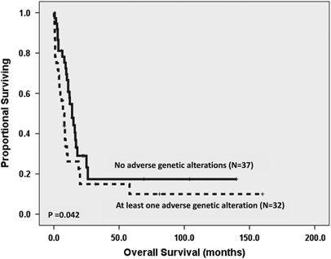
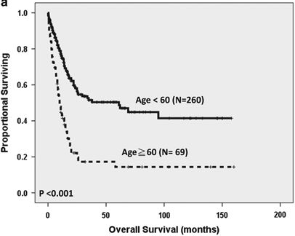
Factors that Significantly Decrease Chance of Survival
Unfavorable disease-related genetic factors: increased risk of AML resistance or recurrence
Unfavorable patient-related factors: increased risk of treatment-associated toxicity and mortality
  Physiologic age
  Poor performance status
  Complex or poorly controlled comorbidities
What tools are available to predict if your older patient can tolerate intense induction therapy?
Arber DA et al. Blood. 2016;127(20):2391-2405.
Tsai C-H et al. Leukemia. 2016;30(7):1485-1492.
Notes:
Arber, D. A., et al. (2016). Blood, 127(20), 2391–405. https://doi.org/10.1182/blood-2016-03-643544
Tsai, C.-H., Hou, H.-A., Tang, J.-L., Liu, C.-Y., Lin, C.-C., Chou, W.-C., … Tien, H.-F. (2016). Genetic alterations and their clinical implications in older patients with acute myeloid leukemia. Leukemia, 30(7), 1485–1492. https://doi.org/10.1038/leu.2016.65
The Kaplan–Meier survival curves for OS in 329 AML patients who received standard intensive chemotherapy. The older patients have significantly poorer OS and DFS than those aged below 60 years (median, 10.0 vs 61.0 months, P<0.001, and median, 3.0 vs 9.0 months, P=0.001, respectively).
The Kaplan–Meier survival curve for OS in older AML patients stratified by having adverse genetic alterations or not. The survival of older patients who harbor any unfavorable genetic alterations is more dismal compared with those who do not (OS, 7.0 vs 14.0 months, P=0.042).

Slide 22
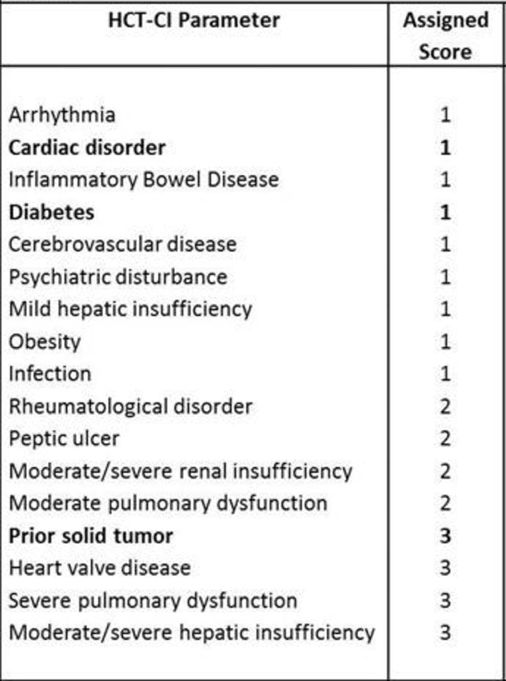
Eligibility for Intensive Therapy:
Hematopoietic Cell Transplantation-Comorbidity Index (HCT-CI) Predicts Survival for Older Patients with AML
AML patients ≥60 y/o undergoing induction (n=177)
HCT-CI Score | CR Rate | 30-day Mortality | Median Survival
0 | 64% | 3% | 11 mos
1-2 | 43% | 11% | 8 mos
≥ 3 | 42% | 29% | 5 mos
Michelis FV et al. Blood. 2015;126(23):3201; Giles FJ et al. Brit J Haematol. 2007;136(4):624-627.
Notes:
N=177 patients >/= 60 years old who received induction chemotherapy for AML
Giles, F. J., Borthakur, G., Ravandi, F., Faderl, S., Verstovsek, S., Thomas, D., … Kantarjian, H. (2007). The haematopoietic cell transplantation comorbidity index score is predictive of early death and survival in patients over 60 years of age receiving induction therapy for acute myeloid leukaemia. British Journal of Haematology, 136(4), 624–627. https://doi.org/10.1111/j.1365-2141.2006.06476.x

Slide 23
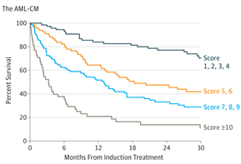
AML Composite Model (AML-CM) can Guide Decision-Making About Treatment
AML-CM HCT-CI PLUS Additional Factors
 |  | Score
Albumin | <3.5 g/dL | 1
Platelets | <20,000/mcL | 1
LDH | >200-1000 U/L | 1
 | >1000 U/L | 2
Age | 50-59 years old | 1
 | ≥60 years old | 2
ELN cytogenetic/ molecular risk group | Intermediate | 1
 | Adverse | 2
AML Composite Model. Available at http://www.AMLCompositeModel.org
Sorror ML et al. JAMA Oncology. 2017;3(12):1675-1682.
Notes:
Sorror, M. L., et al. JAMA Oncology, 2017;3(12), 1675. https://doi.org/10.1001/jamaoncol.2017.2714
The AML-CM is a new model that adds to the HCT-CI to accurately predict 1 year survival (form all causes) in AML.
A multicenter cohort study of 1100 patients was evaluated and the results demonstrated that (1) comorbidities had a significant impact on 1-year mortality after initial therapy for AML, (2) an augmented hematopoietic cell transplant–comorbidity index (HCT-CI) was the best suited index for comorbidity evaluation in AML, and (3) an AML composite model of augmented HCT-CI, age, and cytogenetic/molecular risks has a strong AUC of 0.76 for 1-year mortality.
Death within 1 year from initial therapy was the outcome of interest because it includes both early deaths due to regimen-related toxic effects or to lack of response and/or relapse of AML
Sorror, M. L., Storer, B. E., Fathi, A. T., Gerds, A. T., Medeiros, B. C., Shami, P., … Estey, E. H. (2017). Development and Validation of a Novel Acute Myeloid Leukemia–Composite Model to Estimate Risks of Mortality. JAMA Oncology, 3(12), 1675. https://doi.org/10.1001/jamaoncol.2017.2714

Slide 24
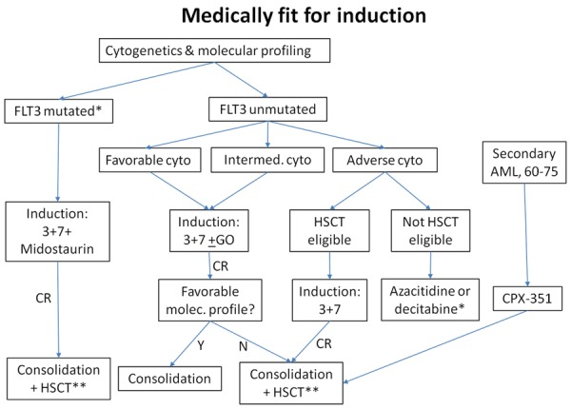
AML Treatment Algorithm
Unfit for induction
chemotherapy
Low-Intensity therapies
Clinical Trials
Azacitidine
Decitabine
Brandwein JM et al. Am J Blood Res. 2017;7(4): 30–40.
Notes:
Induction Chemotherapy x 1-2 cycles
Cytarabine + Ida or Dauno
Post-Remission therapy
Consolidation Chemotherapy x 3-4 cycles
or
Consolidation Chemotherapy x 1-2 cycles followed by HCT
Brandwein, J. M., Zhu, N., Kumar, R., Leber, B., Sabloff, M., Sandhu, I., … Schuh, A. C. (2017). Treatment of older patients with acute myeloid leukemia (AML): revised Canadian consensus guidelines. American Journal of Blood Research, 7(4), 30–40. Retrieved from http://www.ncbi.nlm.nih.gov/pubmed/28804680

Slide 25
7+3 Induction Therapy
Await Count Recovery
Recovery Bone Marrow Biopsy to determine complete remission and MRD
Daunorubicin 60-90 mg/m²
IVP on days 1-3
Cytarabine 100-200 mg/m² CIV on days 1-7
<5% blasts
Day 14 Bone Marrow Biopsy
>5% blasts
Re-induction Chemotherapy
“7+3” regimen first described by Yates et al. in 1973
44 years later, remains standard of care for medically fit patients
  CR rate in younger patients: 60-80%
  CR rate in older patients: 40-60%
  Yet, relapse inevitable in most patients
Döhner H et al. Blood. 2017;129:424–447; Yates JW et al. Cancer Chemother Rep. 1973;57:485–488.
Notes:
Yates, J.W., Wallace, H.J., Ellison, R.R., Holland, J.F., n.d. Cytosine arabinoside (NSC-63878) and daunorubicin (NSC-83142) therapy in acute nonlymphocytic leukemia. Cancer Chemother. Rep. 1973; 57, 485–488.

Slide 26
Side Effect Management in AML
Complication | Management
Prevention of Infection | Recognize early signs and symptoms of infection Emphasize the importance of hand-hygiene Avoid food exposure (raw or undercooked meats/eggs, deli meats, unpasteurized dairy products, cheeses with molds, raw honey/honey in the comb, unwashed raw fruits/vegetables, and raw vegetable sprouts)
Anti-infective prophylaxis | Bacterial prophylaxis: Quinolone recommended Fungal prophylaxis: Posaconazole recommended
Vaccination | Influenza vaccine Pneumococcal vaccine No live vaccines
Blood product support | Transfuse Hb <7 g/dL Transfuse platelets <10,000/mcL or higher if bleeding, DIC, or planned procedure Transfuse cryoprecipitate if fibrinogen <100 mg/dL Irradiate to avoid transfusion associated GVHD CMV-negative if patient is CMV Ab-negative
Fatigue | Exercise Stress management and cognitive therapies Mindfulness-based stress reduction; yoga; meditation, relaxation, group processing and discussion Nutrition: proper diet, monitor weight and hydration status, referral to a dietician) Sleep: assess sleep hygiene, establish routine sleep patterns, avoid use of stimulants
Dohner H et al. Blood. 2017;129:424-447; NCCN Guidelines AML version 1.2018; NCCN Guidelines Prevention of Cancer-Related Infections version 1.2018; Wilson B et al. Clin J Oncol Nursing. 2018;22(2):157-168.
Notes:
References:
1) https://www.nccn.org/professionals/physician_gls/pdf/infections.pdf
2) https://www.nccn.org/professionals/physician_gls/pdf/aml.pdf
3) Döhner H, Estey E, Grimwade D, et al: Diagnosis and management of AML in adults: 2017 ELN recommendations from an international expert panel. Blood 2017;129:424–447
4) Wilson, B., Zitella, L., Erb, C., Foster, J., Peterson, M., & Wood, S. (2018). Prevention of Infection: A Systematic Review of Evidence-Based Practice Interventions for Management in Patients With Cancer. Clinical Journal of Oncology Nursing, 22(2), 157–168. https://doi.org/10.1188/18.CJON.157-168
Cryoprecipitate: Each order (6 units) raises fibrinogen ~45mg/dL (in 70kg patient)

Slide 27
Novel Treatments in AML
For the first time in 45 years, new drugs have been approved by the FDA for AML
Novel agents approved in 2017
  FLT3-mutation positive: midostaurin
  CD33-positive: gemtuzumab ozogamacin
  IDH2-mutation positive: enasidenib
  Secondary AML: Liposomal daunorubicin and cytarabine
Tallman M. J Nat Comp Canc Network. 2018;16(5S):656-659.
Notes:
Tallman, M. (2018). Prognostic Significance of Molecular Markers and Targeted Regimens in the Management of Acute Myeloid Leukemia. Journal of the National Comprehensive Cancer Network, 16(5S), 656–659. https://doi.org/10.6004/jnccn.2018.0050
For the first time in 45 years, new drugs have been FDA-approved or were given breakthrough designation for AML: midostaurin (FLT3 inhibitor) for patients with FLT3 mutations and are treatment-naïve; gemtuzumab ozogamicin (GO; anti-CD33) for patients who are CD33-positive with core binding factor and possibly intermediate risk who are treatment-naïve (and may also be used in patients with relapsed/refractory AML); enasidenib (IDH2 inhibitor) for relapsed/refractory AML with IDH2 mutations; CPX-351 (new 5:1 liposomal formulation of cytarabine and daunorubicin) for treatment-naïve patients with therapy-related AML (t-AML) or AML with myelodysplasia-related changes (MRC); and venetoclax (BCL-2 inhibitor) for treatment naïve patients with low-dose cytarabine.

Slide 28
Pause and Reflect
Which induction therapies have your patients received?
7+3 induction therapy
7+3 induction therapy plus midostaurin
7+3 induction therapy plus gemtuzumab ozogamicin
Other

Slide 29
Case Study
66 year-old male with AML-MRC: AML with myelodysplasia-related changes
Induction treatment selected: liposomal daunorubicin and cytarabine

Slide 30
Liposomal Daunorubicin and Cytarabine
Indicated for the treatment of adults with newly-diagnosed therapy-related acute myeloid leukemia (t-AML) or AML with myelodysplasia-related changes (AML-MRC)
INDUCTION
Day | 1 | 2 | 3 | 4 | 5
 | X |  | X |  | X
Daunorubicin 44 mg/m² and Cytarabine 100 mg/m² liposome IV over 90 minutes on Days 1, 3, and 5
1-2 cycles induction
CONSOLIDATION
Day | 1 | 2 | 3
 | X |  | X
Daunorubicin 29 mg/m² and Cytarabine 65 mg/m² liposome IV over 90 minutes on Days 1 and 3
Up to 2 cycles consolidation
Vyxeos PI. 8.2017.
Notes:
http://pp.jazzpharma.com/pi/vyxeos.en.USPI.pdf
A full VYXEOS course consists of 1-2 cycles of Induction and up to 2 cycles of Consolidation

Slide 31
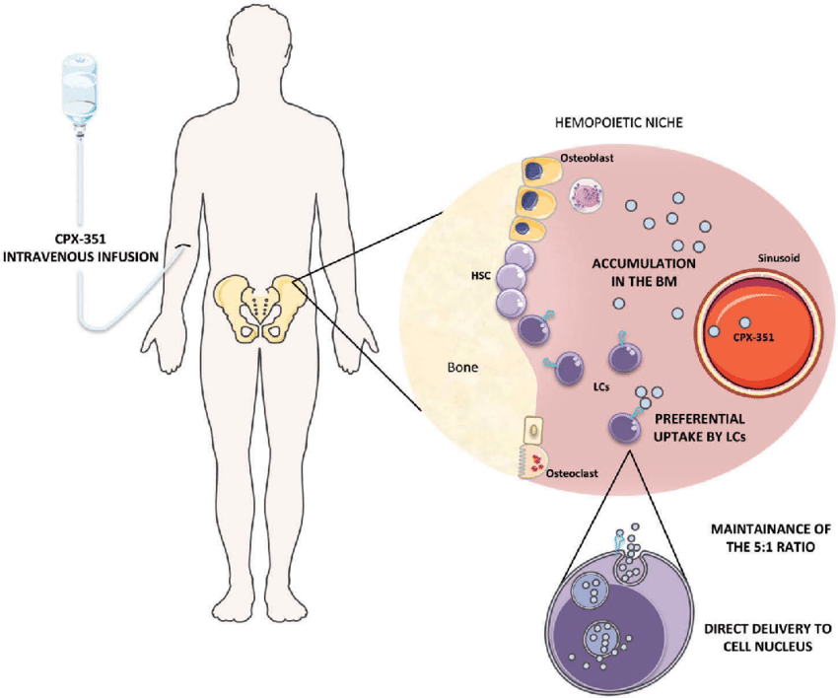
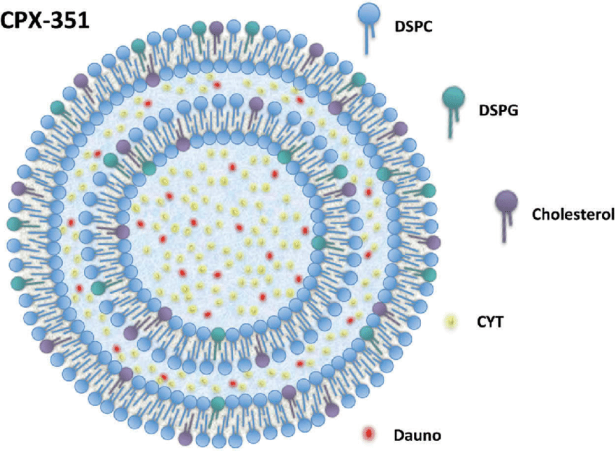
Liposomal Daunorubicin and Cytarabine
Uses a nanoscale delivery complex with fixed molar ratio of cytarabine to daunorubicin (5:1) to increase cytotoxicity
Liposomes persist in bone marrow and are taken up by leukemia cells to a greater extent than normal cells
Liposomes undergo degradation , releasing daunorubicin and cytarabine in the intracellular environment
Elevated cytarabine and daunorubicin concentrations are maintained at a synergistic ratio in the target cell
Brunetti C et al. Exp Rev Hematol. 2017;10(10):853-862.
Notes:
Brunetti, C., Anelli, L., Zagaria, A., Specchia, G., & Albano, F. (2017). CPX-351 in acute myeloid leukemia: can a new formulation maximize the efficacy of old compounds? Expert Review of Hematology, 10(10), 853–862. https://doi.org/10.1080/17474086.2017.1369400
Leukemic cells take up and accumulate more CPX-351 than normal cells due to their higher proliferation rates (possibly due to breakdown of the nuclear
membrane and enhanced drug accumulation in the S-phase) and their specific permeability for liposomes

Slide 32
Liposomal Daunorubicin and Cytarabine is Superior to 7+3 Induction in Older Patients with Secondary AML
Randomized phase III trial
  Patients age 60-75 years with high-risk AML
  CPX-351 vs “7+3”
Complete response:
  CPX-351: 37.3%
  “7+3”: 25.6%
Overall Survival
  CPX-351: 9.56 mos
  “7+3”: 5.95 mos
Preliminary subset analysis of patients who went on to allo HCT:
  CPX-351 improved median survival when compered to “7+3:
  10.25 mos vs not reached, respectively
100
ITT Analysis Population
Events, n/N
104/153
132/156
Median Survival,
Mos (95% CI)
9.56 (6.60-11.86)
5.95 (4.99-7.75)
80
CPX-351
7+3
60
HR: 0.69
P = .005
Survival (%)
40
20
0
0
3
6
9
12
15
18
21
24
27
30
33
36
Mos From Randomization
CPX-351 improved response rates and OS compared with the conventional
“7+3” regimen
Lancet JE et al. J Clin Oncology. 2016;34(15_suppl):7000.
Lancet JE et al. Blood.2016;128:Abstract 906.
Notes:
Randomized phase III trial for patients 60-75 years of age with high-risk AML comparing CPX-351 against traditional 7+3 induction.^{[2]} Patients in this study (N = 309) had previously untreated high-risk AML, defined by therapy-related disease, a history of MDS or chronic myelomonocytic leukemia, or an MDS-like karyotype
Lancet, J. E., Uy, G. L., Cortes, J. E., Newell, L. F., Lin, T. L., Ritchie, E. K., … Medeiros, B. C. (2016). Final results of a phase III randomized trial of CPX-351 versus 7+3 in older patients with newly diagnosed high risk (secondary) AML. Journal of Clinical Oncology, 34(15_suppl), 7000. https://doi.org/10.1200/JCO.2016.34.15_suppl.7000
Lancet JE, Hoering A, Uy GL, et al. Survival following allogeneic hematopoietic cell transplantation in older high-risk acute myeloid leukemia patients initially treated with CPX-351 liposome injection versus standard cytarabine and daunorubicin: subgroup analysis of a large phase III trial [abstract]. Blood 2016;128:Abstract 906.

Slide 33
Side Effects of Liposomal Daunorubicin/Cytarabine Similar to 7+3
Grade ≥3 AEs (≥5% Pts), n (%) | CPX-351 (n=153) | 7+3 (n=151)
Febrile neutropenia | 104 (68) | 107 (71)
Pneumonia | 30 (20) | 22 (15)
Hypoxia | 20 (13) | 23 (15)
Sepsis | 14 (9) | 11 (7)
Hypertension | 16 (10) | 8 (5)
Respiratory failure | 11 (7) | 10 (7)
Fatigue | 11 (7) | 9 (6)
Bacteremia | 15 (10) | 3 (2)
Reduced ejection fraction | 8 (5) | 8 (5)
Lancet JE et al. J Clin Oncology. 2016;34(15_suppl):7000.

Slide 34
Prolonged Cytopenias Associated with Liposomal Daunorubicin/Cytarabine
 | Induction |  | Consolidation
 | CPX-351 (n=58) n (%) | 7+3 (n=34) n (%) | CPX-351 (n=48) n (%) | 7+3 (n=32) n (%)
Prolonged thrombocytopenia | 16 (28) | 4 (12) | 12 (25) | 5 (16)
Prolonged neutropenia | 10 (17) | 1 (3) | 5 (10) | 1 (3)
Lancet JE et al. J Clin Oncology. 2016;34(15_suppl):7000.

Slide 35
Considerations with Liposomal Daunorubicin/Cytarabine
Pre-treatment:
  Assess cardiac function and obtain liver and
  renal function studies
Major adverse events:
  Myelosuppression, infections, bleeding
  Cardiotoxicity
    Echo pre-induction and pre-consolidation and as indicated
    Be mindful of cumulative anthracycline dose
  Copper toxicity
    Contains copper and may cause copper overload in patients with Wilson’s disease or other copper-related metabolic disorders
  Hypersensitivity reactions
  Rash
Notes:
May see prolonged neutropenia and thrombocytopenia

Slide 36
Practical Tips
Moderate emetic risk: Pre-medication: ondansetron and dexamethasone
Calculate cumulative anthracycline exposure
Do not interchange daunorubicin and cytarabine liposome with other daunorubicin and/or cytarabine products
Daunorubicin and cytarabine liposome has unique preparation instructions and takes close to an hour to prepare
  Key steps include equilibration to room temperature, reconstitution followed by swirling vial contents, and aseptically transferring the medication to an infusion bag
Dose adjustments are not required for renal or hepatic insufficiency
If patients develop a hypersensitivity reaction, pre-medicate patients with an antihistamine and/or corticosteroid prior to subsequent doses
Vesicant
  Daunorubicin has been associated with necrosis where the drug leaks into the skin and subcutaneous tissue during IV infusion.
Vyxeos PI. 8.2017.
Notes:
Daunorubicin and cytarabine liposome is metabolized in the liver and excreted renally, but has not been studied in patients with severe renal impairment/end-stage renal disease or bilirubin levels greater than 3 mg/dL.

Slide 37
Pause and Reflect
What toxicities have you treated in patients with AML receiving liposomal daunorubicin and cytarabine?
Pancytopenia-transfusion dependent
Neutropenic fevers
Mild headaches
Anorexia
Other

Slide 38
Case Study
66 year-old male with AML-MRC
  AML with myelodysplasia-related changes treated with liposomal daunorubicin and cytarabine
Toxicities:
  Pancytopenia-transfusion dependent
  Neutropenic fevers-treated with broad spectrum antibiotics, no source identified
  Mild headaches
  Anorexia

Slide 39
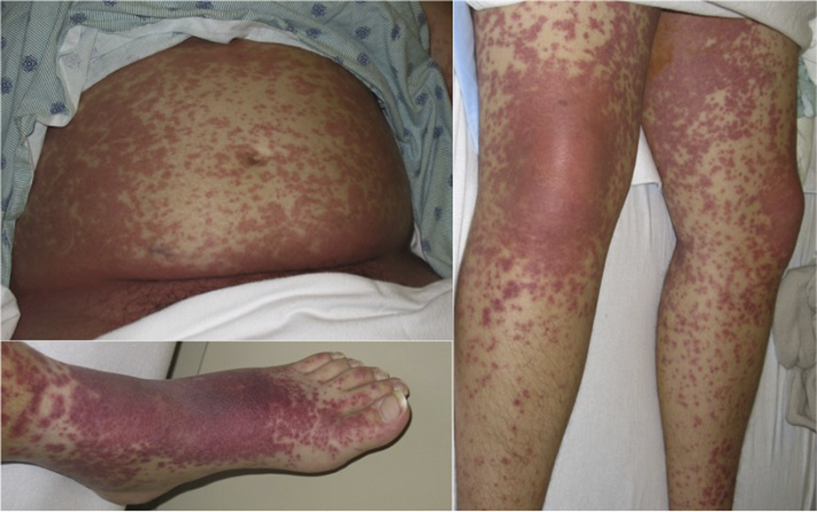
Case Study
On Day 10 after therapy, patient develops rash
Began as erythematous papules that evolved into coalescing purpuric papules and plaques, particularly over trunk and extremities
Intertriginous accentuation in the fold of the pannus
Lower extremity shows scattered palpable purpura
Dorsal right foot shows a striking purpuric plaque
Differential Diagnosis
Antibiotic-induced rash
Viral exanthem
Cytarabine-induced rash
Ruben BS et al. J Am Acad Dermatol. 2015;73(5):821-828.
Notes:
Ruben, B. S., Yu, W. Y., Liu, F., Truong, S. V., Wang, K. C., & Fox, L. P. (2015). Generalized benign cutaneous reaction to cytarabine. Journal of the American Academy of Dermatology, 73(5), 821–828. https://doi.org/10.1016/J.JAAD.2015.07.010

Slide 40
Cytarabine-Induced Rash
Benign rash, but looks impressive
Occurs 1-2 weeks after cytarabine exposure
May present as papular purpuric eruption or morbilliform eruption, particularly over trunk and extremities
May also involve the axillae, groin, back of neck, ears, and scalp
Pathology of skin biopsy typically spongiotic dermatitis
Treated with high potency topical steroid
  0.1% triamcinolone ointment
Ruben BS et al. J Am Acad Dermatol. 2015;73(5):821-828.
Notes:
Ruben, B. S., Yu, W. Y., Liu, F., Truong, S. V., Wang, K. C., & Fox, L. P. (2015). Generalized benign cutaneous reaction to cytarabine. Journal of the American Academy of Dermatology, 73(5), 821–828. https://doi.org/10.1016/J.JAAD.2015.07.010
Cytarabine-induced papular purpuric eruption. Morbilliform eruption over trunk and extremities. Note intertriginous accentuation in the fold of the pannus. Lower extremity shows scattered palpable purpura. The dorsal right foot shows a striking purpuric plaque. Pathology of skin biopsy: spongiotic dermatitis

Slide 41
Case Study
33 year-old with newly diagnosed AML with FLT3-ITD mutation
Induction treatment:
  Standard 7+3 induction therapy
    Daunorubicin 60 mg/m² IVP on Days 1-3
    Cytarabine 200 mg /m² CIV on Days 1-7
  Midostaurin 50 mg PO BID on Days 8 to 21

Slide 42
FLT3 (fms-related tyrosine kinase 3) Gene Mutations
Occur in 30% of adults with newly diagnosed AML
Two types of FLT3 mutations
  FLT3 internal tandem duplication (ITD) mutations
    ~22% incidence
    Associated with a poor prognosis owing to a high relapse rate
  FLT3 point mutation in the tyrosine kinase domain (TKD)
    ~8% incidence
    Impact of TKD mutations on prognosis is uncertain
FLT3 inhibitors prevent growth of leukemia cells
Stone RM et al. N Engl J Med. 2017;377:454-464.

Slide 43
Midostaurin
FDA approval 2017 :
  Indicated for adults with FLT3 mutation-positive AML in combination with 7+3 induction and cytarabine consolidation therapy
  Based on the RATIFY trial, which took 13 years to complete!
Dose:
  50 mg PO BID with food on Days 8-21 of each induction and consolidation cycle
Results:
  4-year survival: 51.4% on midostaurin vs 44.2% on placebo (P=.0074)
  22% reduced risk of death in midostaurin arm
  Benefit was most pronounced for patients with NPM1wt and FLT3-high
Well tolerated:
  Side effects mostly due to induction chemotherapy
  Slightly more anemia and rash than placebo
Stone RM et al. N Engl J Med. 2017;377:454-464.
Notes:
On April 28, 2017, the U.S. Food and Drug Administration approved midostaurin (RYDAPT, Novartis Pharmaceuticals Corp.) for the treatment of adult patients with newly diagnosed acute myeloid leukemia (AML) who are FLT3 mutation-positive (FLT3+), as detected by an FDA-approved test, in combination with standard cytarabine and daunorubicin induction and cytarabine consolidation.
This study is practice-changing, but more information is required to determine clinically meaningful impact based on long-term studies. The OS benefit is only 7% and the benefit was greater in patients with the FLT3^{TKD} mutation (less unfavorable) when compared with those with the FLT3^{ITD}mutation ( more unfavorable).
Midostaurin is approved in Europe for maintenance, but not in the United States. Maintenance may be important in this setting.
Midostaurin is among the least potent FLT3 inhibitors: more potent FLT3 inhibitors in development are gilteritinib, quizartinib, and crenolanib.
Stone, R. M., Mandrekar, S. J., Sanford, B. L., Laumann, K., Geyer, S., Bloomfield, C. D., … Döhner, H. (2017). Midostaurin plus Chemotherapy for Acute Myeloid Leukemia with a FLT3 Mutation. New England Journal of Medicine, 377(5), 454–464. https://doi.org/10.1056/NEJMoa1614359

Slide 44
Case Study: Day 10 of Induction Therapy
Temperature 39 °C
HR 124
RR 24
BP 70/39
WBC 0.2
ANC 0
Hb 8.5
Platelets 24, 000
What is your concern?

Slide 45
Definitions for Sepsis Changed Significantly in 2015
 | Sepsis | Severe Sepsis | Septic Shock
1991-2015 | Suspected or documented infection PLUS 2 or more SIRS criteria: Temperature >38 °C or <36 °C Heart rate >90/min Respiratory rate >20/min or Paco₂ <32 mm Hg (4.3 kPa) White blood cell count >12 000/mm³ or <4000/mm³ or >10% immature bands | Sepsis and organ dysfunction | “Sepsis-induced hypotension persisting despite adequate fluid resuscitation.”
2015 | “Life threatening organ dysfunction caused by dysregulated host response to infection” | N/A | Subset of sepsis in which underlying circulatory and cellular/metabolic abnormalities are profound enough to substantially increase mortality
2015 Clinical Criteria | Suspected or documented infection and an acute increase of ≥2 SOFA points (a proxy for organ dysfunction) | N/A | Sepsis and vasopressor therapy required to achieve MAP ≥65 mmHg and lactate >2 mmol/L despite adequate fluid resuscitation
Patients who meet 2015 clinical criteria for
sepsis have hospital mortality ~10%
and patients who meet criteria for
septic shock have hospital mortality ~40%
SIRS, systemic inflammatory response syndrome
Singer M et al. JAMA. 2016;315(8):801-810.
Notes:
Sepsis is defined as life-threatening organ dysfunction caused by a dysregulated host response to infection. Even a modest degree of organ dysfunction when infection is first suspected is associated with an in-hospital mortality in excess of 10%
Organ dysfunction can be identified as an acute change in total SOFA score ≥2 points consequent to the infection.
The baseline SOFA score can be assumed to be zero in patients not known to have preexisting organ dysfunction.
A SOFA score ≥2 reflects an overall mortality risk of approximately 10% in a general hospital population with suspected infection. Even patients presenting with modest dysfunction can deteriorate further, emphasizing the seriousness of this condition and the need for prompt and appropriate intervention, if not already being instituted.
In lay terms, sepsis is a life-threatening condition that arises when the body’s response to an infection injures its own tissues and organs.
Patients with suspected infection who are likely to have a prolonged ICU stay or to die in the hospital can be promptly identified at the bedside with qSOFA, ie, alteration in mental status, systolic blood pressure ≤100 mm Hg, or respiratory rate ≥22/min.
Septic shock is a subset of sepsis in which underlying circulatory and cellular/metabolic abnormalities are profound enough to substantially increase mortality.
Patients with septic shock can be identified with a clinical construct of sepsis with persisting hypotension requiring vasopressors to maintain MAP ≥65 mm Hg and having a serum lactate level >2 mmol/L (18 mg/dL) despite adequate volume resuscitation. With these criteria, hospital mortality is in excess of 40%.
Reference:
Singer, M., Deutschman, C. S., Seymour, C. W., Shankar-Hari, M., Annane, D., Bauer, M., … Angus, D. C. (2016). The Third International Consensus Definitions for Sepsis and Septic Shock (Sepsis-3). JAMA, 315(8), 801. https://doi.org/10.1001/jama.2016.0287

Slide 46
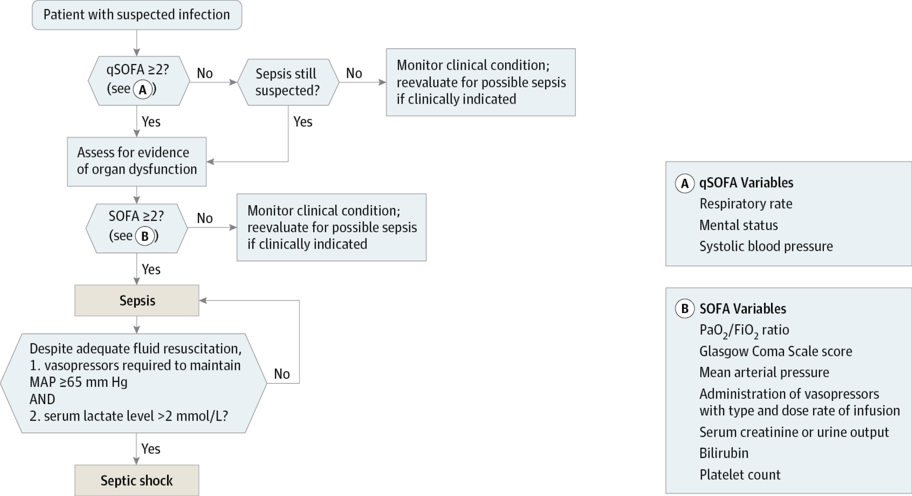
How to Recognize Patients With Sepsis and Septic Shock: SOFA and qSOFA
MAP, mean arterial pressure; qSOFA, quick SOFA; SOFA, Sequential [Sepsis-related] Organ Failure Assessment
Singer M et al. JAMA. 2016;315(8):801-810.
Notes:
Sequential [Sepsis-related] Organ Failure Assessment (SOFA) score should be assumed to be zero unless the patient is known to have preexisting (acute or chronic) organ dysfunction before the onset of infection.
Key Concepts in Sepsis:
Sepsis is the primary cause of death from infection, especially if not recognized and treated promptly. Its recognition mandates urgent attention.
• Sepsis is a syndrome shaped by pathogen factors and host factors (eg, sex, race and other genetic determinants, age, comorbidities, environment) with characteristics that evolve over time. What differentiates sepsis from infection is an aberrant or dysregulated host response and the presence of organ dysfunction.
• Sepsis-induced organ dysfunction may be occult; therefore, its presence should be considered in any patient presenting with infection. Conversely, unrecognized infection may be the cause of new-onset organ dysfunction. Any unexplained organ dysfunction should thus raise the possibility of underlying infection.
• The clinical and biological phenotype of sepsis can be modified by preexisting acute illness, long-standing comorbidities, medication, and interventions.
• Specific infections may result in local organ dysfunction without generating a dysregulated systemic host response.
Reference:
Singer, M., Deutschman, C. S., Seymour, C. W., Shankar-Hari, M., Annane, D., Bauer, M., … Angus, D. C. (2016). The Third International Consensus Definitions for Sepsis and Septic Shock (Sepsis-3). JAMA, 315(8), 801. https://doi.org/10.1001/jama.2016.0287

Slide 47
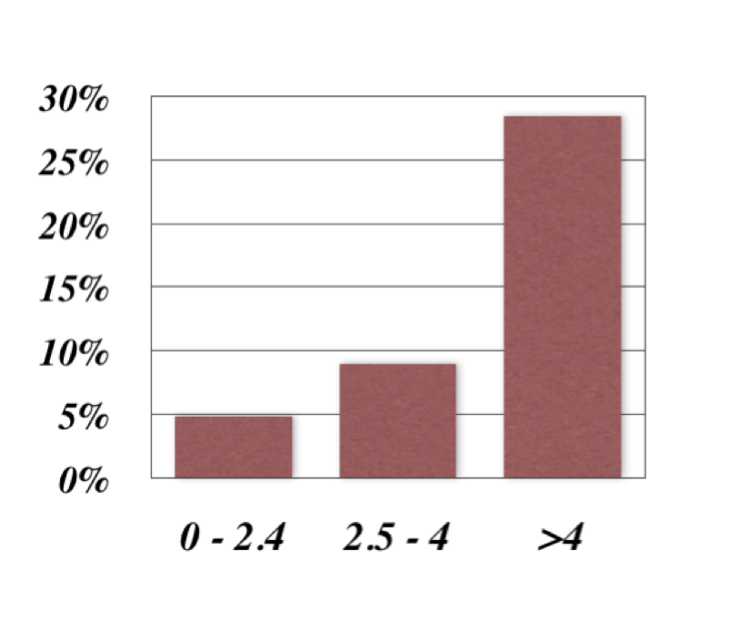
Elevated Lactate Predicts Mortality in Patients with Sepsis
Lactate
  Marker of cellular hypoxia and metabolic acidosis
  Normal level <2
  Levels >4 associated with increased mortality
With serial testing, decreasing lactate is a marker of improved perfusion, reduced mortality, and better prognosis – rising lactate levels suggests the opposite.
Mortality Risk Relative to Lactate Level
Howell MD et al. Intensive Care Med. 2007;33(11):1892-1899.
Shapiro NI et al. Ann Emerg Med. 2005;45(5):524-528.
Notes:
Normally lactate should be < 2 mmol/L.
Levels > 4 mmol/L are associated with severe malperfusion and such patients should be considered in severe sepsis.
Elevated levels over 4 mmol/L are associated with an ~ 27% increase in mortality above whatever mortality is present due to the septic process.
With repeat levels (delta lactate) decreasing lactate is a marker of improved perfusion, reduced mortality, and better prognosis – rising delta lactate suggests the opposite.
With tissue ischemia secondary to falling perfusion cells become hypoxic and switch over to anaerobic metabolism.
One of the major markers of this process is a marked rise in lactic acid resulting in a metabolic acidosis

Slide 48
Management of Sepsis
WITHIN 1 HOUR:
Goal:
MAP >65 mmHg, signs of improved perfusion
(normalization of lactate, normal organ function)
Levy MM et al. Crit Care Med. 2018;46(6):997-1000.
Rhodes A et al. Crit Care Med. 2017;45:486-552.
Notes:
Levy, M. M., Evans, L. E., & Rhodes, A. (2018). The Surviving Sepsis Campaign Bundle. Critical Care Medicine, 46(6), 997–1000. https://doi.org/10.1097/CCM.0000000000003119
Rhodes et al., Crit Care Med 2017; 45:486–552

Slide 49
Case Study
Blood cultures: 2 sets obtained
UA and urine culture obtained
CXR: no evidence of infection
Lactate: 4
Treatment
Started antibiotics: Piperacillin-tazobactam 3.375 g IV bolus then extended infusion over 4 hours q 8 hrs
Fluids: weight 96.4 x 30 mL/kg = 2892 mL NS
Given 3 liters NS
After Fluid Resuscitation
Repeat Lactate: 1.7
BP 108/63
HR 84
RR 18
Temp: 38.2 C

Slide 50
Case Study
Diagnosis: Sepsis due to e. coli bacteremia
Blood cultures (4/4 bottles): e. coli
Sensitive to piperacillin-tazobactam
Bacteremia resolved with piperacillin-tazobactam
Surveillance cultures negative
ANC recovery at Day 32
Achieved CR1
  Bone marrow biopsy on Day 14: hypoplasia
  Bone marrow biopsy after count recovery: CR1
Consolidation treatment:
  IDAC 1.5 g/m² IV over 3 h on days 1-3
  Midostaurin 50 mg PO BID on Days 8 to 21
Allogeneic transplant

Slide 51
Clinical Pearls About Serious Infections
Infection associated with hypotension or respiratory failure carries a poorer prognosis
Infection with gram negative organisms has a greater risk of septic shock than gram positive organisms
Abdominal source of sepsis is more fatal than any other source
The longer a person is ill, hospitalized, or immune compromised, the greater their chance of developing significant sepsis
Sepsis worsens other clinical complications (e.g. malnutrition, adrenal insufficiency)

Slide 52
Pause and Reflect
What protocols do you follow to prevent infection in patients with AML?
NCCN
Professional guideline (not NCCN)
Institutional protocol
Other

Slide 53
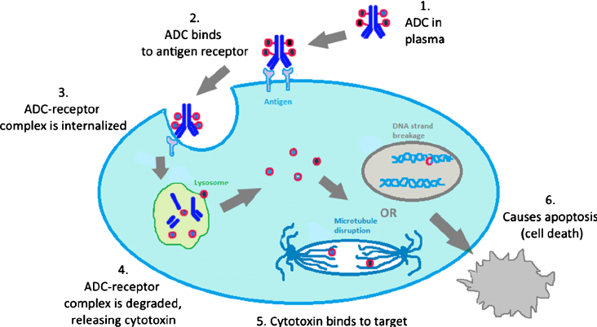
Gemtuzumab Ozogamicin (GO)
Indication:
Newly diagnosed CD33-positive AML in adults
Relapsed or refractory CD33-positive AML in adults and in pediatric patients 2 years and older
Jain, N., et al. Pharmaceutical Research, 32(11), 3526–40.
Mechanism of action:
Antibody-drug conjugate targeted to CD33
CD33 present on AML blasts, not normal hematopoietic stem cells
Appelbaum FR, Bernstein ID. Blood. 2017;130(22):2373-2376.
Castaigne S et al. Lancet. 2012;379(9825):1508-1516.
Notes:
Picture:
Mechanism of action of ADCs: The antibody portion of an ADC hones onto a cell-surface antigen that is ideally specific to a cancer cell. Upon binding, the ADC-antigen protein complex becomes internalized into the cancer cell. When the complex is degraded, it releases the cytotoxin which then binds to its target to cause cancer cell apoptosis.
Image Credit:
Jain, N., Smith, S. W., Ghone, S., & Tomczuk, B. (2015). Current ADC Linker Chemistry. Pharmaceutical Research, 32(11), 3526–40. https://doi.org/10.1007/s11095-015-1657-7
CD33 (or Siglec 3) is a transmembrane receptor expressed by cells of myeloid origin but not by normal hematopoietic stem cells
ALFA-701 and Subsequent Meta-analyses
The pivotal trial presented by the sponsor to the FDA was ALFA-0701, a French multi-center open-label, 1:1 randomized trial of GO (3 mg/m2 days 1, 4 and 7) plus daunorubicin 60/mg/m2 on days 1 to 3, and cytarabine 200mg/m2 as continuous infusion days 1 to 7 (DA) versus DA alone for induction and consolidation involving 271 patients age 50-70 with untreated de novo AML.20 The CR rates in the two arms were similar (70.4% versus 69.9% for GO+DA versus DA),
but the 3-year event-free survival (the primary endpoint of the study) was significantly higher in the GO+DA arm (39.8% versus 13.6%, p<0.001). Along with S0106 and ALFA-0701, three other randomized trials testing the addition of GO in induction therapy have been conducted and reported.21-23 These studies differed somewhat in patient-related variables, induction regimens, and the dose and schedule of GO.24 A meta-analysis that included the 3325 patients entered
onto these 5 studies concluded that, while not increasing the proportion of patients achieving a complete remission (odds ratio [OR] 0.91, p=0.3), the addition of GO significantly reduced the risk of relapse (OR 0.81, p=0.0001), and improved relapse-free (OR 0.87, p=0.005) and overall survival at 5 years (OR 0.90, p=0.01).24 The survival benefit was most apparent in patients with favorable risk cytogenetics (OR 0.47, p=0.0006), and also seen in those with intermediate risk
disease (OR 0.84, p=0.005), but not in those with adverse risk AML.
Reference: Appelbaum, F. R., & Bernstein, I. D. (2017). Gemtuzumab ozogamicin for acute myeloid leukemia. Blood, 130(22), 2373–2376. https://doi.org/10.1182/blood-2017-09-797712

Slide 54
Gemtuzumab Ozogamicin (GO):
An Old Drug is New Again
Originally approved by the FDA in 2000, withdrawn in 2010, and then reintroduced in 2017
Based on ALFA-0701 trial: Patients with AML ages 50-70 years treated with GO plus standard 7+3
  Improved event-free survival in all patients
  Improved overall survival in favorable-risk > intermediate risk disease, not in poor-risk disease
Given in a fractionated schedule to reduce toxicity
 | Induction |  |  |  | Consolidation
Day | 1 | 4 | 7 | 8 | 1
Newly diagnosed AML; in combination with daunorubicin/cytarabine | 3 mg/m² | 3 mg/m² | 3 mg/m² |  | 3 mg/m²
Newly diagnosed AML; single agent | 6 mg/m² |  |  | 3 mg/m² | 2 mg/m² | Up to 8 cycles Q4W
Relapsed or refractory AML; single agent | 3 mg/m² | 3 mg/m² | 3 mg/m²
Appelbaum FR, Bernstein ID. Blood. 2017;130(22):2373-2376.
Castaigne S et al. Lancet. 2012;379(9825):1508-1516.
Notes:
Appelbaum, F. R., & Bernstein, I. D. Blood, 2017; 130(22), 2373–2376. Castaigne, S., et al., The Lancet, 2012; 379(9825), 1508–1516
On September 1, 2017, the U.S. Food and Drug Administration (FDA) approved gemtuzumab ozogamicin for the treatment of adults with newly diagnosed CD33+ acute myeloid leukemia and for patients aged 2 years and older with CD33+ AML who have experienced a relapse or who have not responded to initial treatment.
Originally approved in May, 2000, for patients age >60 with CD33+ AML who were not candidates for aggressive chemotherapy. Dose was 9 mg/m2 IV on days 1 and 14. As part of their post-approval commitment, the drug sponsor worked with the Southwest Oncology Group to develop study S0106, which randomized 637 adults up to age 60 with de novo AML to receive up to 2 cycles of standard daunorubicin/cytarabine induction with or without a single dose of GO (6 mg/m2 ) on day 4.12 In an effort to balance toxicities on the two arms, the daunorubicin dose was reduced from 60 mg/m2 in the control arm to 45 mg/m2 in the GO arm. The results of the study showed no overall improvement in survival and increased treatment-related mortality in the experimental arm, leading to GO’s withdrawal from the commercial market in October, 2010. The recent reapplication and FDA approval are based on increased understanding of GO dosing, specific results of the pivotal study ALFA-701, and extensive additional clinical experience with the drug
Reference: Appelbaum, F. R., & Bernstein, I. D. (2017). Gemtuzumab ozogamicin for acute myeloid leukemia. Blood, 130(22), 2373–2376. https://doi.org/10.1182/blood-2017-09-797712
An OS benefit is seen in favorable-risk patients and a trend toward improved survival is seen in intermediate-risk patients. Event-free survival was significantly improved with GO plus daunorubicin and cytarabine versus daunorubicin and cytarabine in the ALFA-0701 trial of patients aged 50 to 70 years with newly diagnosed AML (P=.003).
Reference: Castaigne, S., Pautas, C., Terré, C., Raffoux, E., Bordessoule, D., Bastie, J.-N., … Acute Leukemia French Association. (2012). Effect of gemtuzumab ozogamicin on survival of adult patients with de-novo acute myeloid leukaemia (ALFA-0701): a randomised, open-label, phase 3 study. The Lancet, 379(9825), 1508–1516. https://doi.org/10.1016/S0140-6736(12)60485-1
GO was approved by the FDA in 2000, withdrawn, and then reintroduced. Currently, it is given in a fractionated schedule to reduce toxicity.
Recommended dose:
• Newly diagnosed de novo AML (in combination with daunorubicin and cytarabine): 3 mg/m2
on days 1, 4 and 7 for induction and 3 mg/m2 on day 1 for consolidation
• Newly diagnosed AML (single agent): 6 mg/m2 on day 1 and 3 mg/m2 on day 8 for induction,
followed by up to 8 continuation cycles of 2 mg/m2 on day 1 every 4 weeks
• Relapsed or refractory AML (single agent): 3 mg/m2 on days 1, 4 and 7

Slide 55
Gemtuzumab Ozogamicin:
Significant Side Effects
Infusion-related toxicities (chills, fever and mild hypotension)
Myelosuppression
Persistent thrombocytopenia
Hyperbilirubinemia
Veno-occlusive disease (VOD) of the liver
Appelbaum FR, Bernstein ID. Blood. 2017;130(22):2373-2376.
Notes:
Appelbaum, F. R., & Bernstein, I. D. Blood 2017; 130(22), 2373–2376.
The acute infusion-related toxicities seen with GO are transient and usually respond to standard interventions. As expected with an agent that eliminates early myeloid precursors, bone marrow suppression is seen with GO used as a single agent. When added to combination chemotherapy in the ALFA-701 trial, myeloid recovery following induction was not delayed, while platelet recovery was prolonged by four days. The toxicity of greatest concern is the development of VOD. The risk of VOD appears to be relatively low when individual doses of no greater than 3 mg/m2 are used in combination with conventional therapy as part of initial therapy of AML, but the risks increase with higher doses or use of the drug in more heavily pre-treated patients
Reference: Appelbaum, F. R., & Bernstein, I. D. (2017). Gemtuzumab ozogamicin for acute myeloid leukemia. Blood, 130(22), 2373–2376. https://doi.org/10.1182/blood-2017-09-797712

Slide 56
Case Study
72 year-old woman AML with relapsed AML, IDH2-mutation positive
Started enasidenib 100 mg orally once daily with or without food
Plan to treat for a minimum of 6 months to allow time for a clinical response
Monitor CBC and CMP prior to initiation and every 2 weeks for the first 3 months during treatment
Notes:
Enasidenib-oral mIDH2 inhibitor

Slide 57
Pause and Reflect
When would you instruct the patient to call the immediately?
They are more fatigued than usual
They experience fever or chills
They experience nausea or vomiting
They experience tenderness or swelling in the abdomen

Slide 58
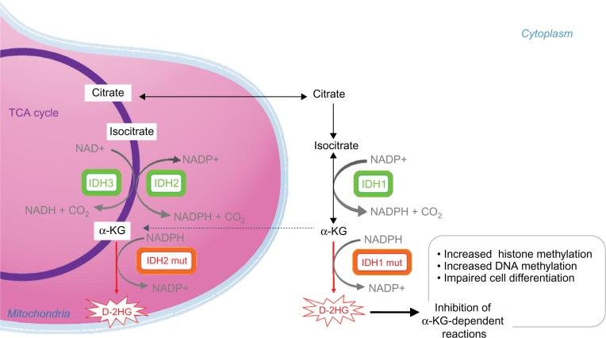
IDH1 and IDH2 in AML
IDH: cellular enzyme
IDH1 and IDH2 mutations
  Alter DNA methylation blocking myeloid differentiation
  Prevent blasts in the bone marrow from differentiating into mature functioning blood cells
Mutations in ~12% of AML
Prognostic implication of the IDH1/2 mutations remain unclear
αKG, alpha ketoglutarate; D-2HG, D-2-hydroxyglutarate; IDH, isocitrate dehydrogenase; DNA, deoxyribonucleic acid; mut, mutated; NAD, nicotinamide adenine dinucleotide; NADP, nicotinamide adenine dinucleotide phosphate; TCA cycle, tricarboxylic acid cycle
Mondesir J. et al. J Blood Med. 2016;7:171-180.
Stein EM et al. Blood. 2017;130:722-731.
Notes:
Mondesir, J., et al., Journal of Blood Medicine, 2016; 7, 171–80. https://doi.org/10.2147/JBM.S70716
Stein, E.M., et al. Blood, 2017;130(6), 722–731. https://doi.org/10.1182/blood-2017-04-779405
Image Credit: Mondesir, J., Willekens, C., Touat, M., & de Botton, S. (2016). IDH1 and IDH2 mutations as novel therapeutic targets: current perspectives. Journal of Blood Medicine, 7, 171–80. https://doi.org/10.2147/JBM.S70716
The IDH family of enzymes comprises three proteins located in the cytoplasm and peroxysomes (IDH1), and mitochondria (IDH2 and IDH3). IDH1 and IDH2 catalyze the reversible NADP+-dependent oxidative decarboxylation of isocitrate to αKG. IDH3 catalyzes the NAD+-dependent conversion of isocitrate to αKG in the TCA cycle. IDH1 and IDH2 mutant enzymes gain neomorphic enzymatic activity, converting NADPH and αKG to NADP+ and D-2HG. D-2HG acts as a weak competitive inhibitor of αKG-dependent dioxygenases. αKG-dependent dioxygenases are involved in various cellular processes such as hypoxia, angiogenesis, maturation of collagens of the extracellular matrix, and regulation of epigenetics. Excess of D-2HG is associated with increased histone and DNA methylation, altering cancer cells differentiation.
Stein, E. M., DiNardo, C. D., Pollyea, D. A., Fathi, A. T., Roboz, G. J., Altman, J. K., … Tallman, M. S. (2017). Enasidenib in mutant IDH2 relapsed or refractory acute myeloid leukemia. Blood, 130(6), 722–731. https://doi.org/10.1182/blood-2017-04-779405
Somatic mutations in IDH1 and IDH2 genes have been described in both solid and hematologic malignancies; mIDH1 is more common in solid tumors, and mIDH2 is more common in hematologic tumors. Recurrent IDH1 mutations have been observed in 6% to 10% of patients with AML. Mutations in IDH1 or IDH2 are seen in approximately 15% to 20% of patients with AML. Mutated IDH reduces α-ketoglutarate to 2-hydroxyglutarate (2-HG), leading to histone hypermethylation and a block in myeloid differentiation, and may also exert leukemogenic effects by inducing dependence on BCL2 and inhibiting homologous recombination. (References: Stein EM. Molecular pathways: IDH2 mutations-co-opting cellular metabolism for malignant transformation. Clin Cancer Res. 2016;22:16-19. and DiNardo, CD, et al. Ivosidenib (AG-120) in mutant IDH1 AML and advanced hematologic malignancies: results of a phase 1 dose escalation and expansion study. Blood. 2017;130:725.)

Slide 59
Enasidenib: IDH2 inhibitor
Responses
Overall response rate: 37%
Complete morphologic remission: 20%
Stable disease: 40% to 50%
Stein EM et al. Blood. 2017;130:722-731.
Notes:
Most common: indirect hyperbilirubinemia (38%) and nausea ( 23%).
Common
vomiting, diarrhea, anorexia
leukocytosis (often noninfectious)
Unlike cytotoxic chemotherapy, myelosuppression is uncommon
Other less common side effects
electrolyte disturbances (hypocalcemia, hypokalemia, hypophosphatemia)
differentiation syndrome
TLS
Stein and colleagues (2017) evaluated enasidenib in a phase I/II clinical trial to evaluate the maximum tolerated dose, pharmacokinetics and pharmacodynamics, safety profile, and clinical efficacy.
Enasidenib is an oral, selective inhibitor of isocitrate dehydrogenase2 (IDH2). Approved by FDA for treatment of relapsed/refractory AML with IDH2 mutation. IDH2 mutation occurs in ~12% of patients.
The trial included 239 adults with IDH2-mutated relapsed/refractory AML or myelodysplastic syndromes with refractory anemia with excess blasts (RAEB), with AML patients representing the largest subgroup in the study (74% of all patients; Stein et al., 2017). The median age was 77 years (range 58-87) with 62% of patients 75 years or older. During the dose escalation phase, patients received enasidenib either daily (dose range, 50–650 mg) or twice daily (dose range, 30–150 mg) in continuous 28-day cycles. A dose of 100 mg daily was chosen for the dose expansion phase based on achieved steady-state concentrations, plasma 2-HG reduction, and clinical efficacy.
The overall response rate (ORR) was 40.3%, with 34 patients (19.3%) achieving a complete remission. Median time to first response was 1.9 months (range, 0.5–9.4 months), with 87.3% patients obtaining a response by cycle 5. Clinical activity was observed in patients with IDH2mutations R140 and R172 (ORR 35.4% and 53.3%, respectively) and 2-HG suppression from baseline to cycle 2; day 1 was not correlated with clinical response. Median overall survival (OS) was 9.3 months (95% confidence interval [CI] = 8.2–10.9 months), and estimated 1-year survival was 39%. For patients achieving a complete or partial remission, median OS was 19.7 months and 14.4 months, respectively. Median event-free survival duration was 6.4 months (95% CI = 5.4–7.5 months), and 30-day mortality was 5.1% (Stein et al., 2017). Of the 157 patients who were red blood cell and/or platelet transfusion dependent prior to study entry, 34% achieved transfusion independence.
Stein, E. M., DiNardo, C. D., Pollyea, D. A., Fathi, A. T., Roboz, G. J., Altman, J. K.,…Tallman, M. S. (2017). Enasidenib in mutant IDH2 relapsed or refractory acute myeloid leukemia. Blood, 130(6), 722–731. https://doi.org/10.1182/blood-2017-04-779405

Slide 60
Case Study
Three months after starting enasidenib, presents with shortness of breath and fevers
Temp 101.8 HR 106 BP 142/78 RR 24
PE: bibasilar rales and 1+ bilateral pedal edema
Differential diagnosis:
  Infection
  Differentiation syndrome

Slide 61
IDH-Inhibitor-Associated Differentiation Syndrome (IDH-DS)
Signs/Symptoms | Management
IDH-DS and pulmonary or renal manifestations | Hospitalize for continued close observation
Severe pulmonary symptoms and/or renal dysfunction attributed to IDH-DS persist for >48 hours after initiation of corticosteroids | Treatment with enasidenib should be interrupted. Note: Due to long the half-life of enasidenib (~45 hours), treatment interruption may not immediately reverse IDH-DS symptoms. Enasidenib may be reinitiated at the original dose after IDH-DS improves to Grade 2 (moderate) or lower
Elevated WBC count (>30x10⁹ /L or rapidly rising) | Prompt initiation of hydroxyurea is suggested. In cases of severe leukocytosis, leukapheresis may be appropriate
Substantial edema or weight gain | Initiation of furosemide may be appropriate
Pericardial effusion (rare symptom of IDH-DS, but can be life-threatening) | Urgent intervention is required; patient should be managed, when appropriate, in consultation with a cardiac specialist.
Increasing serum creatinine | Evaluate for concurrent tumor lysis syndrome (TLS)
Rapid increase in peripheral blood cells | Monitor for disseminated intravascular coagulopathy and related bleeding complications
Stein EM et al. Blood. 2017;130:722-731.
Notes:
Stein EM et al. Blood. 2017;130:722-731. https://doi.org/10.1182/blood-2017-04-779405
Unlike DS associated with all-trans retinoic acid therapy for patients with acute promyelocytic leukemia (APL), IDH-DS tended to occur later, typically during initial myeloid maturation within the first 3-4 months following initiation of enasidenib therapy. There is no pathognomonic clinical sign or laboratory test to diagnose IDH-DS and in some cases, clinical presentation can be confounded by other medical condition(s), such as infections or heart failure. Consequently, IDH-DS diagnosis is made by excluding other potential causes.
IDH-DS should be strongly suspected if the following signs or symptoms–with no other clear or established etiology–emerge during enasidenib therapy:
• New or worsening progressive dyspnea or hypoxemia, with increasing demands for supplemental oxygen; respiratory distress refractory to treatment for the initially suspected cause • Radiologic evidence of new or worsened bilateral pulmonary involvement (infiltrates or opacities) with or without presence of infection, refractory to treatment with antiinfectives (antibiotics, antivirals, antifungals) • Radiologic evidence of new or worsened pleural or pericardial effusion that is refractory to treatment for an initially suspected cause • New or worsened peripheral edema, with rapid weight gain (e.g., >5 kg/11 pounds over 7 days) • Increase in serum creatinine (e.g., >2-fold from baseline)
• The following symptoms or signs may be features of IDH-DS, but if isolated and not accompanied by pulmonary or renal manifestations, may not require rapid initiation of IDH-DS treatment (unless sufficiently severe and prolonged):
− Unexplained fever ≥38°C (100.4°F) − Rash of unknown origin − Bone pain − Lymphadenopathy
Signs and symptoms consistent with IDH-DS but refractory to treatment or that worsen in the first 48 hours in initiating treatment for the initially suspected cause(s), should be managed as potential IDH-DS. In case of uncertain diagnosis (e.g., less specific symptoms), patients should be closely monitored, as condition can rapidly deteriorate. 1. Initiate corticosteroids immediately (e.g., dexamethasone 10-mg every 12 hours) when IDH-DS is first suspected until improvement, followed by progressive steroid dose reduction 2. Interrupt enasidenib if severe pulmonary symptoms and/or renal dysfunction persist after 48 hours of treatment with systemic steroids 3. Resume enasidenib when symptoms improve (in the current study, patients who experienced IDH-DS did not require permanent discontinuation of enasidenib)

Slide 62
Case Study
Admitted to hospital
Started dexamethasone 10 mg IV q 12hr
Held enasidenib
Shortness of breath and fevers resolved within 24 hrs
Started steroid taper and discharged from hospital
Able to restart enasidenib

Slide 63
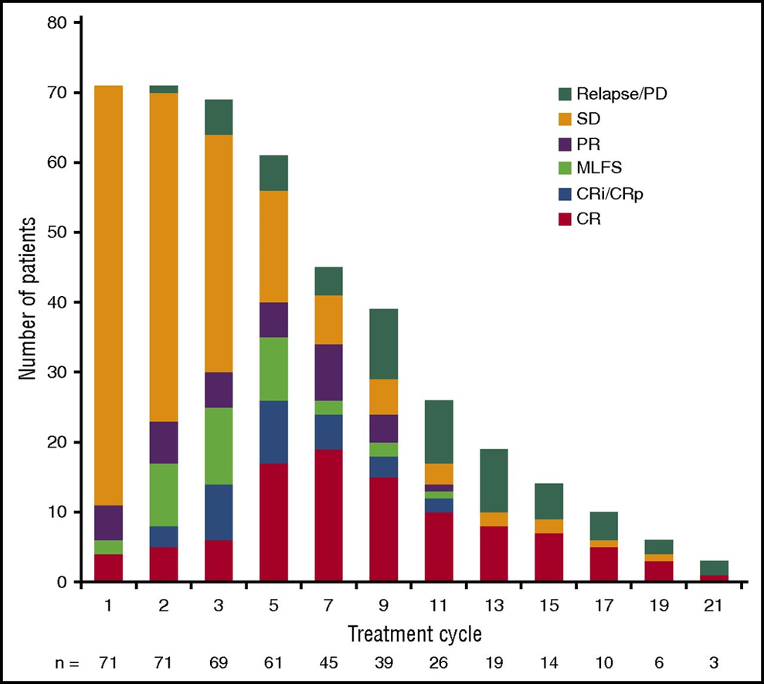
Case Study
Continued drug and achieved CR at 5 months
Enadesinib promotes bone marrow differentiation and maturation (not ablation), so it takes time to see effect
Educate patient that it takes time to achieve response
  Median time to first response 1.9 months (range, 0.5–9.4 months)
  87.3% patients obtained a response by cycle 5
CR, complete response; CRi, CR with incomplete hematologic recovery; CRp, CR with incomplete platelet recovery; MLFS, morphologic leukemia-free state; PD, progressive disease; PR, partial response; SD, stable disease.
Stein EM et al. Blood. 2017;130:722-731.
Notes:
Evolution of response during treatment of responding patients (n = 71). Bars reflect responses at each cycle. CR, complete response; CRi, CR with incomplete hematologic recovery; CRp, CR with incomplete platelet recovery; MLFS, morphologic leukemia-free state; PD, progressive disease; PR, partial response; SD, stable disease.

Slide 64
Summary
AML is a complex hematologic malignancy driven by multiple acquired genetic mutations that evolves over time
Clonal expansion of leukemia cells leads to bone marrow failure and related complications: severe infections, anemia, and bleeding
Age and genomic abnormalities are the most significant predictors of survival
Most newly diagnosed patients are >60 years old and AML in older adults remains a major therapeutic challenge
In 2017, 4 new agents approved for AML, bringing promise of better outcomes
Future successes will depend on further refining risk categories and treatment algorithms for older patients with AML, and incorporation of novel treatments

Slide 65
Suggested Readings
Brandwein JM, Zhu N, Kumar R et al. Treatment of older patients with acute myeloid leukemia (AML): revised Canadian consensus guidelines. American Journal of Blood Research. 2017;7(4):30–40.
Available at http://www.ncbi.nlm.nih.gov/pubmed/28804680.
Döhner H, Estey E, Grimwade D et al: Diagnosis and management of AML in adults: 2017 ELN recommendations from an international expert panel. Blood. 2017;129:424–447.
NCCN Guidelines: Acute Myeloid Leukemia v 1.2018.
Available at https://www.nccn.org/professionals/physician_gls/pdf/aml.pdf.
Tallman M. (2018). Prognostic Significance of Molecular Markers and Targeted Regimens in the Management of Acute Myeloid Leukemia. Journal of the National Comprehensive Cancer Network. 2018;16(5S):656–659.
Available at https://doi.org/10.6004/jnccn.2018.0050.

