Slide 1
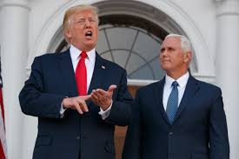
The “Ultimate Deal” or the End of the Line? Trump and the Search for Middle East Peace The Class of ‘54 February 16, 2018
Ambassador (Ret.) Daniel Kurtzer
Woodrow Wilson School of Public and International Affairs
Princeton University

Slide 2
President Trump: November 11, 2016
Referring to the Israel-Palestine conflict as “the war that never ends, “ he tells The Wall Street Journal:
“That’s the ultimate deal. As a deal maker, I’d like to do … the deal that can’t be made. And to do it for humanity’s sake.”
He appoints son-in-law Jared Kushner to lead the effort, raising expectations and elevating the issue to near the top of his agenda.

Slide 3
Context: A troubled region
Notes:
Analysts/policy makers constructed an image of the Middle East that it would change under the pressure of western ideas and globalization of the world economy = wrong.

Slide 4
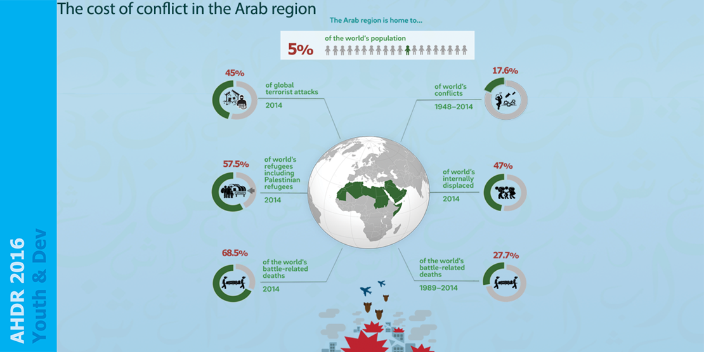

Slide 5
Notes:
• The region has changed but for the worse: (1) Repressive governments. (2) Endless internal wars. (3) Weak regimes. (4) Autocratic, despotic monarchies. (5) Authoritarian, praetorian republics. (6) Corruption, crony capitalism → economic inequality. (7) Population boom → no jobs, food insecurity. (8) Growing Islamist sentiment, and increased militancy. Two examples in the next slides: Youth unemployment and regional conflicts.

Slide 6
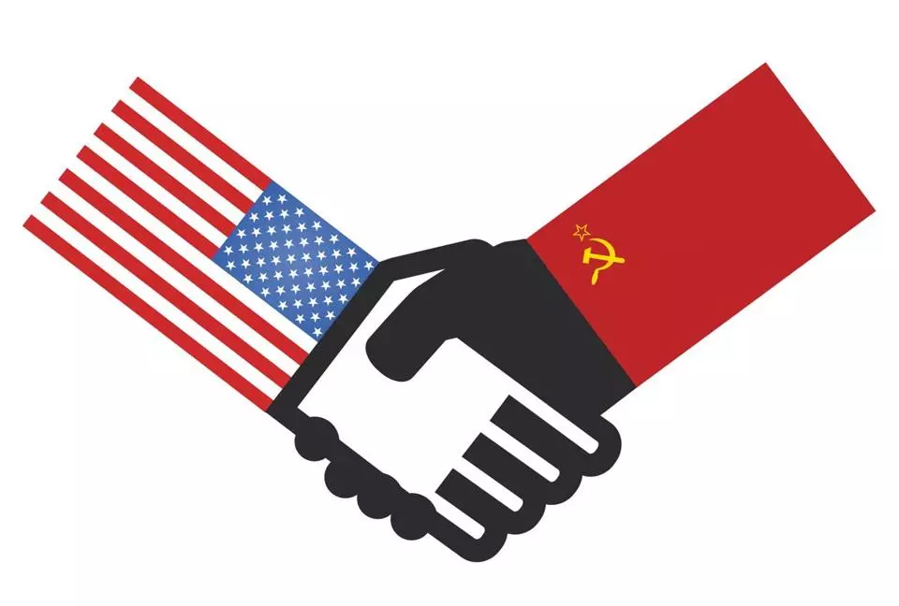
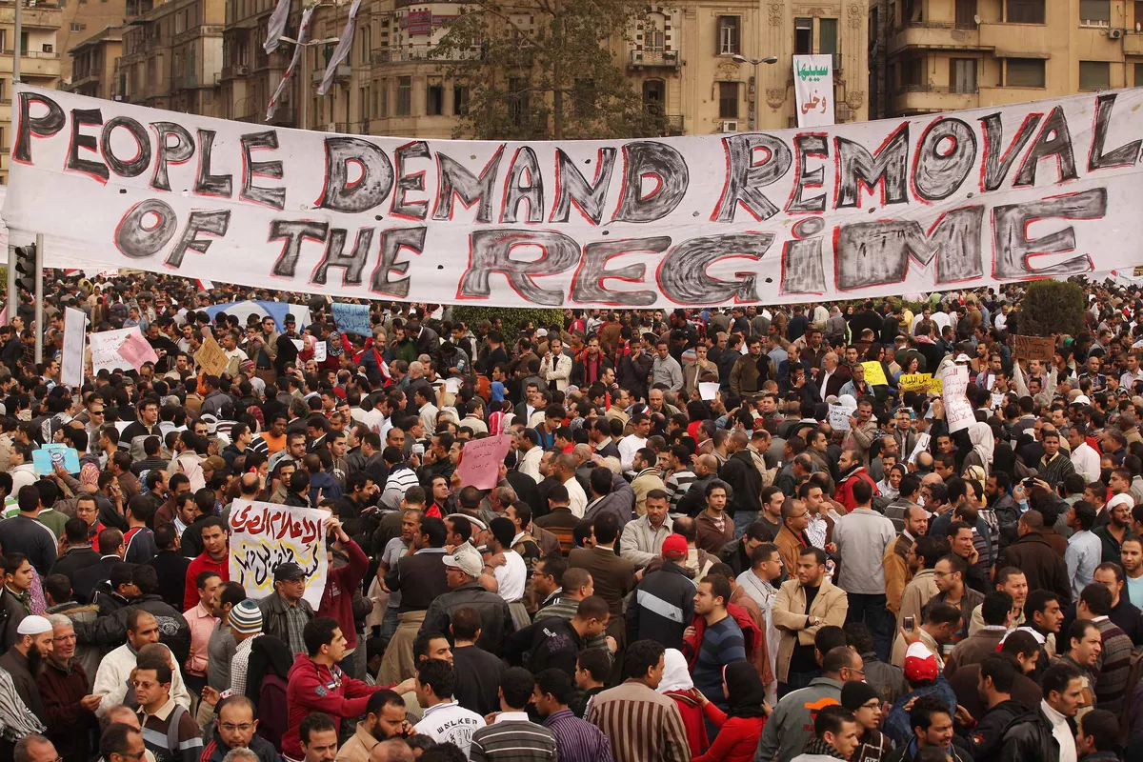
Notes:
Five shocks rocked this already dysfunctional state system

Slide 7
What does POTUS need to know about the peace process?
This is not a real estate deal.
“Outside-in” and “bottom-up” approaches ignore centrality of Palestinian political issue.
CBMs don’t work in the absence of a process.
Status quos are not static.
Importance of monitoring and accountability.
Palestinians split: Fatah vs.
Hamas; West Bank/Gaza.
There are serious differences
between the parties on the
substantive issues.

Slide 8
Homework: Kerry’s diplomacy, 2013-2014
Pre-negotiated steps by Kerry:
Arab foreign ministers reconfirm Arab Peace Initiative.
U.S. develops security architecture.
U.S. supports private sector Isr.-Pal. business initiative.
U.S. supports $4 billion WEF commitment to new state of Palestine.
Pre-negotiated CBMs:
Israel to release Palestinian prisoners from the pre-Oslo era.
PA not to seek upgraded status in the UN.
Effort to craft a framework agreement

Slide 9
Homework: Aqaba regional summit, 2016

Slide 10
Possible Approaches
Possible Outcomes
Withdrawal to separation fence
Israeli options
One state
Binational/Unitary
Federal
Unilateral disengagement
Selective annexation
Two states
Improve conditions on ground
Expand recognition of state
Three states
Palestinian options
‘Lawfare’ (ICC, ICJ)
Fatah-Hamas reconciliation → NUG
Status quo
Long-term
interim arrangements
Separation
Autonomous cantons
Violent resistance
Non-violent resistance
Creeping annexation
Joint I-P options
Renew bilateral negotiations
Coordinated unilateralism
Jordan options
Federation
Confederation
Long-term ceasefire
International/
regional options
Parameters or TOR
Trusteeship
2003 Road Map
2002 Arab Peace Initiative
‘Outside-in’ and /or ‘bottom-up’
Notes:
Existing pathways (Oslo) have not led to success, although some progress, e.g., Taba, Annapolis and Kerry: (1) Differences narrowed on territorial withdrawal and swaps. (2) Refugee issue discussed. (3) Jerusalem, cf. Olmert and JOCI. (4) Jones/Allen study on security. (5) Fayyad plan for Palestinian institutional readiness.

Slide 11
A one-state reality?
Polls show both peoples oppose one-state, but the reality on the ground points in that direction:
Persistent Israeli settlement activity.
Increasing numbers of Palestinian workers in Israel.
Israeli legislation applying Israeli law to settlers.
Weakness of leadership on both sides.
Negotiations are more remote than ever:
Trump’s Jerusalem decision and Abbas’ reaction → U.S. has removed itself as the third-part mediator.
U.S. has cut funding to UNRWA and has indicated intention to remove the refugee issue from the table.

Slide 12
What is the shape of Trump’s “Ultimate Deal”?
Israel to retain overall security responsibility.
Permanent Israeli military presence in Jordan Valley and on West Bank hills.
Israel to control airspace, maritime borders and electromagnetic spectrum.
Demilitarized Palestinian state.
Palestinian capital in the suburbs of Jerusalem.
Israel will maintain the religious status quo.
Israel to retain 10 percent of West Bank.
Israeli withdrawal dependent on Palestinian capacity to maintain security.
West Bank-Gaza passage under Israeli control.
Palestinian refugees to be resettled in Palestine.
(Sources: Axios, Channel 10 (Israel) and Hadashot)
Notes:
If Trump wanted to forge ahead, critical to assimilate lessons: (1) U.S. bias toward Israel = “Israel’s lawyer.” (2) CBMs do not work in absence of a process. (3) Bad actions by the parties act as spoilers. (4) The status quo never remains static. (5) Need combination of top-down + bottom-up + outside-in. (6) Jerusalem decision + UNRWA + Friedman on settlements = Administration shot itself in the foot.

Slide 13
What needs to be done…but won’t happen
Fair U.S. parameters on core issues.
UN Security Council resolution on the parameters.
Expanded and empowered international Quartet.
Monitor the parties’ actions and hold them accountable.
Correct economic imbalances, viz., dependency.
Accelerate Palestinian institution building.
Encourage Palestinian reconciliation – with conditions.
Operationalize the Arab Peace Initiative.
Support Palestinian statehood and mutual recognition.
Push back hard against “lawfare” and delegitimization of Israel.

