Slide 1
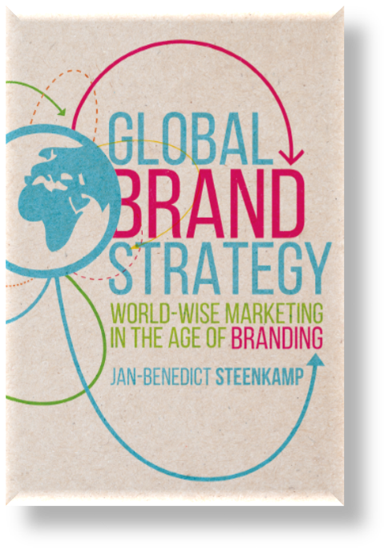
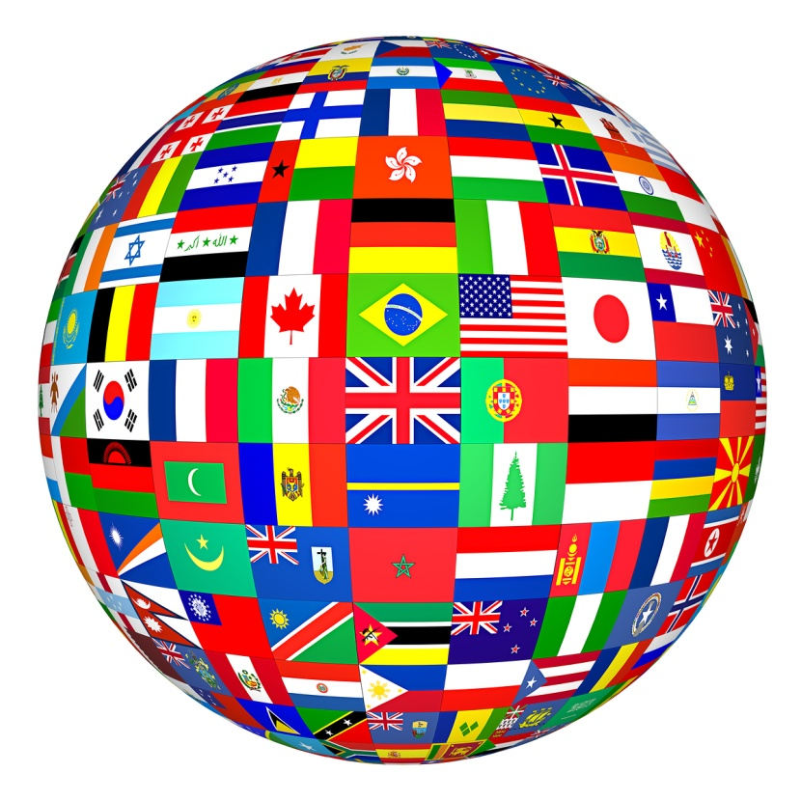
© Prof. J-B.E.M. Steenkamp
Not to be reproduced without permission

Slide 2
About this book…
The book is intended to provide a thorough understanding of:
How to build strong global brands – and how this varies by type of brand;
How to develop marketing mix strategies that are a smart combination of global standardization, local adaptation, and worldwide learning;
How to organize for and manage global brands;
How global brands contribute to the ultimate metric that matters in the C-suite, viz., shareholder value.
© Prof. J-B.E.M. Steenkamp
Not to be reproduced without permission

Slide 3
Axial principles of our age
I. Rise of brands
II. Globalization

Slide 4
The power of branding

Slide 5
Axial principle II – Globalization
Saturation of domestic markets
The emergence of new markets
Emergence of global competitors
Invasion of previously protected markets
The interconnected world - cross-border flows of people, information, money, goods, services, telecommunications, internet,…
Whether a company operates domestically or across national boundaries, it can no longer avoid competitive pressures from around the world.
© Prof. J-B.E.M. Steenkamp
Not to be reproduced without permission

Slide 6
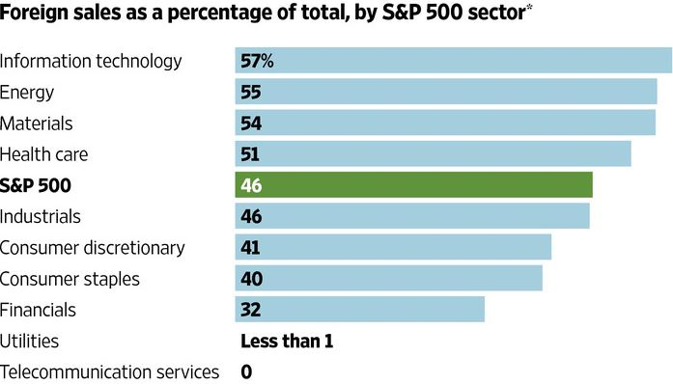
International revenue of S&P 500 companies

Slide 7
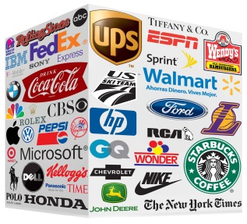
Global brands are at the intersection of these two axial principles
Globalization
Local
Global
Brand
Branding
Commodity

Slide 8
Definition of a global brand
“A global brand uses the same name and logo, has awareness, availability, and acceptance in multiple regions of the world. It shares the same strategic principles, values, positioning, and marketing throughout the world. Although the marketing mix can vary, it is managed in an internationally coordinated manner.”
© Prof. J-B.E.M. Steenkamp
Not to be reproduced without permission

Slide 9
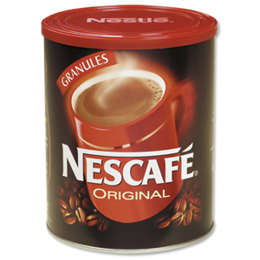
Why care about global brands
“It’s no accident that most of the companies with the biggest increases in brand value operate as single brands everywhere in the world….
The goal today is to create consistency and impact, both of which are a lot easier to manage with a single worldwide identity It’s also a more efficient approach, since the same strategy can be used everywhere…
Given how hard the consumer is to reach today, a strong unified brand message is increasingly becoming the only way to break through…”
- Bloomberg BusinessWeek

Slide 10
Organizing framework – The global brand value chain
Organizational structure
Global Brand
Enabling Structures and Processes
Global brand management
Shareholder value
Corporate social responsibility
Dimensions of value creation
Customer proposition
Marketing mix program
Digital strategy
Global Brand Building
Global brand equity
Performance

