Slide 1
Using Manipulatives to Teach Early Numeracy Concepts

Slide 2
srpowell@austin.utexas.edu
@sarahpowellphd
119

Slide 3
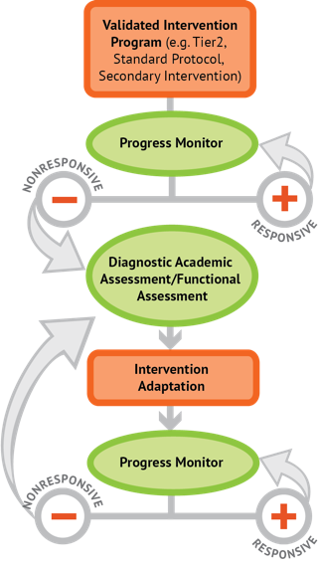
Instructional Platform
INSTRUCTIONAL DELIVERY
Explicit instruction
Precise language
Multiple representations
INSTRUCTIONAL STRATEGIES
Fluency building
Problem solving instruction
Motivation component

Slide 4
Explicit Instruction
Modeling
Practice
Clear Explanation
Guided
Practice
Planned
Examples
Independent Practice
Supporting Practices
Asking the right questions
Eliciting frequent responses
Providing immediate specific feedback
Maintaining a brisk pace

Slide 5
Precise Language
Use formal math language
concise
Use terms precisely

Slide 6
Multiple Representations
Abstract
Pictorial
Concrete

Slide 7
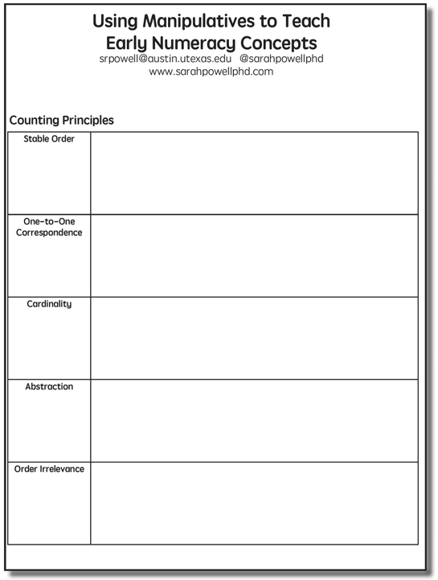

Slide 8
Five Counting Principles
Stable order
One-to-one correspondence
Cardinality
Abstraction
Order irrelevance

Slide 9
Stable order
Saying the number words in order
“One, two, three, four, five…”
Count from 1 to 20
Count from 1 to 100
Count forward from __
Count backward

Slide 10
Stable order
Teacher modeling with echoing
One-minute timings
Count to 12 as many times as you can
Songs
www.youtube.com/watch?v=g9EgE_JtEAw
www.youtube.com/watch?v=F5QLp9Wxrrg
www.youtube.com/watch?v=dk9Yt1PqQiw
www.youtube.com/watch?v=uxPfPyYp84E
www.youtube.com/watch?v=tocO1HKG2Ug
www.youtube.com/watch?v=xx5GWCgklhw
www.youtube.com/watch?v=fZ9WiuJPnNA
Good songs are repetitive, not based on music, and focused on lyrics.

Slide 11
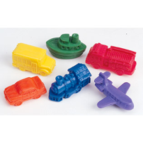
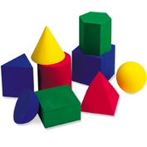
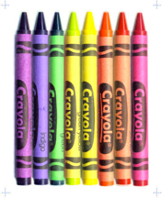
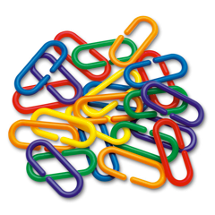
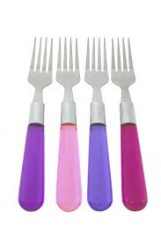
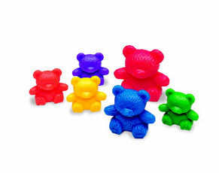
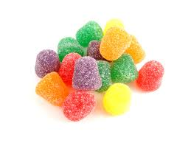
One-to-One Correspondence
Ability to match number words to objects

Slide 12
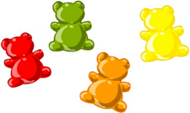
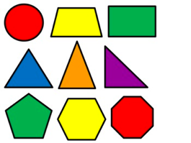
One-to-One Correspondence
Ability to match number words to objects

Slide 13
One-to-One Correspondence
Partitioning and tagging
Transferred from the “to-be-counted” category to the “already-counted” category
A distinct numeral word is assigned and not to be used again in the counting sequence

Slide 14
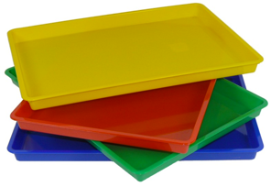
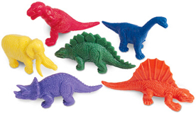
Stable Order AND One-to-One Correspondence
Count to 4
Count to 7

Slide 15
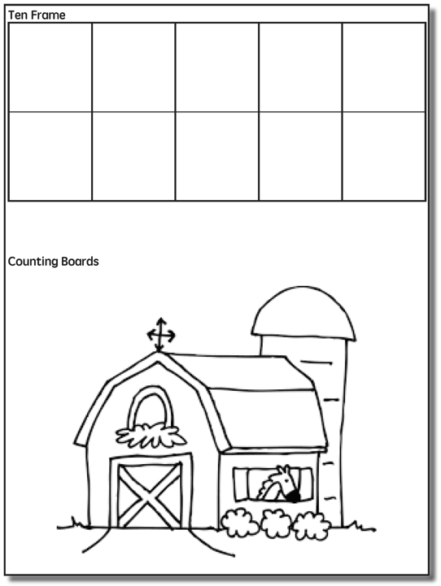

Slide 16
Stable Order AND One-to-One Correspondence
Count to 8
Count to 5

Slide 17
Cardinality
The number tag used for the last object in a count symbolizes the total number of objects in a set
Students must coordinate the stable order and one-to-one correspondence

Slide 18
Cardinality
Teacher asking, “How many?”
Count to 11
Count to 9

Slide 19
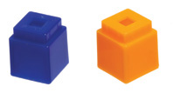
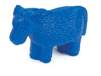
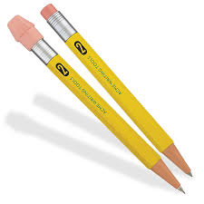
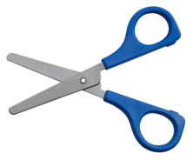
Abstraction
Any types of objects can be counted together in a set

Slide 20
Order Irrelevance
The order in which objects are counted does not matter as long as none of the other counting principles are violated
When teaching counting to “inefficient” counters, however, you should teach a strategy – like partitioning and tagging, working left to right, or using a work mat.

Slide 21
Five Counting Principles
Stable order (rote counting)
One-to-one correspondence
Cardinality
Abstraction
Order irrelevance
Combine all five counting principles.
Explicit instruction
Precise language
Multiple representations

Slide 23
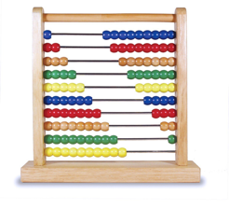
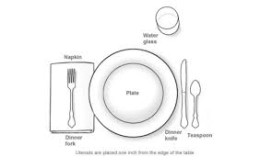
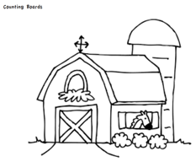
Counting Instruction
Counting objects/pictures
Bears, cubes, clips, pencils
Abacus
Table setting
Passing out papers
Counting with storyboards

Slide 24
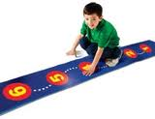
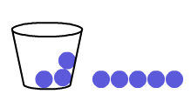
Counting
Counting with number lines
Counting on
I’m hiding three. Count, starting from the hidden counters.

Slide 25
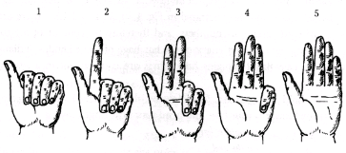
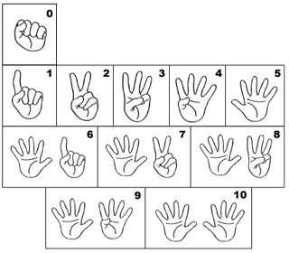
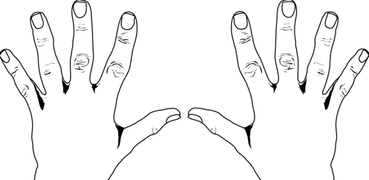
Counting
Finger counting

Slide 26
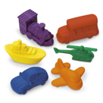
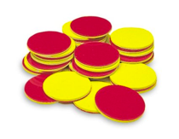
Place Value
15
12

Slide 27
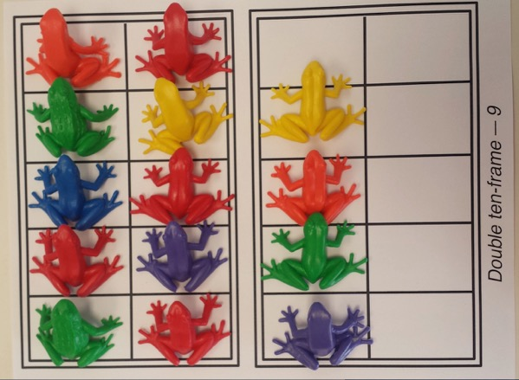
Place Value
“Ten, Eleven, Twelve, Thirteen, Fourteen.”

Slide 28
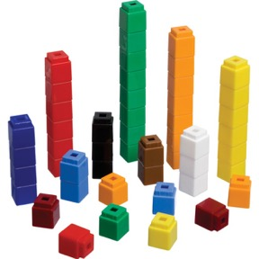
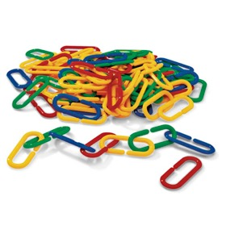
Place Value
19
22

Slide 29
Place Value
Teach about tens and ones.
Explicit instruction
Precise language
Multiple representations

Slide 30
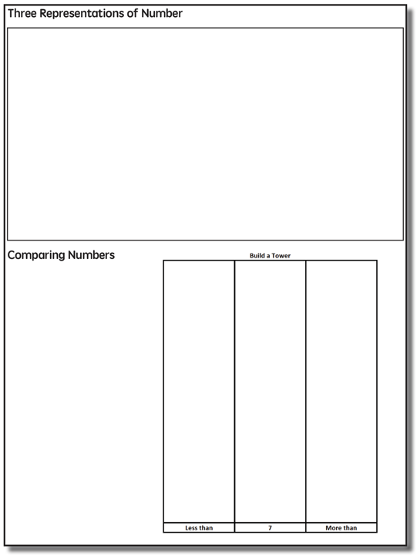

Slide 31
Three Representations of Number
7
seven

Slide 32
Quantity Comparison
Vocabulary:
More, greater, bigger
Less, smaller, fewer
Same, as many as

Slide 33
Quantity Comparison
Teacher modeling
Find the pairs
Finish when one group runs out of items
Figure out more than, less than, or equal

Slide 34
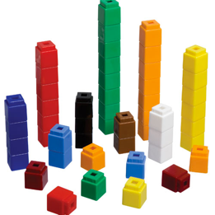
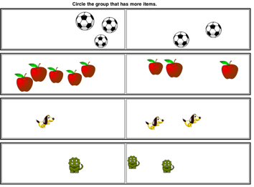
Quantity Comparison

Slide 35
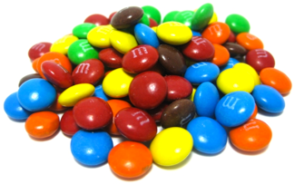
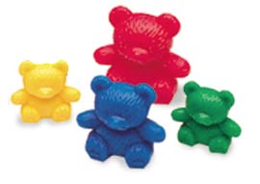
Quantity Comparison
Make chains
Bear compare
Counting cars

Slide 36
Comparison
Teach about comparison.
Explicit instruction
Precise language
Multiple representations

Slide 38
Subitizing
Instantly seeing how many
Young students can subitize sets of 1, 2, or 3 without counting (perceptual subitizing)
4 or 5 is the maximum subitizing amount
Students can subitize larger amounts by combining smaller amounts (conceptual subitizing)

Slide 39
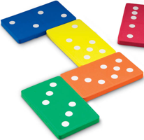
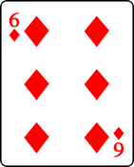
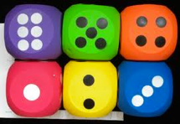
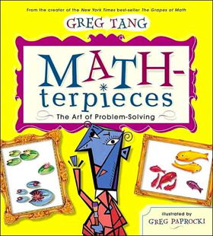
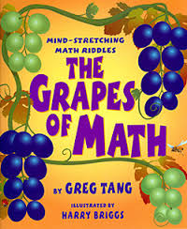
Subitizing Instruction

Slide 40
Subitizing
Teach about subitizing.
Explicit instruction
Precise language
Multiple representations

Slide 41
Instructional Platform
INSTRUCTIONAL DELIVERY
Explicit instruction
Precise language
Multiple representations
INSTRUCTIONAL STRATEGIES
Fluency building
Problem solving instruction
Motivation component

Slide 42
srpowell@austin.utexas.edu
@sarahpowellphd
119

