Slide 1
Testing: Data Requirements and Other Information
TN Data & Attendance Supervisors Conference – September 2017

Slide 2
Agenda
Assessment Overview
Processing Changes
Assessment Process Details
SIS
Data Review
Test Provisioning
Troubleshooting Data
Course Codes
Teacher Student Connection
Closing

Slide 3
TCAP Overview

Slide 4
TN Comprehensive Assessment Program
TCAP
TNReady
Students in grade 3-8: ELA, Math, Science, SS
High School EOC: ELA, Math, Science, SS
Other TN Assessments
Alternate assessments for students in grades 3-11 with the most significant cognitive disabilities (ELA, Math, Science, SS)
Grade 2 optional assessment suite
ELL Assessments

Slide 5
Assessment Task Force Recommendations
Eliminate the TNReady chemistry end-of-course exam
TDOE will provide a chemistry test form as an option for local administration
Eliminate the TNReady English III end-of-course exam
TDOE will prioritize adding a statewide dual credit English composition option available beginning in 2019-20
Collaborate with the Tennessee Board of Regents to use the TNReady U.S. History end-of-course exam as a dual credit exam and help students earn college credit from their TNReady score
Eliminate the stand-alone field test window for at least the next two years
Reduce time on the TNReady English language arts exam in grades 3 and 4 to make it a combined 78 minutes shorter
will not impact the ability to generate TVAAS
will still generate scores across all four performance levels

Slide 6
Ready for TNReady
Grade 5-8 and high school students must test online in 2018-19.
The Ready for TNReady check for online readiness includes three categories of readiness: device readiness, infrastructure readiness, and operational readiness.
The Ready for TNReady overview can be found here.
You must complete this check for readiness and submit it to TDOE.
If you already completed Ready for TNReady, you should have a certificate.
If unsure of your status, please email district.technology@tn.gov for assistance.
6
Notes:
Cliff

Slide 7
Online Testing for 2018-19
Online testing is required for grades 5–12 in 2018-19.
Online testing is optional for grades 3 and 4; there will continue to be a paper option for these grades.
7
Notes:
Cliff

Slide 8
Assessment Processing Changes

Slide 9
Last Fall

Slide 10
Changes to Pre-ID and SDDV Process
Assessment is now driven by data in EIS.
Enrollment, scheduling, demographic, and class roster must entered in district SIS and transferred to EIS.
Pre-ID labels and rostering in Nextera came from EIS.
EdTools is no longer used to clean-up demographic information or complete assessment ordering.
The only key function in EdTools for assessment for 2017-18 is Teacher Student Connection (TSC).
SDDV (the post-testing data clean-up) has been replaced by work in the data prior to testing.
Notes:
Cliff

Slide 11
Changes to Pre-ID and SDDV Process
District Technology team created the Visibility Tool to give a clearer picture of which students were being pulled for assessments.
Improvements were made throughout the year to the Visibility Tool... and there are more to come!
The quality of the data we have from districts is markedly improved thanks to your hard work during this transition.
We appreciate all of the work you did in cooperation with the EIS Help Desk team to clean up student, teacher & class data.
Notes:
Cliff

Slide 12
First things first: SIS Enrollment

Slide 13
It All Goes Back to the SIS…
Visibility Tool
Data Review
Nextera
Test Provisioning
EdTools
Teacher Student Connection (TSC)
Test Administration
Reports of Irregularity (RIs)
Demographic Statistics
SIS
EIS

Slide 14
Key to Success – SIS Vigilance
Districts must ensure that complete and accurate student enrollment data is entered into their district SIS in a timely manner.
Doing this will make assessment administration easier both for the district and for the schools.

Slide 15
Platform Functions
Function | SIS | Visibility Tool | Nextera | EdTools
Enrolling and Scheduling Students | X
Updating Student Demographics | X
Updating Schedules/Class Rosters | X
Reviewing Demographic Information |  | X | X
Test Ordering and Registration |  |  | X
Reports of Irregularity (RIs) |  |  | X
Recording Accommodations |  |  | X
Teacher Student Connection (TSC) |  |  |  | X

Slide 16
EIS Transfers to Nextera
Assessment data transfers from SIS to EIS occur every evening.
Information updated in a district SIS by 5 pm CST will show up in the Visibility Tool the next day.
Information updated in a district SIS by 5 pm CST will show up in Nextera Admin and in EdTools TSC no later than two days after data transfer.
All assessment data transfers occur when the district produces an extract and submits it to EIS.

Slide 17
Final EIS Transfer for Demographic Data
The final EIS assessment transfer to generate demographic data for the Comprehensive Data File (CDF) and assessment reporting will be the last day of the testing window.
For Spring 2018 block and traditional: Friday, May 4, 2018.
Districts must be sure all demographic changes are corrected by the last day of the testing window. No changes will be accepted after the window closes.

Slide 18
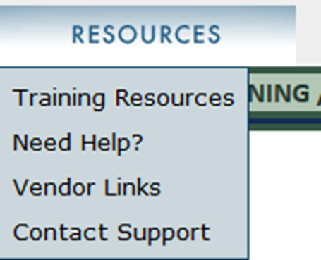
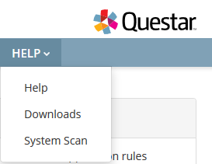
Assessment Course Codes Document
The 2018-19 assessment course codes document is posted on EdTools under the Resources tab (folder: EIS Information 2018-19).
It will also be posted under the Help tab on the Nextera Admin portal and on LiveBinders (Assessment Overview tab).

Slide 19
Demographic Data Review

Slide 20
Data Review
SIS
EIS
Visibility Tool
District Review

Slide 21
Demographic Data
Districts are able to view student demographic data in the Visibility Tool which is read only.
Any and all changes to demographic data must be made through the district SIS.

Slide 22
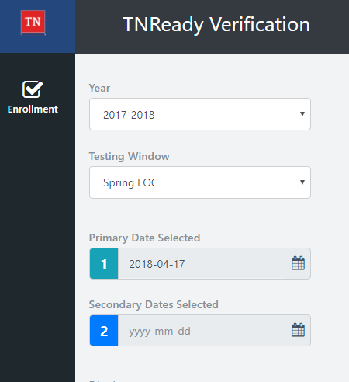
Visibility Tool
The Visibility Tool developed by the TDOE technology team gives districts a clear and timely picture of information uploaded from their SIS to EIS.

Slide 23
Visibility Tool Help
LiveBinders site
http://www.livebinders.com/play/play?id=2244559&backurl=/ shelf/my

Slide 24
Visibility Tool
The technology team is here at the conference today & tomorrow to answer questions about EIS and the Visibility Tool.

Slide 25
Test Provisioning

Slide 26
Test Provisioning
Districts must formally enroll students in order to generate a test registration.
Formal enrollment is defined as; “A state Student ID has been issued to the district SIS by the EIS data system,” and, therefore, a record of that student exists in both the district SIS and in EIS.
Students must meet the business rules for the assessment pull in order to appear in Nextera and EdTools.

Slide 27
Business Rules for the EIS Enrollment
For a student record to result in a test registration, the student must have:
Enrollment in a school
Instructional Grade record for that enrollment
Student Class Assignment (course code) for that enrollment
Class Section (local class number) for the Student Class Assignment
Teacher identified as the teacher of record for the class section (Master Teacher record)
Valid Teacher License number for the teacher of record

Slide 28
New Students
New students enrolling in the district from out of state (home school, private school, another state) must be entered into the SIS as soon as possible in order to properly register them for the appropriate assessments.

Slide 29
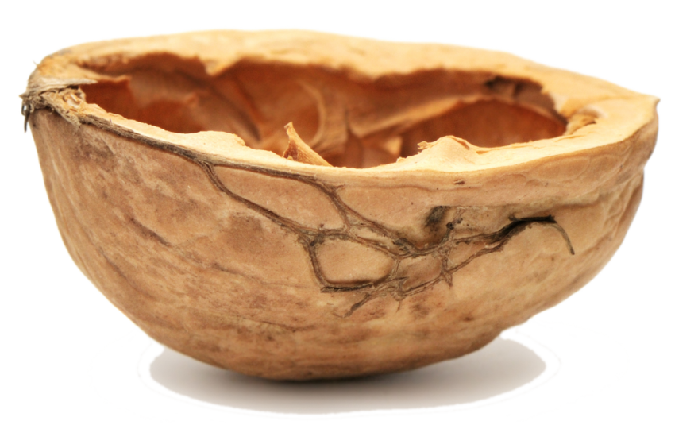
In a Nutshell…
Student scheduling data must be correct in the SIS in order to generate orders and test registration for assessments.
Correct scheduling must reflect the correct course code to trigger the assessment process.

Slide 30
Troubleshooting Data

Slide 31
Common Data Quality Issues: Teachers
All Teacher first and last names are entered
Teacher email address is entered and valid (e.g., contains "@" and the appropriate district/organization "domain.com")
Teacher license number (TLN) is entered and valid
Notes:
Mark

Slide 32
Common Data Quality Issues: Teachers
Teacher class assignments are complete with no missing or empty from and to date values, and date values are entered according to an appropriate and consistent date format.
There are no inappropriate date overlaps between multiple teachers, leaving only one teacher as the Teacher of Record (TOR) for any given class.
In order to mark a teacher as an inactive TOR, the staff assignment end date for the class must be on or before another teacher’s start date as TOR.
Notes:
Mark

Slide 33
Common Data Quality Issues: Classes
Only valid and approved course codes for assessment will be used to provision students for testing.
If you are unsure of the list of valid approved course codes for assessment, please see the Course Codes document.
Notes:
Mark

Slide 34
Common Data Quality Issues: Classes
In order to be a valid class for testing, the class must have a Teacher of Record assigned. This teacher must have a valid teacher license number, and a valid work email address.
There can be only one active teacher of record assigned to a class.
Notes:
Mark

Slide 35
Common Data Quality Issues: Students
All student first name, last name, date of birth, district, school, and grade values are entered.
Student from and to dates are complete with no missing/empty date values, and date values are entered according to an appropriate and consistent date format.
Student enrollments are in no way duplicated.
Notes:
Mark

Slide 36
Common Data Quality Issues: Students
Student class assignments are complete (no active students without class assignments) and appropriate (e.g., no duplicate class assignments for the same course code and/or content area) for all active students.
Class assignment from and to dates are complete with no missing or empty date values
Date values are entered according to an appropriate and consistent date format.
Notes:
Mark

Slide 37
Alternative Schools
Students enrolled in Alternative Schools during TCAP Assessments can test at either their Alternative Schools or Schools of Remand (base school).
Further guidance for enrolling alternative school students will be shared this summer.

Slide 38
Course Codes for Assessment

Slide 39
Course Codes – EOC Math
ACTIVE CODES - EOC | Regular | SPED | The “A” course codes are for the first section of yearlong courses and will not be pulled.
Algebra I | 0842 (7th & 8th)
 | 3102
 | 31024 (pt 2 - spring course) |  | 31023 (pt 1 - test as pt 2 in spring)
 |  | 31026 (B) | 31025 (A - test as B in spring)
Geometry | 0843 (7th & 8th)
 | 3108
 | 31084 (pt 2 spring course) |  | 31083 (pt 1 - test as pt 2 in spring)
 |  | 31086 (B) | 31085 (A - test as B in spring)
Algebra II | 3103
 |  | 31034 (B) | 31033 (A - test as B in spring)
Integrated Math I | 0832 (7th & 8th)
 | 3117
 | 31324 (pt 2 spring course) |  | 31323 (pt 1 - test as pt 2 in spring)
 |  | 31326 (B) | 31325 (A - test as B in spring)
Integrated Math II | 0833 (7th & 8th)
 | 3118
 | 31334 (pt 2 spring course) |  | 31333 (pt 1 - test as pt 2 in spring)
 |  | 31336 (B) | 31335 (A - test as B in spring)
Integrated Math III | 3119
 |  | 31344 (B) | 31343 (A - test as B in spring)

Slide 40
Course Codes – EOC (other content areas)
ACTIVE CODES - EOC | Regular | SPED | The “A” course codes are for the first section of yearlong courses and will not be pulled.
English I | 3001
English II | 3002
English III | 3003 |  | not an assessed EOC in 2018-19
USHistory | 3416 |  | (AP US History - 3440 - not tested)
Biology I | 3210
 | 32104 (pt 2 - spring course) |  | 32103 (pt 1 - test as pt 2 in spring)
 |  | 32106 (B ) | 32105 (A - test as B in spring)
Chemistry I | 3221 |  | not an assessed EOC in 2018-19
 | 32214 (pt 2 - spring course) |  | 32213 (pt 1 - test as pt 2 in spring)
Districts cannot use the same assessment course code twice for different classes. For example, students cannot be scheduled for Biology (3210) and for a Biology lab (3210). This duplication will cause issues with the Visibility Tool and with uploading students into the testing platform.

Slide 41
Course Codes – EOC (Cambridge)
Cambridge IGSCE
Course Name | Course Code | Required EOC
IGCSE Mathematics I | 4135 | Integrated Math I
IGCSE Mathematics II | 4136 | Integrated Math II
IGCSE Additional Mathematics III | 4137 | Integrated Math III
IGCSE English Language | 4222 | English I
IGCSE English Literature | 4226 | English II
IGCSE Biology | 4145 | Biology
IGCSE Chemistry | 4146 | Chemistry – not an assessed EOC in 2018-19

Slide 42
Course Codes – Grades 3-8
ACTIVE CODES - GRADES 3-8 | English Language Arts | Math | Science | Social Studies
Grade 3 - Reg (content specific) | 0301 | 0306 | 0307 | 0319
Grade 4 - Reg (content specific) | 0401 | 0406 | 0407 | 0419
Grade 5 - Reg (content specific) | 0501 | 0506 | 0507 | 0519
Grade 6 - Reg (content specific) | 0601 | 0606 | 0607 | 0619
Grade 7 - Reg (content specific) | 0701 | 0706 | 0707 | 0712
Grade 8 - Reg (content specific) | 0801 | 0806 | 0807 | 0814

Slide 43
Course Codes – Grades 3-8 Notes
Districts cannot use the same assessment course code twice for different classes.
For example: students cannot be scheduled in 0401 for Lang Arts and 0401 for Reading.
Reminder: Reading course codes are retired and not valid.
EL students
For grades 3-8 EL students there is an English Language Development course for each grade that covers a student of a WIDA proficiency of 1 or 2 and specifies that, in addition to their ESL course, they must also be enrolled in an ELA course.
For grades 3-8 EL students there is a course (6315) that is intended for students of a WIDA proficiency of 3 or higher. These students must also be enrolled in an ELA course.

Slide 44
Course Codes – Grades 3-8 Comprehensive
ACTIVE CODES - GRADES 3-8 | Language Arts | Math | Science | Social Studies
Grade 2 - Reg (content specific) | 0220 | 0221 | 0222 | 0223
Grade 3 - Reg (content specific) | 0320 | 0321 | 0322 | 0323
Grade 4 - Reg (content specific) | 0420 | 0421 | 0422 | 0423
Grade 5 - Reg (content specific) | 0520 | 0521 | 0522 | 0523
Grade 6 - Reg (content specific) | 0620 | 0621 | 0622 | 0623
Grade 7 - Reg (content specific) | 0720 | 0721 | 0722 | 0723
Grade 8 - Reg (content specific) | 0820 | 0821 | 0822 | 0823
COMPREHENSIVE CODES are to be used when scheduling students with more severe disabilities who require a replacement of core content instruction. The student must take the general education end-of-year assessment. These courses should be aligned to grade level/content area standards. Students who will participate in the alternative assessment must be scheduled using the alternate assessment course codes.

Slide 45
Course Codes – Grade 2
For grade 2 EL students there is an English Language Development course (6313) that covers a student of a WIDA proficiency of 1 or 2 and specifies that, in addition to their ESL course, they must also be enrolled in an ELA course (0201).
For grade 2 EL students there is a course (6315) that is intended for students of a WIDA proficiency of 3 or higher. These students must also be enrolled in an ELA course (0201).
ACTIVE CODES - GRADE 2 | Lang Arts | Math
2nd grade | 0201 | 0206
2nd grade ALT | 50201 | 50206

Slide 46
Course Codes – MSAA and TCAP Alt
ACTIVE CODES - GRADES 3-8 | Lang Arts | Math | Science | Social Studies
Grade 3 - Alternate Assessment | 50301 | 50306 | 50307 | 50319
Grade 4 - Alternate Assessment | 50401 | 50406 | 50407 | 50419
Grade 5 - Alternate Assessment | 50501 | 50506 | 50507 | 50519
Grade 6 - Alternate Assessment | 50601 | 50606 | 50607 | 50619
Grade 7 - Alternate Assessment | 50701 | 50706 | 50707 | 50712
Grade 8 - Alternate Assessment | 50801 | 50806 | 50807 | 50814
 | MSAA | MSAA | TCAP-Alt | TCAP-Alt
Alternate Assessment: Algebra I | 53102 | MSAA
Alternate Assessment: Biology I | 53210 | TCAP-Alt
Alternate Assessment: English II | 53002 | MSAA
Only students with IEPs who are identified as taking the alternate assessment will be scheduled using these course codes.

Slide 47
Retired Codes
The 2018-19 assessment course codes document also contains lists of retired codes for Grade 2, Grades 3-8 and End of Course.

Slide 48
Important Safety Tips
Districts cannot use the same assessment course code twice for different classes.
Service enrollments do not pull for assessment.
If you need a student to test a particular content area, they need to be given a primary enrollment with an assessed course code.

Slide 49
Teacher Student Connection

Slide 50
Teacher Student Connection
Teacher Student Connection (TSC) editing for 2017-18 is in EdTools.
Districts are able to perform claiming (TSC) any time between submission of their enrollment data to EIS and the last day of the administration window.
Districts do not have to wait until after testing to commence TSC.

Slide 51
Teacher Student Connection
Teacher of Record must be defined in the district SIS through complete scheduling.
Districts should only use teacher student claiming (TSC) in EdTools to update roster information in circumstances where multiple teachers taught a specific class as co-teachers or based on personnel changes throughout the school year.
Otherwise, TSC will reflect the same field values and information as in prior years (instructional responsibility and instructional availability).

Slide 52
Questions

Slide 53
Questions?

