Slide 1
A school’s indoor environment can have a significant impact on health and learning. Children, in particular, are more vulnerable to the negative health and performance effects of poor environmental conditions, including IAQ. Children often are more heavily exposed to toxic substances in the environment than adults because they spend more time on the ground and engage in more hand to mouth behavior. Children also breathe more air, drink more water and eat more food per pound of body weight than adults (American Academy of Pediatrics Council on Environmental Health, 2003). A child’s respiratory, immune, nervous, reproductive and skeletal systems continue to develop throughout childhood. Exposures to environmental contaminates that occur early in life can cause adverse health impacts in children that have implications well into adulthood (EPA Office of Research and Development, 2007).

Slide 2
Purpose
The U.S. Environmental Protection Agency (EPA)
developed the Energy Savings Plus Health Guide
to protect and improve indoor air quality (IAQ) in
schools during building upgrades, particularly energy
efficiency upgrades and building renovation activities.
Energy management and protection of IAQ
both should be critical priorities for school facility
management. As school districts pursue energy cost
savings and occupant health-protection goals, there
can be a mistaken impression that the two goals are
at odds with each other. In fact, when energy efficiency and IAQ protection goals are integrated and
addressed holistically, schools can achieve strong
results in both areas. Alternatively, if careful attention
is not paid to the interaction between energy
management and IAQ, occupant health can suffer.

Slide 3
This Guide focuses primarily on opportunities to protect
and improve IAQ during building upgrades by preventing
and controlling exposure of occupants to contaminants
that may be disturbed or introduced during
upgrade projects, controlling moisture, and ensuring
that occupants are provided with adequate ventilation
to promote health and comfort.

Slide 4
This Guide is divided into four parts:
Introduction – How to Use This Guide
Assessment Protocols and Recommended Actions
Appendices
Master Verification Checklist

Slide 5
A school’s indoor environment can have a significant impact on health and learning. Children, in particular, are more vulnerable to the negative health and performance effects of poor environmental conditions, including IAQ. Children often are more heavily exposed to toxic substances in the environment than adults because they spend more time on the ground and engage in more hand to mouth behavior. Children also breathe more air, drink more water and eat more food per pound of body weight than adults (American Academy of Pediatrics Council on Environmental Health, 2003). A child’s respiratory, immune, nervous, reproductive and skeletal systems continue to develop throughout childhood. Exposures to environmental contaminates that occur early in life can cause adverse health impacts in children that have implications well into adulthood (EPA Office of Research and Development, 2007).

Slide 6
Energy management and protection of IAQ both should be critical priorities for school facility management. As school districts pursue energy cost savings and occupant health-protection goals, there can be a mistaken impression that the two goals are at odds with one another. In fact, when energy efficiency and IAQ protection goals are integrated and addressed holistically, schools can achieve strong results in both areas.

Slide 7
Fundamental Principles of IAQ
The guidelines in this document are intended to encourage IAQ professionals to integrate health protections into energy efficiency and building renovation projects by undertaking the following activities:
Integrating strong IAQ protections into the design, renovation and construction processes.
Commissioning key energy and IAQ systems to ensure that they operate as designed.
Controlling moisture in building assemblies, mechanical systems and occupied spaces.
Limiting entry of contaminants from outdoors.
Limiting contaminants from indoor sources.
Capturing and exhausting contaminants from building equipment and activities.
Protecting building elements, occupants and workers during construction projects.
Ensuring that there is a strong communications plan in place to share the project’s IAQ goals with occupants and other stakeholders, with a clear process for addressing feedback and concerns. This includes, for example, ensuring that building occupants are aware of the availability of the Asbestos Hazard Emergency Response Act (AHERA) Management Plan, Lead Safety Plan and Material Safety Data Sheets.
Educating building occupants about the actions they can take to protect IAQ in their school.

Slide 8
The Business Side of IAQ
When your school district makes a substantial investment in renovations, equipment upgrades, or new buildings schools have an important opportunity to:
Protect indoor air quality of the building envelope
Integrate healthy building practices
Save and bring in more money

Slide 9
Studies have demonstrated that increased classroom
ventilation rates are associated with improvements in
student health and performance. A European study
showed that a doubling of the ventilation rate from
about 7.5 cubic feet per minute per person
(cfm/person) to 15 cfm/person improved speed of
academic performance by about 8 percent (Wargocki
& Wyon, 2006).

Slide 10
A U.S. study in fifth-grade classrooms
from 100 schools used student performance in standard
academic tests as the measure of performance and estimated that there was nearly a 3-percent increase in the proportion of students passing standardized math and reading tests for each 2 cfm/person increase in ventilation rate across the range of 2 to 15 cfm/person
(Haverinen-Shaugnessy et al., 2011).

Slide 11
A recent study also demonstrated that for each 2.1 cfm/person increase in ventilation rate, on average, the illness absence of students decreased by 1.6 percent (Mendell et al., 2013). In some school districts, income from government sources is linked to days of student attendance; thus, increased ventilation rates may increase school district income.

Slide 12
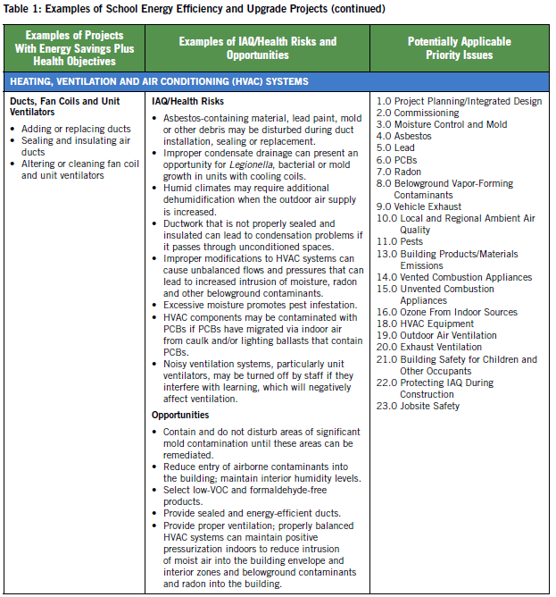

Slide 13
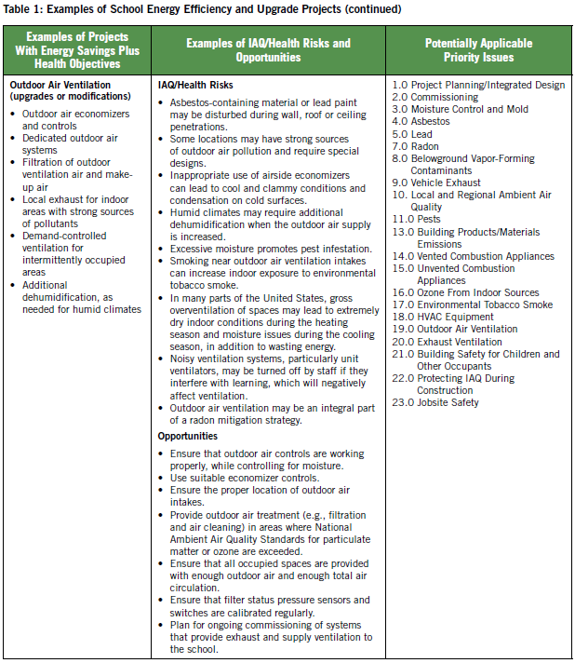

Slide 14
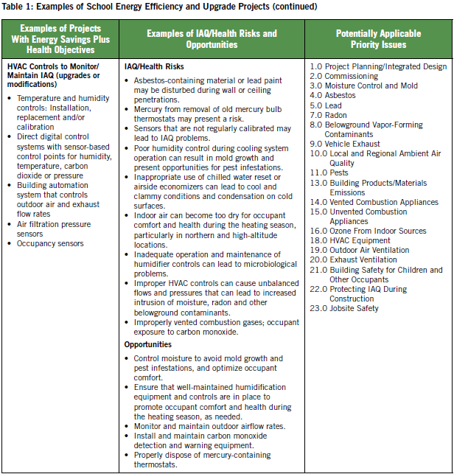

Slide 15
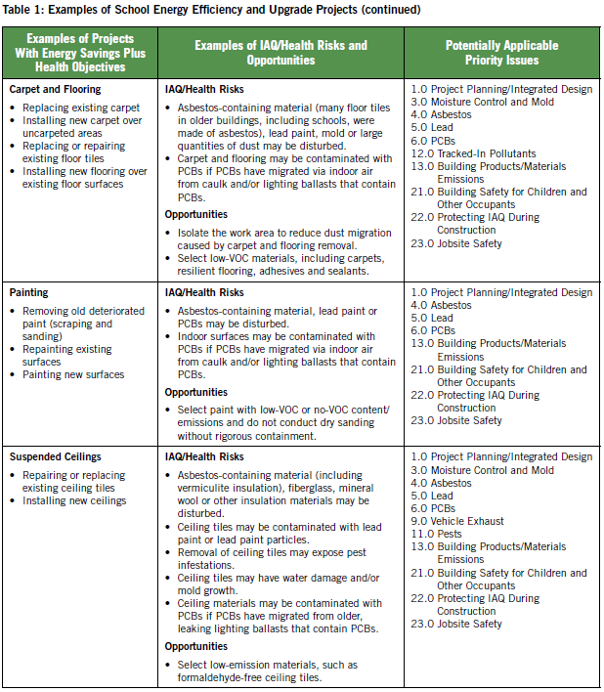

Slide 16
Energy Savings Plus IAQ Takes:
Upfront Planning
Coordination and communication among all of the stakeholders such as school officials, parents, students, teachers, other school employees and other building users.

Slide 17
This document will help you achieve the goal of a successful Energy/IAQ Project

Slide 18
Section 2: Assessment Protocols
and Recommended Actions
Integrated Process
Introductory Note for Priority Issues 1.0 Project
Planning/Integrated Design and 2.0 Commissioning
A wide range of school building upgrade projects is
possible, from small-scale retrofits of components/
systems to much larger and more extensive projects
involving modifications to multiple building systems and
major renovations to the school building. A project’s
planning, design and commissioning processes will
depend on its magnitude and unique characteristics.

Slide 19
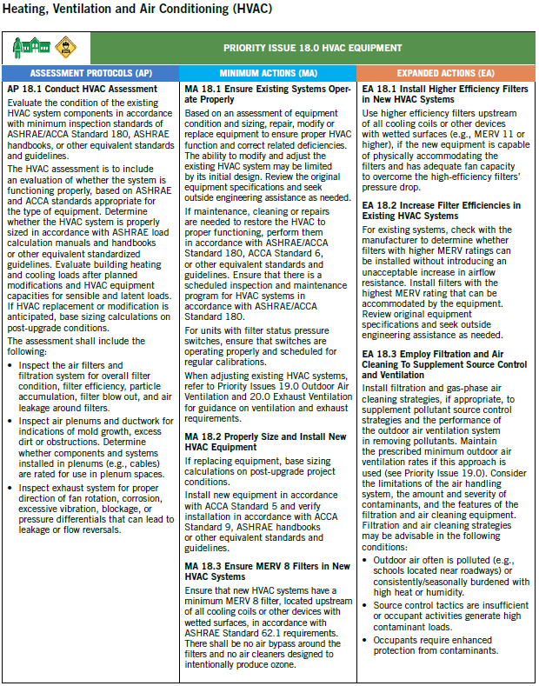

Slide 20
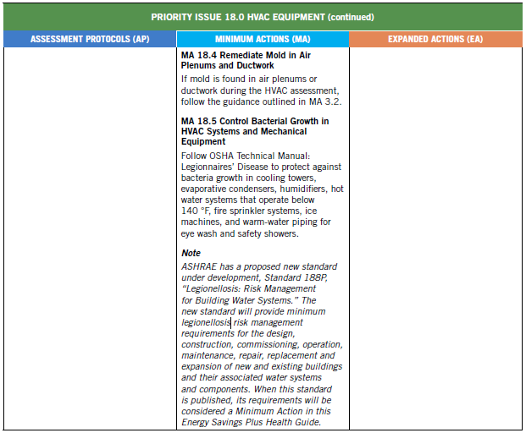

Slide 21
Section 3: Appendices
There are 3 appendices in this document that you need to be aware of:
Appendix A – Project Planning
These are the key steps during the building upgrade process that provide opportunities to reduce cost and leverage synergies, or if not addressed adequately, can increase costs and lead to future challenges.

Slide 22
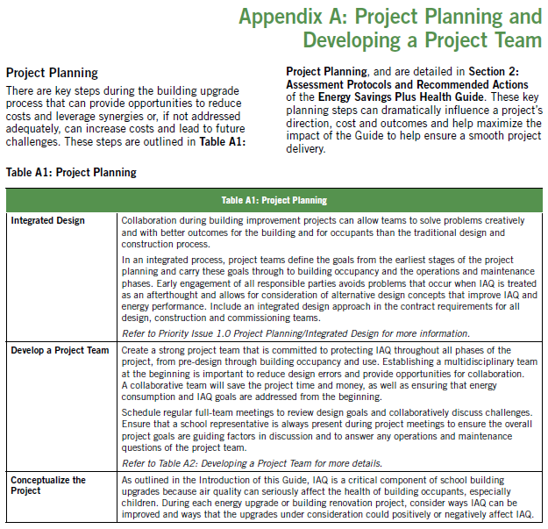

Slide 23
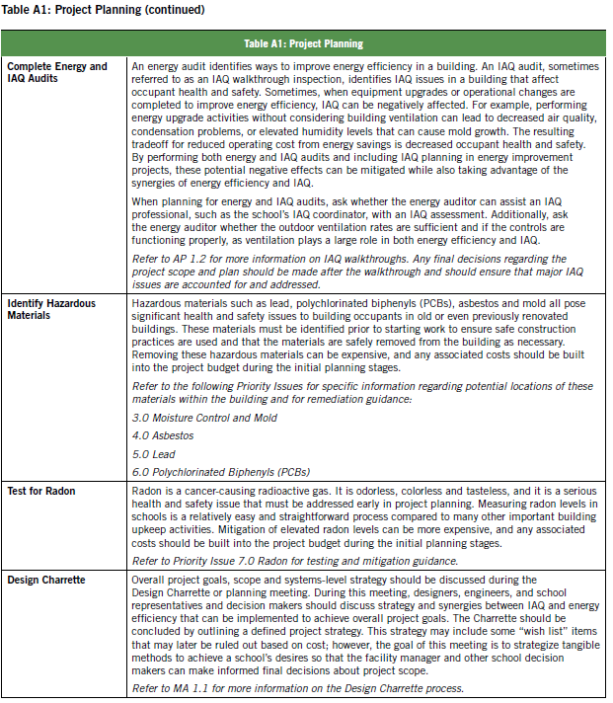

Slide 24
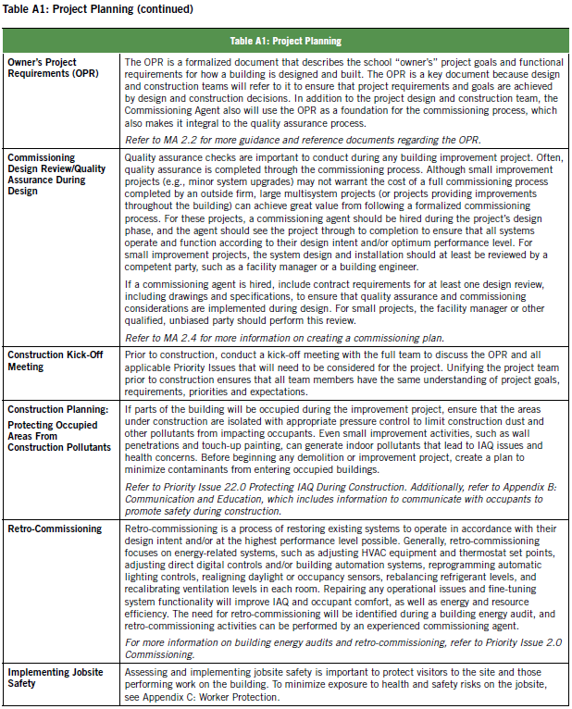

Slide 25
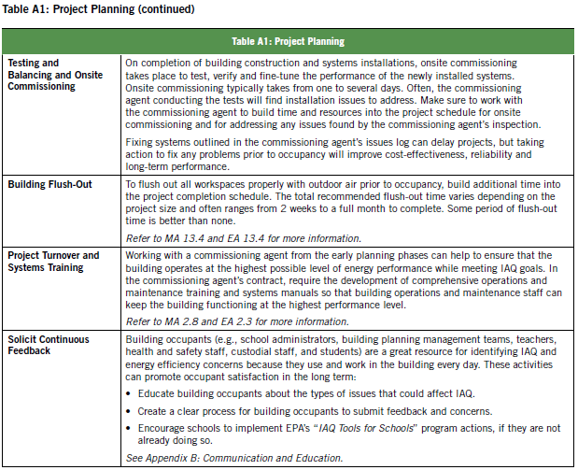

Slide 26
Developing a Project Team
An integrated design approach is a drastic change
from traditional design and construction practices.
Traditionally, each discipline—such as the architect;
mechanical, electrical, plumbing and civil engineers;
and the construction team—would work independently.
During planning and design, the architect often would
lead the work by creating the overall building layout
and then pass the design on to the engineers, who
would all work independently. This type of process can
create major design errors that go unchecked until
the construction team tries to implement the design.
A traditionally organized design team does not necessarily have a meeting with the construction team
to review the project goals. Even if the design team
understands that energy efficiency is extremely important to the school, this information may not be relayed to the construction team, which may make installation or purchasing decisions that it thinks are equivalent to the design but in the end do not meet the project’s goals.

Slide 27
Table A2: Developing a Project Team outlines who should be involved during each phase of the project to maximize collaboration, reduce the potential for misunderstandings and meet the goals of the project, which first and foremost prioritizes a healthy and productive indoor environment for children, teachers and all who use the school building.

Slide 28
Section 3: Appendices
There are 3 appendices in this document that you need to be aware of:
Appendix B
Communication and Education

Slide 29
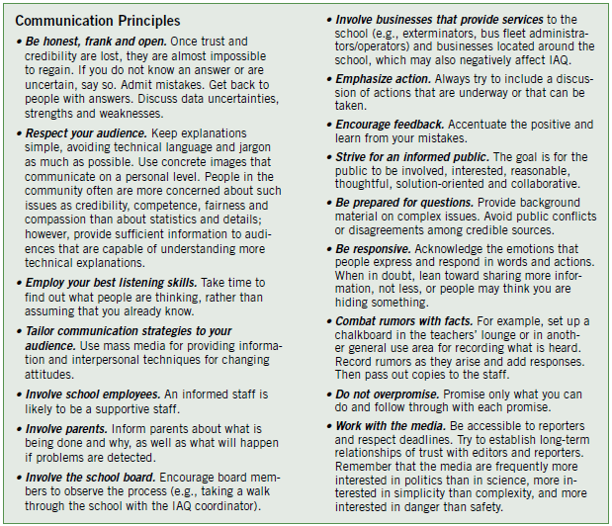

Slide 30
Section 3: Appendices
There are 3 appendices in this document that you need to be aware of:
Appendix C
Worker Protection

Slide 31
Priority Issue 23.0 Jobsite Safety of the Energy Savings Plus Health Guide refers to this appendix for worker protection. This appendix contains information to help those performing and supervising the building upgrade assess the risks to workers; it recommends actions to minimize risks to workers’ health and safety and identifies resources for additional information.

Slide 32
Section 4: Master Verification Checklist
This is another tool that is of great value in the document:
This section verifies that the assessment protocols in section 2 have been applied and appropriate actions have been taken.
This checklist allows the team to keep track of the progress during the building upgrade. This includes accomplishments already accomplished and coming issues to be addressed.

